Slide 1
THYROID FUNCTION
Endocrine organ
Anterior neck below the larynx
20g
2 lobes connected by isthmus
Very vascular
superior thyroid arteries/Inferior thyroid arteries
Spherical follicles
Single layer of cuboidal follicular cells surrounding cavity containing colloid
Thyroid hormones stored attached to thyroglobulin in colloid

Slide 2
SYNTHESIS
Iodide uptake/trapping/concentration
Na – Iodide pump 1:30 - 40x plasma
Oxidation of Iodide to Iodine
Peroxidase/Hydrogen peroxide
Iodination (organification) of tyrosine residues of Thyroglobulin
Mono-iodotyrosine (MIT)
Di-iodotyrosine (DIT)
Condensation (Coupling) reaction of Iodotyrosines
MIT + DIT = T₃ Tri iodothyronine
DIT + DIT = T₄ Tetraiodothyronine

Slide 3
SECRETION
Pinocytosis of colloid by apical membrane of follicular cells
Fusion of vesicle with lysosome
Hydrolysis of Tg by protease
Diffusion of thyroid hormones into ECF.

Slide 4
TRANSPORT
 | T4 | T3
TBG | 55% | 65%
TBPA | 35% | -
ALB | 10% | 35%
TBG : Thyroxine Binding Globulin
TBPA : Thyroxine Binding Pre-Albumin
ALB : Albumin
T₄ 99.95% bound 0.05% free
T₃ 99.5% bound 0.5% free

Slide 5
Transport Cont…..
T₃ = Triiodothyronine
T₄ = Tetraiodothyronine (Thyroxine)
T₃ : 3 – 4x more potent > T4
Target Cells T₄ T₃

Slide 6
ACTIONS
Growth
Attainment of adult stature
THS act synergistically with GH & somatomedin
promote bone formation
Stimulate bone maturation from ossification & fusion of growth plates
Bone maturation in Hypothyroidism bone age < chronological age

Slide 7
CNS
Perinatal Period
CNS maturation dependent on THS
Reduced THS causes irreversible mental retardation
Treat THs replacement
Mandatory screening for neonatal hypothyroidism

Slide 8
CNS Cont…
Adult
Hyperthyroidism
Hyperexcitability
Irritability
Hypothyroidism
Listlessness
Slow speech
Somnolence
Impaired memory
Reduced mental capacity

Slide 9
ANS
THS similar activity to beta adrenergic stimulation
Hyperthyroidism
Beta blocker treatment e.g. propranolol
Basal Metabolic Rate (BMR)
Oxygen consumption and BMR increase by THs in most tissues
Increased heat production hence THs role in BTR

Slide 10
Basal Metabolic Rate (BMR) Cont…
Increase synthesis of Na⁺- K⁺ ATPase increased oxygen consumption related to Na⁺ - K⁺ pump

Slide 11
METABOLIC EFFECTS
Overall increase in metabolism to meet demand for substrate associated with increased oxygen consumption.
Increase glucose absorption from GIT
Increased glycogenolysis
Increased gluconeogenesis
Glucose oxidation.
All to meet demand for ATP

Slide 12
METABOLIC EFFECTS Cont…
Increased lipolysis
Increased protein synthesis & catabolism overall effect catabolic
CVS/RS
Increase cardiac output and ventilation rate both increase oxygen delivery to tissues.
HR x SV = CO

Slide 13
SKELETAL MUSCLE
Increases Myosin Heavy Chain Protein (also in cardiac muscle)
Myopathies
Hyperthyroidism (weakness, wasting, fatigability)
Hypothyroidism (muscle stiffness delayed contraction and relaxation)

Slide 14
OTHER ACTIONS
Secretion of lung surfactant
Beta carotene to vitamin A
Increases RBF and GFR in kidney
Milk secretion
Erythropoiesis
Increased RCM
Increased 2,3 DPG in RBCs
Increased deoxygenation of Hb

Slide 15
REGULATION OF FUNCTION
Hypothalamus
T₄ T₃
TRH
-
T₄ T₃
AP
TSH
Thyroid
T₃, T₄ Actions

Slide 16
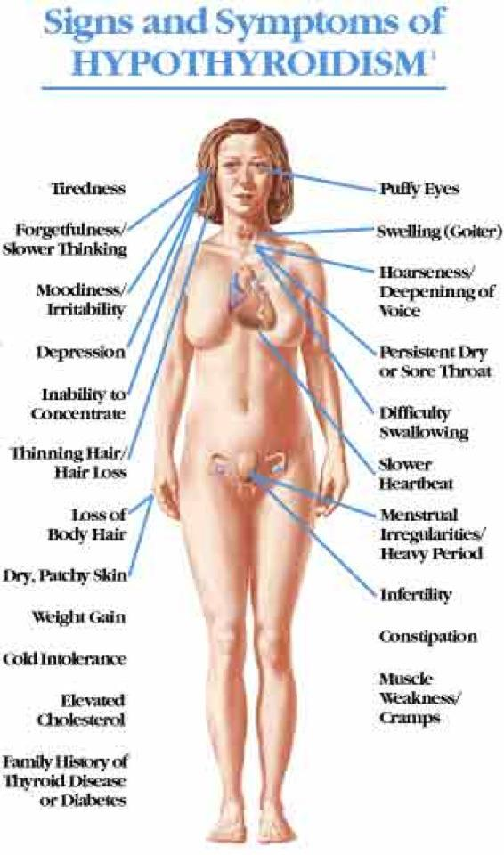

Slide 17
Thank You

