Slide 1
BACILLUS
KIMAIGA H.O
MBChB (University of Nairobi)

Slide 2
Bacillus
MORPHOLOGY
Bacillus, is placed in the family Bacillaceae.
Are gram positive bacilli
Can be seen as single cells or as a chain of cells
Aerobic or facultative anaerobes
Form endospores
Are heat resistant
Form spores which remain viable in the environment for a long time
Most are motile except Bacillus anthracis
Most produce clear zones; complete haemolysis in blood agar except the B. anthracis

Slide 3
EXAMPLES OF SPECIES
B. anthracis
B. cereus
B. subtilis
B. pumilis
B. stearothermophilus
B. alvei
B. megaterium
B. coagulans
B. laterosporus
B. sphaericus
B. circulans
B. brevis
B. licheniformis
B. macerans
B. pumilus
B. thuringiensis

Slide 4
B. anthracis
Has gram positive rods
May be seen as single cells or chains resembling a bamboo rod
It is capsulated in tissues, made of polypeptide material
Form spores outside the infected animal
When shed in the environment or grown on artificial media
Spores are oval, centrally placed & same diameter as the width of the cell and never make the cell to burst

Slide 5
Physical properties
Bacilli/vegetative cells (non spore) are destroyed by heat at temp of 60⁰C for 30 minutes
Spores are
Relatively resistant to disinfectants (inc 95% ethanol) and heat. Can withstand dry heat at 140 ⁰C for 1-3 hrs and boiling at 100 ⁰C for 5-10 mins
Can survive in the environment or in animal products

Slide 6
Virulence and Pathogenicity
Pathogenicity is determined by many factors including
Ability to form spores
A capsule that inhibits phagocytosis
Production of an extra-cellular toxin or Bacillus anthracis exotoxin.
Exotoxin is a complex made of 3 components and each cpt has its distinct function in disease causation
major virulence factor of the organism

Slide 7
Clinical Implication
Causative agent of anthrax disease which attacks domestic animals like cows, goats and sheep.
Due to close association with humans, they can also accidentally get it and it occurs as an outbreak

Slide 8
Transmission
Infective agents in most cases are spores
Originate from the bacilli shed from infected animals passed out through the openings; including nose mouth or in faeces
Contaminate the environment including soil, pastures, water etc so humans and other susceptible animals can acquire the infectio
Humans and other animals may accidentally acquire the spores
From the environment or from the animals
Through handling contaminated animals products such as skin, bones, wool, and carcasses or eating meat from infected animals
For humans, entry occurs through contaminated damaged skin and it enters or through the mucous membrane by inhaling the spores or even ingesting them

Slide 9
Clinical manifestation
Cutaneous anthrax;
Infections occurs throughout the skin
Lesions tend to occur on the exposed parts
Lesion is an cancer ulcer/ Malignant Pustule
Characteristically develops dark color at the center referred to asa eschar
Increased risk in people who handle animals and animal products some of which may be infected including farmers, veterinary workers, surgeons, dock workers and meat factory workers.

Slide 10
Inhalational anthrax/ Wool-sorter’s disease;
Occurs via inhalation of spores in dust or from contaminated animal products including wool
Inflammatory process follows in the lungs hence manifests as severe pneumonic process with including difficulty breathing, cough, fever, chills, and production of sputum

Slide 11
Gastro-intestinal anthrax;
Results from eating meat from infected animals
Manifestations include abdominal pain, vomiting, fever, diarrhoea, which may contain blood
Septicemia anthrax;
There are numerous bacilli in the circulation system and hence severe symptoms. The bacilli can get to any organ and may even cause meningitis.

Slide 12
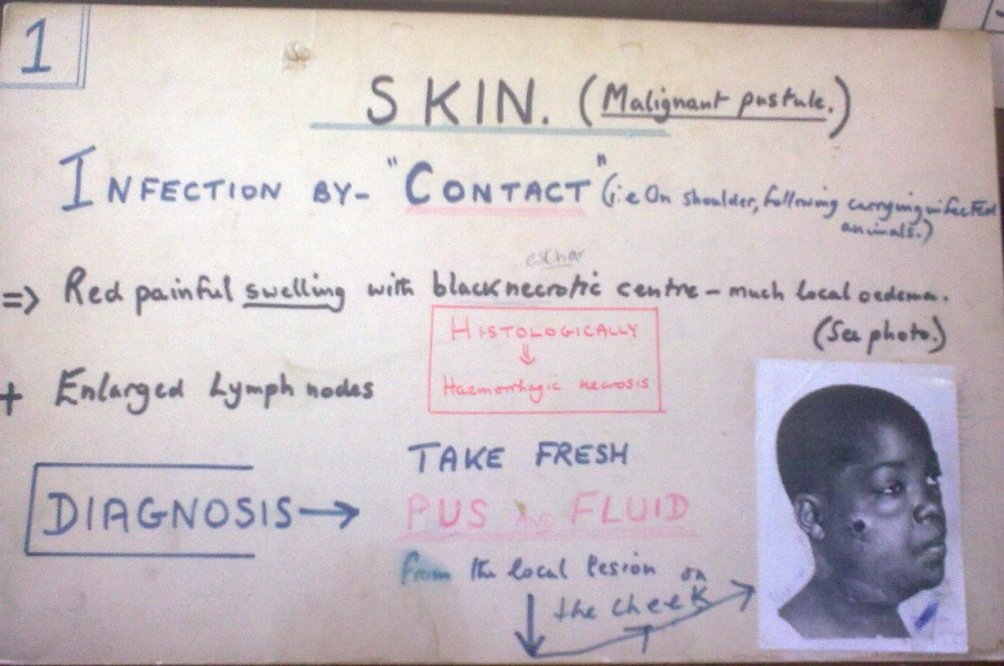
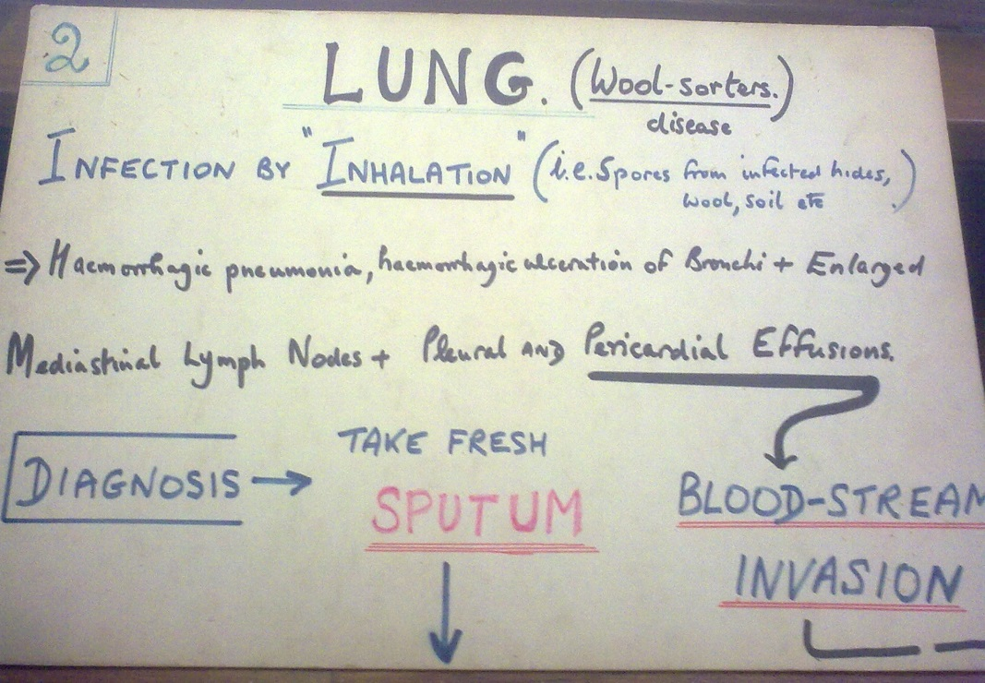
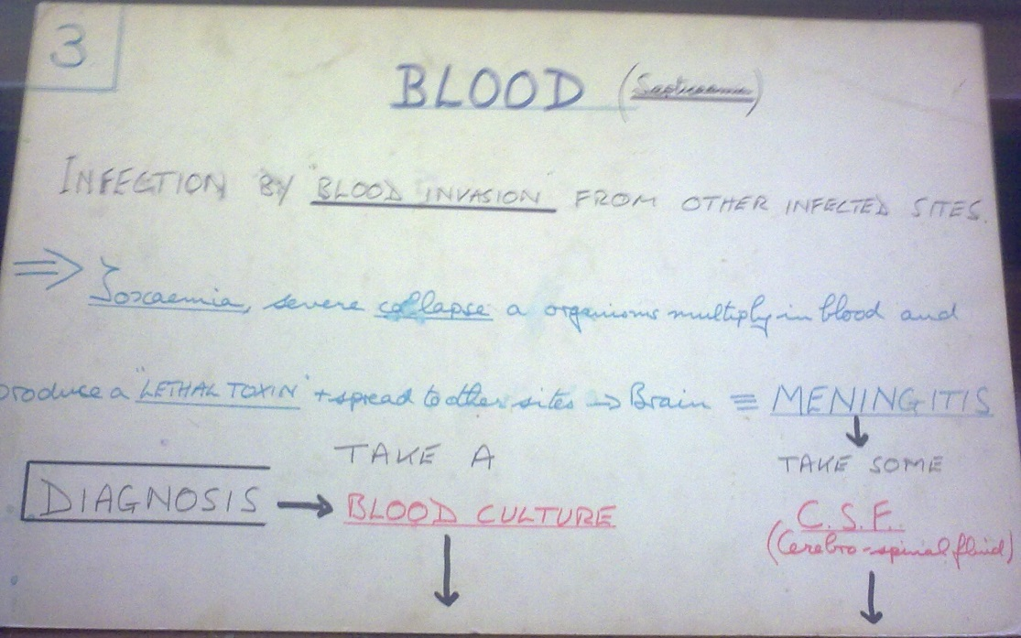
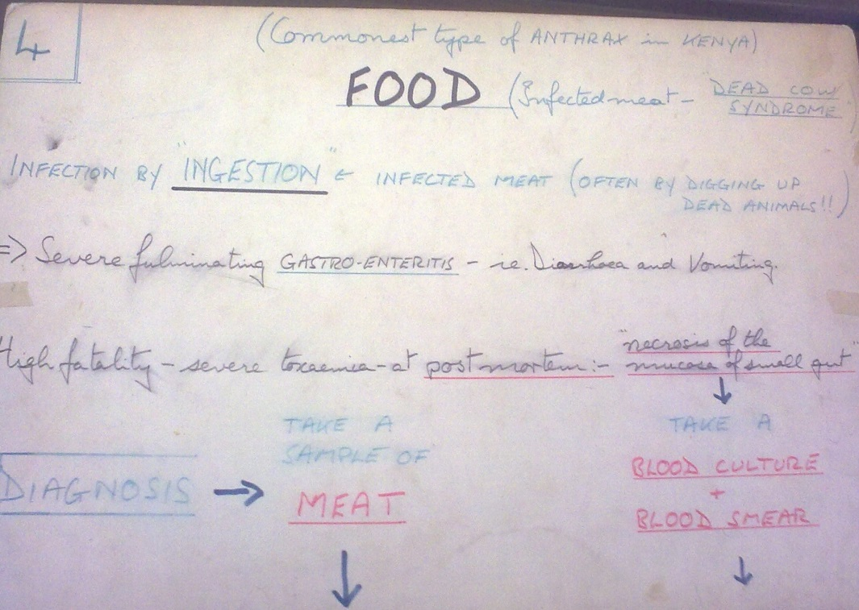

Slide 13
Laboratory Confirmation
Specimen
From cutaneous lesions, blood, sputum or pleural fluid
The specimens are highly infectious, and transported and processed as higher risk specimen
Gram stain- Gram positive bacilli
Polychrome methylene blue stain on capsular material (McFadyean’s reaction) diffuse purple btw blue stained bacilli.
Ascoli Test - test-extracts from infected tissues mixed with immune serum . There’s an antigen antibody reaction forming precipitates
Culturing; blood agar is used and also the nutrient agar
Incubation in air at 35-37 ⁰C for 18 to 24 hrs
Have a wavy margin with small projections hence is called a medusa head colony grayish white
Non-haemolytic for most strains
Is aerobic
Temperatures between 35 – 37ºC is optimum

Slide 14
B anthracis Gram Stain

Slide 15
Identification
Gram staining
Growth characteristics
Motility tests; is non motile
Gelatin liquefaction test; is positive – ability to liquefy gelatin but occurs slowly

Slide 16
Antibiotics
Is susceptible to penicillin, tetracycline and erythromycin

Slide 17
Prevention and Control
Prevention of the disease in humans is by preventing the disease from the animals
Vaccination of domestic animals that are at risk
When an animal dies of an unknown disease, the carcass should be disposed off by burning or burying very deep into the soil
Prevention in humans involves sterilization of animal products
Isolating the infected to avoid spread of the vector
Vaccination to those at risk

Slide 18
Anthracoids
Are saprophytes found in the environment
May contaminate pastures
Are motile
Are non capsulated
Are contaminants and not regular pathogens

Slide 19
B. cereus
Associated with food poisoning; gastroenteritis – includes rice exposed over a long time, meat stews (mild manifestations – vomiting and diarrhea for a few hours only)
B. stearothermophilus
Destroyed at 125⁰C
Spores are heat resistant used in test the efficiency of autoclaves in sterilization procedures

