Slide 1
CLOSTRIDIA
KIMAIGA H.O
MBChB (University of Nairobi)

Slide 2
INTRODUCTION
HABITAT
Environment, decomposing animals and plants
Play role in putrefaction
Some species are normal flora of animals and human intestines – potential pathogens- cause contamination of environment when passed out with feces.
Most of the clostridia are saprophytes but a few are pathogenic for humans.
Those that are pathogens have primarily a saprophytic existence in nature and are opportunistic pathogens.
Clostridium tetani and Clostridium botulinum produce the most potent biological toxins known to affect humans. As pathogens of tetanus and food-borne botulism, they owe their virulence almost entirely to their toxigenicity.
Other clostridia, however, are highly invasive under certain circumstances.

Slide 3
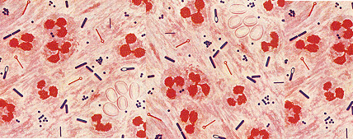
Stained pus from a mixed anaerobic infection. At least three different clostridia are apparent.

Slide 4
PATHOGENIC PROPERTIES
Mechanisms of Dx causation by pathogenic species include:
The requirement of anaerobic conditions
Capacity to form spores
Capacity to produce potent exotoxins and other virulence factors especially aggressions.

Slide 5
Clostridium perfringens
Normal flora in large intestines in humans and animals – passed out in feces
Microscopic appearance
Gram +ve bacilli form spores which are relatively large oval and centrally placed.
Capsulated in tissues
Forms spores in feces and in the environment. Does not form spores in contaminated cooked food or tissues.
Non motile

Slide 6
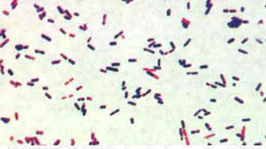
Clostridium perfringens, Gram Stain. Most clostridia are reknowned for staining "Gram-variable".culture from canned beef.

Slide 7
Antigens
Soluble antigens released
5 different antigen identified – Used as a basis for classification into serotypes.
5 serotypes A-E
SEROTYPES | ANTIGENS
A | Alpha
B | Alpha, beta & epsion
C | Alpha, beta
D | Alpha, epsion
E

Slide 8
PATHOGENIC PROPERTIES
Ability to form spores increases the chances of survival and enhances transmission
The ability to release exotoxins
Serotypes differ in the types of exotoxins they release.
Toxins have different mechanisms of action can be haemolytic, lethal or have enzymatic activities
Other virulence products include; DNAse, Hyalurinidase, collagenase proteases, lipases and collagenase which contribute to invasive process
Enterotoxins – produced by certain strains which can contaminate meat.
Has capacity to invade the blood circulatory system.

Slide 9
Production of Alpha toxins
Common for all serotypes.
Major toxin for serotype A.
An phospholipase enzyme, lecithinase C
Splits lecithin—An important constituent of cell membranes including RBC and other cells
Also haemolytic
The most significant of lethal toxins

Slide 10
PATHOGENESIS
Most cases are associated with muscle injury
Traumatic ---from compound fractures , bullet wounds
Injury involving the colon and Biliary tract.
Injuries results in:
Impaired or Normal blood flow leading to reduction in O₂ tension.
Dead tissue
Foreign contaminated material that causes the injury may contain the spores clostridium perfringens and possibly other organisms
Main source of organisms is human & animal feces through the environment where they survive under adverse conditions.

Slide 11
Causative organism:
Clostridium perfringens (welchi’s) –type A
Clostridium septicum
Others: bacteria including facultative anaerobes may be found in the wounds.
Severity is due to action of exotoxins accompanied by gas production
Hyalurinadase facilitates spreading
Collagenase and other organisms breakdown muscle
Alpha toxins causes toxicaemia associated with gas gangrene.

Slide 12
FOOD POISONING
Caused by strains which form heat resistance spores and can survive boiling for several hours
Produce an enterotoxin on contaminated foods
Source of infection can be a carrier
Manifestations:
Abd cramps 8-12 hrs after ingestion and diarrhea
Mild compared to other types of food poisoning
Symptoms subside within 24-48 hrs
Diagnosis:
Isolation of organisms from stool or suspected foods
Isolation of the organisms from those at risks
PUERPERAL INFECTIONS
Also can complicate traumatic abortion
Organisms originate from the colon, contaminate perineal skin, reach the devitalized tissue in the female reproductive system

Slide 13
Treatment
Treatment is approached after a positive neagles reaction test
General supportive measures – Correction of fluid and electrolyte imbalance
Specific
Surgical reaction
Antimicrobial reaction – Penicllin & alternatives ( clindamycin, metronidazole)
Use of use of antitoxins
Associated with high incidence of serum sickness
Not generally recommended

Slide 14
CLINICAL SIGNIFICANCE
Causative agents
Surgical infections- gas gangrenes
Food related gastroenteritis (food poisoning)
Peuperal sepsis
Gas gangrenes: - Infectious process characterized by rapidly spreading swelling, necrosis of tissue, myositis, gangrene and gas production.
Often occurs as a complication or traumatic wound infection.

Slide 15
PREVENTION
Through wound cleaning
Proper cleansing of skin before performing invasive procedures
Antibiotic prophylaxis for contaminated wounds
Penicillin given as early as possible

Slide 16
Clostridium tetani
MICROSCOPIC MORPHOLOGY
Slender, gram –ve, motile rods with numerous peristichous flagella.
Form terminal spores, spherical, produces drumstick appearance – seen as swollen part of one end.
Occurrence
Naturally found in …..

Slide 17
PHYSICAL XTICS
Form spores which physically
Are resistant to adverse environmental conditions
Destroyed by boiling upto 3 hours
Can be resist dry heat at 1500c for 1 hr
ANTIGENS
Several flagella are H antigens???
Used in classification into serotypes
METABOLISM
Doesn’t ferment sugar generally – rarely glucose may be fermented
Predominantly proteolytic

Slide 18
PATHOGENIC PROPERTIES
Spore formation
Release a highly potent exotoxin as it multiplies
Toxin responsible for dx causation in humans is totero spasmin (neurotoxin)=Protein in nature, highly potent, heat labile.

Slide 19
PATHOGENESIS
Dx caused is tetanus
Starts with contamination of wounds with spores which may be acquired from the soil, dirty clothing, dust and other items
The disease stems not from invasive infection but from a neurotoxin (tetanus toxin/ tetanospasmin) produced when spores germinate
Results in vegetative cells – process is reduced O2 tension dependent in devitalized tissue and non-viable material in wounds
Infection remains localized in wounds
Sometimes infections site remains undisclosed

Slide 20
Infections of the umbilical wound of new born infants results into tetanus neonatorum
The exotoxins released at infections site diffuse in blood and reaches other parts migrates along neural paths to sites of action in the central nervous system.
clinical pattern of generalized tetanus consists of severe painful spasms and rigidity of the voluntary muscles
The exotoxins acts through inhibition of release of acetylcholine and interferes with neuromuscular transmission resulting in muscles spasms and hyperflexia

Slide 21
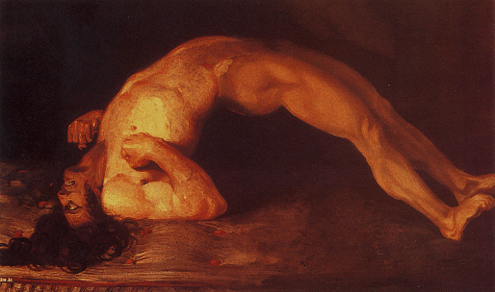
Sir Charles Bell's portrait of a soldier dying of tetanus.

Slide 22
Tetanus Toxin.
Tetanospasmin is encoded on a plasmid which is present in all toxigenic strains.
Tetanus toxin is one of the three most poisonous substances known, the other two being the toxins of botulism and diphtheria.
The toxin is produced by growing cells and released only on cell lysis.
Cells lyse naturally during germination the outgrowth of spores, as well as during vegetative growth.
After inoculation of a wound with C. tetani spores, only a minimal amount of spore germination and vegetative cell growth are required until the toxin is produced.
The toxin is heat labile, being destroyed at 56 degrees C in 5 minutes, and is O2 labile. The purified toxin rapidly converts to toxoid at 0 degrees C in the presence of formalin.

Slide 23
Toxin Action.
Tetanospasmin initially binds to peripheral nerve terminals. It is transported within the axon and across synaptic junctions until it reaches the central nervous system.
There it becomes rapidly fixed to gangliosides at the presynaptic inhibitory motor nerve endings, and is taken up into the axon by endocytosis.
The effect of the toxin is to block the release of inhibitory neurotransmitters (glycine and gamma-amino butyric acid) across the synaptic cleft, which is required to check the nervous impulse.
If nervous impulses cannot be checked by normal inhibitory mechanisms, it produces the generalized muscular spasms characteristic of tetanus.

Slide 24
MANIFESTATIONS
Incubation period after wound infection followed by
Tetanus – Xtrized by muscle spasms
Lock-jaw causing inability to open the mouth

Slide 25
SOME ASPECTS OF MANAGEMENT
Admin of antitoxins neutralize toxins, human antitoxin has many advantages over animal antitoxins
Antimicrobial agents
Susceptibility to penicillin and its derivatives
Others;
Supportive care
Muscle relaxants
Active immunization with tetanus toxoid
Surgical aspects – removal of necrotic tissue from wounds

Slide 26
Tetanus: treatment for infection
SAD RAT: Sedation Antitoxin Debridement Relaxant Antibiotic Tracheostomy

Slide 27
PREVENTION ASPECTS
Active immunization with tetanus toxoid to be admin
When treating traumatic wounds
During antenatal care for expectant mothers
Patients who are undergoing recovery from tetanus
Proper cleaning and care of wounds contaminated with diety foreign materials
Admin of penicillin

Slide 28
Clostridium botulinum
PHYSICAL XTICS
Spores can withstand most heat at 1000cfor several hours and destroyed at 1200c in 5 mins
ANTIGENS
Seven different types identified designated as A-G
Used in classification into serotypes each producing antigenically distinct exotoxin.

Slide 29
PATHOGENIC PROPERTIES
Spores contaminate foods improperly prepared; canned or preserved meats
Releases a highly potent exotoxins in foods
Toxin acts as a neurotoxin, destroyed at 800c for 30-40 mins
Seven toxigenic types of the organism exist, each producing an immunologically distinct form of botulinum toxin. The toxins are designated A, B, C1, D, E, F, and G). Not all strains of C. botulinum produce the botulinum toxin.

Slide 30
PATHOGENESIS
Causes Botulism (food poisoning) which involves the nervous system
Botulinum toxin is ingested with food in which spores have germinated and the organism has grown.
Neurotoxins is absorbed from duodenum and jejunum, and passes into the blood stream by which it reaches the peripheral neuromuscular synapses.
Action is slow with incubation of 12- 36 hrs after ingestion
The toxin binds to the presynaptic stimulatory terminals and blocks the release of the neurotransmitter acetylcholine which is required for a nerve to simulate the muscle-flaccid paralysis
Associated with wound infections

Slide 31
MANIFESTATIONS
Clinical symptoms of botulism begin 18-36 hours after toxin ingestion with weakness, dizziness and dryness of the mouth. Nausea and vomiting may occur.
Neurologic features soon develop: blurred vision, Pharyngeal paralysis – difficulty in speaking, swallowing and vomiting
Descending weakness of skeletal muscles and respiratory paralysis.
Involvement of occulomotor – diplopia
Botulinum toxin may be transported within nerves in a manner analogous to tetanospasmin, and can thereby gain access to the CNS but symptomatic CNS involvement is rare.

Slide 32
SOME RX ASPECTS
Admin of antitoxins
Supportive measures

Slide 33
PREVENTION
Proper cooking of foods
Boiling foods for at least 20 mins before consumption
Prophylactic dose of antitoxin to those suspected to have eaten food suspected of botulism
Toxoids for active immunization where necessary

Slide 34
Clostridium difficile
Pathogenesis
Clostridium difficile causes antibiotic asociated diarrhea (AAD) and more serious intestinal conditions such as colitis and pseudomembranous colitis in humans.
These conditions generally result from overgrowth of Clostridium difficile in the colon, usually after the normal flora has been disturbed by prolonged antimicrobial therapy with broad spectrum antimicrobial agents such as clindamycin, ampillicin, cephalosporins, tetracyclins
People in good health usually do not get C. difficile disease. Individuals who have other conditions that require prolonged use of antibiotics and the elderly are at greater risk of the disease.
Also, individuals who have recently undergone gastrointestinal surgery, or have a serious underlying illness, or who are immunocompromised, are at risk.

Slide 35
C. difficile produces two toxins:
Toxin A is referred to as an enterotoxin because it causes fluid accumulation in the bowel.
Toxin B is an extremely lethal (cytopathic) toxin.
Stool cultures for diagnosis can contain non toxigenic strains of the bacterium, so the most reliable test involve testing for the presence of the Toxin A and/or Toxin B in the stool.
The toxins are very unstable. They degrade at room temperature and may be undetectable within two hours after collection of a stool specimen leading to false negative results of the diagnosis.

Slide 36
Antimicrobial susceptibility
Susceptible to vancomycin

Slide 37
LAB DIAGNOSIS OF CLOSTRIDIA
Specimen collection
C perfiringens and C. tetani; Wounds exudates, necrotic tissue
C. botulinum and C. difficile; Stomach content, stool, blood, intestinal content & remains of suspected foods.
Gram stain from specimen
Gram +ve bacilli
Lab growth and Culture
MEDIA - Variety including; Robertson’s cooked meat (RCM) & Blood Agar (BA)
Temperature range 37-45ºc – incubated at 37ºc
Incubation – Anaerobic –possible growth under micro-aerophilic conditions
C.. Tetani and C. botulinum and C. difficile are strictly anaerobic
C. tetani is incubated in BA/ RCM for 2-3 days then sub-cultured on MBA

Slide 38
Colonial morphology and effects in BA
C perfiringens:
Large, colonies round smooth surfaces, Low convex – translucent
Double zone haemolysis on BA – Zone of complete haemolysis at a larger zone of incomplete haemolysis depends on the strains and blood source (Double hemolytic)
Spores are large oval and centrally placed if present
C. tetani
Gram +ve bacilli with drumstick appearance (spores)
Spores stain
Sarming due to motility-Motility test positive
C. botulinum
Gram +ve bacilli, relatively large, motile with peritrichous flagella
Spores are oval , centrally placed sub terminal
Gram staining of colony, +ve

Slide 39
Biochemical tests
C. perfringens:
Essentially saccharolytic (Breakdown CHOs) - Lactose, maltose and sucrose fermentation +ve
Saccharolytic species include:
Clostridium perfringens
Clostiridium septicum
Clostridium oetematiens
Clostridium fallax
Mildly proteolytic(breakdown proteins)
Other clostridium species are non-proteolytic
Nitrate reduction test +ve
antigenic tests A,B,C,D & E
C. botulinum and C. difficile
Demonstration of toxins in blood, left over foods and stool.

Slide 40
Presumative identification tests of c. perfringens
NAGLES REACTION TESTS
Swabbing half of the egg york antigen plate with type A antitoxins and allowing the plate to dry
Streaking the whole plate with the isolated organisms
Incubation for 24-48 hrs at 35ºc
RESULTS:
Lecithinase activity is observed on the half without antitoxins and inhibited on the side with antitoxins.
Licithinase splits lipoprotein producing opalescence; Opalescence indicates a +Ve nagler reaction.

Slide 41
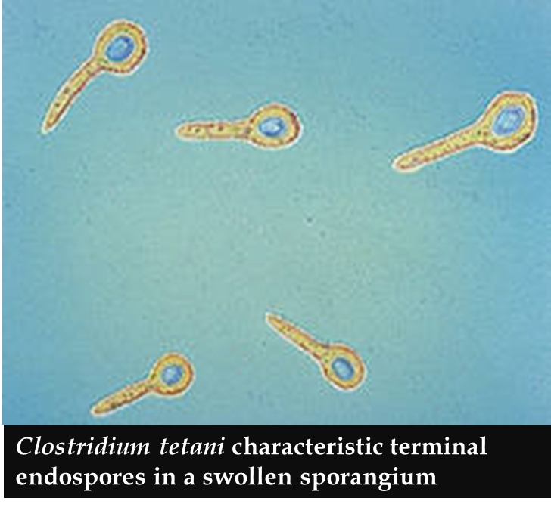
Clostridium tetani on B.A
Note swarming

Slide 42
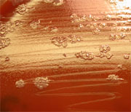
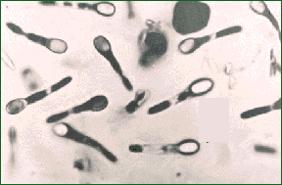
C. difficile colonies on blood agar.
C. difficile endospores.

