Slide 1
HORMONES FROM ADRENAL MEDULLA –CATECHOLAMINES
Ganong, 24th Edition pp 353- 358

Slide 2
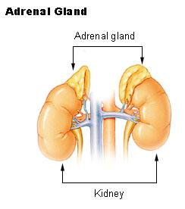

Slide 3
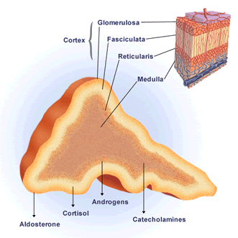

Slide 4
Secretions of adrenal medulla
(1) catecholamines
Catechol

Slide 5
Secretions of adrenal medulla
(1) granules which contain:
-epinephrine
-nor epinephrine and small amounts of
-dopamine

Slide 6
(2) -(the granules also contain ATP, chromogranin A, and opioid peptides – it is the source of most of the METENKEPHALIN in circulation)

Slide 7
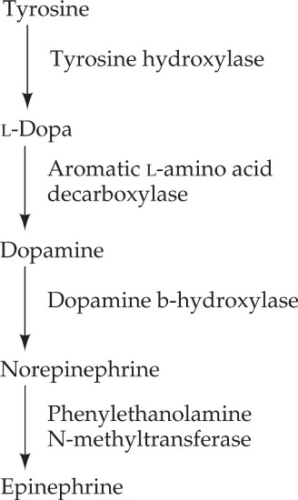
Synthesis of catecholamines

Slide 10
Blood transport
95% of dopamine and 70% of NE and N in blood are conjugated to sulfate in circulation
Half-life of catecholamines is about 2 minutes

Slide 11
inactivation
Removed by diffusion into tissues followed by:
methylation —>
by catechol O-methyltransferase

Slide 12
2) Oxidation by —>
monoamine oxidase (MAO)
3) then excretion in urine

Slide 13
Met- enkephalin, (discovered and characterized by Hughes, Kosterlitz, et al. in 1975 after a search for endogenous ligands of the opioid receptors)

Slide 14
Met- enkephalin is an endogenous opioid peptide with effects of short duration: one of the two forms of enkephalin the other being leu-enkephalin. The enkephalins are the primary endogenous ligands of the δ-opioid receptors

Slide 15
Physiological role of adrenal medulla
Adrenal medulla is a sympathetic ganglion specialized to activate a large number of tissues using blood as an “axon”.

Slide 16
enervated by sympathetic pre- ganglionic fibers
Secretion stimulated by Ach from pre –ganglionic innervations

Slide 17
The secretary cells have mini axons

Slide 18
Function of adrenal medullary secretions
Maintains sympathetic tone in:
the vasculature and
glucose metabolism

Slide 19
Major part of efferent responses to stress and
Synergizes with or activates secretion of other stress response hormones (ACTH, Cortisol, growth hormone and prolactin)

Slide 20
General effects
Mimics the effects of adrenergic discharge to the heart and blood vessels, but dilates arterioles in non-exercising muscles. Causes brochodilation.

Slide 21
Norepinephrine is a strong stimulator of α adrenergic receptors
While epinephrine is a stronger stimulator of β receptors

Slide 22
Metabolic effects
Stimulates glycogenolysis by liver and muscle and gluconeogenesis in by the liver synergistically with glucocorticoids and glucagon

Slide 23
Stimulates lipolysis --> increased blood f.a.as
Stimulates basal metabolism synergistically with thyroid hormones

Slide 24
MWISHO

