Slide 1
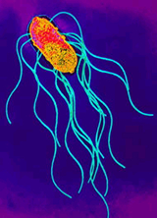
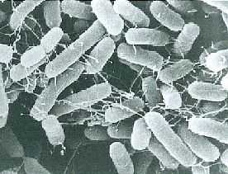
SALMONELLA
KIMAIGA H.O
MBChB (University of Nairobi)

Slide 2
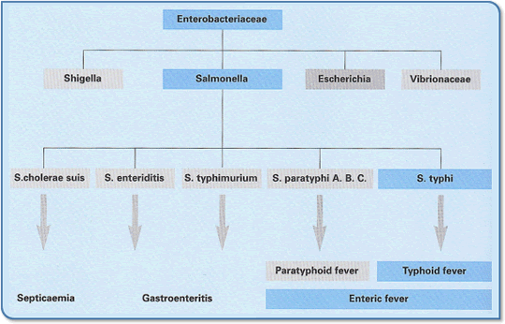

Slide 3
SALMONELLA
Typical members of the Enterobacteriaceae:(See features)
Distinguished from other members by
Biochemical characteristics
Antigenic structures.
Classification:
Ewing: S. typhi (1 serotype), S. cholerasuis (1 serotype) and S. enteritidis (1500 serotypes).
Kaufman and White: Assigned species names to each serotype (about 1500 species).
Currently: Over 2000 antigenic types, serotypes of a single species, Salmonella enterica-Based on DNA analysis

Slide 4
ANTIGENIC STRUCTURE
O (somatic) and H (flagellar) and Vi (virulence)
O antigen / Cell Wall Antigens. :
Heat stable and alcohol resistant long chain lipopolysaccharides (LPS).
Located in the outer membrane
Exhibit variation in sugar composition and degree of polysaccharide branching
Structural heterogeneity contributes to the large number of serotypes of S. enterica.

Slide 5
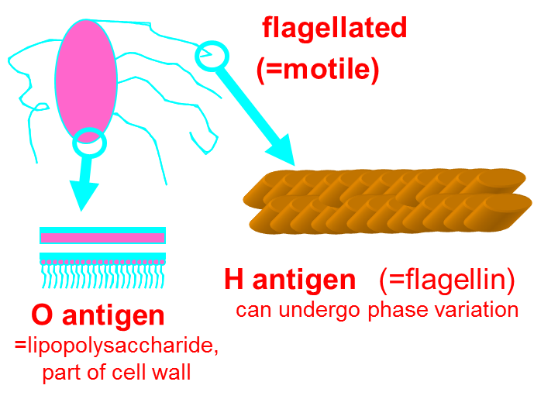
Flagellar H antigens:
Flagellar protein subunits
Contain epitopes: basis of flagella based serotyping.
Exhibit diphasic variation: phase 1 and phase 2 antigens.
Salmonellae express only one or two flagellar phases.
Heat labile.

Slide 6
Vi antigen:
Surface envelope polysaccharides.
May encapsulate the entire bacterium
Make it difficult for antibodies designed to recognize the LPS antigens.
Salmonella enterica serotype Typhi is the most important example which expresses this antigen.

Slide 7
The antigenic structure of any serotype of salmonella has 3 parts
An example:
‘H’ antigens
Serotype ‘O’ antigens Phase 1 Phase 2
Typhi 9,12,(Vi) : d : -
Paratyphi B 1,4,5,12 : b : 1,2
Typhimurium 1,4,5,12 : I : 1,2
Phage typing: It is useful for discriminating strains serotypes Typhimurium, Virchow, Enteritidis and Typhi.

Slide 8
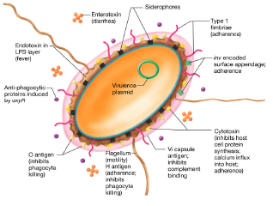

Slide 9
Host Range:
Harboured by all vertebrae in their gut and arthopods such as flies and cockroaches
Typhi & Paratyphi A, B and C- primarily human pathogens.
Paratyphi B- also isolated from cattle, pigs, poultry.
Transmission: Ingestion of food and water contaminated by human and animal waste.
Frequent animal source: poultry, eggs, inadequately cooked meat products.

Slide 10
PATHOGENESIS
Infective dose
There is strain-to-strain variation in virulence and therefore the infective dose.
The vehicle of ingestion (food or water) influences pathogenesis.
Organisms ingested in water may be carried through the stomach rapidly, evading the effect of gastric acid.
Administration of antacids reduces the infective dose.

Slide 11
Initiation of infection
Salmonellae have to compete with the gut flora to adhere to the mucosa and multiply.
Fimbriae- enables them adhere to the microvilli of the ileal mucosa.
Some serotypes insert their own binding sites-carried in DNA sequences and code for an adhesion mechanism.
After attachment, there is degeneration of microvilli and the bacteria enter the intestinal epithelial cells.

Slide 12
Penetration can result in inflammation and diarrhea.
Some strains multiply in these cells and in macrophages of the Payer’s patches.
They spread to the phagocytes of the liver, gall bladder and spleen- leads to bacteremia.
Other strains penetrate the submucosa and pass to the local mesenteric lymph nodes.
Bacteremia can result in the seeding of many organs with osteomyelitis, pneumonia and meningitis as the most common sequel.

Slide 13
CLINICAL MANIFESTATIONS (Salmonellosis)
1. Enteric fever
Caused by strains of S. typhi or S. Paratyphi A, B or C.
Organisms pass the ileal mucosa via the lymphatics to the mesenteric lymph nodes
They multiply and invade the bloodstream via the thoracic duct.
Peyer’s patches and gut lymphoid tissue become involved in an inflammatory reaction
Necrosis, sloughing and formation of characteristic typhoid ulcers.

Slide 14
Early symptoms- dull continous headache, abdominal tenderness, hepatomegaly, splenomegaly
Diarrhoea is uncommon.
Complications: severe intestinal haemorrhage and perforation.
Survival and growth of the organism within phagocytic cells, and invasion of the gall bladder can result in establishment of a carrier state.

Slide 15
2. Gastro-enteritis and Food poisoning
Enterocolitis- invasion of the epithelial and subepithelial tissue of small and large intestine.
Caused by S. enteritidis.
Organisms penetrate mucosal cells into the lamina propria with resulting inflammation and diarrhea.
Clinical features: vomiting, abdominal pain, fever and diarrhea.
Dehydration can lead to hypotension, cramps and renal failure.
Persistent or high fever suggests bacteremia, possibly with metastatic infection.

Slide 17
3. Bacteraemia and Metastatic disease.
A constant feature of enteric fever
Caused by S. typhi and S. Paratyphi.
Sickle cell anaemia- important predisposing factor resulting in osteomyelitis, pneumonia and meningitis.
Ability of the salmonella to survive within macrophages particularly in the liver and bone marrow occasionally leads to persistent infection and chronic carrier state.

Slide 18
4. Prolonged Carrier State
Chronic carriage- excretion of salmonella for a year or more.
Can occur with any serotype.
Bacilli are present in the gall bladder and are shed in faeces.
The long duration of the carrier state enables the enteric fever bacilli to survive in the community in non- epidemic times

Slide 19
Immune Response
White blood cells recognize – trigger T cells, B cells
Two types of B cells: one to attack now, one for memory
Macrophages and neutrophils attack bacteria, secrete interleukins, causing cell-mediated response by T-cells
Antibodies from B cells attach to bacteria, allowing cytotoxic T cells, macrophages, and neutrophils to kill the organism
This is a standard immune response.
Most people with a healthy immune system can rid themselves of a usual Salmonella infection without the use of antibiotics.

Slide 20
Tumor Necrosis Factor-α
Flagella from S. Typhimurium induces expression of TNF-α through cell-mediated reponse
Tumor Necrosis Factor-alpha is a cytokine involved in the inflammatory response.
A cytokine is just a chemical substance that delivers a message between different cells in the body.
Phase II flagella are less-potent inducers
Switch to Phase II causes less of an inflammatory response. Switching mechanism may provide bacteria with a way to down-regulate inflammatory response within host

Slide 21
LABORATORY DIAGNOSIS
SPECIMEN
In enterocolitis
Organism is isolated from a stool sample.
Stool samples may also be positive in chronic carriers
In enteric fever
Blood culture is most likely to reveal the organism.
Bone marrow cultures are often positive.
Blood clot- organism can be recovered after the clot is digested with streptokinase and incubated in broth.

Slide 22
CULTURE
Fluid enrichment media
Tetrathionate or selenite broth -these inhibit replication of normal intestinal bacteria
Selective media
Dosoxycholate citrate agar (DCA), Bismuth sulfite agar, Hektoen enteric (HE) medium, Brilliant green agar, Xylose lysine desoxycholate agar (XLD) or Salmonella-Shigella agar (SS) are used for isolation.
EMB, McC
Colonial characteristics on SS- Agar
Non-lactose fermenters
Hydrogen sulfide gas production-Colonies appear colorless with black centers
On TSI: Alkaline slant with an acid butt frequently with both gas and H₂S.

Slide 23
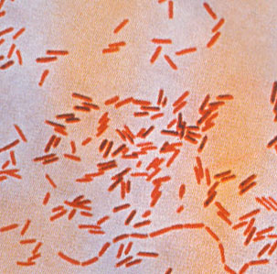
Salmonella typhi - Gram stain.

Slide 25
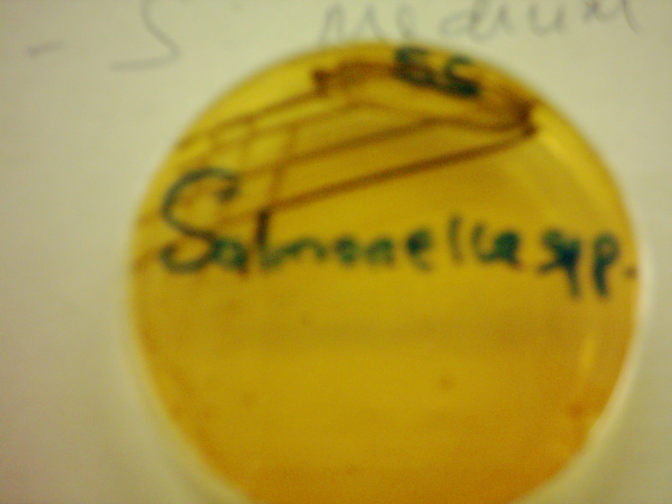
Salmonella on BA
Salmonella on SS

Slide 26
Differentiation of Shigella and Salmonella from nonpathogenic bacteria is accomplished by three reactions:
Xylose fermentation,
Lysine decarboxylation, and
Hydrogen sulfide production.
Xylose: enterics (except Shigella) ferment xylose rapidly.
Salmonella rapidly exhaust xylose and decarboxylate lysine, and revert to alkaline conditions (simulates the Shigella reaction).
Lactose and sucrose, added in excess, prevent lactose fermenters from similarly reverting.
The production of hydrogen sulfide under alkaline conditions results in the formation of colonies with black centers, whereas, under acidic conditions, this black precipitation is inhibited

Slide 27
Selenite F Broth
Wilson and Blair bismuth sulphite medium jet black colony with a metallic sheen

Slide 28
XLD
Salmonella sp. after 24 hours growth on XLD agar
Selective and differential medium designed for the isolation of Gram-negative enteric pathogens from clinical specimens.
Contains xylose, lysine, sodium desoxycholate, sodium thiosulfate and ferric ammonium citrate.

Slide 29
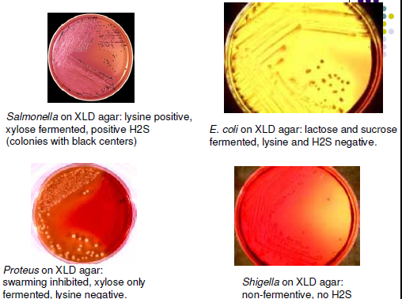

Slide 31
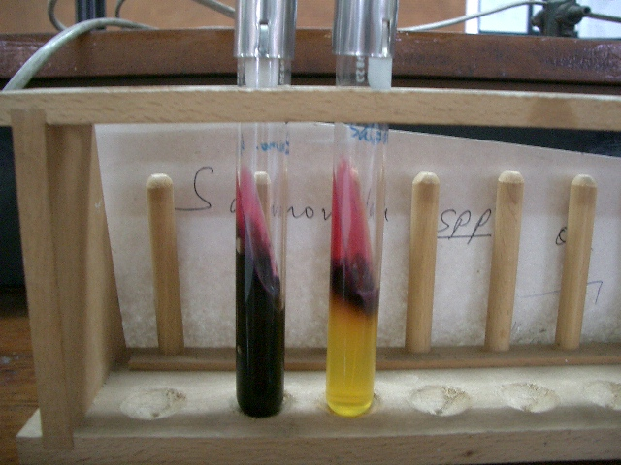
Salmonella on TSI
Slant – Pink(alkaline)
Butt - Acid, Production of H₂S gas and Fe²⁺

Slide 32
BIOCHEMICAL TESTS
Facultative anaerobic gram negative bacilli
Motile
Oxidase negative
Urease negative
Non-lactose fermenters.

Slide 33
SEROLOGICAL TESTS
Slide agglutination -detects presence of the somatic (O) antigen from suspicious colonies from culture plates.
Colonies are also subcultured to peptone water for determination of flagellar (H) antigen.
Widal test (detects O, H, Vi antigens)
Widal test is positive if TO antigen titer is more than 1:160 in an active infection, or if TH antigen titer is more than 1:160 in past infection or in immunized persons.
Test results need to be interpreted carefully in the light of past history of enteric fever, typhoid vaccination, and the general level of antibodies in the populations in endemic areas of the world

Slide 34
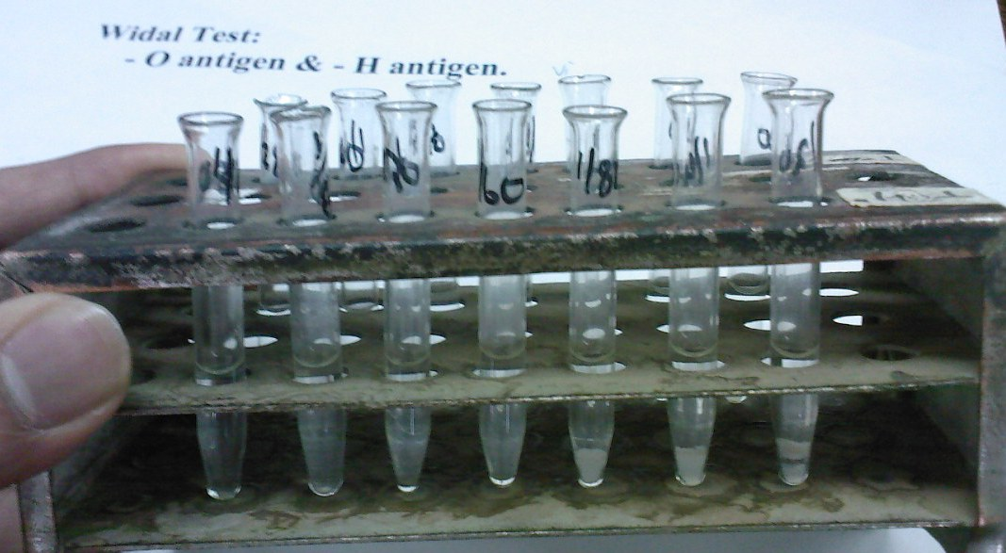
Widal’s Tests

Slide 35
MOLECULAR TECHNIQUES
Phage typing and antibiotic resistance typing
Can be used to characterize common food poisoning serotypes
Isolates from patients can be matched with those from the infected food or animal source.
Plasmid and pulsed-field gel electrophoresis typing
Differentiated strains further

Slide 36
TREATMENT
Enteric fever:
Ciprofloxacin
Ceftriaxone
Gastro- enteritis:
Management includes replacement of fluids and electrolytes and control of nausea, vomiting and pain.
Enterocolitis
Usually a self-limited disease that resolves without treatment.

Slide 37
Salmonella bacteremia:
Ciprofloxacin, chloramphenicol, co-trimoxazole or high dose ampicillin.
Salmonella meningitis
Cefotaxime and ceftriaxone - both can penetrate into the CSF.
Chronic asymptomatic carriers:
Cholesystectomy (it poses a risk of dissemination of the organism during surgery.)
In the absence of biliary disease prolonged courses of ampicillin, amoxicillin, cotrimoxazole or ciprofloxacin.

Slide 38
PREVENTION AND CONTROL.
Vaccination-
Parenteral heat killed phenol preserved and inactivated whole vaccines containing a mixture of cultures of Typhi, Paratyphi A and Paratyphi B (TAB)
Oral live-attenuated vaccine
Parenteral capsular polysaccharide vaccine
Public availability of treated water
Proper disposal of human excreta.
Prevention of contamination by food handlers
Elimination of contamination by rodents
Raw foodstuffs of animal origin must never have direct or indirect contact with cooked foods.
Cooked foods should be held at temperature conditions which prevent the organism from growing.

