Slide 1
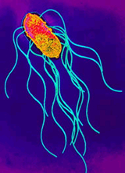
SHIGELLA
KIMAIGA H.O
MBChB (University of Nairobi)

Slide 2
IMPORTANT PROPERTIES
Genus - 4 species based on serology and biochemical reactions:
Serogroup A; S. dysentriae -12 serotypes
Serogroup B; S. flexneri -6 serotypes.
Serogroup C; S. boydii -18 serotypes
Serogroup A; S. sonnei -1 serotype. Serologically homogenous and are therefore typed by other means.
Causes bacillary dysentery by an invasive mechanism identical to Enteroinvasive E. coli (EIEC).

Slide 3
IMPORTANT PROPERTIES
They all have O antigens (polysaccharide) in their cell walls.
Pathogens of man and other primates.
Spread by contaminated food and water.
Transmission is by the fecal oral route, with the principle factors in transmission being fingers, flies, food and feaces.

Slide 4
PATHOGENESIS
Shigella is transmitted by the Four F's - Food, Fingers, Flies, Faeces.
Cause disease almost exclusively in the GIT.
Small infective dose, 10- 100 organisms.
Site of infection- M cells in the Peyer’s patches in the large intestine.
Association with intestinal mucosal cells initiates intestinal inflammation and bloody diarrhea.
Bacteria multiply and spread laterally to adjacent cells and deep into the lamina propia- there is development of an inflammatory reaction with capillary thrombosis.

Slide 5
Necrotic epithelial cells are sloughed and ulcers form.
Leucocytes, red blood cells and sloughed epithelial cells can be seen microscopically in stool.
Shigellae have innate tolerance to low PH and bile in the digestive tract.
Eukaryotic cell invasion is linked to the presence of plasmid encoded proteins.

Slide 6
Lipopolysaccharide (LPS) -causes localized cytokine release with resultant inflammatory response and cellular disruption.
Sh. dysentriae produces a potent protein toxin (Shiga toxin) Expression of this toxin increases under conditions of iron restriction.
The toxin has two portions (A- biological activities, B- specific binding and uptake).
The toxin prevents protein synthesis and causes cell death.

Slide 7
CLINICAL FEATURES
Incubation period is 2 to 3 days.
Initial symptom is abdominal colic followed by the onset of watery diarrhoea.
Progresses to frequent passage of small volumes of stool consisting predominantly of bloody mucus.
Severity of disease associated with the species and the age of the patient.

Slide 8
Sh. dysentriae causes a more severe illness with marked prostration and paedriatic febrile convulsions.
It is also associated with toxic megacolon and hemolytic uraemic syndrome.
Shigella rarely invades other tissues hence septicaemia and metastatic infection rarely occurs.

Slide 9
LABORATORY DIAGNOSIS
Specimen; Stool
Fecal smear (usually methylene blue-numerous PMN’s, RBC’s and epithelial cells
Gram negative bacilli
Culture
Like Salmonella- SS, XLD or DCA.
Colourless colonies on SS and Bismuth sulfite medium
NLFs on MAC agar.
Sh. sonnei is the only late lactose fermenter (S sonnei shares antigens with Pleisomonas shigelloides; however P shigelloides is Oxidase +ve whilst Shigellae are not)
Enrichment cultures-Selenite F or tetrathionate broth-these inhibit replication of normal intestinal bacteria
Suspiscious colonies- confirmed with species specific antisera followed by type specific antisera.
Serology is NOT used to diagnose Shigella infections

Slide 10
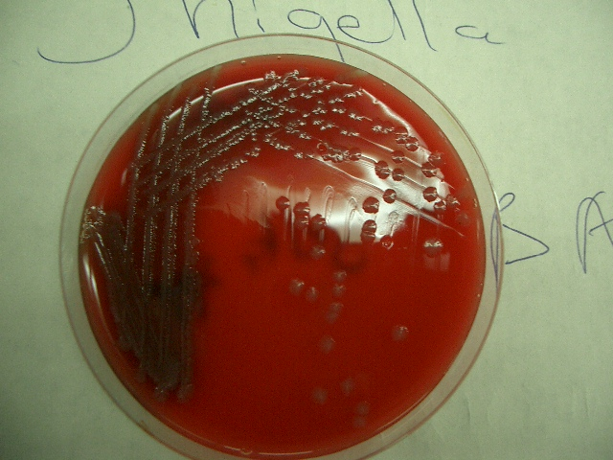
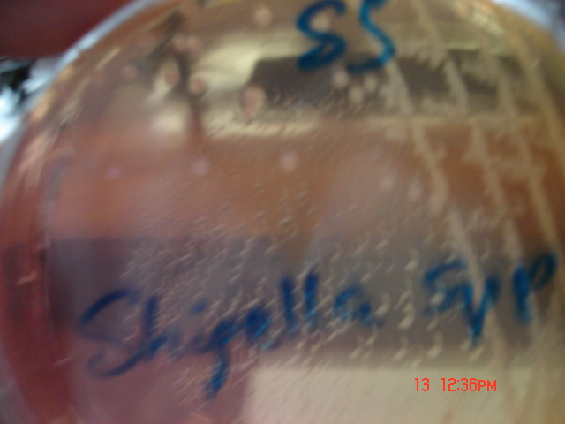
Shigella on SS- No H2S

Slide 11
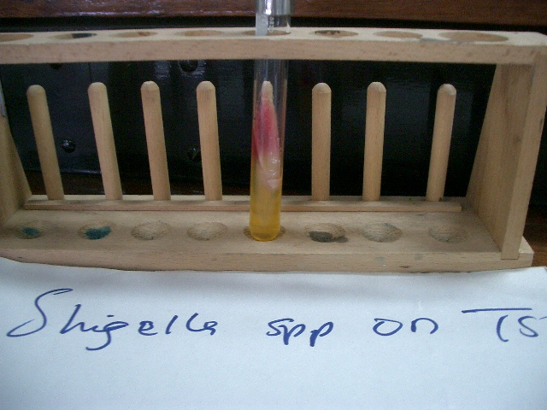
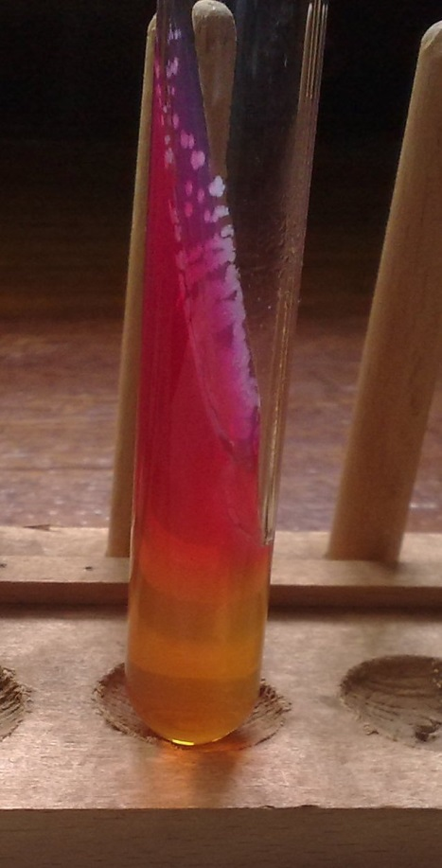
TSI
Slant – Pink(alkaline)
Butt - Acid, No production of H₂S gas and Fe²⁺

Slide 12
TREATMENT
Most cases are mild and self limiting, so are treated with oral rehydration therapy rather than with antibiotics.
Antibiotics may be indicated in severe infections, patients of extreme age or the immunocompromised.
Options include ciprofloxacin, co- trimoxazole
Antiperistaltic drugs are contraindicated-they prolong the fever, diarrhea and excretion of the organism.

Slide 13
PREVENTION
Largely dependent on interruption of fecal oral transmission by proper sewage disposal.
Adequate chlorination of water.
Good personal hygiene.
Public health education

