Slide 1
NON-FERMENTATIVE GRAM-NEGATIVE BACTERIA/ NON- LACTOSE FERMENTERS
KIMAIGA H.O
MBChB (University of Nairobi)

Slide 2
Pseudomonas/ Alcaligenes/ Acinetobacter
Pleisomonas/ Aeromonas
Vibrios
Campylobacter/ Helicobacter

Slide 3
Non-Fermentative Gram-Negative Bacteria
Nonfermentative for glucose (TSI = alkaline over no reaction)
Oxidase-positive for glucose (Hugh-Leifson O-F glucose positive)
Asaccharolytic for glucose (Hugh-Leifson O-F glucose negative)
Cytochrome oxidase positive or negative
Gram-negative rods.
Motile with polar flagella.
Obligate aerobe.
Group of motile gram -ve bacilli
May or may not produce pigment in culture
Resistant to multiple drugs.

Slide 4
Hugh-Leifson OF versus TSI Medium
TSI AGAR SLANT
Total protein = 2.6 g%
Total carbohydrate = 2.1 g%
Protein to carbohydrate (w/w) = 1.2
OF BROTH MEDIUM
Total protein = 0.2 g%
Total carbohydrate = 1.0 g%
Protein to carbohydrate (w/w) = 0.2

Slide 5
Growth of Gram-Negative Non-Fermenters on TSI Agar Slants
Non-fermentative gram-negative bacteria grow abundantly within 16-18 hours of inoculation on the surface of TSI agar slants.
But they neither grow in nor acidify the butt of TSI slants.

Slide 6
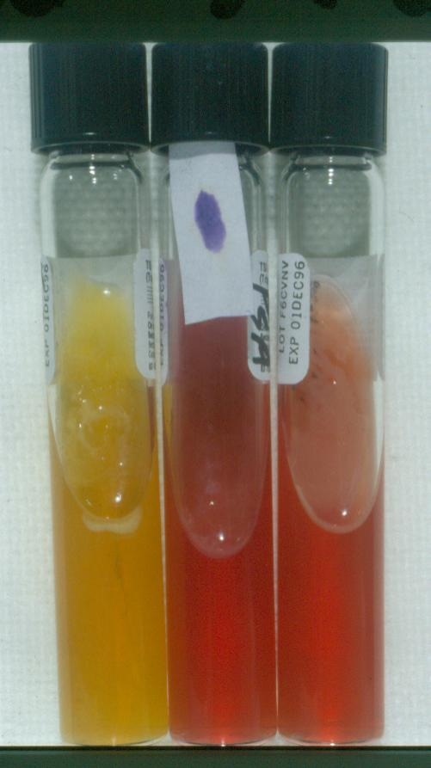

Slide 7
Growth of Oxidative Non-Fermenters in Hugh-Leifson OF Broth
Growth with acidification of broth in Hugh-Leifson tube not sealed by mineral oil (oxidative tube)
No growth in Hugh-Leifson tube sealed by a layer of mineral oil (fermentative tube)
Substrates utilized: glucose, lactose, maltose, xylose, mannitol, sucrose, adonitil, dulcitol

Slide 8
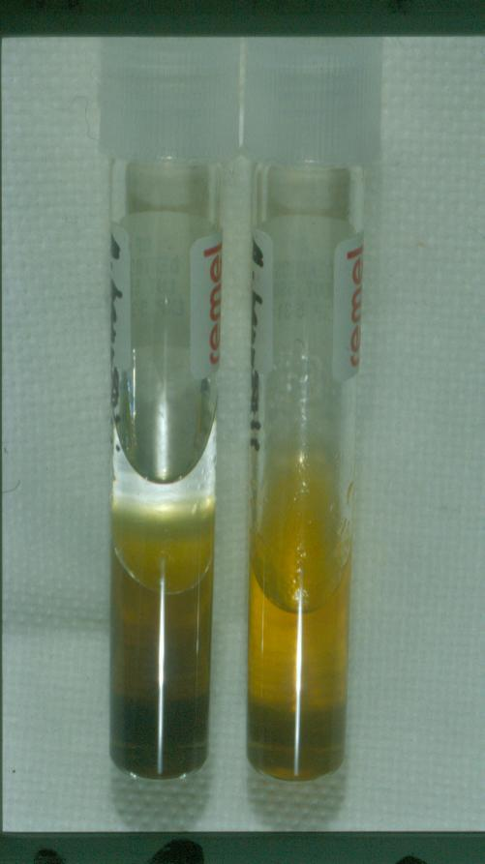

Slide 9
Growth of Asaccharolytic Non-Fermenters in Hugh-Leifson OF Broth
Growth without acidification but with alkalinization of broth in Hugh-Leifson tube not sealed by mineral oil (oxidative tube)
No growth in Hugh-Leifson tube sealed by a layer of mineral oil (fermentative tube)

Slide 10
Non-lactose fermenters
Pseudomonas
P. aeruginosa: Main pathogenic spp. Opportunistic infections of multiple sites
P. Fluorescens
P. Putida
Burkholderia
B. pseudomallei: opportunistic pulmonary infections
B. mallei
B. cepacia: RT infection in cystic fibrosis patients, UTI, opportunistic infections
Stenotrophomonas
S. maltophilia: opportunistic infections
Acinetobacter species
A. baumannii
Moraxella
Achromobacter xylosoxidans

Slide 11
Pseudomonas Aeruginosa
Part of the normal flora in the large intestine of humans and other animals
Also occurs in the environment – soil, water and sewage
Adapts to its environment – can survive/remain viable even in places which are unfavorable for the survival of other bacteria – places can be reservoirs
Moist places and equipments in hospitals – wards, bathrooms, kitchen
Can contaminate medication – eye drops
Diluted disinfectants including antiseptics

Slide 12
AERUGINOSA: Aerobic Exotoxin A Rod/ Resistance UTIs, burns, injuries Green-blue dressings Iron-containing lesions Negative gram Odor of grapes Slime capsule sometimes (in CF pt) Adherin pili

Slide 13
Pathogenesis and Immunity
P. aeruginosa is present in moist environments
Disinfectants, soaps, eye drops, irrigation fluids, dialysis fluids, hydrotherapy baths, and showerheads (nosocomial/ hospitals. sources)
Swimming pools, hot tubs, contact lens solution, cosmetics, illicit injectable drugs (community sources)
It is pathogenic when contacts into areas without normal defenses, e.g.,
Damaged mucous membrane and skin
Usage of intravenous or urinary catheters.
Neutropenia (as in cancer therapy).

Slide 14
Invasive and toxigenic. It attaches to and colonizes the mucous membrane or skin, invade locally, and produces systemic diseases and septicemia.
Resistant to many antibiotics. It becomes dominant when more susceptible bacteria of the normal flora are suppressed.

Slide 15
Virulence and pathologic properties
Exopolysaccharide
Similar to capsular material
Not possessed by all strains
Strains which posses the exopolysaccharide are isolated more frequently in association with lung infections in pts with an abnormality of the lungs- cystic fibrosis
Exopolysaccharide
Enhance adherence to the lung tissue and epithelial cells
Protects bacterial cells from phagocytic cells of host

Slide 16
Pili – attachment or adherence on hosts epithelial surface
Toxins
Endotoxin - Cell wall lipopolysaccharide
Exotoxin - Exotoxin A inhibits hosts cell protein synthesis, causing tissue destruction and necrosis
Extracellular enzymes – S and T: Cytotoxic to host cells.
Elastases – Helps bacteria spread and inhibit neutrophil chemotaxis; induces antibodies in chronic infections.
Hemolysins
Phospholipase C;
Rhamnolipid, also inhibits ciliary activity.
Pyocyanin: Catalyzes production of toxic forms of oxygen that cause tissue damage.
Fluorescein pigment functions as siderophores

Slide 17
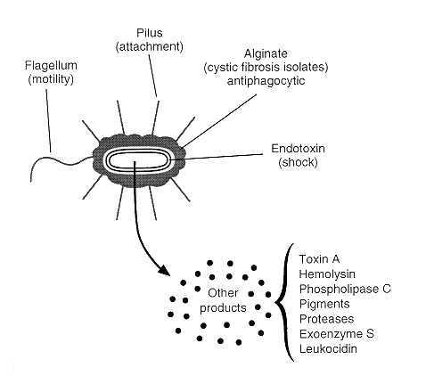

Slide 18
Predisposing factors and Infections
Neutropaenia e.g. in leukaemia – septicaemia
Burns –wound infection and septicaemia
Cystic fibrosis – pneumonia
Trachoestomies – wound colonisation and pneumonia
Cystoscopy and catheterization – urinary tract infection
Trauma – osteomyelitis
Surgical operation – wound infections
Neurosurgical operation – meningitis
Corneal injury – panophthalmitis
Diabetes – malignant otitis externa

Slide 19
Clinical manifestations
Mneuminic; BE PSEUDO
Burns, wound, skin and nail infections.
Blue-green pus.
Verdoglobin or fluorescent pigment detected in wounds, burns, or urine by UV fluorescence.
Eye infections: Corneal ulcer.
Contamination of eye drops and contact lenses
Pulmonary infection
Necrotizing pneumonia in cystic fibrosis patients (diffuse, bilateral bronchopneumonia with microabscess and necrosis).
Meningitis (when introduced by lumbar puncture).

Slide 20
Sepsis: most cases originate from infections of lower RT, UT, and skin and soft tissue.
Ecthyma gangrenosum in sepsis: hemorrhagic necrosis of skin, often do not contain pus.
Endocarditis seen in intravenous drug abusers.
Urinary tract infection- Primarily in patients with long-term indwelling urinary catheters.
Ear infections
Otitis externa: mild in swimmers; malignant (invasive) in diabetic patients. Can be acquired from contaminated water in a swimming pool – swimmer’s ear.
Chronic otitis media

Slide 21
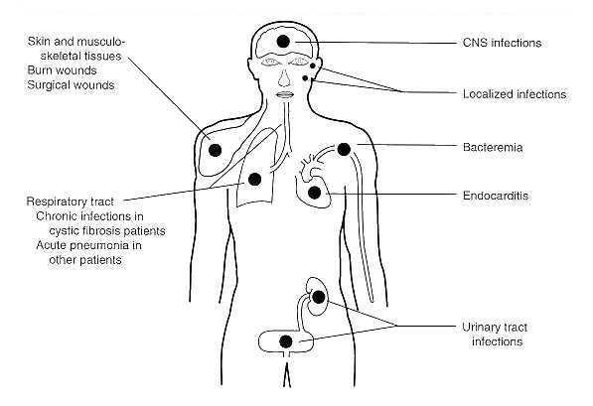

Slide 22
Laboratory Diagnosis
Specimens
Pus, spinal fluid, sputum, Swabs from burns or ulcers or skin lesion wounds, blood for culture, urine
Gram stain of smears
Gram –ve bacilli
Microscopic examination
Non spore forming
Capsulated
Piliated, flagellated and hence motile

Slide 23
Culture Media – forming NLF colonies
MAC – Used to grow pure specimen, Produces colorless colonies (as it does not ferment lactose)
Cetrimide agar - Selective plate used if specimen is not pure. Pyocyanin produced
Nutrient agar
CLED
Blood agar plate - b-hemolysis,
Grape-like sweet smell due to amino acetophenone
Obligate /strict aerobe- Requirement of oxygen for growth, They have oxidative respiration(Not fermentative)
Grow at 42 °c for 18 - 24 hrs
They also have a metallic sheen described as having feathered edges
Colonial morphology
Approximately 2mm in diameter , Low convex , Irregular surface , Dry surface
Mucoid colonies from encapsulated strains
Pigmented colonies
Pyocyanin- blue, nonfluorescent
Pyoverdin – fluorescent green pigment
Pyorubin(brown/red)
Fluorescein(yellow-green)
Nb. Other pigments observed in less commonly encountered strains
Pyorubin – red
pyomelanin – black

Slide 24
Gram stain and microscopic examination of colonies
Biochemical tests
Mainly to differentiate from NLF enterobacteriaceae
Oxidase positive
Oxidative method of respiration – enterobacteriaceae are fermentative
Urease –ve
Sugar fermentation and urease production tests –ve - enterobacteriaceae are positive
Positive cytochrome oxidase reaction, while enterobacteriaceae is negative
TSI –No sugars fermented hence
Slant – Pink(alkaline)
Butt - Pink(alkaline) No production of H2S gas and Fe2+
Further identification by
Serotyping based on the (somatic) O and (flagella) H antigens
Phage typing
Other methods of typing.

Slide 25
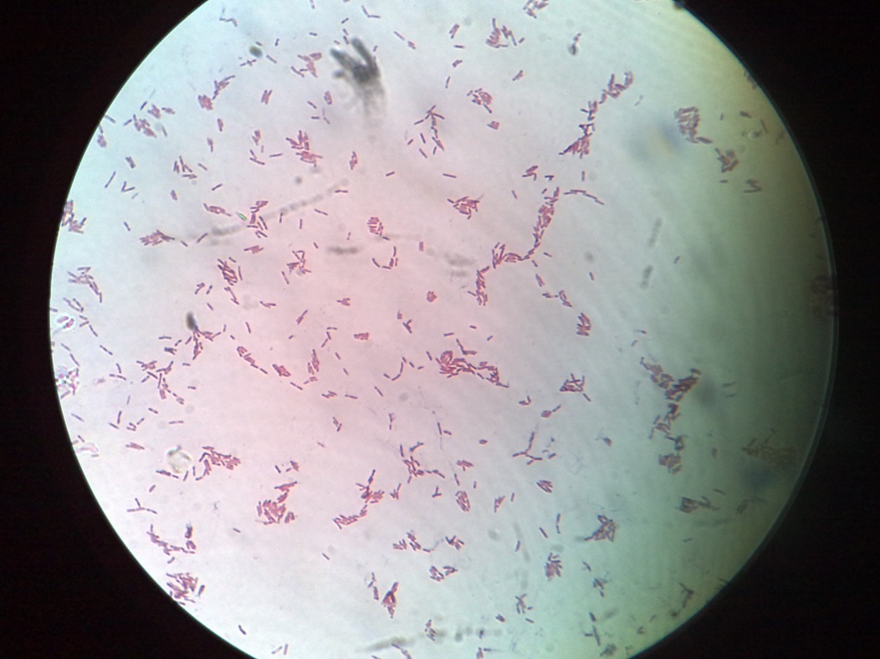
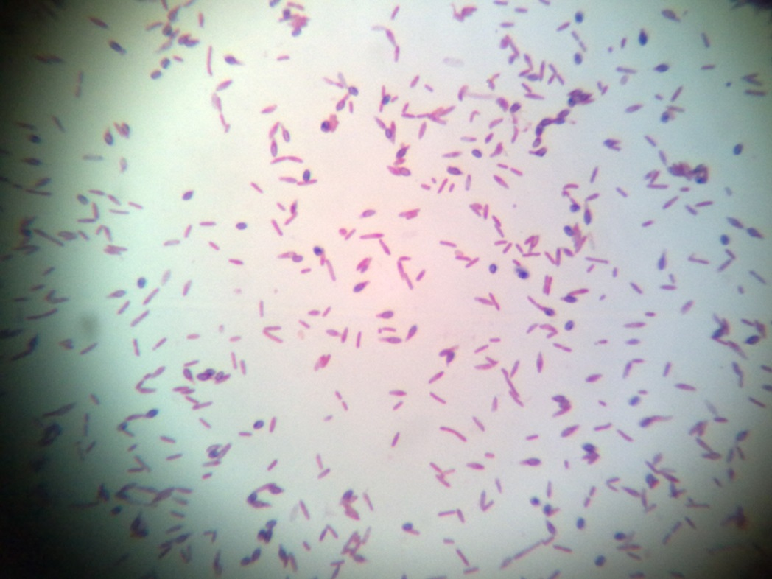
Pseudomonas aeruginosa negative Gram stain

Slide 26
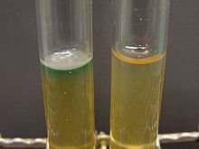
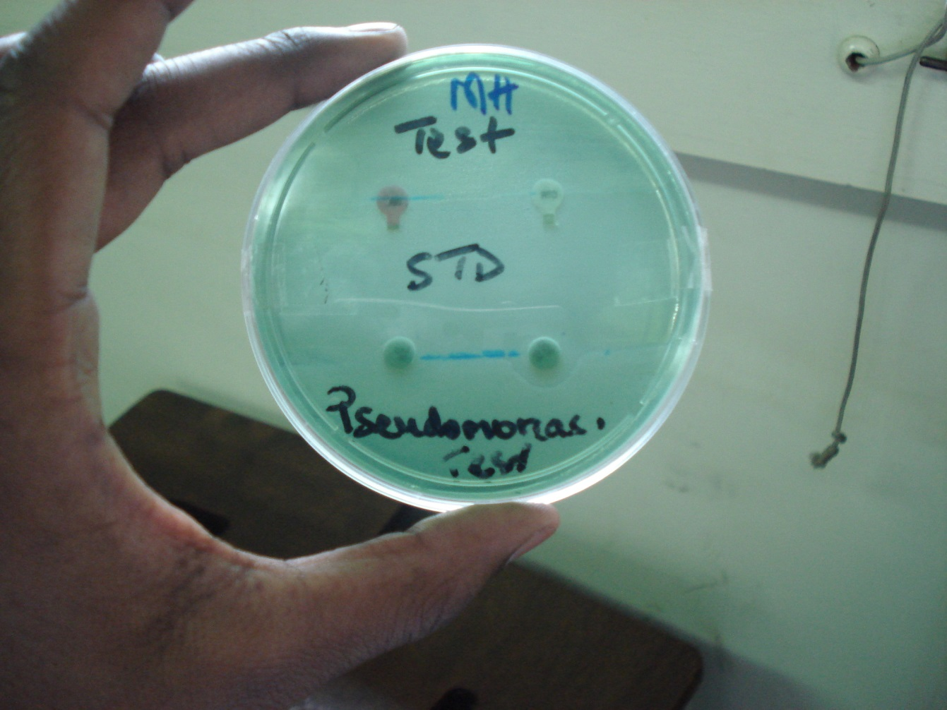
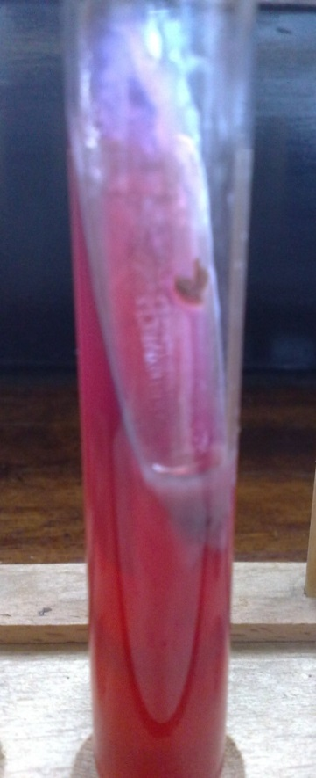
Production of pyocyanin, water-soluble green pigment of Pseudomonas aeruginosa. (left tube)
Pseudomonas TSI(alkaline slant and Butt)
Stoke's method Pseudomonas

Slide 27
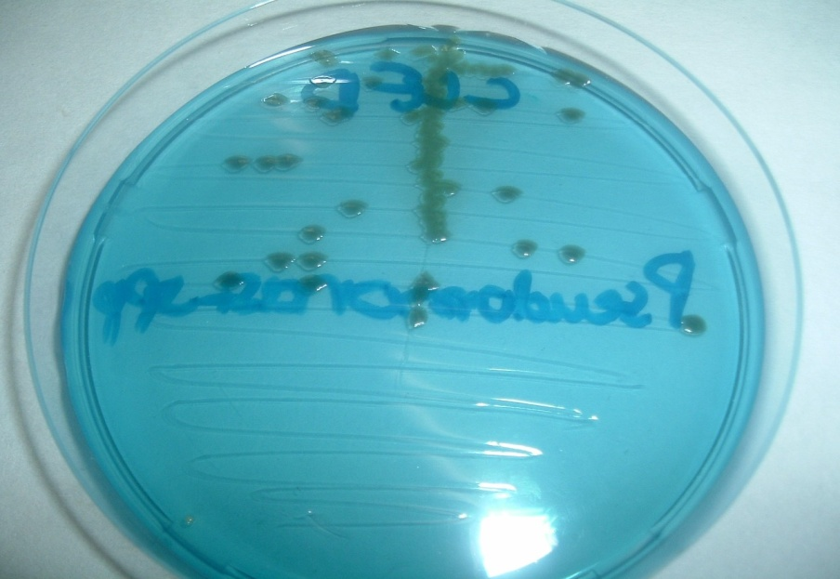
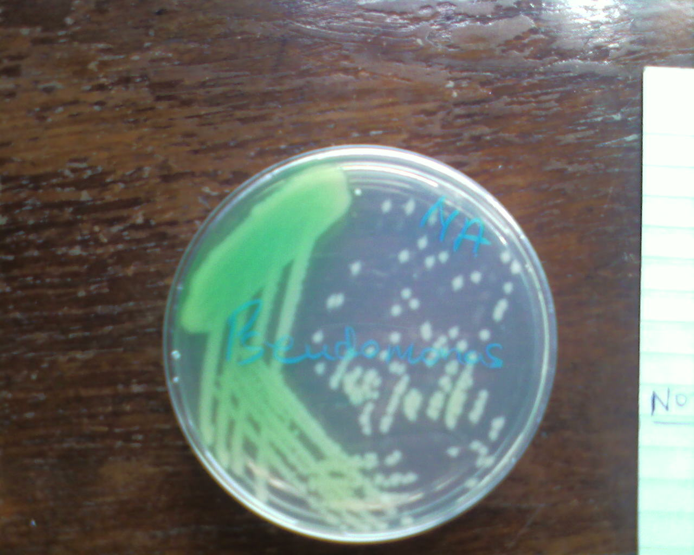
Pseudomonas Culture-Pigments

Slide 28
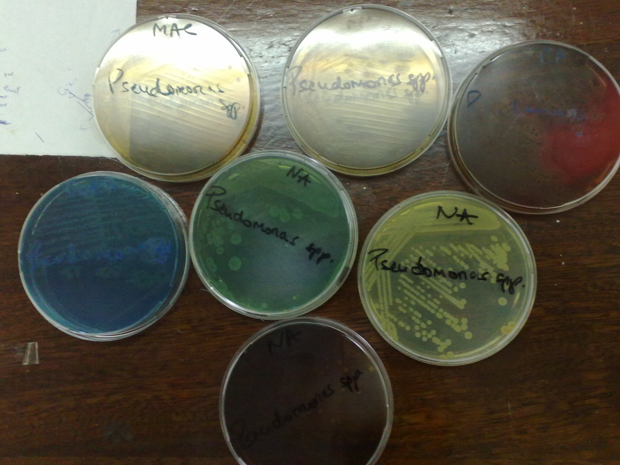

Slide 29
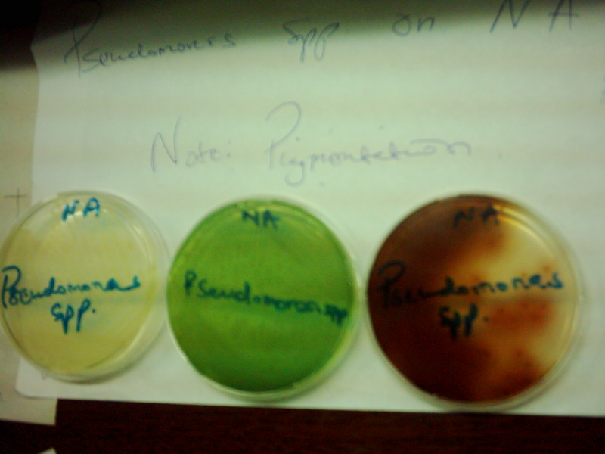
Pseudomonas on NA- Note pigmentations

Slide 30
Pseudomonas on BA
Pseudomonas on CLED

Slide 31
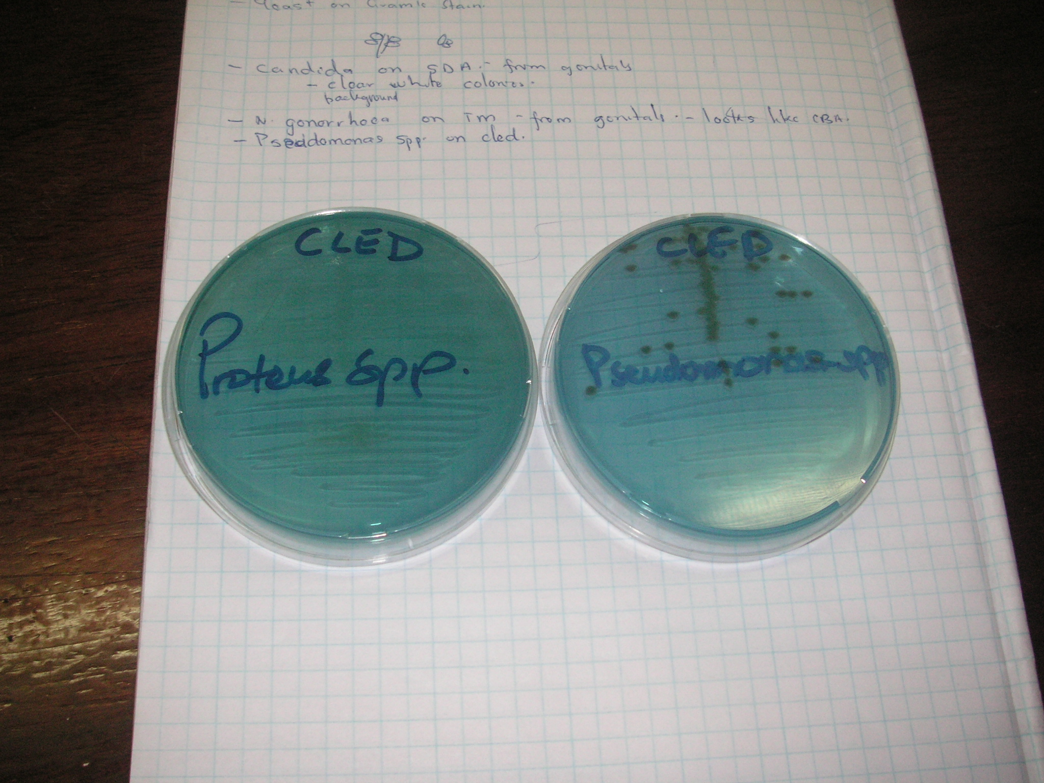

Slide 32
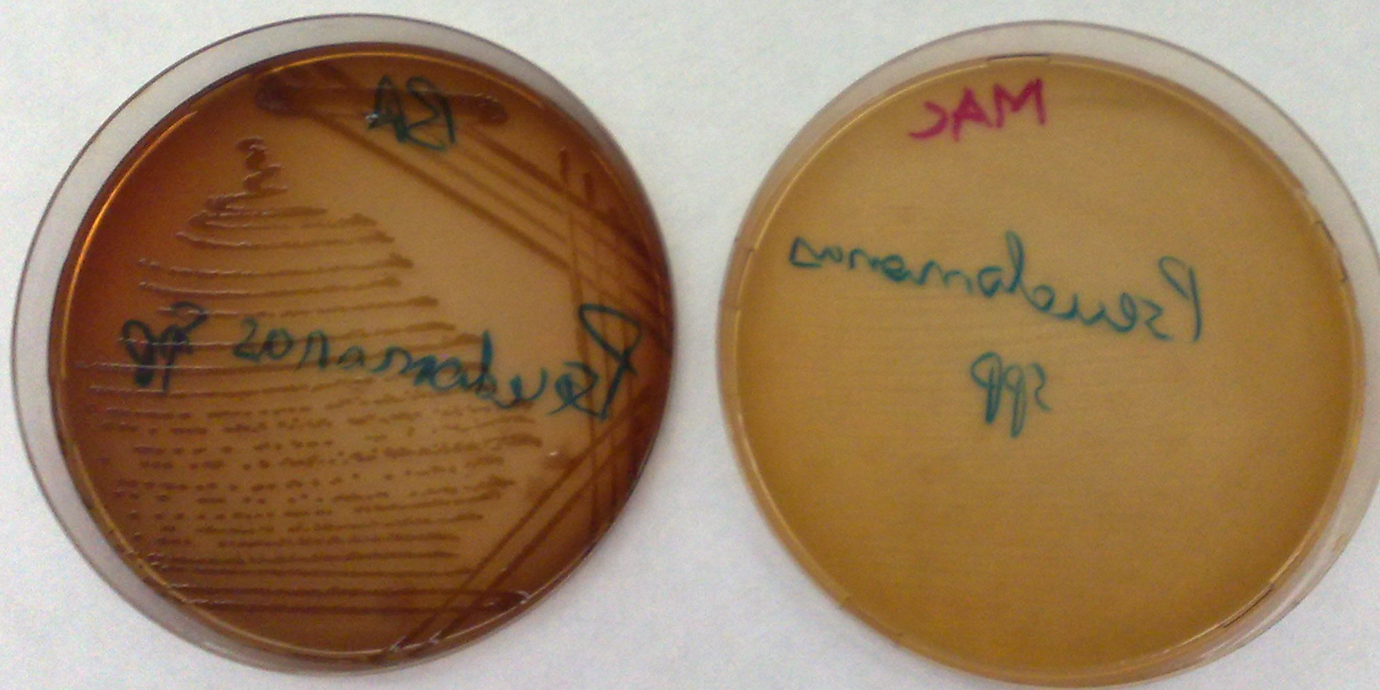
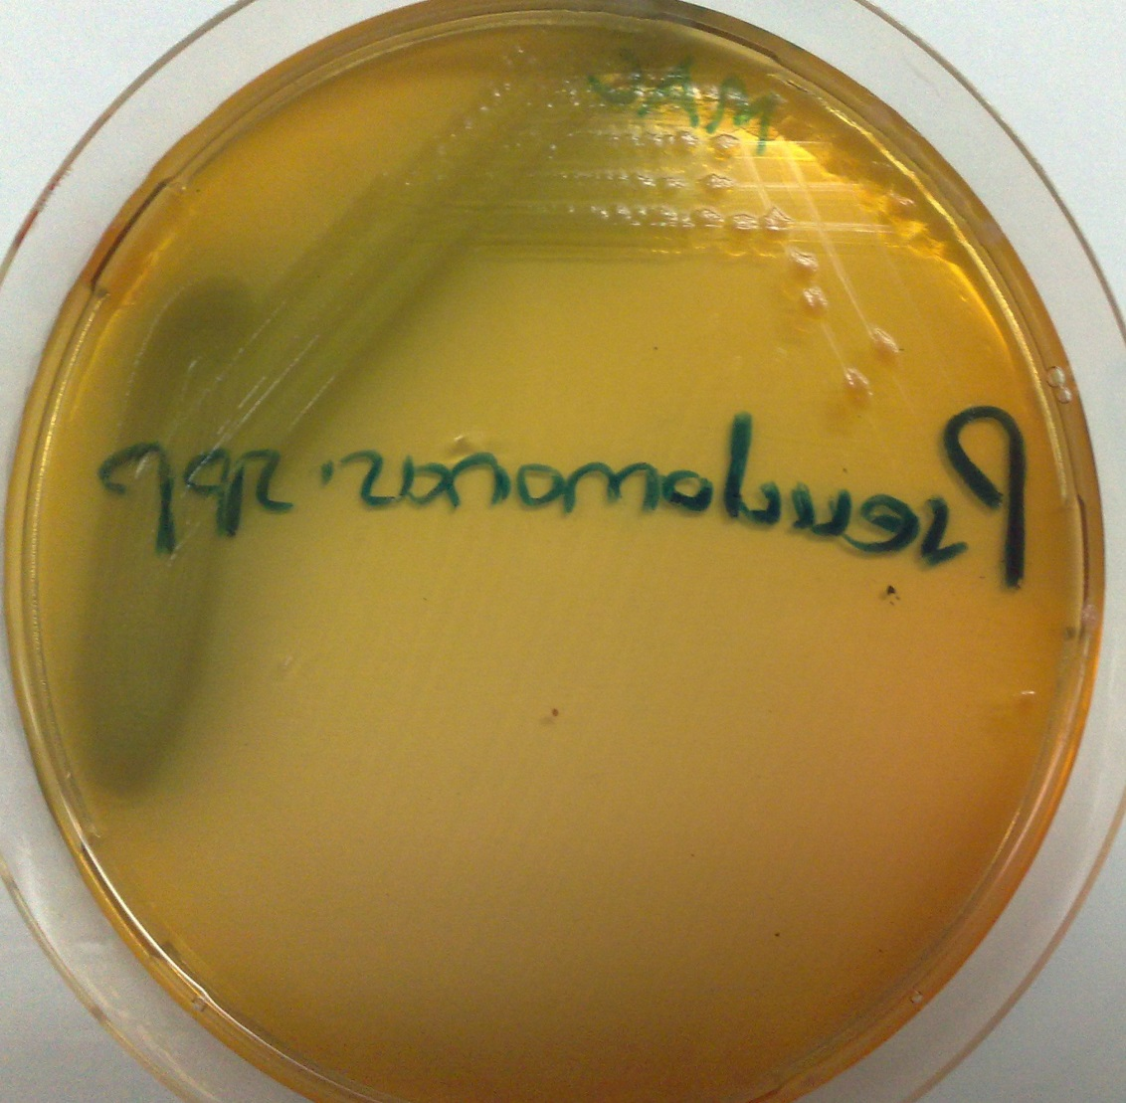
Pseudomonas on BA and MAC

Slide 33
Antimicrobial susceptibility
Resistant to many antimicrobial agents and disinfectants commonly used
Resistance is natural or acquired
Acquired resistance is mostly due to resistance factors transferred from other gram –ve bacilli
In vitro susceptibility tests necessary esp. in isolated cases
Generally may be susceptible to
Aminoglycosides – gentamicin, Amikacin
Penicillins – carbenicillin, piperacillin, ticaricillin
Cephalosporins – ceftrazidime
Fluoroquinolones –

Slide 34
Treatment
Mneumonic; how to kill pseudomonas 1-Tie it up (ticarcillin) 2-Hit it with a pipe (pipercillin) 3-Run over it with a car (Carbenicillin)
Antipseudomonal antibiotics
Ticarcillin
Piperacillin
Carbenicillin
Combined antibiotic therapy used to avoid resistance that develops rapidly when single drugs are employed.
Avoid using inappropriate broad-spectrum antibiotics, which can suppress the normal flora and permit overgrowth of resistant pseudomonads.
Injection of hyperimmune globulin and granulocyte transfusion to augment compromised immune function for selected patients.

Slide 35
Prevention
Pseudomonas spp. normally inhabit soil, water, and vegetation and can be isolated from the skin, throat, and stool of healthy persons.
Spread is from patient to patient via contact with fomites or by ingestion of contaminated food and water.
Methods for control of infection are similar to those for other nosocomial pathogens.
Special attention should be paid to sinks, water baths, showers, hot tubs, and other wet areas.
High risk population: patients with leukemia, burns, cystic fibrosis, and immunosuppression.

Slide 36
Control
Patients at high risk should not be admitted to a ward where cases of pseudomonas infection are present.
Patients infected with P. aeruginosa should be isolated.
Sterilize all instruments, apparatus, and dressing; antimicrobial and other therapeutic substances.
Monitor clinically relevant isolates of P. aeruginosa by a suitable typing system to identify epidemic strains.

Slide 37
Pseudomonas fluorescens and Pseudomonas putida
Morphologically similar to p. Aeruginosa
Less commonly encountered in association with disease
Occasionally isolated as contaminants of stored fluids
Capable of growing at low temp such as 4 ° c
Differentiated from Ps. Aeruginosa by oxidative tests

Slide 38
Pseudomonas fluorescens and P. putida: Types of Infectious Disease
Fluorescent group of Pseudomonas = P. aeruginosa, P. fluorescens, P. putida
P. fluorescens and P. putida generally not significant clinically
P. fluorescens and P. putida associated with transfusion acquired bacteremia (source=skin of blood donor)
P. fluorescens associated with pseudobacteremia due to infusion of contaminated solutions

Slide 39
Burkholderia pseudomallei
A saprophyte associated with animal infections; animal disease – meliodosis
Human infections occur accidentally from environmental sources – through broken skin and possibly inhalation and ingestion
Results in asymptomatic infection or a localized suppurative lesion at the inoculation site. Possible
Compilations – septicemia and further spread
Common manifestation include primary pneumonitis, skin lesions and septiceaemia
Shows susceptibility to several antimicrobials agents such as tetracycline, amoxicillin, chloramphenicol, piperacillin

Slide 40
P. Mallei
Closely related to B. pseudomallei genetically
Primary pathogen of donkeys, horses and mules causing – a pulmonary infection and subcut ulcerative lesion
Rarely acquired accidentally by human via broken skin or contact with infected discharges form animals.
Colonially manifests as – an ulcer on the skin or mucous membranes – abscesses, lymphoangitis, pneumonia
Lab test – serology to detect and demonstrate rising antibody levels, culture and identification from specimens obtained from lesions

Slide 41
Stenotrophomonas maltophilia
A common nonfermentative, gram-negative isolate.
Widely distributed including moist hospital environments (respiratory therapy equipment)
Colonizer of human respiratory tract in a hospital setting
It infects debilitated or immunocompromised persons, and causes a wide spectrum of diseases, including wound infections, UTI, pneumonia, sepsis, meningitis, bacteremia, endocarditis, ambulatory peritoneal-dialysis related peritonitis,
It is resistant to many commonly used antibiotics, and patients receiving long-term antibiotic therapy are particularly at risk for acquiring infections.

Slide 42
Modes of Infection
Colonization of hospital patients by environmental sources
Introduction of organisms into normally sterile sites by medical instrumentation (similar to Acinetobacter)
Infections may be acquired from contaminated disinfectants, respiratory therapy and monitoring equipment, and ice machines.

Slide 43
Burkholderia
They colonize the moist environmental surfaces and are commonly associated with nosocomial infections.
B. cepacia and B. pseudomallei are important pathogens.
B. cepacia causes RT infections particularly in cystic fibrosis patients, UT infections and septicemia. Usually non-fatal except for RT infections in CF patients.
B. pseudomallei usually causes opportunistic infections, but may sometimes infect previously healthy persons. Infection by this organism may result in asymptomatic infection, acute suppurative cutaneous infection that may progress to sepsis, and chronic pulmonary infection ranging in severity from mild bronchitis to necrotizing pneumonia.

Slide 44
Other non-carbohydrate fermenters
Saprophytes are part of normal flora
Saprophytes in the environment may be
Isolated from animals
Associated with opportunistic infections in humans
Gram –ve bacilli
Occasionally cause disease in human as opportunistic infections
Morphologically resemble other pathogens and are to be differentiated from common pathogens.

Slide 45
Alcaligenes
Gram –ve motile bacilli
Normal flora in the large intestine also Saprocytes
Similarities with salmonella typhi
Do not grow in Salmonella Shigella medium
Strict aerobes –
Oxidase +ve, lactose fermentation test –ve
Uncommon causing agent of opportunistic infections.

Slide 46
Acinetobacter
A commensals on skin and mucous membranes- normal flora on skin
Retains viability in various parts of the hospital e.g medical instrumentation (intravenous or urinary catheters, endotracheal tubes or tracheostomies, respiratory care equipment) in debilitated hospital patients (antibiotic treatment, surgery, intensive care units, surgery)
Associated with hospital acquired infections
Meningitis
Wound infections
Pneumonia
Septicemia
Spp associated with most infxns is Acinetobacter baumanii
Organism show ↑ resistance to commonly used antibiotics

Slide 47
Properties
Short gram –ve bacilli or cocco-bacilli
Tend to occur in pairs resembling diplococcic – similar to neisseria
Strict aerobes
Oxidase –ve(to differentiate them from Neisseria since they resemble Neisseria)
They also don’t occur intracellularly
Species occasionally as causative agents and common in hospital acquired infections

Slide 48
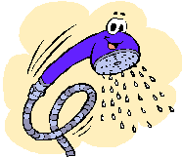
LEGIONELLA
Numerous spp
Main pathogenic spp – legionella pneumophila (Lung loving)
Associated with hot water systems and air conditioning
Morphology
Gram –ve bacilli which do not stain easily by gram’s method – stainable by silver

Slide 49
Clinical manifestations
Legionellosis
Characterized by rising fever (up to 41 ºC), cough, diarrhea, and abdominal pain.
Pneumonia is the most severe disease, progressing to impaired respiration and organ function.
Respiratory tract infection of variable severity – can occur sporadically or in epidemics
Other infections
Can manifest as a severe form of pneumonia – legionnaire’s disease

Slide 50
Transmission:
Usually a nosocomial or opportunistic disease. Legionella appears to be widely distributed in aqueous habitats such as tap water, cooling towers, spas, ponds, in addition, other fresh water sources.
The organism can be released during aerosol formation and are often carried for long distances. Cases have been traced to supermarket vegetables sprayers, air conditioning towers, etc.

Slide 51
Laboratory diagnosis
Fastidious growth in the lab – a special medium formulated for its growth – contains required minerals, amino acids and other nutrients
Gram positive rods
Don’t stain easily with Gram stain –stained by silver impregnation methods and fluorescent stains
Slow growth 3-5 days or upto 21 days
DNA probes and fluorescent antibody techniques are also used. Impregnation and fluorescent antibody stains
Associated with warm moist environs and aquatic habitats – fresh water lakes, rivers, tanks, pipes

Slide 52
Treatment
Susceptibility to several antimicrobial agents – erythromycin, ciprofloxacin, azithromyc
Chlorination and regular cleaning of artificial habitats are of some benefit. in.

Slide 53
Kingella
Kingella kingae
Oxidase +ve
Gram negative rod or coccobacillary
Non-motile
Hemolytic on BA
Encountered as commensals in the upper respiratory tract
Are Catalase negative ferment glucose
Uncommon causative agents of opportunistic infections mostly in children
Associated with bacteremia

Slide 54
Plesiomonas
P. Shigelloides
Gram negative bacillus with polar flagella
Associated with fresh water fish and diahorreal stool in humans
Has some similarities with shigella sonnei
Oxidase positive

Slide 55
Aeromonas
A. hydrophilic
Fresh water habitat
Diarrheal illness clinically associated
Aerobic /facultative anaerobe oxidase +ve
Colonies on BA morphologically resemble enterobacter
Colonies with complete hemolysis on BA

