Slide 1
DIABETES MELLITUS
world prevalence: more than 220 million
Term referring to all states characterized by sustained hyperglycemia

Slide 2
Type I– insulin dependent ( insulin dependent diabetes mellitus - IDDM): Characterized by absolute insulin deficiency; caused by autoimmune-mediated destruction of insulin producing B-cells in the pancreas
Develops before the age of 40
Also called juvenile diabetes

Slide 3
  Type II- non-insulin-dependent diabetes mellitus(NIDDM). May be caused by:
  Tissue insulin resistance due to
  obesity ( or weight gain)

Slide 4
  the metabolic syndrome –both due to effects of free fatty acids
  hyper secretion of hyperglycemic hormone (s)

Slide 5
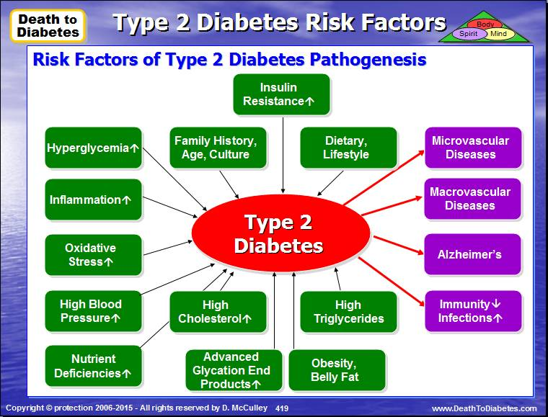

Slide 6
  Other diseases e.g. polycystic ovary syndrome
  Insulin hyposecretion due to overstimulation of B cells by high sugar intake,

Slide 7
Classical clinical symptoms:
Elevated blood glucose concentration ;
Polyuria, Glycosuria, Polydypsia and Polyphagia
Other symptoms of diabetes mellitus
Glycosylated hemoglobin
Formation of Advanced Gycosylated end-products--AGEs ( rate depends on blood glucose levels)
Weakness or fatigue
Keto-acidosis

Slide 8
5. Atherosclerosis which may result in: stroke, myocardial infarction
6. AGEs cause multiorgan micro vascular damage: diabetic nephropathy, neuropathy, retinopathy etc
7. Reduced resistance to infections

Slide 9
GLUCOSE TOLERANCE TEST (CURVE)
When a normal fasting person ingests 1 gram of glucose per kg of body weight blood glucose rises to 120-140mg/ dL and falls back below normal in about two hours
In a diabetic person blood glucose concentration rises much higher is and always above 110mg/dL after 2 hours
Data from sampling at short intervals can be used to plot a curve (Glucose tolerance curve)

Slide 10
GTT necessary because renal tubules adapt to high glucose loads
Type I and Type II are distinguished by assaying for insulin

Slide 11
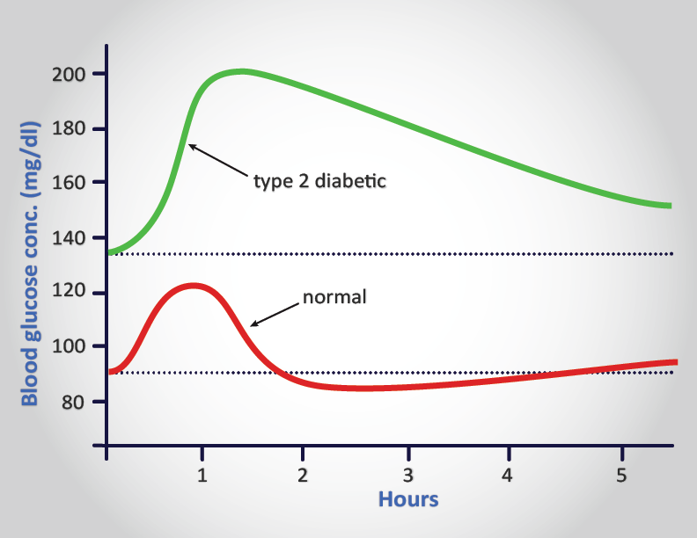

Slide 12
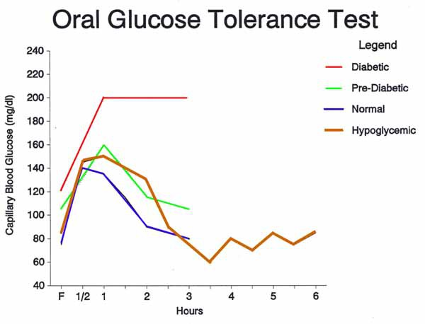

Slide 13
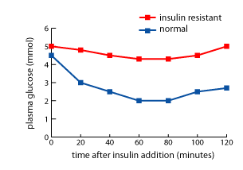
Insulin sensitivity test

Slide 14
Explanation of the symptoms of Diabetes
1. High blood glucose concentration
2. Failure of glucose to enter muscle and adipose tissue (insulin deficiency or insulin resistance in most cases) and
3. Increased mobilization and utilization of fatty acids for energy
4. Oxidation of fatty acids
5. Reduction of metabolic products of glucose metabolism in Kreb’s cycle
6. Ketacidosis

Slide 15
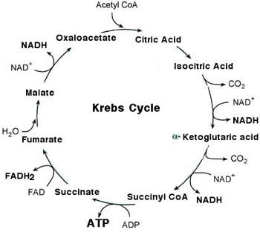

Slide 16
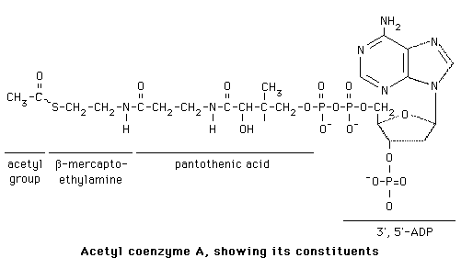

Slide 17
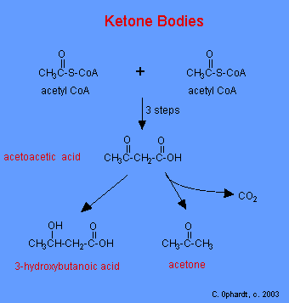

Slide 18
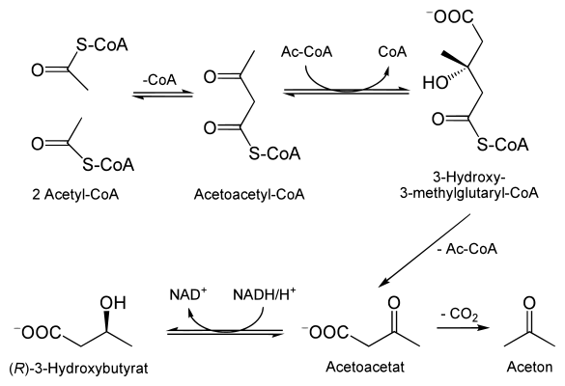
Ketoacidosis

Slide 19
7. Oxidative damage to neurons, blood vessels and micro vascular system by:
Activation of aldose reductase→ formation of sorbital→↓cellular Na-K ATPase
ii. NON ENZYZMATIC GLYCATION: formation of
amadori products →formation of advanced glycosylation products(AGEs)
iii. AGEs

Slide 20
AGPs: advanced glycation products
      cross-link with cell matrix proteins
      damage blood vessels
      interfere with leukocyte responses

Slide 21
8. The metabolic syndrome
is a disorder of energy utilization and storage, diagnosed by a co-occurrence of three of the following medical conditions
(It is a lipid-sugar syndrome)

Slide 22
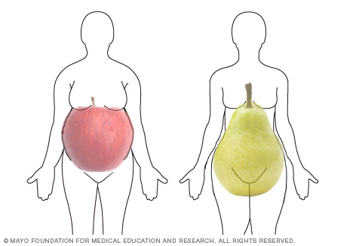

Slide 23
elevated fasting plasma glucose,
abdominal (central) obesity,
elevated blood pressure
iv high serum triglycerides, and
v. low high-density cholesterol (HDL) levels.
Metabolic syndrome increases the risk of developing cardiovascular disease, particularly heart failure, and clinical diabetes

