Slide 1
ENTEROBACTERIACEAE
KIMAIGA H.O
MBChB (University of Nairobi)

Slide 2
Taxonomical Classification
Two important classifications
Based on taxonomy
  Kingdom- Bacteria
  Phylum- Proteobacteria
  Class- Gammaproteobacteria
  Order- Enterobacteriales
  Family – Enterobacteriacaea
Based on lactose fermentation

Slide 3
TAXONOMY (Ewing)
Tribe concept proposed by Ewing group in genera that share similar biochemical reactions and diagnostic importance (7 Tribes)
 | TRIBE | GENUS
I | Escherichieae | Escherichia, shigella
II | Edwardsielleae | Edwardsiella
II | Klebsielleae | Klebsiella, Enterobacter, Edwardsiella, Hafnia, Serratia
III | Salmonelleae | Salmonella, Arizona
IV | Citrobactereae | Citrobacter
IV | Protease | Proteus, Providencia, Morganella
V | Yersineae, | Yersinia, Pasteurella
 | Erwinieae | Erwinia, Pectobacterium

Slide 4
Classification based on lactose fermentation
Lactose fermenters (LF) – CEEK
Citrobacter
Enterobacter
Escherichia coli
Klebsiella
Non lactose fermenters (NLF) - SSYPS
Salmonella
Shigella
Yersinia
Proteus
Serratia
Late lactose fermenters
Shigella sonnei
Edwardsiella,, Citrobacter, Arizona,Providencia, Erwinia

Slide 5
General characteristics
Primarily normal flora in intestinal tract of humans and animals and others found in water and soil. Also called coli forms or enteric bacteria
Gram negative rods
Non-capsulated except Klebsiella
Non-spore forming
Ferment carbohydrates/glucose with acid production
Most are oxidase –ve (lack cytochrome oxidase)
Catalase +ve
Facultative anaerobes
Some motile by peritrichous flagella few genera non motile e.g Klebsiella
Contain endotoxin in cell wall
  Most reduce nitrate to nitrite via nitrate reductase
Grow in media with bile salts (MacConkey)
Combinations of chromosomal & plasmid-mediated drug resistance hence importance of in-vitro susceptibility testing

Slide 6
Media used to distinguish Lactose fermenters and Non-Lactose Fementers
  MacConkey agar - LF-colored/pink, NLF- colorless colonies
  Eosin Methylene Blue (EMB) agar
  Salmonella Shigella (SS) agar
  Triple Sugar Iron (TSI)agar - Slant, butt, gas, H₂S

Slide 7
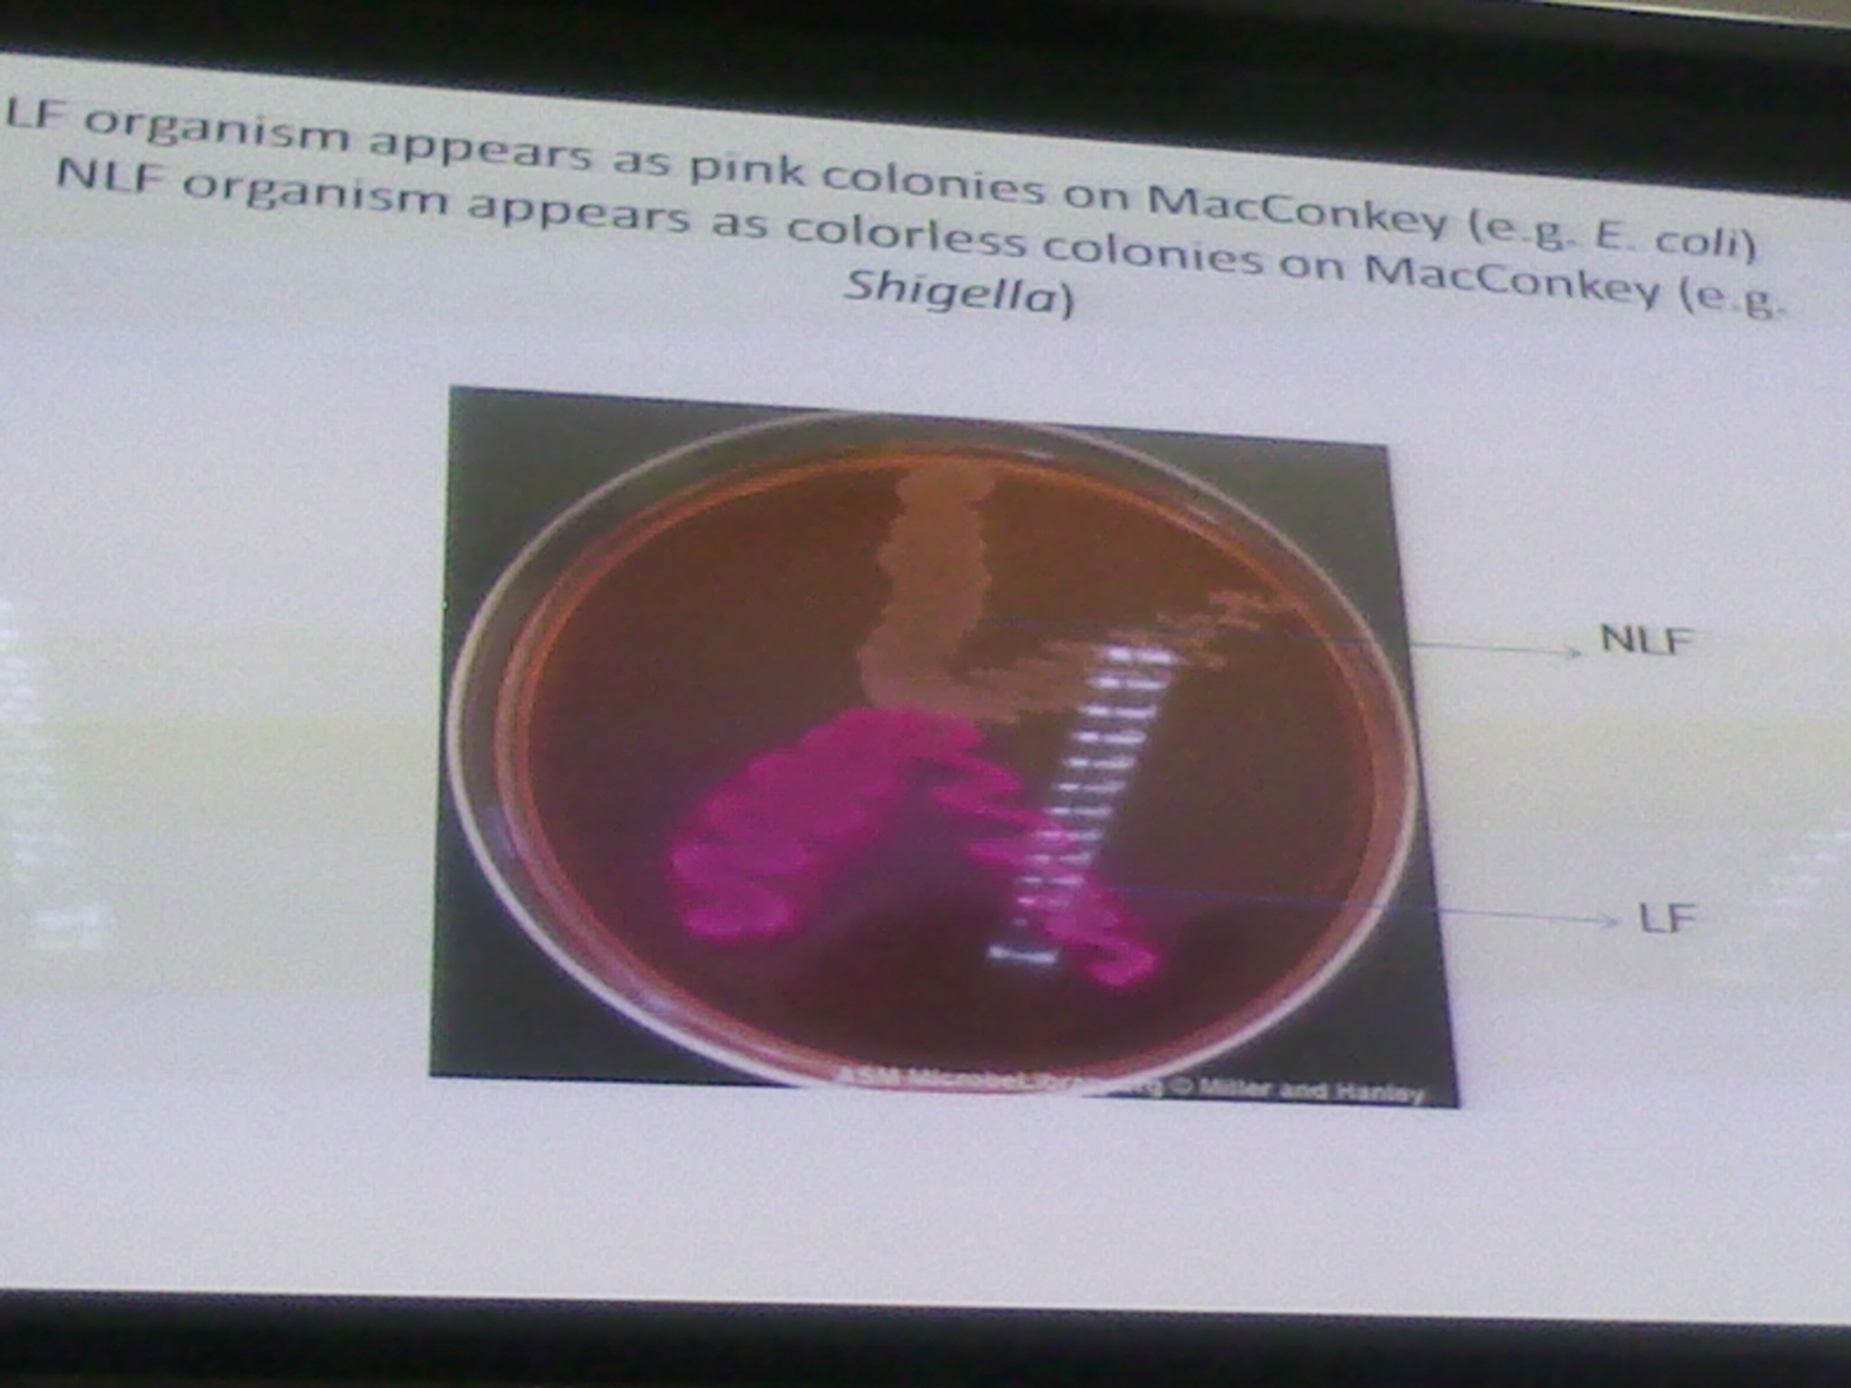

Slide 8
CITROBACTER
Normal intestinal flora may cause opportunistic infections.
NLF, Associated with nosocomical UTI and respiratory infections, Endocarditis, neonatal meningitis and brain abscesses
Treatment
  Multidrug resistance
  Aminoglycosides/ carbapenems/ quinolones/ antipseodomonal penicillins

Slide 9
Enterobacter species
Previously known as aerobacter spp
Compromised of 12 species; E. cloacae and E. aerogenes are most common
Characteristics
Cononies resemble Klebsiella
Motile peritrichous flagella
IMViC--++

Slide 10
Clinical manifestations
Commensals in the human gut
Most strains cause infections in immunocompromised individual- hospital impatients
Cause wound infections, burn infection, pneumonia, UTI, Intra-abdominal infections, neonatal
Resistance
1st generation cephalosporins
β-lactamase production – resistance to many cephalosporins
Treatment
Carbapenams,4th generation cephalosporins
Ampicillin and gentamicin- E.sakazakii

Slide 11
KLEBSIELLA
SPECIES
Klebsiella pneumonia – Lobar pneuomina , Most common
K. oxytoca.- Lobar pneumonia
K. ozaenae – atrophic rhinitis (ozena)
K. rhnosceleromatis- rhinoscleroma (Granuloma of the nose and pharynx)
K. granulomatis- Granuloma inguinale/ donovanosis- painless, non-purulent genital ulcer
Klebsiella, Citrobacter, Hafnia, Serratia
Habitat – large intestines, soil, H₂O

Slide 12
Pathogenesis
Virulence factors
Large polysaccharide capsule. Capsular K antigen- antiphagocytic capsule
Synthesis of siderophores, that are capable of competitively taking up iron bound to proteins
Pili – adherence to respiratory and urinary epithelia
Endotoxin – The carry plasmids that code for heat labile and heat stable toxins. Gram negative septic shock

Slide 13
CLINICAL PRESENTATION
Pulmonary infections- pneumonia lobar;
  High fatality
  Predisposing factors : elderly, chronic respiratory dx, diabetes, alcoholism
  Extensive necrosis and hemorrhage resulting in thick, mucoid, brink red sputum currant jelly like.
Extrapulmonary infections
  Meningitis and enteritis in infants
  UTI
  Septicemia/Bacteremia
  Cholecystis, cholangitis, otitis media, sinusitis, peritonitis, wound/ burn infections,
  An important cause of nosocomial infections
K.rhinoscleromaticus – inflammatory granulomatous lesions of nose, pharynx, etc

Slide 14
LAB DIAGNOSIS
Specimens - urine, pus, blood, sputum, CSF
Gram –ve rods
Culture:- MAC , CLED, or BA:—
  Growth conditions, 35⁰C ,18-24 hrs
  Mucoid colonies on BA, pink(LF) in MAC and CLED
  LF thus yellow in CLED and pink in McC
  Non motile
Biochemical tests
  IMViC(--++)
  Urease positive
  TSI- acid slant, acid butt, gas, no H2S
  KSM positive
  K pneumoniae can liquefy gelatin.
Short and plump- Capsule swelling (Quellung reaction)– Typing based on about 90 capsular (K) antigens there are three types – K2,K3 and K21. Rapid identification.

Slide 15
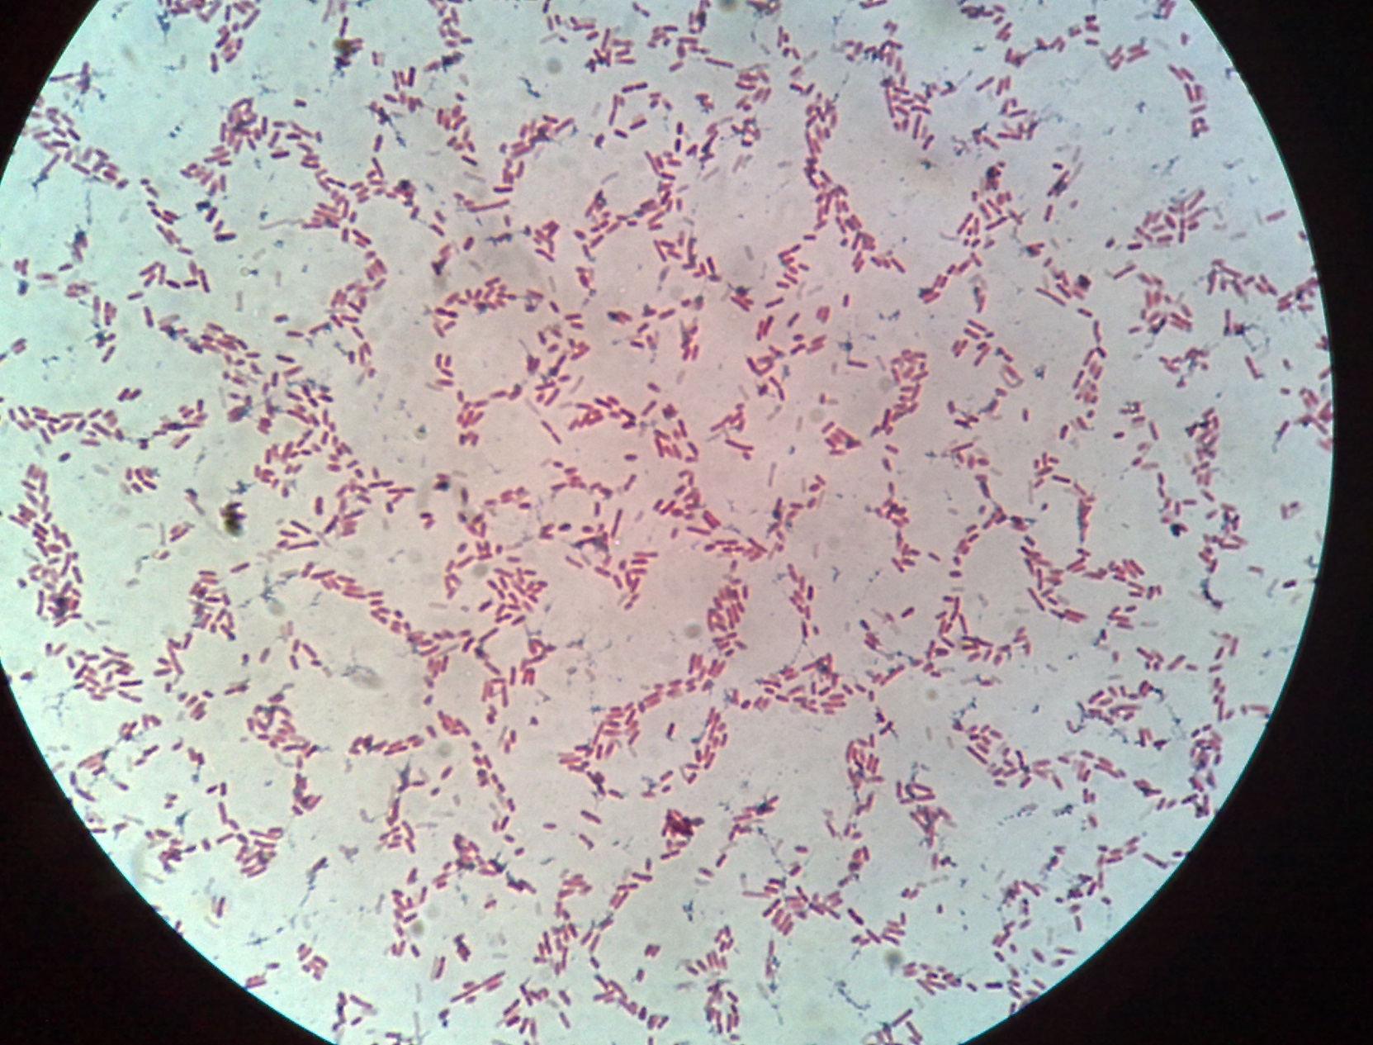
Gram –ve Klebsiella rods

Slide 16
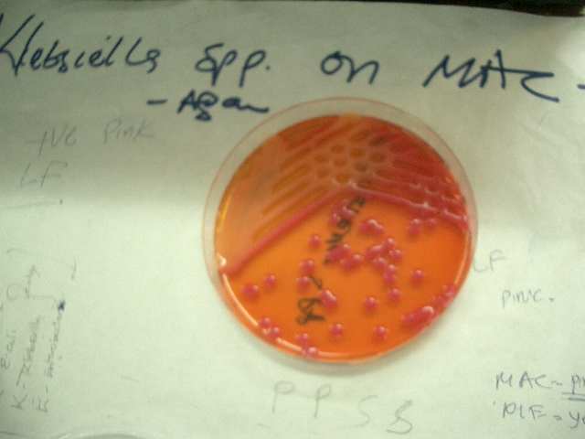
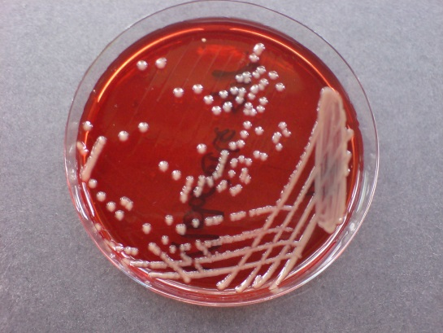
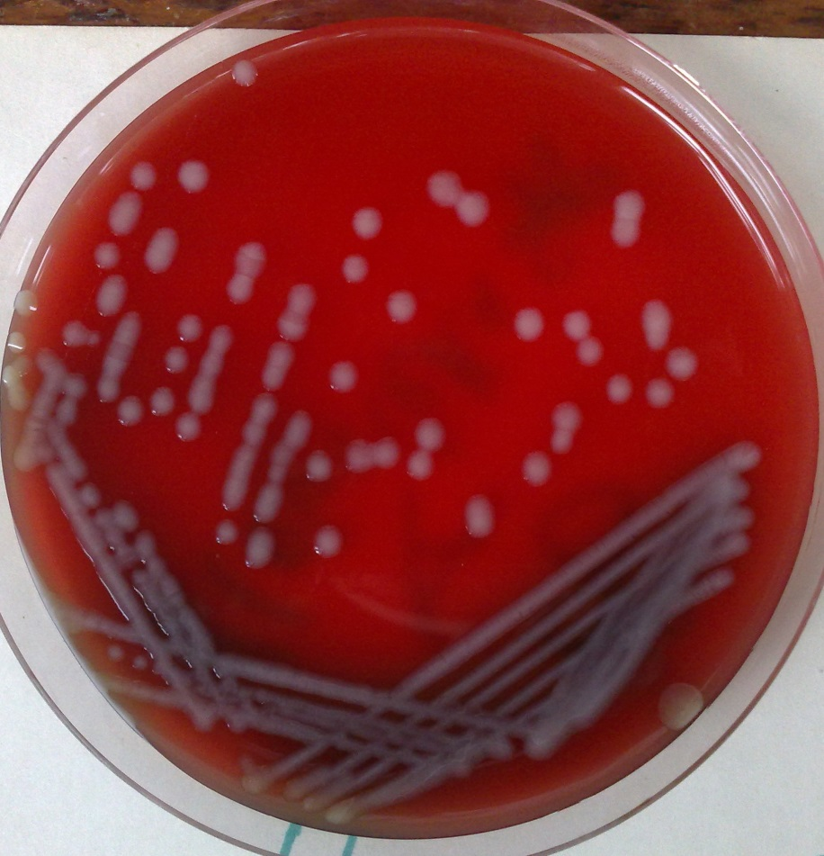
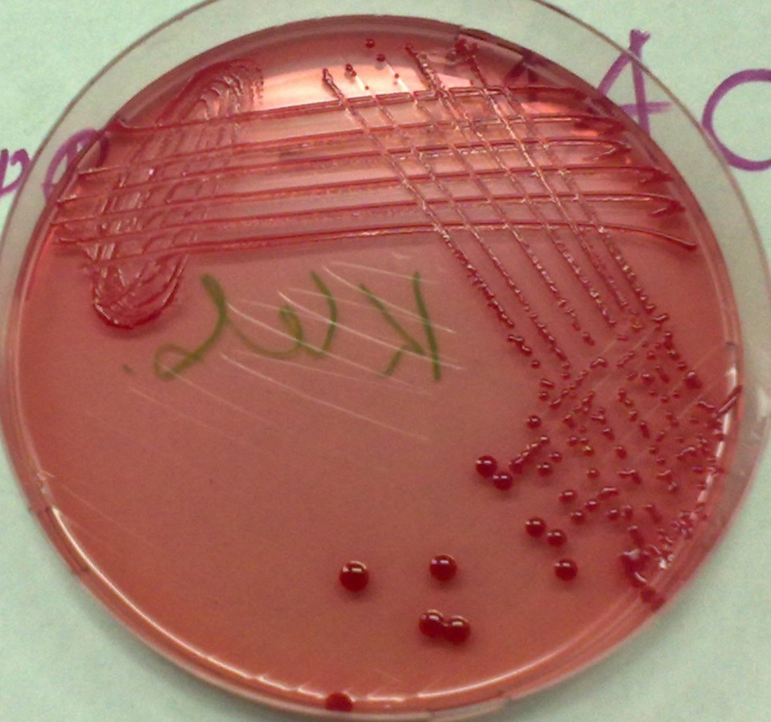
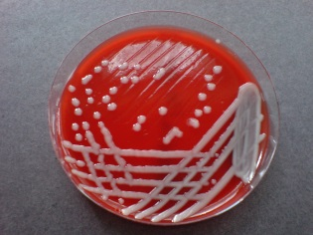
Klebsiella on MAC
Klebsiella Spp BA

Slide 17
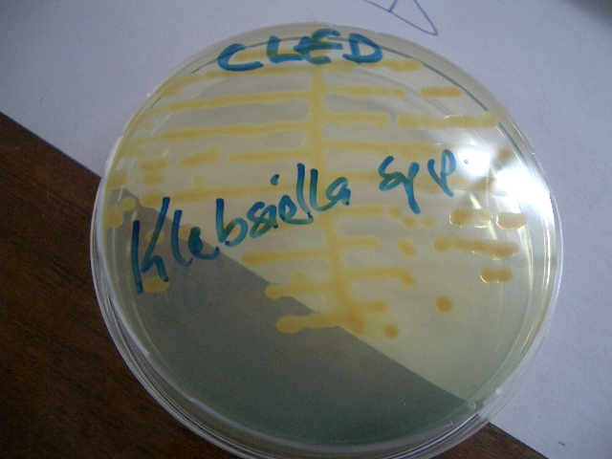
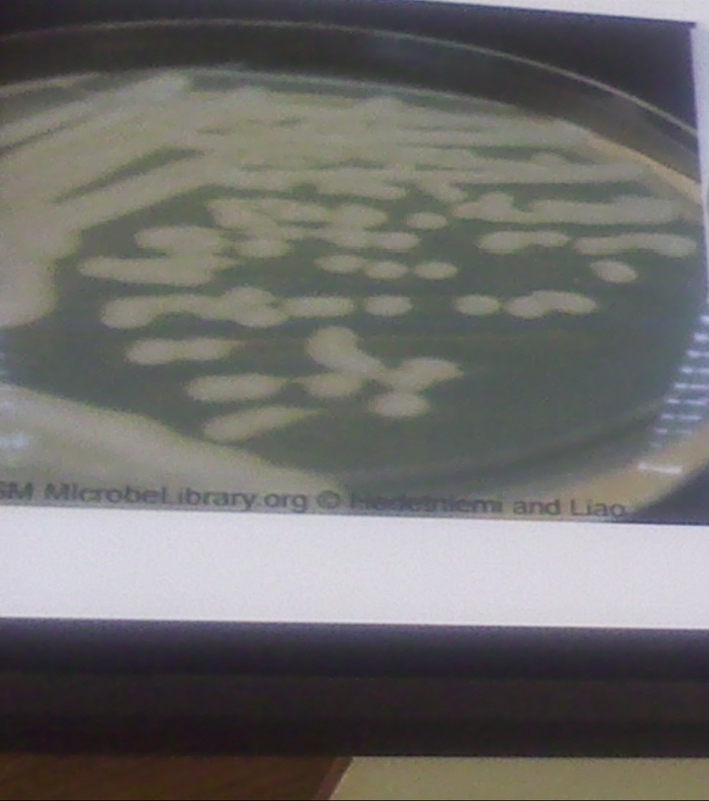
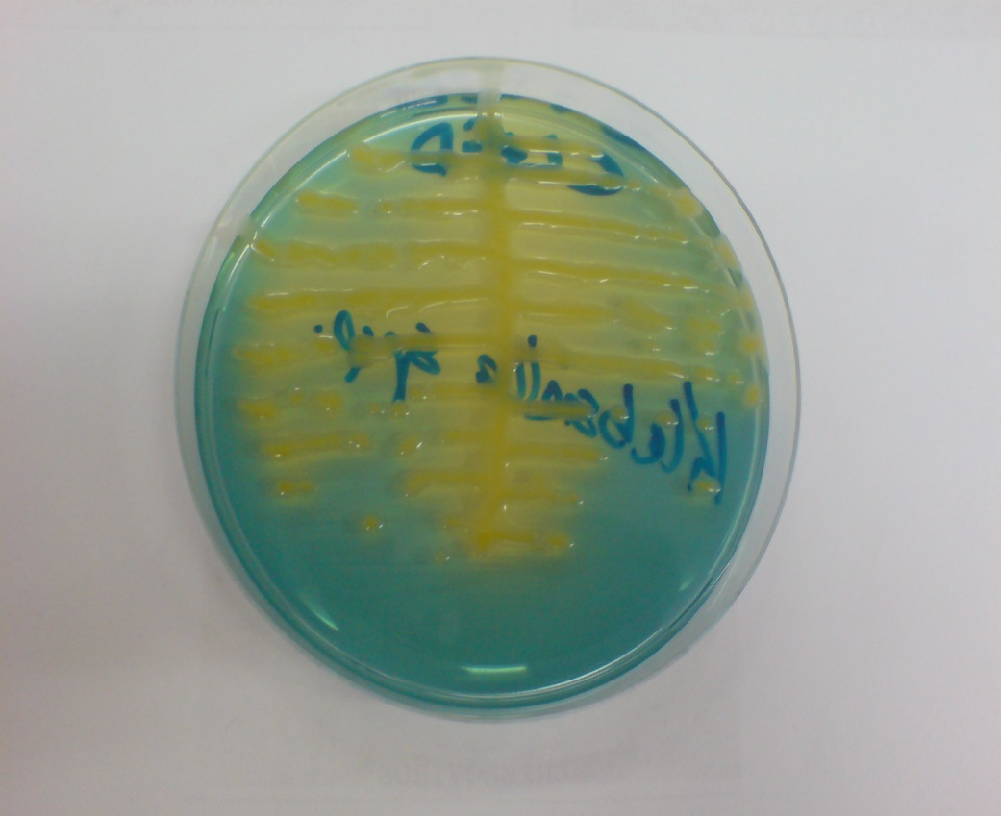
Klebsiella on NA
Klebsiella on CLED

Slide 18
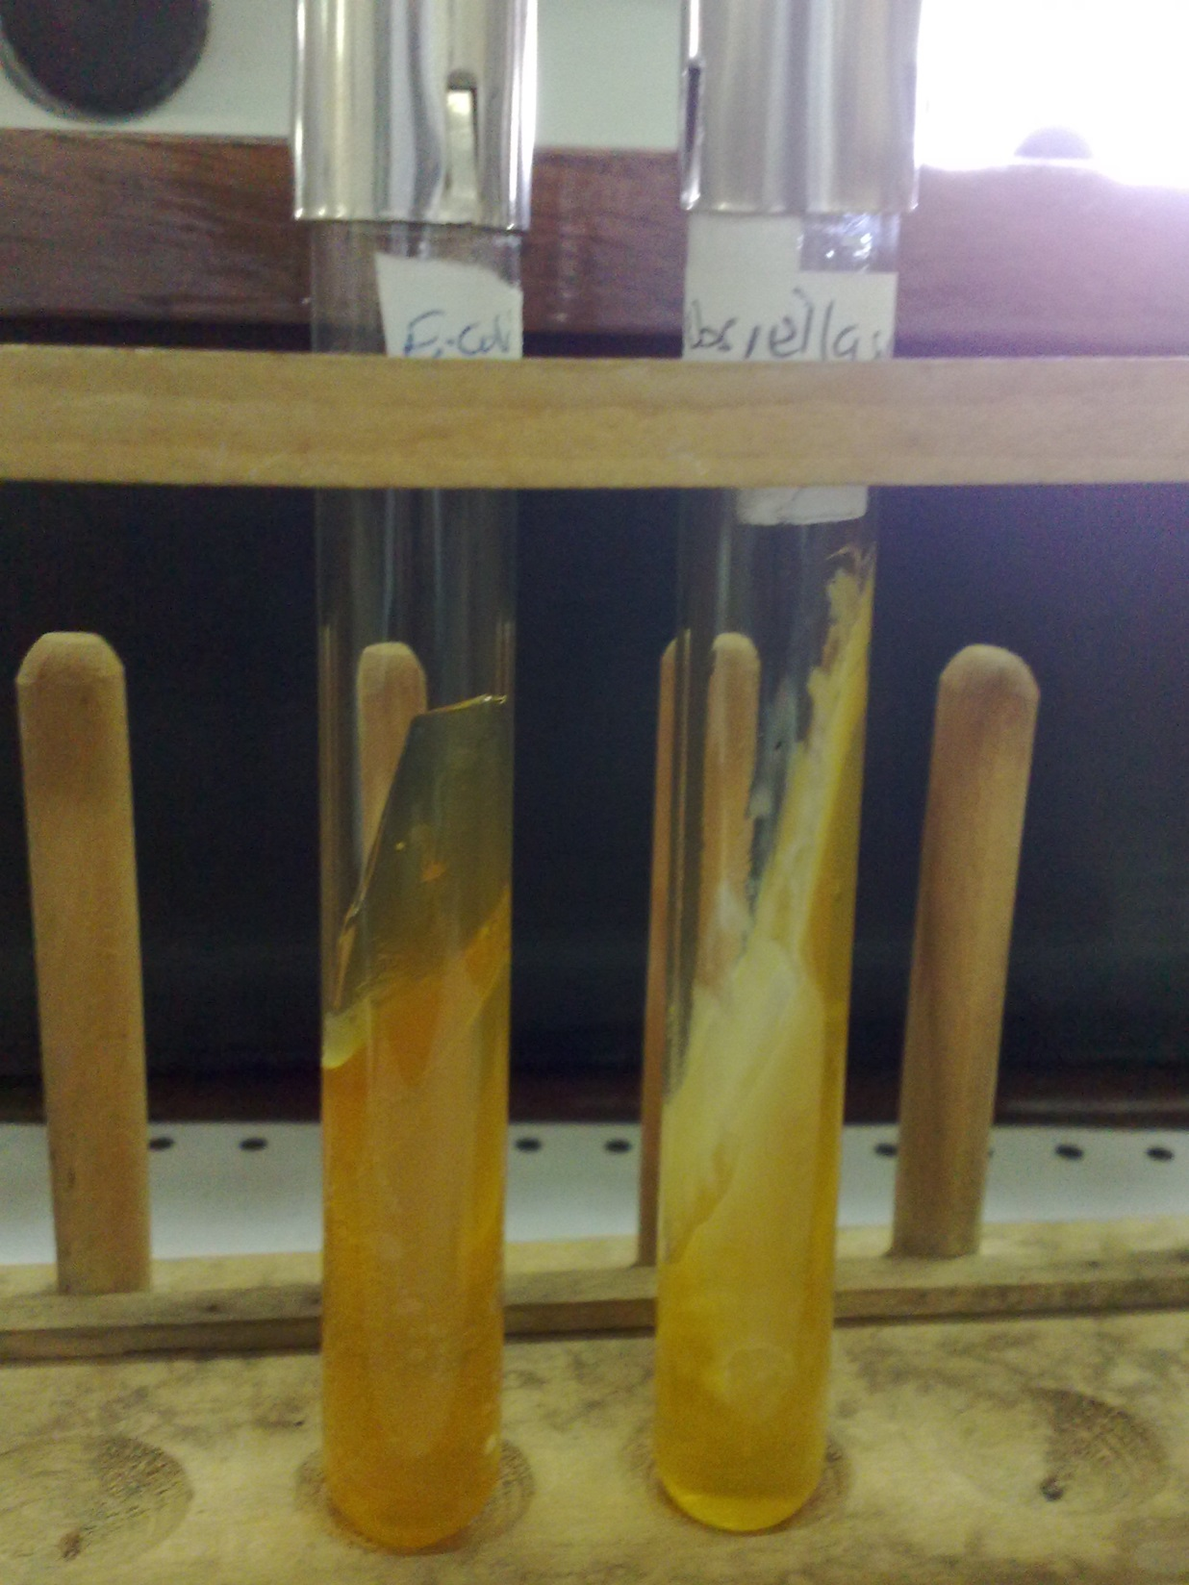

Slide 19
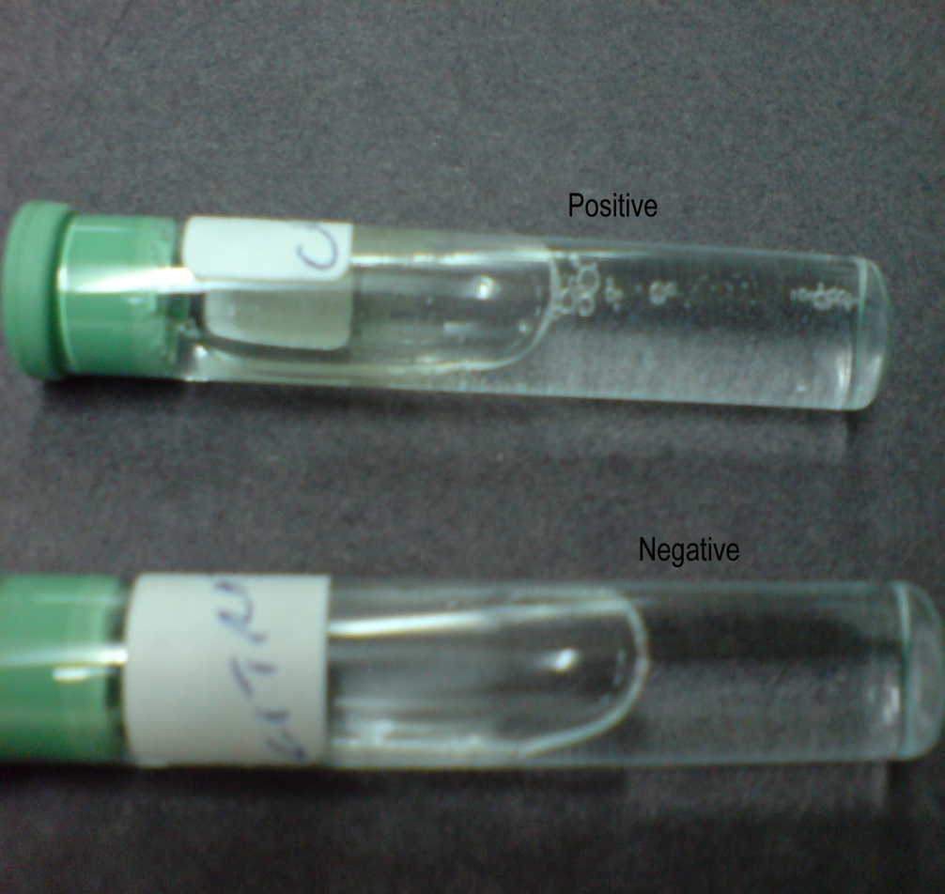
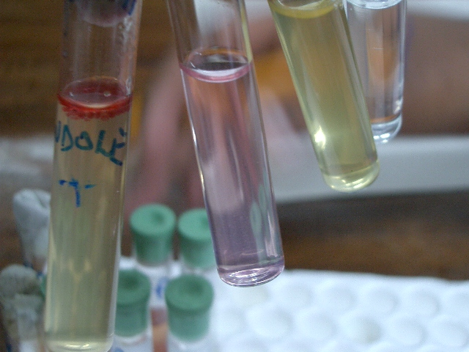
Klebsiella_Citrate test
Indole test

Slide 20
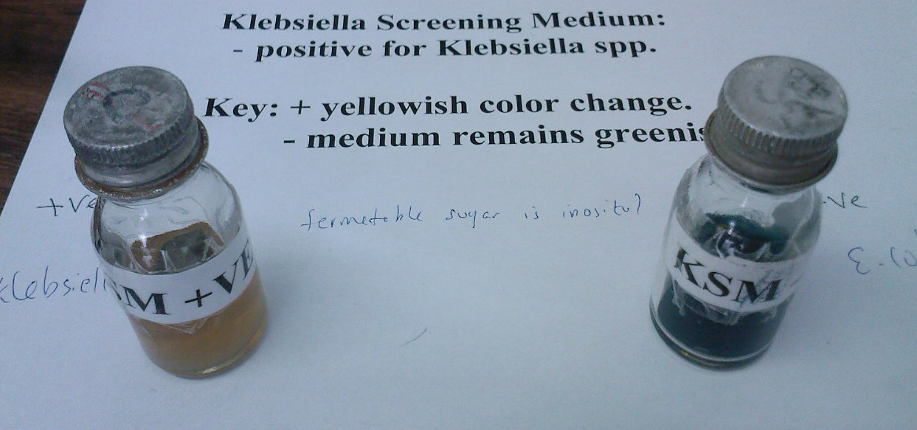
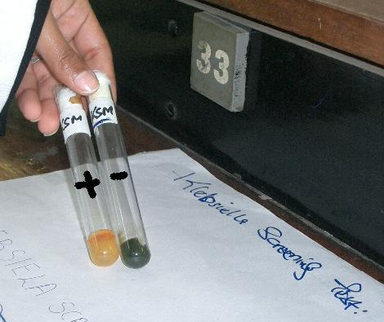
Klebsiella ferments inositol but E. coli does not

Slide 21
TREATMENT
Hospital- acquired infections – resistance to multiple antibiotics
Based on antibiotics susceptibility tests
  Beta lactam + beta lactamase inhibitior combination
  3rd generation of cephalosporins e.g cefataxime, ceftriaxone + aminoglycoside

