Slide 1
ESCHERICHIA COLI
KIMAIGA H.O
MBChB (University of Nairobi)

Slide 2
Escherichia coli
Normal flora of GIT
Produces vitamin K in the large intestine
Exclusively in large intestine and faeces
If found in H₂O indicates pollution and faecal contamination
Morphology Characteristics
Gram –ve bacilli
Lactose fermenter
+- capsule
Motile by petrichate flagella
Produce indole

Slide 3
Virulence factors
Surface antigens and Toxins
Cell wall/ Somatic or O antigen- heat stable
Capsular/K antigen- heat labile, Prevent O agglutination and phagocytosis
Flagella /H antigen – heat labile and destoyed by alcohol . Not all are motile

Slide 4
Exotoxins
Haemolysins and enterotoxins (LT/heat labile toxin, ST/heat stable toxin, VT/serotoxin/ST/Shiga like toxin
Adhesins
Intimin – associated with adhesion and effacement phenomenon which causes destruction of intestinal surfaces cells
Outer memb proteins
Fimbriae
P fimbriae – associated with urinary tract pathogens
CFA (Colonization Factor Antigen) fimbriae – associated with ETEC (Enterotoxigenic E. coli)
Endotoxin (LPS)
Released when the cell dies
Treating infections with antibiotics may place the patient in severe shock
Fever, hypotension, leucopenia, complement activation, intravascular coagulation in G-ve sepsis and death

Slide 5
PATHOGENESIS
Reservoir – humans and animals
Sources of infection for diseases:
Pt own normal flora → UTIs
Mother’s birth canal flora → neonatal meningitis/ sepsis
Contaminated food/ H₂O → Traveler's diarrhea
Undercooked meat → diarrhea by EHEC O157

Slide 6
Gastrointestinal – caused by 5 different classes
ETEC – Entereotoxigenic E. coli
EPEC – Enteropathogenic E.coli
EIEC- Enteroinvansive E.coli
EHEC- enterohaemorrhagic E.coli
EAEC- enteroaggregative E.coli
Extra-intestinal
Urinary tract infections
Pyogenic infections
Septicaemia

Slide 7
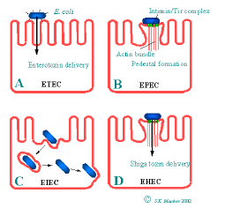

Slide 8
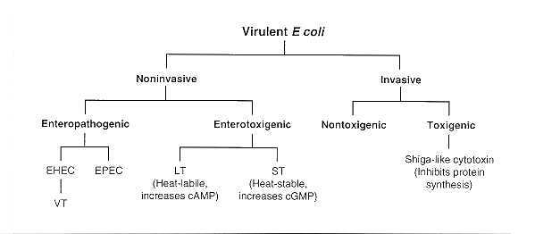

Slide 9
Enterotoxigenic E.coli (ETEC)
Traveler’s diarrhea
Transmitted by fecal-oral route via contaminated water or water
Adhere to cells of jejunum and ileum by pili, synthesize plasmid- encoded enterotoxins LT and ST that act on the cells causing diarrhea

Slide 10
Heat labile toxins (LT)
ADP – Ribosylation of regulatory protein, activation of adenylate cyclase, increases cAMP, net secretion of fluids and electrolytes into bowel lumen, profuse watery, non –inflammatory diarrhea.
LT resembles cholera toxin in its structure, function and mode of action. Made of complex polypeptide subunit. One Subunit A (action-enzymic), five subunits of B (binding)
Heat stable toxin (ST)
Binds to a glycoprotein receptor , activation of membrane-bound guanylate cyclase, increases cGMP, inhibition of intestinal fluid uptake, net fluid secretion
1-2 days incubation, then vomiting, diarrhea, fever, chills, headache
The illness is self limiting
Dehydration is a major complication

Slide 11
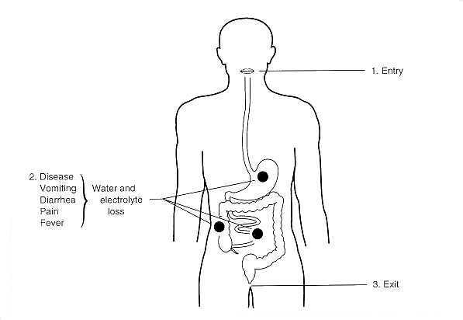

Slide 12
Enteropathogenic E.coli (EPEC)
Causes infantile & childhood diarrhea
Do not produce enterotoxins
Attachment to enterocytes in small bowel using fimbirae causing loss of microvilli (effacement) resulting to loss of large areas of nutrient absorption
There’s osmotic pressure in lumen making the enterocytes to loose water causing non-inflammatory diarrhea with mucus but no blood, vomiting and fever
Usually self-limiting but may be chronic in some cases

Slide 13
Enteroinvasive E.coli (EIEC)
Restricted to <5yr olds in developing countries
Humans only known reservoir
Similar disease to shigellosis/dysentry
Passage of blood, mucus, and leukocytes in stool
Pathogenesis – bacteria invades epithelial cells by endocytosis and can spread laterally to adjacent cells, causes tissue destruction, necrosis and ulceration.

Slide 14
Invansive of mucosal cells hence damage to intestinal lining
Invade, proliferate, destruction of colon epithelium
Fever, severe abdominal cramps, malaise
Bloody mucous diarrhea.
Enterohemorrhagic E.coli (EHEC)
Attachment – effacement lesions but in caecum and large bowel
Elaborate shiga-like toxin ( verotoxins) – A subunit enzymatically cleaves adenine base from rRNA – prevents elongation factor -1 – blocks protein synthesis within the enterocytes– cell death- inflammatory hemorrhagic colitis.
Abdominal cramps, watery diarrhea progresses to bloody
No or minimal fever

Slide 15
Hemolytic uremic syndrome is a complication of EHEC usually after antibiotic use – Hemolytic anaemia, thrombocytopenia, acute renal failure.
Serotype 0157:H7 is most commonly isolated
Cattle are a reservoir, and hamburger, unpasteurized milk, fruit juices, and uncooked vegetables are common sources of human infections.
Enteroaggregative E.coli (EAEC)
Watery diarrhea
Plasmid-conferring pili implicated in adherence
Persistent diarrhea in children in developing countries
Pathogenesis – shortening of villi, mucus biofilm, heat stable cytotoxin ( hemorrhagic necrosis and edema)

Slide 16
UROPATHOGENIC E. COLI
Utilize P fimbriae ( pyelonephritis associated pilli) to bind endothelial cells of urinary tract and colonize bladder
Also produce alpha and beta hemolysins – cause lysis of urinary tract cells
Evade innate immunity – formation of intracellular bacterial communities
Ability to form K antigen that contribute to biofilm formation
Recalcitrant to immune factors and antibiotic therapy
Responsible for chronic UTIs which can lead to acute cystitis (bladder infections) and pyelonephritis (kidney infection)

Slide 18
CLINICAL INFECTIONS
Gastroenteritis – enterotoxigenic or invasive
ETEC - Travelers diarrhea, diarrhea in children
EPEC – childhood & adult diarrhea
EIEC – dysentry
EHEC- hemorrhagic colitis, HUS
EAEC- peristalistic diarrhea

Slide 19
Extra-intestinal infections – community & hospital acquired
Urinary tract infections (UTI)
Community acquired - usually in females
Nosocomial - indwelling urinary catheters
Wound infections (trauma/ burns)
Pyogenic infections
Intra-abdominal abscesses, peritonitis, biliary tract infections,

Slide 20
Neonatal meningitis
Caused by different serogroups
K1 polysaccharide sialic acid
Usually with strains carrying the K capsular antigen
Bacteremia/ septicemia
Blood stream invasion by E.coli may lead to septic shock and systemic inflammatory syndrome (SIDS)
Others – septis, arthritis, skin and soft tissue infections, sinusitis, e.t.c

Slide 21
Lab diagnosis
Specimens: urine, pus, stool, blood, CSF
Gram stain (direct) – Gram –ve rods, +/- pus cells
Culture – in air, 35-37oc, 16-24 hrs
BA – some strains beta heamolytic
MAC- colonies are lactose fermenters (pink)
Eosin- methylene blue (EMB) medium
Characteristic green sheen- CLED
Gram stains of colonies :- gram –ve rods.
IMViC test
Indole +ve
Methyl red +ve
Voges-Proskauer –ve
Citrate –ve
Urease –ve
Tripple sugar iron media- acid slant, butt, gas, no H₂S
Klebsiella Screening Media (KSM) –ve
Diarrheic strains identification – EPEC serotyping.

Slide 22
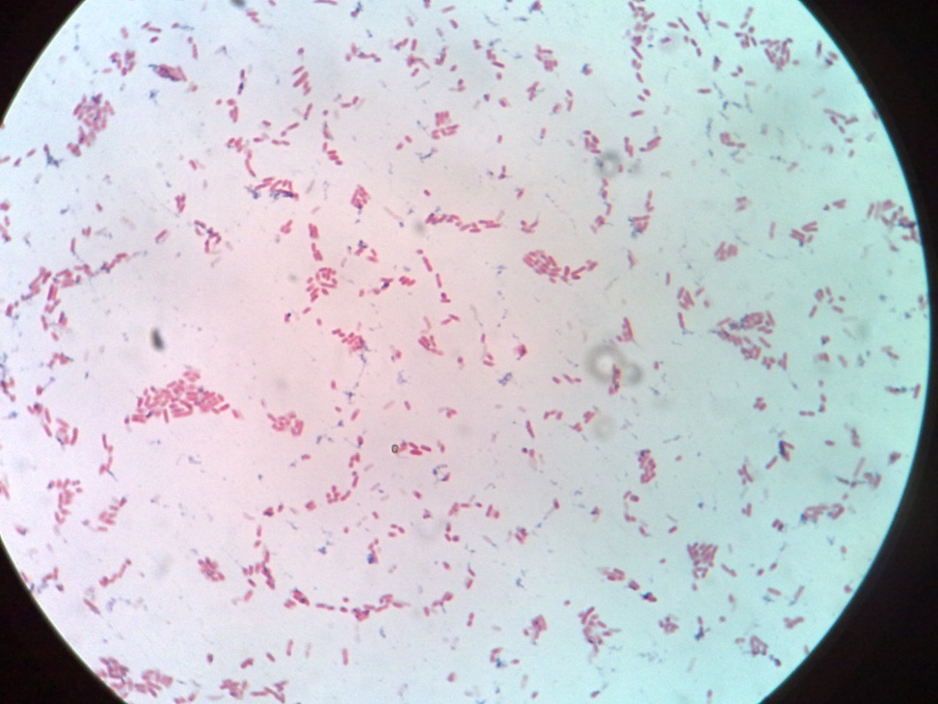
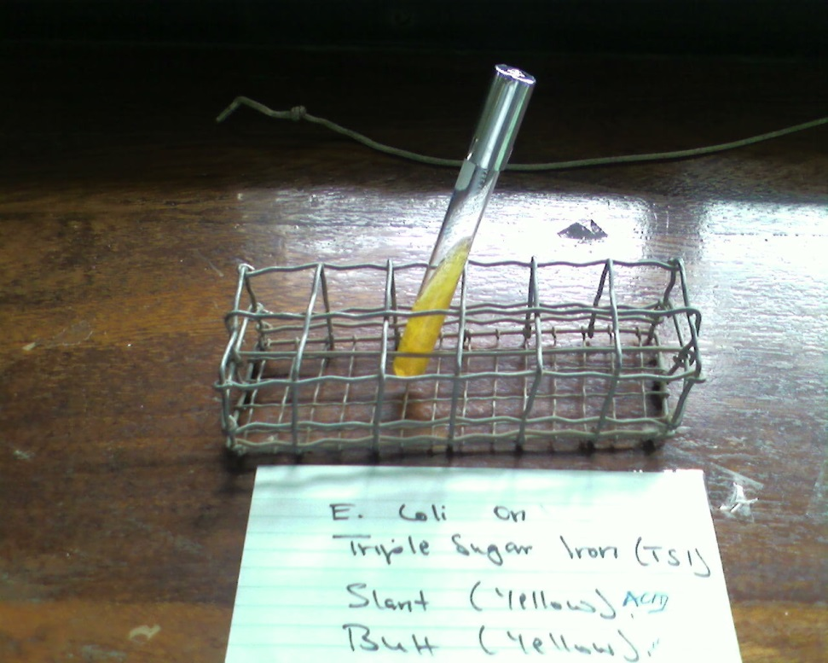
E.coli – Gram negative

Slide 23
Eijkman test
Is a differential test for fecal and non-fecal E.coli. Fecal E.coli will grow at 44°C, produce acid and gas and is indole positive.

Slide 24
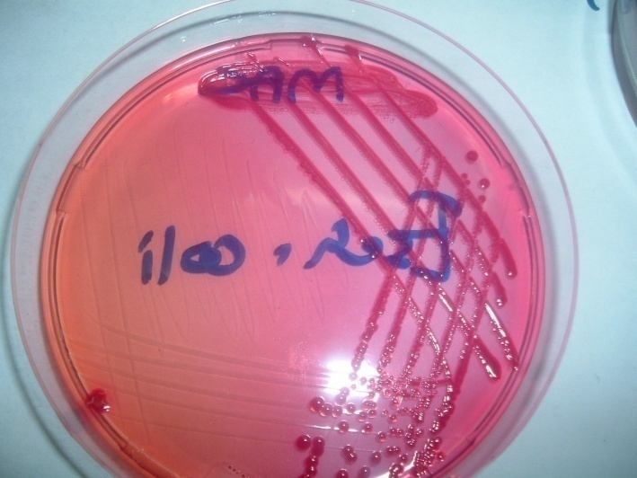
E.coli on MacConkey- LF
E. Coli on CLED

Slide 25
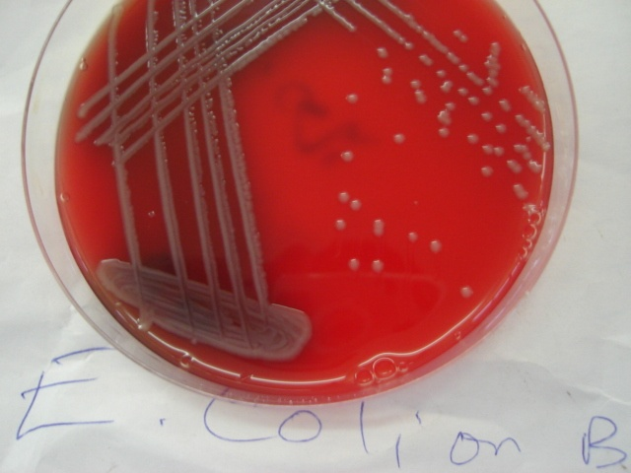
E. Coli on BA (Gamma-Hs)
E. Coli on BA (B-Hs)

Slide 26
E.coli vs Klebsiella on BA
E.coli vs Klebsiella on CLED

Slide 27
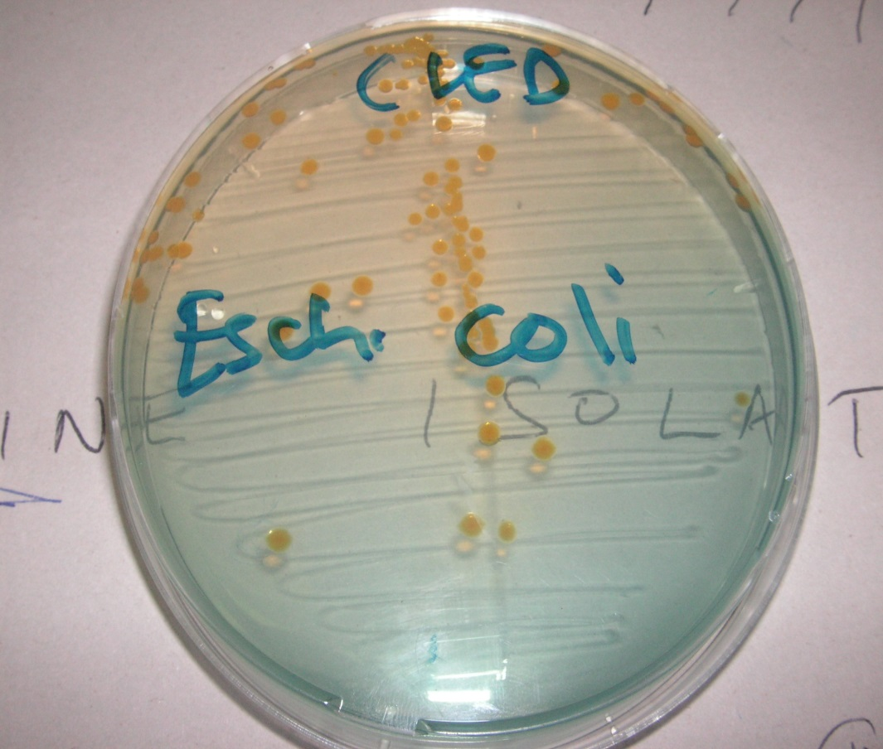
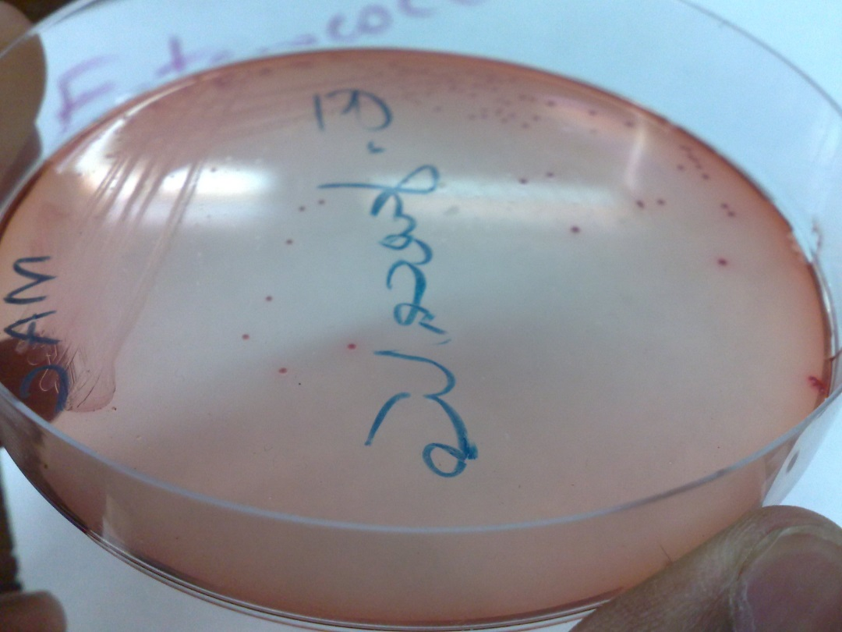
E.coli on CLED
E.coli on MAC

Slide 28
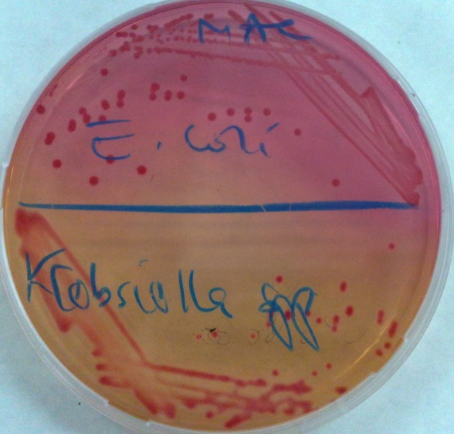
E.coli vs Klebsiella on MAC
E.coli vs Klebsiella on CLED

Slide 29
EMB:
Peptones 10.0;
Di-potassium hydrogen phosphate 2.0;
Lactose 5.0;
Sucrose 5.0;
Eosin Y;
Methylene blue 0.07; agar-agar 13.5.
Dark-blue colonies with a metallic green sheen on EMB agar

Slide 31
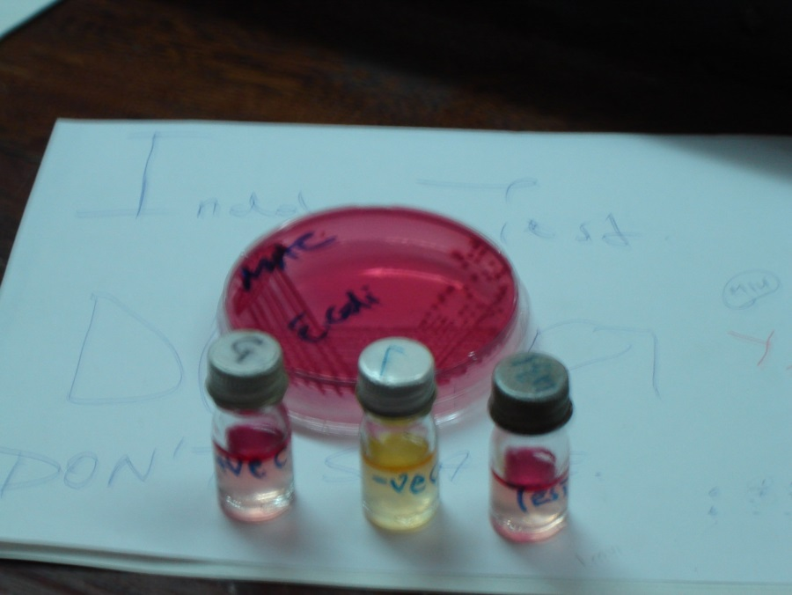
Simmon’s Citrate Test negative
E. Coli Indole +ve

Slide 32
Treatment
Should be guided by in vitro susceptibility tests
Site of infection and resistance patterns of isolate (plasmid factors shared with other enterobacteriacea)
Uncomplicated UTI – oral penicillin/ trimethoprim-sulfamethoxazole, fluoroquinolone
Sepsis – cephalosporin ± aminoglycoside
Neonatal meningitis – penicillin + cephalosporin
Diarrheal dx – self-limiting; antibiotics not usually necessary but can reduce duration of symptoms

Slide 33
Prevention
Judicious use & withdrawal of catheters
Recurrent UTIs
Long-term prophylaxis
Cranberry juice
Prompt removal or change of intravenous catheters
Avoid uncooked foods & unpurified water

