Slide 1
PROTEUS AND SERRATIA
KIMAIGA H.O
MBChB (University of Nairobi)

Slide 2
PROTEUS SPECIES
Morganella
Providencia
Are normal intestinal flora and UTI’s

Slide 3
PATHOGENESIS
Habitat- human colon, soil, H2O
Presence in colon- colonization of urethra
Highly motile may contribute to ability to invade urinary tract
Contain O (Somatic antigen) and H(flagellar antigen)
Has fimbriae.
Urease hydrolyzes urea in urine into NH3- increase PH- Encourage calculus formation
Obstruction of urine flow
Damage urinary epithelium
Alkaline urine favors growth of the organism and causes more extensive renal damage
NH₃ odor in UTI
Bacteria in the calculus not reached by drugs; site for re-infections

Slide 4
CLINICAL PRESENTATION
UTIs
Anatomical defects or damage
Elderly
Indwelling catheters
Wound infections ( include pressure sores, burns, damaged tissues)
Septicemia
Ear infections
Brain abscesses
Involved in synergistic non- clostiridial anaerobic myonecrosis
Caused by a combination of GNB ( E. coli, klebsiella or enterobacter spp) and anaerobes
P.mirabilis - most community and hospital-acquired infections
P.rettgeri – nosocomial infections

Slide 6
Laboratory diagnosis
Specimen
Gram Stain- Gram negative bacilli
Culture
MAC- Non-lactose fermenters (NLFs) thus colorless on CLED and McC
BA- Swarming effect on BA (Highly motile), distinct fish odour
Dienes phenomenon on BA– For typing of proteus strain
When two different strains of Proteus mirabilis encounter one another on An agar plate, swarming is inhibited and a visible line of demacation forms (Dienes line) associated with rounded cells. – produce antibiotic-like substances which are species-specific
Similar strains grow into each other(waves merge)
Gram Stain- Gram negative bacilli

Slide 7
Biochemical reactions
Oxidase negative
Urease positive
Produce two enzymes
Urease: Urea → NH₃ + CO₂
Phenylalanine deaminase
TSI; Alkaline slant, acid butt, gas (NLF); P.vulgaris, P. mirabilis, produce H₂S- blackens butt
Indole test- P. mirabilis is indole –ve, the othe Protei are +ve
Cross reactivity with Rickettsial antigens (OX-2,OX-19,OX-K) in the Weil-Felix Reaction -used in the lab to detect antibody presence of certain rickettsia in serum

Slide 8
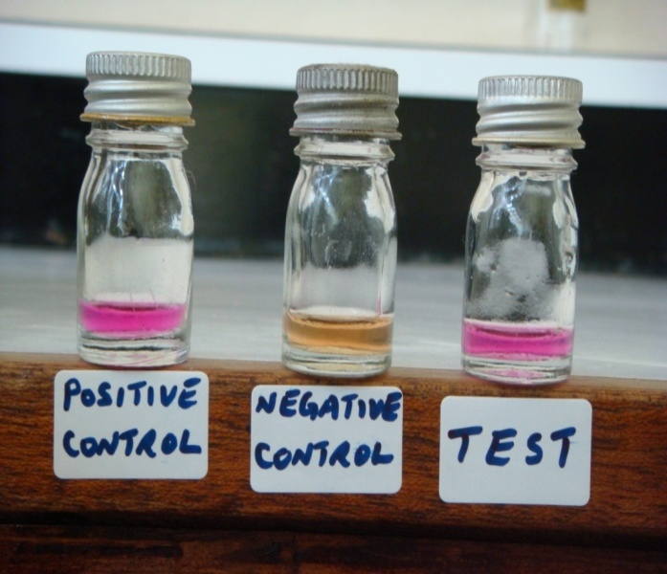
Proteus Gram negative
TSI proteus mirabilis

Slide 9
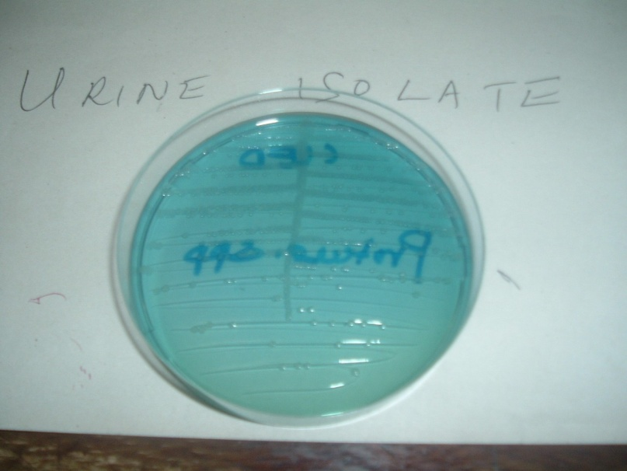
Proteus on CLED
Proteus on MAC

Slide 10
Proteus on BA
Proteus on BA

Slide 11
Proteus on BA swarming
Proteus on BA swarming

Slide 12
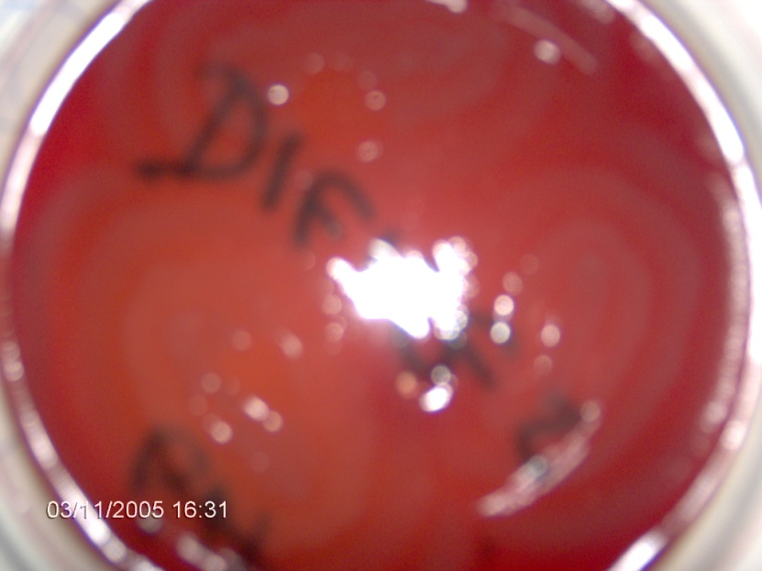
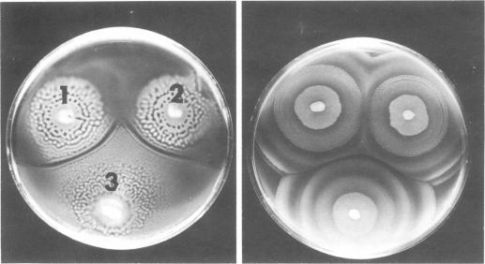
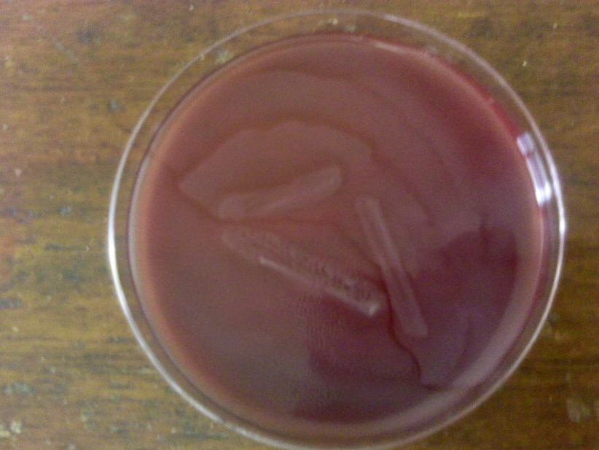
Diene’s Phenomenon on BA
Diene’s Phenomenon on

Slide 13
Swarming is inhibited on
CLED (Cysteine lactose electrolyte-deficient media) used for urinary pathogens
Culturing on media containing bile salts
The concentration of agar to about 6%
Incorporating chloral hydrate in the media
Ditching or cutting a narrow strip on the media

Slide 14
TREATMENT
Based on susceptibility testing
Most sensitivity to aminoglycosides & trimethoprim-sulfamethoxazole
Ampicilin – P. mirabilis
Cephalosporins- P. mirabilis
Rest are resistant to 1st generation cephalosporins
Fluoroquinolone

Slide 15
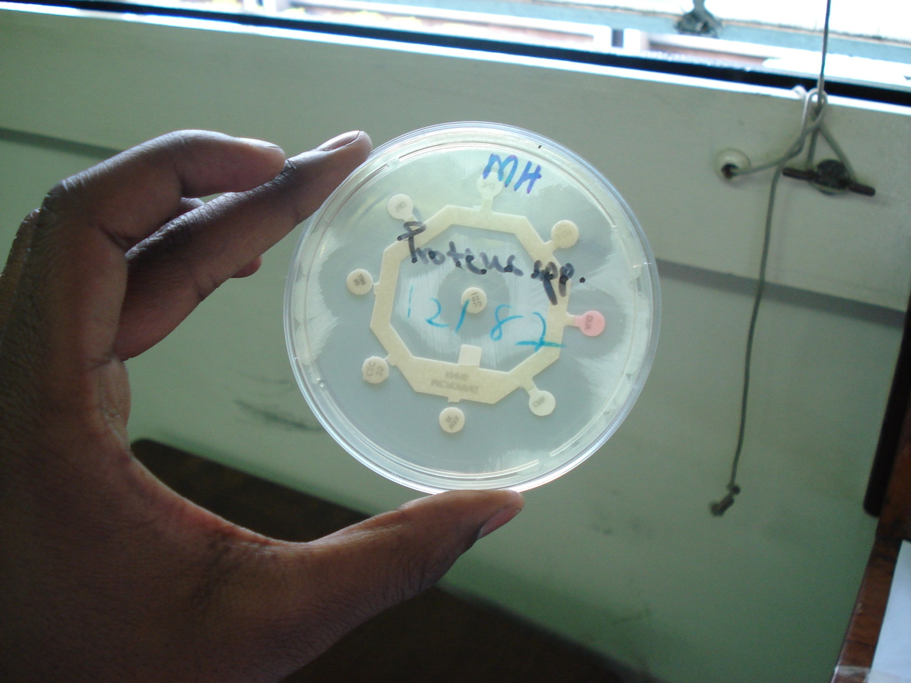
Disk Diffusion Method on Proteus spp

Slide 16
SERRATIA SPECIES
S. Marcescens is mains pathologic one
Slow LF –Use citrate as sole source of carbon
Other Slow LF’s include: Edwardsiella, Arizona, Providentia and Erwinia.
Distinctive bright red or brick red colonies on BA
Commonly resistant to penicilins, aminoglycosides
Frequently found in nosocomial infections of urinary and respiratory tracts
Opportunistic hospital infections – pneumonia, bacteremia, endocariditis, Osteomyletis in IVDUs and cellulitis in patients on hemodialysis.

Slide 17
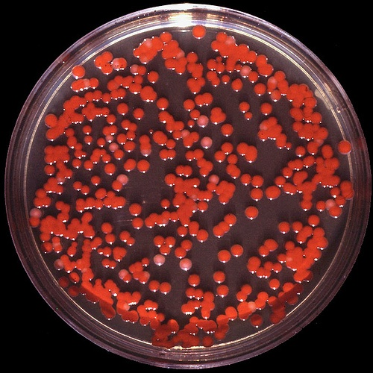
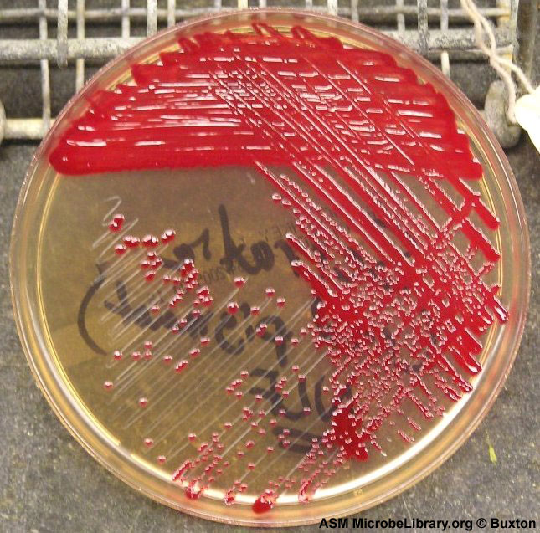
Serratia marcescens

Slide 19
Treatment-
Amikacin, piperacin, tazobactam and carbapenams

