Slide 1
VIBRIOS
KIMAIGA H.O
MBChB (University of Nairobi)

Slide 2
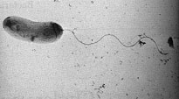
VIBROS
Class – gamma proteobacteriae
Order – vibrionales
Family – vibrio nacaeae
Species
Vibiro cholerae main pathogenic spp
Other spp: V. parahaemollyticus, V. vulnificus, V. alginolyticus, V. mimicus, V. fluvialis

Slide 3
Characteristic
Curved or comma shaped gram -ve bacilli
1- 3micrometer, diameter of 0.5-0.8 micrometer
Habitat – salty water
Highly motile – single polar flagellum
Non spore formers
Non capsulated
Aerobes/facultitive anaerobes
Oxidase positive, enterobacteriaceae is negative
Ferment sucrose and glucose but not lactose TSI not all tube turns yellow
Possess both H & O antigens
V. cholerae main pathogenic spp
Others – v. parheamolyticus, v. vulnificus

Slide 4
V. CHOLERAE
Many vibrios show a single flagellar (H) antigen.
The somatic (O) antigen subdivides Vibrio spp into serogroups
There are 200 identified serogroups of V. cholerae
O1 & O139 bengal group – cholera epidemics
Non o1 – O2-O75 – Non pathogenic/sporadic diarrhea
O1 divided into biotypes
Classical biotype
EL Tor

Slide 5
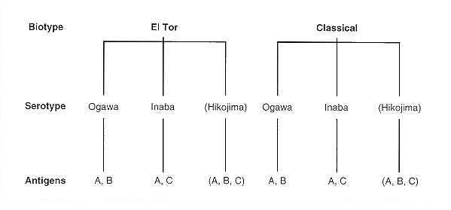
Each biotupe is divided into 3 serotypes
Ogawa -O antigen A & B
Inaba – O antigens A & C
Hikojima – O antigens A, B & C

Slide 6
EPIDEMIOLOGY
Has affected app. 3-5 million people worldwide
Mainly in developing countries, also now in the West
Cholera is Endemic C(occurring frequently at predictable rate in a specific location) in Indian subcontinent, Africa, Asia and Europe
Also in the western hemisphere-USA,latin America
Predisposing factors; poor sanitation and food hygiene, ingestion of undercooked sea food (coz the vibrios inhabit salty water) malnutrition & overcrowding (poor sanitation & hygiene).

Slide 7
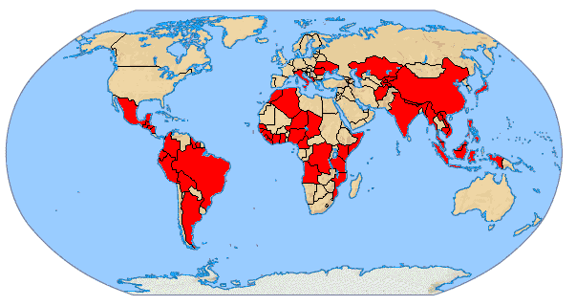
V. Cholerae Afflicted Areas (2000)

Slide 8
Hanging latrine on Meghna River, Nepal

Slide 9
Susceptible hosts
Children(2-4yrs)
Elderly people
People with blood type O —allows bacteria to adhere to gut lining
People with high pH in the stomach(alkaline)
Patients with immunocompetent diseases e.g. AIDS
People living in poor sanitary areas

Slide 10
Transmission
Transmitted by fecal contamination of water (mainly) & food
Carriers are asymptomatic
Animal reservoirs – marine shellfish
Serotype 01 is responsible for major pandemics
Low tolerance for acid, grows in alkaline conditions

Slide 11
Pathogenesis
Bacteria must content with;
Acidic nature in stomach – large inoculum – infectious dose when ingested in Water is 103-106
Mucous layer lining small intestine – affect adhesion
Production of proteases (mucinase) which dissolves protective glycoprotein coating over cells
High motility

Slide 12
High infectious dose is required to elicit an infection
Water-10^10 of V.cholerae bacterias
Food-10^2-10^4
Marked reduced in
– hypocholrhydric pts
– pts using anatacids
– after a meal ( due to buffering of the gastric acid)
– predisposes pt to more severe dx
Bacteria adheres to the epithelial cells of gastric intestinal mucosa via pilli
Survive the acidic conditions of human stomach
Production of proteases (mucinase) which dissolves protective glycoprotein coating cells
High motility

Slide 13
Multiply and release enterotoxin - choleragen toxin (CT)
Each molecule has one subunit of A (action – enzymic), five subunits of B (binding)
The E. coli toxin is similar to CT
B subunit binds to gastric mucosa ganglioside receptor on surface of cells lining intestinal mucosa.
This allows entry of A subunit into enterocyte’s cytosol,
A splits into A1 & A2
A2 allows only biologically active A1 to be linked with B.
A1 catalyses ADP-ribosylation of stimulatory G (Gs) protein

Slide 14
Persistent stimulation of adenylate cyclase and increase in cAMP leads to blockage of NA & Cl; promotes secretions of CL, water, potassium and bicarbonate
Massive watery diarrhea without inflammatory cells (non-invansive)
Gene encoding toxin is introduced by horizontal gene transferred
Virulent strains carry a variant of lysogenic bacteriophage – CTXf or CTX..
Fluid loss originates in duodenum and upper jejunum
Ileum relatively insensitive to toxin; still in a state of absorption but overwhelmed by large volumes of fluid loss
All ages susceptible; infants protected by maternal antibodies.

Slide 15
NORMAL CONDITION
Adenylate cyclase (AC) is activated normally by a regulatory protein (GS) and GTP; however activation is normally brief because another regulatory protein (Gi), hydrolyzes GTP.

Slide 16
CHOLERA
Enzymatically, fragment A1 catalyzes the transfer of the ADP-ribosyl moiety of NAD to a component of the adenylate cyclase system.
The A1 fragment catalyzes the attachment of ADP-Ribose (ADPR) to the regulatory protein forming Gs-ADPR from which GTP cannot be hydrolyzed.
Since GTP hydrolysis is the event that inactivates the adenylate cyclase, the enzyme remains continually activated.

Slide 17
Thus, the net effect of the toxin is to cause cAMP to be produced at an abnormally high rate which stimulates mucosal cells to pump large amounts of Cl- into the intestinal contents.

Slide 18
H2O, Na+ and other electrolytes follow due to the osmotic and electrical gradients caused by the loss of Cl-.
The lost H2O and electrolytes in mucosal cells are replaced from the blood.
Thus, the toxin-damaged cells become pumps for water and electrolytes causing the diarrhea, loss of electrolytes, and dehydration that are characteristic of cholera.

Slide 19
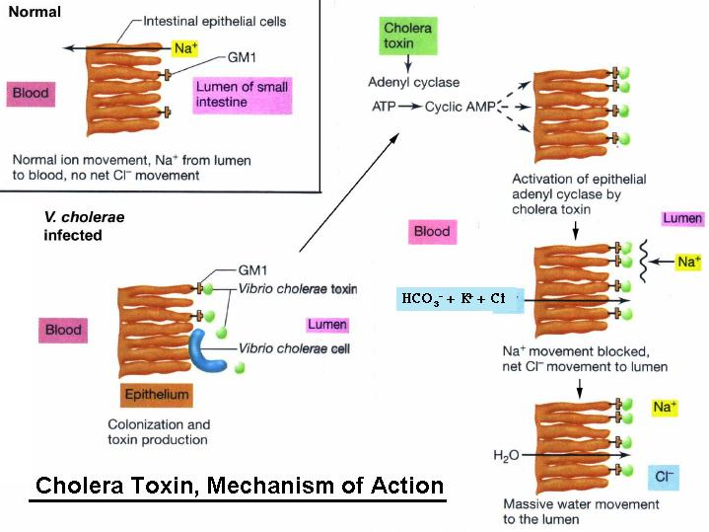

Slide 20
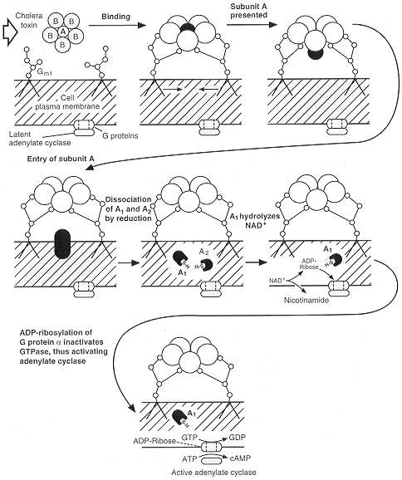

Slide 21
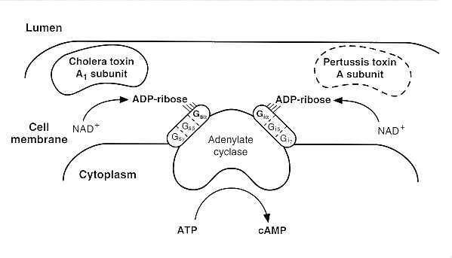
FIGURE 24-5 Comparison of activities of cholera enterotoxin (CT) with pertussis toxin (PT). The a-subunits of Gs and Gi, with GTP-binding sites, are ADP-ribosylated, respectively, by A1 peptide of CT or by the A subunit of PT, preventing, respectively, the hydrolysis of Gs-GTP to GDP or the responsiveness of Gi to inhibitory hormones, both effectively producing increases in adenylate cyclase activity. (Modified from Gill DM, Woolkalis M: Toxins which activate adenylate cyclase. CIBA Found Symp 112:57, 1985, with permission.)

Slide 22
Pathogenesis

Slide 23
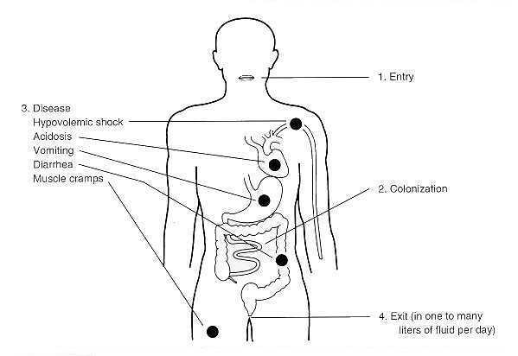

Slide 24
Clinical features
Incubation period; 24 -48 hrs
Sudden onset of nausea, vomiting & painless watery/profuse diarrhoea– odorless, described as rise-water & uncontrollable–
+/- abdominal pains
Rice-water stools ( due to mucous flecks)
No fever, no WBCs or RBCs in stool
Massive fluid & electrolyte loss. Up to 20 L/day (>250 ml/kg in 24 hrs)
Leads to muscular cramps, renal failure, marked dehydration & electrolyte imbalance, hypotension, metabolic acidosis & shock pulmonary edema
Sunken eyes, sagging skin
Death

Slide 25
Lab diagnosis
Specimen
Stool or rectal swabs transport in Cary Blair medium
Wet preparations of fresh stool – dark-field microscopy – dating motility
Look like “shooting stars”
Gram Stain -ve
Red, curved rods of bacteria

Slide 26
Lab isolation
Put into alkaline peptone water (enriched medium) for 4-6 hrs. It suppresses growth of other organisms and allows vibrio to grow. It requires an alkaline medium
Culture on TCBS (thiosulphate citrate bile salt sucrose) or an TTGA (Taurocholate tellurite gelatin agar or Monsur's medium) at 37 deg C, for 18-24 hrs – solid medium.
TCBA – sucrose fermentation (yellow colonies)
TTGA-Greyish colonies with dark center, clear halo around

Slide 27
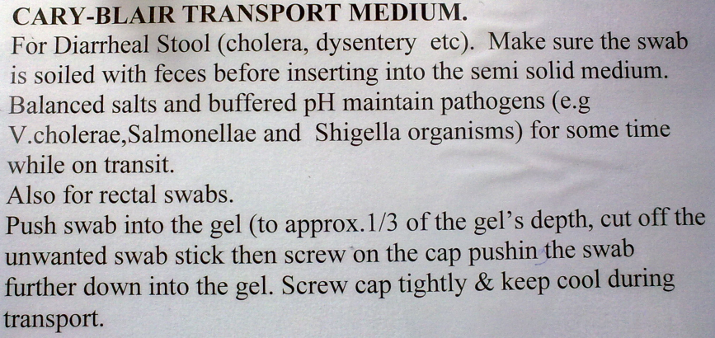
Alkaline Peptone Water
Alkaline Peptone water
Peptone water with high sodium hydroxide to raise the pH to 8.6
An enrichment media for V.cholerae

Slide 28
V.cholerae on Krigler Iron Agar (KIA)
Butt - yellow
Slant - Pink
No gas - No H₂S
V. Cholera on TSI
Butt - Yellow
Slant - Yellow

Slide 29
Vibrio on TCBS(Yellow Colonies-Sucrose Fermentation)

Slide 30
Gram stain – gram -ve curved rods
Oxidase test +ve (+Ve on BA, -ve on TCBS)
TSI- acid slant, acid butt, no gas, no h2s
Serotyping
Antigen detection using antisera
Monoclonal antibody-based tests – o1 & o139

Slide 31
Treatment
Prompt, adequate replacement of water and electrolytes – oral or IV
Susceptibility to several antimicrobial agents – erythromycin, ciprofloxacin, azithromycin.
Antibiotics may be used (not necessary if acute)
Swollen duration & volume of fluid loss
Hastens clearance of organisms
Adults – Tetracycline/doxycycline, erythromycin, ciprofloxacin
Children – furazolidone, trimethoprim, sulphamethoxazole.

Slide 32
Treatment: How ORS Works
Na+ transport coupled to glucose transport in small intestine
Glucose enables more efficient absorption of fluids and salts
Potassium passively absorbed
Notes:
1)cotransport- coupling system
2)Glucose Enables small intestine to absorb fluids and salts more efficiently
3)Boil water for at least 10 minutes
4)Bicarbonate—corrects acidosis
5)Sports drinks
a)excess sugar—worsen condition bc of osmolosis
6) $2300 per infant vs $270
a)1 billion dollars on children in US
b)600.year die from dehydration
c)doctors not reimbursed for ORT bc not widely accepted practice in industrailized countries—use IV
d)ORT requires mom to hold/feed—helathcare profs won’t give that attn
2)Doctors don’t trust bc it is so simple/cheap
3)Time consuming
4)Insurance companies don’t reimburse

Slide 33
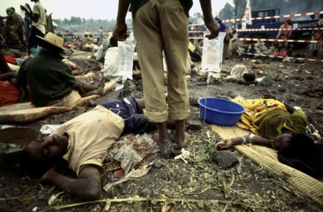
Treatment: Intravenous Rehydration
Used when patients have lost more than 10% bodyweight from dehydration
Unable to drink due to vomiting
Only treatment for severe dehydration
Notes:
1)Need intuitive system
2)epidemic-local people help each other
no medical personel, illiterate
3)Doctors without borders
4) IV drip treatment of cholera victims at Refugee camp mozambique

Slide 34
Treatment: Intravenous Rehydration
Ringer’s Lactate
Commercial product
Has necessary concentrations of electrolytes
Alternative options
Saline
Sugar and water
Do not replace potassium, sodium, bicarbonate
Notes:
1)Saline can be used because it’s better than nothing

Slide 35
Treatment: Antibiotics
Adjunct to oral rehydration
Reduce fluid loss by half
Reduce recovery time by half
2-3 days instead of 4-6
Tetracycline, Doxycycline
Not recommended
Short duration of illness
Antibiotic resistance
Limited gain from usage

Slide 36
Prevention
PREVENTION AT RESERVOIR
Aquatic
Water treatment- chlorination, boiling, filtration
Put warning signs in water bodies known to be infested by the cholera
Human
Detection and treatment of carriers
Isolation of infected persons
Sterilization of bedding etc
Vaccination for people living in cholera endemic regions
Killed whole-cell
Live-attenuated

Slide 37
PORTAL OF EXIT- DEFECATION
Physiological process difficult to control & avoid. Education.
Proper fecal matter disposal
Build latrines
Treatment of dip pit latrines
Health education& sensitization of the public
PREVENTION AT PORTAL OF ENTRY-MOUTH
Washing of food and fruits with clean water before eating
Eating properly cooked food
Drinking clean safe water
Hand washing after visiting the toilet & before eating.

Slide 38
Vaccines: Killed Whole-cell Vaccines
Provides antigens to evoke protective antitoxic and antibacterial immunity
Contains:
1 x 1011 heat inactivated bacteria
Mixture of V. cholerae O1 El Tor and classical strains
1 mg of B subunit of cholera toxin
Killed Whole-cell Vaccines: Disadvantages
50% protection for 6 months to adults
Gives less than 25% protection to children aged 2-5
Need for multiple doses of nonliving antigens

Slide 39
Vaccines: Live-Attenuated
Eliminates need for multiple doses of non-living antigens
Ensures that crucial antigens potentially altered during killing process would be retained
Expected to mimic broad immunity conferred by natural infection
85-90% protection against classical biovar
65-80% protection against El Tor biovar
Live Attenuated Vaccines: Disadvantages
In children, protection rapidly declines after 6 months
In adults, only receive 60% protection for 2 years
Live vaccine induces mild cholera symptoms
Mild diarrhea, abdominal cramping

Slide 40
NON-O1 V. CHOLERAE
Do not agglutinate in o1 antiserum
Habitat – marine environment
Food- borne outbreaks of gastroenteritis -eating raw oysters
Incubation <2 days, lasts 2-7 days
Otitis media, wound infections, bacteremia – occupational

Slide 41
V. Parahyemolyticus
Marine organisms
Raw sea-food
Grows best in high salt, 8-10% NaCl solution
Food poisoning due to contaminated sea fish
Transmission – ingestion of undercooked/ improperly handled foods, or toehr foods
Enterotoxin – non invansive diarrhea

Slide 42
Clinical presentation
Cause the acute gastroenteritis – watery diarrhoea accompanied by nausea, vomiting, abdominal cramps, & sometimes fever
Severe dx associated with diabetes, preexisting liver dx, iron-overload sttes or
Immunocompromised – fluids and antibiotics
Associated with kanagawa phenomenon – clinical isolates hemolytic, non human isolates, non hemolytic isolates on BA
Treatment
Rehydration
In severe infxns – fluoroquinolones, doxycycline, 3rd gen cephalosporins (e.g. ceftriaxone)
Preventions- proper refrigeration and cooking

Slide 43
V. Vulnificus
Marine organisms; warm salty water
Consumption of infected oysters
Capsulated, produces a cytolysi
Enter the body through open wounds (survives in high salty water environment)
Clinical presentation
Primary sepsis – in pts with underlying liver dx (cirrhosis, hematochromatosis), heamtopoietic dx, chronic renal insufficiency, immunosuppressive thrapy, alcholics
Primary wound infections in pts with wounds – fresh or old wounds in contact with sea water
Lab – cultures from skin lesions, occasionally from blood
Treatment
Antibiotics , Ceftazidime, doxycycline
Debridement of lesions

