Slide 1
CAMPYLOBACTER AND HELICOBACTER
KIMAIGA H.O
MBChB (University of Nairobi)

Slide 2
Campylobacter
G –ve curved rods
Often attached in pairs giving a S-shaped & ‘seagull’
Motile by polar flagella; corkscrew shape – rapid, darting motility in corkscrew fashion
Facilitate penetration & colonization of mucosal environments
Microaerophilic
Oxidase +ve
Non-spore forming
Species
C. jejuni – causes 80-90% of all illnesses
Other spp – C. coli, C. upsaliensis, C. lari, C. fetus
Neither ferment nor oxidize CHO
C. jejuni – thermophilic (42 deg C)

Slide 3
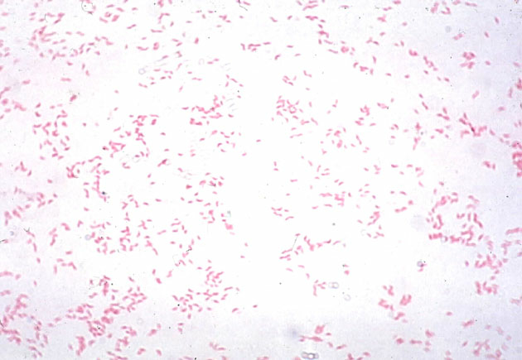
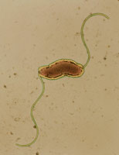

Slide 4
Source
C. jejuni
Commonly associated with poultry
Naturally colonises the digestive tract of many bird spp
Also common in cattle
Transmission
Raw or undercooked food products
Through direct contact with infected animals

Slide 5
Pathogenesis
Ingestion of infected food & then colonization of GIT
Susceptible to gastric acid
Multiply in SI → invade the jejunum, ileum & terminal ileum (colon, rectum) → produce inflammation → cause bloody stools
Involvement of mesenteric lymph nodes & transient bacteremia

Slide 6
Clinical manifestations
Enterocolitis with watery, sometimes bloody diarrhoea & fever
Extraintestinal infxns
Bacteremia
Cholecystitis, arthritis, deep abscesses, osteomyelitis, meningitis
Complications of C. jejuni
GI infxns associated with autoimmune dx e.g. Guillain-Barre syndrome, reactive arthritis

Slide 7
Lab diagnosis
Specimen – stool, blood, etc.
Wet prep of stool – dark-field microscopy-darting motility
With Gram or Wright’s stain
Culture on Campylobacter-special media (contains polymixin*)
BA with antibiotics e.g. Skirrow’s medium
Other alternative media: Butzler’s medium, campy BAP, Brucella agar base with sheep blood
Incubate in microaerophilic conditions, thermophilic at 42 deg C, for up to 48 hrs

Slide 8
On Skirrow’s medium selective(BA with antibiotics - has VCT-PA: vancomycin, cephalothin, Trimethoprim, Amphotericin B and Polymyxin)-Black
Non hemolytic, spreading, water droplet-like colonies
G stain – Gram -ve bacilli, comma or S-shaped rods, `gull-wing’ appearance
Oxidase +ve
Hippurate hydrolysis (C. jejuni is +ve)
Serotyping, biotyping, phage typing

Slide 9
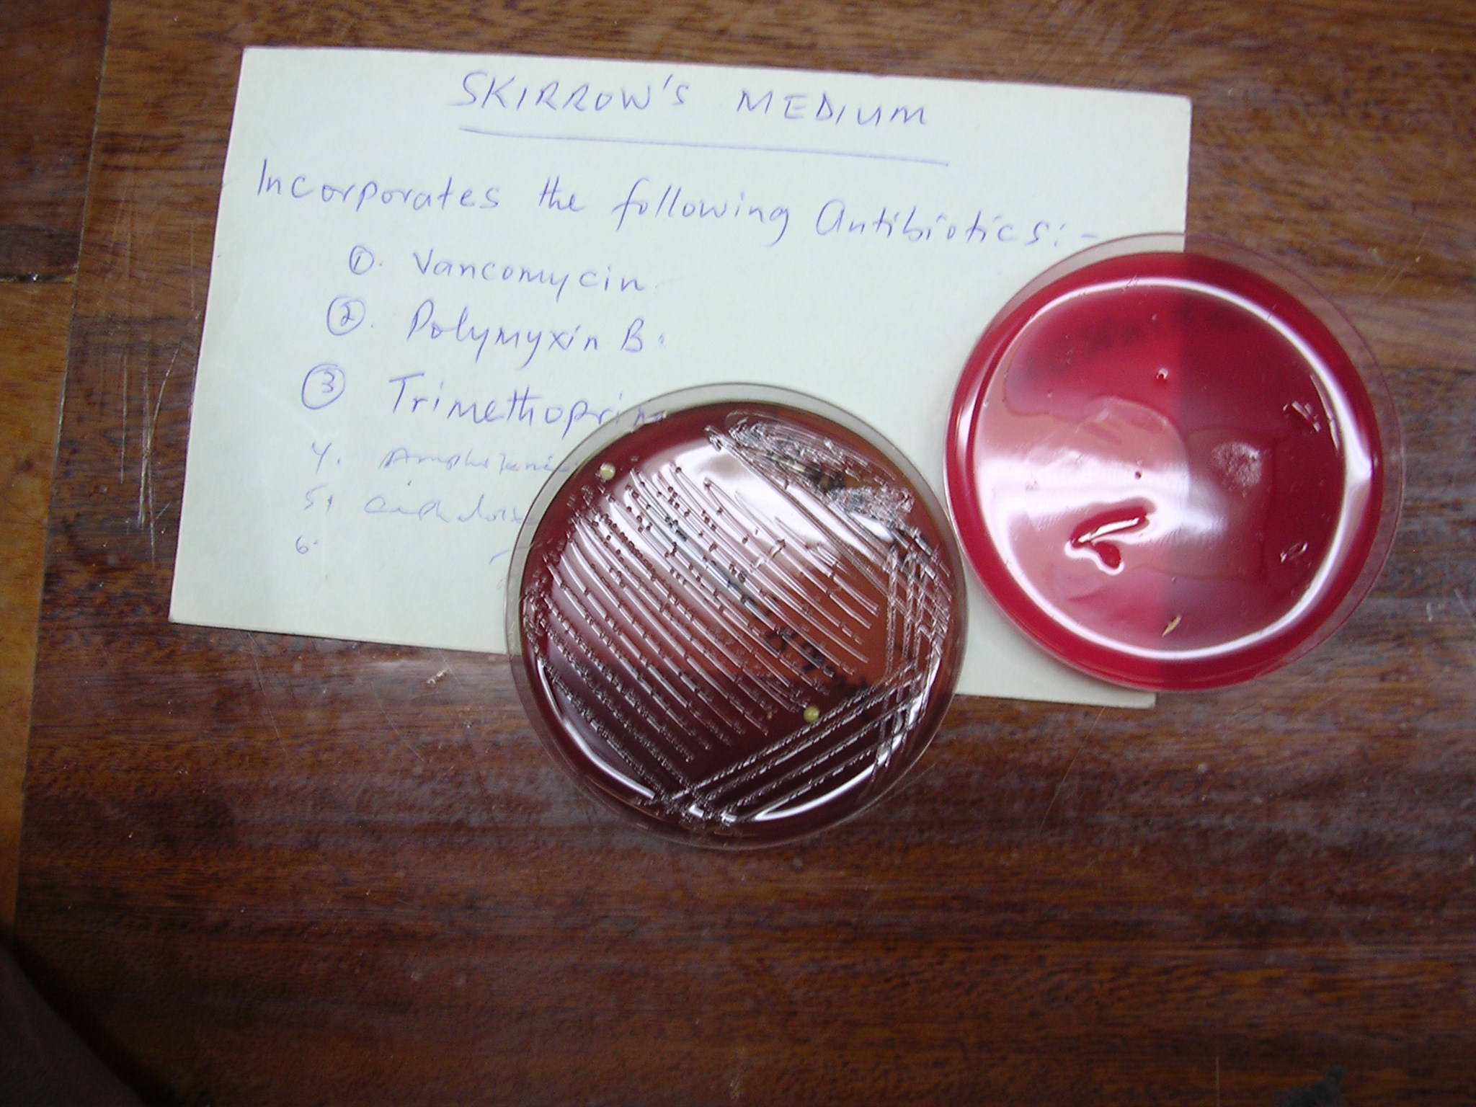

Slide 10
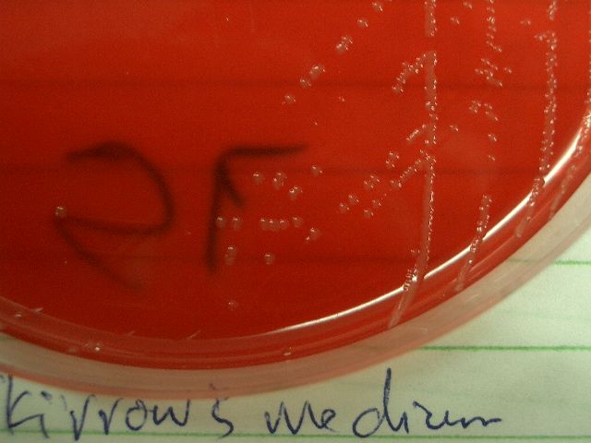
C. Jejuni on SK

Slide 11
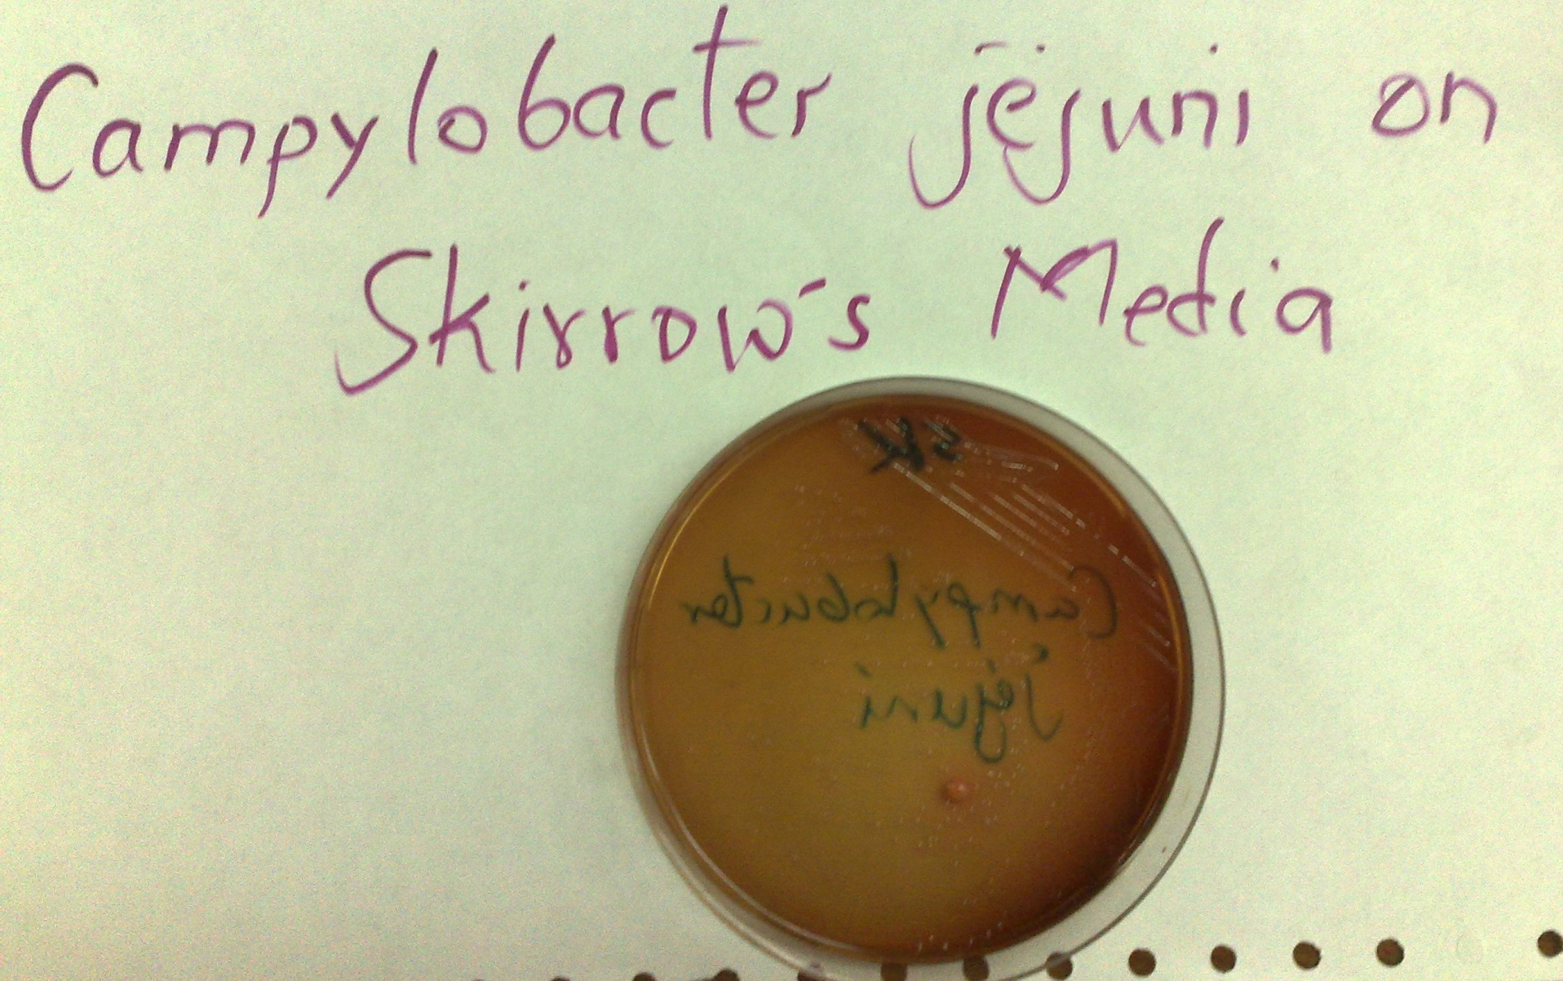

Slide 12
Treatment
Rehydration – since it is self-limiting
Susceptibility to nalidixic acid (1st quinolone discovered) & cephalothin (1st gen cephalosporin) (resistance to nalidixic acid –ve, resistance to cephatholin +ve)
Severe dysentery – erythromycin, ciprofloxacin
C. coli – trimethoprim-sulphamethoxazole
Antimotilty agents are NOT recommended

Slide 13
Helicobacter
Colonizes stomach ~ 50% of world popn
H. pylori is contagious, although the exact route of transmission is not known
Person-person transmission by either the oral-oral or fecal-oral route is most likely
Main risk factor for
Gastric & duodenal ulceration
Stomach cancer
Gastric MALT (mucosa-associated lymphoid tissue) lymphoma

Slide 14
Characteristics of H. pylori
Gram –ve curved rod
Shaped like a helix
Microaerophilic
Motile coz it has 4 to 6 Lophotrichous (from one end) flagella
Produce oxidase, catalase, mucinase, hydrogenase & urease enzymes

Slide 15
Virulence factors
Multiple polar, sheathed flagella
Corkscrew motility enables penetration into viscous environment (mucus)
Adhesins which help it adhere to epithelial cells
Mucinase degrades gastric mucus → localized tissue damage
Pathogenicity island gene codes for injection secretion system which inject VacA & a protein Cag gene into epithelial cells
Cag induces changes in multiple cellular proteins

Slide 16
Urease converts urea (abundant in saliva & gastric juices) into ammonia (alkaline)
Neutralize the local acid environment
Localized tissue damage
Tissue damage
Vacuolating cytotoxin causes apoptosis in eukaryotic cells generating large cytoplasmic vacuoles – epithelial cell damage
Invasins e.g. hemolysins, phospholipases & also catalase

Slide 17
Pathogenesis
Attach to mucus-secreting cells of gastric mucosa → production of large amounts of NH3 & inflammatory response → mucosal damage
Loss of protective mucus coating predisposes to gastritis & peptic ulcer (in upper abdominal pain. Lower abdominal pain is associated with ***
NH3 neutralizes stomach acid allowing organism to survive

Slide 18
Clinical manifestations
Recurrent upper abd pain
Anorexia
Nausea/vomiting, belching
If perforated ulcer- bleeding into GIT
Stool is black due to blood – malena

Slide 19
Lab diagnosis
Non-invasive methods
Blood antibody test
Stool antigen test
Carbon urea breath test (in which the px drinks C14 or C13 – labelled urea, which the bacterium metabolizes, producing labelled CO2 that can be detected in the breath)

Slide 20
Invasive methods
Gastric biopsy
Urease +ve
Culture – oxidase, catalase, urease +ve. Special medium required e.g. Skirrow’s, Brucella, etc.
Histological stains

Slide 21
Treatment
Triple chemotherapy (synergism)
Proton pump inhibitor e.g. omeprazole
One or more antibiotics (e.g. clarithromycin, amoxicillin, metronidazole)
Bismuth compound
NB: milk worsens condition

