Slide 1
Digestive System: General Functional Organization
Dr A W Muriithi
MBChB, BPharm, BDS
February 2018

Slide 2
objectives
1. introduction
2. review anatomy of digestive system
3. regulation of gut function – neural, humoral
4. blood supply
5. gut motility
6. secretions

Slide 3
References
Principles of Physiology
  Berne and Levy
Textbook of Medical Physiology
  Guyton and Hall
Review of Medical Physiology
  Ganong

Slide 4
A good stomach and set of bowels is more important to human health and happiness than a large amount of brains
  A Harvard Medical School gastroenterologist

Slide 5
What are some reasons for eating?
Why do you eat?

Slide 6
We are made from what we eat

Slide 7
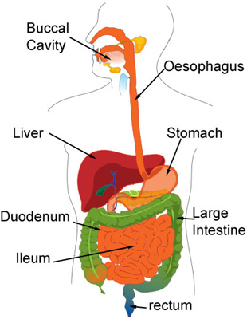
Anatomy of the digestive system

Slide 8
Functions of the digestive system
1.Taste
2.Sensual stimulation
3.Generation of warmth
4.Digestion
5.Absorption
6.Contributes to water balance (homeostasis)
7.Immune – 1st line of defense: food pathogens
8.Excretion

Slide 9
Functions of alimentary canal
Provides body with continual supply of:
  Water
  Electrolytes
  Nutrients
To achieve this the following must occur:
  Movement of food along the tract
  Secretion of digestive juices
  Absorption of digestive end-products
  Circulation of blood through g i organs
  Control and regulation of above events

Slide 10
Regional specialization
Different parts exhibit differing anatomy to match the different functions:
  Mouth (oral cavity)
  Oesophagus
  Stomach
  Small intestine (duodenum, jejunum, ileum)
  Colon
  Rectum

Slide 11
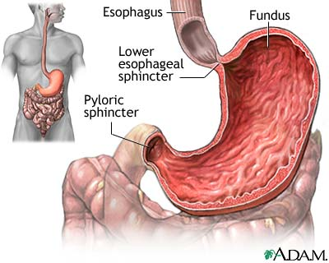
The human stomach

Slide 12
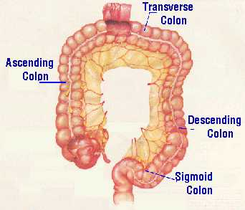
The colon

Slide 13
The digestive system is complex
The activity, control and regulation of the digestive system is highly complex
Unique due to relative freedom from central control – has its own ‘brain’
However,
  overall function is modulated by higher centres
  moment-to-moment functioning of the gut is handled in the gut

Slide 14
Dr. Walter B. Cannon
Over 100 years ago, recognized the difficulties in unraveling gut function
The problem then, and indeed now, is that exposing the intestine, either during surgery or in the course of collecting tissue for an experiment, causes massive release of inflammatory agents and a profound change in the behavior of the intestine.

Slide 15
Cannon used the ‘non-invasive’ techniques of the day (x-rays) to observe normal movements during digestion
Nowadays:
barium meals and swallows are used to investigate gut motility in patients
Endoscopy
Encapsulated electronic cameras – transit time

Slide 16
“Any sufficiently advanced technology is indistinguishable from magic.”
  From The Lost Worlds of 2001,
    By Arthur C. Clarke

Slide 17
Factors the affect digestive function
The normal patterns of the nerves and muscles are influenced every day by many factors:
Sleeping, waking + exercise change motility
Emotional distress can have profound effects on gastrointestinal motility
Even the food that you eat releases substances into the blood which influence motility (eg certain foods affect your mood)

Slide 18
Factors the affect digestive function
Nerve connections between the brain and the GI tract send messages in both directions
These modify not only GI motility, but also perceptions from the gut.
Whether the perceptions feel good or feel bad has important consequences on diet and food choices.

Slide 19
"One’s mind, once stretched by a new idea never regains its original dimensions."
~ Oliver Wendell Holmes

Slide 20
Characteristics of gut wall
Serosa/Adventitia
Longitudinal muscle layer
  Myenteric plexus (Auerbach’s)
Circular muscle layer
Sub-mucosa
  Sub-mucosal plexus (Meissner’s)
  Muscularis mucosae
Mucosa
          LUMEN
Gut associated lymphoid tissue (GALT)
  Peyer’s patches

Slide 21
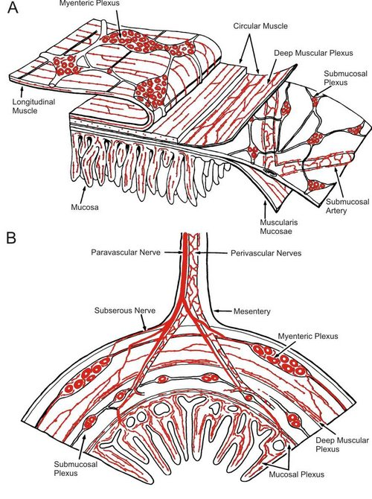
The intestinal wall

Slide 22
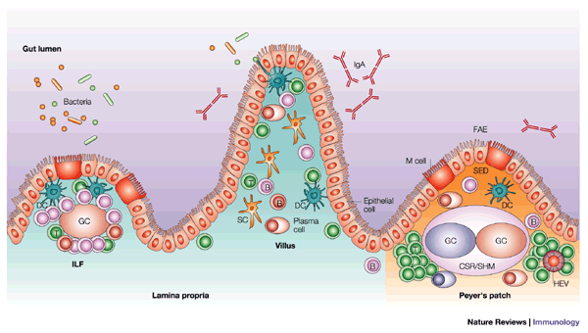

Slide 23
The Enterocyte
Enterocyte = the epithelial cell lining the mucosa of the intestine
Microvilli increase luminal surface area. This ensures maximal contact/interaction of cells with luminal contents. Enhances digestion and absorption
Glutamine: an essential substrate for cell division and energy production in lymphocytes, enterocytes and macrophages

Slide 24
Glutamine metabolism (1)
Glutamine can be readily synthesized by various tissues in the body: skeletal muscles, liver and adipose tissue
The demand for plasma glutamine rises during exercise or other times when stress is applied to the body’s normal metabolic rate, e.g. fasting, severe injury, illness.
Various cells of the immune system such as lymphocytes and macrophages depend on this substance as their primary fuel source.

Slide 25
Glutamine metabolism (2)
About 40-50% of glutamine is consumed by the enterocytes of the small intestines, which makes them the largest consumers of this substance. Additionally, this substance is required for the synthesis of nucleotides in the cell nuclei.
Nucleotides are especially important to enterocytes during intestinal development, maturation, and repair.
This explains the increased demand for glutamine during cell division. For rapid growth and development, a sufficient supply of glutamine is therefore important.

Slide 26
Glutamine metabolism (3)
Research suggests that glutamine is essential to the health and maintenance of the intestinal tract.
In fact, the intestine, and particularly the small intestine, is the greatest user of glutamine in the body
The intestinal enterocytes absorb glutamine from the lumen of the gut and from the bloodstream
The intestinal cell mitochondria then convert glutamine to glutamate, and then to alpha-ketoglutarate, which is used in the Krebs cycle for ATP production

Slide 27
Only those who have patience to do simple things perfectly ever acquire the skill to do difficult things easily.
James J Corbett

Slide 28
Thank you

