Slide 1
HMP200/UPC203/VMP200/NOV/DEC/2016
PANCREATIC SECRETION

Slide 2
REFERENCES
GANONG’S REVIEW OF MEDICAL PHYSIOLOGY, 25 Edition, 2016, McGraw Hill Education Lange.
BORON & BOULPAEP MEDICAL PHYSIOLOGY A Cellular & Molecular Approach. 2nd Edition 2012 by Saunders, Elsevier.
GUYTON & HALL TEXTBOOK OF MEDICAL PHYSIOLOGY A south Asian Edition. Vaz, Kurpad & Raj. 2013 Elsevier.
LECTURER: Dr. Paul Mungai Mbugua (PMM)
Department of Medical Physiology

Slide 3
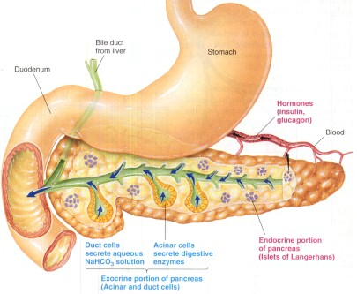

Slide 4
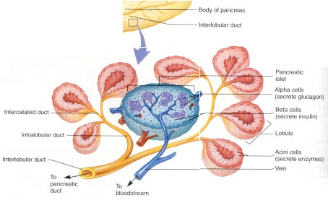

Slide 5
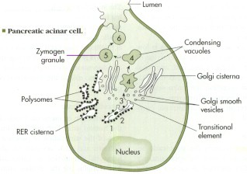

Slide 6
PANCREATIC SECRETION
Protein-rich, alkaline secretion
Humans produce approx 1.5 L per day
Highest rates of protein synthesis & secretion
15-100 g of protein delivered to SI per day
Secretes more than 20 proteins

Slide 7
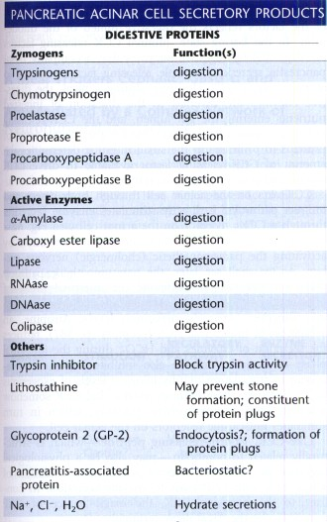

Slide 8
PANCREATIC SECRETION
High [Ca²⁺] & [HCO₃⁻]
HCO₃⁻ neutralizes acid in duodenum, allows digestive enzymes to function properly, facilitates micellar solubilization of lipids
[HCO₃⁻] increases with increase in secretory flow rates

Slide 9
PANCREATIC SECRETION
STIMULATION OF PROTEIN SECRETION FROM THE PANCREATIC ACINAR CELLS

Slide 10
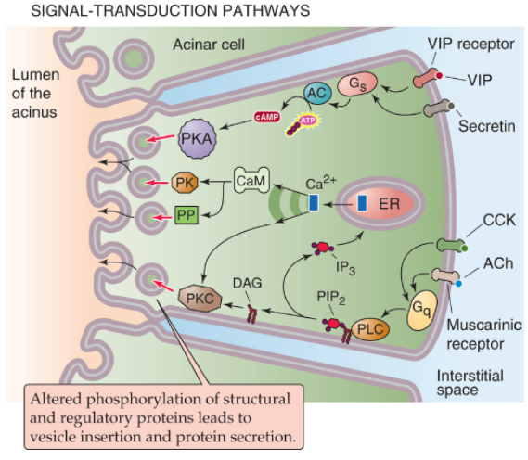

Slide 11
PANCREATIC SECRETION
STIMULATION OF OF ISOTONIC NaCI SECERTION BY THE PANCREATIC ACINAR CELLS

Slide 12
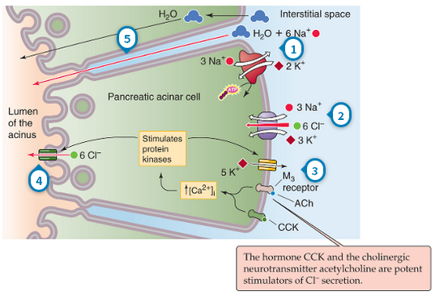

Slide 13
PANCREATIC SECRETION
STIMULATION OF OF ISOTONIC NaCI SECERTION BY THE PANCREATIC ACINAR CELLS

Slide 14
PANCREATIC SECRETION
HCO₃⁻ SECRETION BY THE CELLS OF THE PANCREATIC DUCT

Slide 15
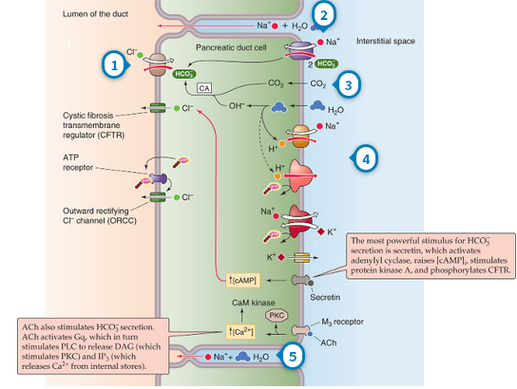
0

Slide 16
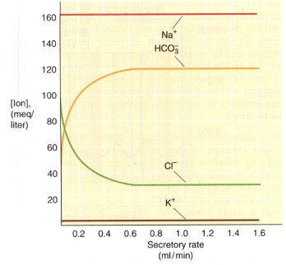

Slide 17
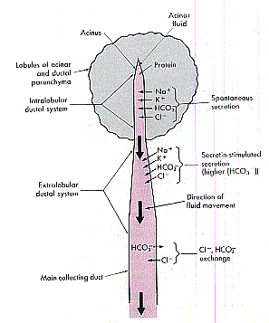

Slide 18
PANCREATIC SECRETION
HCO₃⁻ SECRETION BY THE CELLS OF THE PANCREATIC DUCT

Slide 19
PANCREATIC SECRETION
CCK stimulates enzyme secretion by acini
Secretin stimulate HCO₃⁻ & fluid secretion by the ducts

Slide 20
PANCREATIC SECRETION
A meal triggers:-
CEPHALIC
GASTRIC
INTESTINAL
Phases of pancreatic secretion that are mediated by a complex network of neurohumoral interactions

Slide 21
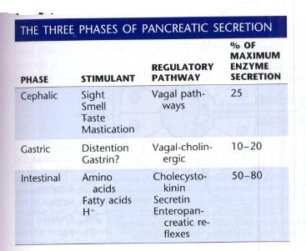

Slide 22
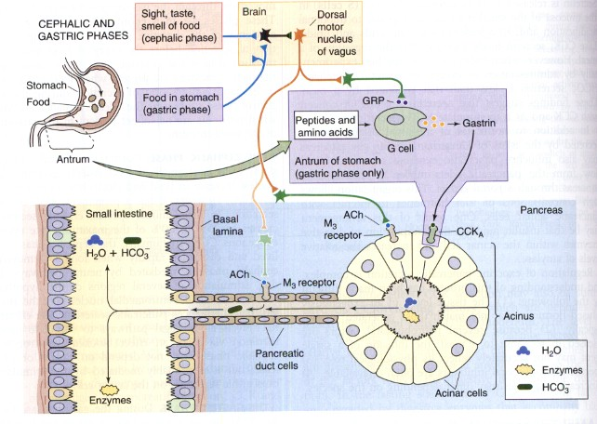

Slide 23
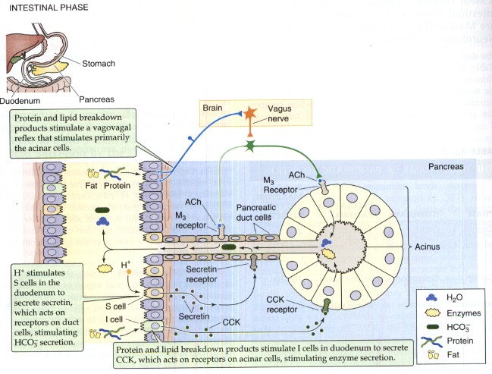

Slide 24
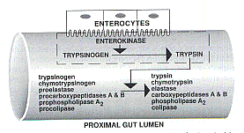

Slide 25
CCK stimulates enzyme secretion by acini
Secretin stimulate HCO₃⁻ & fluid secretion by the ducts

Slide 26
THANK YOU

