Slide 1
HMP200/UPC203/VMP200/NOV/DEC/2016
BILE PRODUCTION, SECRETION, STORAGE, AND ENTEROHEPATIC CIRCULATION OF BILE ACIDS

Slide 2
REFERENCES
GANONG’S REVIEW OF MEDICAL PHYSIOLOGY, 25 Edition, 2016, McGraw Hill Education Lange.
BORON & BOULPAEP MEDICAL PHYSIOLOGY A Cellular & Molecular Approach. 2nd Edition 2012 by Saunders, Elsevier.
GUYTON & HALL TEXTBOOK OF MEDICAL PHYSIOLOGY A south Asian Edition. Vaz, Kurpad & Raj. 2013 Elsevier.
LECTURER: Dr. Paul Mungai Mbugua (PMM)
Department of Medical Physiology
College of Health Sciences
UNIVERSITY OF NAIROBI

Slide 3
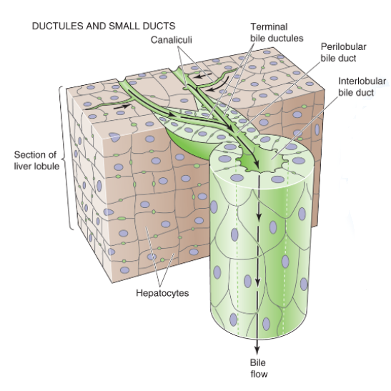

Slide 4
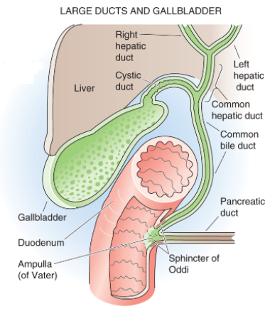

Slide 5
COMPOSITION OF BILE
Na⁺, K⁺, Ca²⁺, CI⁻ , HCO₃⁻
Bile acids
Fatty acids
Bilirubin
Phospholipids (lecithin)
Cholesterol
IgA
Proteins

Slide 6
COMPOSTION OF BILE
Excretory or waste products found in bile:-
Cholesterol
Bile pigments
Trace minerals
Plant sterols
Lipophilic drugs
Metabolites
Antigen-antibody complexes

Slide 7
HEPATOCYTES
Synthesize PRIMARY bile acids from cholesterol
Cholesterol 7α-hydroxylase
Cholic acid & Chenodeoxycholic acid
Principal routes of cholesterol excretion & catabolism

Slide 8
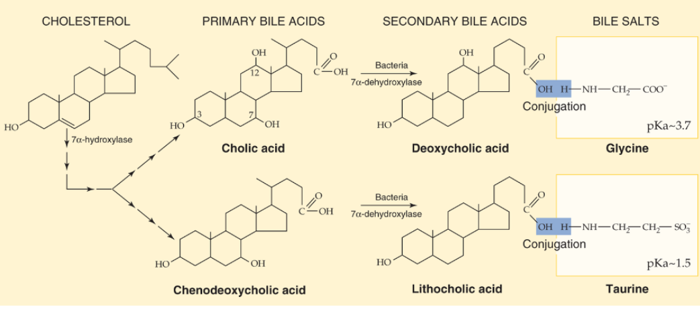

Slide 9
SECRETION OF HCO₃⁻ - RICH FLUID BY CHOLANGIOCYTES -Biliary Epithelial Cells

Slide 10
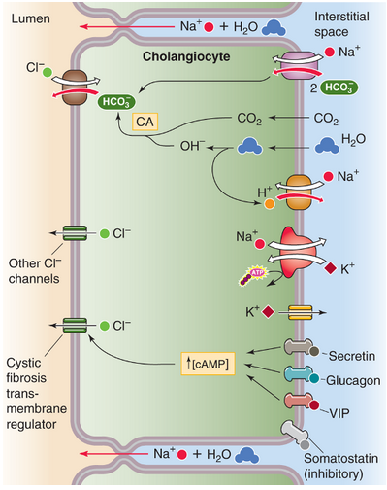

Slide 11
GALLBLADDER
STORES BILE
CONCENTRATES BILE
DELIVER BILE TO THE DUODENUM DURING A MEAL

Slide 13
ISOTONIC FLUID REABSORPTION BY THE GALLBLADDER EPITHELIUM

Slide 14
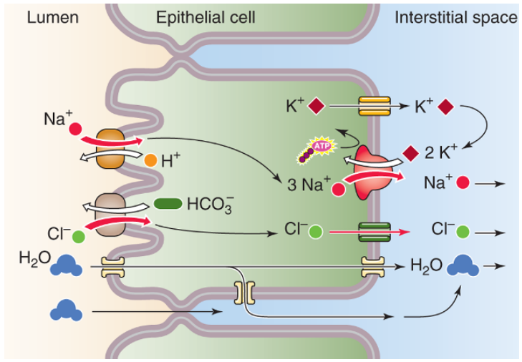

Slide 15
ENTEROHEPATIC CIRCULATION OF BILE ACIDS

Slide 16
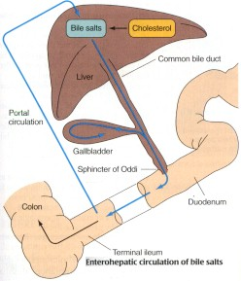

Slide 17
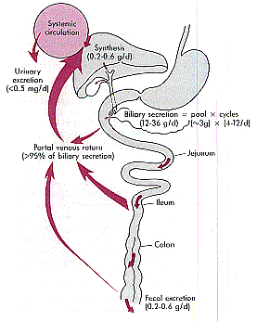

Slide 18
ACTIVE ABSORPTION OF BILE ACIDS IS RESTRICTED TO THE TERMINAL ILEUM

Slide 19
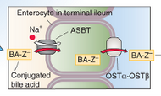

Slide 20
THANK YOU

