Slide 1
HMP200/UPC203/VMP200 NOV/DEC/2016
PROTEIN DIGESTION AND ABSORPTION

Slide 2
REFERENCES
GANONG’S REVIEW OF MEDICAL PHYSIOLOGY, 25 Edition, 2016, McGraw Hill Education Lange.
BORON & BOULPAEP MEDICAL PHYSIOLOGY A Cellular & Molecular Approach. 2nd Edition 2012 by Saunders, Elsevier.
GUYTON & HALL TEXTBOOK OF MEDICAL PHYSIOLOGY A south Asian Edition. Vaz, Kurpad & Raj. 2013 Elsevier.
LECTURER: Dr. Paul Mungai Mbugua (PMM)
Department of Medical Physiology
College of Health Sciences
UNIVERSITY OF NAIROBI

Slide 3
PROTEIN DIGESTION

Slide 4
SOURCES OF PROTEIN
Dietary proteins
Endogenous sources of proteins – enzymes, hormones, immunoglobulins, etc
Protein entering small intestine in salivary, gastric, pancreatic, biliary & jejunal secretions
Desquamated intestinal epithelial cells
Plasma proteins

Slide 5
LUMINAL DIGESTION
Gastric chief cells secrete pepsinogen
PEPSIN
Maximal proteolytic activity at a pH of 1.8 to 3.5
Irreversibly inactivated at a pH of about 7
Endopeptidase
Partially digests 10% to 15% of dietary protein
Pepsin hydrolysis is NOT absolutely necessary

Slide 6
5 PANCREATIC PROTEOLYTIC ENZYMES
Secreted as inactive proenzymes
Trypsinogen converted to trypin by jejunal brush border enzyme, enterokinase (enteropeptidase)
Autoactivated by trypsin
Trypsin activates other pancreatic proenzymes

Slide 7
5 PANCREATIC PROTEOLYTIC ENZYMES
Endopeptidases – trypsin, chymotrypsin, elastase
Oligopeptides with 2 to 6 AAs
Exopeptidases – carboxypeptidase A & B
AAs
Integrated, coordinated pancreatic proteolytic action
70% oligopeptides – dipeptides, tripeptides, tetrapeptides
30% free AAs

Slide 8
BRUSH BORDER PEPTIDASES
A large number of membrane peptidases
Endopeptidases
Exopeptidases
Carboxypeptidases
Aminopeptidases
Dipeptidases

Slide 9
CYTOPLASMIC PEPTIDASES
Intracellular peptidases
Hydrolyze dipeptides, tripeptides, tetrapeptides to AAs
Oligopeptides almost completely hydrolyzed to AAs
Few peptides appear in portal vein
Proline-containing dipeptides are relatively resistant to hydrolysis & are the primary peptides that are present in the portal circulation

Slide 10
PROTEIN ABSORPTION

Slide 11
ABSORPTION OF AMINO ACIDS
Multiple apical membrane AA transporters
Overlapping affinities for various AAs
Distinct (7) apical membrane transport systems
System Bº – predominant apical AA transport system

Slide 12
ABSORPTION OF AMINO ACIDS
Na⁺-dependent uptake of neural AAs (Phe, Trp, Tyr)
Uphill absorption of neural AAs is driven by an inwardly directed Na⁺ gradient that is maintained by the basolateral Na⁺-K⁺ pump
Electrogenic Secondary Transport

Slide 13
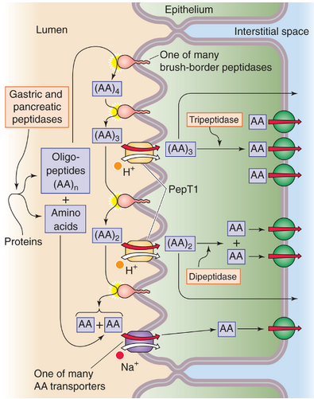

Slide 14
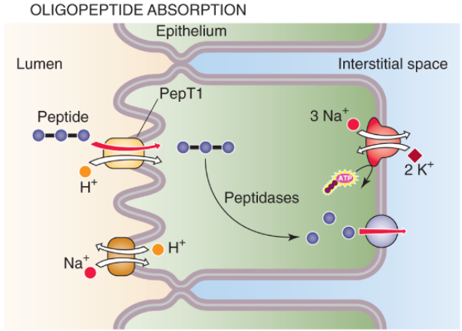

Slide 15
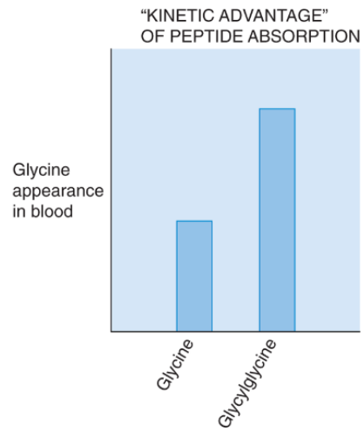

Slide 16
HARTNUP DISEASE
Hereditary disorder
Apical membrane System Bº defective
Reduced absorption of neural AAs – Phenylalanine
Oligopeptides containing neutral AAs absorbed normally

Slide 17
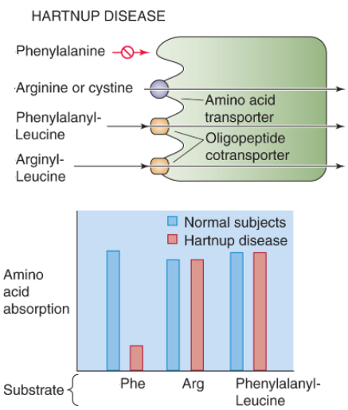

Slide 18
CYSTINURIA
Hereditary disorder
Apical membrane System b^{o+} defective
Reduced absorption of cationic (basic AAs, cystine)
Oligopeptides containing cationic AAs absorbed normally

Slide 19
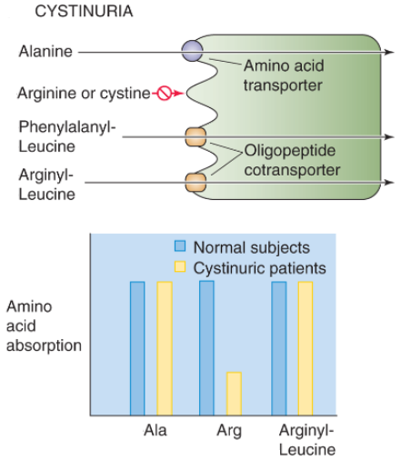

Slide 20
LYSINURIC PROTEIN INTOLERANCE
Hereditary disorder
Impaired basolateral membrane Na⁺ - independent cationic AA transport
SYSTEM y⁺L
Cationic AAs absorbed normally by apical membrane systems
Normal intracellular hydrolysis of oligopeptides
Symptoms of malnutrition/protein deficiency
Hepatocytes, kidney cells

Slide 21
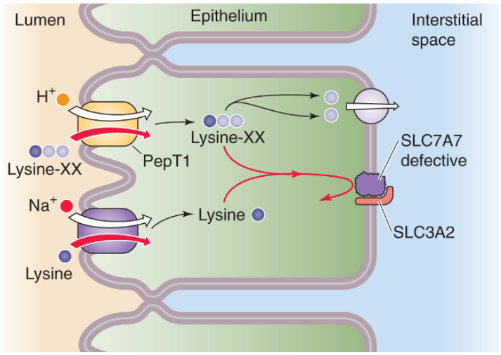

Slide 22
Proteins in colostrum absorbed intact through endocytosis
Passive immunity from mother to child
Active until approx 6 months
Adults immune responses associated to endocytotic absorption whole proteins

Slide 23
M CELLS/MICROFOLD CELLS
M immunocompetent cells
Specialized for intact protein absorption
Package proteins (antigens) in clathrin-coated vesicles
Basolateral extrusion into the lamina propria
Antigens are transferred to lymphocytes
Initiate immune response
Important in mucosal immunity
Gut-associated lymphoid tissue (GALT)

Slide 24
THANK YOU

