Slide 1
HMP200/UPC203/VMP200 NOV/DEC/2016
LIPID DIGESTION AND ABSORPTION

Slide 2
REFERENCES
GANONG’S REVIEW OF MEDICAL PHYSIOLOGY, 25 Edition, 2016, McGraw Hill Education Lange.
BORON & BOULPAEP MEDICAL PHYSIOLOGY A Cellular & Molecular Approach. 2nd Edition 2012 by Saunders, Elsevier.
GUYTON & HALL TEXTBOOK OF MEDICAL PHYSIOLOGY A south Asian Edition. Vaz, Kurpad & Raj. 2013 Elsevier.
LECTURER: Dr. Paul Mungai Mbugua (PMM)
Department of Medical Physiology
College of Health Sciences
UNIVERSITY OF NAIROBI

Slide 3
LIPID
DIGESTION

Slide 4
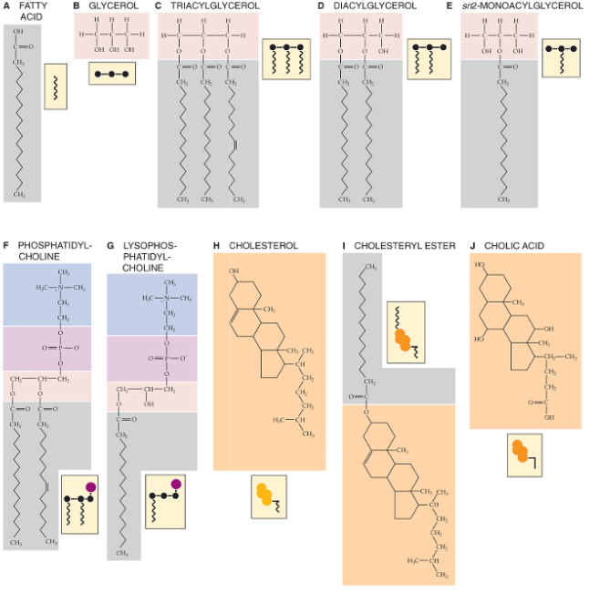

Slide 5
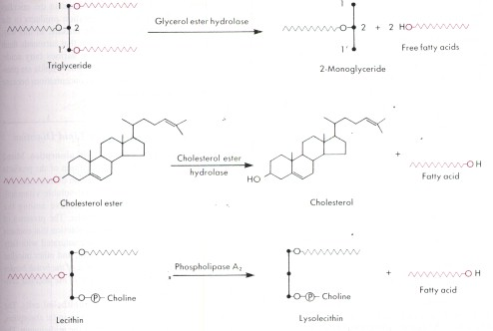

Slide 6
DIETARY FAT
Consists mainly of triglycerides (TGs)
Triacylglycerols (TAGs)
90 – 95%
Phospholipids
Most abundant dietary phospholipid is phosphatidylcholine (lecithin)

Slide 7
DIETARY STEROLS
Major dietary sterols:
Cholesterol from animal fat
Sitosterol from plants – not absorbed by the human intestine

Slide 8
DIETARY FATTY ACIDS
Major fatty acids (FAs) of dietary TG:
Oleate, palmate, stearate, & linoleate
Animal TGs contain mostly long-chain saturated FAs
Polyunsaturated FAs are derived from phospholipids of vegetable origin
Linoleic acid, linolenic acid
Essential FAs

Slide 9
ENDOGENOUS LIPIDS
BILIARY LIPIDS
PHOSPHOLIPIDS (LECITHIN)
APPROX 10 TO 15 G/DAY
CHOLESTEROL
APPROX 1 TO 2 G/DAY

Slide 10
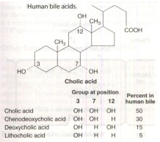

Slide 11
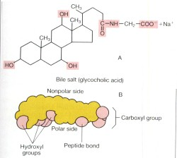

Slide 12
MICELLES
[BSs] in bile approx. 35 mM
[BSs] in duodenum approx. 10 to 20 mM
Above critical micellar concentration (CMC)
Amphipathic
Aggregate in disk-like particles
Hydrophobic sterol backbones oriented toward each other
Hydrophilic groups facing aqueous intestinal fluid

Slide 13
MICELLES
BSs act as emulsifying agents at the oil-water interface
Mixed micelles about 50 to 80 nm in diameter
Dissolve FAs, MGs, cholesterol
Don’t dissolve TGs
Bile phospholipids enlarge mixed micelles, enhancing capacity for fat dissolution
Mixed micelles are the major route of transport of lipolytic endproducts

Slide 14
EMULSIFICATION OF LIPIDS
Solid fat & oils transformed into an emulsion of fine oil droplets in water
Grinding, marinating, blending, cooking
Chewing, gastric churning, grinding action, TRITURATION
Intestinal peristalsis

Slide 15
EMULSIFICATION OF LIPIDS
PANCREATICOBILIARY
Biliary & pancreatic secretion
Reduced size of lipid droplets
Dramatic increase in the ratio of surface area to volume
Increased area of oil-water interface

Slide 16
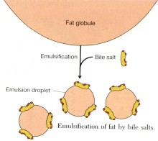

Slide 17
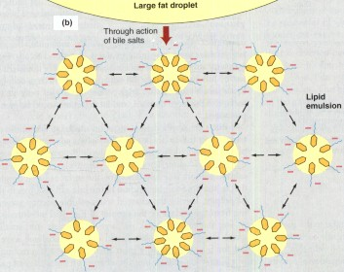

Slide 18
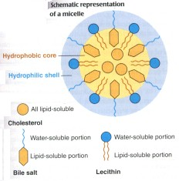

Slide 19
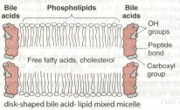

Slide 20
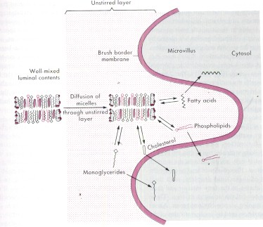

Slide 21
EMULSIFICATION OF LIPIDS
To stabilize the emulsion, the fat droplets are coated with dietary phospholipids
Mixed emulsion formed in the duodenum consists:
Predominantly TGs
Cholesteryly esters
Diglycerides
FAs
MGs
BSs
Coated by phospholipids

Slide 22
MILK LIPASE
Stimulated by bile salts
Stable in acidic stomach
Active at the alkaline pH of the duodenum & jejunum
Protected by bile salts from proteolysis
Important for fat digestion in breast-fed infants

Slide 23
GASTRIC LIPASE
Gastric chief cells
Glycoprotein
Gastrin
Acidic pH optima approx 4
Stable in acidic stomach
Resistant to digestion by pepsin
Inactive at neutral pH
Readily inactivated by pancreatic proteases
Approx 15% gastric lipid digestion

Slide 24
GASTRIC LIPASE
Gastric chief cells
Glycoprotein
Gastrin
Acidic pH optima approx 4
Stable in acidic stomach
Resistant to digestion by pepsin
Inactive at neutral pH
Readily inactivated by pancreatic proteases
Approx 15% gastric lipid digestion

Slide 25
PANCREATIC LIPASE
TAG lipase
Colipase-dependent pancreatic lipase
1000 – fold excess
Full lipolytic activity requires:
Colipase – cofactor
Alkaline pH
Ca²⁺
Bile salts
Long-chain FAs

Slide 26
COLIPASE
Procolipase
Trypsin/colipase/enterostatin
Penetrate phospholipid coating of emulsion droplets & acts as an anchor
Colipase-lipase complex

Slide 27
BILE SALTS
Inhibit lipolysis by displacing lipase from oil-droplet surface
Bring colipase-lipase complex closer to interface
Solubilize & remove lipolytic products from emulsion droplet

Slide 28
FATTY ACIDS (FAs)
Enhance emulsification
Augment lipolysis
Buildup causes product inhibition of lipase

Slide 29
CARBOXYL ESTER HYDROLASE
Pancreatic esterase
Cholesterol esterase
Lysophospholipase
End products are free cholesterol & free glycerol
Same protein as bile salt-stimulated milk lipase
Lacks substrate specificity
Hydrolyze a wide range of esters

Slide 30
PHOSPHOLIPASE A₂ (PLA₂)
Secreted as a proenzyme
Effective at alkaline pH
Requires bile salts for activity
Convert glycerophospholipids to:
FAs & lysophospholipids

Slide 31
LIPID
ABSORPTION

Slide 32
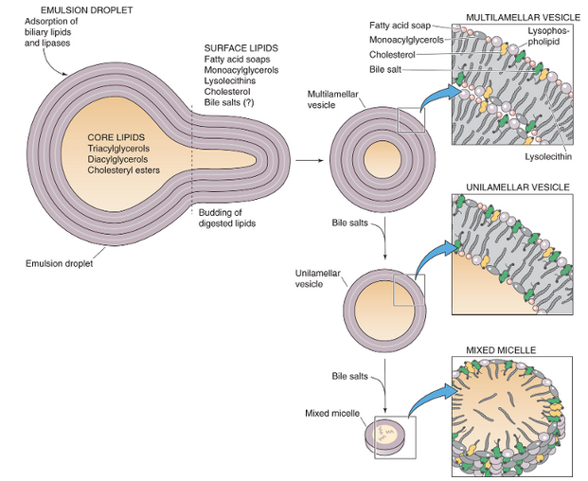

Slide 33
Multilamellar vesicles of FAs, MGs, lysolecithins, cholesterol builds up on the surface of the emulsion particle
They are transformed to unilamellar vesicles by bile salts
Unilamellar vesicles are composed of bile salts & mixed lipids:
FAs, MGs, lysophospholipids, cholesterol

Slide 34
3 diffusion barriers to be crossed by lipolytic products:
Mucous gel layer lining intestinal epithelial surface
Unstirred water layer
Apical membrane
Mixed-lipid micelles act as a reservoir
Effective concentration of lipolytic products
Most efficient mechanism for bringing lipolytic products to the BBM

Slide 35
Short-& medium-chain FAs efficiently diffuse through unstirred water layer to the enterocytes
LCFAs absorbed through:
Nonionic diffusion
Incorporation into enterocyte membrane
FA translocase - FAT/CD36
Plasma membrane fatty acid-binding protein (FABPpm)

Slide 36
FATTY ACIDS (FAs)
Absorbed by diffusion
Incorporated into cell membrane
Absorbed through carrier-mediated transport
Fatty acid translocate (FAT/CD36)

Slide 37
ENTEROCYTES RE-ESTERIFICATION:
LONG-CHAIN FAs
MAGs
LYSOPHOSPHOLIPIDS
CHOLESTEROL

Slide 38
CHYLOMICRONS
COMPOSE OF:
PHOSPHOLIPIDS
CHOLESTERYL ESTERS
CHOLESTEROL
CONSIST PRIMARY OF TAG

Slide 39
Digested & absorbed lipid end products are re-esterified in the cytoplasm of enterocytes.
Short-and medium-chain FAs & glycerol are absorbed by enterocytes and they pass unchanged through the cytoplasm of enterocytes & enter into the blood capillaries

Slide 40
In the cytoplasm of enterocytes, long- chain FAs & 2-MAG are resynthesized into TAG in the SER
The enterocytes change cholesterol into cholesteryl esters
The enterocytes change lysolecithin into lecithin

Slide 41
The intracellular 8 steps that illustrate how the absorbed lipolytic endproducts are processed by enterocytes leading to the formation of chylomicrons & VLDLs are summarized as follows:

Slide 42
STEP ONE (1)
LONG-CHAIN FAs & OTHER RODUCTS OF LIPID DIGESTION ARE CONVERTED BACK TO TAGs, PHOSPHOLIPIDS, & ESTERS OF CHOLESTEROL IN THE SER

Slide 43
STEP TWO (2)
FAT DROPLETS FORM IN THE CISTERNAE OF THE SER

Slide 44
STEP THREE (3)
APOLIPOPROTEINS ARE SYNTHESIZED IN THE RER & THEN (EXCEPT FOR APOLIPOPROTEIN A-l) MOVE TO THE SER, WHERE THEY ASSOCIATE WITH LIPID DROPLETS. APOLIPOPROTEIN A-l ASSOCIATES WITH CHYLOMICRONS IN THE GOLGI APPARATUS

Slide 45
STEP FOUR (4)
CHYLOMICRONS & VLDLs ARRIVE AT THE CIS FACE OF THE GOLGI APPARATUS. HERE, APOLIPOPROTEINS ARE GLYCOSYLATED

Slide 46
STEP FIVE (5)
VESICLE CARRYING CHYLOMICRONS OR VLDLs BUD OFF FROM THE TRANS-GOLGI APPARATUS, & MOVE TO THE BASOLATERAL MEMBRANE IN TRANSPORT VESICLES

Slide 47
STEP SIX (6)
TRANSPORT VESICLES FUSE WITH THE BASOLATERAL MEMBRANE, RELEASING CHYLOMICRONS OR VLDLs

Slide 48
STEP SEVEN (7)
CHYLOMICRONS & VLDLs PASS THROUGH LARGE INTERENDOTHELIAL CHANNELS OF LYMHATIC CAPILLARIES, & ENTER THE LYMPH

Slide 49
STEP EIGHT (8)
GLYCEROL, SHORT-CHAIN & MEDIUM-CHAIN FAs PASS THROUGH THE ENTEROCYTE & ENTER BLOOD CAPILLARY

Slide 50
THANK YOU

