Slide 1
HMP200/UPC203/VMP200 NOV/DEC/2016
ABSORPTION OF MINERALS

Slide 2
REFERENCES
GANONG’S REVIEW OF MEDICAL PHYSIOLOGY, 25 Edition, 2016, McGraw Hill Education Lange.
BORON & BOULPAEP MEDICAL PHYSIOLOGY A Cellular & Molecular Approach. 2nd Edition 2012 by Saunders, Elsevier.
GUYTON & HALL TEXTBOOK OF MEDICAL PHYSIOLOGY A south Asian Edition. Vaz, Kurpad & Raj. 2013 Elsevier.
LECTURER: Dr. Paul Mungai Mbugua (PMM)
Department of Medical Physiology
College of Health Sciences
UNIVERSITY OF NAIROBI

Slide 3
CALCIUM
HOW IS IT ABSORBED IN THE SMALL INSTESTINES?

Slide 4
ABSORPTION OF CALCIUM
MILK & MILK PRODUCTS
DIGESTIVE SECRETIONS
OXALATE & PHOSPHATES ANIONS FORM INSOLUBLE Ca²⁺ SALTS IN THE INTESTINE
REDUCES AVAILABILITY OF Ca²⁺ FOR ABSORPTION
ABSORPTION IS FACILITATED BY PROTEIN
ABSORPTION ADJUSTED TO BODY NEEDS

Slide 5
ABSORPTION OF CALCIUM
SMALL INTESTINE ABSORBS ~ 500 mg per day
SMALL INTESTINE SECRETES ~ 325 mg per day
NET ABSORPTION BY SMALL INTESTINE ~ 175 mg per day

Slide 6
ABSORPTION OF CALCIUM
DUODENAL ENTEROCYTES
ACTIVE TRANSCELLULAR UPTAKE
CONTROLLED BY VIT D
LARGE TRANCELLULAR FLUXES OF Ca²⁺
Ca²⁺ CHANNELS DRIVEN BY ELECTROCHEMICAL GRADIENT
INTESTINAL LUMEN FREE [Ca²⁺] ~ 1 mM
CYTOSOLIC FREE [Ca²⁺]i ~ 100 nM

Slide 7
ABSORPTION OF CALCIUM
CYTOSOLIC Ca²⁺ BINDS CALBINDIN
EXTRUSION OF Ca²⁺ INTO INTERSTITIAL FLUID BY:
Ca²⁺ PUMP (H⁺-Ca²⁺ ATPase)
3Na⁺-Ca²⁺ EXCHANGER

Slide 8
VITAMIN D
1,25-CHOLECALCIFEROL
1, 25-DIHYDROXYVITAMIN D
STIMULATES ALL THREE STEPS OF ACTIVE TRANCELLULAR PATHWAY
IMPORTANT EFFECT IS INCREASED SYNTHESIS OF CALBINDIN

Slide 9
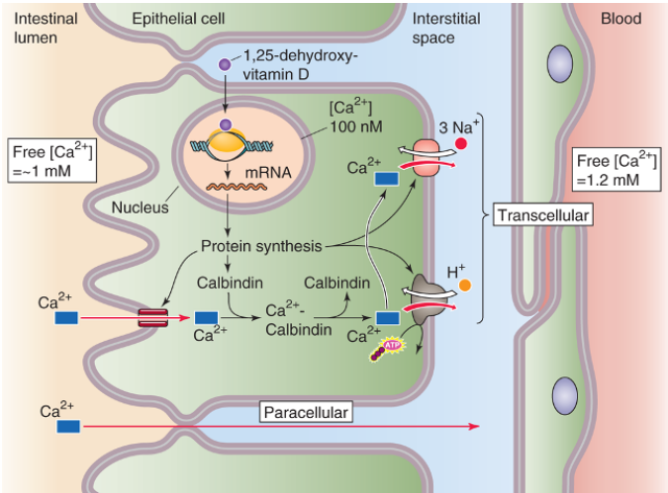

Slide 10
ABSORPTION OF CALCIUM
PASSIVE, PARACELLULAR DIFFUSION
MORE Ca²⁺ IS ABSORBED IN JEJUNUM & ILEUM BY DIFFUSION THAN IN THE DUODENUM BY ACTIVE TRANSCELLULAR UPTAKE
PREDOMINANT PATHWAY
NOT UNDER CONTROL OF VIT D

Slide 11
ABSORPTION OF CALCIUM
ENHANCED BY:-
LOW PLASMA [Ca²⁺]
DURING PREGNANCY & LACTATION
AGING TENDS TO DIMINISH Ca²⁺ ABSORPTION

Slide 12
IRON
HOW IS IT ABSORBED IN THE SMALL INSTESTINES?

Slide 13
ABSORPTION OF IRON
DIETARY IRON-LIVER, FISH, VEGETABLES
RDA-10 TO 15 mg/d
HEME IRON (cytochromes, hemoglobin, myoglobin)
NONHEME IRON (Fe³⁺ - ferrous; Fe²⁺ - ferric)
HEME IRON IS ABSORBED MORE EFFICIENTLY THAN NONHEME IRON
BODY STORES OF IRON DEPEND ALMOST EXCLUSIVELY ON IRON ABSORPTION

Slide 14
ABSORPTION OF IRON
NO REGULATED PATHWAY FOR IRON EXCRETION EXISTS
CRITICAL ROLE AS HEME GROUPS OF CYTOCHROMES
KEY COMPONENT OF O₂-CARRYING HEME MOITIES OF HEMOGLOBIN & MYOGLOBIN
ONLY 10% TO 20% OF INGESTED IRON IS ABSORBED

Slide 15
NONHEME IRON
FERRIC (Fe³⁺) OR FERROUS (Fe²⁺)
Fe³⁺ COMPLEX WITH ANIONS (phytic acid, phosphates, oxalates)
COMPLEXES FORMED NOT READILY ABSORBED
TANNINS IN TEA FORM INSOLUBLE COMPLEXES WITH IRON

Slide 16
ASCORBIC ACID (VIT C)
Gastric secretions dissolve iron
Forms soluble complexes with Vit C
REDUCES Fe³⁺ TO Fe²⁺ STATE
ENHANCES IRON ABSORPTION
Partial Gastrectomy
Iron Deficiency Anemia

Slide 17
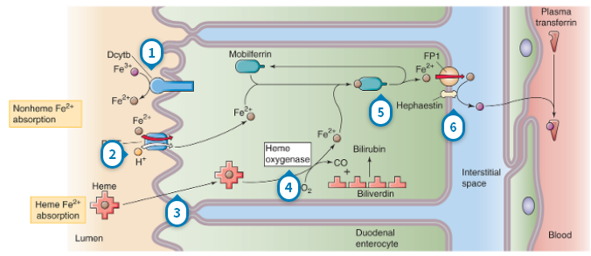

Slide 18
ABSORPTION OF IRON
ABSORPTION RESTRICTED TO THE DUODENUM
DIVALENT METAL TRANSPORTER (DMT1)
COTRANSPORTS Fe²⁺ & H⁺
ENERGIZED BY THE INWARDLY DIRECTED H⁺ GRADIENT
MAINTAINED BY Na⁺-H⁺ EXCHANGE

Slide 19
ABSORPTION OF IRON
FERRIC REDUCTASE REDUCES (Dcytb) Fe³⁺ TO Fe²⁺ AT THE EXTRACELLULAR SURFACE OF APICAL MEMBRANE BEFORE UPTAKE BY DMT1
Fe²⁺ BINDS TO MOBILFERRIN
FERRIED TO THE BASOLATERAL MEMBRANE

Slide 20
ABSORPTION OF IRON
FERROPORTIN TRANSPORTER (FP1)
EXTRUDES Fe²⁺
FERROXIDASE ACTIVITY OF HEPHAESTIN
OXIDIZES Fe²⁺ TO Fe³⁺
Fe³⁺ BINDS TRANSFERRIN FOR CARRIAGE IN BLOOD

Slide 21
HEME IRON
DERIVED FROM MYOGLOBULIN & HEMOGLOBIN
ABSORBED BY DUODENAL EPITHELIAL CELLS
BINDS BRUSH BORDER PROTEIN
THROUGH AN ENDOCYTOTIC MECHANISM

Slide 22
HEME IRON
HEME OXYGENASE
ENZYMATICALLY SPLITS HEME IRON
OXIDIZES Fe²⁺ IN HEME
RELEASE FREE Fe³⁺, CO, & BILIVERDIN
Fe³⁺ REDUCED TO Fe²⁺
TRANSFERS TO MOBILFERRIN

Slide 23
DESCRIBE 8 STEPS THROUGH WHICH NONHEME & HEME IRON IS ABSORBED BY DUODENAL ENTEROCYTES

Slide 24
Dcytb reduces nonheme Fe³⁺ to Fe²⁺
DMT cotransports Fe²⁺ with H⁺
Heme Fe²⁺ absorbed
Heme oxygenase oxidizes Fe²⁺ to Fe³⁺ & then reduced to Fe²⁺

Slide 25
5. Fe²⁺ transfers to mobilferrin
6. Basolateral ferroportin extrude Fe²⁺
7. Hephaestin convert Fe²⁺ to Fe³⁺
8. Fe³⁺ bind to transferrin in blood plasma

Slide 26
IRON IN THE BODY
70% of the iron in the body is in HEMOGLOBIN
3% of the iron in the body is in MYOGLOBIN
27% of the iron in the body is in FERRITIN
APOFERRITIN + IRON = FERRITIN (major storage of soluble form of iron)
Smaller amounts of storage iron exist in an insoluble form called HEMOSIDERIN

Slide 27
BODY STORAGE OF IRON
TRANSFERRIN DEPOSIT IRON MAINLY IN LIVER & RES
Fe³⁺ COMPLEX WITH APOFERRITIN
FERRITIN-MAJOR STORAGE FORM OF IRON
HEMOSIDERIN
INSOULBLE FORM

Slide 28
LOSS OF IRON FROM BODY
VERY LITTLE LOST
MENSTRUATING WOMEN REQUIRE:-
~50% MORE IRON IN DIETS
GASTROINTESTINAL BLEEDING
EXCESSIVE MENSTRUAL FLOW

Slide 29
DISORDERS OF IRON UPTAKE
Iron deficiency causes Anemia
Iron overload causes HEMOSIDERIN to accumulate in tissues, producing HEMOSIDEROSIS
Large amounts of hemosiderin can damage tissues
Common genetic disorder
HEMOCHROMATOSIS

Slide 30
HEMOCHROMATOSIS
Hereditary or acquired syndrome
Skin pigmentation
Pancreatic damage with diabetes
Cirrhosis of the liver
High incidence of hepatic carcinoma
Pituitary & gonadal failure
Arthritis
Cardiomyopathy

Slide 31
MAGNESIUM
HOW IS IT ABSORBED IN THE SMALL INSTESTINES?

Slide 32
ABSORPTION OF Mg²⁺
GREEN VEGETABLES, CEREALS, MEATS, DIGESTIVE SECRETIONS
ENZYME COFACTOR
PARATHYROID HORMONE-SECRETION & ACTION
ATP COMPLEX WITH Mg²⁺
CRITICAL FOR NEUROTRANSMISSION & MUSCULAR CONTRACTION

Slide 33
ABSORPTION OF Mg²⁺
ACTIVELY ABSORBED IN THE ILEUM
REST OF SMALL INTESTINE ABSORPS
Mg²⁺ PASSIVELY
Mg²⁺ DEFICIENCY AFFECTS:
NEUROMUSCULAR
CARDIOVASCULAR
GASTROINTESTINAL

Slide 34
TRACE ELEMENTS
Elements found in tissues in minute amounts
Essential for life
Iodine deficiency – thyroid disorders
Zinc deficiency – skin ulcers, depressed immune responces, hypogonadal dwarfism
Copper deficiency – anemia & changes in ossification (excess causes brain damage-Wilson Disease)
Chromium deficiency – insulin resistance
Fluorine deficiency – increases incidence of dental caries

Slide 35
TRACE ELEMENTS THAT ARE CONSIDERED TO BE ESSENTIAL FOR LIFE
ARSENIC | CHROMIUM | COBALT
COPPER | _{FLUORINE} | _{IODINE}
MANGANESE | MOLYBDENUM | NICKEL
SELENIUM | SILICON | VANADIUM
ZINC

Slide 36
THANK YOU

