Slide 1
HMP200/UPC203/VMP200 NOV/DEC/2016
INTESTINAL FLUID
AND
ELECTROLYTE MOVEMENT
IN THE SMALL INTESTINE (SI)
AND
LARGE INTESTINE (LI)

Slide 2
REFERENCES
GANONG’S REVIEW OF MEDICAL PHYSIOLOGY, 25 Edition, 2016, McGraw Hill Education Lange.
BORON & BOULPAEP MEDICAL PHYSIOLOGY A Cellular & Molecular Approach. 2nd Edition 2012 by Saunders, Elsevier.
GUYTON & HALL TEXTBOOK OF MEDICAL PHYSIOLOGY A south Asian Edition. Vaz, Kurpad & Raj. 2013 Elsevier.
LECTURER: Dr. Paul Mungai Mbugua (PMM)
Department of Medical Physiology
College of Health Sciences
UNIVERSITY OF NAIROBI

Slide 3
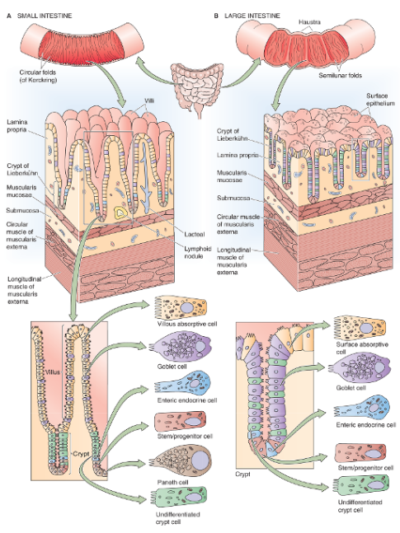

Slide 4
Structural and Functional Differences between the Small Intestine and the Large Intestine

Slide 5
DESCRIPTION | SMALL INTESTINE | LARGE INTESTINE
LENGTH | 6 m | 2.4 m
AREA OF APICAL CELL MEMBRANE | ~200 m² | ~25 m²
FOLDS | YES | YES
VILLI | YES | NO

Slide 6
DESCRIPTION | SMALL INTESTINE | LARGE INTESTINE
Crypts or Glands | Yes | Yes
Microvilli | _{Yes} | _{No}
Nutrient Absorption | Yes | No
Active Na+ Absorption | YES | Yes
Active K+ Secretion | No | Yes

Slide 7
Fluid Balance in the Gastrointestinal (GI) tract

Slide 8
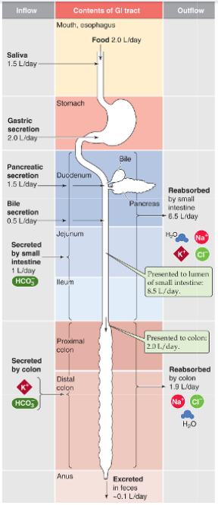

Slide 9
FLUID MOVEMENT IN THE SMALL INTESTINE | VOLUME
FLUID CONTENT OF AVERAGE DIET | ~ 1.5-2.5 L/day
SALIVA | ~ 1.5 L/day
GASTRIC SECRETION | ~ 2.0 L/day
PANCREATIC SECRETION | ~ 1.5 L/day
BILE SECRETION | ~ 0.5 L/day
SMALL INTESTINE SECRETION | ~ 1.0 L/day
TOTAL LOAD PRESENTED TO SI LUMEN | ~ 8.5 L/day
REABSORBED BY SMALL INTESTINE | ~ 6.5 L/day
ILEOCECAL FLOW | ~ 2.0 L/day
MAXIMAL SI WATER ABSORPTIVE CAPACITY | 15 - 20

Slide 10
ABSORPTION BY SMALL INTESTINE
ABSORBS NET AMOUNTS OF:-
WATER, Na⁺, Cl⁻, & K⁺
SECRETES HCO⁻₃
Na⁺ ABSORPTION IS ~ 600 mEq/d
Na/K - ATPase
[Na⁺]_{i ~} 15 mM
DRIVING FORCE
Na⁺ CHANNELS
Na⁺-COUPLED TRANSPORTERS
Na/GLUCOSE Cotransporters
Na-H EXCHANGE

Slide 11
ABSORPTION BY LARGE INTESTINE
ABSORBS NET AMOUNTS OF:-
WATER, Na⁺, Cl⁻
SECRETES K⁺ & HCO⁻₃

Slide 12
INTESTINAL FLUID MOVEMENT
ALWAYS COUPLED TO ACTIVE SOLUTE MOVEMENT
WATER MOVEMENT OCCURS PREDOMINANTLY BY PARACELLULAR ROUTE
SOLUTE MOVEMENT IS THE DRIVING FORCE FOR FLUID MOVEMENT

Slide 13
SMALL INTESTINAL EPITHELIAL CELLS (ENTEROCYTES)
Essential for life
D & A CAPACITY
PHYSIOLOGICAL RESERVE
Remove jejunal/Ileal short segments
Compensatory HYPERTROPHY
Compensatory HYPERPLASIA

Slide 14
DIARRHEA
Common medical problem
Defined as a SYMPTOM
Increase in the number of bowel movements
Decrease in stool consistency
Defined as a SIGN
Increase in stool volume of more than 0.2 L/24 hrs
Dietary nutrient that is not absorbed
OSMOTIC DIARRHEA
Lactase deficiency

Slide 15
SECRETORY DIARRHEA
Endogenous secretions of fluid & electrolytes
Infections with Escherichia coli
E.coli cholera toxin
Bacterial enterotoxins
Increases [cAMP]i, [cGMP]i or [Ca²⁺]i
Intestine secretes massive amounts of fluid & electrolytes
Second messengers DO NOT alter the function of nutrient-coupled Na⁺ absorption

Slide 16
ORAL REHYDRATION SOLUTION (ORS)
Applied physiology
Therapeutic use of ORS
Diarrheal illnesses
Bacterial exotoxins
Induce fluid & electrolyte secretion
BACTERIAL ENTEROTOXINS
Massive toxin-induced fluid secretion
Nutrient-coupled Na⁺ absorption are normal

Slide 17
ORAL REHYDRATION SOLUTION (ORS)
Therapeutically increase [glucose], [Na⁺], [AAs]
ORS contains glucose, Na⁺, CI⁻, & HCO⁻₃
Extremely effective
Enhancing fluid & electrolyte absorption

Slide 18
ORAL REHYDRATION SOLUTION (ORS)
Reverse the dehydration & metabolic acidosis caused by severe diarrhea
Primary cause of morbidity & mortality
Especially in children younger than 5 yrs
Physiology of glucose & AAs-stimulated Na⁺ absorption

Slide 19
SHORT GUT SYNDROME
> 50% SI resected/bypassed
Nutrient Malabsorption
Malnutrition
Wasting
Arthritis
Hypocalcemia
Liver fatty infiltration
Cirrhosis

Slide 20
TERMINAL ILEUM RESECTION
No EHC of BAs
Deficient fat absorption
Colonic BAs activate CI⁻ secretion
Diarrhea

Slide 21
STEATORRHEA
Fatty, bulky, watery stools
Impaired D & A of fats
Mostly due to lipase deficiency
Lack of alkaline pancreatic secretion
Hypersecretion of HCI
Inhibits pancreatic lipase

Slide 22
STEATORRHEA
Defective EHC of BAs
>50% of ingested fat appears in feces
Severe ADEK malabsorption
Terminal ileum resection

Slide 23
MALABSORPTION SYNDROME
Autoimmune disease
CELIAC DISEASE
Genetically predisposed
GLUTEN PROTEIN
Wheat, rye, barley, oats

Slide 24
MALABSORPTION SYNDROME
Intestinal T cells
Mount an inappropriate immune response
Damage IECs
Loss of villi
Flattening of the mucosa
Impaired D & A CHOs, AAs, Fats, ADEK

Slide 25
MALABSORPTION SYNDROME
Hypoproteinemia
Edema
Omit gluten from the diet

Slide 26
CONTROL OF FOOD INTAKE
Complex regulation of feeding behavior
CCK inhibit further food intake
SATIETY FACTOR
ANOREXIN

Slide 27
GHRELIN
Stomach, pancreas, adrenal glands
Levels increase preprandially
Levels decrease postprandially
Stimulate food intake
OREXIN

Slide 28
GHRELIN
Increase synthesis & release of central orexins
Neuropeptide Y
Cannabinoids
Suppress the ability of leptin to stimulate release of anorexigenic factors

Slide 29
LEPTIN
Adipose tissue
Decrease food intake (ANOREXIN)
Stimulate metabolic rate
May inhibit secretion of ghrelin (effect lost in obesity)
Can develop resistance to the effects of leptin (leading to obesity)

Slide 30
HYPOTHALAMUS ANOREXIGENIC FACTORS
PRO-OPIOMELANOCORTIN (POMC)
COCAINE-AMPHETAMINE-REGULATED TRANSCRIPT (CART)
NEUROTENSIN
CORTICOTROPIN-RELEASING HORMONE (CRH)

Slide 31
HYPOTHALAMUS OREXIGENIC FACTORS
NEUROPEPTIDE Y
CANNABINOIDS

Slide 32
OBESITY
Most expensive nutritional problem
Globally Overweight = underfed
BODY MASS INDEX (BMI)
Indicator of body fat
Body weight (kg)/square of height (m)
>25 abnormal
25-30 overweight
>30 obese

Slide 33
COMPLICATIONS OF OBESITY
Accelerated atherosclerosis
Gallbladder disease
Type 2 diabetes
Many types of cancer
Excess of energy intake in food over energy expenditure
Decreased physical activity
Decreased sensitivity to leptin

Slide 34
PARENTERAL NUTRITION

Slide 35
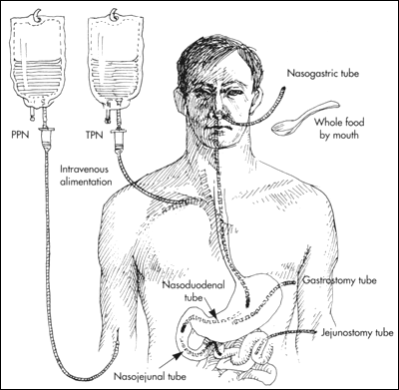

Slide 36
PARENTERAL NUTRITION (DEFINITION)
Components are in elemental or “pre-digested” form
Protein as amino acids
CHO as dextrose
Fat as lipid emulsion
Electrolytes, vitamins and minerals

Slide 37
PARENTERAL NUTRITION (PN) DEFINITION
Delivery of nutrients intravenously, via the bloodstream.
Central Parenteral Nutrition: often called Total Parenteral Nutrition (TPN); delivered into a central vein
Peripheral Parenteral Nutrition (PPN): delivered into a smaller or peripheral vein

Slide 38
Common Indications for PN
Severe acute pancreatitis
Severe short bowel syndrome
Mesenteric ischemia
Paralytic ileus
Small bowel obstruction

Slide 39
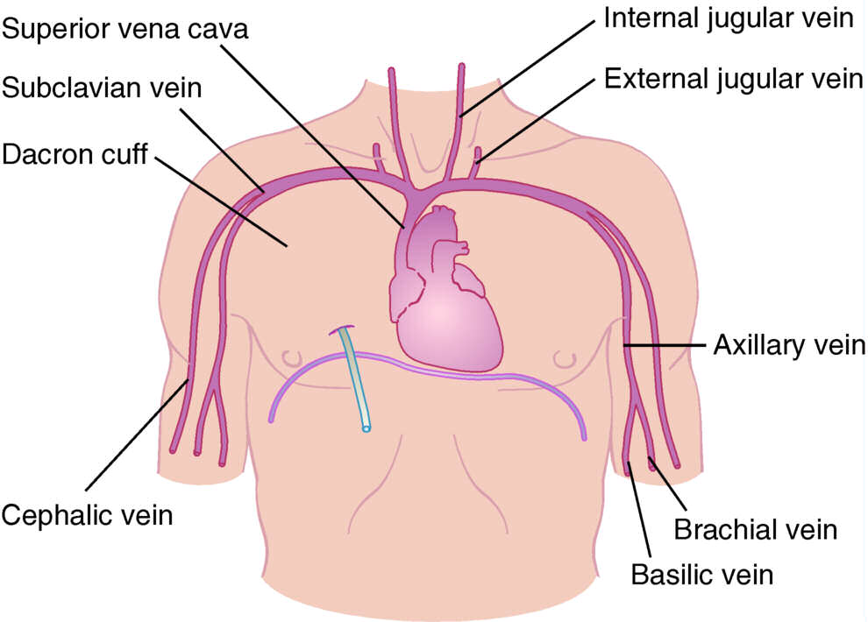

Slide 40
HYPERALIMENTATION
Parenteral Nutrition-delivery/introduction of nutrients, including amino acids, lipids, carbohydrates, vitamins, minerals and water, through a venous access device (VAD) directly into the intravascular fluid required for metabolic functioning of the body.

Slide 41
CLINICAL INDICATIONS
Paralytic Ileus
Intestinal obstruction
Acute pancreatitis
Malabsorption/malnutrition
Persistent vomiting/ Severe diarrhea
Fistula
Inflammatory bowel disease
Severe anorexia nervosa

Slide 42
THANK YOU

