Slide 1
Acid-Base Balance

Slide 2
Acid-Base Balance
Normal pH:
Arterial blood - 7.4
Venous blood, interstitial fluid - 7.35
Intracellular fluid - 7.0
Alkalosis (alkalemia) – arterial blood pH >7.45
Acidosis (acidemia) – arterial blood pH <7.35

Slide 3
Sources of Hydrogen Ions
Cellular metabolism:
Breakdown of phosphorus containing proteins - phosphoric acid
Anaerobic respiration - lactic acid
Fat metabolism - organic acids, ketones
Carbon dioxide – release of hydrogen ions by bicarbonate

Slide 4
Hydrogen Ion Regulation
Sequentially by:
Chemical buffer systems (within seconds)
The respiratory center in brain stem (within minutes)
Renal mechanisms (require hours to days)

Slide 5
Chemical Buffer Systems
Strong acids – complete dissociation of H⁺ in water
Weak acids – partial dissociation in water (prevent pH changes)
Strong bases – easy dissociation in water, tie up H⁺
Weak bases – accept H⁺ more slowly (HCO₃¯, NH₃)

Slide 6
Chemical Buffer Systems
Three major systems:
Bicarbonate buffer system
Phosphate buffer system
Protein buffer system
Any drifts in pH are resisted by the entire chemical buffering system

Slide 7
Bicarbonate Buffer System
A mixture of carbonic acid (H₂CO₃) and its salt, sodium bicarbonate (NaHCO₃)
If strong acid is added:
Hydrogen ions released combine with bicarbonate ions and form carbonic acid (a weak acid)
HCl + NaHCO₃ ↔ H₂CO₃ + NaCl
The pH of the solution decreases only slightly

Slide 8
Bicarbonate Buffer System
If strong base is added:
It reacts with carbonic acid to form sodium bicarbonate (a weak base)
NaOH + H₂CO₃ ↔ NaHCO₃ + H₂O
The pH of the solution rises only slightly
This system is the only important ECF buffer

Slide 9
Phosphate Buffer System
Nearly identical to bicarbonate system
Components:
Sodium salts of dihydrogen phosphate (H₂PO₄¯), a weak acid
Monohydrogen phosphate (HPO₄²¯), a weak base
Effective buffer in urine, intracellular fluid

Slide 10
Protein Buffer System
Most plentiful, powerful buffers
Some amino acids have:
Free organic acid groups (weak acids)
Groups that act as weak bases (amino groups)
Amphoteric molecules are protein molecules that can function as both a weak acid and a weak base

Slide 11
Physiological Buffer Systems
Involves the respiratory system
There is a reversible equilibrium between:
Dissolved carbon dioxide and water
Carbonic acid and the hydrogen and bicarbonate ions
CO₂ + H₂O ↔ H₂CO₃ ↔ H⁺ + HCO₃¯

Slide 12
Physiological Buffer Systems
When hypercapnia (rising plasma H⁺):
Deeper, rapid breathing expels more carbon dioxide
Hydrogen ion concentration is reduced
Alkalosis causes slower, shallow breathing, causing H⁺ to increase
Respiratory system impairment causes acid-base imbalance (respiratory acidosis, respiratory alkalosis)

Slide 13
Renal Mechanisms of Acid-Base Balance
Chemical buffers tie up excess acids or bases (cannot eliminate them)
Lungs eliminate carbonic acid by eliminating carbon dioxide
Only kidneys can rid the body of metabolic acids
The ultimate acid-base regulatory organs are kidneys

Slide 14
Renal Mechanisms of Acid-Base Balance
Most important renal mechanisms are:
Conserving (reabsorbing) or generating new bicarbonate ions
Excreting bicarbonate ions
Losing a bicarbonate ion is same as gaining hydrogen ion
Reabsorbing a bicarbonate ion is same as losing hydrogen ion

Slide 15
Renal Mechanisms of Acid-Base Balance
Hydrogen ion secretion occurs:
PCT
Type A intercalated cells
Hydrogen ions produced from dissociation of carbonic acid

Slide 16
Reabsorption of Bicarbonate
CO₂ + H₂O ↔ H₂CO₃ ↔ H⁺ + HCO₃¯
For each hydrogen ion secreted, a sodium ion and a bicarbonate ion are reabsorbed by PCT cells

Slide 17
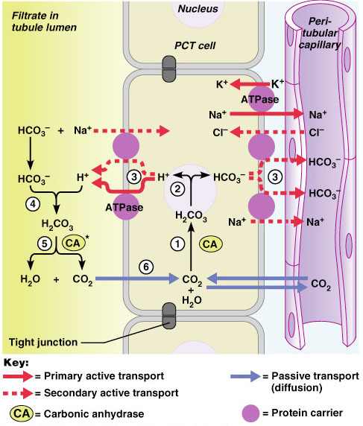
Reabsorption of Bicarbonate
Carbonic acid formed in filtrate dissociates to release carbon dioxide and water
Carbon dioxide then diffuses into tubule cells, where it acts to trigger further hydrogen ion secretion
Figure 26.12

Slide 18
Generating New Bicarbonate Ions
Two mechanisms (by type A intercalated cells):
Hydrogen ion excretion
Ammonium ion excretion

Slide 19
Hydrogen Ion Excretion
Excreted hydrogen ions binds to urinary buffer (phosphate buffer system)
Intercalated cells actively secrete hydrogen ions
The bicarbonate generated moves into the peritubular capillary blood

Slide 20
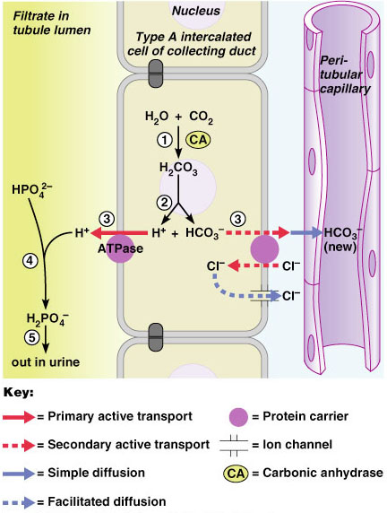
Hydrogen Ion Excretion
In response to acidosis:
Kidneys generate bicarbonate ions and add them to blood
An equal amount of hydrogen ions are added to urine
Figure 26.13

Slide 21
Ammonium Ion Excretion
Uses ammonium ions produced by glutamine metabolism (PCT)
Each glutamine metabolized →two ammonium ions + two bicarbonate ions
Bicarbonate moves to blood
Ammonium ions excreted in urine

Slide 22
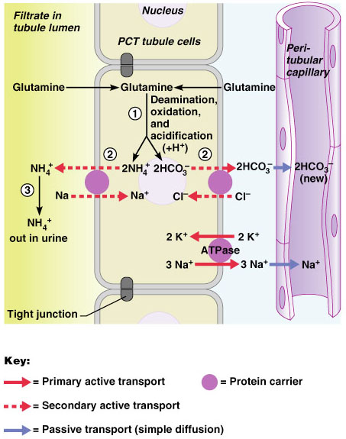
Ammonium Ion Excretion
Figure 26.14

Slide 23
Bicarbonate Ion Secretion
In metabolic alkalosis
Type B intercalated cells:
Bicarbonate ion secretion
Reclaim hydrogen ions (acidification)
Opposite of bicarbonate ion reabsorption process

Slide 24
Respiratory Acidosis and Alkalosis
Result from failure of respiratory system to balance pH
P_{CO2} is single most important indicator of respiratory inadequacy
P_{CO2} levels
Normal P_{CO2} (35 - 45 mmHg)
>45 mmHg (respiratory acidosis)
<35 mmHg (respiratory alkalosis)

Slide 25
Respiratory Acidosis and Alkalosis
Respiratory acidosis is most common cause of acid-base imbalance
Person breathes shallowly
Gas exchange hampered by lung diseases
Respiratory alkalosis is a common result of hyperventilation

Slide 26
Metabolic Acidosis
Metabolic acid-base imbalance - bicarbonate ion levels above or below normal (22-26 mEq/L)
Metabolic acidosis is second most common cause of acid-base imbalance
Ingestion, excessive formation of acids
Excessive loss of bicarbonate ions

Slide 27
Metabolic Alkalosis
Causes:
Vomiting (gastric acid)
Intake of excess base (antacids)
Constipation (excessive bicarbonate reabsorption)

Slide 28
Respiratory and Renal Compensations
Acid-base imbalance due to inadequacy of physiological buffer system is compensated by other system
Respiratory system will attempt to correct metabolic acid-base imbalances
Kidneys attempt correct respiratory acid-base imbalances

Slide 29
Respiratory Compensation
In metabolic acidosis:
Elevated rate, depth of breathing
Low blood pH, bicarbonate levels
As carbon dioxide is eliminated, P_{CO2} falls

Slide 30
Respiratory Compensation
In metabolic alkalosis:
Slow, shallow breathing
High blood pH, bicarbonate
Rising P_{CO2}

Slide 31
Renal Compensation
In respiratory acidosis:
High P_{CO2} (cause of acidosis)
High bicarbonate levels (kidneys retaining bicarbonate)

Slide 32
Renal Compensation
In repiratory alkalosis:
Low P_{CO2}
Low bicarbonate (kidneys eliminate bicarbonate)
PLAY
InterActive Physiology®: Fluid, Electrolyte, and Acid/Base Balance: Acid/Base Homeostasis

