Slide 1
Neuromyogenic control of digestive system
Dr. A W Muriithi
MBChB, BPharm, BDS
February 2018

Slide 2
Characteristics of gut wall
Serosa/Adventitia
Longitudinal muscle layer
  Myenteric plexus (Auerbach’s)
Circular muscle layer
Sub-mucosa
  Sub-mucosal plexus (Meissner’s)
  Muscularis mucosae
Mucosa
          LUMEN
Gut associated lymphoid tissue (GALT)
  Peyer’s patches

Slide 3
I’ve come to believe there are only two things you need in any new teaching situation to succeed—humility and inquiry.
Lisa Delpit

Slide 4
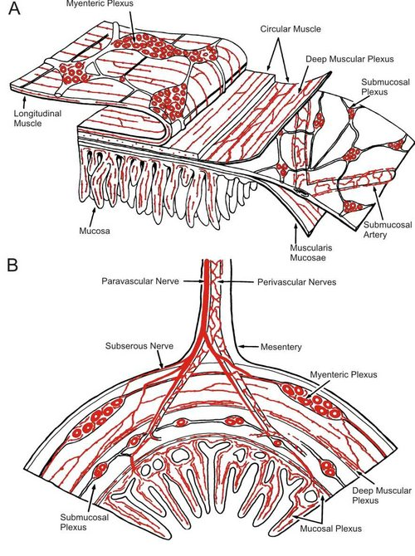

Slide 5
Enteric Nervous System
3rd Part of the autonomic nervous system
ENS = an independent nervous system
  Controls movement, secretion and blood flow
  Sympathetic and parasympathetic systems can and do modulate activity of the ENS
  = PLEXUS OF GANGLIA AND NERVES
Contains 1 x 10⁸ (100 million) neurons
  Sensory, Motor, Secretor neurons and Interneurons

Slide 6
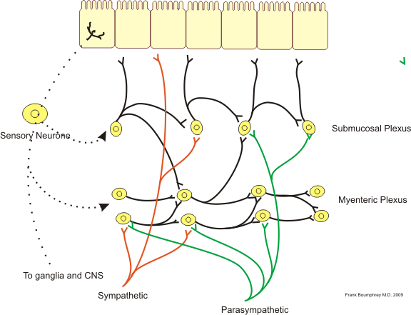
Neural connections

Slide 7
Myenteric plexus
Location
  Gut wall; between longitudinal and circular muscle layers
Functions
  Motility (movement)
      Of gut; propulsion of luminal contents
  Integration of impulses
  Mixing of luminal contents
  Facilitates blood and lymph flow

Slide 8
Sub-mucosal plexus
Location
  Deep in sub-mucosa
Functions
  Sensory-sampling of luminal contents
  Secretion-digestive enzymes, water, mucous, bicarbonate, bile, gut hormones/peptides
  Blood flow
  Integration

Slide 9
Enteric Neurotransmitters, peptides
Hormones are released from endocrine cells
Paracrine agonists are released from cells in the vicinity of target cells
Neurocrine substances are released from enteric nerves
  These cells that release these chemicals all reside within the gut wall.

Slide 10
Gut peptides
  Examples include:
Acetylcholine, nor-epinephrine, ATP, serotonin (5HTP), dopamine, cholecystokinin (CCK), substance P, vasoactive intestinal polypeptide (VIP), somatostatin , leu-enkephalin, met-enkephalin, bombesin
  Are inhibitory or excitatory in nature

Slide 11
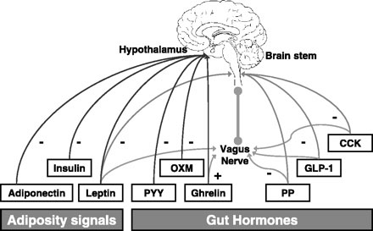
ENS-CNS dialogue brain/gut axis

Slide 13
A man too busy to take care of his health is like a mechanic too busy to take care of his tools
Spanish proverb

Slide 14
Parasympathetic influence
Main nerve is the vagus (up to transverse colon)
Pelvic nerves (rest of colon, rectum and anus)
Most fibres are pre-ganglionic and predominantly cholinergic
Tend to terminate on the ganglion cells of intramural plexuses

Slide 15
Parasympathetic influence (2)
Excitation of parasympathetic system stimulates motor and sensory activities of the gastrointestinal tract

Slide 16
Sympathetic influence
Most fibres are post-ganglionic from pre-vertebral and para-vertebral ganglia
Celiac, superior and inferior mesenteric, hypogastric plexuses innervate the gut
Fibres terminate in intramural plexuses but
  Some fibres may directly innervate blood vessels of the g i tract
  Others innervate glandular structures in the wall

Slide 17
Sympathetic influence (2)
Stimulation of sympathetic n s inhibits motor activity of muscularis externa, but stimulates contraction of muscularis mucosae and certain sphincters

Slide 18
Afferent sensory nerves from gut
Part of enteric nervous system
  Involved in local reflexes and other intrinsic reflexes
⅔ of all vagal afferent fibres are from the stomach. Carry sensation to the higher centres of the c n s
Sight, smell, taste, imagination, feel, memory – all influence activity in the digestive system or your perception and appreciation of food and eating

Slide 19
Gastrointestinal reflexes
Intrinsic
  Short (local)
    From mucosa to myenteric plexus
    From myenteric plexus to muscle or gland
      i.e. within the gut wall and in the same region
      Example: peristaltic reflex
  Long (from one region to another)
    From duodenum to pylorus: duodenogastric reflex
    Along wall of segment of ileum: ileo-ileal reflex
Extrinsic
  Involve sympathetic and parasympathetic nerves
  Take shorter time (response is more rapid)
  Gastrocolic, duodenogastric,

Slide 20
musculature of the gut
Smooth muscle: Acts as a syncitium – cells are well-coupled electrically
Responsible for mechanical digestion and propulsion
Consists of a thin outer longitudinal layer and a thick, densely innervated circular layer
Gap junctions are abundant in circular and rare in longitudinal muscle layer
Resting membrane potential is smaller than that of skeletal muscle (-40 to -80 mV). It is generated by the electrogenic Na⁺, K⁺-ATPase

Slide 21
musculature of the gut (2)
The resting membrane potential varies over time. Oscillations produce slow waves known as BER Basic Electrical Rhythm
The BER in man is
  3 min⁻¹ - in stomach antrum
  12 min ⁻¹ - in duodenum
  8 min ⁻¹ - in ileum
  6 – 10 min ⁻¹ - in colon

Slide 22
rhythmicity of gut contractions
  = Due to pacemaker cells known as
  - Interstitial Cells of Cajal (ICC) (myofibroblasts)
ICC cells are equivalent to the Purkinje fibers of the heart.
They make contact with each other and with muscle cells and nerve terminals.
They function as the pacemakers in GI muscles by initiating rhythmic electrical activity (Vanderwinden 1999).

Slide 23
Importance of ICC cells
Loss of, or defects in, ICC cells can result in abnormal gut motility:
gastric distension, abnormal small bowel motility, inflammatory bowel disease, chronic idiopathic intestinal pseudo-obstruction (CIP),
GI stromal tumors and multiple GI autonomic tumors,
achalasia, intestinal obstruction with hypertrophy in the small intestine,
Hirschsprung’s disease, juvenile and adult intestinal pseudo-obstruction,
slow transit constipation, anorectal malformations and Chagas disease

Slide 24
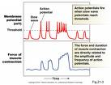

Slide 25
Motor activity of the gut
Contraction of smooth muscle
  Synchronized contraction and relaxation of muscle
  Amplitude and frequency of slow waves are altered by the activity of extrinsic, intrinsic nerves and circulating hormones
  Sympathetic – decreases amplitude / abolishes slow waves
  Parasympathetic – increases amplitude

Slide 26
Motor activity of the gut (2)
  When threshold is achieved by the peak of a slow wave, action potentials are fired (the entry of Ca²⁺ initiates contraction)
  The greater the number of action potentials occurring at the peak of the slow wave, the more intense the contraction of smooth muscle

Slide 27
Proper Preparation Prevents Poor Performance
The athletes five P mantra

Slide 28
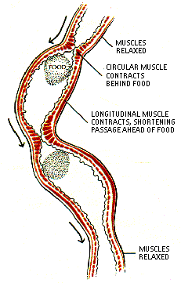
PERISTALSIS

Slide 29
Peristalsis
= progressive contraction of successive sections of circular smooth muscle – [gut + gland ducts]
  One way movement. Gut is polarized
    Distention of wall by bolus causes reflex relaxation ahead of bolus (stretch releases of serotonin – activates sensory neurons – activates myenteric nerves).
    Cholinergic nerves behind the bolus release substance P and Acetylcholine and hence cause muscle contraction. Cholinergic nerves distal to bolus activate neurons that secrete NO, VIP and ATP producing relaxation in front of bolus
LAW OF THE GUT
= a reflex. 1 stimulus, 2 responses

Slide 30
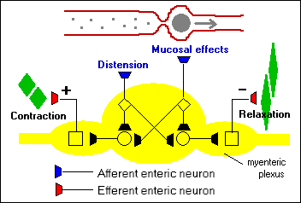
PERISTALSIS

Slide 31
The peristaltic reflex
The peristaltic reflex can be evoked by stroking the intestine or by circumferential stretch
The reflex consists of two components:
  descending relaxation caudal and
  ascending contraction oral to the site of stimulus

Slide 32
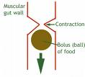

Slide 33
Types of contraction
Two basic types: tonic and rhythmic phasic contractions
  Propulsive, segmentation, tonic contractions
  Pendulous movements
Peristaltic waves travel at rates of 2 – 25 cm/s

Slide 34
Types of contraction (2)
Migratory Motor Complex - MMC
  Starts from stomach - travels distally to distal ileum
  Occurs every 90 minutes
  Travels at a rate of 5 cm/min
  Occurs during fasting (inter-digestive period)
  Stops immediately on the ingestion of food
  ‘Mass movement’ - only in colon

Slide 35
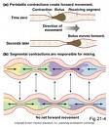

Slide 36
I've learned that people will forget what you said, people will forget what you did, but people will never forget how you made them feel.
Maya Angelou

Slide 37
Further reading
Enteric nervous system
John B. Furness (2007), Scholarpedia, 2(10):4064.
Teaching basic gastrointestinal physiology using classic papers by Dr. Walter B. Cannon
Paul P. Bertrand and Rebecca L. Bertrand
  Adv Physiol Educ 31: 136–139, 2007;
  doi:10.1152/advan.00112.2006.

Slide 38
Further reading
The autonomic nervous system. Aidan O’Donnell and Brigid Glasgow
The New Zealand Medical Student Journal Number 13 July 2011 P 11-13
Glutamine Metabolism: Nutritional and Clinical Significance Malcolm Watford J. Nutr. 131: 2523S–2524S, 2001.

Slide 39
Further reading
Smooth muscle contraction and relaxation R. Clinton Webb Advan in Physiol Edu 27:201-206, 2003.

Slide 40
Thank you

