Slide 1
Motility of the gut
Dr. A W Muriithi
MBChB, BPharm, BDS
February 2018

Slide 2
Oral cavity
Mastication (reflex behaviour) = semi-reflex
  Skeletal muscle: Teeth, tongue, cheeks
  Proprioceptive receptors in pdl and muscles
Main functions:
  Mechanical digestion
  Mixing of food with saliva (wetting, chemical digestion)
  Lubrication + moistening , formation of bolus
Rhythmic jaw movements controlled by brainstem centres

Slide 3
Swallowing (deglutition)
  Reflexly coordinated (swallowing centres)
  Three phases:
    Oral - voluntary
    Pharyngeal
    Oesophageal
  Temporary interruption of breathing
  Rapid contraction and relaxation of skeletal muscles; thus necessity for reflex coordination
  Infantile swallow

Slide 4
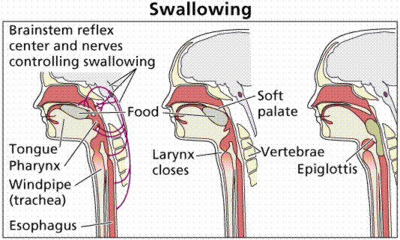

Slide 5
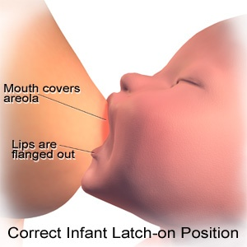
Suckling

Slide 6
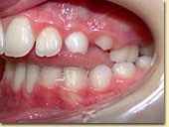
Tongue thrusting

Slide 7
Oesophagus - motility
Successive contraction of constrictor muscles
Gravity assists when in an upright position (bolus traverses in less than 10 s [4 cm/s])
Skeletal and smooth muscle
Lower oesophageal sphincter - LES
  Oesophagus passes through diaphragm
  Enters stomach at an angle
Achalasia – failure of muscle to relax
Gastro-oesophageal reflux diseases (GERDs)

Slide 8
Heri nguo ziraruke kuliko akili

Slide 9
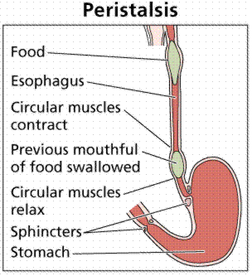

Slide 10
Gastric motility
Three layers of muscle in wall
  Surface area increased by: Rugae, plica circulares
Functions as a ‘blender’ (pylorus is tightly closed)
  Mechanical digestion
  Mixing of contents with gastric juice (protein digestion)
  Contractions move from fundus (weak) to pylorus (strong)
  Receptive relaxation of stomach accommodates 1 ½ litre without increase in pressure – mediated by 10th c nerve
Gastric emptying: critical to g i function
  Fat strongly inhibits emptying of the stomach
  Acids, amino acids also inhibit emptying

Slide 11
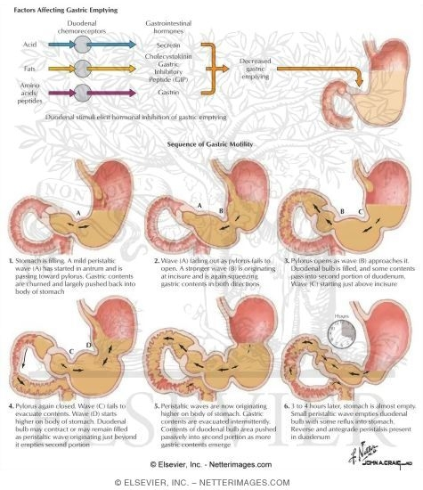

Slide 12
Small intestine
Chyme takes 2 – 4 hours to traverse the small intestine (5 m in length)
Rhythmic segmental contractions important for mixing of luminal contents
The BER of the small intestine is independent of extrinsic innervation (NB: ANS practical)
Agents of analgesia and anaesthesia will affect motility- pre-operative preparations
Musculares mucosae contracts irregularly – allows mucosa to interact with fresh chyme
Intestinal villi also contract (change length) – assist in lymph flow

Slide 13
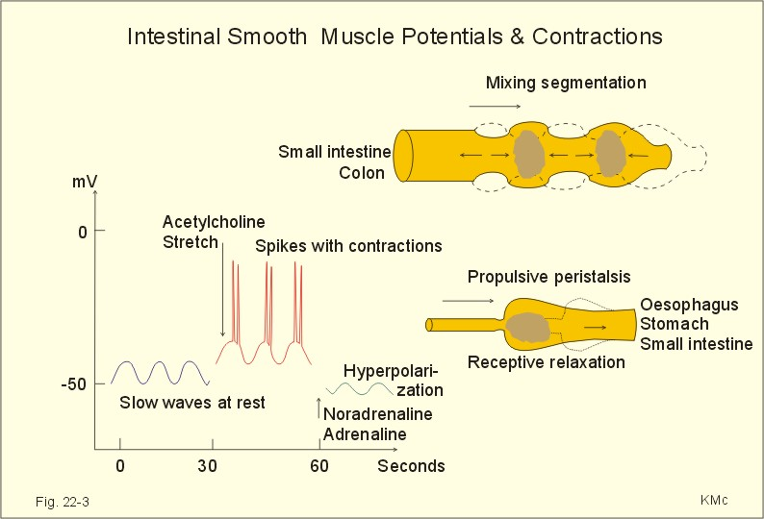

Slide 14
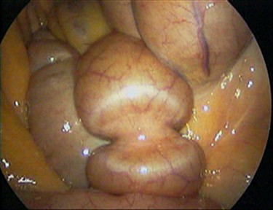

Slide 15
Taabu huisha lakini ujinga hudumu

Slide 16
Colon
Motility of colon:
  Allows for final absorption of salts and water
  Permits orderly evacuation of faeces.
Colon receives 500 – 1500 ml chyme per day
Contents progress slowly: 5-10 cm/hr
Mixing here is similar to a kneading process
‘Mass movement’ – evacuation of content
  Taenia coli
  Hirschsprung’s disease (Congenital megacolon)

Slide 17
Reflexes in the colon
Gastro-colic reflex
  Increase in frequency of mass movements and increased motility of proximal and distal colon in response to meal entering the stomach
Colono-colonic reflex
  Distension of one part of the colon resulting in the reflex relaxation of other parts

Slide 18
Rectum
Defecation: requires co-ordination of rectum and anal canal - complex behaviour involves reflex and voluntary actions
Integrating centre for defecation reflex lies in sacral spinal cord – failure: involuntary voiding
  Modulation of the process is by higher centres
Normally rectum is empty. It has more active segmental contractions than the sigmoid colon
  Rectal contents tend to move back into colon
Filling of rectum causes the urge to defecate:
  Reflex relaxation of internal anal sphincter
  Reflex contraction of external anal sphincter

Slide 19
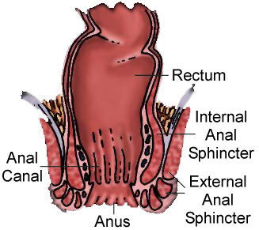

Slide 20
Defecation
Reflex reactions of sphincters to distension are transient. When defecation is postponed, then the sphincters regain normal tone and the urge temporarily subsides
At appropriate circumstances, voluntary relaxation of the external anal sphincter allows defecation to proceed
Efferent pathways are cholinergic parasympathetic fibres in pelvic nerves

Slide 21
Steps involved
1. External anal sphincter is voluntarily held in relaxed state
2. Pressure in abdomen is elevated to aid in expulsion of faeces
3. Deep breath moves diaphragm downwards
4. Glottis is closed.
5. Contraction of respiratory muscles elevates intra-thoracic and intra-abdominal pressures.
  Valsalva’s maneuver
6. Contraction of abdominal wall further increases intra-abdominal pressure. Pelvic floor is lowered
7.Faeces is forced through the relaxed sphincters.

Slide 22
Proper Preparation Prevents Poor Performance
  The athletes five P mantra

Slide 23
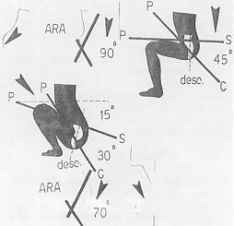

Slide 24
Clinical application
Constipation
  Role of fibre, water in diet
  Laxatives, exercise
Overfilling of intestines and colon leads to
  Putrefaction of luminal contents
  Atony of smooth muscle

Slide 25
Clinical application (2)
Abdominal fat (hard, difficult to get rid of)
Waist-hip ratio - measure of obesity
Rectal temperature (core)
Administration of drugs - par rectum

Slide 26
‘You can get help from teachers, but you are going to have to learn a lot by yourself, sitting alone in a room.’
Dr. Seuss
American writer and cartoonist (1904-1991)

Slide 27
THANK YOU
THANK YOU

