Slide 1
HMP200/UPC203/VMP200 NOV/DEC/2016
GASTROINTESTINAL SECRETIONS

Slide 2
REFERENCES
GANONG’S REVIEW OF MEDICAL PHYSIOLOGY, 25 Edition, 2016, McGraw Hill Education Lange.
BORON & BOULPAEP MEDICAL PHYSIOLOGY A Cellular & Molecular Approach. 2nd Edition 2012 by Saunders, Elsevier.
GUYTON & HALL TEXTBOOK OF MEDICAL PHYSIOLOGY A south Asian Edition. Vaz, Kurpad & Raj. 2013 Elsevier.
LECTURER: Dr. Paul Mungai Mbugua (PMM)
Department of Medical Physiology
College of Health Sciences
UNIVERSITY OF NAIROBI

Slide 3
HMP200/UPC203/VMP200/NOV/DEC/2016
GASTROINTESTINAL SECRETIONS

Slide 4
PARTS of the Gastrointestinal (GI) Tract
MOUTH
ESOPHAGUS
STOMACH
DUODENUM
JEJUNUM
ILEUM
CECUM
COLON
RECTUM
ANUS
PANCREAS
LIVER

Slide 5
GASTROINTESTINAL (GI) SECRETIONS
SALIVA
STOMACH
PANCREAS
LIVER

Slide 6
GI SECRETIONS
FUNCTIONS
COMPOSITION
ORIGIN OF EACH COMPONENT
MECHANISM OF SECRETION
CONTROL/REGULATION

Slide 7
SALIVA

Slide 8
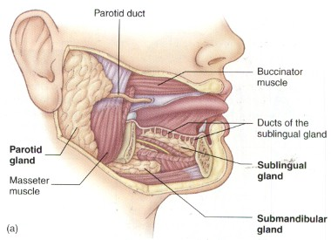

Slide 9
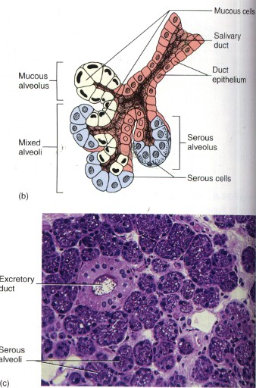

Slide 10
SECRETORY SALIVARY CELLS
SEROUS SALIVARY ACINAR CELLS
PROTEINACEOUS COMPONENTS
MUCOUS SALIVARY ACINAR CELLS
MUCINOUS COMPONENTS

Slide 11
SALIVARY GLANDS
PAROTID glands-fairly watery saliva – serous – low glycoprotein content but enriched in α-amylase
SUBMANDIBULAR glands-viscid saliva – seromucous secretion
SUBLINGUAL glands-viscid saliva – seromucous secretion
Labial, Buccal, & Palatal glands in the lips, cheeks, & palate – a mucous secretion – enriched in mucin (glycoprotein)
Lingual glands in the tongue – a mucous secretion

Slide 12
SALIVARY GLANDS
Extremely active - ~90% three major salivary glands
~10% minor salivary glands
Blood vessels
Basal rate ~0.5 mL per min (K⁺- rich, hypotonic)
Stimulated – 10-fold increase over the basal rate
1000-1500 mL per day
Oral pH at about 7.0
Always hypotonic
Salivary [K⁺] always greater than plasma [K⁺]

Slide 13
ORGANIC & INORGANIC COMPONENTS OF SALIVA
Sodium, Chloride, Potassium, Bicarbonate, Calcium, Phosphate, Thiocyanate
Alpha-amylase, Lingual lipase, Lysozymes
Proline-Rich Proteins, Mucin Glycoproteins
Immunoglobulin A

Slide 14
HUMAN SALIVA CONTAINS SMALL AMOUNTS OF:-
LIPASE
NUCLEASES
PEROXIDASES
LACTOFERRIN
SECRETORY IgA
GROWTH FACTORS
REGULATORY PEPTIDE
VASOACTIVE PROTEASES - Kallikrein & Renin

Slide 15
PROLINE-RICH SALIVARY PROTEINS
Abundant in parotid & submandibular saliva
Antimicrobial
Neutralize dietary tannins
Lubricate ingested foods
Enhance tooth integrity

Slide 16
SALIVARY ALPHA (α) AMYLASE
Major constituent of saliva
Digest starch
Not essential for effective CHO digestion & absorption
Pancreatic insufficiency - (dysfunction)
Partially compensate for CHO maldigestion

Slide 17
FUNCTIONS OF SALIVA
Antibacterial, antifungal, antiviral
Digestion of starch & fat
Sense of taste - solvent
Protective coating – soft & hard tissues
Lubrication –oral cavity, speech, mastication, swallowing-FOOD BOLUS
Buffering

Slide 18
FUNCTIONS OF SALIVA
Facilitates swallowing
Keeps mouth moist
Wash away food particles
Aids speech – lips & tongue
Keeps mouth & teeth clean
Antibacterial action (lysozyme & IgA)
Maintain proper oral hygiene
Overall dental integrity

Slide 19
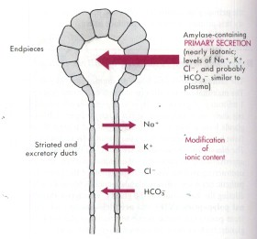

Slide 20
MODIFICATION OF IONIC CONTENT
Na⁺ & CI⁻ extracted/Salivary duct cells absorb Na⁺ & CI⁻
K⁺ & HCO₃⁻ added/salivary duct cells secrete K⁺ & HCO₃⁻
Ducts relatively impermeable to H₂O
Loss of NaCI - hypotonic

Slide 21
SALIVARY DUCT MEMBRANE TRANSPORTERS
SALIVARY
DUCT
TRANSPORTERS

Slide 22
REABSORPTION OF Na⁺
Na⁺ enters salivary duct cells from the lumen through apical epithelial Na⁺ channels (ENaCs)
Basolateral Na⁺-K⁺ pump extrudes Na⁺

Slide 23
REABSORPTION OF CI⁻
CI⁻ enters salivary duct cells from the lumen through apical membrane CI⁻ /HCO₃⁻ exchangers
Apical CI⁻ channels recycle the CI⁻ that is absorbed by CI⁻ /HCO₃⁻ exchangers
CI⁻ exit duct cells through basolateral CI⁻ channels

Slide 24
SECRETION OF HCO₃⁻
Secretion of HCO₃⁻ enters occurs through apical membrane CI⁻ /HCO₃⁻ exchangers
HCO₃⁻ enters duct cells through Na⁺ /HCO₃⁻ cotransporters

Slide 25
SECRETION OF K⁺
Secretion of K⁺ occurs through apical membrane K⁺/H⁺ exchangers
K⁺ enters duct cells through basolateral Na⁺ /K⁺ pump

Slide 26
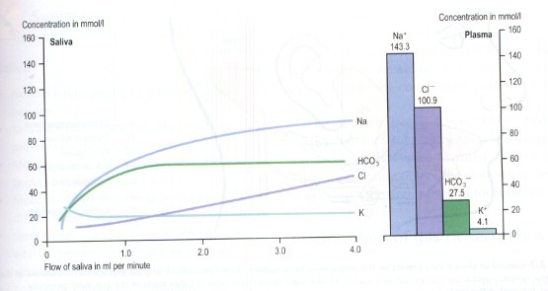

Slide 27
PARASYMPATHETIC NERVOUS SYSTEM
Most important physiological regulator
ACh
Muscarinic M₃
Increase [Ca²⁺]
Taste, tactile stimuli, sight, smell, thinking, nauses
GLANDULAR ATROPHY
Maintaining normal mass of salivary glands

Slide 28
SYMPATHETIC NERVOUS SYSTEM
Noradrenergic stimulation
β -adrenoceptors
Increase [cAMP]i
Slightly modifies the composition
Increases proteinaceous content
Little influence on volume

Slide 30
SJÖGREN'S SYNDROME
chronic & progressive autoimmune disease
Antibodies that react primarily with salivary & lacrimal glands
Immunologic injury to acini
Loss of salivary functions
XEROSTOMIA- dry mouth
KERATOCONJUNCTIVITIS SICCA- dry eyes
Dental carries
Dental fractures
Loss of dentition

Slide 31
THANK YOU

