Slide 1
MOTOR SYSTEMS
Isaac Ochieng

Slide 2
INTRODUCTION
Motor systems produce movement by changing muscle force or muscle length
Motor system plans, coordinates, executes movement.
Once trained, the motor systems execute the motor programs for each of these skills with ease and for the most part automatically.
The ability of humans to carry out skilled movements while still performing cognitive tasks-such as thinking while using tools or speaking while walking requires flexibility and skills.

Slide 3
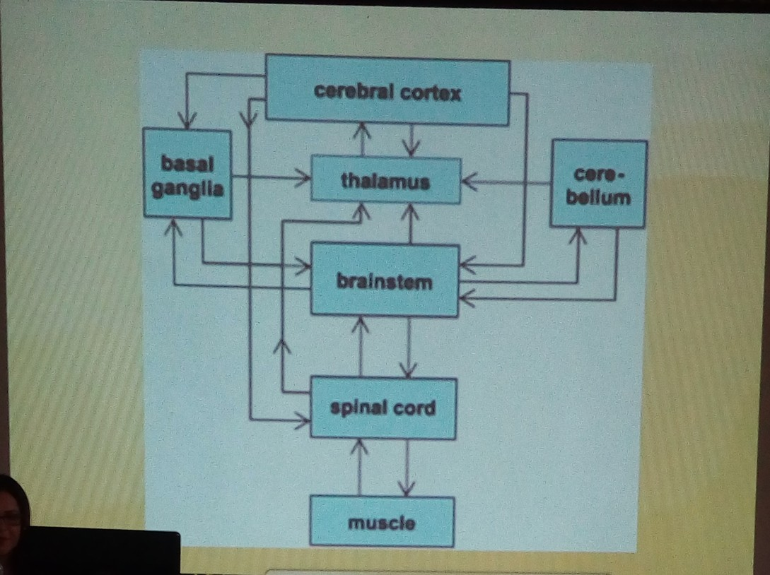

Slide 4
VOLUNTARY MOVEMENTS
Introduction
Spinal and brain stem circuits can organize elementary movement patterns in response to somatosensory, vestibular and other stimuli.
Reflex actions are stereotyped and the repertory of movement is limited.
Motor areas of the cerebral cortex integrate visual, proprioceptive and other information to produce the more elaborate voluntary movements that require planning.

Slide 5
VOLUNTARY MOVEMENTS
Organized around the performance of a purposeful task.
Selection of which joints and body segments will be used for a movement depends on the goal of the movement.
Vary in response to the same stimulus depending on the behavioral tasks.
The effectiveness improves with experience and learning.
Not mere responses to environmental stimuli but can be generated internally.

Slide 6
THE PRIMARY MOTOR CORTEX CONTROLS SIMPLE FEATURES OF MOVEMENT
The experiment of Hertig and Fitz (1870)
In the early 20th century, electrical stimulation was used to identify specific motor effects of discrete sites in the frontal lobe
The resulting motor maps were correlated with anatomical and clinical observations on the effects of local lesions.
The contralateral precentral gyrus(Brodman's area 4)the region now called the primary motor cortex proved to be the area in which the lowest intensity stimulation elicited movements.

Slide 7
MOTOR MAPS
There is an orderly arrangement along the gyrus of control areas for the face, digits, hand, arm, trunk,leg, and foot.
Areas of the fingers, hands, and face have disproportionbly large representations.
Lesions in the arm representation lead to degeneration of myelinated fibres in the cervical cord while lesions in the leg representations produce degeneration extending all the way to the lumbar cord

Slide 8
PREMOTOR CORTICAL AREAS
In the late 1930S it was discovered that movement can also be elicited by direct electrical stimulation of the premotor areas Brodman's area 6.
There are motor maps and stimulation often evokes more complex movement like hand shaping and reaching rather than simple movements at the joint.
Stimulation of the nedial parts of area 6, supplementary motor area can give rise to bilateral movements

Slide 9
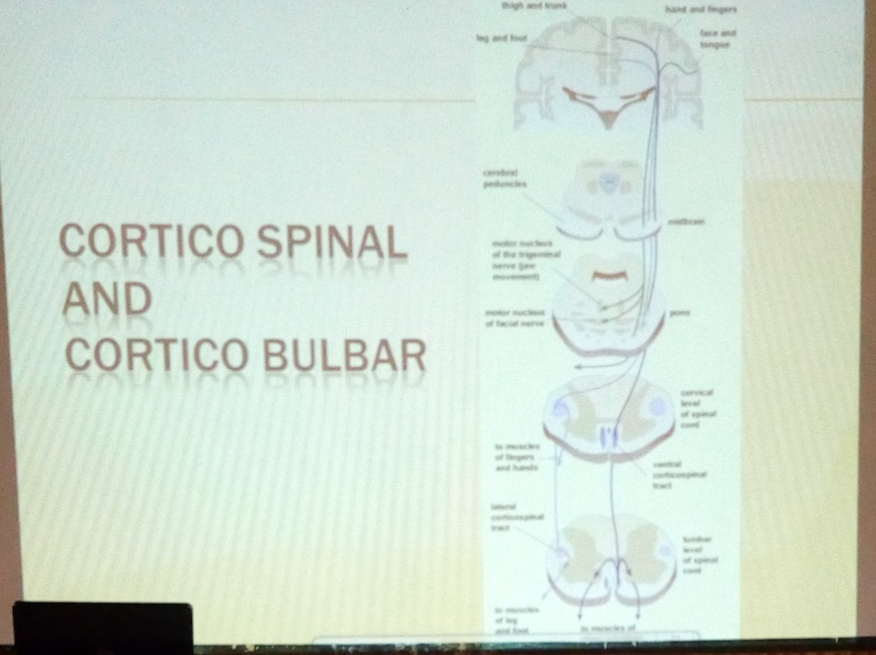

Slide 10
SOMATOTOPIC ORGANISATION IS PLASTIC
The somatotopic organisation of the motor cortex is not fixed but can be altered during motor learning and following injury.
It is the ability of the CNS to compensate for damage caused
Also used in the process of learning
Sprouting of axons to repair damaged tissue
Increase number of receptors
Remaining receptors are made more sensitive.

Slide 11
HUMAN STUDIES
A characteristic feature of voluntary movements is that they improve with practice. This may be associated with cortical reorganization.
Experiment in which subjects were asked to practice a finger opposition task for 20 minutes every day.
Performance curve reached asymptote in about 3 weeks.
Functional(fMRI) scans revealed that the area of the cortex activated during performance of trained sequence was larger than that activated during a novel untrained sequence.
The speed of finger movements does not explain the difference.
Practice with one finger sequence did not facilitate performance of a new sequence nor did it transfer to the untrained hand.
Hand areas are unique in that they are not connected across the corpus callosum.

Slide 12
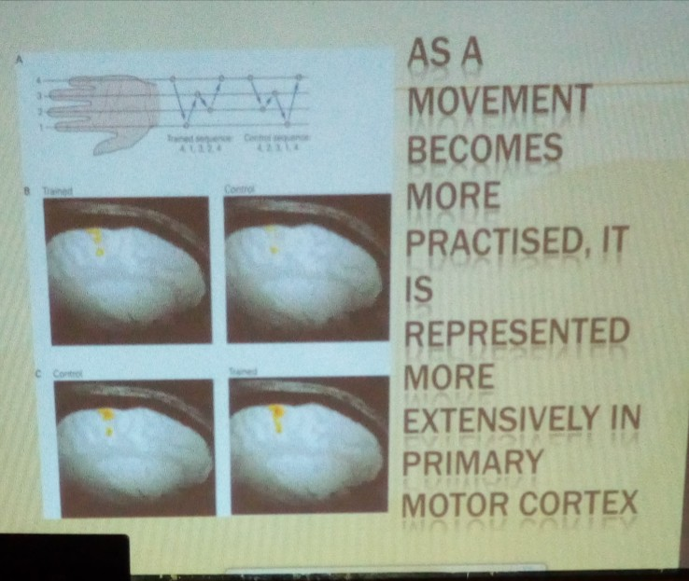

Slide 13
BASAL GANGLIA
The principal nuclei of the basal ganglia are
1: Striatum -three areas
2: Globus pallidus(or pallidum) - two segments
3: substantia nigra -two areas
4: The subthalamic nuclei

Slide 14
Cerebellar functions
The cerebellum influences the motor system
Evaluation of disparities between the intention and action
Adjustment of the operation of motor centers in the cortex and the brain stem while movement is in progress
Also during repetitions of the same movement
Maintenance of balance and posture
Coordination of body movements
Coordination of fine movements
It contains 50% of the neurons in the brain
Involved in the learning of new languages

Slide 15
Vestibulocerebellum
(Flocculonodular lobe)
Most primitive
Input directly from the primary vestibular nuclei
Project to the lateral vestibular nuclei
Function
-balance and eye movement

Slide 16
cerebrocerebellum
(Lateral parts of the hemisphere)
Receives input exclusively from the cerebral cortex
Projects via the dendate nucleus to the motor, premotor and prefrontal cortices.
Function
-Planning and mental rehearsal of motor actions
-Concious assessment of movement errors.

Slide 17
Hypotonia
Reduced resistance to passive limb displacements.
Pendular reflexes.
Leg oscillation up to 6-8 times following knee jerk reflex

Slide 18
Ataxia
Abnormalities in voluntary movement.
Delay in initiation of movement
Errors in range of movement - dysmetria
Errors in rate and regularity of movements-dysdiadochokinesia
Errors in relative timing

Slide 19
Action or intention tremor
Most marked at the end of a movement
A range of movement due to failure of adaptive control

Slide 20
Reflexes -Introduction
Coordinated, involuntary motor responses initiated by a stimulus applied to peripheral receptors.
Some reflexes initiate movements to avoid potentially hazardous situations, whereas others automatically adapt motor patterns to maintain or achieve a behavioral goal.

Slide 21
Reflexes -Introduction
Reflexes are stereotyped movements elicited by activation of receptors in the skin or muscle and form basic units of movement.
The sensory stimuli for spinal reflexes arise from receptors in the muscle, joints and skin and the neural circuit responsible for the motor response is entirely in the spinal cord or the brain stem
Under normal conditions reflexes can be modified to adapt to the task

Slide 22
Sensory/receptor Afferent path
Cerntral neuron
Effector/muscles Efferent path

Slide 23
Stretch reflex
The most important and certainly the most studied reflex is the Stretch reflex
A contraction of the muscle that occurs when the muscle is lengthened
Muscle spindle:
-senses the change in muscle length
-afferent nerve from the muscle spindle makes a direct excitatory connection to alpha motor neurons.
Sherrington discovered the stretch reflex.
When he attempted to flex passively the rigidly extended hindlimb of a decerebrate cat, he felt increased contraction of the muscle.

Slide 24
Inverse stretch reflex
Compared to the action of stretch reflex, the inverse stretch reflex causes relaxation of the muscle.
The receptor is Golgi tendon organ located in the muscle tendon.
The afferent nerve is the 1b
Bisynaptic
Innervated by 1b
Slow stretch reflex
Golgi tendon
Inhibits alpha motor neurons causing muscle relaxation
Prevents excessive muscle tension

Slide 25
Flexion-withdrawal reflex
The limb is quickly withdrawn from a painful stimulus, usually by contraction of all the flexor muscles in the limb.
It is spinal reflex because it persists after spinal transection.
A protective reflex in which a discrete stimulus causes muscles to contract in a coordinated fashion at multiple joints. Through a divergent polysynaptic pathways the sensory signal both excites motor neurons that innervate flexor muscles of the stimulated limb and inhibits motor neurons that innervate extensor muscles of the limb.
Excitation of one group of muscles and inhibition of their antagonists is called reciprocal innervation.
Along with flexion of the stimulated limb, the reflex can produce an opposite effect in the contralateral limb, that is, excitation of extensor muscles and inhibition of flexor muscles-crossed extensor reflex,which serves to enhance the postural support.

Slide 26
Proprioceptors in reflex activity
All movements activate receptors in the muscles, joints and skin. The sensory signals generated by the body's own movement were referred to as proprioceptive by Sherrington. They control important aspects of normal movement.
Eg. Hering-Breuer reflex which regulates the amplitude of inspiration. Stretch receptors in the lungs are activated during inspiration and the Hering-Breuer reflex eventually triggers the transition from inspiration to expiration when the lungs expand.
In walking, sensory signals generated at the end of the stance phase initiate the onset of the swing phase.

Slide 27
CNS damage
Stretch reflexes can be evoked in many muscles throughout the body and are routinely used in clinical examinations of patients with neurological disorders.
They are typically evoked by sharply tapping the tendon of a muscle with a reflex hammer-hence tendon reflexes of tendon jerks- although the receptor is in the muscle belly not in the tendon.
Absence or weak stretch reflexes often indicate a disorder of one or more components of the reflex arc:
Sensory or motor axons
Cell bodies of the motor neuron or muscle
Excitability of motor neuron is dependent on both excitatory and inhibitory descending influences either hyperactive or hypoactive reflexes can result from lesion of CNS.

Slide 28
Spasticity
Disorders of muscle tone are frequently associated with lesions of the motor system especially those that interfer with descending motor pathways because the strength of stretch reflexes is controlled by higher brain centers.
This may involve abnormal increases in tone(hypertonus) and decreaseshypotonus. The most common form of hypertonus is spasticity, characterized by hyperactive tendon reflexes and increased resistance to rapid muscle stretch.
A common procedure is to give baclofen, an agonist of GABA (B) receptor which are present on the 1a terminals intrathecally.

Slide 29
VOLUNTARY MOVEMENTS | REFLEXES
Repertory of movement well pronounced | Stereotyped movements
Gets better with practice | Genetically determined, no modification with practice
Internal in origin i.e planned | Elicited by external stimulus

Slide 30
PARKINSON’S DISEASE
Reduced movement
Akinesia
Small shuffling quick steps
Rigidity in joints producing cogwheel movement
Treated with administration of levodopa
Dopamine agonists
Neuromeliline is black in colour from breakdown of dopamine

Slide 31
Huntington’s chorea
Chorea- dance-like movement
Excessive unnecessary movements
Hyperkinetic disorders

Slide 32
Motor unit
Final pathway
All motor nerves are passed through this to produce movement.
Recruited by both voluntary movements and reflexes.
Single motor neuron

