Slide 1
CONTROL OF POSTURE AND BALANCE

Slide 2
Introduction
All living organisms on earth have the ability to sense and respond appropriately to changes in their internal and external environment. Organisms including humans must sense accurately before they react to survival.

Slide 3
Posture
The human body has the ability to sense body movement and maintain balance(equilibrium).
Also the ability to sense and determine the direction and speed in which it is moving and maintain balance (postural equilibrium)
-Walk on a tight rope, combine twists and turns in diving or gymnastics.
Keep a track of the relative position of arms and legs with the rest of the body.

Slide 4
Posture
Requires integration of
visual
vestibular
somatosensory(touch, posture, muscle spindles of the stretch receptors)

Slide 5
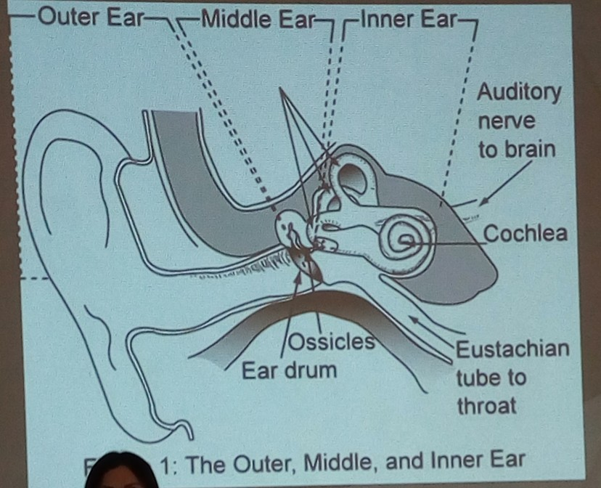

Slide 6
Vestibular system
Saccule and utricle (otolith organs)
sense direction and speed of linear acceleration
Semicircular canals
-sense direction and sprrd of angular acceleration

Slide 7
Linear and angular Acceleration
Linear - change in velocity without change in direction
Angular - change in velocity and direction at the same time

Slide 8
Gaze control
With slow movement, the eyes can be kept stationary by visual mechanisms.
As the speed of movement increases, the vestibular system takes over the image stabilization process.
Reflexive eye movement - nystagmus

Slide 9
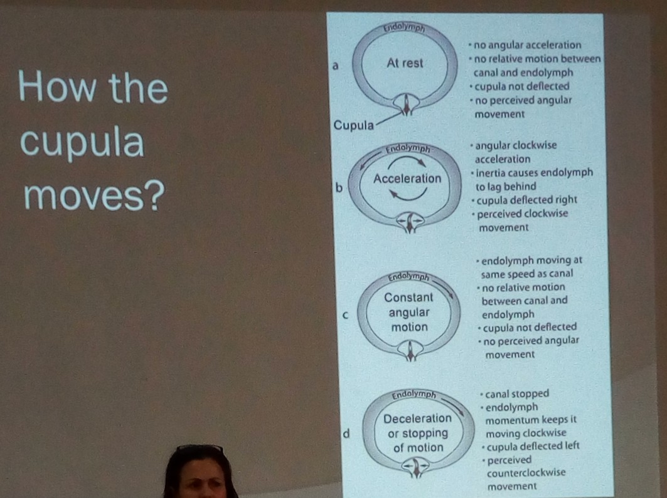

Slide 10
Otolith organs
Effected by linear acceleration and gravity
Provide information on the change in head position- tilt

Slide 11
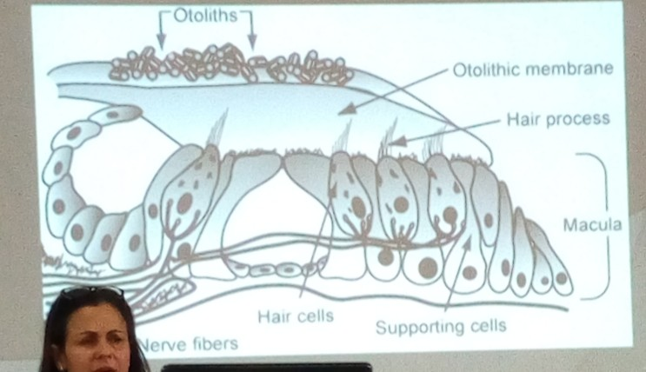
The importance of support
Maintaining the center of mass(CM) within the supports

Slide 12
Pressure Receptors
Design of the Mars Explorer
Simple rule:
-If pressure increases, extend the limb if pressure reduces, flex the limb.
Postural sway reaction
Stepping response
Hopping reaction
Placing reactions

Slide 13
Tonic neck reflex

Slide 14
Summary
Postural and balance as a whole uses several sensory inputs
Vestibular
Visual
Proprioceptive
Somatosensory-pressure, touch

