Slide 1
EEG
BASIC AND APPLIED
2016

Slide 2
EEG ---cont
Hans Berger German psychiatrist (1873-1941) discovered the EEG and gave it the term. EEG used to be called “Berger Waves”
Berger called the waves he claimed to have recorded from the scalp surface i.e. skin surface of the head “EEG” using electrodes.
At first no one believed him.
EEGs can also be recorded from the surface of the cortex.
The waves are then termed Electrocorticogram ECoG

Slide 3
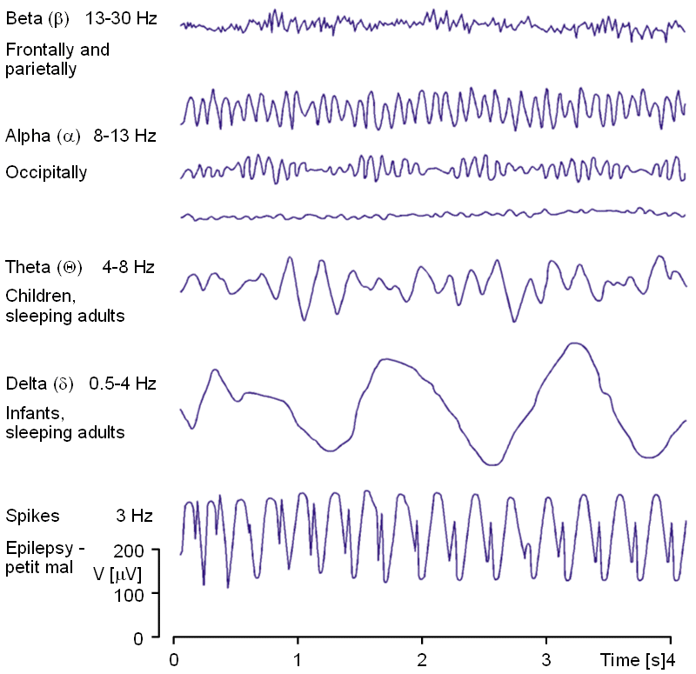

Slide 4
EEG WAVES –RYHTHMS-1
Alpha
8-12 Hz
High voltage waxing & waning
Adult at rest
Mind wandering with eyes closed
Mainly in parietal-occipital
Beta
18-30 Hz
Low voltage with harmonic alpha waves
Adult
Frontal

Slide 5
EEG WAVES –RYHTHMS-2
Theta
4-7 Hz
Large amplified voltage
Hippocampus in experimental animals & children
Delta
<4 Hz
Large amplified voltage
Sleep stage 3 & 4
Gamma
30-80 Hz
Low voltage

Slide 6
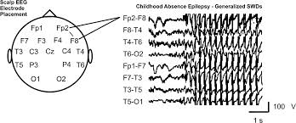

Slide 7
EEG VARIATIONS
Resting rhythm & age
Infants- beta like
-Occipital slow waves 0.5-2 Hz (0-2 years)
Childhood-faster rhythm- adult pattern by 12 yrs
Alpha frequency-decreased by-
Decreased blood glucose
Lowering of body temp.
Decreased adrenal secretions
Decrease in arterial PCO2-& vice versa
Anaesthesia
Hyperventilation causes “spike waves” and may trigger convulsions in some subjets

Slide 8
ALPHA BLOCK OR AROUSAL / ALERTING RESPONSE
No alpha waves in RRG
Instead one sees low voltage, high frequency irregular waves (Beta waves - around 30 Hz),
Sometimes Gamma waves - very low voltage very high frequency (30-80 Hz) are seen if attention is focused
Sensory stimulation also causes Alpha block
Mental conscious work e.g. calculations does the same
This phenomenon is therefore termed “Desynchronisation” of EEG waves i.e. replacement of alpha rhythm by higher frequency irregular low voltage waves

Slide 9
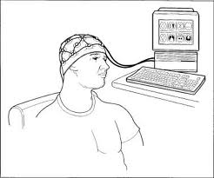

Slide 10
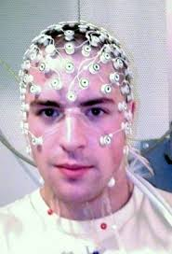

Slide 11
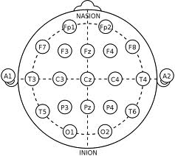
AN EEG MONTAGE

Slide 12
CLINICAL APPLICATION OF EEG
Localization of lesions
Fluid over cortex-decreased local EEG voltage e.g. sob-dorsalis
Local cortical lesions-local irregular slow waves
Epileptogenic foci- produce high voltage localized waves
Epilepsy
partial or local seizures i.e. one hemisphere only
general onset seizures-
grand mal- tonic clonic spiked waves(slow before each jerk)-fast EEG.
Petit mal-absence of seizures doublets of spikes and rounded waves. After seizure, slow waves then normal again.

Slide 13
MEANING OF EEG
Record of neuronal discharges in a volume conductor-dipole movements. Activity of most superficial layers picked up by EEG i.e. mainly dendrites & few axons, very few cell bodies.
Electrical “Dipoles” are set between- dendrites & cell bodies.
NB. Dendrites-subject to increase & decrease polarization and electroto nic spread
Dendritic stimulation does not always lead to action potentials i.e. this is not an “all or none” phenomenon like a simple nerve fibre action potential
EEG waves also seen in cerebellar cortex & hippocampal cortex thus dendritic & cell arrangement that can generate EEGs found in other parts of the brain.

Slide 14
MEANING OF EEG -cont
Arousal EEG
stimulation of specific afferent to mid brain level
stimulation specific thalamic relay nuclei
stimulation of cortex primary receiving areas
BUT high frequency stimulation of :
reticular formation-midbrain tegmentum base
non-specific thalamic nuclei i.e. RAS is responsible hence decrease in the activity of the midbrain tegmentum e.g in coma causes decrease in RAS activity

Slide 15
RAS
  gets inputs that converge from:
    ascending sensory spinal fibers
    special senses
these are non-specific stimulation of RAS by any sensory input cf. modality specific sensory pathways
  part of RAS bypasses thalamus and diffuse projection to cortex
  part-specific thalamic nuclei-specific areas of cortex
-intra lamina thalamic nuclei have diffuse projection to whole neocortex.

Slide 16
AROUSAL AND EEG
Arousal
EEG arousal is not same as behavioral arousal e.g. REM sleep.-paradoxical sleep with fast waves and slow voltage
  Behavioral arousal depends on posterior hypothalamus
EEG arousal depends on midbrain tegmentum- RAS
painful stimulation in sleep causes-
    behavioral arousal with sleep EEG- if midbrain tegmentum is cut
    EEG arousal with behavioral arousal- if posterior hypothalamus is inhibited

Slide 17
AROUSAL EEG
CAUSED BY
stimulation of specific afferent to mid brain level
stimulation specific thalamic relay nuclei
stimulation of cortex primary receiving areas
BUT high frequency stimulation of :
reticular formation-midbrain tegmentum base
non-specific thalamic nuclei i.e. RAS is responsible hence decrease midbrain tegmentum-coma-decrease of RAS
RAS
gets inputs that converge from:
  ascending sensory spinal fibers
  special senses
these are non-specific stimulation of RAS by any sensory input cf. modality specific sensory pathways
  part of RAS bypasses thalamus and diffuse projection to cortex
  part-specific thalamic nuclei-specific areas of cortex
-intra laminate thalamic nuclei diffuse projection to whole neocortex.
Arousal
EEG arousal is not same as behavioral arousal e.g. REM sleep.-paradoxical sleep with fast waves and slow voltage
  Behavioral arousal depends on posterior hypothalamus
EEG arousal depends on midbrain tegmentum- RAS
  painful stimulation in sleep-
    behavioral arousal with sleep EEG- if midbrain tegmentum is cut
    EEG arousal with behavioral arousal- if posterior hypothalamus is inhibited

Slide 18
RAS
stimulation of specific afferent to mid brain level
stimulation specific thalamic relay nuclei
stimulation of cortex primary receiving areas
BUT high frequency stimulation of :
reticular formation-midbrain tegmentum base
non-specific thalamic nuclei i.e. RAS is responsible hence decrease midbrain tegmentum-coma-decrease of RAS
  gets inputs that converge from:
    ascending sensory spinal fibers
    special senses
these are non-specific stimulation of RAS by any sensory input cf. modality specific sensory pathways
  part of RAS bypasses thalamus and diffuse projection to cortex
  part-specific thalamic nuclei-specific areas of cortex
-intra laminate thalamic nuclei diffuse projection to whole neocortex.

Slide 19
RAS AND CORTICAL FUNCTION
Arousal:
Frequency and amplitude shift and 35HZ frequency from slow waves
Thalamo-cortical feed-back
Increased sensitivity of cortical neurons
High frequency small waves enable all cortex to receive more simultaneous sensory information from thalamus and more coordinated fire from cortical neurons.
When all parts of the cortex are firing in this co-coordinated manner, one experiences consciousness and conscious perception.
But meditation- transidential consciousness with parietal lobe.

Slide 20
AROUSAL AND CORTEX STIMULATION
Orbital surface of frontal lobe- monkeys
Superior temporal gyrus
Electrical stimulation increases RAS and EEG arousal leading to sleeping- waking up with motor activity but if awake stimulation has no effect thus neocortical events can cause arousal.
This type of cortical activity is emotional and psychic and not generated by external stimulation. Cortex can sometimes wake up “alone” – no ability to move
NB: circadian rhythm of supra-chiasmatic nucleus has intrinsic 25-30hrs cycle modified by light from retinohypothalamic pathway.

Slide 21
EEG SYNCHRONIZATION( WHY WAVE FORMS OCCUR)
Waveforms come from a multitude of neurons and dendrites firing in unison. Caused by :
Rhythmic thalamic fire e.g. reticular nuclei
Influence of active cortical cells on their surrounding via collaterals reccurent inhibition followed by rebound hyper excitation.
To a small extent, electro-tonic spread of depolarization to parallel axons and dendrites in a volume card – dipoles. Physiology of slow waves sleep and EEG associated with it.

Slide 22
REFERENCE WIKIPEDIA
German physiologist and psychiatrist Hans Berger (1873–1941) recorded the first human EEG in 1924.^{[6]}
Berger also invented the electroencephalogram (giving the device its name), an invention described "as one of the most surprising, remarkable, and momentous developments in the history of clinical neurology".^{[7]}
In 1934, Fishfirst demonstration of EEG epileptiform “spikes”.
In 1935 inter ictal (ictus means epileptic seizure) “spike waves” and the 3 cycles/s pattern of clinical absence seizureswere described
In 1936 the inter-ictal spike as the focal signature of epilepsy. The same year, the first EEG laboratory opened at Massachusetts General Hospital.
Then followed the development of the earliest EEG machines and recorders

Slide 23
SOURCE OF EEG ACTIVITY
The brain's electrical charge is maintained by billions of neurons. Neurons are electrically charged (or "polarized“)
The brain behaves like an electrical volume conductor.
Waves of depolarization and repolarization in the mass conductor picked by electrodes placed on the scalp, as a constantly changing voltage The Recording trace of these voltage changes are the EEG. The voltage generated by an individual neuron is far too small to be picked up by EEG electrodes
The EEG is produced by the summation of the synchronous activity of thousands or millions of neurons that have similar spatial orientation such as the cortical pyramidal cells.

Slide 24
EEG CHANGES WITH CHANGES IN STATE OF BRAIN ACTIVITY
EEG activity shows oscillations which have a variety of frequencies which and wave forms which g=have been classified as Alpha, Beta, Delta, Gamma waves .
These waves spatial distributions and are associated with different states of brain functioning (e.g.,
waking and the various sleep phases or stages). These synchronized oscillations represent activity over a network of neurons.
The neuronal networks underlying some of these oscillations are jnown(e.g.,
  the thalamocortical resonance underlying sleep spindles that are seen in some stages of NON-REM sleep,
  The PGO (Ponto Genicolo Occipital lobe) spikes of REM sleep
Others are not (e.g.,
The Gamma waves (in alert person) and Delta waves( in stage four of deep non-REM sleep) are associated with cerebral neuron electrical activity.

Slide 25
CLINICAL USES OF EEGs
A routine clinical EEG recording involves recording from scalp electrodes. Electroencephalography is used in the following clinical circumstances:
Distinguish epileptic seizures from other similar conditions e.g.:-
  psychogenic non-epileptic seizures,
  syncope (fainting)
  sub-cortical movement disorders and
  migraine variants.
Differentiating real encephalopathy or delirium from primary psychiatric syndromes such as catatonia
Serving as one of the main test for diagnosing brain death
Predicting the likely eventual outcome of treating some coma patients
Determining whether to gradually withdraw of anti-epilepsy medication
Continuous EEG monitoring including recording of siezure EEGs sometimes done to get s better picture of the patients . This can be complimented with simultaneous audio-visual recordings.) c
This technique gives amore comprehensive information on the condition including possible localization of the focal point of the

Slide 26
CLINCAL USE OF EEG
EEG EPILEPSY MONITORING USED FOR:
distinguishin epilepsy seizures from other conditions e,g.
    psychogenic non-epileptic seizures,
    syncope (faintin)
    sub-cortical movemet disorders and
    Different types of migraine
determining the typeof epilepsy so as to determine the right treatment
Determinung whether the epilepy had a distinct focus which could be removed surgically.
OTHER CONDITIONS AMENABLE TO EEG MONITORING
depth of anesthesia
cerebral perfusion in operation for widening artheroma-clogged carodit arterial system
Effect of amobarbital injection into each carotid in turn for testing cerebral dominance (WADA TEST)
brain function in ICUs patients
non-convulsive seizures including non-convulsive status epilepticus
the effect of sedative/anesthesia in patients in medically induced coma (for treatment of increased intracranial pressure or unmanagable seizures

Slide 27
CLINICAL USE OF ECoG
FOR MORE ACCURATE LOCALIZATION OF SIEZURE LOCUS BY NEUROSURGEONS
Direct recording from the surface of the brain
Deeper recording through implanted electrodes
Craniotomy or “burr holes” used before such procedures are performed…..explain

Slide 28
METHOD
Electrodes placed on point on the scalp lubricated with a conductive gel or paste. Number of electrodes vary according to intensity of information required
Each electrode is attached to an individual wire
Special head Caps or Nets used to hold the electrodes in orderly
Electrode locations and names are specified by the International 10–20 system
In most clinical applications, 19 recording electrodes (plus ground and system reference) are used. Fewer canbe used in babies etc.

Slide 29
METHODS…cont
Each electrode is connected to one input of a differential amplifier (one amplifier per pair of electrodes
a common system reference electrode (“earth terminal”) is connected to the other input of each differential amplifier)
In analog EEG, the signal is then filtered (next paragraph), and the EEG signal is output as the deflection of pens as paper passes underneath the EEG signal is output as the deflection of pens as paper passes underneath.
For modern digital systems, the amplified signal is digitized via an analog-to-digital converter
The digital EEG signal is stored electronically and can be filtered for display
During the recording, a series of activation procedures may be used such .
procedures for inducing normal or abnormal EEG activity that might not otherwise be seen. These procedures include
  Hyperventilation
  Photic (light) stimulation at certain frequencies (using a strobe light)
  Eye closure and opening
  Mental activity like mental arithmetic
  Sleep and sleep deprivation.
  In epilepsy monitoring in hospitalized individuals, seizure treatment may be deliberately withheld to induce seizure or study any other effects

Slide 30
EEG ANALYSIS
A typical adult human EEG signal is about 10 µV to 100 µV in amplitude when measured from the scalp and is about 10–20 mV when measured from subdural electrodes (i.e. ECoG)
The EEG recording can be analysed using various programs; e.g., using free open-source software or commercial software packages
EEG voltage signal represents a difference between the voltages at each of the pairs of electrodes used
Therefore, the display of the EEG for the reading encephalographer may be set up in one of several ways
The representation of the EEG channels is referred to as a montage.

Slide 31
COMMON MONTAGES
SQUENTIAL MONTAGE
Each channel (i.e., waveform) represents the difference between two adjacent electrodes. The entire montage consists of a series of these channels.
REFERENTIAL MONTAGE
Each channel represents the difference between a certain electrode and a designated reference electrode. There is no standard position for this reference; it is, however, at a different position than the "recording" electrodes. Midline positions are often used because they do not amplify the signal in one hemisphere vs. the other. Another popular reference is "linked ears," which is a physical or mathematical average of electrodes attached to both earlobes or mastoids
AVERAGE REFERENCE MONTAGE
The outputs of all of the amplifiers are summed and averaged, and this averaged signal is used as the common reference for each channel.
LAPLACIAN MONTAGE
Each channel represents the difference between an electrode and a weighted average of the surrounding electrodes.
When analog (paper) EEGs are used, the technologist switches between montages during the recording in order to highlight or better characterize certain features of the EEG.
DIGITAL EEG:
All signals are typically digitized and stored in a particular (usually referential) montage; since any montage can be constructed mathematically from any other, the EEG can be viewed by the electroencephalographer in any display montage that is desired.
INTERPRETATION OF RESULTS
The EEG is read by a clinical neurophysiologist or neurologist (depending on local custom and law
Done through visual inspection of the waveforms (graphoelements).
Computer signal processing of the EEG—so-called quantitative EEG—also used.

Slide 32
COMPARISON TABLE OF EEG RHYTHMIC ACTIVITY FREQUENCY BANDS(Wikipedia)
BAND | Frequency (Herts) | lLocation | Normally | Pathologically
DELTA | Less than 4Hz | Frontally in adults Posteriorly in children High amplitude waves | Adult slow wave sleep In babies During some continuous- attention tasks | Sub-cortical lesions Metabolic Encephalopathy Hydrocephalus Deep midline lesions
THETA | 4-7 Hz | Found in locations not related to task being performed | Higher in young children Drowsiness in adults Idling Associated with inhibition of elicited responses. But has been found to “spike”in situations where person is actively trying to suppresss a response or action | Focal sub-cortical lesions Metabolic encephalopathy e,g. in renal or hepatic failure Deep midline disorders Sometimes in Hydrocephalus

Slide 33
MWISHO = END

