Slide 1
FRONTAL AND PRE-FRONTAL LOBE FUNCTIONS

Slide 2
PREFRONTAL FUNTIONS
PREFRONTAL CTX IS:
Uniquely large in humans It is the largest cortical division in human
Concerned with the highest brain functions e.g.
  Abstract thinking
  Decision making
  Anticipating side effects of particular cause of action
  Social behavior
  Religion
Damage of orbital surface of frontal lobe causes– prefrontal leucotomy signs & symptoms.

Slide 3
CONNECTIONS
To all ipsilateral cortex areas by direct assoc. areas except primary motor
Medial dorsal nuclei of thalamus=limbic nuclei of thalamus connection to prefrontal area
Hypothalamus
Stratum especially nucleus accumbens
Sub-thalamus
Midbrain
  I.e. oldest parts of the brain

Slide 4
PREFRONTAL SPECIALIZED AREAS
Area that encodes info about verbal material such as attaching names to objects or events
Area for spatial memory i.e. how to get from place A to B
Area of memory of events
Area for executive processes i.e. that enables us to take action.
NB:
Works with other areas during “working memory” phase of memory processing
Prefrontal ctx = major part of mesolimbic dopamine pathway.

Slide 5
FRONTAL LOBECTOMY
Experimental neurosis can be caused in monkeys
E.G. the monkey and circle vs elipses test. The monkey gets a mild electric shock if it chooses the wrong shape and a reward if it chooses the right shape e.g the circle.
Tension for making the wrong choice when the shapes are almost the same causes neurosis.
Pre-frontal leucotomy abolishes the neurosis in the monkey hence prefrontal leucotomy treatment in humans in the past .
In humans tension from delusions of failure & real failure worries can cause similar neurosis ig depression and suicidal thoughts.
Such tension can be treated with leucotomy since the person no longer bothers about success or failure. Same treatment was tried for intractable pain e.g. thalamic-post ischaemic morphine preferred .
But side effects-
social & toilet habits
problems e.g. lady with leucotomy & “rain”
relief from pain e.g. temporary e.g. up to one year.

Slide 6
PHINEAS GAUGE
Leucotomy(traumatic) of Phineas Gage 1868-a consiencious efficient construction foreman in rail road
Accident in blasting-stone
Tapping powder into hole with tamping iron
Iron firing through face & out through front of skull i.e. frontal leucotomy
Fitful, irreverent, indulging at times grossly profane(abusive), no respect to fellow humans, impatient of restraint or advice when it conflicts with own desire, very obstinate at times, capricious, vacillating & devising many plans for future options which are immediately abandoned for better ones i.e. completely new personality.
Hence surgical leucotomy was replaced by medical treatment using tranquilizers & other specific drugs is nowadays used for the treatment of mental illness.

Slide 7
DRUGS & CNS FUNCTION
Racial difference e.t.c.
  E.g.Japanese & beer drinking
Alcohol and inhibition of mammillary bodies
Alcohol and & inhibition of cortex
  Causes confabulation in alcoholics
Animals and alcohol
Opiates e.t.c.
NB: Frontal lobe and language
The temporal lobe stores all known words. The prefrontal stores all known meanings-semantic store.

Slide 8
PRE-MOTOR CORTEX-EFFERENTS
brain stem postural control areas
motor cortex
cortico-spino pyramidals
cortico-bulbar
NB: the funtion of these efferents is setting posture for beginning and end of movement.

Slide 9
FRONTAL LOBE SUMMARY
MOTOR CORTEX
voluntary muscle activity
Has DYNAMIC and STATIC motor neurons
Pyramidal system etc
PRE MOTOR CORTEX
Receives command from the prefrontal lobe
Generates pattern of muscle movement required for specific motor activity
Has specialized areas for critical accurate voluntary motor function e.g.
  Area of hand movements
  Area of head movements
  Frontal eye fields
Has mirror cells which imitate actions which on sees others doing or is told about
  Used in learning (and ??yawning)
Also has “waiting to do something neurons” that keep firing till the something is done. Causes anxiety but aids planning for the future and to b “reliable”.

Slide 10
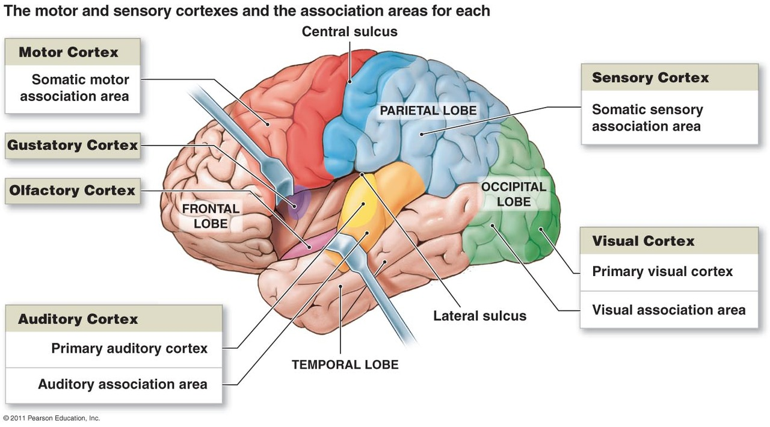

Slide 11
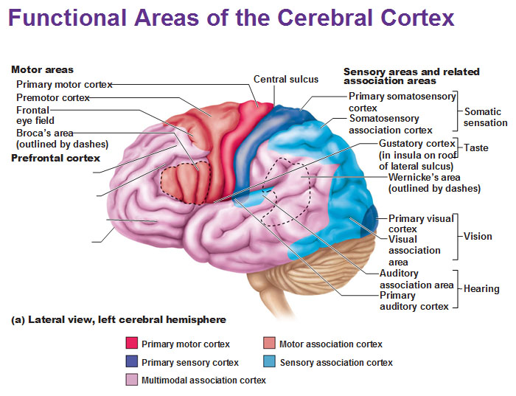

Slide 12
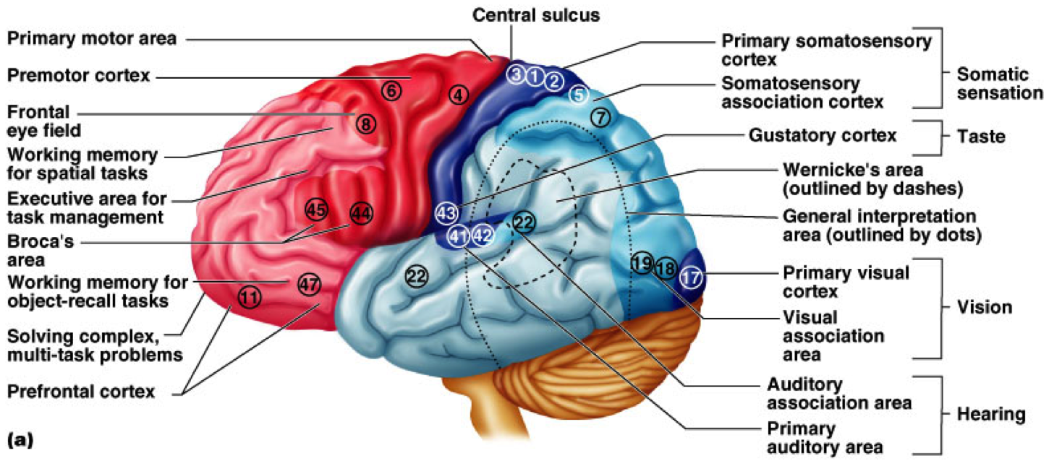
DIAGRAMATIC SUMMARY

Slide 13
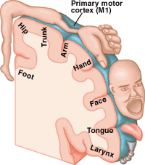

Slide 14
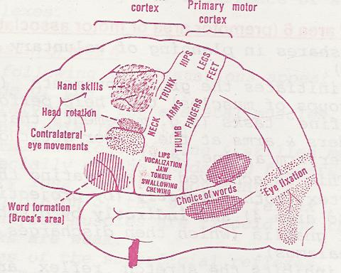

Slide 15
END

