Slide 1
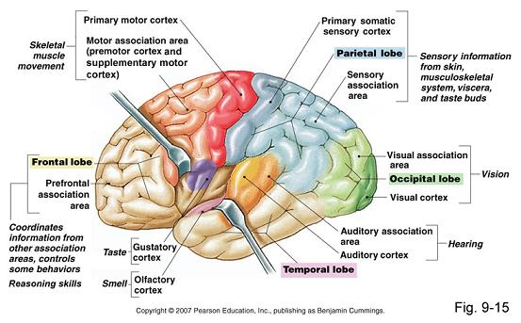
ASSOCIATION CORTICES - DETAILS

Slide 2
ASSOCIATION AND PRIMARY CORTICAL AREA

Slide 3
BRAIN FIBRE INTERCONNECTIONS
Fibres form the white matter of the CNS
COMMISURAL
Connect the two hemispheres point to point
E.g. the corpus callosum
ASSOCIATION
Connecting different areas in same hemisphere
ASCENDING
Bring in information from peripheral nerves and lower centres
DESCENDING
Carry information from the brain to lower centres and effector organs

Slide 4
COMPLIMENTARY SPECIALIZATION(“CEREBRAL DOMINANCE”)
The categorical hemisphere (Dominant)
Analytical processing
Language/Speech
Right hand
Time sequencing
Behaviour
The representational hemisphere(Non Dominant)
Global, holistic processing
Visuospatial skills
Left hand
Recognizing faces
Tone of voice
Musical ability
Emotions
Humor/ Metaphor

Slide 7
PYRAMIDAL SYSTEM

Slide 14
HOMONCULUS

Slide 15
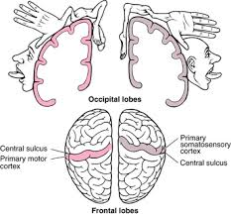

Slide 17
END

