Slide 1
LANGUAGE FUNCTION

Slide 2
LANGUAGE
Tonal and non-tonal languages
Language and brain development
Polyglots – babies and children’s ability
Gender differences and “MOTHERESE”
Mother tongue
Linguistics and language teaching – examples
  Non-mother tongue teacher (e.g. Perfect Kimeru taught by Luo linguist in Moi University)
  Teaching a “dumb” child – KT
Brain capacity for generational correction of deficient languages
Brain ability to construct new synaptic mechanisms for any language heard

Slide 3
HANDEDNESS AND SPEECH
HUMAN PECULIARITY
Only the human has fully developed language and speech- “Rachel Watts” “Kikamba so philosophical and complex”
BRAIN ANATOMY-
Ranking of regions by size
  Largest is the association cortex then
  frontal lobes and
  parietal lobes.
  temporal lobes then
  occipital lobes
NB: Temporal extends down to limbic system
Assoc. area –6 layered neo-cortical mantle of gray matter next to allo and juxta-allo-cortex which is around brain stem

Slide 4
CORTICAL NEURONS
EFFERENTS:
To other levels of brain
Collaterals to same neurons for feedback
Connections to other(contra lateral) and same (ipsilateral) cxt.
AFFERENTS:
Non-specific thalamic afferents
Reticular
Assoc. fibers from other areas of ctx.
Specific thalamic afferents to layer 4.

Slide 5
PLASTICITY (PROVEN BY PET AND FUNCTIONAL MRI)
IN LEARNING
Motor homunculus for specific part-enlargement as a new task is learnt fro one week and a maximum of 4 weeks. Same for sensory homunculus
COMPENSATORY CHANGES AFTER TRAUMA:
Recovery after ischaemic damage learning continues in adjacent cortex
NB: planned sequential motor tasks e.g. counting numbers aloud-associated with activity in left supplementary motor area in right handers i.e:-
  This is the area that controls complicated motor functions for both contra and ipsi-lateral body

Slide 6
SPACIOTEMPORAL OR REPRESENTATIONAL HEMISPHERE
Non-dominant- different functions
used for analysis and appreciation of spatio-temporal relations
stereognosis
  identification of the object by their shape and form
appreciation of musical themes and
production of tonal nuances in speech, jokes etc.
Processing of tonal languages (e.g. all Kenyan Indigenous Mother Tongues and in
Europe Swedish, Norwegian Serbo-Croat, Latvian, Slovene, Lithuanian and Luxemburgish; while in Asia, Chinese Vietnamese etc and Indo-Aryan languages i.e. Punjabi, Dogri (Jamu and Kashmir) and Lahnda (also called Western and Eastern Punjabi) are also tonal but Korean and Tamil,like English French and German and Russsian are notare not.
Facial recognition i.e. visuo-spacial analysis
But language does not determine hemispherical specialization

Slide 7
RIGHT/LEFT HEMISPHERE LESIONS
Lesions of categorical hemisphere
affect language
Lesions of visuo-spatial hemisphere-
Cause astereognosis
feeling with no recognition
agnosias- inability to recognize despite intact sensory modality pathway
Amorphosynthesis (hence codition usually affects the left side of the body)

Slide 8
HANDEDNESS
Right-handers
91% of human race
96% of them –L hemisphere is dominant (left brained)
4% R hemisphere dominant- artists (right brained) i.e. 3.6% of the general population
Left-handers
9% of human race
15% of them- R hemisphere dominant (right brained) i.e. 1.35% of general population
15%- no dominance i.e. clearly ambidextrous
70%- L hemisphere dominant (left brained)
BN: About 5% of general population are Right brained while the majority, 95%, are Left brained!

Slide 9
NEUROCHEMISTRY OF HANDEDNESS
Chemical hemispherical differences:
There is concentration of dopamine in the nigro- striatal pathways (extra-pyramidal) i.e. substantia nigra releases more dopamine to putamen and caudate nucleus of the preferred side L or R side
Concentration on L side high in R handers and vice versa i.e.
  Initiation of movement,
  Timing and
  Termination
  are made very easy.
This may be one of the reasons why handedness leads to “light” or “heavy” hand feeling i.e. posture setting for muscle movement

Slide 10
LANGUAGE

Slide 11
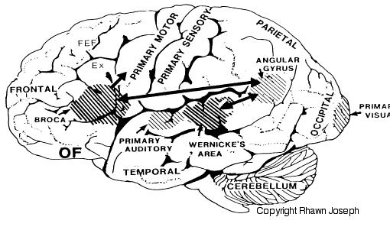

Slide 12
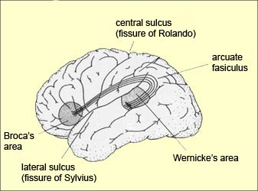

Slide 13
WERNICKE’S AREA -_CATEGORICAL HEMISPHERE
Posterior end of superior temporal gyrus
Sub-serves (responsible for) understanding of auditory and visual infomation
Projections via arcuate fasciculus to Broca’s area which is immediately anterior to inferior end of motor cortex.

Slide 14
BROCA’S AREA
processes Wernicke’s information into detailed and coordinated pattern for vocalization i.e. words
projects the pattern to motor cortex to move lips, tongue, larynx and respiratory center to produce speech.

Slide 15
ANGULAR GYRUS
Occipital area just behind Wernicke’s. process visual words i.e. written words into a form, which Wernicke’s can convert into, spoken words

Slide 16
SPEECH DISORDERS:-
DYSLEXIA
Definition:-
  Difficulties in learning to read; interpret words; recognize symbols and letters of alphabet despite normal intelligence
May be caused by Autoimmune damage of ganglion cells of visual and auditory pathways including Lateral Geniculate Bodies and he Superior Colliculi. These cells are also involved in some patients who have Reading and Speech difficulties
READING
Activates two pathways in parallel
“Pathway A”
  Via Angular Gyrus and Wernicke’s area to access a phonological (speech sounds) representation of every syllable in a temporal lobe memory store
“Pathway B”
  Via Left dorso- lateral Prefrontal Cortex to access semantic memory store (dictionary of actual meanings) of every word

Slide 17
DYSLEXIA
ASSOCIATION WITH LEFT HANDEDNESS
Inability to learn to read 12 times more common in left-handers. Thus left hemisphere abnormality thought to causes a switch to the Right hemisphere in early development (an example of brain plasticity)
“PROS AND CONS OF LEFT-HANDEDNESS ”
Spatial ability may be above average e.g. musicians, artists, mathematicians, and locksmith’s e.t.c. but
They used to die earlier than right-handers mainly because of accidents since most word appliances and facilities are for the right handed (USA has laws on tools which protect left hander).
ANATOMICAL DIFFERENCES (Proved by MRI)
RIGHT frontal lobe thicker than LEFT
LEFT occipital lobe wider and protrudes across midline
Upper parts of LEFT temporal lobe is larger in RIGHT handers especially planum temporale area which is posterior superior temporal gyrus for language used for processing auditory information produced by the primary auditory cortex.

Slide 18
BRAIN CHANGES IN DYSLEXIA
Inhibition of forebrain development causes dyslexia i.e. reading difficulties in 3-4% of the populations
Planum temporale (gyrus behind transverse temporal gyrus of Heschyl which is the primary auditory sensory area)-) in the dominant hemisphere is smaller in dyslexic children ( demonstrated in MRIs)
Retina ganglionic layer-magno-cellularis. (M_cells) are smaller and have smaller axons which conduct slowly.
Scanning movements for reading are controlled by M cell input to the superior colliculus and are so slow that syllables sound as though they are said together and while reading letters seem transposed. One may have wobbling eyes as he tries to read.
Lateral Geniculate Bodies (visual) and M-cells- damage lead to “speaking in unintelligible jargon (tongues).”
Superior Colliculi (which control saccades and reflex eye movements) malfunction also be implicated.
Auditory side –
M-cells in Medial Geniculate Bodies (auditory), which project to the auditory primary area (gyrus of Herschyl )-have reduced detection of frequency and amplitude of sounds-, this causes reduced perception of words that are read aloud.

Slide 19
APHASIAS
AT CORTICAL LEVEL
Commonest causes are embolism and thrombosis
Fluent –sensory
Non- fluent- motor
NON_FLUENT APHASIAS
Caused by lesions of Broca’s area
Slow speech, and word hunting
Patient with severe lesions may have only a few words, which fail to express all their emotions etc. the few spared words available to them are sometimes the last words they immediately before the damage

Slide 20
APHASIAS TYPES DETAILS -1
APROSODIA
If it is caused by the Inhibition of non-dominant Brocas area
  Causes speaking in monotones.
LISTENING ERRORS (mishearing)
Caused by inhibition of superior temporal gyrus between primary auditory and Wernicke’s equivalent (planum temporale) on the R side
  In this condition, patient cannot tell difference between questions and statements.
SENSORY (RECEPTIVE) APHASIA
Inhibition or damage of Wernicke’s area also causes difficulties in understanding other people’s speech

Slide 21
APHASIA TYPES DETAILS -2
PARAPHRASIA:- 2TYPES
Verbal paraphrasia i.e.
  Exchange of connected words in speech e.g. for knife or fork the person will say “cut with a fork” meaning “cut with a knife”.
Phonemic paraphrasia:-
the person will use made up words with similar sounds e.g. instead of “knife and fork” will say, “bife and dork”
But the person is:-
(a)completely unaware of errors, and
(b) understands what others are saying but he/she in both types of paraphrasia has NO ability to monitor their own speech

Slide 22
FLUENT APHASIAS- WERNICKE’S
The person may have normal speech but excessive and full of jargon and neologisms with no meaning therefore also termed “jargon aphasia”. NB: The person is unable to understand spoken or written words.
CONDUCTION APHASIAS
Speaking is almost normal,
understanding of spoken words is normal, but
cannot put words together or produce his or her own words i.e.
can read and repeat but cannot produce his/her own speech.
Site Lesion In Conduction Aphasia
is around the auditory cortex (Brodmann areas 40,41,42) not in arcuate fasciculus.

Slide 23
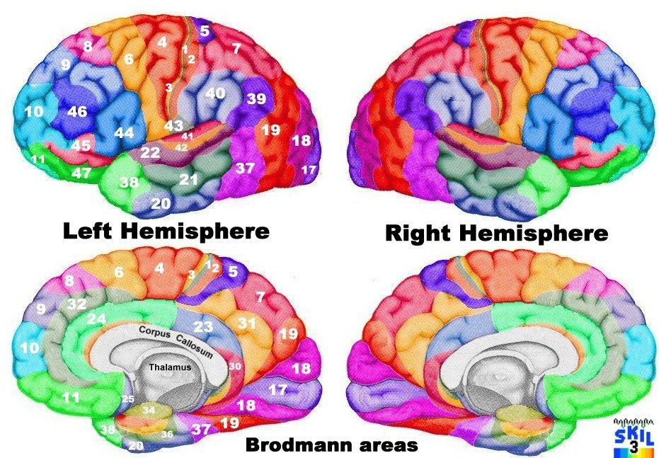

Slide 24
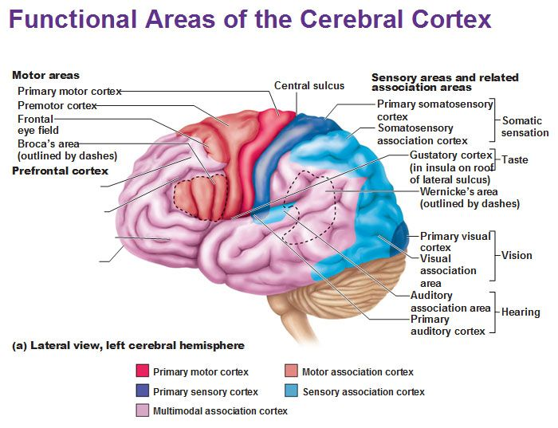

Slide 25
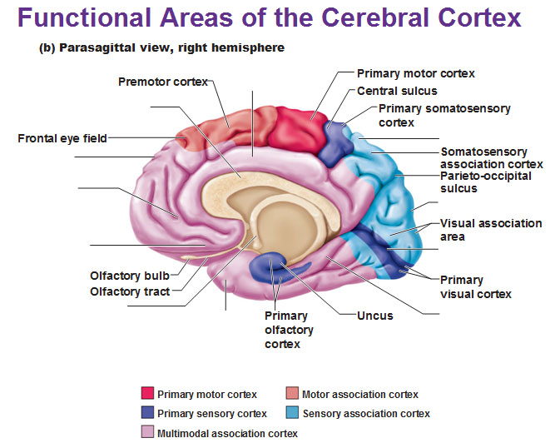

Slide 26
ANOMIC APHASIA
CAUSED BY INHIBITION OF LEFT TEMPORAL AREA 39
i.e. Inhibition of angular gyrus in dominant hemisphere
The Limited hear ability left is because the rest of Wernicke’s area and the whole of and Broca’s area are normal
There is Normal speech and understanding of auditory (as opposed to written) words
Difficulties in understanding written words and pictures i.e. no processing of visual infomation. So the rest of Wernicke’s areaa (for understanding speech) cannot name things or words i.e . The person has ANOMIA.
OTHER COMPLICATED ANOMIAS
Inability to remember names of places and persons i.e. proper nouns. but can remember common nouns verbs and adjectives. Scant non-fluent speech-writing is abnormal
DYSPHASIA IN THE DEAF
Deaf sign language: Deaf sign language goes if dominant hemi is inhibited ; i.e. All forms of human language (e.g. sign language, whistling language, Morse code etc.) are hard-wired and use the same brain areas.

Slide 27
ROLE OF THE NON-DORMINANT HEMISPHERE
NON-DOMINANT HEMI INHIBITION
Causes inability to
  tell a story
  make a joke
  understand a joke
  comprehend meaning of a joke
Causes loss of understanding the finer implications in speech e.g. wit or sarcasm i.e. color & inflection of speech. E.g. “Oh really!” “Really?” one expressing doubt and the other disbelief. Or difference between “Please keep quiet’ (polite request) and “I will thank you to keep quiet” (harsh repremand)

Slide 28
PROSOPAGNOSIA (NON-DOMINANT HEMI)
CAUSED BY LESION OF FUSIFORM GYRUS(AREA 37)
Inhibition of medial portion of R-temporal in right handers:-
inability to recognize faces
normal ability to recognize people via other modalities e.g. voice also a rose by smell
can show right emotional reaction to strange or familiar faces
recognition of faces also involves left hemisphere in right handers but in secondary roles. Autonomic response to familiar faces caused by separate dorsal pathway for visual info-the encephalon without conscious levels i.e. sub-conscious recognition.

Slide 29
The fusiform gyrus, also known as the (discontinuous) occipitotemporal gyrus, is part of the temporal lobe and occipital lobe in Brodmann area 37.^{[1]}The fusiform gyrus is located between thelingual gyrus and parahippocampal gyrusabove, and the inferior temporal gyrusbelow.^{[2]} Though the functionality of the fusiform gyrus is not fully understood, it has been linked with various neural pathways related to recognition. Additionally, it has been linked to various neurological phenomena such as synesthesia (synaesthesia), dyslexia, and prosopagnosia.
NB1: In synaesthesia stimulation of one modality evokes involuntary sensation of another one e.g music notes and colour, number sequence and spatial arrangement etc. may lead to perfect pitch or superior memory etc. Other types of synaesthesia include:-
Misophonia: Is a type of synaesthesia in which negative emotions(anger,disgust,hatred,fear)are triggered by specific sounds.
Ordinal Linguistic Personification. In this formof synaesthesia. Numbers and letters invoke specific human characters eg. Number 7 - A young girl with short temper, letter P may invoke a old man with a kind face like father xmas etc

Slide 30
SYNAESTHESIA ..cont
Mirror-touch synaesthesia.
  The subjects observes someone being touched on the forehead and feels a touch in the same area
Lexical-gustatory synaesthesia
  Hearing some words or name evokes certain tastes in the mouth
Spatio-temporal synaesthesia
  Subject can ‘see the time’ as mental map of hours, days, or months or years, etc. as ribbons, rings or circles with the sequences written on them.
Others include Sound-flavour, month flavor, associating different colours with different lexemes, phonemes,smells, pain, and visual-tactile.
Theory: Synaesthesia arises out of Cross Activation of modalities specific brain areas of specific perseptions. It could also arise from problems with interpretation of the meaning of things or activities

Slide 31
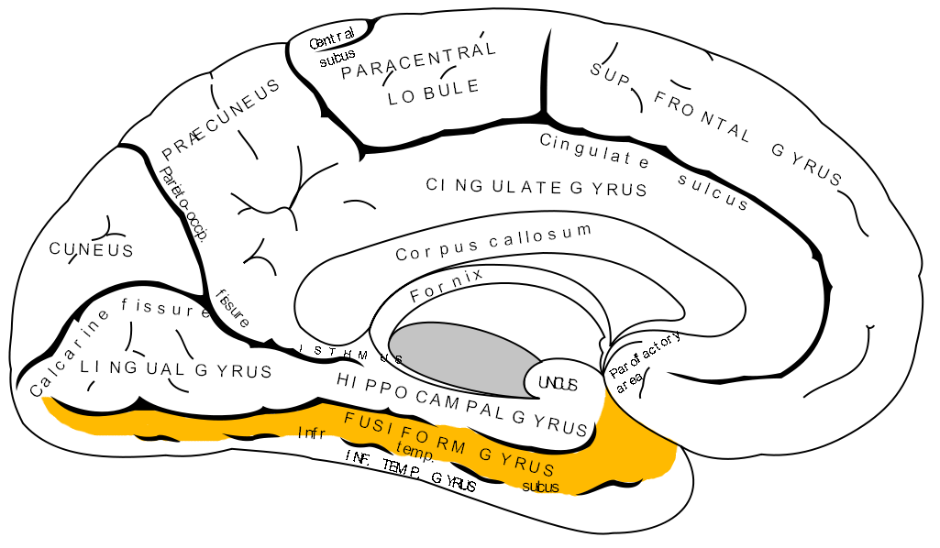
MEDIAL CEREBRAL CORTEX SHOWING
FUSIFORM GYRUS

Slide 32
INFORMATION FROM MRI & PET STUDIES OF PATIENTS WITH STROKE & HEAD INJURIES
LOCALIZATION OF FUNCTION RESEARCH (MRIs etc) has shown
FRONTAL PARIETAL DAMAGE causes
ACALCULIA i.e.loss of mathematical ability
COMPLEX ANOMIAS e.g. no name for animals, normal naming of other things
LEFT PARIETAL LESIONS-(i.e. in dominant hemisphere)
This is the “Word Structure Area”. Damage here causes:-
COMPLEX SPEECH DIFFICULTIES e.g.
  difficulty with second half of words & normal first half of words

Slide 33
OTHER PARIETAL-OCCIPITAL LESIONS
THESE LESIONS HAVE REVEALED:-
Consonant vowel area
Damage here leads to some people writing only with consonants, no vowels in writing (like Welch) i.e. each specific brain area has detailed specific aspect which it possesses-
Some claim there are “God idea and God seeking areas’ in temporal lobe & prefrontal lobes.
Still early days in brain function research

Slide 34
END

