Slide 1
MOTIVATION BEHAVIOUR AND EMOTION
WITH COLOUR ILLUSTRATIONS
See slides 1-39 then 43-86

Slide 2
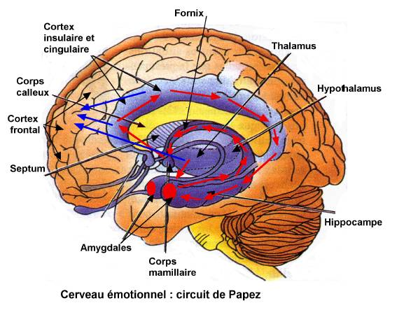
PAPEZ EMOTION CIRCUIT - 2

Slide 3
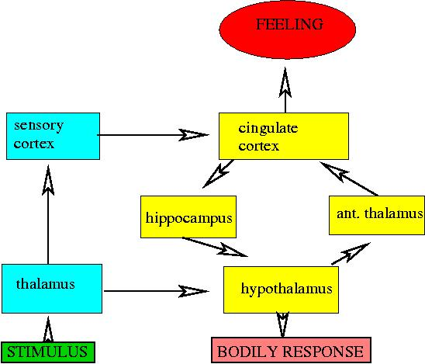
PAPEZ EMOTION CIRCUIT - 1

Slide 4
EMOTIONS
1.MENTAL COMPONENTS:
Affect-
  feeling of self
Cognition-
  awareness of sensation
Conation
  - urge to take action
2.PHYSICAL ASPECTS:
Increased BP
Increased pulse
Increased sweating
BOTH INVOLVE HYPOTHALAMUS AND LIMBIC SYSTEM
Instinct
Instinct for preservation of group or species
Instinct for self preservation

Slide 5
ANATOMY OF THE LIMBIC SYSTEM
old rhinencephalon
allocortex
3 cell layer- most of it
the juxta allocortex joins allocortex to neo-cortex and juxta-allocortex has 3-6 layers e.g. gyrus cinguli
CONNECTIONS
NB: only few connections with neo-cortex in lower animals but humans have a large SUBICULUM which connects the hippocampus to the neocortex in a special way.
This explains why emotions cannot be turned on and off at will but first switch is voluntary.
Raining can strengthen the voluntary control
Limbic circuits have a prolonged after discharge i.e. like emotions

Slide 6
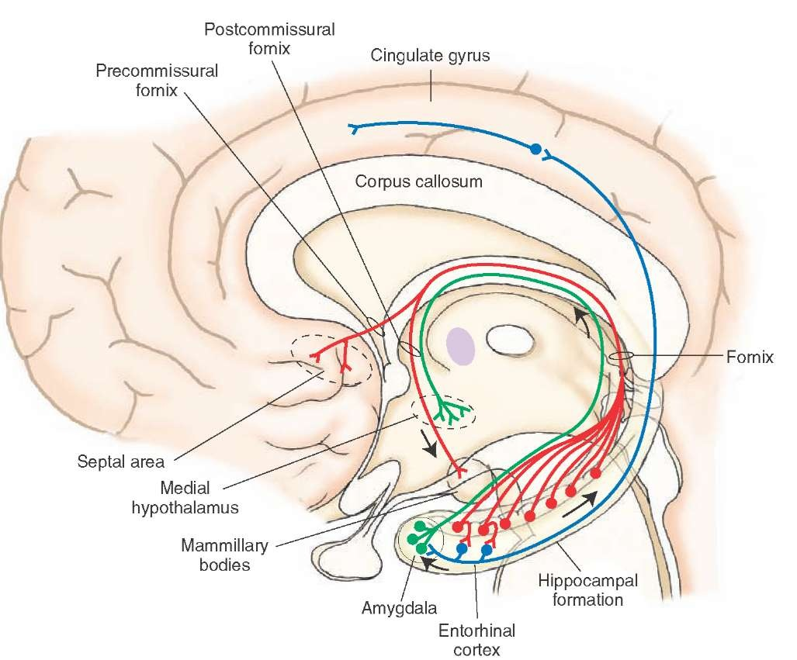
HOPPOCAMPUS CONNECTIONS

Slide 7
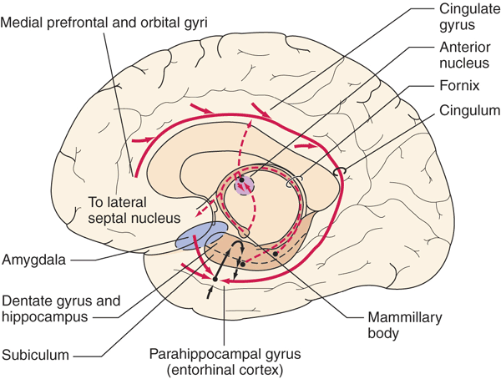
LIMBIC SYSTEM

Slide 8
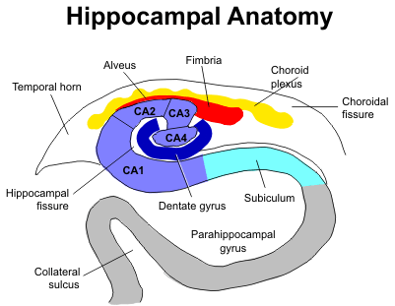
DETAILED ANATOMY

Slide 9
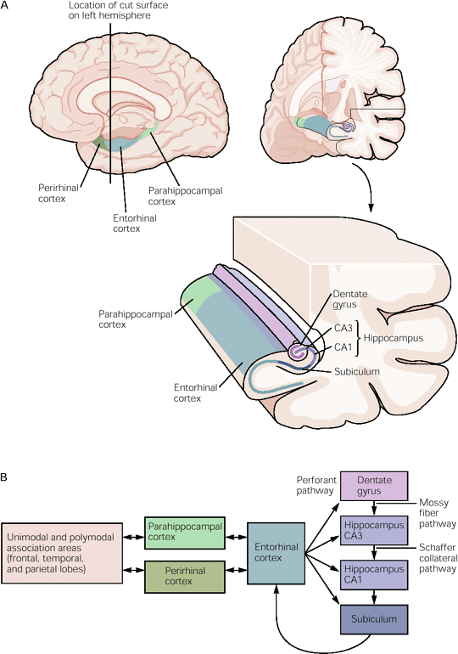
THE SUBICULUM AND ITS CONNECTIONS

Slide 10
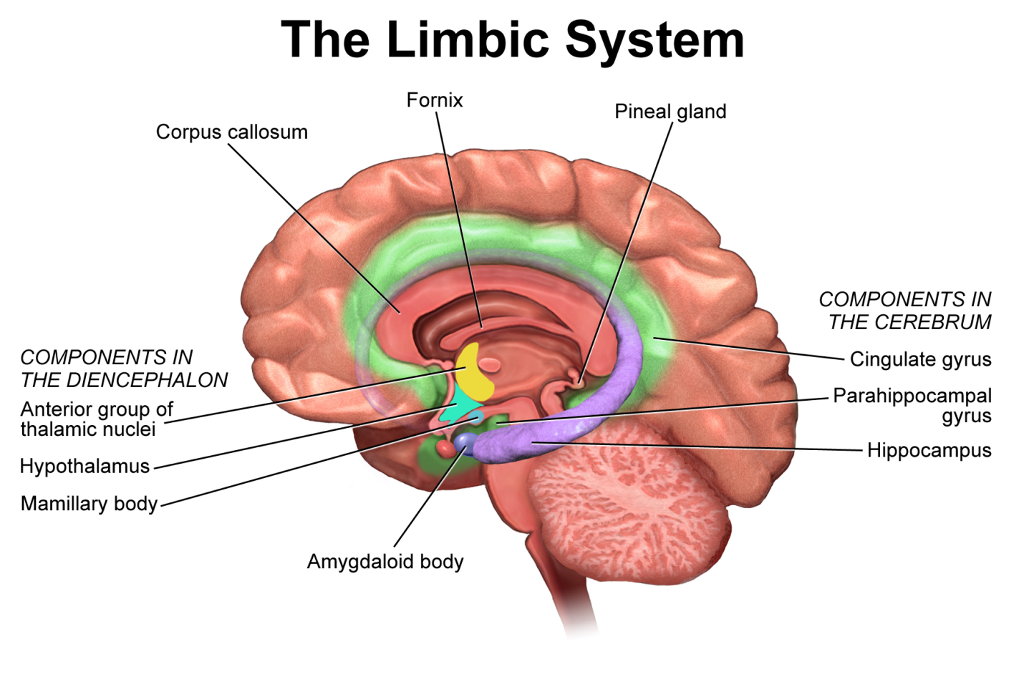

Slide 11
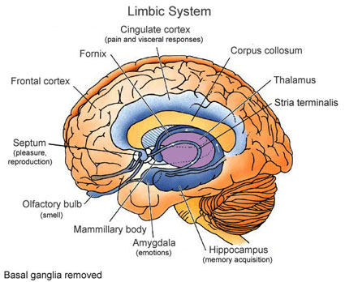

Slide 12
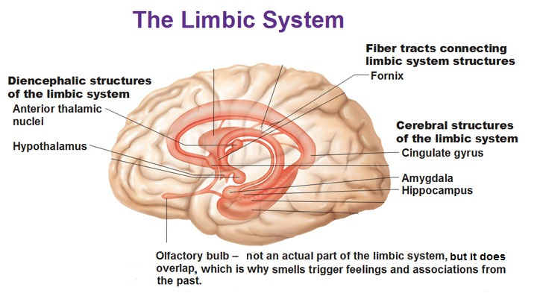

Slide 13
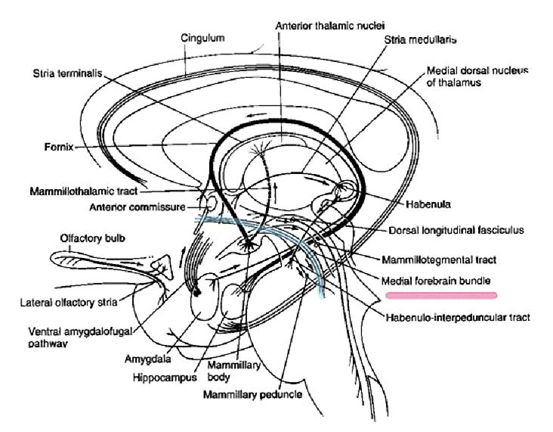
DETAILS OF LIMBIC CONNECTIONS

Slide 14
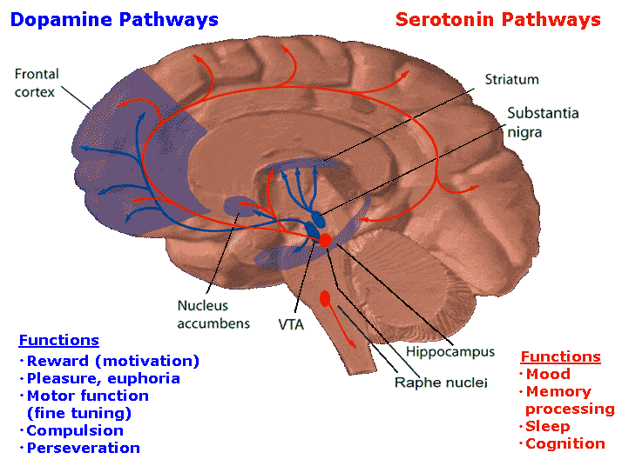

Slide 15
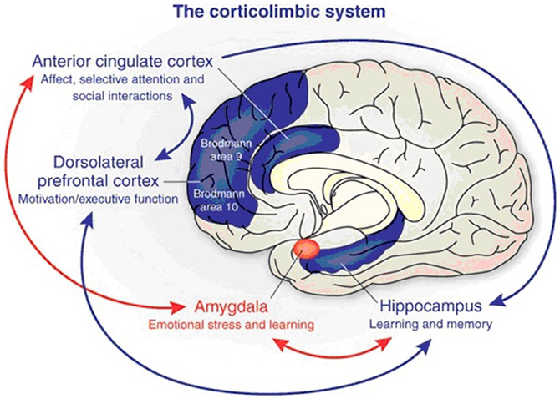
CORTICOLIMBIC SYSTEM

Slide 16
AUTONOMIC CHANGES
BP
respiration
pulse
sweating
show very low localization-generalized reaction e.g.
amygdala stimulation
  Can cause feeding movements
inhibition of amygdala
  Causes hyperphagia
  omniphagia i.e. loss of discerning between food and non-food (distinction of these comes from instinct and training by mother or other adultsduring childhoood)

Slide 17
BEHAVIOUR
NEEDS SETTING ,
homeostic or survival or psychological
Hypothalamic involvement
FULFILMENT OF NEED
Activities that satisfy the set or felt need constitute behaviour
ENCEPHALIZATION OF EMOTIONS AND BEHAVIOUR
A notable human attribute
Depends on both learning and instinct e.g. morality and new born babies

Slide 18
SEXUAL BEHAVIOR.
Human brain- most important sex organ
Mating- series of reflexes leading to lower brain stem reflex and spinal reflex.
Urge and behavior-
  result from limbic activation
In most animals mating is instinctive
These functions do not need training (Prof Tucker joke). Part of “doing what comes naturally”
But for primates learning is involved.
In humans it is very encephalised conditioned by social and psychic factors.

Slide 19
CASTRATION(SPAYING NEUTERING)
In lower animals – no sexual activity
Loss is slow in cats dogs and cattle
Injection of sex hormones in castrated animals
  Restores normal sexuality esp testosterone and estrogen
Humans
Ovarectomy:
  Does not decrease in libido
Post-menopause (after women reach menopause)
  There is no change in sexual behaviour and frequency.
This is because;
  Continued production of sex steroids
  encephalisation
HRT (hormone replacement therapy):
  Increases libido and interest in sex but
  Exposes women to uterine cancer risk

Slide 20
CNS CONTROL IN MALE S AND FEMALES (HUMANS)
Inhibiton of neo-cortex leads to decreased sexual behaviour especially frontal lobe- therefore decreased motor functions.
Inhibition of amygdaloid complex(cats,dogs, monkeys and humans)
  increase sex drive and activity
  Leads to indiscriminate sex
  Attempt to have sex with:
    other males/, mature and immature females and even “beastality”-i.e. sexual deviation
For these reasons some rapists request that they be voluntarily castrated to cure their excessive criminal sexual urge

Slide 21
HYPOTHALAMUS
Medial forebrain bundle and its surrounding areas.
Stimulation in males causes:
  penile erection
  emotional accompaniment for copulation
Inhibition of hypothalamus
  Causes abolition of sexual behaviour in animals
Hypothalamic testosterone implants
  Restores normal behavior in castrated animals.
NB Loud music with heave bass causes Stimulation of the saccule in the inner ear which in turn stimulation-sexual arousal and “feeling good”

Slide 22
HUMAN REPRODUCTION (SEX) BEHAVIOUR-1
Human Sexual behavior continuous but more spontaneous.
Female initiated sex- around ovulation time has been observed
  hence teenage pregnancy after “ once only”
Pheromones in females increase sexual drive in males
  e.g. fatty acid secretion from vagina in monkeys during heat.
  In humans- similar pheromones from genitalia and arm pits sweat glands produced at mid cycle (deosprays)

Slide 23
HUMAN REPRODUCTION (SEX) BEHAVIOUR-2
CNS control
Inhibition of neo-cortex and limbic cortex-
  Causes abolishing male seeking in females i.e. no enticements or reactions
Inhibition of amygdaloid complex:
  Has no effect IN ANIMALS unlike on male seeking or general sex behaviour as is does in males. BUT it has effect in human females
Inhibition of hypothalamus in special areas( e.g. anterior area):
cause abolishion of heat behaviour without changing endocrine cycles.
Estrogen implants in spayed animals-
  Restores normal sexual behaviour
i.e. The female hypothalamus switches on the response to estrogen.

Slide 24
MALE SEX BAHAVIOUR
Determined by evolutional history culture and socialization (explain)
ALSO DEPENDS ON
Gender clock setting
Negative or positive gender bonding at ages 1 to 6 years!
Encephalization
Amygdaloid nucleus control and androgens

Slide 25
FEMALE SEXUAL BEHAVIOR
Estrus or “Heat” makes female animals have - heat and
  male seeking behaviour, e.g. in lionesses
  attempting to mate other females e.g. in cows
Humans have non-heat cycles but some women have increased urge around their ovulation time i.e. “mid-period”
Oestrus- increased estrogens.
Some animals have estrus till pregnancy
Neuro-endocrine ocular reflex in rabbits and ferrets-
  during copulation there is a surge of LH- rapture of ovarian follicle i.e. reflex ovulation
In humans there is automatic cyclic ovulation.
Monkeys and apes- have cyclic sexual behavior in the wild but continuous sexual behaviour in captivity e.g . in zoos.
The book “The Human Zoo by Desmond Morris suggests that human behaviour has been “zoonized by civilization”.

Slide 26
SETTING OF BEHAVIOUR CLOCK -1
Female exposure to male sex steroid in utero-
  Leads to abnormal sexual behaviour as adult’s e.g. single pulse of testosterone.
A female rat castrated before fifth day of life:
Causes masculinization of the female i.e..
  When mature will have no normal heat and no cyclic hypothalamic and pituitariy function i.e. these will show the “tonic (continuous secretion) male patterns
A male rats exposed to estrogen i.e. castrated at birth
  Develops a female hypothalamus
  Female sex behaviour if given ovarian hormones
These ovarian hormones have no feminizing effects in normal rats but have gender specific reaction on females only.

Slide 27
SETTING OF BEHAVIOUR CLOCK-2
PRIMATES:
Exposure of “wrong” hormones in utero:
  Causes an animal to have the “Wrong” behavioral brain
Gay people have unexplained presence of ADH in the arcuate nucleus
MATERNAL BEHAVIOR
Inhibition of cinguli and retro splenial parts of limbic cortex i.e. behind the splenium of corpus callosum,
  decreases maternal behaviour
But maternal behavior is increased by prolactin which is produced in large amounts in normal pregnancy and lactation

Slide 28
PSYCHOACTIVE DRUGS
ADDICTION
  Defined as repeated compulsive behaviour , e.g. ethanol addiction-
  all species so seem to be vulnerable to ethanol addiction
  See the South African film “Beautiful People”
Opiates-morphine, heroin, cocaine, amphetamine, ethanol, nicotine-
  all increase dopamine for D2 receptors in nucleus accumbens i.e. cause stimulation of “reward system”
ADDICTIVE DRUGS:
These include hallucinogens, tranquilizers and antidepressants etc
Amines
  Serotonergic,noradrenergic,adrenergic,histaminergic,dorpaminergic drugs

Slide 29
LIMBIC CHEMICALS -SUMMARY
Serotonin(5HT)
  Neurons in midline raphe produce 5HT. They project to the hypothalamus, neocortex and spinal cord.
LSD-agonist:
  Cause hallucination by binding to 5HT receptors.
Ectasy-3,4 methylene/doixy methamphetamine(MDMA)-
  Causes euphoria followed by depression and insomnia. By a huge production or surge of 5HT which is causes depletion of 5HT hence the insomnia and depression that follows the euphoria.
5HT depletion
  p-chloro/phenylalanine blocks tryptophan thus causing insomnia in animals but not in humans.
5HT is important in sleep

Slide 30
5HT NEURONS
SLEEP AND 5HT
5HTSecretion:
is increased in wakeful state
decreases in drowsiness
Is slowed down but has bursts of increased discharge during sleep
Shows no discharge in REM sleep
OTHER 5 HT FUNCTIONS
Descending pathways-decrease pain
5HT is involved in prolactin surge
5HT nourons innervate supra chiasmatic nucleus of hypothalamus i.e. the biological clock mechanism
In Migraine there is increased impulses from the 5HT neurons to the dorsal raphe nuclei
NB:Treatment with anti-histamines decreases firing of dorsal raphe neurons hence the drowsiness side effect of these drugs.

Slide 31
5HT (SEROTONIN)AND DOPAMINE PATHWAYS

Slide 32
HISTAMINE AND CNS FUNCTIONS
HISTAMINE
Cells in tubomammillary nucleus project to all parts of brain. Thus they are involved in regulation of
  BP, sexual behavior, wakefulness, drinking, pain threshold and pituitary surge regulation.

Slide 33
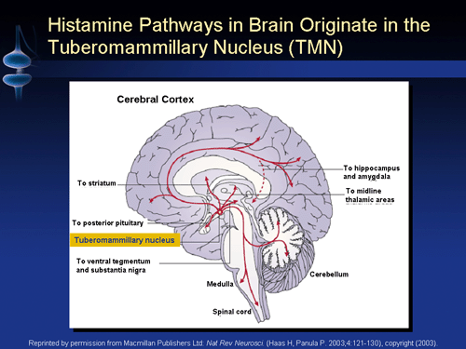

Slide 34
OREXIN AND WAKEFULNESS (WIKIPEDIA)
Orexin, also called hypocretin, is a neuropeptide that regulates arousal, wakefulness, and appetite.^{[1]} The most common form of narcolepsy, in which the sufferer briefly loses muscle tone (cataplexy), is caused by a lack of orexin in the brain due to destruction of the cells that produce it.^{[2]}
There are approximately 70,000 orexin producing neurons in the human brain that project from the lateral hypothalamus to neurons and brain regions that modulate wakefulness.^{[1][2]} However, the axons from these neurons extend throughout the entire brain and spinal cord,^{[3]} where there are also receptors for orexin.
Orexin was discovered in 1998 almost simultaneously by two independent groups of rat-brain researchers.^{[4][5]} One group named itorexin, from orexis, meaning "appetite" in Greek; the other group named it hypocretin, because it is produced in the hypothalamus and bears a weak resemblace to secretin.

Slide 35
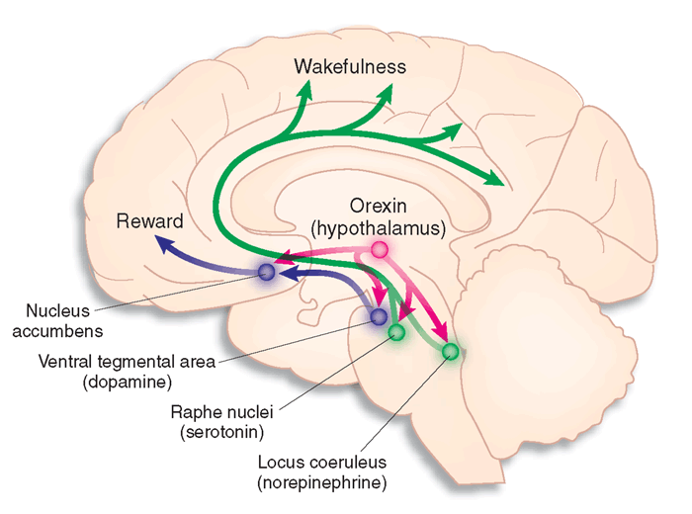
OREXIN AND AROUSAL AND WAKEFULNESS

Slide 36
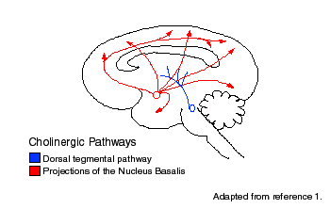
CHOLINERGIC PATHWAYS

Slide 37
ACH AND WAKEFULNESS
Wakefulness is maintained by activity in two systems of neurons, shown in green and red.
The green pathway shows neurons that make the neurotransmitter acetylcholine in the brainstem, while the red pathway is in the forebrain.
The brainstem arousal center supplies the acetylcholine for the thalamus and brainstem, and the forebrain center supplies the cerebral cortex.
Activation in these centers alone can create rapid eye movement sleep.
Activation of other neurons that make the neurotransmitters norepinephrine, serotonin, and histamine, shown in the blue pathways, is needed for waking.
Illustration by Lydia V. Kibiuk, Baltimore, MD; Devon Stuart, Harrisburg, PA

Slide 38
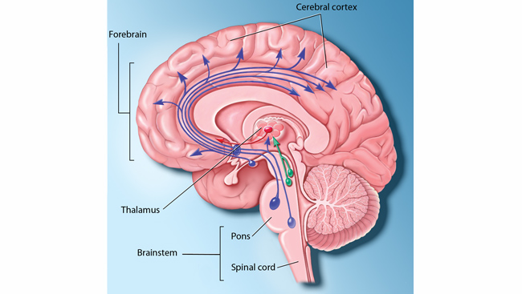
ACETYL CHOLINE AND WAKEFULNESS DIAGRAM

Slide 39
DEPRESSION
Anti-depressant drugs e.g. prozac decrease 5Ht reuptake but treatment needs 4 to 6 weeks to become effective i.e. not active through simple inhibition of re-uptake.
NORADRENALINE NEURON SYSTEM( from locus ceruleus which is located at junction of mid brain and pons)
From locus ceruleus descending to lateral tegmentum
descending spinal cord and brain stem and also
ascending through the ventral noradrenergic bundle.
Increased noradrenaline production.
Excitatory in some localities but inhibitory in some areas
Necessary for REM sleep
NB:Decreased noradrenaline
  Depresses mood

Slide 40
OTHER CHEMICALS -1
DOPAMINE
Ultra short, long, intermediate systems. Lost in basal ganglia with age. (This is shown by PET studies).
Men lose more dopamine than women.
In Schizophrenia- there is over stimulation of dopamine D2 limbic receptors.
HISTAMINE
Cells in tubomammillary nucleus project to all parts of brain. Thus they are involved in regulation of
  BP, sexual behavior, wakefulness, drinking, pain threshold and pituitary surge regulation.

Slide 41
OTHER CHEMICALS-2
ACETYL CHOLINE (ACh)
The Ach giant cells are located in the mesencephalon and the pons. These sre the GIGANTOCELLULAR NEURONS of the reticular activatory (AChsystem. These huge cell axon divide into two, one going up to higher areas and the othrer going down t the spinal level. Their activity causes acute wakefulness
Ach-is ubiquitous in CNS and is an excitatory neurotransmitter in most localities of the CNS.
Acetylcholine producing neurons are Lost in Alzheimer’s disease thus causing nucleus basalis inhibition.
OPIOID PEPTIDES.
3types –ubiquitous
needed for “drug tolerance” that is associated with drug and addiction
GABA
A general inhibitory neurotransmitter found in many pats of the brain

Slide 42
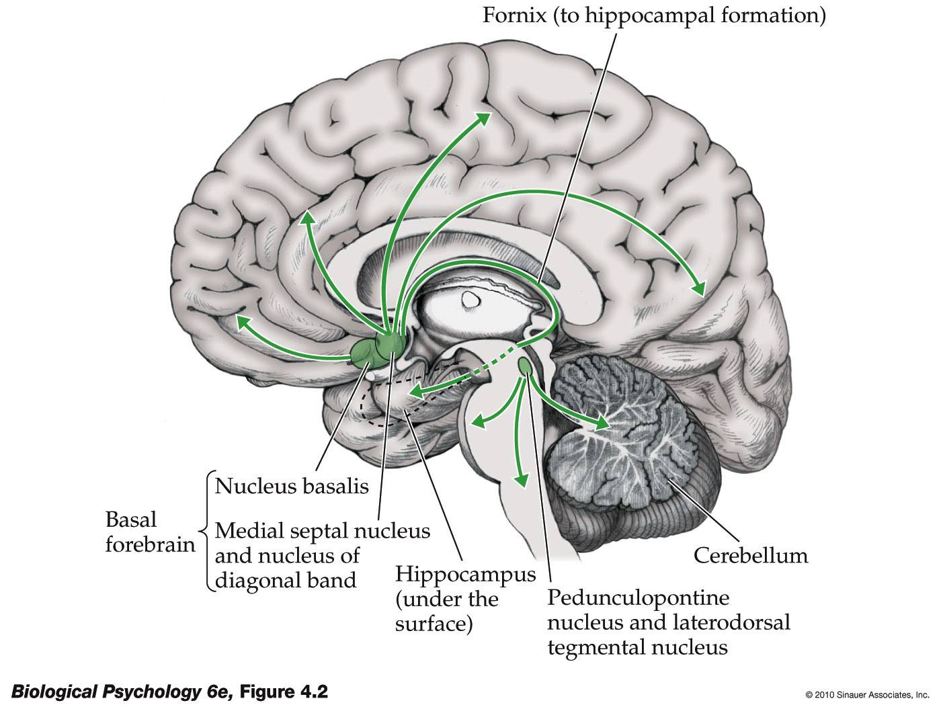

Slide 43
MOTIVATION AND BEHAVIOUR
ENERGY FOR LIFE
Living uses energy and we therefore need to replenish energy or i.e. we must spend energy to get energy. Animals must know where and how to invest energy.
ASSOCIATION CORTEX
A development for managing investment risk by using:
  all available information
  all past relevant experiences in memory
TO make the right investment decisions
We are adding knowledge stored outside the brain in books, computers and other people e.t.c. motivation leads to drive e.g. in hunger and feeling. Motivation makes a person to “feel like and DO something”.

Slide 44
MOTIVATION…cont
MOTIVATIONAL MAPS
Simplest tropisms e.g. phototropism, chemotropism e.t.c. in lower forms of life e.g. amoeba, plants e.t.c.
Higher animals are more complex because of 2 reasons:
  They face very many desirable and undesirable stimuli
  Most of the stimuli are learnt. i.e. most of these stimuli are secondary motivators like money which are linked to many desirables

Slide 45
HYPOTHALAMUS
The hypothalamus controls autonomic functions e.g. blood glucose, temp., osmolarity, hormone level and thus defines ones internal needs
controls primary consumatory responses i.e. drinking, eating, e.t.c.
the hypothalamus is linked to the hippocampus i.e. human behavior however complex may depend on the above simple factor these are:
  internal needs and
  external environment
i.e. human behavior is motivated by a series of tropistic gradients i.e. attractants and repellants.
The brain has reward and punishment centers.

Slide 46
REWARD CENTRES
Reward centers are located in:
The most potent ones are located in
  The area of the medial forebrain bundle up to
  The nucleus accumbens in the limbic between anterior thalamic nucleus hypothalamus.
NB strong stimulation of lateral nucleus of the hypothalamus causes –punishment feelings

Slide 47
REWARD CENTRES-cont
Reward centres also include:
septum
amygdala
parts of the thalamus
basal ganglia
Base of the mesencephalic tegmentum

Slide 48
PUNISHMENT CENTERS
MOST POTENT ARE :
central gray around aqueduct Sylvius in mesencephalonextending upwards into:
periventricular areas of hypothalamus
periventricular area of the thalamus
LESS POTENT-
amygdala
hippocampus
NB: stimulation of punishment centers can block reward areas completely. Therefore “nasty” feelings are more potent than “good” feelings

Slide 49
RAGE REACTION
RAGE REACTION
Can be elicited by stimulation of the middle and posterior punishment areas

Slide 50
FEAR AND ANXIETY REACTION
Can be elicited by stimulation of anterior punishment areas especially the midline pre-optic area.
Normal mood balance (seesaw diagram) +areas are:
  limbic system i.e. hippocampus, amygdala and anterior Limbic cortex esp. anterior Gyrus cinguli and sub-callosal gyrus.
Stimulation of these leads to suppression of rage.
Bilateral inhibition of the above limbic areas makes the subject have a “very short fuse”
i.e. the above areas do not necessarily have to cause “a feeling good”-their stimulation simply act by switching off rage.
*********************************************

Slide 51
HYPOTHALAMUS.
THE HYPOTHALSMUS
  Its functions control the internal environment
  controls autonomic functions e.g. blood glucose, temp., osmolarity, hormone level and thus defines ones internal needs
  controls primary consumatory responses i.e. drinking, eating, reproduction e.t.c.
the hypothalamus is linked to the hippocampus i.e. human behavior however complex may depend on a above simple factors:-
  internal needs and
  external environment
i.e. human behavior motivated by a series of tropistic gradients i.e. attractants and repellants.
The brain has reward and punishment centers.

Slide 52
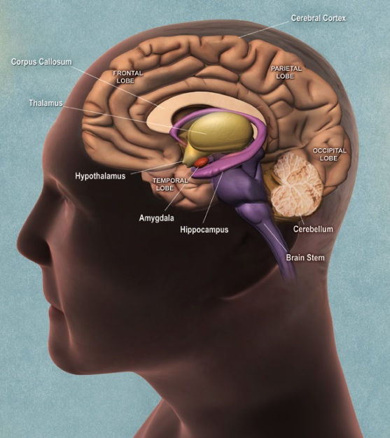
LOCATION OF HYPOTHALAMUS

Slide 53
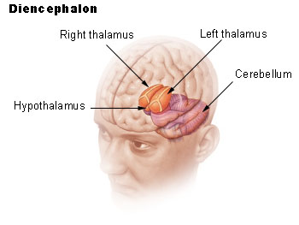
HYPOTHALAMUS LOCATION IN 3D

Slide 54
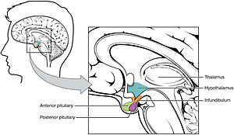
RELATIVE SIZE

Slide 55
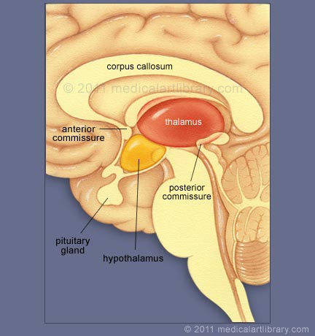
CROSS SECTION VIEW

Slide 56
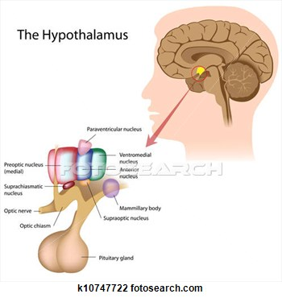
HYPOTHALAMIC NUCLEI/REGIONS

Slide 57
HYPOTHALAMUS –cont..
Almost all sensory stimuli ends up stimulating some part of the hippocampus. From hippocampus they go to anterior thalamus, hypothalamus and limbic system via main-main pathway which is the hippocampus
These hypothalamic connections enables sensory stimulation to cause appropriate behavior e.g. rage, passivity, sexual desire etc
NB: the hippocampus has only three layers in cortex thus it is very excitable- can experience local seizures with hallucinations and no loss of consciousness.
Hallucination involves olfactory, visual, auditory and tactile feelings .
Subiculum is the gray matter between the hippocampus & the neocortex .It is the mainconnection between the two and is largest in primates especially in humans.

Slide 58
LEARNING AND HIPPOCAMPUS
Bilareral damage will make the subject lose the ability to learn new learning things from the verbal symbolism i.e. verbal teaching. e.g. new names
.Such subjects can remember very short term memory events lasting from seconds to 2 minutes or so i.e. they seem to have normal no working memory.
They however have no ability for short trm memory. They cannotremember evets that occurred few minutes to one year before the damage occurred i.e. they have retrograde.
FUNCTIONS
Old rhinencephalon where smell-cognition, recognition, implication and food, danger e.t.c.
Humans: determines importance of information. important “things” are learned& non important things are not learned. I.e. 99% of stuff.

Slide 59
AMYGDALA
Deep nucleus of anterior temporal lobe.
Has Connection with hypothalamus & limbic system. Lower animals amygdala is connected to rhinencephalon.
Corticomedial nucleus of amygdala takes most of olfactory fibers and is important in animals.
Basal lateral nucleus in humans- Amygdala in humans has very strong connection with other sensory inputs.

Slide 60
The amygdala of the human brain is placed somewhat strategically at dorsomedial part (above and inside) of temporal lobe, anteriorly (in front) of the hippocampus and close to the tail of the caudate nucleus. It is placed quite near to the the hypothalamus and also the brainstem. Picture below shows the diagrammatic representation of amygdala’s location and structure. (image obtained from [ref2]).

Slide 61
This almond like structure, ranging from 1-4cm , average about 1.8cm, has extensive connection with the brain. This include it’s neighboring structure hippocampus, entorhinal cortex, basal ganglia (especially the striatum), brainstem, thalamus and hypothalamus. It is also connected well with the limbic system and other associative cortex, prefrontal cortex (major role in behavior), basal forebrain and ect. Hence, it’s stimulation is predicted to bring a major effect to the entire brain!

Slide 62
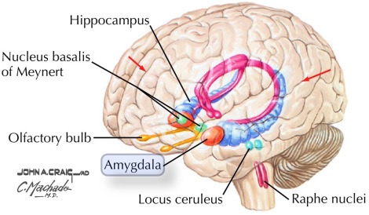

Slide 63
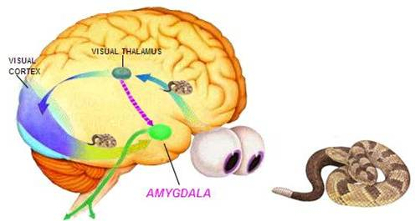
AMYGDALA AND FEAR

Slide 64
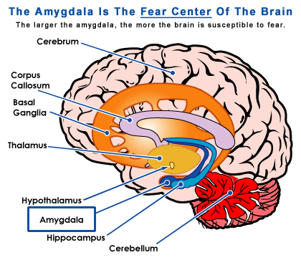

Slide 65
INPUTS INTO AMYGDALA
Afferents to amygdala come from:
  Limbic system
  neocortex-primary & associative especially auditory and visual association
This enables the amygdala to act as a window through the limbic system sees the place of the individual in the environment i.e. emotional, social & physical.

Slide 66
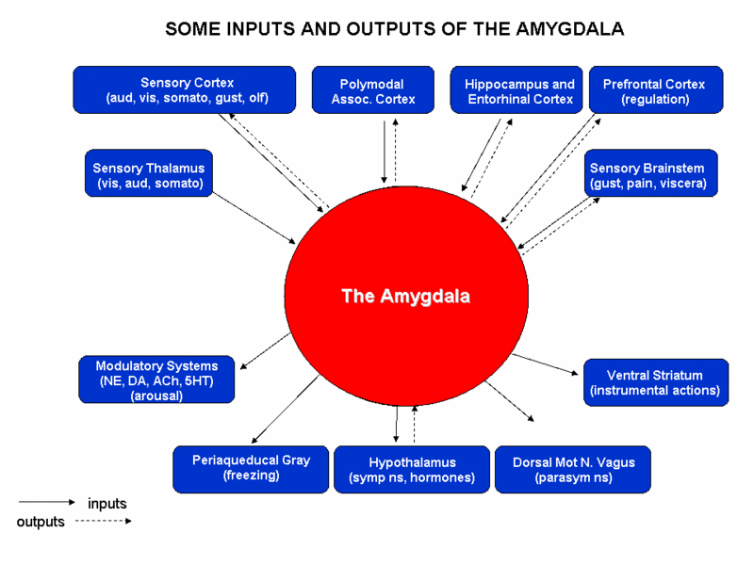

Slide 67
OUTPUTS FROM THE AMYGDALA
Feed back to neo cortex
feedback into hippocampus
into septum
into thalamus
into hypothalamus

Slide 68
AMYGDALA OUTPUTS ..cont..
many effects mediated via hypothalamus
blood pressure increase and decrease
increase and decrease in heart rate
GIT motility and surge increase & decrease
defecation and micturition
puppilary dilation & rarely constriction
piloerection
anterior pituitary hormone surge especially ACTH & gonadotropins surge.

Slide 69
AMYGDALA OUTPUTS ..cont-2
Involuntary movements e.g.(somatic)
tonic-raising head and bending body
circling movements
clonic rhythmical movement-ballistic motor activity
vegetative movements-olfactory, eating, licking, chewing, swallowing
complex behavior patterns e.g. rage, escape, fear, punishment, reward and pleasure i.e. stimulation to hypothalamic reactions.

Slide 70
AMYGDALA AND SEXUAL ACTIVITIES
These activities involve complex reflexes that depending on circustances may lead to:
erection
copulatory movements
ejaculation
ovulation
uterine contractions
parturition-pre mature labor

Slide 71
KLUVER BUCY SYNDROME
Bilateral ablation of amygdala and of temporal cortex above it in monkeys & humans.
cross examination of objects orally in monkeys
fearlessness(monkey will prod snakes)
decreased aggression
increased tameness
change of dietary habits –herbivorous to omnivorous
psychic blindness(not able to “see” feelings in others. )
cross examination of same object
Increased sex drive (in male animals) towards - immature animals of same kind, mature animals and animals of other species
Human males show similar traits as other primates
Human females become nymphomaniacs and exhibit inciting sex behaviour towards men be they strangers or their male doctors (see extra notes in “word” format
rapid forgetfulness
overeating and omniphagia

Slide 72
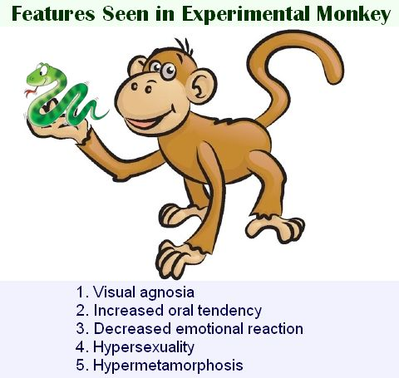
KLUVER BUCY SYNDROME IN MONKEY

Slide 73
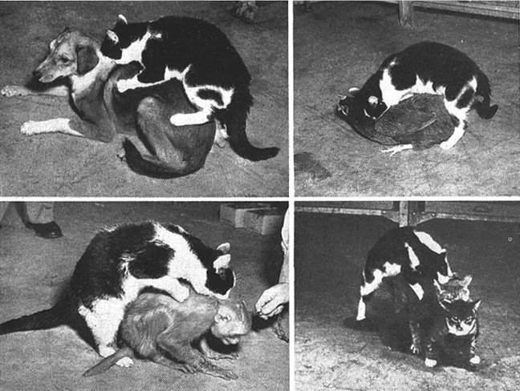
KLUVER BUCY MALE CAT MATING BEHAVIOUR

Slide 74
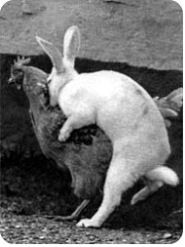
KLUVER BUCY MALE RABBIT MATING BEHAVIOUR

Slide 75
SUMMARY OF AMYGDALA FUNCTION
Amygdala acts as a behavior awareness “keyboard” which operates at a semiconscious level
The amygdala “informs” the limbic system of individuals-environment & thoughts thus ensures behavioral pattern is appropriate for the emotional & external environment & occasion

Slide 76
LIMBIC CORTEX
Cerebral association area for behavioral function. Ablation studies prove this e.g.
anterior temporal cortex bilateral inhibition- inhibition of amygdala as well thus kluver Bucy syndrome.
inhibition of posterior orbital& frontal cortex(the underside of frontal cortex)- insomnia, motor restlessness(moving all the time-akathisia)
inhibition of gyrus cinguli anterior together with sub-callosal gyrus –inhibition of communication between prefrontal cortex and sub cortical limbic structures. Thus release of rage structure in hypothalamus & septal area thus viciousness and very short fuse.

Slide 77
SUMMARY OF LIMBIC FUNCTIONS
Anterior temporal cortex-gustatory & olfactory are the association areas
parahippocampal gyri- complex auditory association area & complex thought association from Wernicke’s area.
middle & posterior temporal lobe-sensory motor association
LIMBIC SYSTEM is the visceral brain. Limbic cornus receives interoceptive & exteroceptive inputs.

Slide 78
EMOTIONAL STATES
Only two:
arousal
conservation
arousal
emotional state associated with sleep tropistic gradient.
  Source of desirable goal toward or away from sources of threat
  fight or fright
physiological body changes facilitate anticipated activity to suit the emotional state 7 accompany activity. Details to the system response to fight or flight –explain coward “thinks with feet” e.t.c. this state consumes a lot energy but considering threat there is need for self preservation.

Slide 79
CONSERVATION
When faced with a situation in which every possible action is unpleasant thus “standing in the middle of minefields” one “freezes” & hopes threat will go away on its own
Stupor, atonia, sleeps, hibernating animals “feign dead”. too bad for monkeys & snakes and small animals & cars. Thus temporary threat is tolerated, energy saved & when threat gives way the animals makes off.
Emotional accompaniment
Face falls
Jaw sags
Mouth angle decreases
Nothing is worth doing feeling
Sleepy
Fixed immobile eyes

Slide 80
MIXED AND/OR CONFUSED EMOTIONAL STATES
NB: attractants are also repellants e.g. predators quarry may kill or injure hunter, mating opens males to killing by rivals
NB. Human’s food does not injure except Japanese fish
Frustrations may cause rage e.g. in lab chimps expected to tell difference & circles & ellipses when the two shapes are almost similar
Sexual behavior in humans may change to sadism
Affection may be show by kissing, love bites & licking- part of food drive?
Anticipatory frontal lobe memory
Very important in humans. Adds a temporal dimension to human emotions e.g. hope, worry, regret, confidence.

Slide 81
NEURAL MECHANISMS OF EMOTIONS
Maintaining life(conserving self)involves:
keeping a constant internal environment
reacting to or (with changing for humans) the external environment so as to ensure that the parameters for internal environment are kept within controllable limits e.g. temperature, food , body & limb integrity e.t.c.
involves receiving and analyzing external stimuli and making appropriate responses
Hence bulk of brain is for:
sensory analysis
co-ordination of motor responses- all determined by the hypothalamus with its 4 inputs (autonomic afferents and receptors for milieu interior exterior through limbic) and out puts(autonomic systemic control and pituitary efferent control).

Slide 82
HYPOTHALAMIC NEURAL MECHANISMS
Thee hypothalamus therefore acts as the
interphase unit between the brain and blood
organ for co-coordinating internal stimuli & responses with external stimuli & responses thus hypothalamus needs detectors & response generator.

Slide 83
PAPEZ EMOTION CIRCUIT - 1

Slide 84
PAPEZ EMOTION BRAIN SCHEME

Slide 85
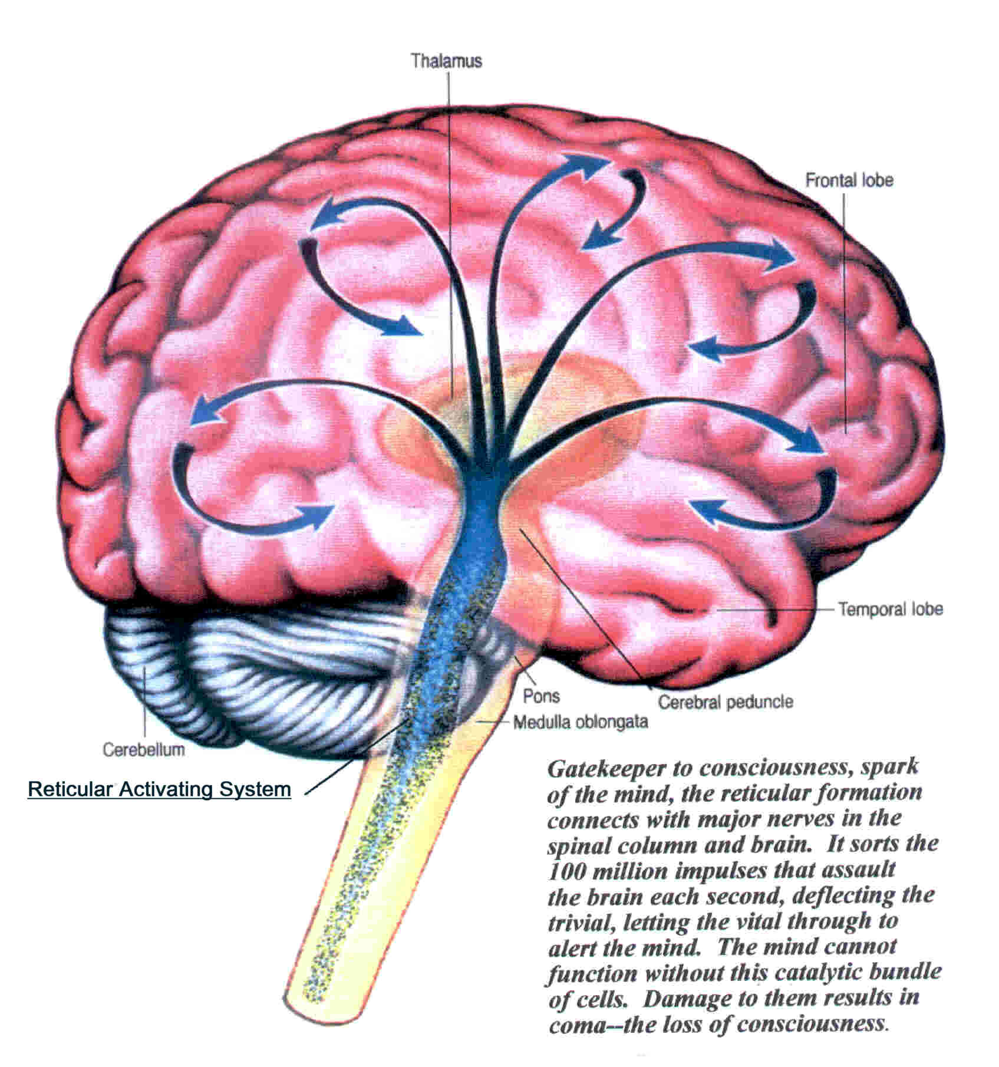
RAS

Slide 86
END

