Slide 1
EXERCISE

Slide 2
MEASURUMENT OF HEART RATE
Palpating arterial pulse: Radial, femoral artery etc.
ECG
Digital pulse on a continuous monitor
Flow meter/pulse oximeter
Auscultation (esp. in pediatrics)

Slide 3
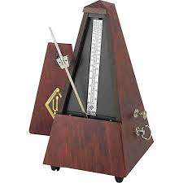
HARVARD STEP TEST
Requirements:
Stop watch
Step/platform
Metronome-synchronize number of steps per minute

Slide 4
HARVARD STEP TEST
Aim: Assess aerobic fitness based on change in heart rate
Procedure;
1) Resting HR and BP measured (Time zero)
2)Step up and down for 5 min or exhaustion.
3) Measure HR and BP every 30s and 1min respectively for 5 min after exercise.

Slide 5
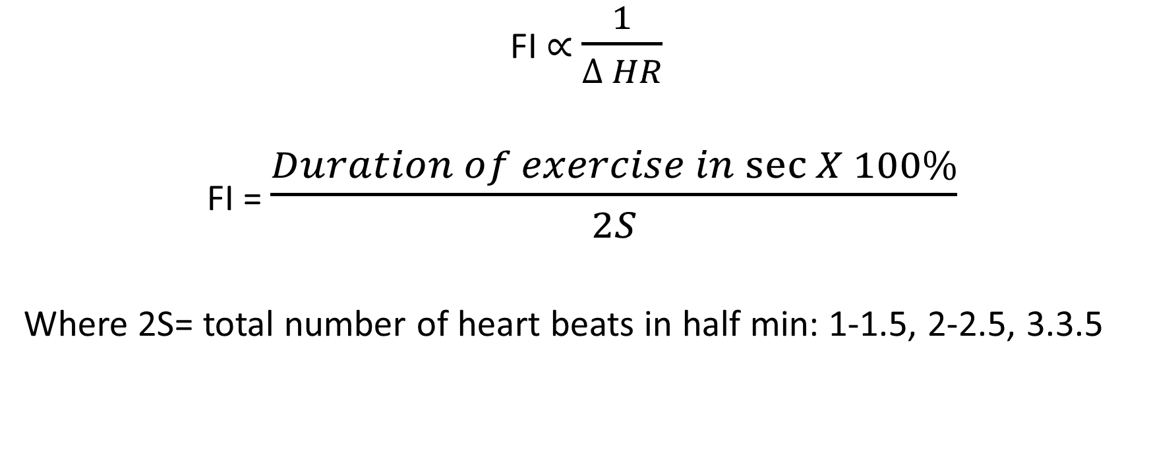
Fitness index (FI)
FI $∝$ $\frac{1}{∆ HR}$
FI = $\frac{Duration of exercise in\sec{X 100\%}}{2S}$
Where 2S= total number of heart beats in half min: 1-1.5, 2-2.5, 3.3.5

Slide 6
HARVARD STEP TEST
Time (min) | Pulse( beats/min) | Systolic BP | Diastolic BP
0 | 76 | 120 | 80
0.5 | 142 | - | -
1 | 138 | 150 | 100
1.5 | 136
2 | 126 | 150 | 90
2.5 | 118
3 | 110 | 130 | 90
3.5 | 98
4 | 90 | 110 | 80
4.5 | 82
5 | 78 | 120 | 80
Calculate for the above subject
S
Fitness index
Grade FI

Slide 7
Grading of FI
Fitness index (%) | comment
Over 89 | excellent
79- 89 | Very good
69- 79 | Good
59- 69 | Fair
Less than 59 | Poor

Slide 8
Indicators of fitness
Low resting HR (Normal 60-100 beats/min)
Slight rise in HR
Steep drop back to resting or below resting after 5 min
Systolic BP behaves typically like HR

Slide 9
TRENDS IN DIASTOLIC BP
Remain constant
Rise slightly the declines to resting
Initial drop, followed by a rise then a drop
Initial drop is caused by natural downregulation of adrenergic receptors in peripheral arterioles

Slide 10
THANK YOU

