Slide 1
Applied Physiology Practical – (Heart, Gut and ANS)
Dr A W Muriithi
MBChB, BPharm, BDS Level II
January 2018

Slide 2
Applied Physiology
The practical involves:-
Observation of normal rabbit tissue activity in:-
    in vitro heart preparation
    in vitro jejunum preparation
Observation of the effects of various chemical interventions on normal muscular activity

Slide 3
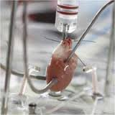
Rabbit heart preparation

Slide 4
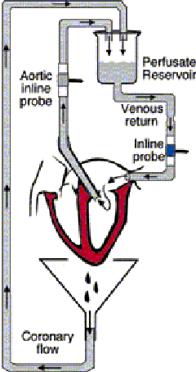
In vitro perfusion of the rabbit heart

Slide 5
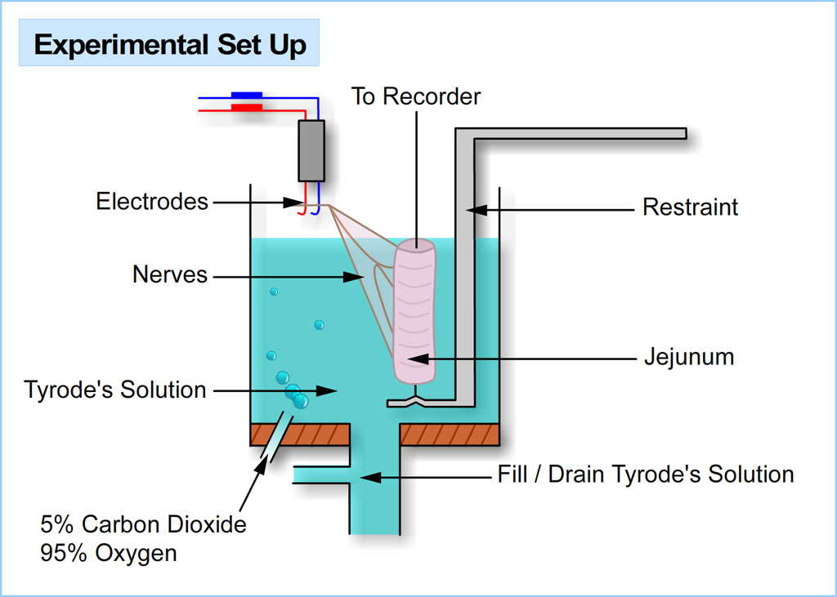
Rabbit jejunum preparation

Slide 6
‘Success is a lousy teacher.
It seduces smart people into thinking they can’t lose.’
Bill Gates
Co-founder Microsoft, Philanthropist

Slide 7
Revision topics - 1
The following topics are critical to the appreciation of the practical session. They should be read and understood prior to the laboratory session.
Level one Anatomy – gross, histology, embryology
  Heart
  Digestive system
  Autonomic nervous system

Slide 8
Revision topics - 2
Level one Physiology
  Basic cell physiology
  Receptor physiology
  Cell-to-cell communications, neuropeptides etc
  Autonomic nervous system – Sympathetic, Parasympathetic and Enteric nervous systems
  Muscle physiology (especially smooth and cardiac muscle)

Slide 9
Thank you
We invite you to enjoy the learning process afforded by the practical ☺

