Slide 1
CLINICAL EXAMINATION OF CHEST
RESPIRATORY SYSTEM
NB: MOST OF THE IMMAGES IN THIS PRESENTATION HAVE BEEN DOWNLOADED FROM THE WEB.

Slide 2
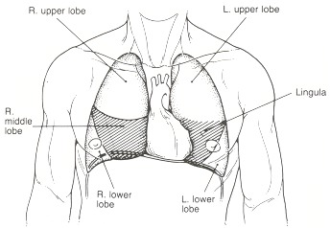
ANATOMY

Slide 3
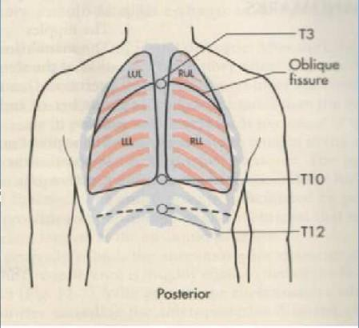
ANATOMY

Slide 4
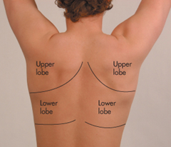
SURFACE ANATOMY

Slide 5
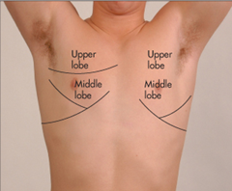
SURFACE ANATOMY

Slide 6
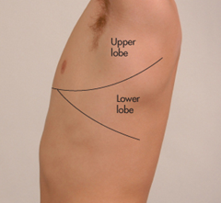
SURFACE ANATOMY

Slide 7
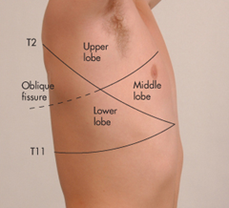
SURFACE ANATOMY

Slide 8
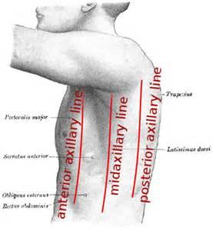
EXAMINATION LANDMARKS – AXILLA

Slide 9
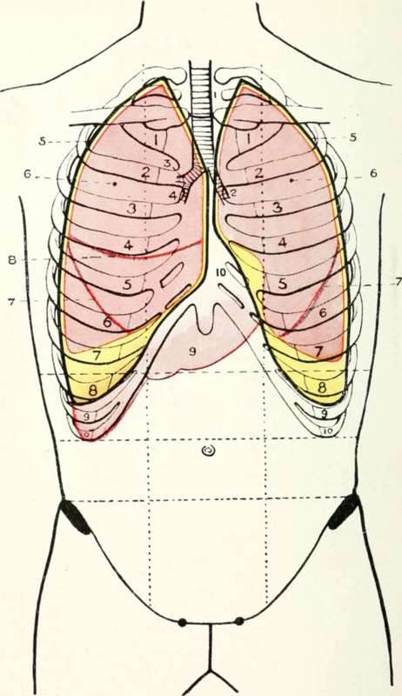
SURFACE ANATOMY SKELETAL LANDMARKS

Slide 10
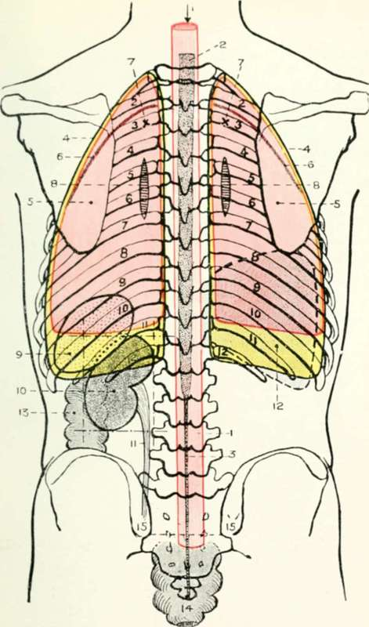
SURFACE ANATOMY SKELETAL LANDMARKS

Slide 11
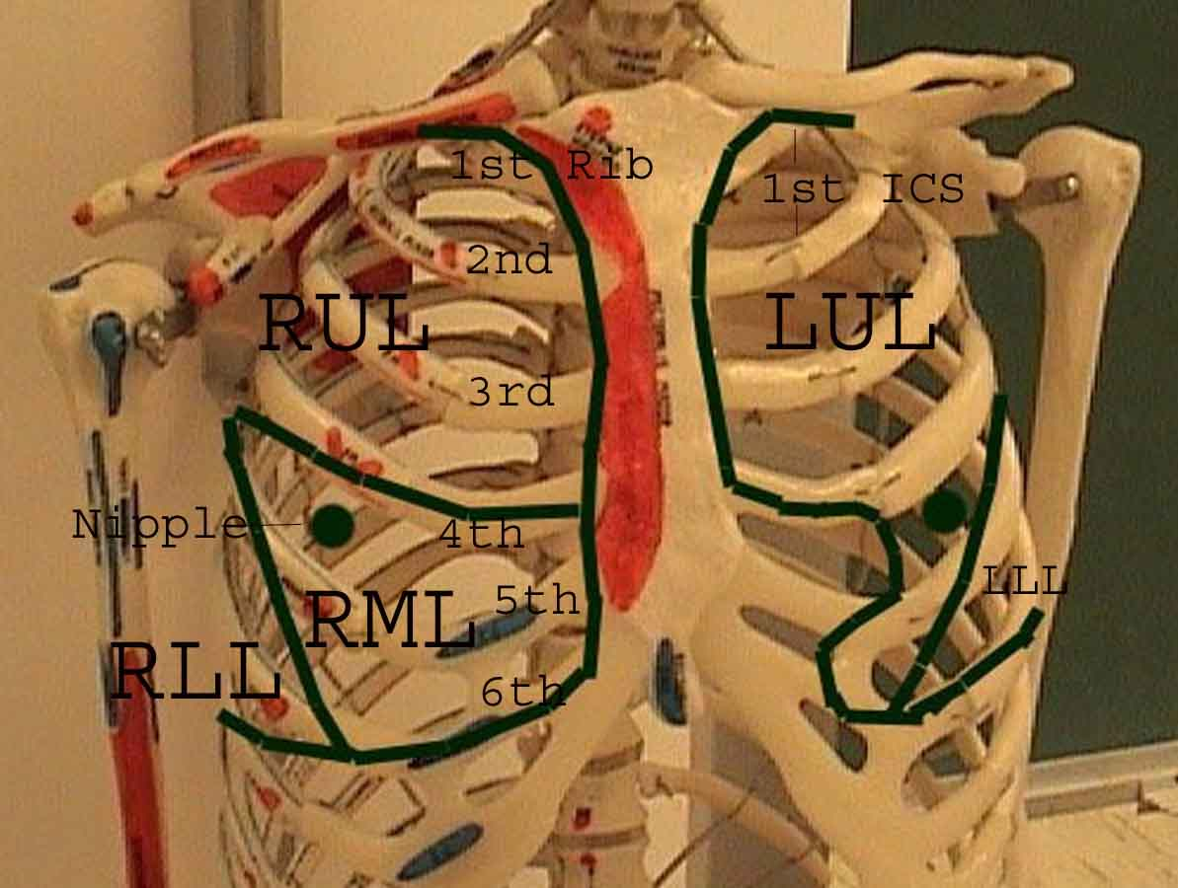
SKELETAL LANDMARKS

Slide 12
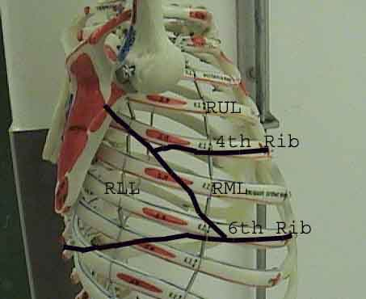
SKELETAL LANDMARKS

Slide 13
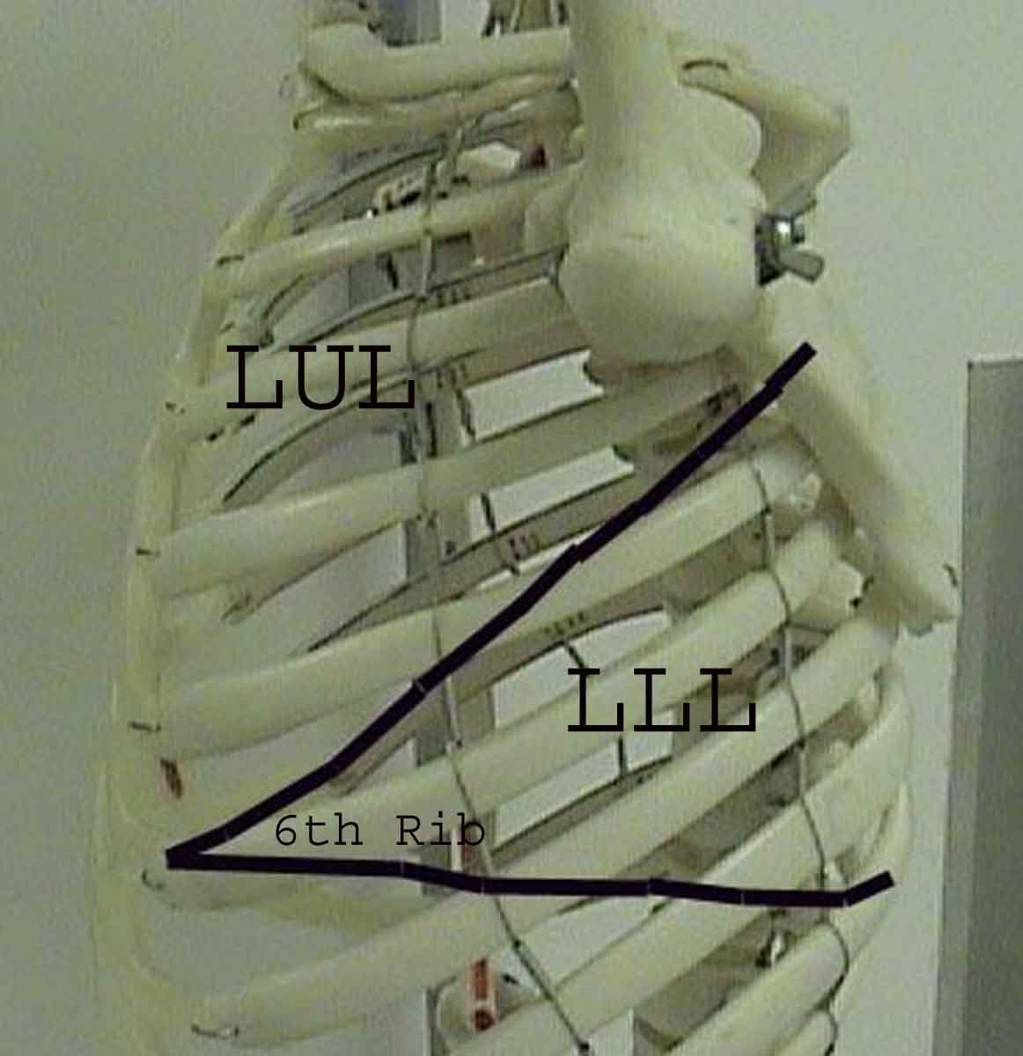
SKELETAL LANDMARKS

Slide 14
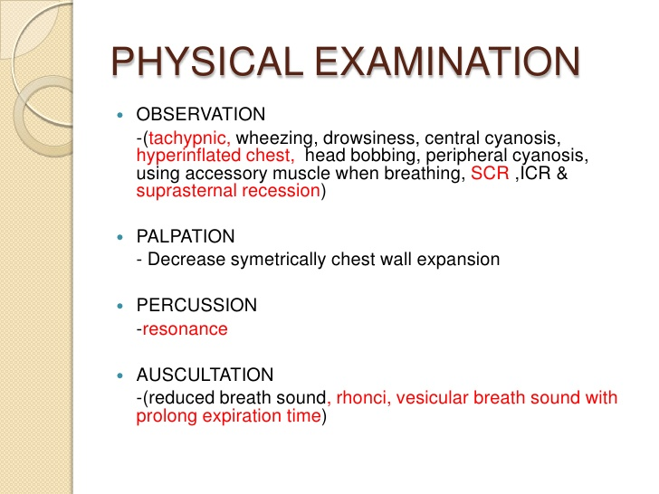
NB: OBSEVATION IS THE SAME AS “INSPECTION”

Slide 15
CLINICAL EXAMINATION
INVOLVES THE FOLLOWING PROCEDURES
HISTORY TAKING (not part of the practical but will be covered thoroughly in the clinical years)
PHYSICAL EXAMINATION
RECORDING THE FINDINGS, CAREFULLY AND SYSTEMATICALLY, FOR EACH PATIENT IN AN INDIVIDUAL FILE
THE PROCESS IS CALLED “Clerking a patient”
NB: MOST OF THE IMMAGES IN THIS PRESENTATION HAVE BEEN DOWNLOADED FROM THE WEB.

Slide 16
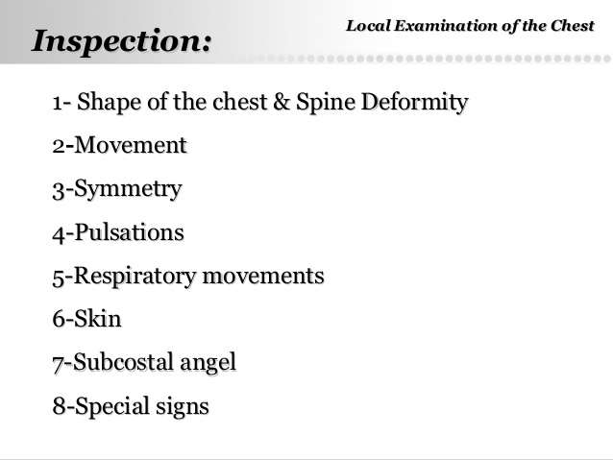

Slide 17
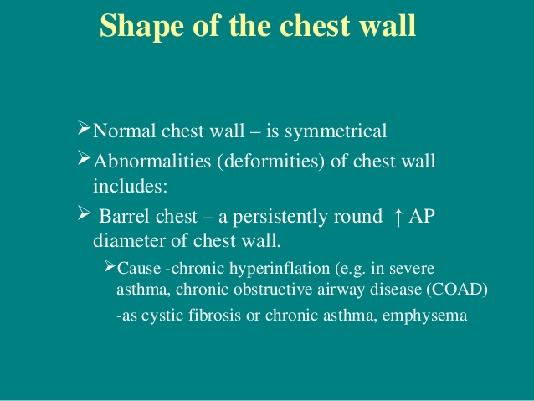

Slide 18
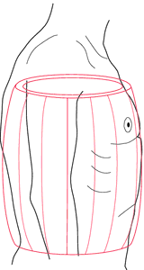
BARREL-SHAPED CHEST WALL

Slide 19
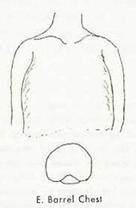
BARREL-SHAPED CHEST WALL

Slide 20
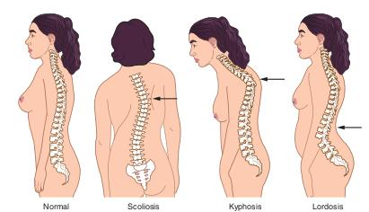

Slide 21
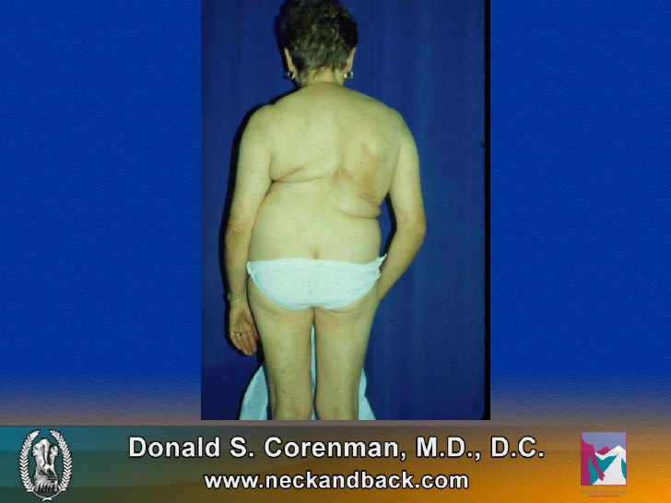
LADY WITH SCOLIOSIS

Slide 22
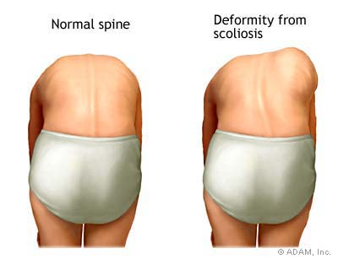
NORMAL vs SCOLIOSIS DEFORMITY

Slide 23
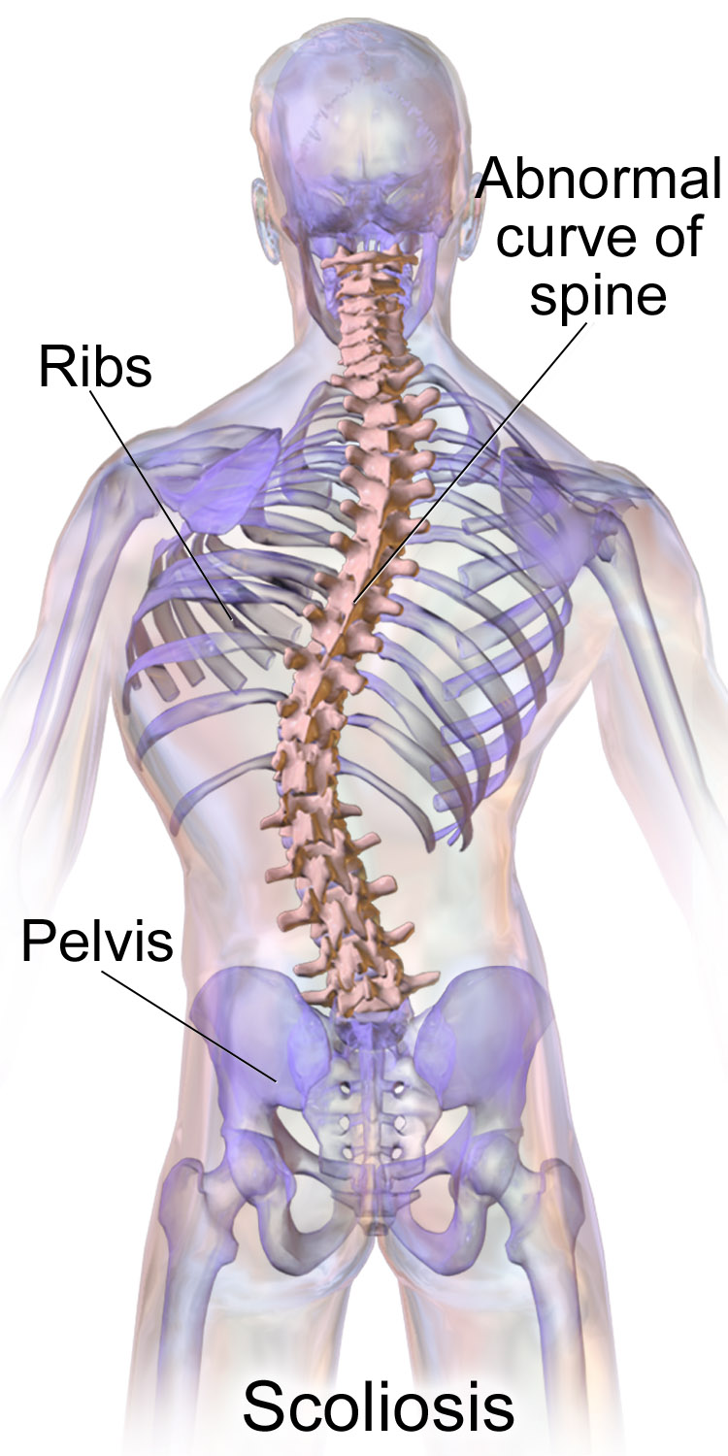
SKELETAL ABNORMALITY IN SCOLIOSIS

Slide 24
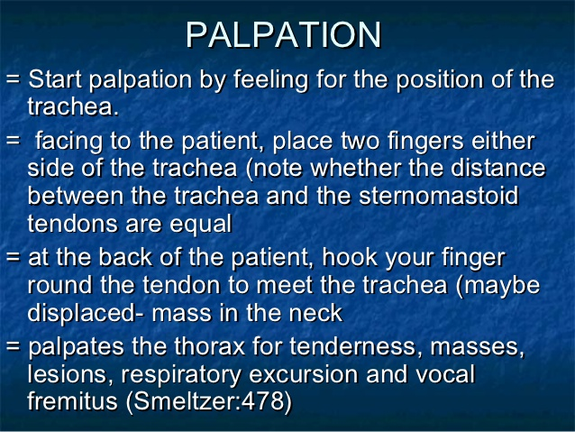

Slide 25
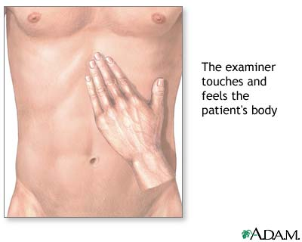
PALPATION

Slide 26
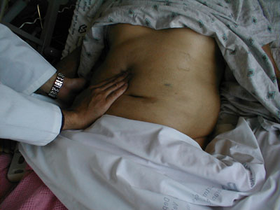
PALPATION

Slide 27
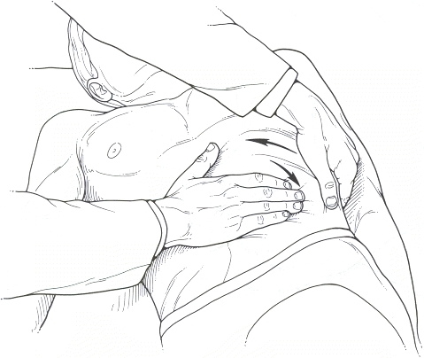
PALPATION

Slide 28
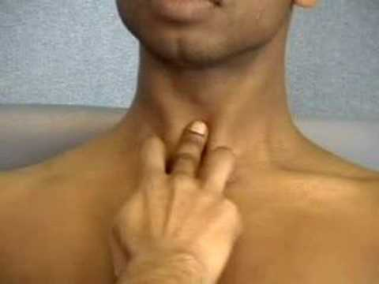
POSITION OF THE TRACHEA

Slide 29
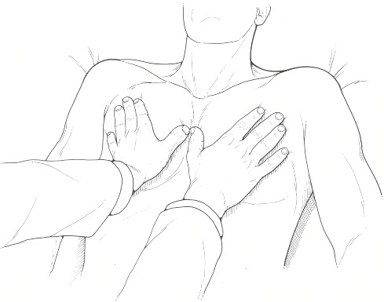
PALPATION FOR CHEST MOVEMENT-1

Slide 30
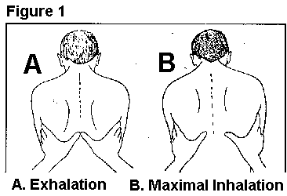
PALPATION FOR CHEST MOVEMENT-2

Slide 31
PALPATION

Slide 32
PALPATION FOR TACTILE VOCAL FREMITUS
ELICIT TACTILE VOCAL FREMITUS (TVF)
PALPATE ALL LUNG FIELDS WHILE SUBJECT/PATIENT IS VOCALIZING “NINETY NINE”
NB THE SAME PHENOMENON IS TERMED “VOCAL RESONANCE” (VR) WHEN IT IS ELICITED DURING AUSCULTATION

Slide 33
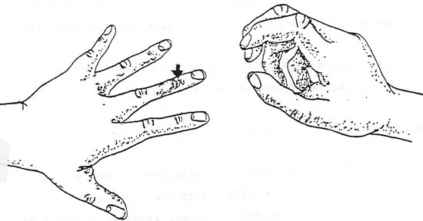
PERCUSSION

Slide 34
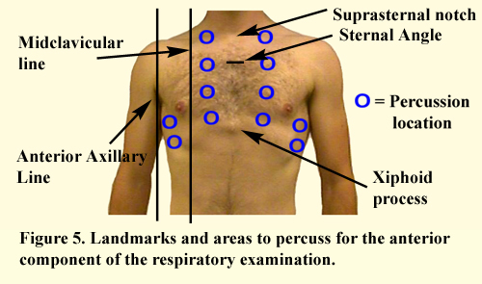
PERCUSSION POINTS- FRONT

Slide 35
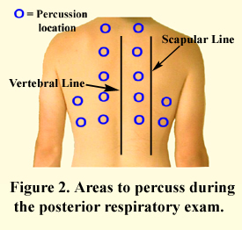
PERCUSSION POINTS- BACK

Slide 36
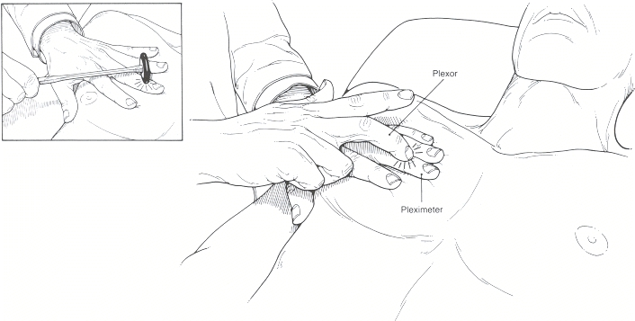
PERCUSSION

Slide 37
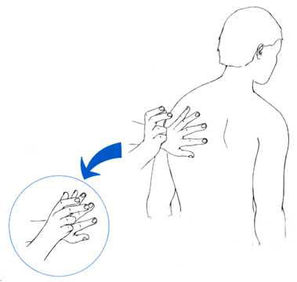
PERCUSSION

Slide 38
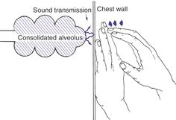
PERCUSSION

Slide 39
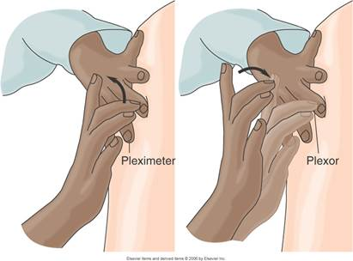
PERCUSSION

Slide 40
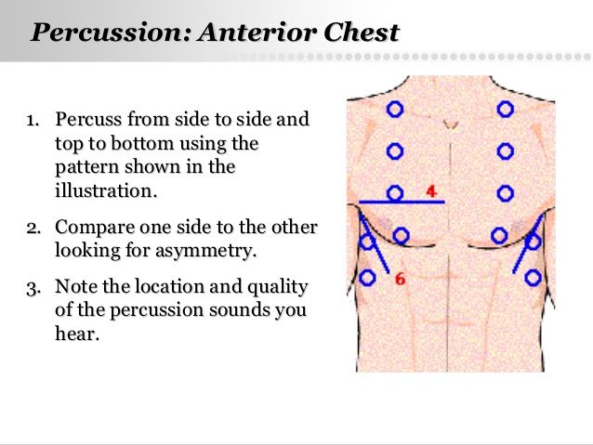
PERCUSSION

Slide 41
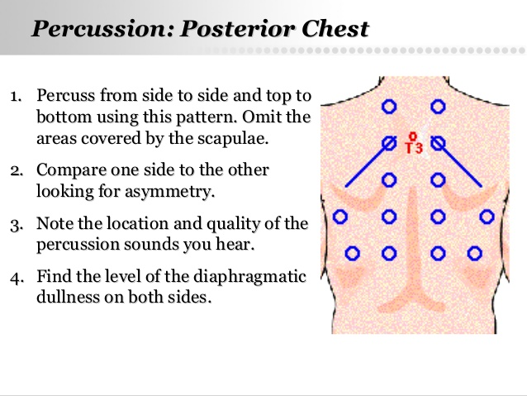
PERCUSSION

Slide 42
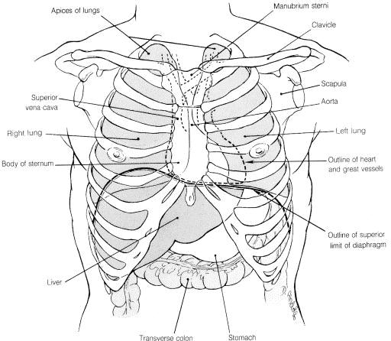
NON-RESPIRATORY ORGANS THAT AFFECT PERCUSSION NOTE

Slide 43
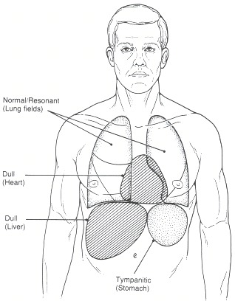
PERCUSSION

Slide 44
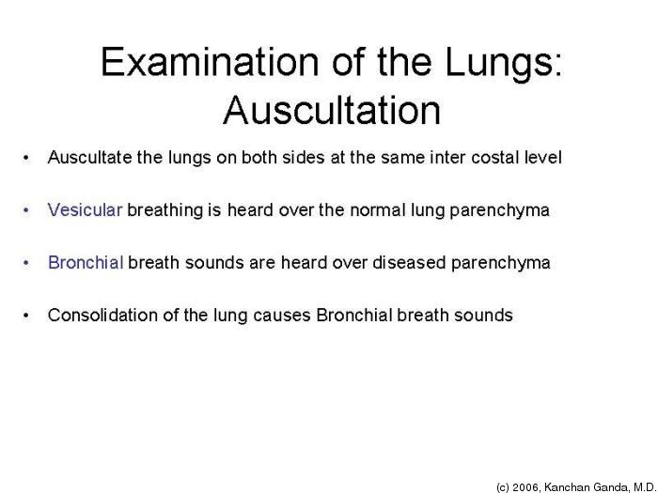
AUSCULTATION

Slide 45
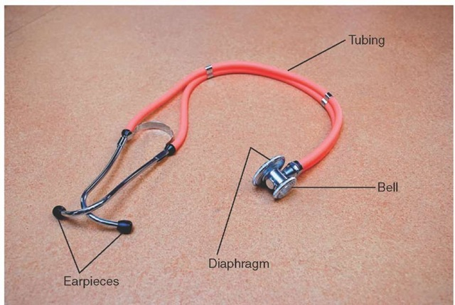
STETHOSCOPE

Slide 46
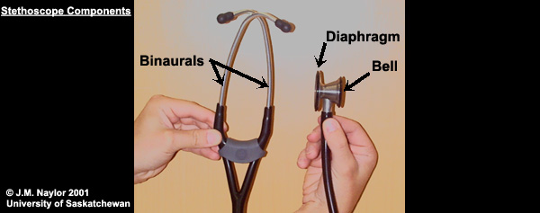
EAR AND CHEST PIECES

Slide 47
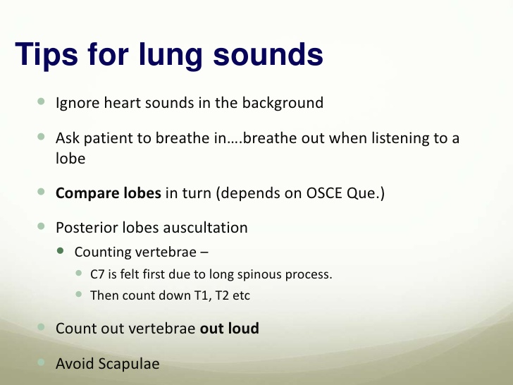
AUSCULTATION TIPS

Slide 48
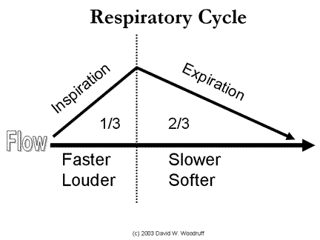
NORMAL BREATH SOUNDS

Slide 49
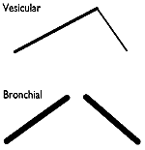
BRONCHIAL vs VESICULAR BREATH SOUNDS

Slide 50
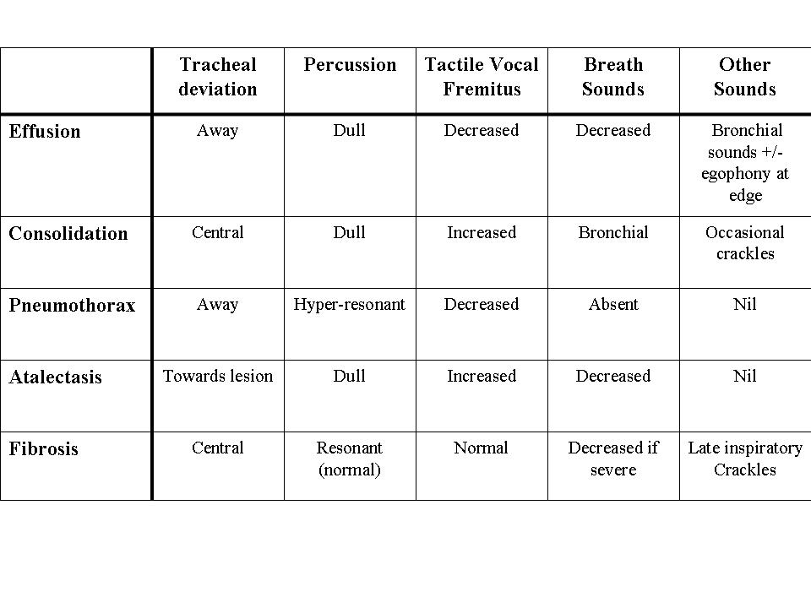
SUMMARY TABLE

Slide 51
..THE END…
I THANK YOU ALL
FEB 4 2015 MILLENIUM HALL

