Slide 1
Introduction to Vision Assessment
Dr Teresa Kinyari Mwendwa
Level 2 MBChB, Bpharm,BDS
Thursday September 11th 2015

Slide 2
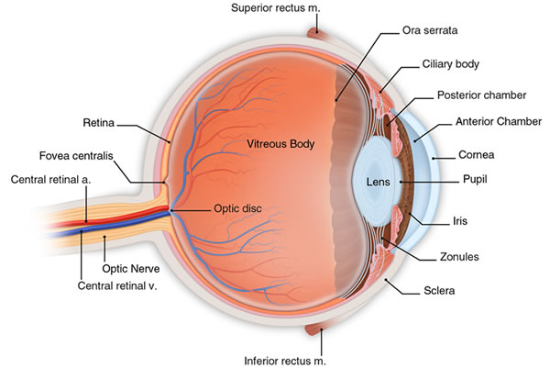
Anatomy

Slide 3
Anatomy
Extraocular movements
Medial
Lateral
Upward
Downward

Slide 4
Visual Acuity
General physical examination should include :
Visual acuity
Pupillary reaction
Extraocular movement
Direct ophthalmoscope
Dilated exam (in case of visual loss or retinal pathology)
Distance or Near
Distance visual acuity at age 3
early detection of amblyopia

Slide 5
Definition
The resolving power of the eye used to assess and quantify the eye’s ability to resolve varying letter sizes
Visual acuity is dependent on:
The refractive error of the eye
The health and the integrity of the eye
The test targets used
The test conditions

Slide 6
Measurement
The measurement of VA is done to monitor change in vision with disease progression of disease and/or treatment plan
It is a way to measure “blur” vision
Visual acuity must be measured on every patient at every visit!

Slide 7
Standard Test Distances
Distance visual acuity (DVA)
20ft or 6M is equivalent to optical infinity
Near visual acuity (NVA)
40cm

Slide 8
Weymouth Classification of Visual Acuity Measurements
Minimum distinguishable (or minimum visible)
The ability to see something as being distinguishable from the background
Minimum separable
The ability to determine a group of points or lines as separate and distinct
Minimum cognizable or legible
The ability to form sense (e.g., Landolt C) or minimum legible (e.g., letters or numbers)

Slide 9
History
Early astronomers found two stars resolvable as separate if the distance between the stars subtend an angle of at least 1 minute of arc

Slide 10
Snellen Test
In 1862 Snellen and Giraud-Toulon introduced a system for measuring VA
A form of minimum legible visual acuity task
Snellen acuity is based on a minimum angle of resolution of 1 minute of arc
Visual acuity target designs: optotypes
The Snellen optotype has overall dimensions that are 5 times the detail

Slide 11
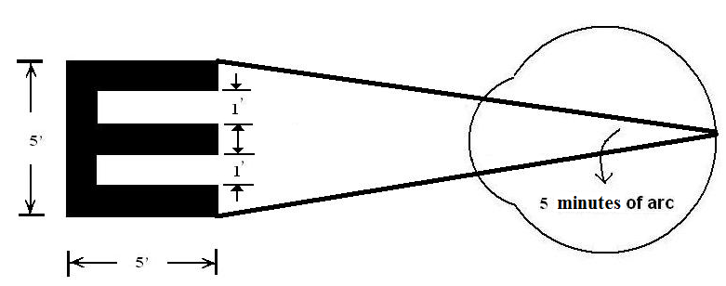
Typical Snellen Optotype

Slide 12
Snellen Notation
Snellen fraction
Test distance divided by the distance at which optotype would subtend 5 minutes of arc at the retina
The denominator of the Snellen fraction is termed the foot-letter size
The letter’s overall size, both angularly and linearly
The average emmetrope has a VA of 20/20 or better
This is based on a test distance of 20ft
The classic Snellen fraction is the reciprocal of the minimum angle of resolution (MAR)

Slide 13
Snellen Acuity and Minimum Angle of Resolution
Snellen Acuity | Snellen Acuity | Minimum Angle of Resolution
Fraction | Decimal | Minutes of Arc
20/20 | 1.0 | 1
20/25 | 0.80 | 1.25
20/30 | 0.67 | 1.5
20/40 | 0.50 | 2
20/50 | 0.40 | 2.5
20/100 | 0.20 | 5
20/200 | 0.10 | 10

Slide 14
Snellen Chart

Slide 15
Snellen Test
Snellen equivalent
If the test distance is not 20ft, the measured Snellen fraction may be used to predict what the patient’s VA would be for a 20ft distance
Example
Patient can resolve a 30ft letter at a test distance of 15ft. The Snellen acuity is 15/30.
15/30 =20/x
x = 40
The Snellen equivalent is 20/40

Slide 16
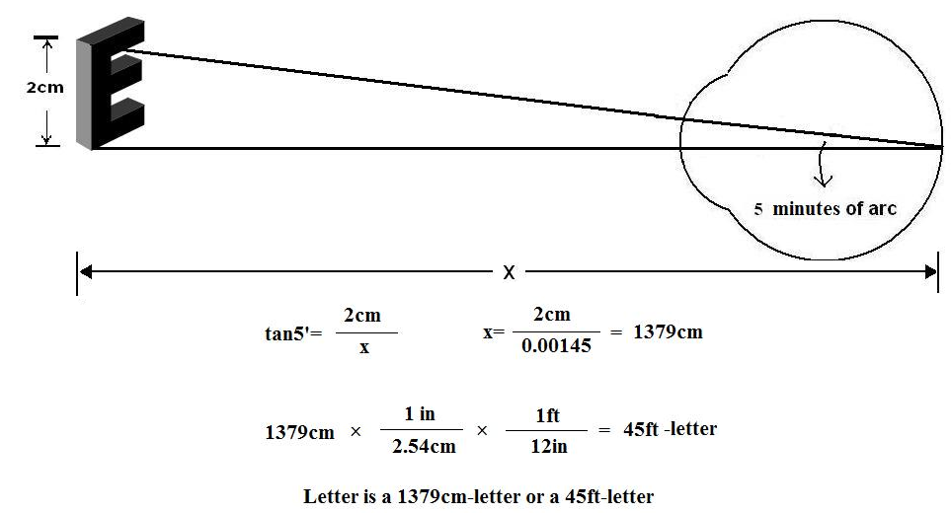
Calculating a Visual Acuity Test Object’s Foot-Letter Designation
Example of a letter that is 2cm tall

Slide 17
Types of Distance Visual Acuity Charts
Wall charts
Testing VA in literate adults
Printed on cardboard and mounted on a wall
Well-suited for vision screenings and doctors’ offices
Variations: Tumbling E chart, Landolt C chart, Bailey-Lovie chart

Slide 18
Tumbling E Chart

Slide 19
Landolt C Chart

Slide 20
Bailey-Lovie Chart

Slide 21
Types of Charts
Hand-held visual acuity cards
Primarily for children in vision screenings
Simplest form is the letter E in different sizes printed onto hand-held cards
Free space testing

Slide 22
Types of Charts
Chart projectors
Projects test objects onto a screen
Standard chart projector can be calibrated for varying testing distances between 10ft and 20ft
Optically “fold” the testing distance using mirrors to create appropriate testing distance (20ft is the standard)

Slide 23
Calibration of Chart Projectors
Measure the testing distance
Calculate how large an optotype would have to be on the screen to represent 20/200 for that testing distance
Adjust the lenses in the chart projector until the letter size from the previous step is achieved

Slide 24
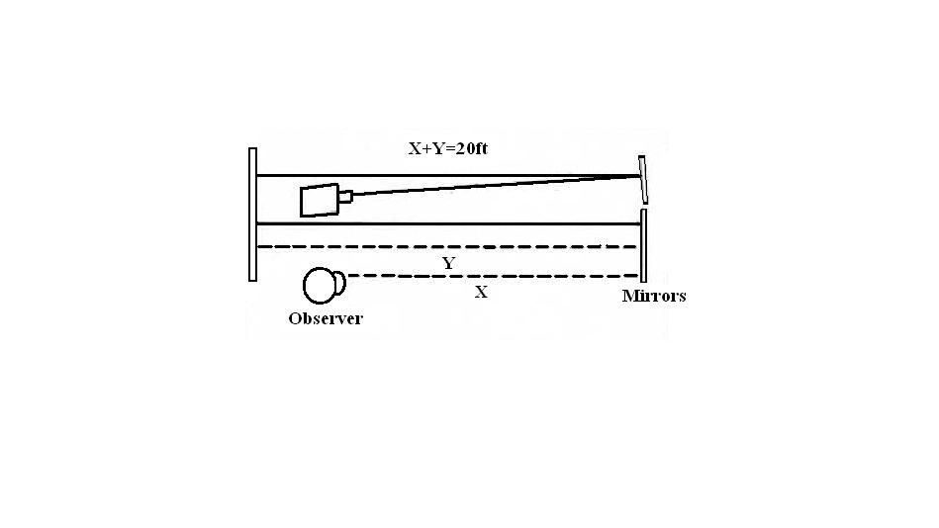
Chart Projector Set-Up

Slide 25
Calibration of Chart Projector
A 20 foot-letter is 8.87mm. May use direct proportions to calculate the letter size that would be needed to represent 20/20 for any possible testing distance.
Example
8.87mm/20ft = x/17ft
x = 7.54mm

Slide 26
Recording
Record the VA line for which more than 2 letters (or less than half the number) are read incorrectly

Slide 27
Recording
Examples
Two out of five letters on the 20/20 line are read incorrectly
20/20 -2
All letters on the 20/20 line are read correctly, and one letter on the next line down is read correctly
20/20 +1
One of the letters on the 20/20 line is read incorrectly, and two letters on the 20/15 line are read correctly
20/20 -1/+2

Slide 28
Recording
Points to consider
Ask the patient to read a line over again or show the letters to the patient one line at a time
Isolate lines on the chart to avoid distracting influences
May consider showing the patient a line of the same VA on a different slide, if the projector has more than one slide

Slide 29
Expected Findings
A visual acuity of 20/20 or better is considered normal
The difference between the two eyes should be no greater than one line

Slide 30
Pinhole Visual Acuity
Purpose
To determine if a decrease in vision is correctable by lenses
Pinhole visual acuities are taken when the patient’s entering VA is worse than 20/30 at distance and near through the habitual correction

Slide 31
Expected Findings
If the cause of the patient’s decreased visual acuity is due to an uncorrected refractive error, the VA is expected to improve through the pinhole
If the cause of decreased visual acuity is not optically based, no improvement, and possibly a decrease, will occur through the pinhole

Slide 32
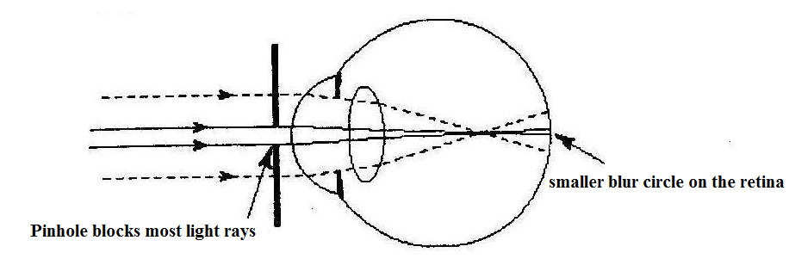
Pinhole Effect

Slide 33
Near Visual Acuity
Testing the VA at close range (usually 40cm)
Near visual acuities are taken through the habitual correction
The purpose is to detect people with near vision difficulties (e.g., uncorrected high hyperopia, accommodative dysfunction)
In patients over 40 years old, the reduced near visual acuity is one of the symptoms of presbyopia

Slide 34
Near Vision Charts
Types of notation
Reduced Snellen Acuity card
Test distance at 16in (or 40cm)
Jaeger Acuity Card
20 letter sizes classified J1 to J20
Test distance at 14in
Point system
Each point is 0.35mm
M notation
Based on meter unit

Slide 35
Bailey-Lovie Reading Card

Slide 36
Lea Symbols

Slide 37
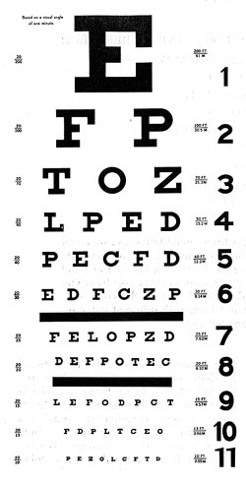
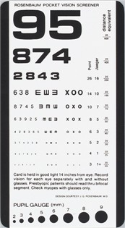
Snellen eye chart
Rosenbaum pocket chart

Slide 38
Distance Visual Acuity Testing
Place patient at 6 metres from Snellen chart
OD then OS
VA is line in which > ½ letters are read
Pinhole if < 6/12
6/6
Distance between the patient and the eye chart in metres
_____________________________________________
Distance at which the letter can be read by a person with normal acuity in metres

Slide 39
Near Visual Acuity Testing
Indicated when
Patient complains about near vision
Distance testing difficult/impossible
Distance specified on each card (35cm)

Slide 40
Pupillary Examination
Direct penlight into eye while patient looking at distance
Direct
Constriction of ipsilateral eye
Consensual
Constriction of contralateral eye

Slide 41
Ocular Motility
Rt superior rectus Lt inferior oblique |  | Lt superior rectus Rt inferior oblique
Rt lateral rectus Lt medial rectus |  | Lt lateral rectus Rt medial rectus
Rt inferior rectus Lt superior oblique |  | Lt inferior rectus Rt superior oblique

Slide 42
Direct Ophthalmoscopy
Tropicamide or phenylephrine for dilation
unless shallow anterior chamber
unless under neurological evaluation
Use own OD to examine OD
Same for OS

Slide 43
Intraocular Pressure Measurement
Range: 10 - 22

Slide 44
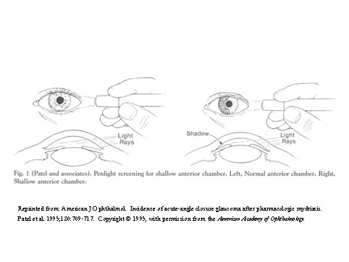
Anterior chamber depth assessment
Likely shallow if
≥ 2/3 of nasal iris in shadow

Slide 45
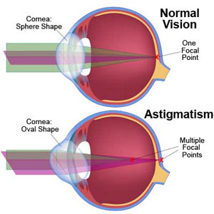
Astigmatism

Slide 46
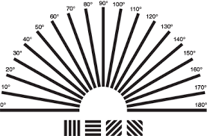
Astigmatism

Slide 47
Principles of Visual Field Testing and Perimetry
Why are visual fields performed ?
(a) It is the only clinical test that measures peripheral visual function.
(b) Visual fields improve detection of disease (many ocular and neurologic deficits affect peripheral vision before the fovea or macula is involved.

Slide 48
PURPOSE
This procedure measures in diopters a patient’s ability to change the focus of the eye’s crystalline lens in response to a near stimulus.

Slide 49
EQUIPMENT
Near point visual acuity card.
Tape measure in centimeters.
Occluder.

Slide 50
SET-UP
The patient is tested wearing his habitual distance correction. This test may also be performed behind the phoropter as a part of the post-refraction phorometry sequence.
Either the patient or the examiner may hold the near point card.
The near point card should be well-illuminated.

Slide 51
STEP-BY-STEP PROCEDURE
Instruct the patient to occlude his left eye to test the right eye.
Direct the patient’s attention to a row of letters one or two lines larger than his near VA.
Instruction the patient to keep the letters clear.
Slowly move the chart closer to the patient and ask the patient to report when the letters become and remain blurry.

Slide 52
STEP-BY-STEP PROCEDURE
Measure the distance from the chart to the patient’s spectacle plane in centimeters. The linear measurement is referred to as the near point of accommodation.
Convert the linear distance into diopters by dividing the near point of accommodation in centimeters into 100. The resulting dioptral value represents the patient’s amplitude of accommodation.
Occlude the right eye and test the left eye using steps 1 to 6.

Slide 53
RECORDING
Record the method of testing used.
Record the amplitude of accommodation in diopters (round off to the nearest half diopter).
Separately record the results for the right and left eyes.
EXAMPLES
Amp (push-up) OD 7.0D OS 7.0D
Amp (push-up) OD 6.0D OS 6.0D

Slide 54
EXPECTED FINDINGS
The expected amplitude of accommodation decreases with age. The two most commonly used systems for obtaining the expected amplitude of accommodation are
A. Hofstetters’ formulas
Minimum expected amplitude = 15 – 0.25 (age)
Average expected amplitude = 18.5 – 0.30 (age)
Maximum expected amplitude = 25 – 0.40 (age)
Donder’s table for age-referenced amplitude of accommodation
The amplitude of accommodation of the two eyes should be within one diopter of each eye.

Slide 55
Donder’s table
Age | Amplitude | Age | Amplitude
10 | 14.00 | 45 | 03.50
15 | 12.00 | 50 | 02.50
20 | 10.00 | 55 | 01.75
25 | 08.50 | 60 | 01.00
30 | 07.00 | 65 | 00.50
35 | 05.50 | 70 | 00.25
40 | 04.50 | 75 | 00.00

Slide 56
Fundoscopy
https://youtu.be/YP1nbM3x-uU

Slide 57
Principles of Visual Field Testing and Perimetry

Slide 58
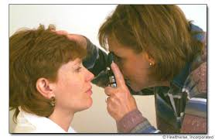
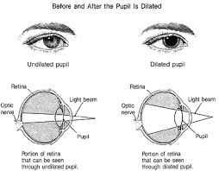
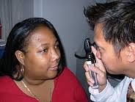
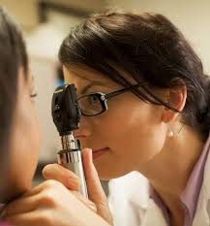
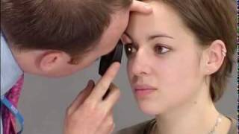
Fundoscopy

Slide 59
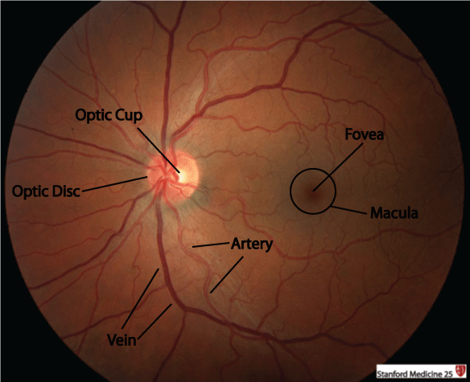
Fundoscopy

Slide 60
Why are visual fields performed ?
(c) Visual fields provide useful differential diagnostic information – the pattern and location of visual loss is specific to damage at particular locations along the visual pathways, unlike visual acuity loss, which is not very specific.
(d) Many people are unaware of peripheral vision loss, particularly if it is gradual, and even if it affects their ability to perform daily tasks such as navigation, etc.

Slide 61
A cookbook for visual field evaluation
(a) Place the left eye visual field on the left and the right eye visual field on the right.
(b) For each eye, is the visual field normal or abnormal ? (If normal in both eyes, you’re done)
(c) If abnormal, is it one eye or both eyes ?
(d) If in one eye, it’s retina or optic nerve.

Slide 62
A cookbook for visual field evaluation
(e) Where is the defect ? (sup, inf, nasal, temporal)
Nasal or binasal – glaucoma, optic nerve or retina
Bi temporal – chiasm
Nasal in one eye, temporal in the other – postchiasm

Slide 63
A cookbook for visual field evaluation
(f) What is the shape (features) of the defect ? Respect the vertical, respect the horizontal, point to the blind spot, point to fixation, etc.
(g) How do the two eyes compare ? (homonymous, congruous) (h) Where is the most likely location of the deficit ?

Slide 64
Key features to remember
(a) Respect the horizontal - Glaucoma, optic nerve, retina
(b) Respect the vertical - Chiasm, post-chiasm
(c) Point to the blind spot - Optic nerve, glaucoma
(d) Point to fixation - Chiasm, post-chiasm

Slide 65
Key features to remember
(e) Bitemporal – Chiasm
(f) Homonymous - Post-chiasm - The greater the congruity between eyes, the farther back in the optic radiations.
(g) Central - Retina, optic nerve

Slide 66
Types of deficits
(a) Optical factors (cataract, corneal abnormalities) - Usually diffuse or widespread losses
(b) Retinal Disease - Ring Scotomas (retinitis pigmentosa), arcuate defects (branch artery occlusion), central and centrocecal (between the blind spot and fixation – candle flame shaped) irregular (scalloped) edges to deficits.
(c) Glaucoma - Nasal steps, paracentral defects, arcuate scotomas, temporal wedges, fan-shaped defect that points to the blind spot.

Slide 67
Types of deficits
(e) Chiasmal lesions (pituitary adenoma, pituitary apoplexy) – Bitemporal defects. Defects point to fixation and vertical meridian is respected.
(f) Lateral geniculter lesions – Are very rare. Deficits appear as a tongue shape along the horizontal meridian or the tonue is the only remaining visual field.

Slide 68
Types of deficits
(g) Post-chiasmal defects (temporal lobe, parietal lobe, occipital lobe deficits) The vertical meridian is respected
Temporal Lobe – Defects are “pie in the sky” deficits and are incongruous between eyes and point to fixation.
Parietal lobe - Defects are “pie on the floor” are more congruous between eyes and point to fixation.
Occipital lobe - Cookie cutter punched out lesions that are highly congruous between eyes and point to fixation.

Slide 69
Summary of steps in eye exam
Visual Acuity
Pupillary examination
Visual fields by confrontation
Extraocular movements
Inspection of
lid and surrounding tissue
conjunctiva and sclera
cornea and iris
Anterior chamber depth
Lens clarity
Tonometry
Fundus examination
Disc
Macula
vessels

