Slide 1
Fluid balance and replacement therapy
Dr Otieno ES

Slide 2
Body Water Content
Infants have low body fat, low bone mass, and are 73% or more water
Total water content declines throughout life
Healthy males are about 60% water
females are around 50%

Slide 3
Body Water Content
This difference reflects females’:
Higher body fat.
Smaller amount of skeletal muscle
In old age, only about 45% of body weight is water

Slide 4
Body compartments
Composition of Body Fluids

Slide 5
Water Balance and ECF Osmolality
To remain properly hydrated, water intake just equal water output
Water intake sources
Ingested fluid (60%) and solid food (30%)
Metabolic water or water of oxidation (10%)

Slide 6
Water Balance and ECF Osmolality
Water output
Urine (60%) and feaces (4%)
Insensible losses (28%), sweat (8%)
Increases in plasma osmolality trigger thirst and release of antidiuretic hormone (ADH)

Slide 7
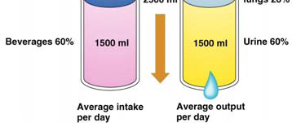
Water Intake and Output

Slide 8
Regulation of Water Intake
The hypothalamic thirst center is stimulated:
By a decline in plasma volume of 10%–15%
By increases in plasma osmolality of 1–2%
Via baroreceptor input, angiotensin II, and
other stimuli

Slide 9
Regulation of Water Intake
Thirst is quenched as soon as we begin to
drink water
Feedback signals that inhibit the thirst centers
include:
Moistening of the mucosa of the mouth and
throat
Activation of stomach and intestinal stretch
receptors

Slide 10
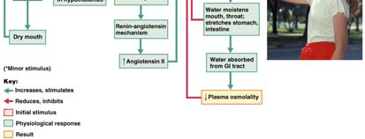
Regulation of Water Intake: Thirst Mechanism

Slide 11
Regulation of Water Output
Obligatory water losses include:
Insensible water losses from lungs and skin
in feaces
Sensible water loss of 1500ml in urine
Kidneys excrete 900-1200 mOsm of solutes
blood homeostasis

Slide 12
Influence and Regulation of ADH
Hypothalamic osmoreceptors trigger or inhibit
ADH release
Factors that specifically trigger ADH release
include prolonged fever; excessive sweating,
vomiting, or diarrhea; severe blood loss; and
traumatic burns

Slide 13
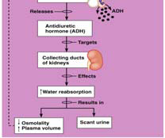
Mechanisms and Consequences of ADH Release

Slide 14
Disorders of Water Balance: Dehydration
Water loss exceeds water intake and the
body is in negative fluid balance
Causes include: haemorrhage, severe burns,
prolonged vomiting or diarrhoeal, profuse
sweating, water deprivation, and diuretic
abuse
Other consequences include hypovolaemic
shock and loss of electrolytes

Slide 15
Disorders of Water Balance: Dehydration

Slide 16
Disorders of Water Balance: Hypotonic Hydration
Renal insufficiency or an extraordinary amount
of water ingested quickly can lead to cellular
over hydration, or water intoxication
ECF is diluted – sodium content is normal but
excess water is present
The resulting hyponatremia promotes net
osmosis into tissue cells, causing swelling
This leads to nausea, vomiting, muscular
cramping, cerebral oedema, disorientation,
convulsions, coma and death

Slide 17
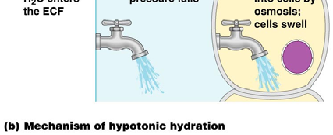
Disorders of Water Balance: Hypotonic Hydration

Slide 18
Disorders of Water Balance: Oedema
Atypical accumulation of fluid in the interstitial
space, leading to tissue swelling
Caused by anything that increases flow of
fluids out of the bloodstream or hinders their
return
Factors that accelerate fluid loss include:
Increased capillary hydrostatic pressure
Increased blood pressure, capillary
permeability, incompetent venous valves,
localized blood vessel blockage,
congestive heart failure, hypertension,
high blood volume

Slide 19
Disorders of Water Balance: Oedema
Increased capillary permeability
Due to inflammation
Decreased blood colloid osmotic pressure
Hypoproteinemia
Forces fluids out of capillary beds at the
arterial ends
Fluids fail to return at the venous ends
Results from protein malnutrition, liver
disease, or glomerulonephritis

Slide 20
Oedema
Increased interstitial colloid osmotic
pressure
Blocked (or surgically removed) lymph
vessels cause leaked proteins to
accumulate in interstitial fluid
Interstitial fluid accumulation results in low
blood pressure and severely impaired
circulation

Slide 21
Race is still on...

