Slide 1
THE MALE AND FEMALE REPRODUCTIVE SYSTEMS
Introduction: Both male and female reproductive systems develop and function along the same model undergoing similar or equivalent developmental stages at corresponding times in life.
they originate from bipotential cells or tissues which respond, differentiate, develop and functionalise towards either male or female polarity. The potential for incomplete or partial expression may remain and be observed even at later stages, hence ambiguous genitalia.
Direction of differentiation and development is determined or influenced by:
(i) Sex Chromosomes (X,Y) Hy Antigen presence
at 6 weeks – gonads at 7 weeks – int genitalia (female)
and expression

Slide 2
Gonadol Secretions (hormones) at 8 weeks Extgenitalia (both)
at 32 weeks Descent of testes
at 7 weeks Int.genitalia (Male)
at 8 weeks Ext.genitalia (Male)
after 12 weeks Ext.genitalia(female)
at term Descent of testes
Pubscence size and function
Exogenous hormones & 6-9 weeks teratogecity
External factors orgnogenesis abberations
at term size & expression
(female)
Hypothalamus – hypophyseal at birth development and
and environmental factors pubescence function
(v) Appropriate Receptor all stages Gonals, genitalia Distribution tissues

Slide 3
DIFFERENTIATION AND DEVELOPMENT OF GONADS
Both start off as Bipotential Gonads at 6 weeks I.U.L.
MALE GONAD requires Y-chromosome, Hy antigen (peptide), SRY ring, Testicular Determining Factor (TDF) to differentiate into testes.
FEMALE GONAD only needs on 2 normal X-chromosomes.
Serteh cells already elaborate Hy Antigen and M.I.S. at 7 weeks and intersticial cells of leydig produce active Testosterone at 8 weeks.
These hormones are functional throughout development of male genitalia in uterus. Emibryonic steroids do not influence development of genitalia in uterus.

Slide 4
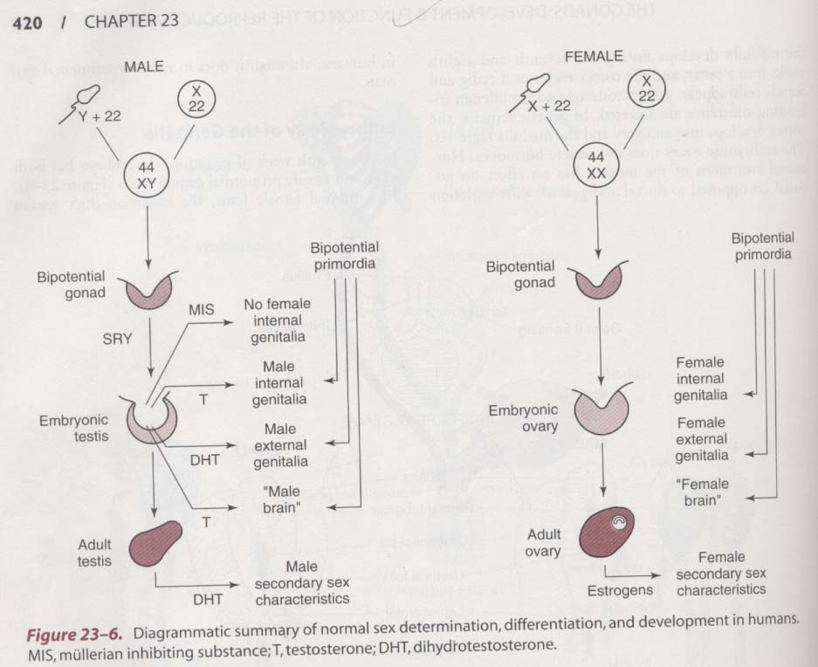
IV.

Slide 5
III. DIFFERENTIATION AND DEVELOPMENT OF INTERNAL GENITALIA
Week 5 Week 5 Male Female
Indifferent
Urogenital ducts Week 6
From Metanephros Week 7
UROGENITAL RIDGE Mesophros
Primordial Ducts Renal Calices Paramesonephros
On Ureters WOOLFIAN DUCTS
Lateral Body Mass Dependent on XY MULLERIAN DUCTS
dependent on XX
Epidydymis Fallopian Tubes
Vas Deference Uterus
Seminal Vesicles Urine Cervix
Ejaculatory ducts upper 4/5 vagina
mulenian ducts involute or regree under MIS woolfian ducts involute

Slide 6
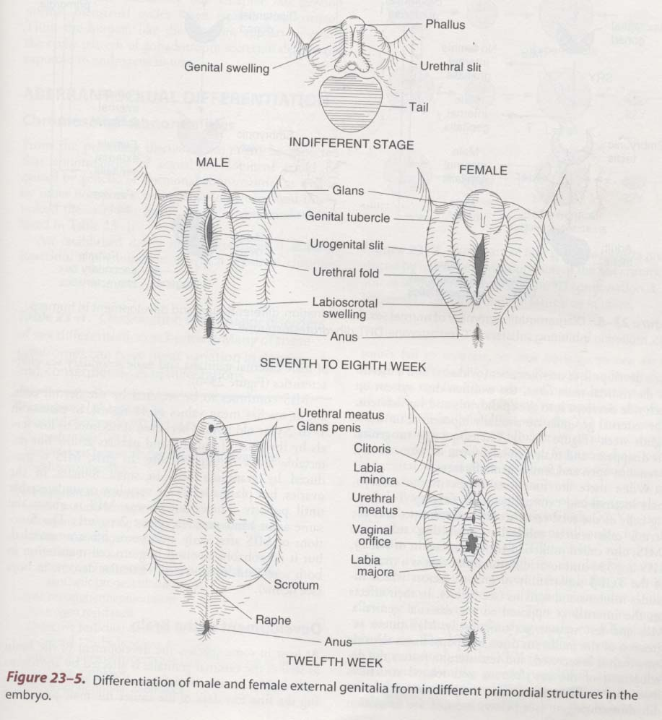
V. DIFFERENTIATION OF MALE AND FEMALE GENITALIA FROM BIPOTENTIAL PRIMORDIA UROGENITAL SINUS
17mm
49mm 45mm
Adult

Slide 7
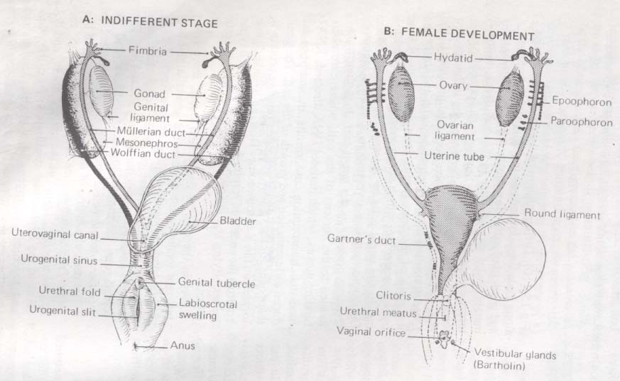
VI.

Slide 8
(I)
PUBERTY
DEFINATION: A specific time when full reproductive capacity is achieved .151/2 years in Females and 17 years in Males. Marked by the fusion of the Y- Ligament of Bingelow.
Ovulation - 1 Year after menarche
Spermache
PROCESS - PUBESENCE
ADOLESCENCE – Physiological
TEENAGE
age of rapid growth spurt .
AGE AT ONSET 12-14 years for girls
13-15 years for boys (Boys one year later than girls)
Delayed puberty 17years or 2 years after full (PRIMARY AMMENORRHOEA) Thelarche.
19years for boys (EUNUCHOID)

Slide 9
II
SEQUENCE OF EVENTS IN ADOLESECENCE
I ADRENARCHE Adrenal Androgens
13 yrs
Bone growth
II. THELARCHE 14 yrs
BREAST DEVELOPMENT
STAGE 1 to STAGE 5
3
III. PUBERCHE _______________________
AMBISEXUAL HAIR
Changed FSH/ LH pattern
STAGES 1 to 4
IV. MENARCHE
Pubatilse Gonadotropin Secretion
OVULATION
SPERMACHE

Slide 10
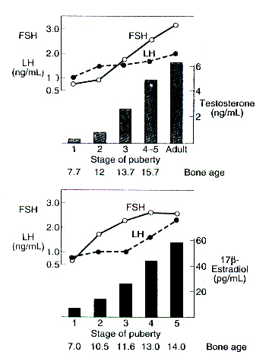
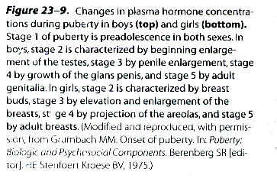

Slide 11
Classification of the causes of precocious sexual development in humans.
True precocious puberty
Constitutional
Celebral: Disorders involving posterior hypothalamus
Tumors
Infections
Developmental abnormalities
Gonadotropin-independent precocity
Precocious pseudopuberty (no spermatogenesis or ovarian development)
Adrenal
Congenital virilizing adrenal hyperplasia
Androgen-secreting tumors (in males)
Estrogen-secreting tumors (in females)
Gonadal
Leydig cell tumors of testis
Granulosa cell tumors of ovary
Miscellaneous

Slide 12
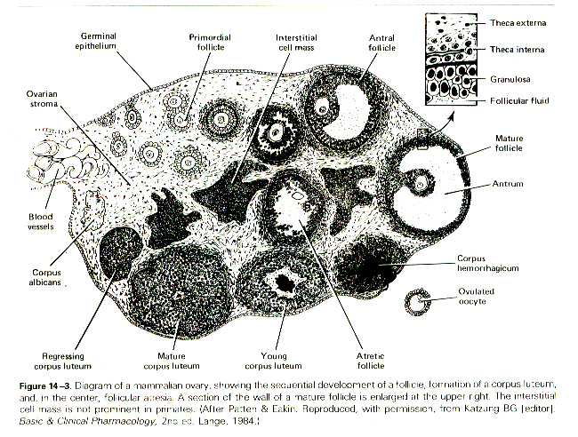

Slide 13
REPRODUCTIVE PHYSIOLOGICAL SYSTEMS
ENDOCRINE
FUNCTION
LH – RH
LH
(ICSH)
INTERSTITIAL
CELLS
GAMESTOGENIC
FUNCTION
GN RH
FHS
SEMINIFOROUS
TUBELES
Accessory GLANDS
Sperm Production
Sperm Maturation
Sperm Transport
SERTOOLI CELLS
ACTIVITIES
ENDOCRINE
FUNCTION
LH-LR/FHS-RH
FHS/LH
GRAAFIAN FOLLICLE
FOLLICULAR ANTRIUM
THECA-GRANULOSA
ESTROGEN PRODUCTION
(PROGESTERONE)
SHORT PEPTIDES
ANDROGENS
CORPUS LEUTEUM
GAMETOGENIC
FUNCTION
GNRH
FHS/LH
GANETE
MATURATION
PROGESTERONE
OVULATION
FERTILIZATION
HYPOTHA
LAWNS
PITUITARY
GONADS
TARGET ISSUES …………………………………………………………………………
………………………………………………………………………………………………

Slide 14
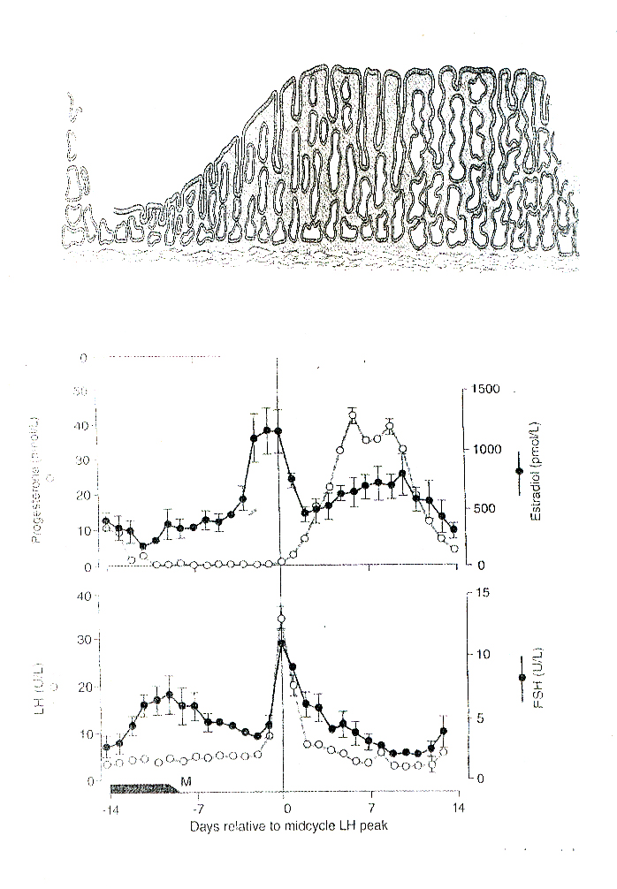

Slide 15
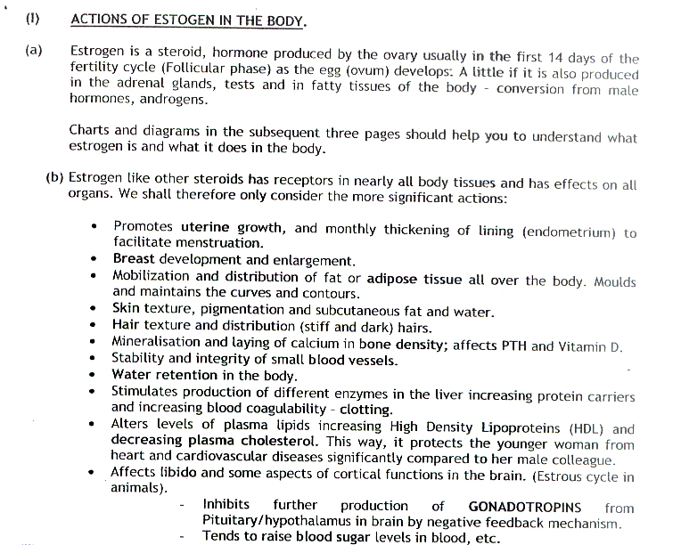

Slide 16
Actions of estrogen
Hormone of increase mitosis, proliferation, growth, thickening and vascularization without differentiaton/complexity
Endometrium, mammary glands, external genitalia, adipose tissue, epithelium
Metabolic system, glucose, fat distribution, heme mineralisation
Hair texture, distribution, skin, gland integrity
Mineralocorticoid effects, water and Na+ reabsorption, phosphaturia
Endometrium proliferation for menstuation form 2 to 5mm

Slide 17
Specific actions of estrogen
Stromal and ductular growth and development of breasts-enlargement
Adipose fat distibution, maintaining curves and contours
Skin and hair distribution, texture, secretions, pigmentation,water, and subcutaneousdfat
Integruty of capillaries and small vessels
Oestrous cycle
Inhibit further gonadotropin production by –ve feedback mechanism except at ovulation

Slide 18
Metabolic actions of estrogen
Bone mineralisation-osteoblastic activity(pro-PTH)
Increase high density lipo-proteins and reducing circulating total cholesterol
Stimulates production of liver enzymes for carrier proteins and clotting protein
Increases serum glucose, FFA and amino acid(anti-insulin)
H20 and Na+ retention

Slide 19
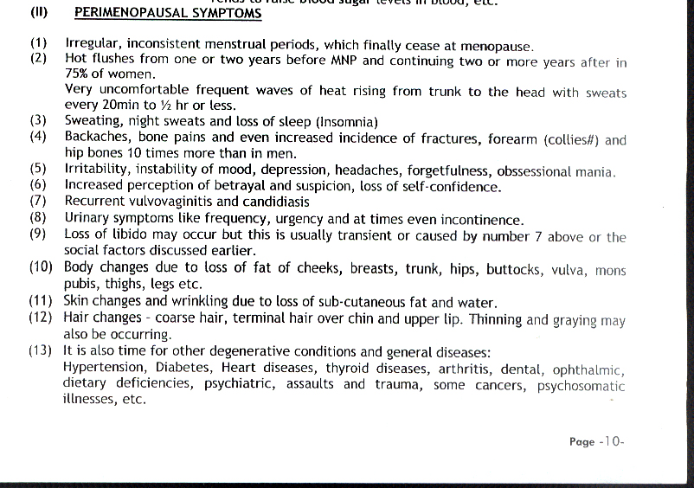

Slide 20
Increased Gonadotropin production effects
Both hypothalmic release hormones(peptides) and Gonadotropin production incrases signficantly
Capillary/ vascular instability
Hot flashes/excessive sweating
Sympathetic discharge instability-mood
Skin and Hair changes

Slide 21
Progesterone
SUMMARY: Differentiation, Specialisation, Maturation, Functionalisation
Milk production
Secretory cell development
Maintain pregnancy- Inhibit secretion of embryo rejection
Inhibits myometrial contraction-Estrogen stimulation
H20 and Na+ retention
Promotes coagulation of blood
Prepares for pregnancy/implantation

Slide 22
Perimenopausal Hormonal Changes
REDUCED ESTROGEN LEVELS
  EFFECTS
    1. On

Slide 23
Estrogen replacement during climacteric to keep off the unpleasant symptoms especially HOT FLASHES
Controversial because of the possibility of endometrial hyperplasia, PMB and increased chance of endometrial cancer
Therefore balance estrogen with a progesterone e.g. the combined contraceptive pill
Principle of counseling and treating individual symptoms like anxiety, depression, night sweats, headaches, insomnia, osteoporosis, stress incontinence, etc.
Accepting, adjusting social support (TLC) and coping

Slide 24
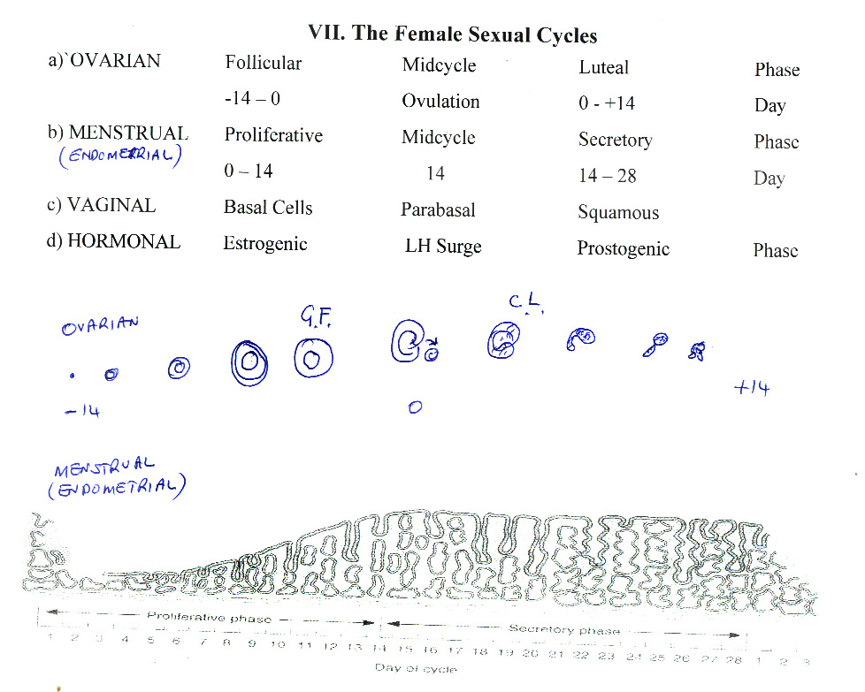

Slide 25
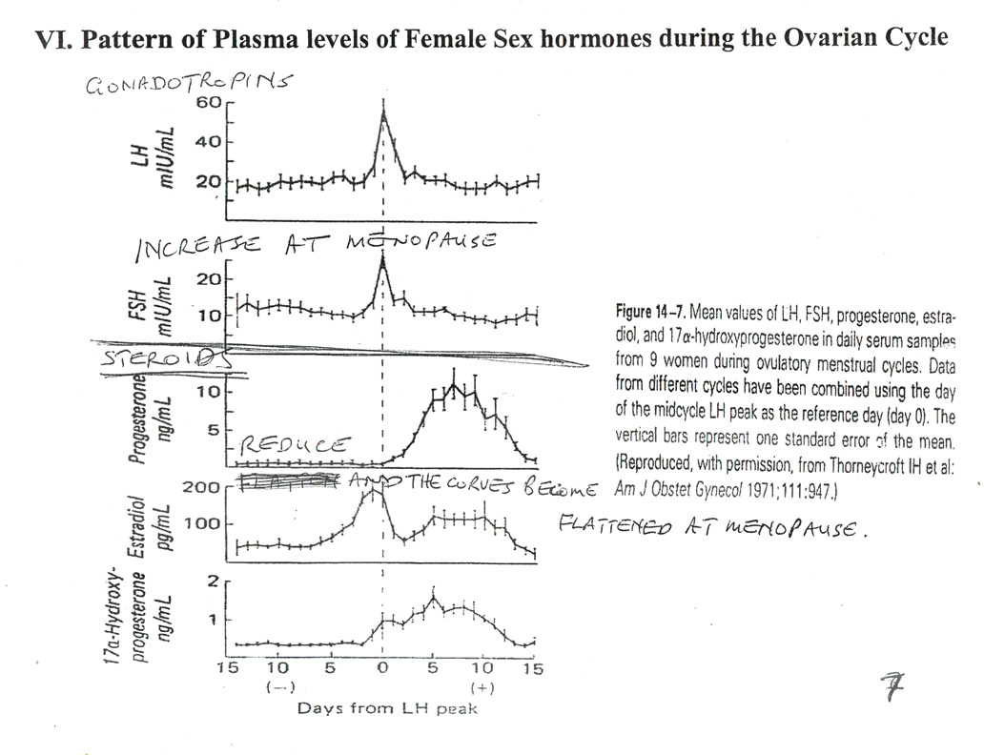
LH is 5-10nm and suddenly rises TO 50-70
FSH is almost constant 10-20 subunits
Normal menstrual cycle-28+or-2
Can be 21 or 32

Slide 26
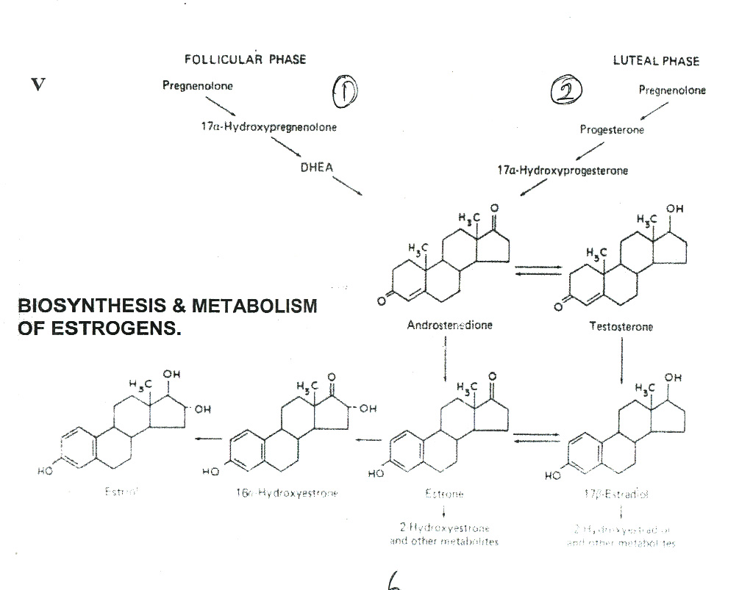

Slide 27
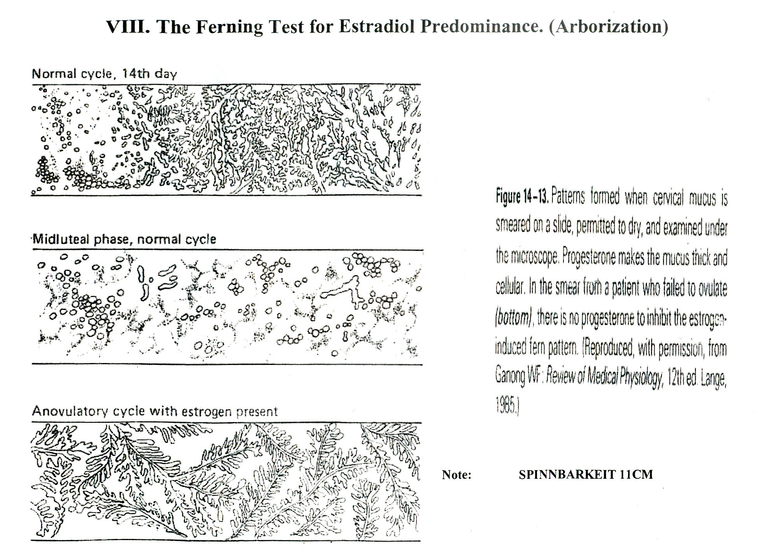

Slide 28
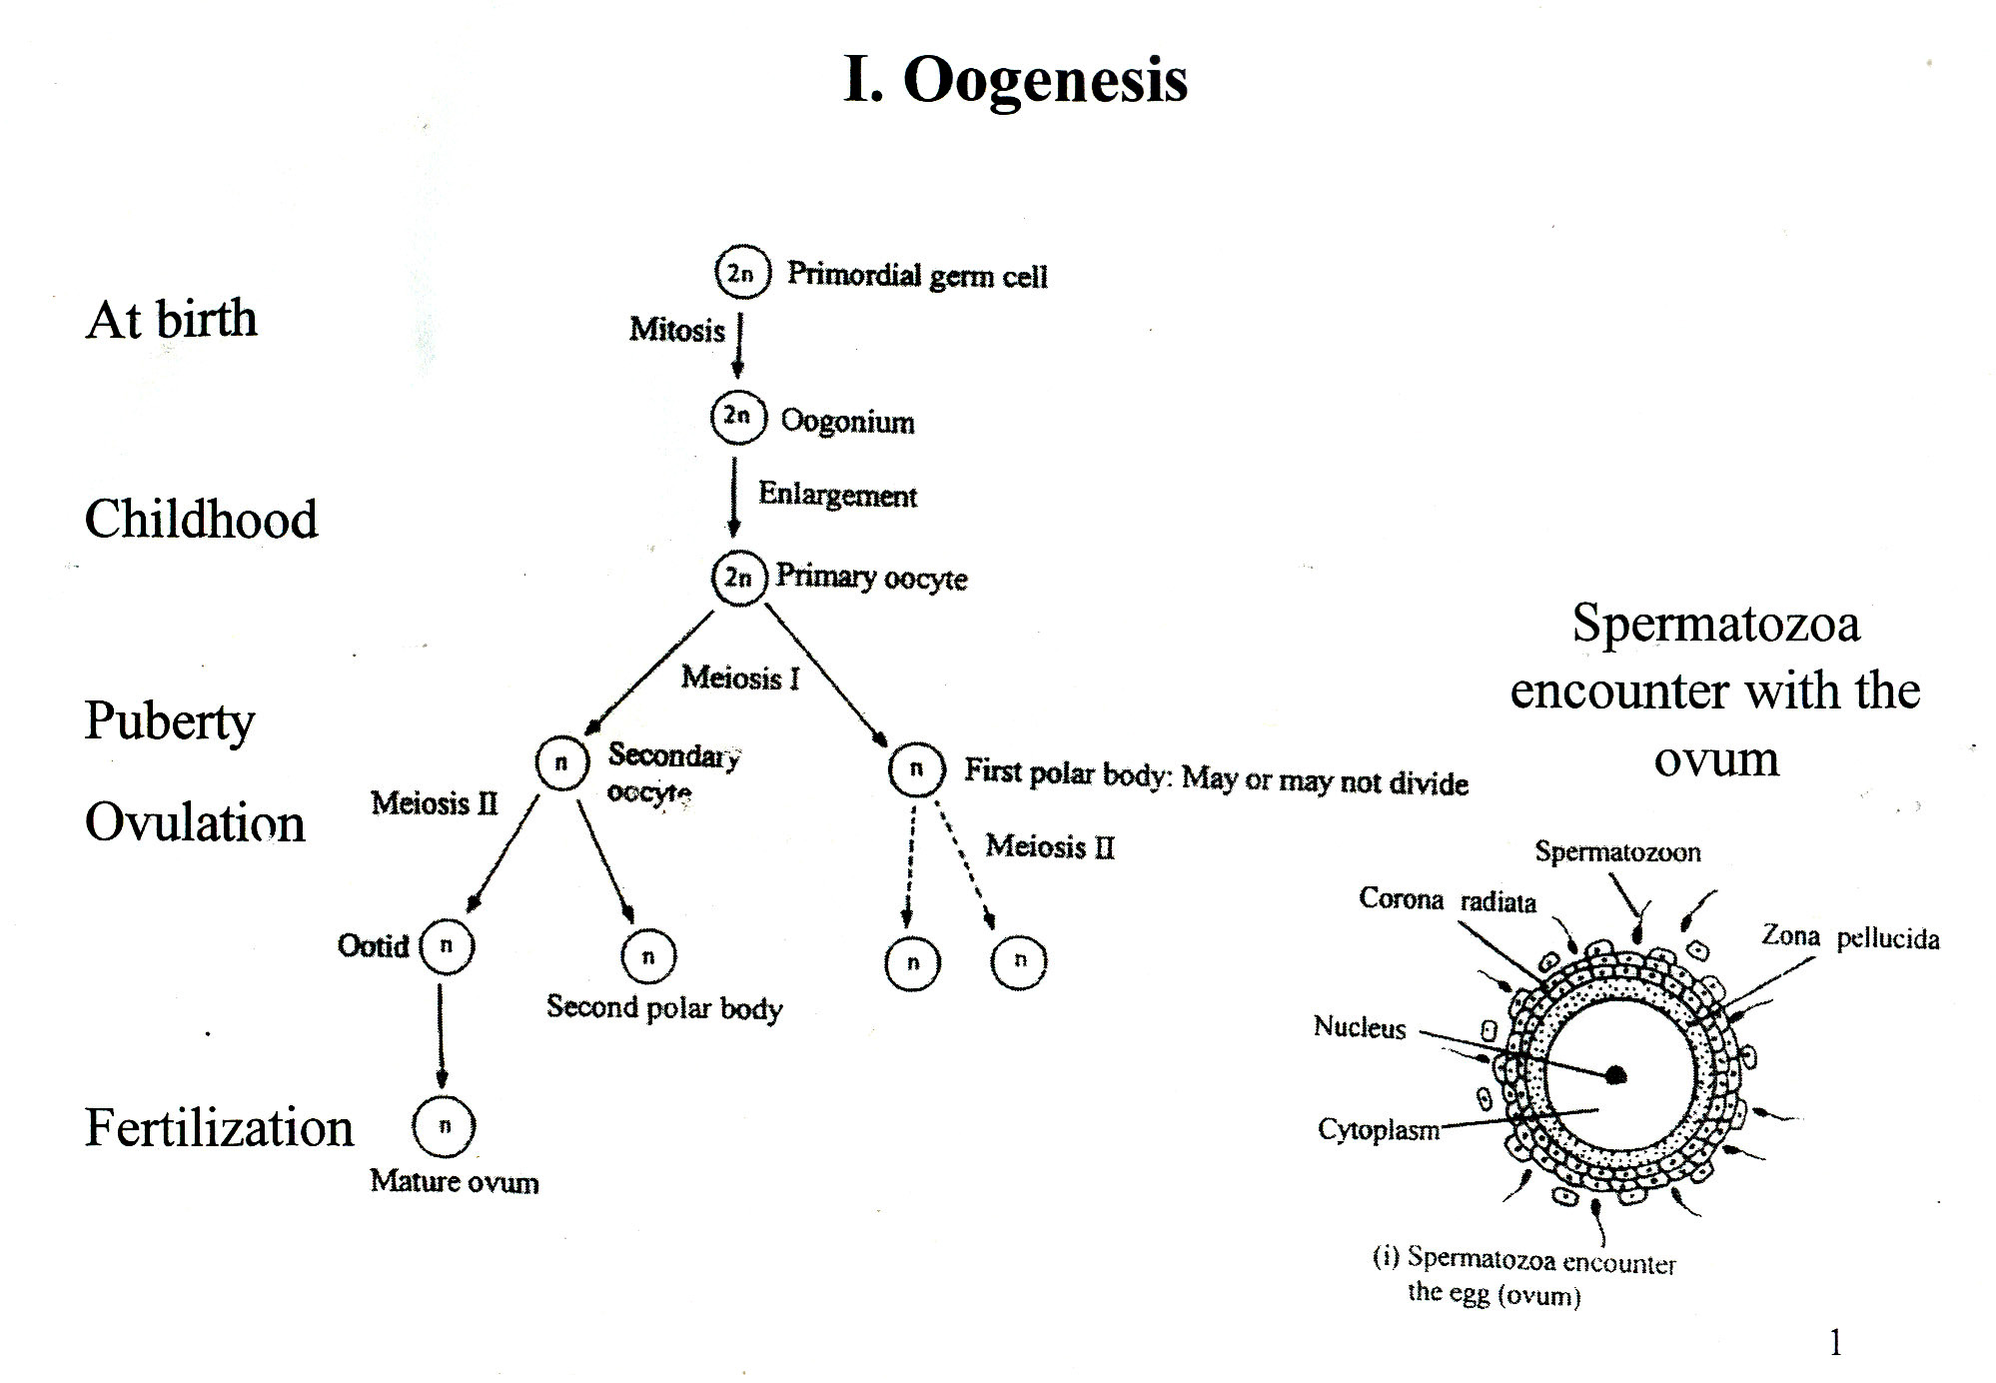

Slide 29
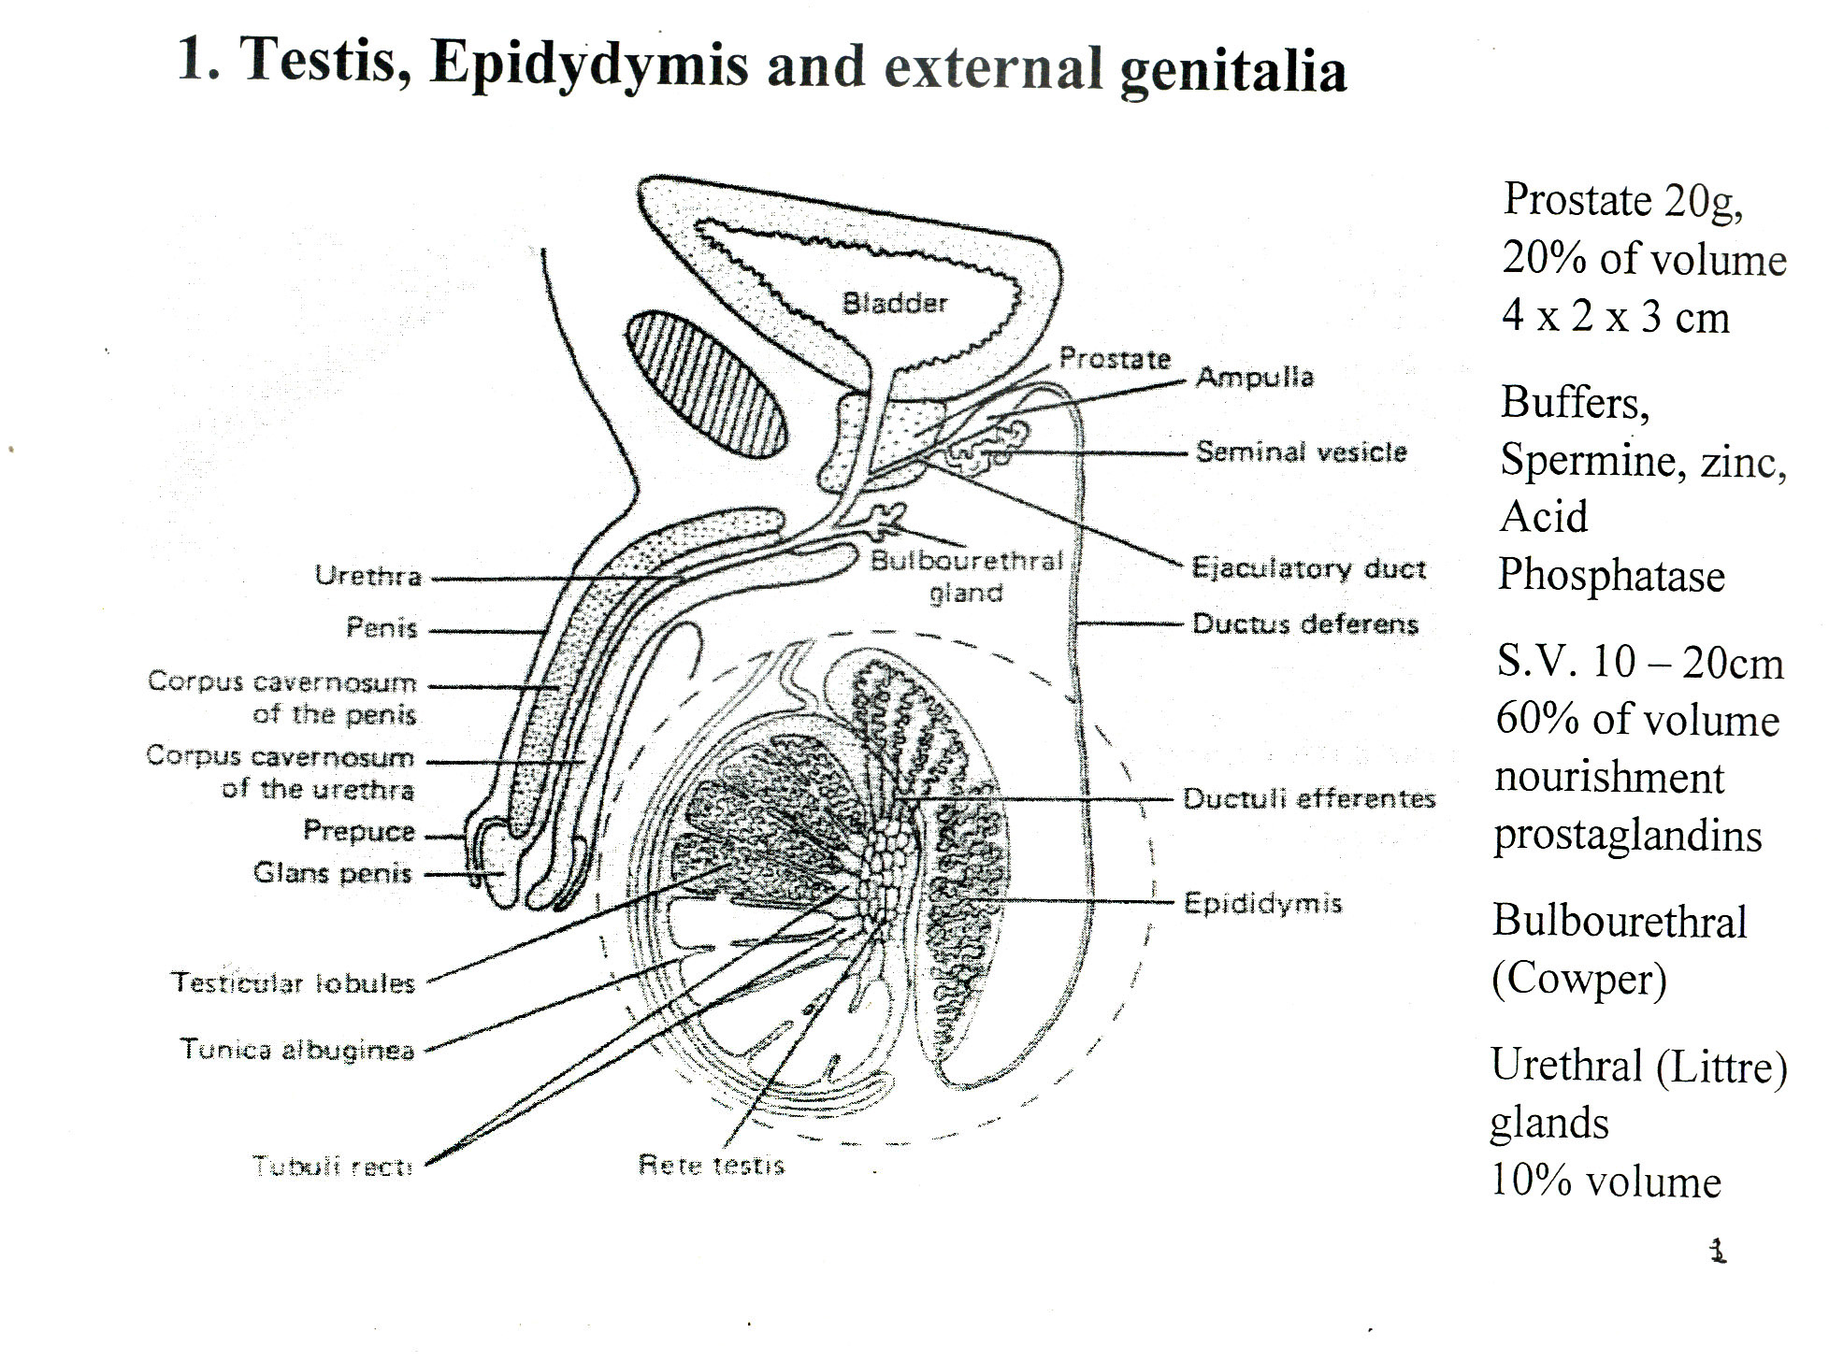
MALE REPRODUCTIVE SYSTEM

Slide 30
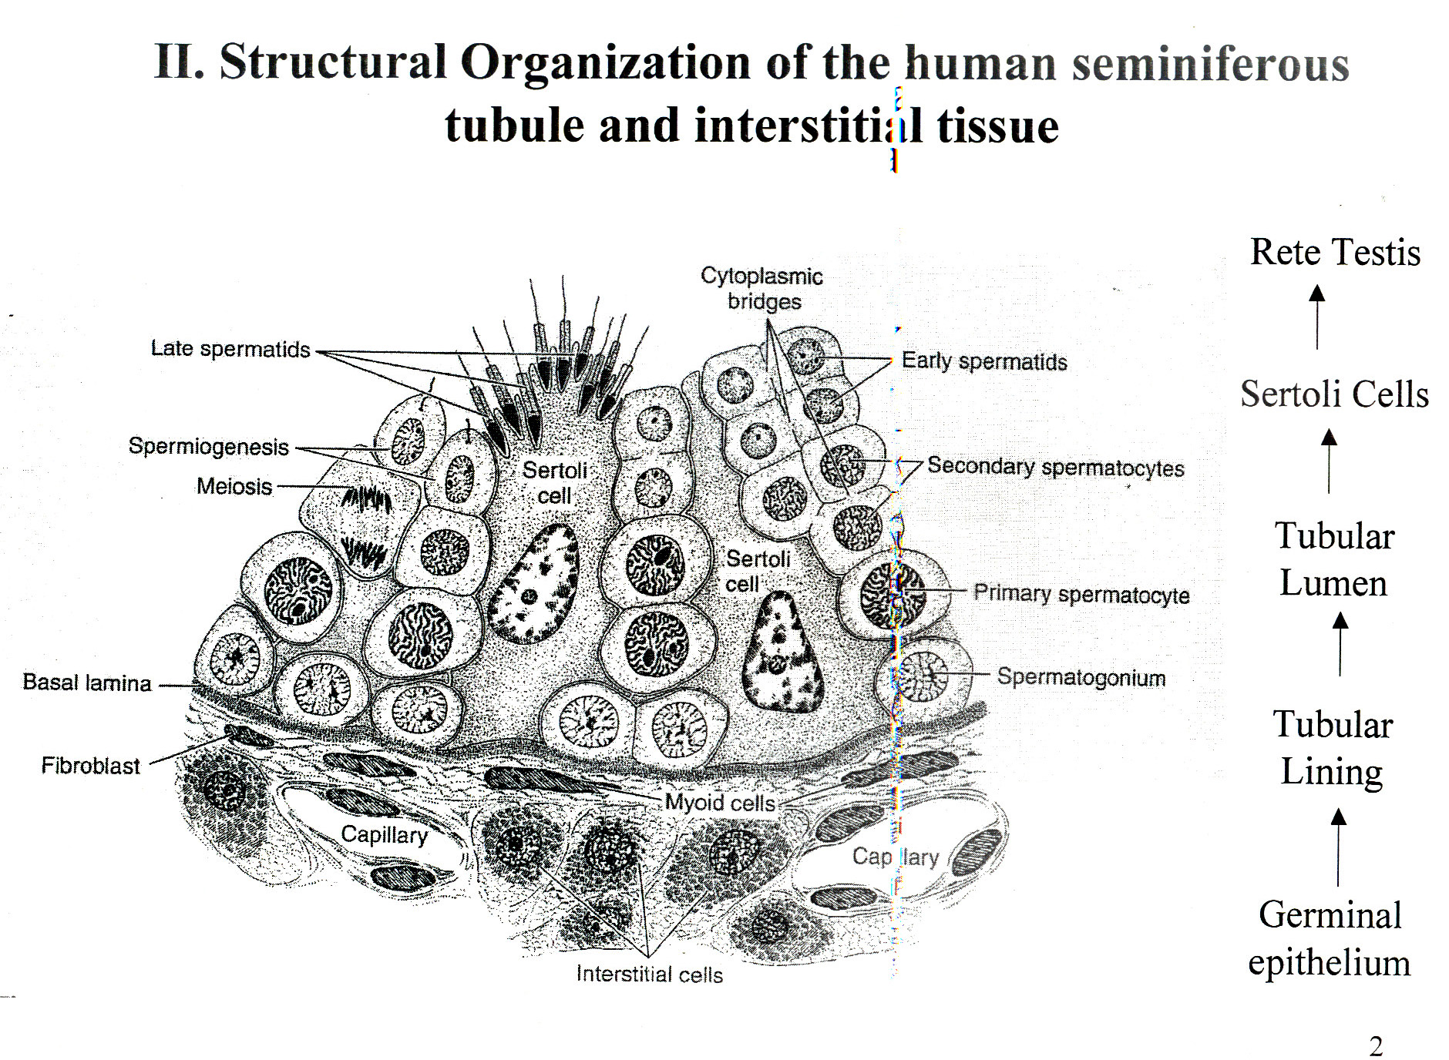

Slide 31
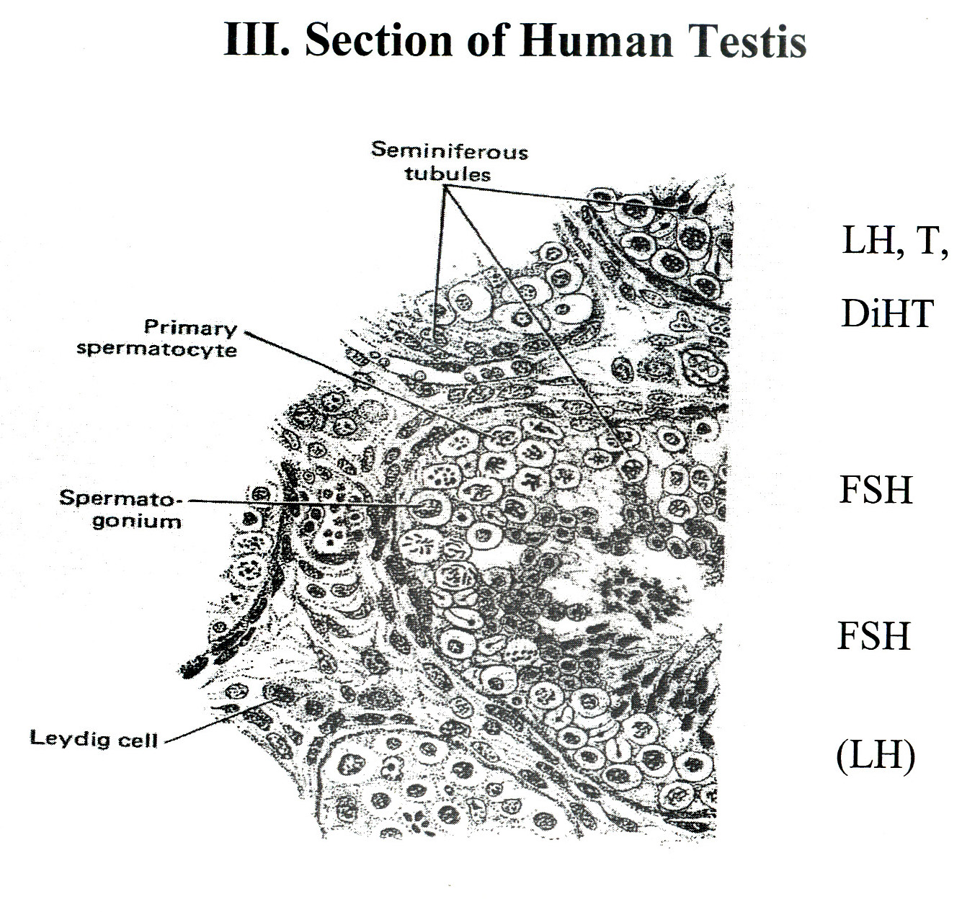

Slide 32
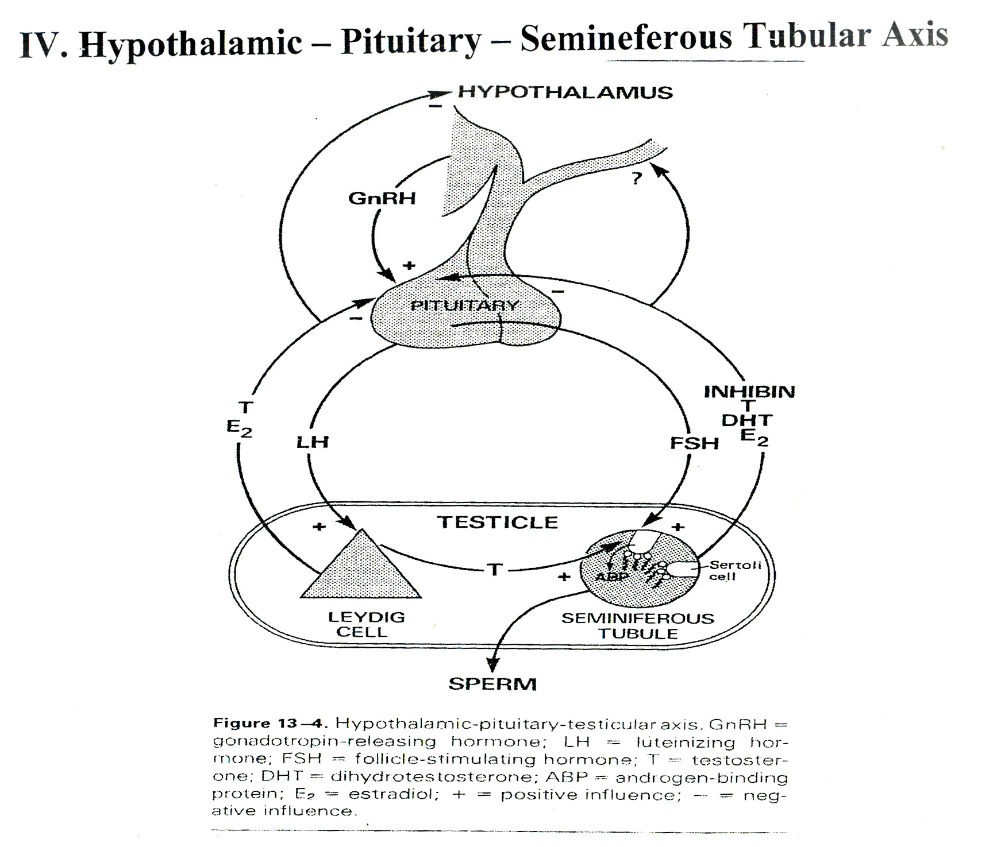
9th June 2006

Slide 33
HORMONAL CHANGES IN PREGNANCY
FERTILIZATION
6-7 DAYS
BLASTOCYST
IMPLANTATION
1,000 – 10,000 CELLS
1µL Vol
EARLY TROPHOBLAST
(Luteotropic Hormones)
Ampullary region of the tube
Steroidhormones from C.L.P
24-36Hrs HCG in material serum
Glycopeptide 237 aas (145 in þ–submit)
1,000 mIµ/tml
10Weeks 100,000 mIµ/tml the drops
4-5 Weeks
HPL – Human Placental Lactogen
HCS – Human Chronomic Sommatoniammotrophic
Polypeptide – 190aa’s Analogous to Growth Hormone (hGH)
Prolactin

Slide 34
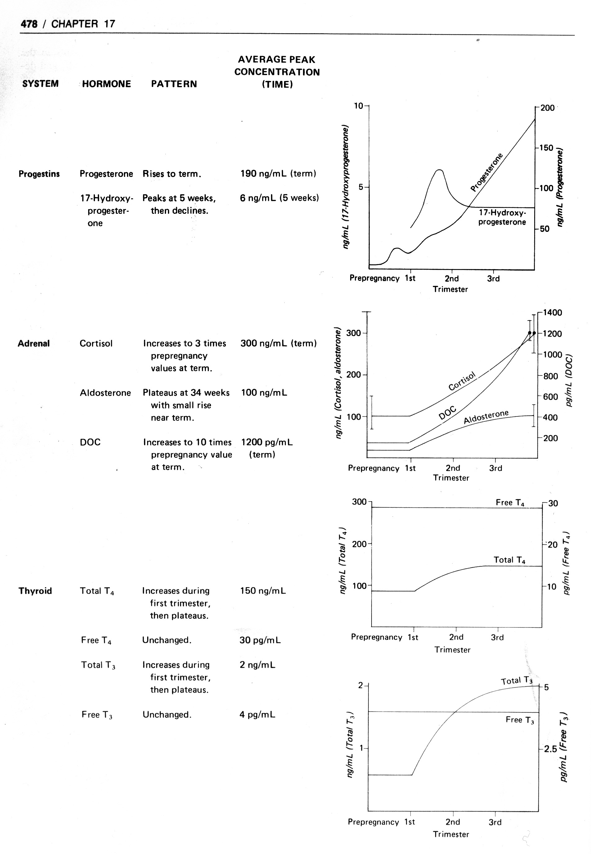
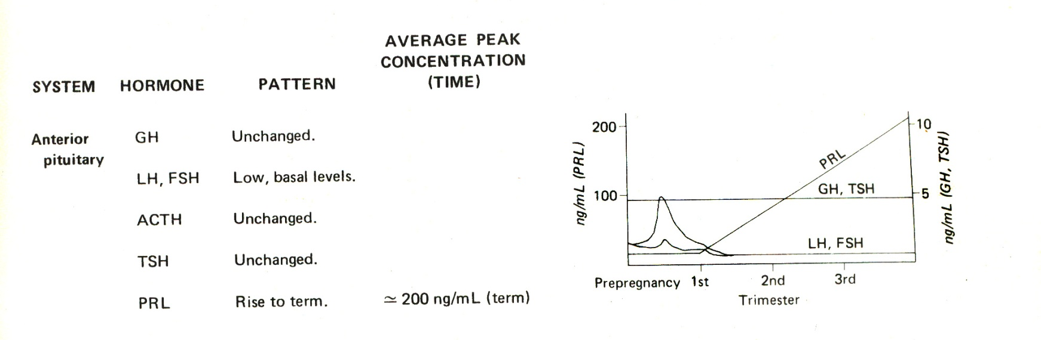
ENDOCRINOLOGICAL CHANGES IN PREGNANCY

Slide 35
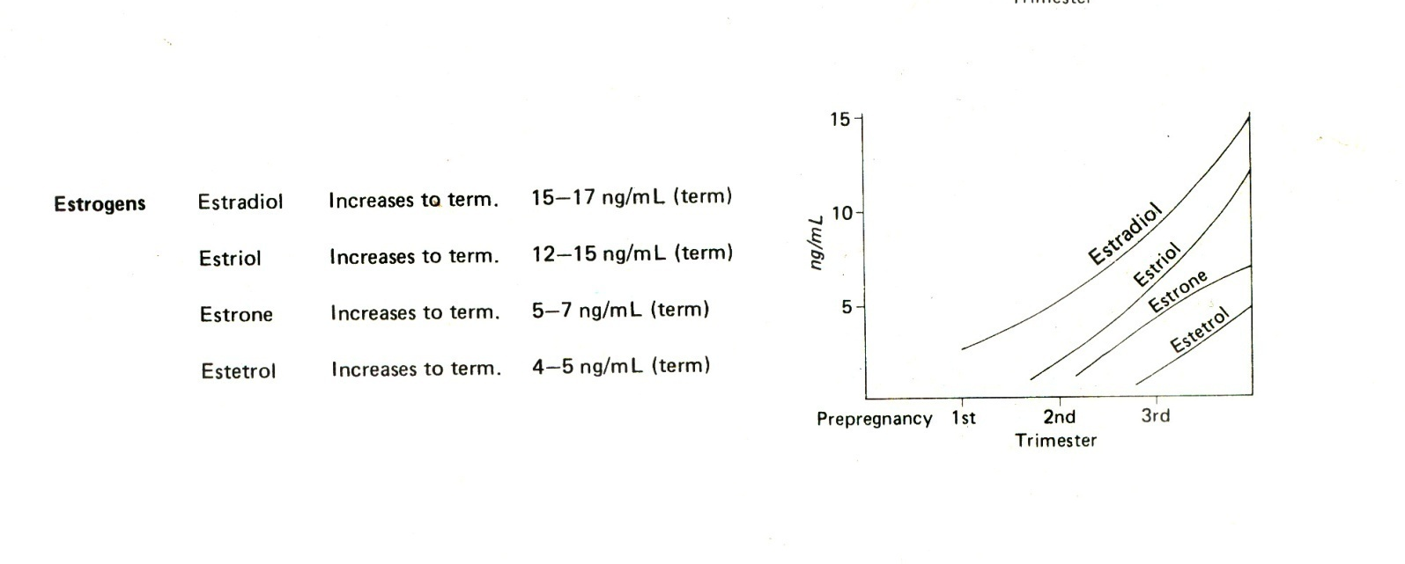

Slide 36
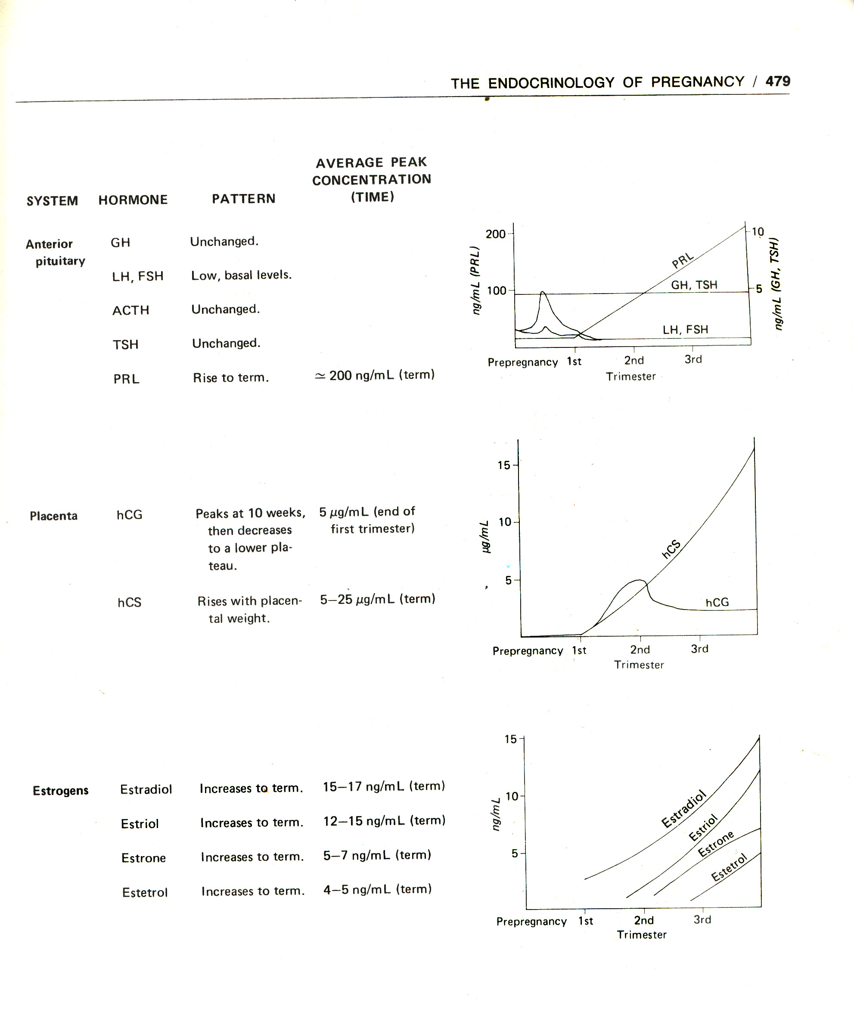
ENDOCRINOLOGICAL CHANGES IN PREGNANCY

Slide 37
OTHER HORMONES
Adrenocorticosteroids Glucocorticoids and Androgens increase
Thyroid Hormones T₃ T_{4 levels increase}
T₃ T_{4 conversion increases}
predesposition to hyperthyroidism
Prolactin and Oxytocin at term increase minimally but their receptors are highly upgraded upto 100 fold

Slide 38
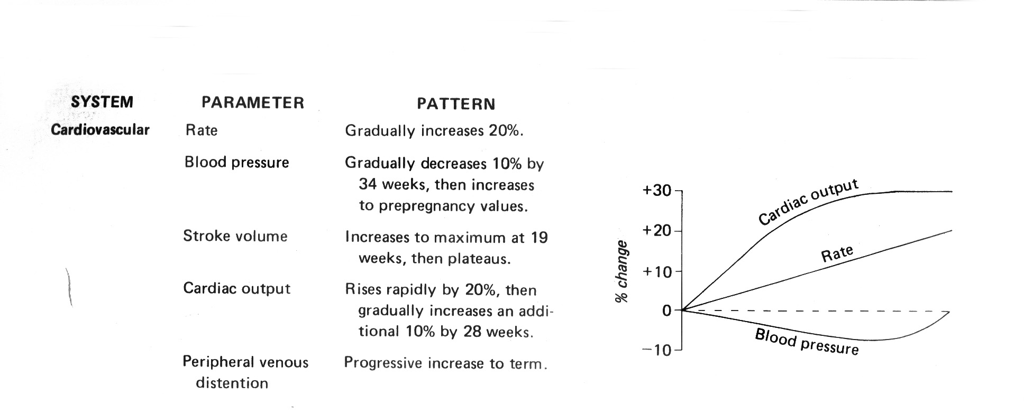
PHYSIOLOGICAL CHANGES IN PREGNANCY

Slide 39
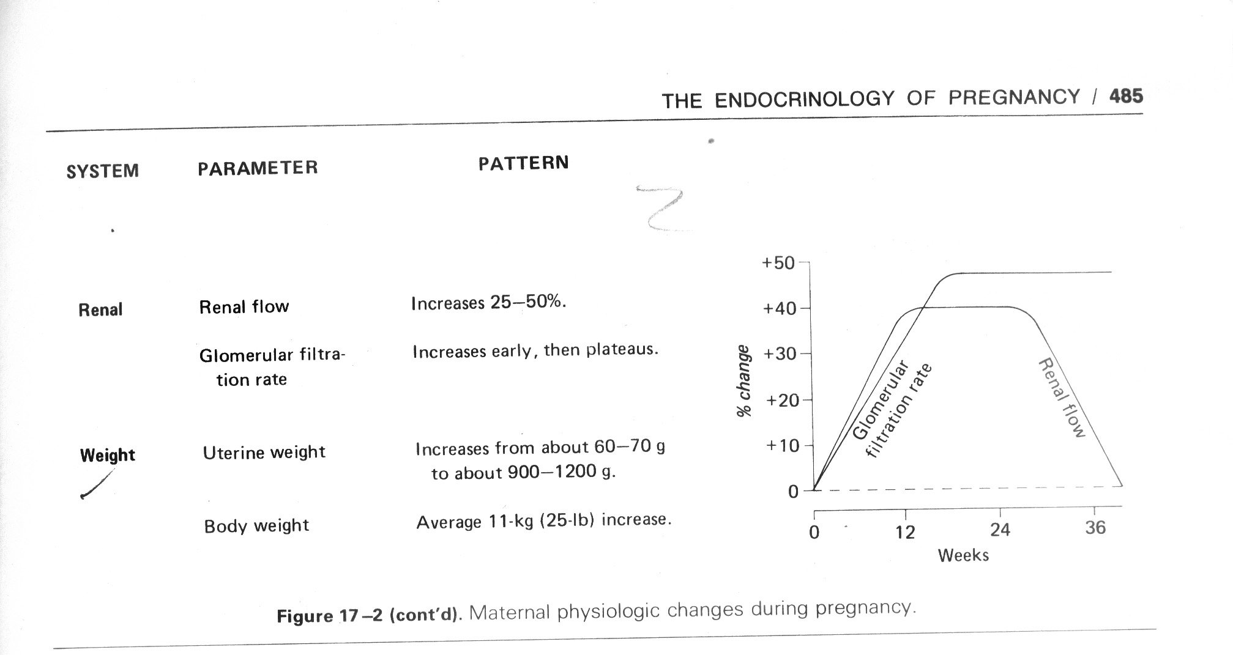
PHYSIOLOGICAL CHANGES IN PREGNANCY

Slide 40
FOETAL ADAPTATIONS AND ADJUSTMENTS AT BIRTH
RESPIRATORY ADAPTATIONS
Site of oxygenation changes from placenta/umbilical vein.
CIRCULATORY ADJUSTMENTS
a) Reversal of oxygenated blood from IVC to Right Atrium to PVR to Venticle to Aorta
b) Collapse of umbilical vein reduction of portal vein (shunt) drop in right atrial Pressure
c) Suction of blood into pulmonary vascular system.
d) Pulmonary Artery blood flow
e) Pulmonary veins blood flow into left ventricle.
f) CLOSURE OF FARAMEN CLOSURE OF
OVALE DUCTUS ARTERIOSUS
g) Complete reversal of PARALLEL FLOW (Shunt) to IN SERIES FLOW Right heart to left Heart.

Slide 41
3. HAEMOGLOBIN CHANGE
From HBF to HbA
Over two months
Change in O₂/Hb dissociation curve
TEMPERATURE ADJUSTMENT
37⁰C to 22⁰C (ambient)
effect on enzymes, glucose utilization, etc.
OTHERS
Swallowing
Excretion
Physical Environment

Slide 42
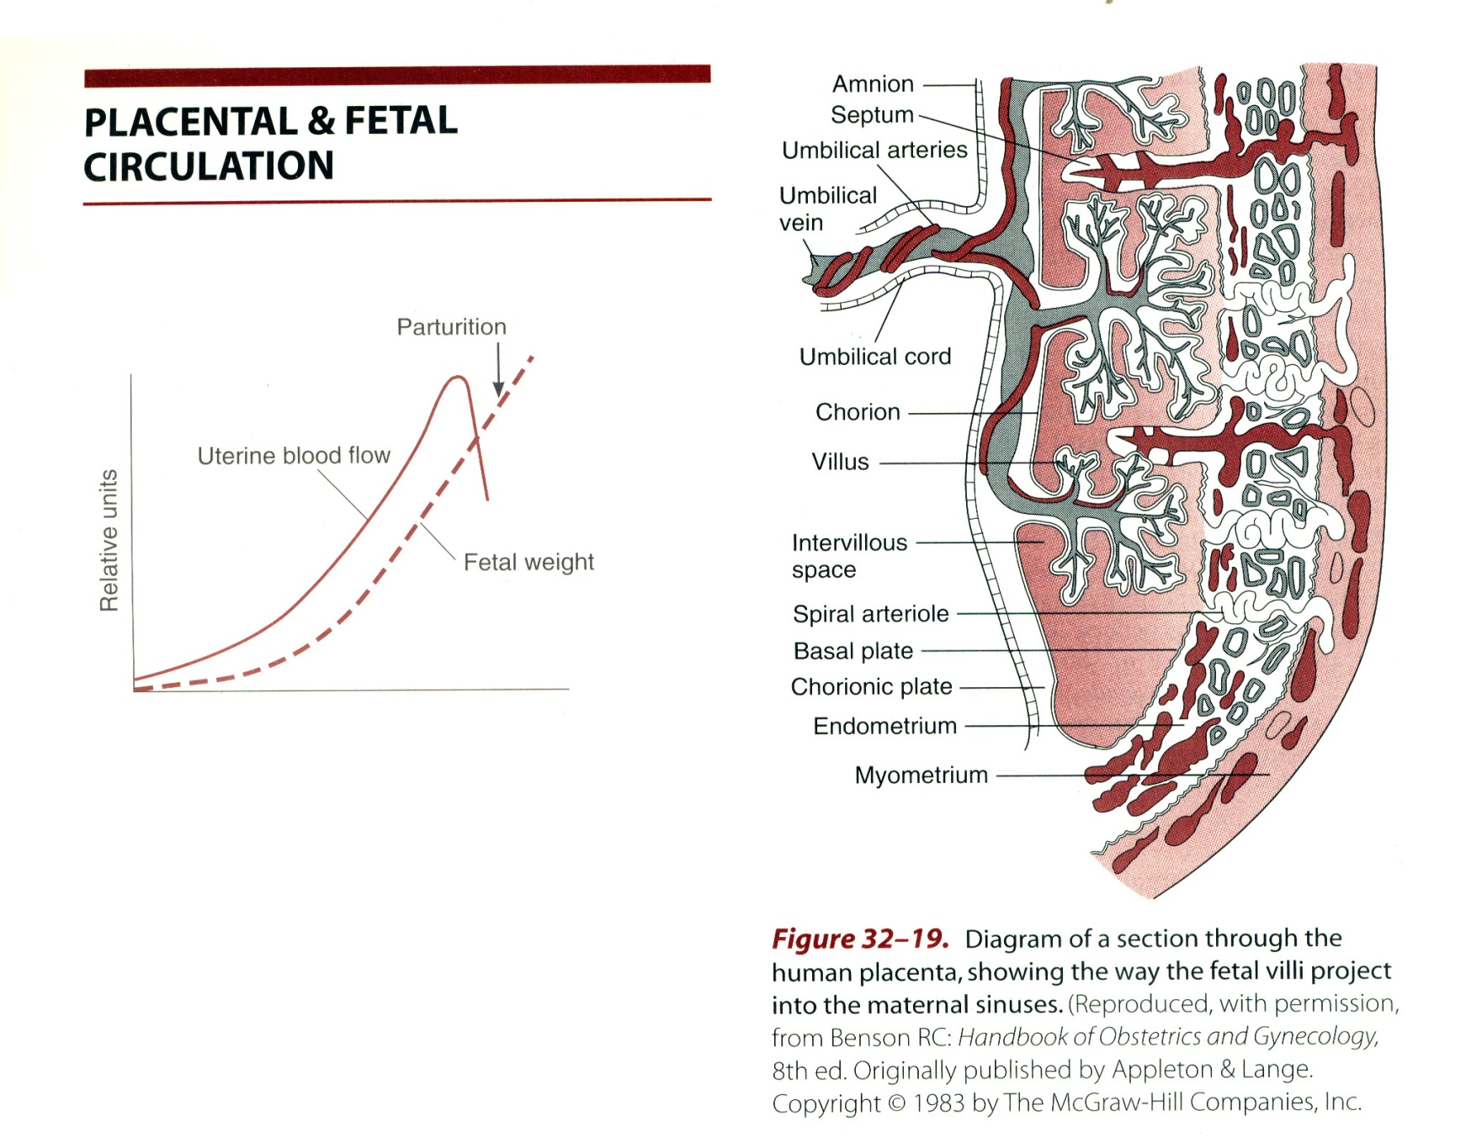
OXYGEN SATURATION
ADULT - arterial 98%
amb vein 80%
FOETAL - IVC Mixed 67%
IVC/Portal 26%

Slide 43
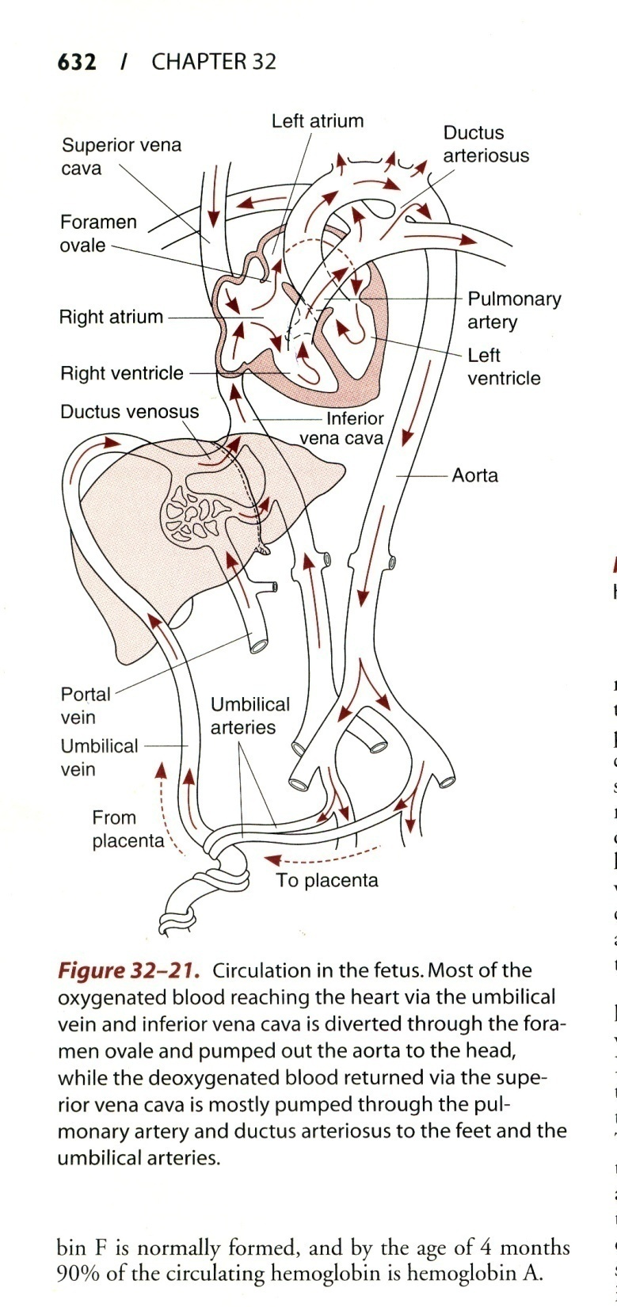

Slide 44
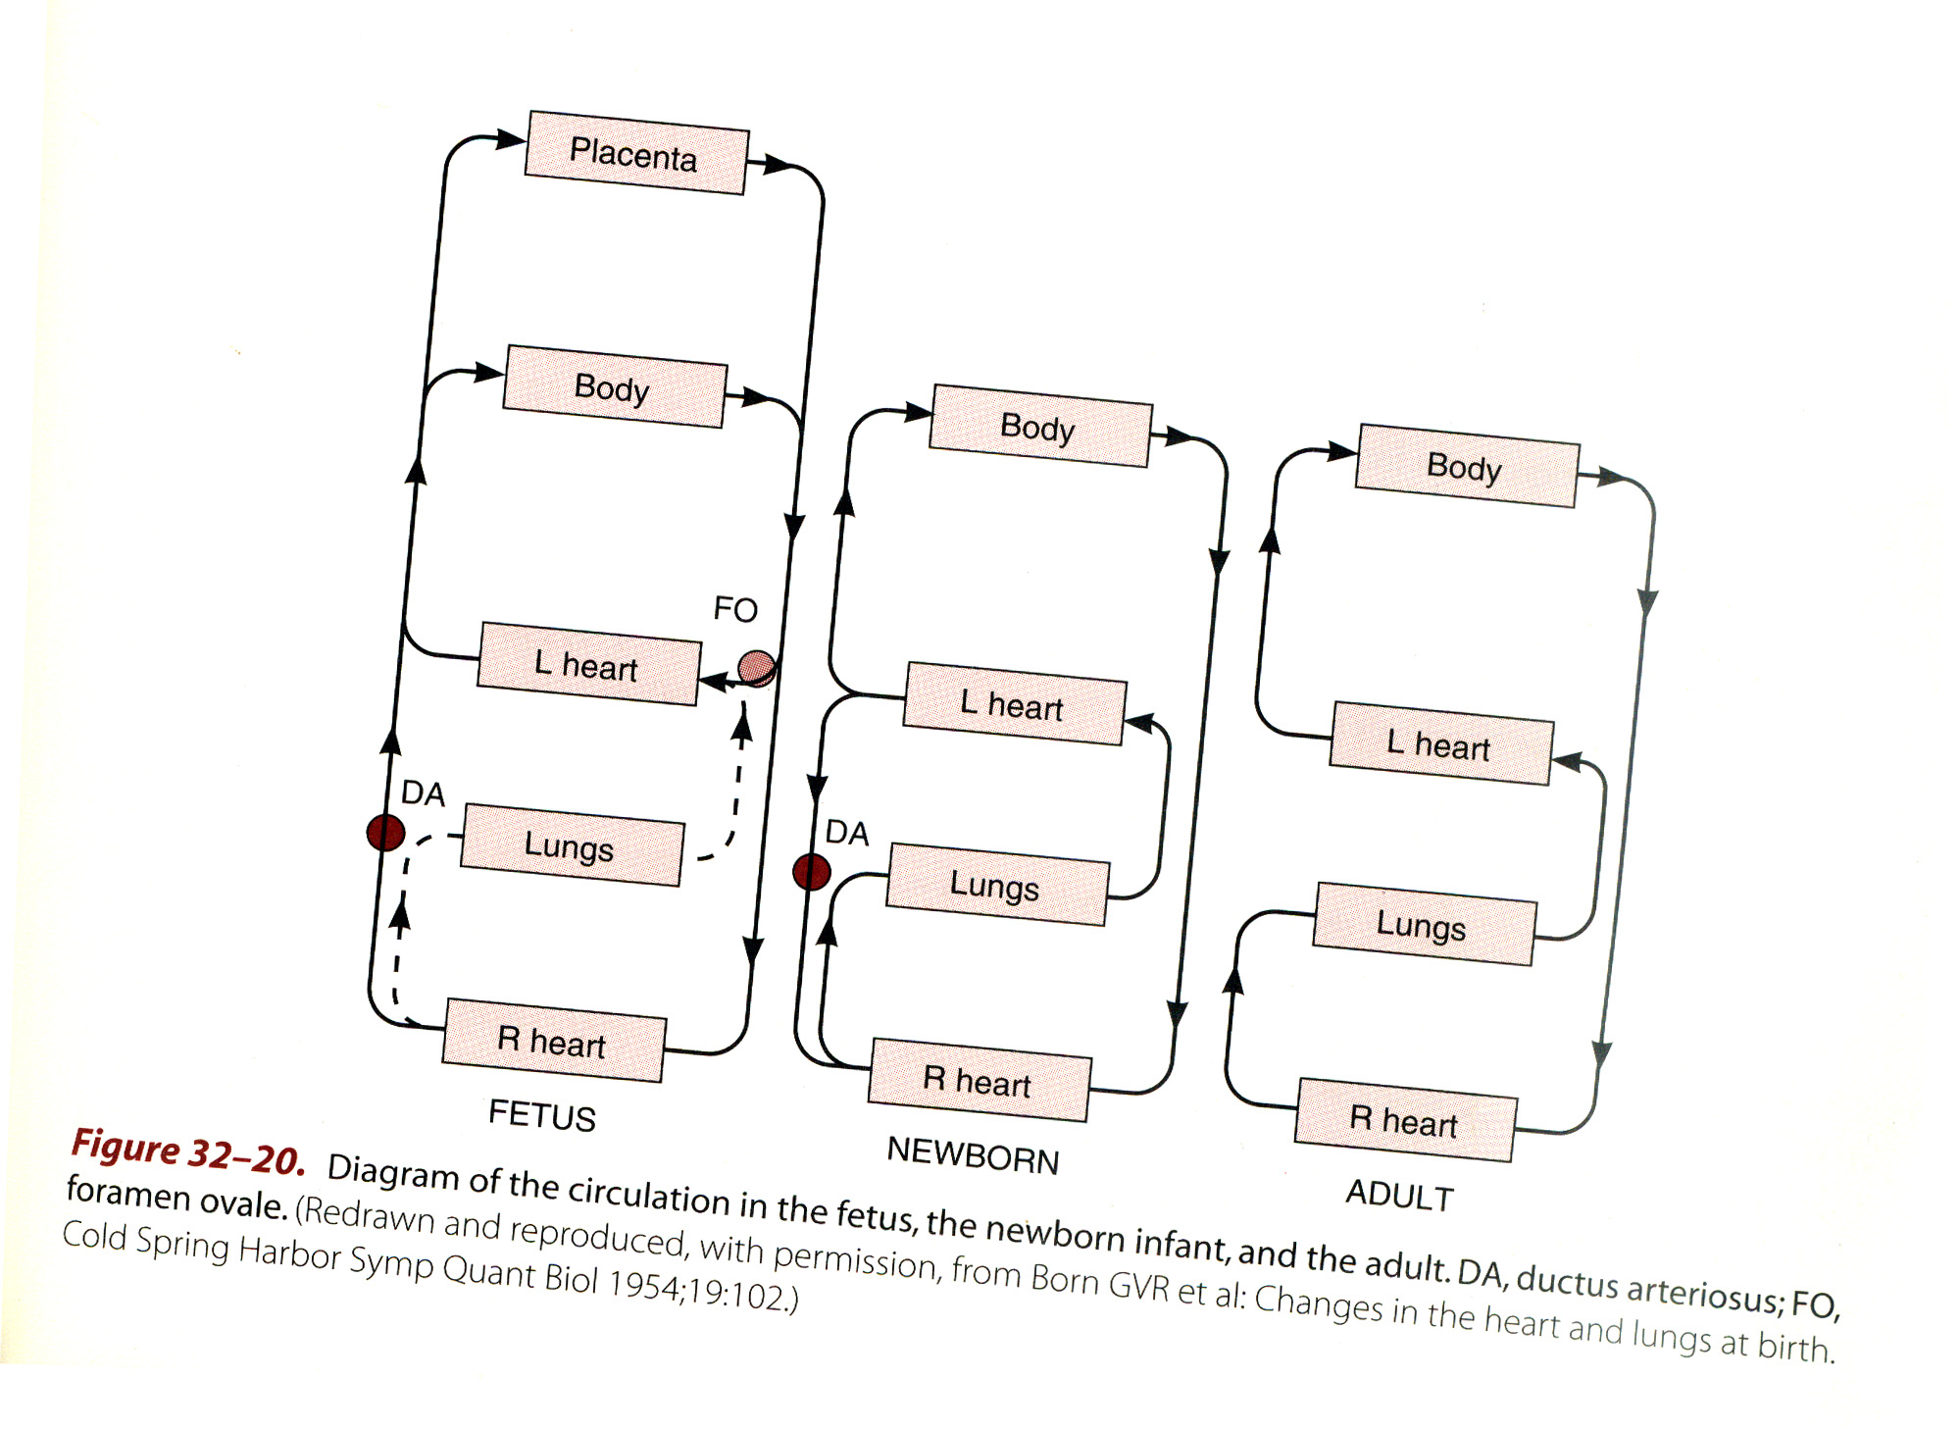

Slide 45
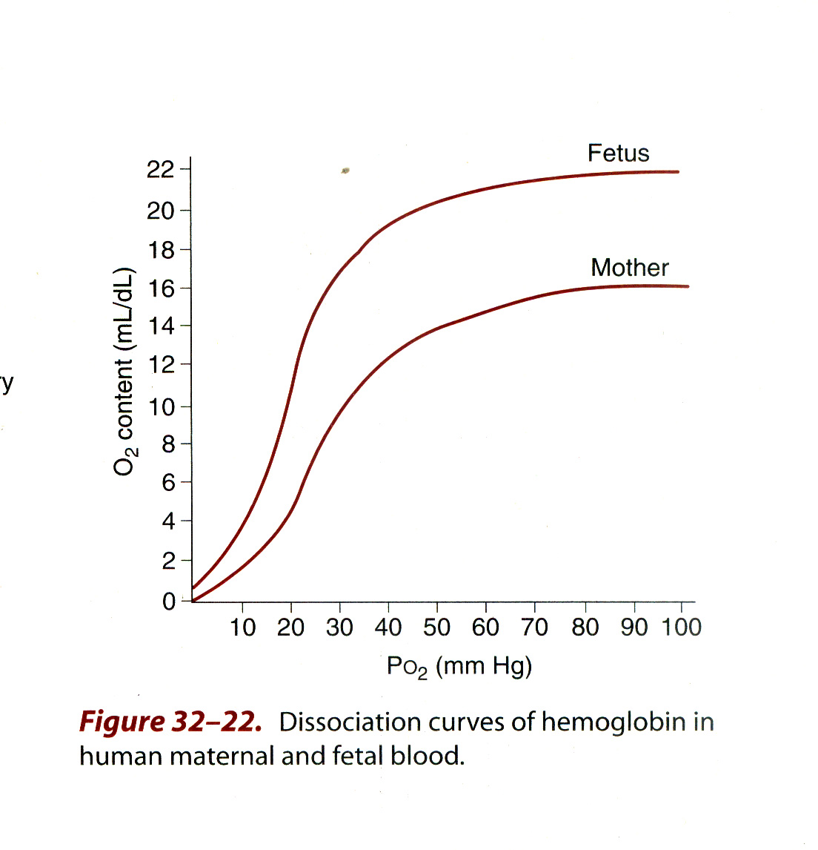

Slide 46
SEQUENCE OF EVENTS AT BIRTH
A
Placental circulation cut off.
Umbilical Vein Clamped
Umbilical Vein
Collapses
Sudden Pressure Drop
Right side of the heart
Septum secundum slaps on
septum primum
Closing the foramen ovale
All right side blood enters
Right ventricle and forces
pulmonary artery flow
B
Severe Asphyxia
First Gasp of Life
Lungs expand to
50mmHg Pressure
Suction Pressure
Pulmonary Vasculature
Resistance drops to
less than 20%
Blood Sucked from Right
Atrium through
pulmonary artery flow
Increased left
Atrial Pressure
100mls blood gushes through ductus venosus Into the right atrium

Slide 47
RESULTS
Blood now returns to right atrium, flows through each valve to the lungs and the left vetricle and its pumped put to the body from the left ventricle “in series” circulation.
The pressure changes cause D.A to collapse and close in 24-48Hrs.
Fibrosis under prostaglandins E2 alpha synthetase inhibitors and COX inhibitors.

Slide 49
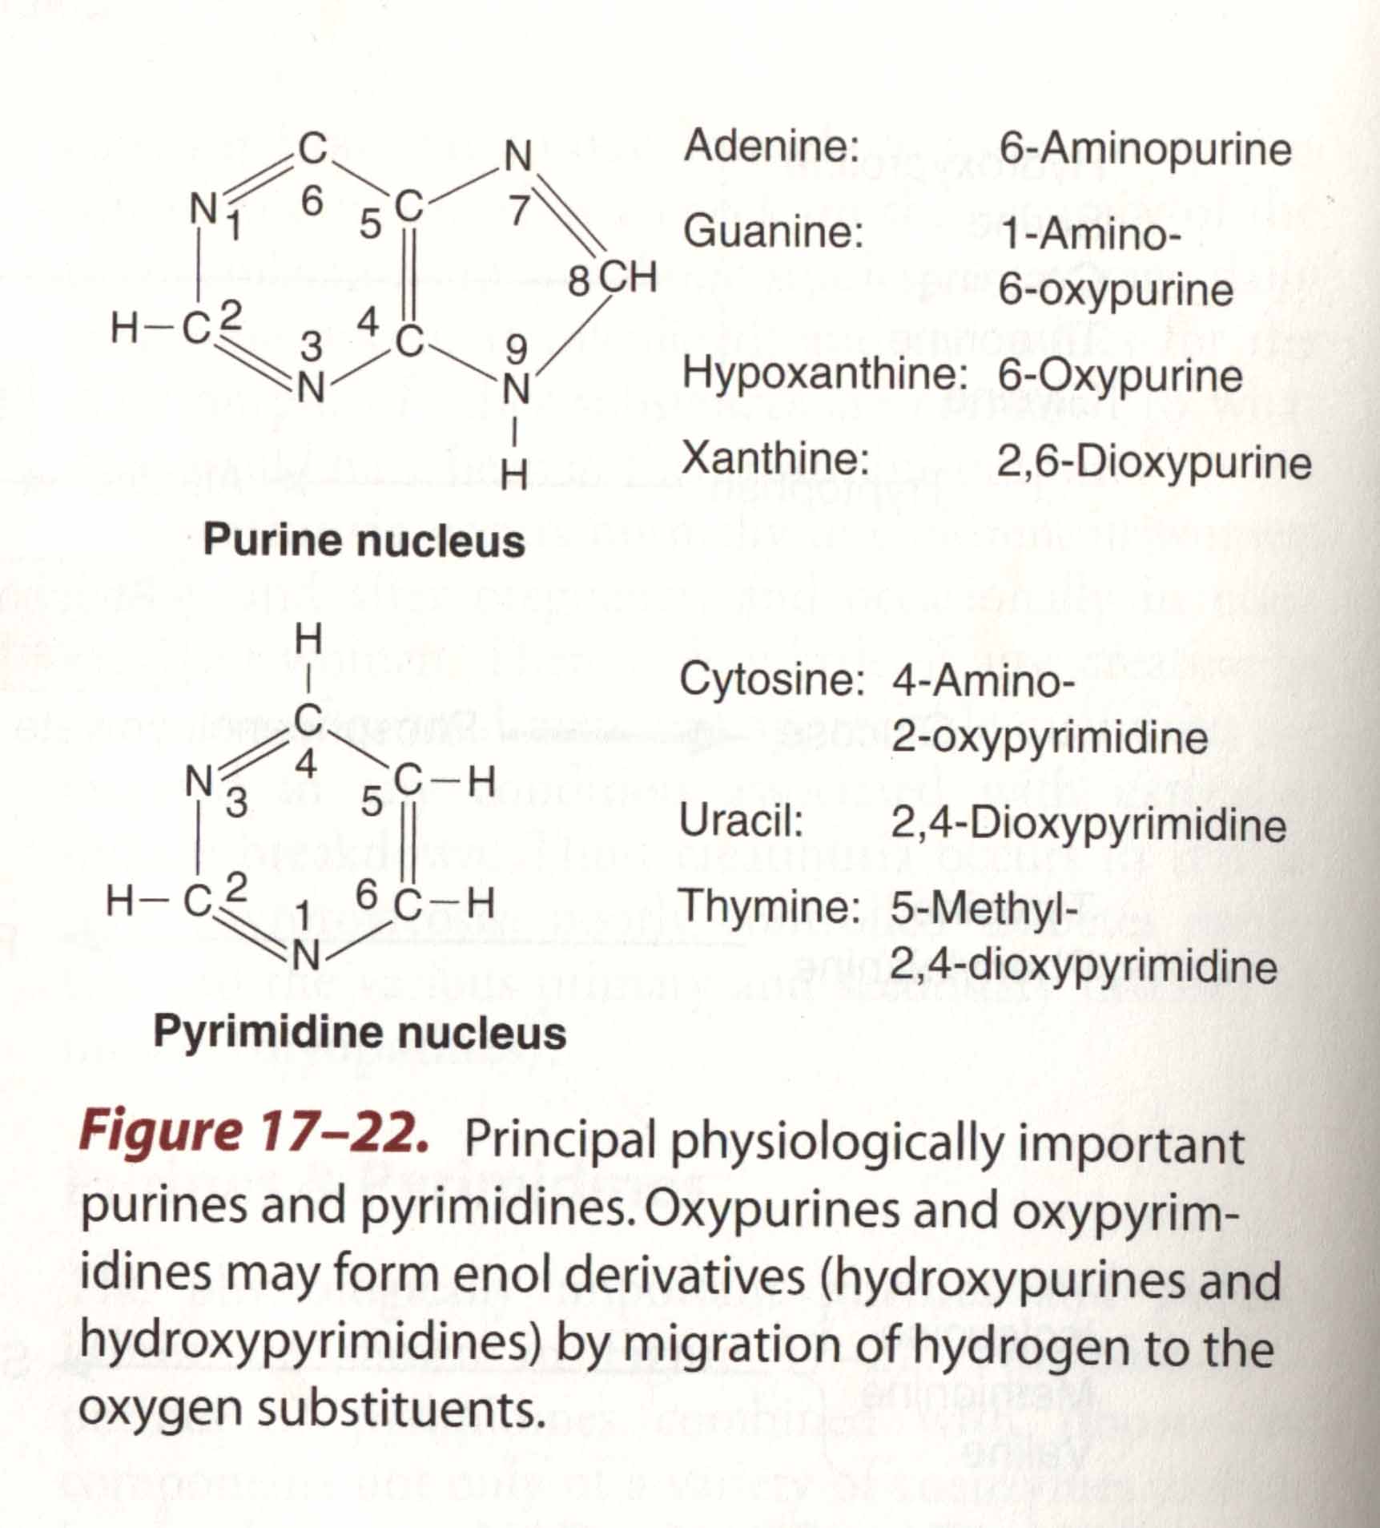

Slide 50
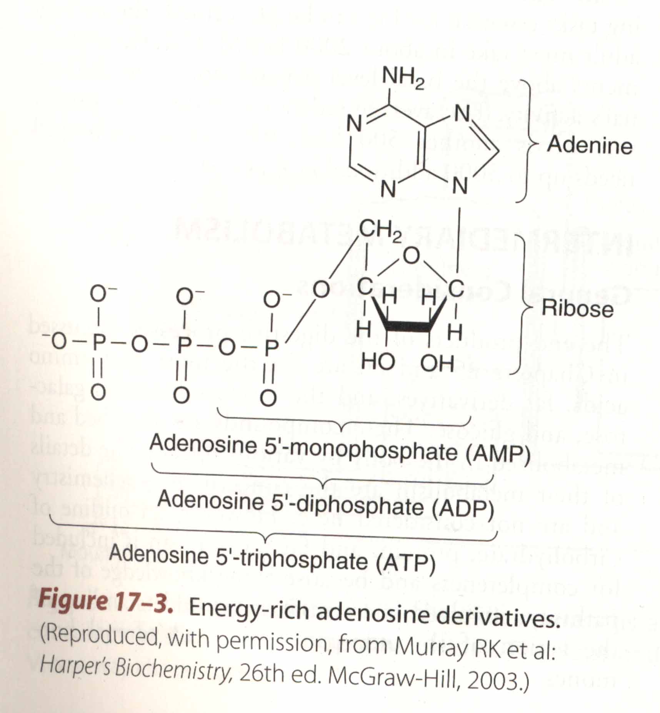
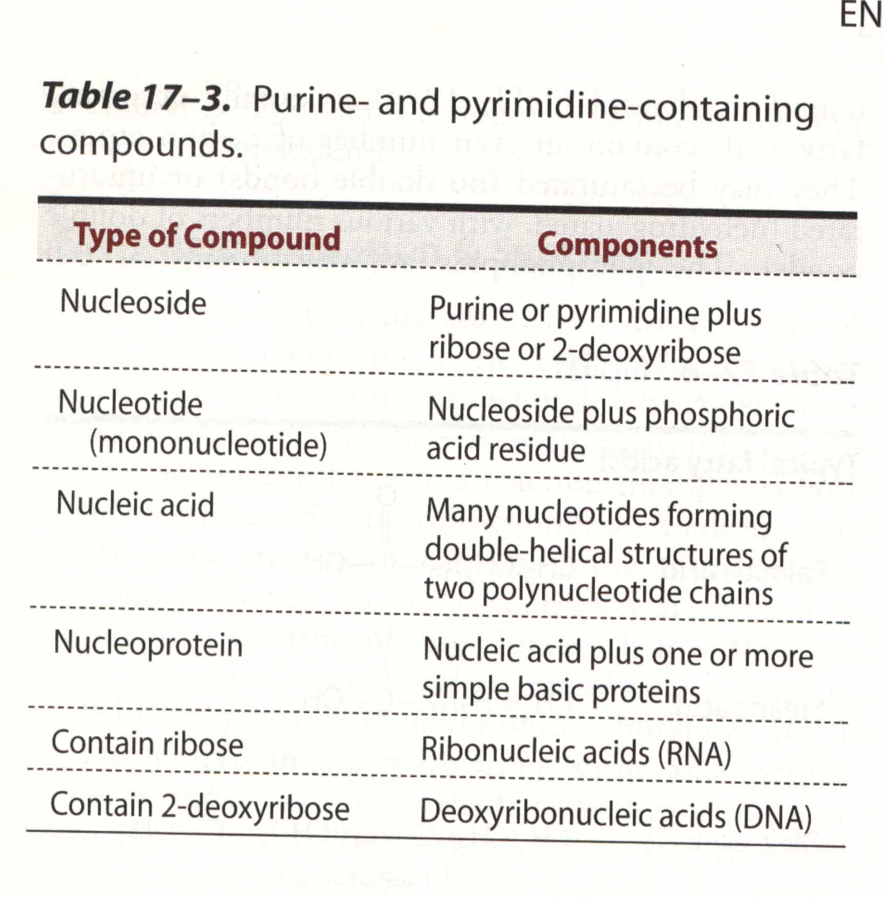

Slide 51
DNA BUILDING BLOCKS
Nucleic Bases
Nucleic Base + Sugar (Deoxyribose) = NUCLEOSIDE
Nucleoside + PO₄^{2- = NUCLEOTIDE}
^{Nucleotides + Protein skeleton}
^{= NUCLEIC ACID}
Chain of Nucleic Acids (polymer) = DNA

Slide 52
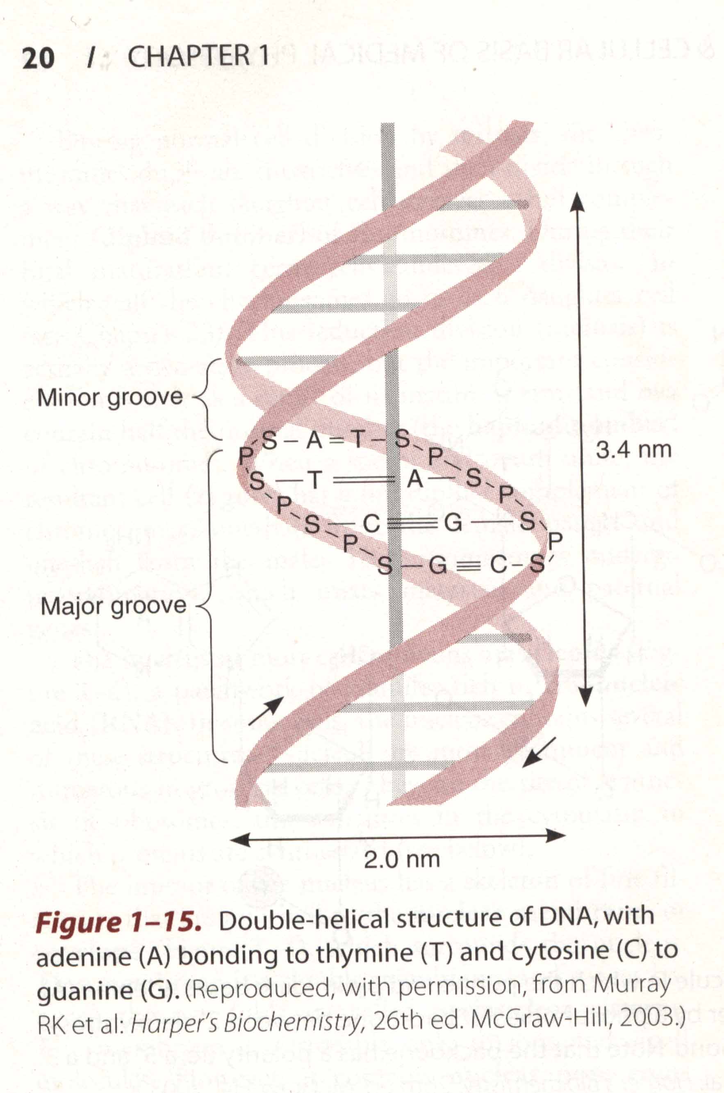

Slide 53
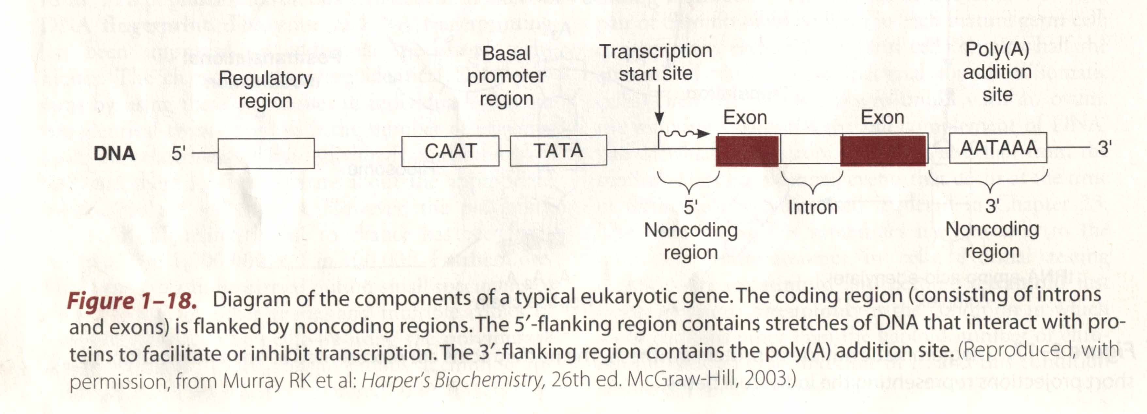

Slide 54
1.
ROLE OF GENETICS IN REPRODUCTION
Sexual differentiation. i.e. differentiation of indifferent, bipotential Gonad into ovary or testis is determined by X and Y chromosomes and more specifically by segment on the short arm of the Y chromosome that carries the SRy ring or protein.
General Growth is determined by genes on both autosomal chromosomes and sex chromosomes.
The sex chromosomes X and Y share many characteristics with autosomes.
The place of sex chromosomes in the hierarchy and staining characteristics of the spectrum of chromosomes is important in appreciating genetic ditribution.
KARYOTYPE
GENETIC MAPPING
- The Human Genome Project (HGP) – 1990-2003

Slide 55
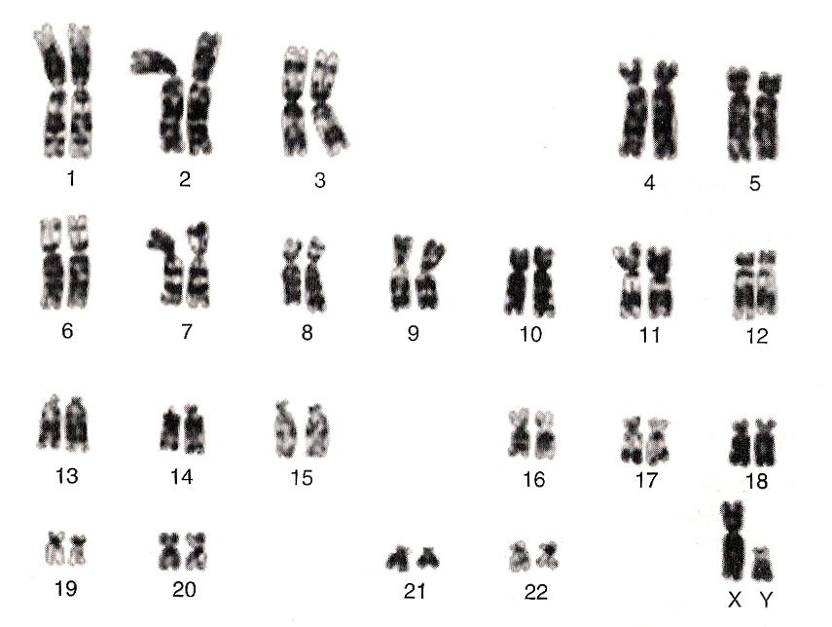
2.
KARYOTYPE OF CHROMOSOMES FROM NORMAL MALE

Slide 56
Hierachy of Chromosomes
Larger chromosomes carry more genes and are more essential for life
Chromosomes of gp A &B not compatible with life but are found in over 40% of first 8 weeks abortions (common)
Gp C chromosomes most typical and more commonly carry single gene (enzymes) disorders – not chromosomal

Slide 57
Smaller,eccentric/telocentric chromosomes
Gp D,E &F exhibit major chr. Abnormalities with common features and frequently get to term/preterm
- Mongoloid, E trisomies, etc
Gp G (21,22) major chr. Abnormalities are compatible with life though neither normal nor sustainable – eg monosomy, trisomy like Down’s Syndrome – (21% chr. Abnorms @ birth)
More than 50% contribution in late pregnancy deaths
Relationship between gp D and Y chromosome

Slide 58
THE Y CHROMOSOME
Smallest, only 3 arms
Very few autosomal genes compared to X – explains sex-linked disorders
Not essential for life
Abnormalities compatible with life e.g. trisomy (xyy) - Klinefelter -25%
Y chromatin occassionally translocated onto D chromosomes ? Adjacent orbits.

Slide 59
3
BASICS OF KARYOTYPING
Arranging the different chromosomes of the cell (nucleus) in order of size from largest to smallest:
Total size (span) of the chromosome.
Length of the long arm.
Centromeric position.
Banding pattern on staining
- Giemsa stain – G-bands
- H & E stain (Haematoxylin & Eossin)
- quinacrine stain – q-bands
Fluorescent staining for identifying marker on Y chromosome – F-Body
Inactivated X chromatin is condensed on nuclear membrane in cells with more than one X to appear as Barr body in about 15% of normal female cells. Less than 3% in males. CALLED DRUMSTICK ON POLYMORPHS.

Slide 60
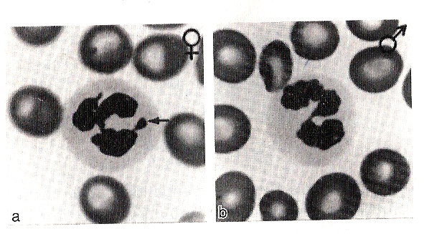
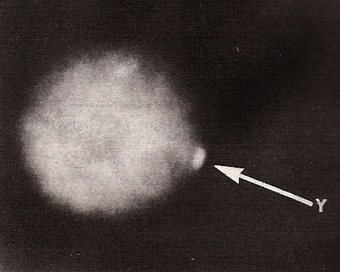
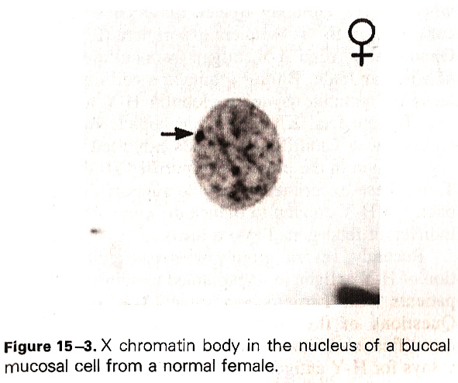
4
DRUMSTICK
BARR BODY
Rate of Recovery of sex chromatin (Barr Bodies)
10-15% of cells in normal female
2-4% Kchinefelter syndrome
< 2% normal male

Slide 61
5
STEPS IN PREPARATION FOR KARYOTYPE
Grow cell in cell culture – cell line.
Recover cell and separate
Add colchicine (antinucleic acid or antimetabolite) to arrest mitosis in metaphase or interphase for fluorescent stain.
Incubate in hypotonic saline to swell the cell and break it up releasing the chromosomes.
Prod and disperse the chromosomes on a slide using microglass rods.
Stain to view.

Slide 62
THE HUMAN GENOME PROJECT (HGP)
1990 to 2OO3 USA collaborative
Mapping of all the 50 thousand human genes in sequence and function
More accurate genetic engineering and gene replacement
Correcting gene abnormalities
Tissue replacement and possibility of cloning – ethical constraints

Slide 63
6
DIFFERENTIATE BETWEEN
SRy segment or ring – a protein bound on to a specific DNA segment on the short arm of the Y chromosome. It opens up the DNA segment to initiate production of Testis Development Factor, TDF.
Sex Regulatory protein on Y Chromosome.
TDF – a peptide that acts on cells of the UROGENITAL RIDGE, specifically indeterminate gonad to differentiate into testes.
Hy Antigen – a peptide elaborated by cells of the urogenital ridge and latter SERTOLI CELLS of the testis to promote testicular development, descent of testes and integrity of seminiferous tubules.
Mullerian Inhibiting Hormone (MIH)
Mullerian Inhibiting Peptide
Mullerian Regression Factor (MRF)
A medium sized peptide produced by SERTOLI cells of the testes from 6 weeks IUL to suppress parallel development of the mullerian ducts while wolfian ducts develop.

Slide 64
REPRODUCTIVE PHYSIOLOGICAL SYSTEMS
ENDOCRINE
FUNCTION
LH – RH
LH
(ICSH)
INTERSTITIAL
CELLS
GAMETOGENIC
FUNCTION
GN RH
FSH
SEMINIFOROUS
TUBULES
Accessory GLANDS
Sperm Production
Sperm Maturation
Sperm Transport
SERTOLI CELLS
ACTIVITIES
ENDOCRINE
FUNCTION
LH-LR/FHS-RH
FHS/LH
GRAAFIAN FOLLICLE
FOLLICULAR ANTRIUM
THECA-GRANULOSA
ESTROGEN PRODUCTION
(PROGESTERONE)
SHORT PEPTIDES
ANDROGENS
CORPUS LEUTEUM
GAMETOGENIC
FUNCTION
GNRH
FHS/LH
GAMETE
MATURATION
PROGESTERONE
OVULATION
FERTILIZATION
HYPOTHA
LAMUS
PITUITARY
GONADS
TARGET ISSUES …………………………………………………………………………
………………………………………………………………………………………………

