Slide 1
THE RESPIRATORY SYSTEM
ORGANIZATION

Slide 2
COMPONENTS-1
THE CONDUCTING SYSTEM COMPONENTS (anatomical dead space)
Nose
Pharynx
Larynx
Trachea
Left and Right bronchi
Bronchioles
Terminal bronchioles
GAS ECHANGE SYSTEM COMPONENTS
Respiratory bronchioles
Alveolar Ducts
LUNGS AND ALVEOLI
Concept of the “AIRWAYS”
NEED TO KEEP THE AIRWAYS OPEN ESPECIALLY IN:
Newborn
People in states of reduced consciousness

Slide 4
COMPONENTS
Nose designed for
Air intake depending on temperature and humidity
Filtration and
Humidification
Environment and variations in design
Tropical dwellers and newborns
Arctic dwellers e.g. Inuit (“Esquimos”) and some North Eastern groups
Caucasian
Misleading theories of nose and brain
Monkeys Chimps and Proboscis monkey

Slide 5
FUNCTIONS OF THE NOSE
THREE FUNCTIONS (“AIR CONDITIONING”)
Warming . The extensive surface of conchae and septum = 160 sq cm air only ONE degree below body temp when it leaves the nose.
Humidification. AIR almost saturated with water vapour by time it leaves nose
Partial filtration. By hair (minor ) and by turbulent precipitation (major) the conchae (turbinares) assure maximumu turbulence. Hardly any particle larger than 6 micrometres (lesser than an RBC) is allowed to pass.
Particles between 1 and 5 micrometres settle in the smaller bronchioles by gravitational precipitation
Particles smaller than 1micrometer enter the alveoli and stick to the alveolar fluid.
Many particles smaller that 0.5 micrometers remain suspended in alveolar air and are breathed out! (e.g. cigarette smoke at 0.3, 30% l precipitate there rest breathed out to cause secondary smoking)
Those stuck on alveolar fluid are removed by alveolar macrophages

Slide 6
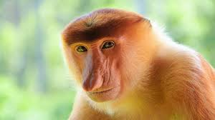

Slide 7
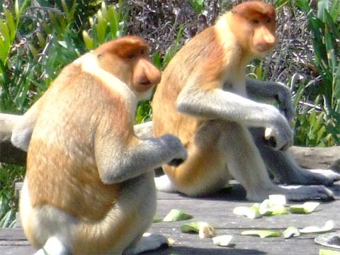

Slide 8
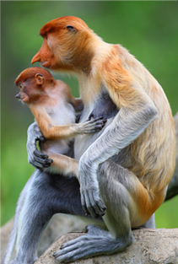

Slide 10
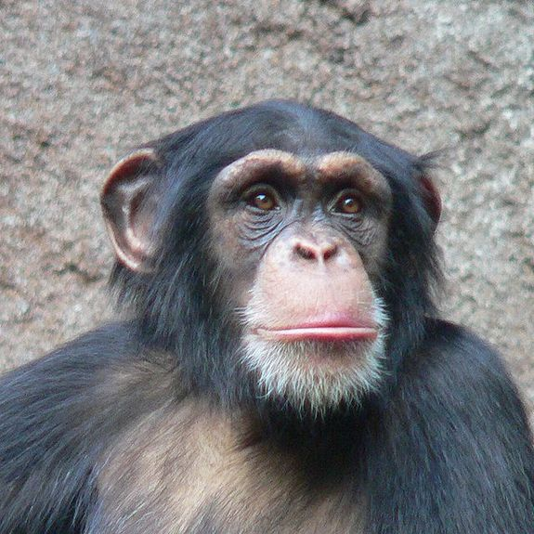

Slide 11
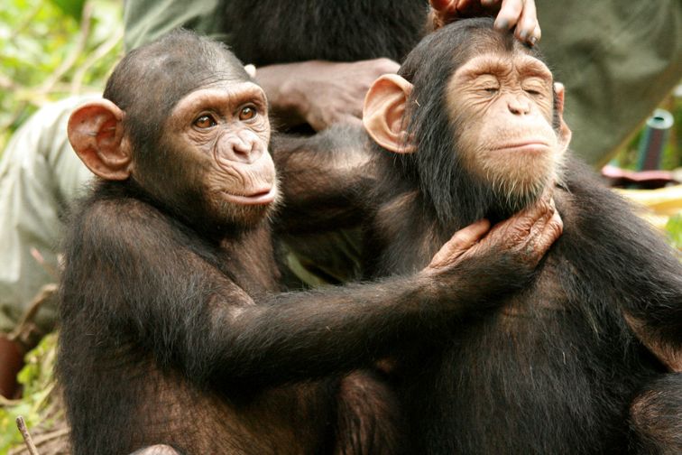

Slide 12
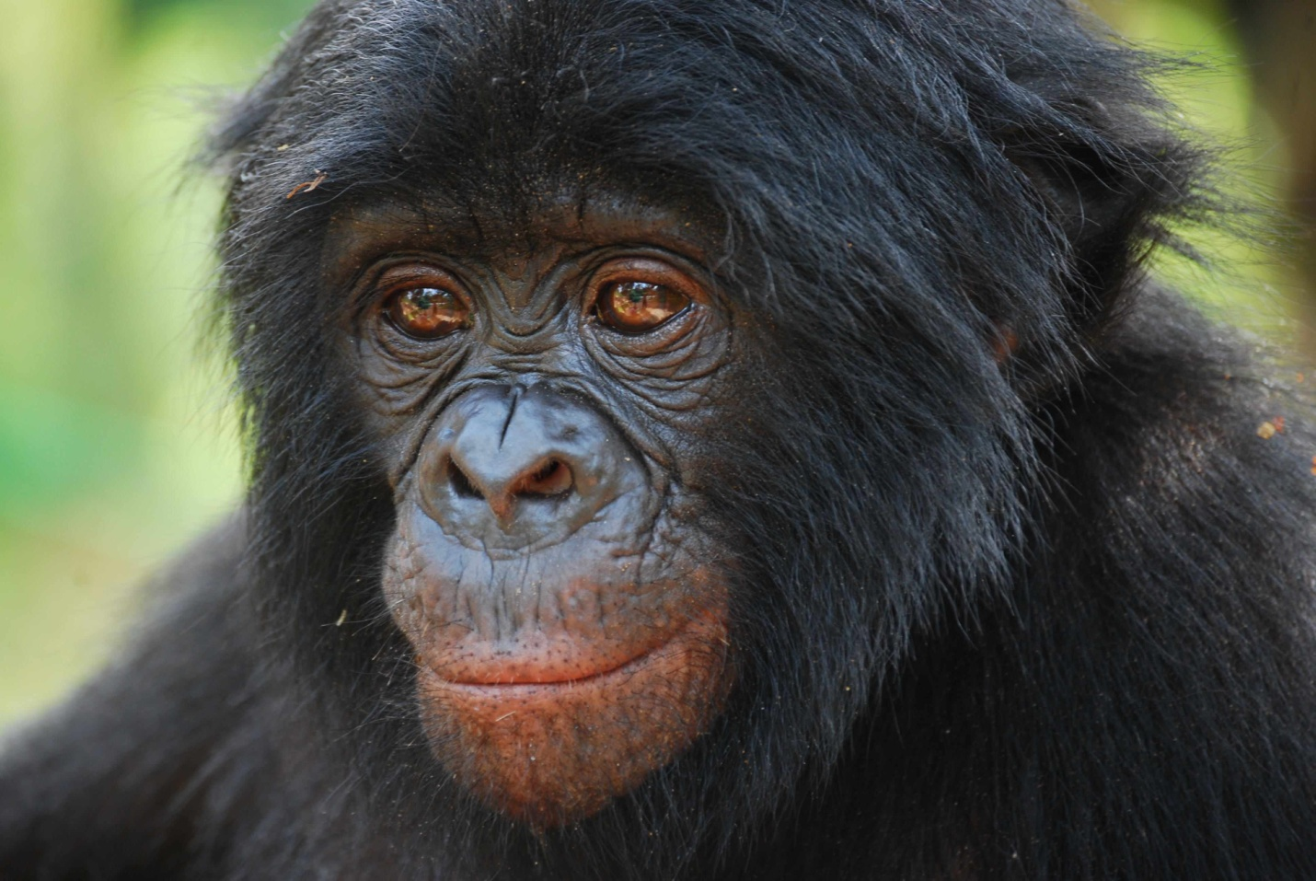

Slide 13
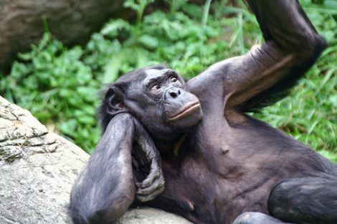

Slide 14
NASOPHARYNX

Slide 15
NASOPHARYNX -2

Slide 16
DETAILS OF COMPONENTS
NOSE
Filtering system , WARMING and Humidifying
Nasal hairs
mucus – amount depends on temperature irritants etc.
Lining – colomnar ciliated epithelium with mucus glands.
Cilia in nose waft mucus backwards towards the glotis
Cilia in brochi etc waft mucus fro alveolar end of the conductin system to larynx
MUCUS ESCALATOR
Air way epithelium secres both mucus and a watery fluid on which the mucus slides easily
Some diseases suppress this fluid secretion e.g. cystic fibrosis (commonest killer disease of caucasians)- mucus layer therefore becomes thick and dehydrated leading to chronic pulmonary obstruction disease (a common cause)
Fundamental cause is defect in Chloride channels in the fluid secretory process
Clears lungs of dust and othe particulate matter
Clears bacteria that ride on the particulate matter
Movement of cilia ensures mucus is normally swallowed thus making sure that bacteria etc are continually destroyed by the acid in the stomach. In
Cilia rhythm depends on temperature etc –explain
Overwhelming of the system in disease –smpking, inflamation etc
Microorganosm parasitic opportunism – e.g TB influenza, corrhiza pneumonic plague and coughing

Slide 17
PROTECTIVE MECHANISMS OF CONDUCTING PATHWAYS
The mucus escalator - vide supra v.s. (i.e. see above)broncho-constriction
Keeps away particles and irritants from respiratory zone
Macrophages in alveoli and airway engulf bacteria and particles that enter the sysytem
Macrophages are damaged by air polutants e.g smog and smoke from cigarettes etc

Slide 18
COMPONENTS-3
Upper Airways (nose, mouth, pharynx, larynx) and Lower Airways (trachea, bronchi, bronchioles)
Two lungs (right and left)
Right – three lobes: upper, middle lower
Left – two lobes: upper. Lower
300, 000,000 (300M) alveoli are very small air sacs
Gas exchange takes place in alvioli (and repitory broncioles and alveolar ducts
Total surface area of for gas exchange ?? Sq metres (area of a tennis court)
Evolutionary significance
Extreme high altitude – eg Bolivian footballers

Slide 19
ALVEOLI AND PULMONARY BLOOD SUPPLY

Slide 20
BREATHING (VENTILATION)
RESPIRATORY CYCLE
depends on flows caused by presuure gradient changes between chest cavity and the atmosphere
Inspiration (inhalation)
Air from environment into lungs down pressure gradient
Expiration
Expiration (exhalation)
Pushing air out into environment

Slide 24
CARDIORESPIRATORY COOPERATION -1
Cardiac cycle ensures right ventricle pumps deoxygenated blood into lungs at 5 L per min atrest – i.e. the cardiac output - almost all of it)
Minute ventilation is 6L per minute at rest
At rest 4L per minute “bathes” the ALVEOLI
Pulmoary artery, arterials capillaries venules veinules and Pulmonary Vein
Pulmonary capillaries surround every alveolus
IN SEVERE EXERCISE:
Minute ventilation can rise X 20 to 120L per min and Cardiac output can go up X6 to 30L per min
Pulmonary capillaries form dense mesh that sorround each alveolus
The pulmonary circulation is a LOW PRESSURE CIRCULATION compared with the systemic one (??????? Values)

Slide 25
CARDIORESPIRATORY COOPERATION -2
IN inspiration air has to traverse the nasopharynx and the oropharynx which is a common pathway for BOTH food and AIR
Pharynx opens into esophagus (posteriorly) for food and (anteriorly) Larynx through the glotis for the air.
The epiglotis guards the entranceinto the larynx (the glotis) acts as a trap door that closes the glotis to allow foood to pass into esophagus in swallowing
During swallowing breathing stops
Choking –explain causes and mechanisms
1st AID –babies and gown ups
Larynx contains phonation mechanism:
Vocal cord (NB dangers of laryngeal spasm)
Lary geal muscles and nerves
Laryngeal cartilages

Slide 26
THE BRONCHUS AND BRONCHEAL SYSTEM
Reiforcemnt (streng thening) of walls of the air conducting system (trachea, bronchus and whole of the broncheal tree)
Cartilage rings provide cylindrical shape and support
Support prevents collapse or ballooning with changes in intra thoracic pressure during breathing coughing and sneezing
SMOOTHMUSCLE
Surround walls of pulmonry ARTERIALS and BRONCHIOLES
The smooth muscle control diameter of these two
Changes of broncials diameter and respiratory cycle -explain
Bronchial “tree” branches X20 from beginning at the bronchial bifurcation, the CARINA, to the respiratory bronchioles
Each sequential branching leads to numerous shorter and narrower tubes
Names and illust ??

Slide 27
BRONCHUS AND BRONCHIEAL TREE

Slide 29
ZONES OF AIRWAYS
Filtration zone
Hair and mucus in nasal cavity and mucus in oral cavity trap particulate matter
Nasal cavities designed for maximum turbulence for filtration (and humidification) of air
Therefore dust etc sticks onto the mucus
Conducting zone
From top of trachea to beginning of respiratory bronchioles
Has no gas exchange function becase has no alveoli
Respiratory zone (for gas exchange with the blood)
Respiratory bronchioles to alveoli

Slide 30
THE ALVEOLI-1
300MillionTerminal air sacs connected to respiratory bronchioles by alveolar ducts
Sadjacent alveoli share common partitioning wall (like maisonnettes)
ALVEOLAR CELLS
Type I
Flat epithelial cells that form a one-cell layer alveolar wall.
Type II
Thicker cells found between the type I cells
Produce SURFACTANT which has detergent qualities for lowering the surface tension of the alveolar wall
Surfactant is chemically ---------------

Slide 31
ALVEOLI

Slide 32
THE ALVEOLI-2
WALL COMPONENS
Alveolar cells (v.s.)
Basement membrane under the alveolar cells
Capillaries
Interstitial space – very small
Thin layer of loose mesh of connective tissue which is absent in some areas and so capillary epithelium and the alveolar basement membranes fuse
Barrier between air and blood in the alveoli very thin -2uM
Total surface area (tennis cout) and thinnnes of the membrane facilitate very rapid gas exchange (CO2 and O2) between alveolar air and blood in the alveolar vapillaries (?????? Secs)
ALVEOLAR PORES
Interconnect some alveoli
Is a safety mechanism for ensuring some alveolar ventilation when disease processes block some alveoli.

Slide 33
FUNCTIONAL ANATOMY OF CHEST -1
Trachea and Lungs are thoracic organs
Thorax and its boundaries ….Illist see resp practical slides
Resilience and strength of thoracic walls
Primary muscles of respiration ---fig
Diaphragm and its enervation
Intercostal muscles and their enervation
Inspiratory and expiratory muscles
Secondary muscles of respiration….fig
Each lung with its visceral pleura
Parietal pleura
The thin layer of pleural (intrapleural) fluid – lubricates the two pleura during breathing
They can easily slide but very difficult to separate e.g. wet glass slides or wet microscope slide and its coverslip.

Slide 34
LUNGS AND PLEURA

Slide 35
FUNCTIONAL ANATOMY OF CHEST -2

Slide 36
FUNCTIONAL ANATOMY OF CHEST -3

Slide 37
ORGANIZATIOJN OF THE RESPIRATORY CONTROL
Respiration is one of the vital life maintaining functions vis O2 and CO2 control for energy at all levels and for pH control
Complete Respiration failure leads to death
Therefore controlled via homeoststic mechanisms these comprise
Involuntary mechanisms and
voluntary “overide” mechanisms

Slide 38
INVOLUNTARY MECHANISMS - 1
CNS CETRES
1 The Respiratory Centres
Medulla and Lower Pons
Control the nerves that supply muscles of ventilation
They comprise
A pacemaker neurons which determines rhythm
Neurons that drive inspiration
Neurons that drive expiration when extra ventilation effort is required e.g. in exercise

Slide 40
INVOLUNTARY MECHANISMS - 2
2 .THE RESPIRATORY CHEMORECEPTORS
Central Chemoreceptors in the medulla monitor pCO2 (via Hydrogen ions)
Peripheral Chemoreceptors in the:
Carotid bodies in the neck
Aortic bodies by the arch of the aorta in the thorax
Peripheral ones monitor pO2 and pCO2
CO2 crosses the blood brain barrier and entres extra cellulsr space of receptor neurons it forms the acid H2CO3 which dissociated into H+ and HCO3-. H+ stimulates the receptor neurons
Swallowing inhibits breathing involunarily through CNS mechanisms
Speaking coordinates breathing and vocalization automatically through CNS mechanisms

Slide 41
VOLUNTARY OVERIDE
VOLUNTARY INTERFERENCE WITH AUTOMATIC CONTROL IS POSSIBLE BY CEREBRAL CORTEX i.e..
Prefrontal cortex (will power and decision to do something)
Pre-motor cortex (motor planning, motor cortex execution of voluntary purposeful motor activities e.g.
Singing
Voluntary holding of breath – for a period only
Voluntary hyperventilation - Also limited in time by development of voluntary alkalosis
Voluntary exercise – the command to hyperventilate drives (accelerates) the respiratory system in the absence of any change in the pCO2 or pO2 e.g in fit athletes and in individuals just before an exercise starts
In emergencies for the “Fight or Flight” reaction. NB this switches on sympathetic autonomic nervous system mechanism

Slide 42
END

