Slide 1
Physical principles related to Respiratory Gas Transfer
Dr G Ogweno

Slide 2
Gas Laws
Boyle’s law: Pv=K, inverse relationship
Charles law:V=kT,direct relationship
Universal: PV=kT, R=8.13JK⁻¹M^{-1; (}molar volume=22.4L)
Van der waal’s equation: (P+a/V²)(V-b)=RT; re stated PV/RT=Z
Graham’s law=diffusion inversely proportional to √MW
Dalton’s law of partial pressures or tension-sum of each individual gas pressure equals total pressure

Slide 3
Dalton’s law:
Partial pressure of gas in mixture is equal to pressure gas would exert if it occupied entire volume
Henry’s law:
Concentration of dissolved gas depends on partial pressure and solubility

Slide 4
Conversion of units
Force, 1 N=10 ⁵ dyn
Pressure,
kPa=7.5mmHg; 10.2 cmH₂o,
Std atm=101.3 kPa; 760 mmHg; 1033 cmH₂o ; 10 m of sea water
1 torr= 1mmHg; 1.36 cmH₂o
1 Bar=1 atm; 10⁶dyn/cm²

Slide 5
Standard conditions of measurements
STPD= 0ºC; 760mmHg (standard temperature and pressure, dry)
BTPS=body temperature and pressure, staurated with water vapor
ATPD=ambient temperature and pressure, dry
ATPS=Ambient temperature and pressure, saturated with water vapor

Slide 6
Quantification of respiratory gases
Spirometry
Plethysmography
O₂ and co₂ electrodes
Pulse oximetry and capnography/metry
Infra red absorption spectroscopy
Gas chromatography
Mass spectrometry

Slide 7
Partial gas pressures
partial pressure is usually used to compare the proportion of gases in a mixture
the partial pressure of a gas in a mixture of gases is the pressure exerted by that gas (measured in kilopascals, kPa)
ex. at sea level, total atmospheric pressure is 101.3 kPa
atmosphere contains 21% oxygen, therefore oxygen has a partial pressure of
.21 x 101.3 kPa or 21.3 kPa

Slide 8
Composition of inspired (atmospheric air), alveolar, and expired air (percentage composition by volume)
Gas Inspired air alveolar air expired air
Oxygen 20.95 13.8 16.4
CO₂ 0.04 5.5 4.0
Nitrogen 79.01 80.7 79.6

Slide 9
Gas Composition of Air
P_{air} = 760 mm Hg = P_{N2} + P_{O2}
P_{N2} = 0.79 x 760 mm Hg = 600 mm Hg
P_{O2} = 0.21 x 760 mm Hg = 160 mm Hg
Air is only 0.03% carbon dioxide
P_{CO2} = 0.0003 x 760 mm Hg = 0.23 mm Hg

Slide 10
Composition of Air at 100% Humidity
P_{air} = 760 mm Hg = P_{N2} + P_{O2}+ P_{H2O}
P_{N2} = 0.741 x 760 mm Hg = 563 mm Hg
P_{O2} = 0.196 x 760 mm Hg = 149 mm Hg
P_{H2O} = 0.062 x 760 mm Hg = 47 mm Hg
P_{CO2} = 0.00027 x 760 mm Hg = 0.21 mm Hg

Slide 11
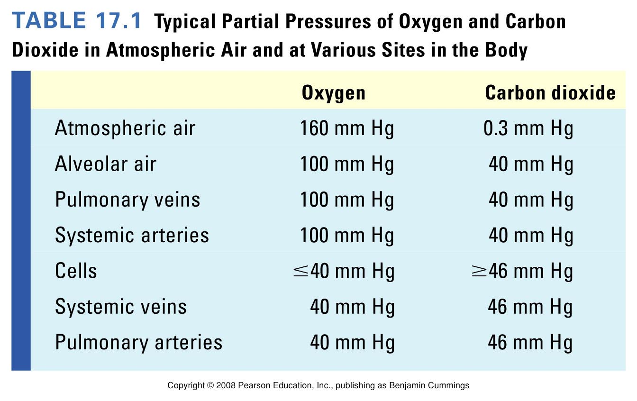
O₂ and CO₂ Partial Pressures
Table 17.1

Slide 12
Oxygen cascade

Slide 13
Tracheal composition
Dilution of inspired oxygen by water vapor=humidification
FIo_{2 in dry gas phase}= (barometric pressure-svp of water)
Po_{2 at 37}⁰_{C}=0.2094x(101-6.3)
=0.2094x95=19.9kPa or
0.2094x(760-47)= 149mmHg

Slide 14
Alveolar gas tension equation
Alveolar Po₂=dry barometric pressure( inspired O₂ concentration-oxygen uptake/alveolar ventilation
PAo2=PIo₂-PACo₂(PIO₂-PEo₂/PEco2)
PAo₂=PIo₂-PAco2(FIo₂+1-FIo₂/R)

Slide 15
Primary factors affecting alveolar oxygen tension
Dry barometric pressure-altitude(svp)or depth
Inspired oxygen concentration
Oxygen consumption
Alveolar ventilation

Slide 16
Secondary factors influencing alveolar oxygen tension
Cardiac output-wash out and tissue extraction effects
Concentration or third gas or Fink effect-large soluble and diffusible gases such as nitrous oxide on less soluble nitrogen=dilution effects

Slide 17
Alveolar/arterial Po₂difference
Normal<2 kPa(15 mmHg)
Venous admixture-Shunt and dead space
Temperature and pH
Hb concentration
Alveolar ventilation

Slide 18
Alveolar Gas Equation
Respiratory quotient (R): ratio of CO₂ production to O₂ consumption
R ~ 0.8
P_{H2O}: because air is humidified in trachea
P_{H2O} = 47 mm Hg
FI_{O2} = 21%; changes if on ventilator
PA_{O2} = alveolar O₂
PI_{O2} = inspired O₂

Slide 19
Role of oxygen in the cell
Disolved molecular oxygen enter many metabolic processes, mostly cytochrome c oxydase system (90% of total), other oxydases include:
Electron transfer-reduces to superoxide anion, hydrogen peroxide or water to produce ATP; NADPH; conversion of 5HT and 5HIAA and urate to allantoin
Oxygen transferases-incorporation into substrates without any reduced oxygen product eg cyclooxynases and tryptophan to formylkynurenine
Mixed function oxidases-cyt p450, mixed function detoxification rxn eg catecholamines

Slide 20
Critical oxygen tension for aerobic metabolism
Deficient po₂, oxydative phosphorilation continues to level of 0.3 kPa (2 mmHg)
Below critical level, ETC revert to reduced state, NADH/NAD+ and lactate/pyruvate ratio rises, ATP/ADP ratio falls; switch to anaerobic metabolism
critical level also known as pasteur point

Slide 21
Hyperbaricity on blood oxygen tensions
compartment | Normal barometric pressure |  | At 2 ATA | At 3 ATA
 | Air | oxygen | oxygen | oxygen
Inspired Po2(humidified) | 20 kPa | 95 kPa | 190 kPa | 285 kPa
Arterial Po2 | 13 kPa | 80 kPa | 175 kPa | 270 kPa
Venous Po2 | 5.2 kPa | 6.4 kPa | 9.1 kPa | 48 kPa

Slide 22
Oxygen toxicity-free radicals
Produced by:
Fenton reaction or Haber Weiss
Myeloperoxidase reaction( hypochlorite)
Ionizing radiation
Species
Singlet oxygen
Superoxide anion
Hydroxyl radical
Hydrogen peroxide

Slide 23
Sources of electrons for free radicals
Xanthine or reperfusion injury
Xanthine and tumor necrosis factor
Ferrous iron conversion to ferric state
NADPH oxidase system
High Po2 by mass action
Exogenous compounds eg paraquat
Others-complement activation, nitric oxide interaction, glucose oxidase

Slide 24
Biochemical targets of oxygen derived free radicals
DNA-breakage of chromosomes
Membrane lipids
Sulphydril containing proteins

Slide 25
Defences against oxygen free radicals
enzymes-
Superoxide dismutase (SOD)
Catalase
Antienzymes-allopurinol
Free radical scavengers-glutathione/glutathione peroxidase(GSH); ascorbic acid, vit E, dimethylthiourea, n-acetyl cysteine and dimethylsulphoxide
Iron chelating agent-
steroids

Slide 26
