Slide 1
MECHANISM OF PULMONARY VENTILATION

Slide 2
MUSCLES OF RESPIRATION
LUNGS EXPANDED IN TWO WAYS:
Vertical changes in chest cavity by diaphragm movements
Changes in rib cage dimensions by contraction of external intercostal muscles as follows:
antero-posterior diameter (pump handle rib movemets)
transverse diameter (bucket handle rib movements
NB: interchoral muscle do not cause diameter changes

Slide 4
QUIET BREATHING - 1
Mainly uses the diaphragm alone
Diaphragm is dome shaped.
Conraction therefore pushed abdominal viscera downwards and expands chest cavity in same direction
In expiration diaphragm relaxes
Elastic recoil of
Abdominal structures
Lungs
Chest wall
Pushes the diaphragm upwards back to its dome shape
Reduces the diameter of the chest
Lungs are compressed and air is driven out
Abdominal muscled facilitate the process by contracting and pushing viscera up against the diaphragm

Slide 5
QUIET BREATHING - 2
Changes in anteroposterior diameter of chest:
The ribs at rest slant downward and sternum is shifted inwards see fig
Contraction of the external intercostals raise the ribs forwards so that they asume a positio which is almost horizontal see fig
This increases antero-posterior diameter by 20%
Muscles that do this are termed inspiratory muscles
Muscles that lower the rib cage are termed expiratory muscles

Slide 6
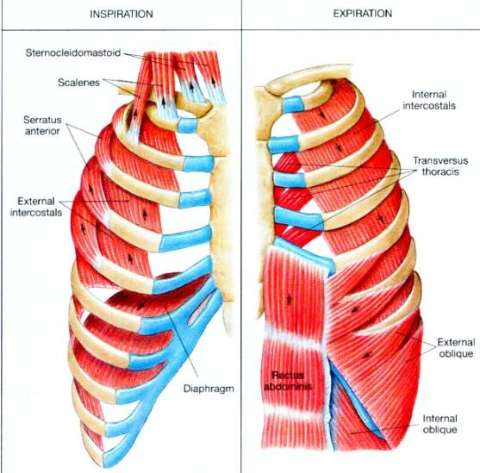

Slide 8
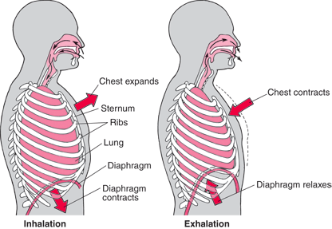

Slide 9
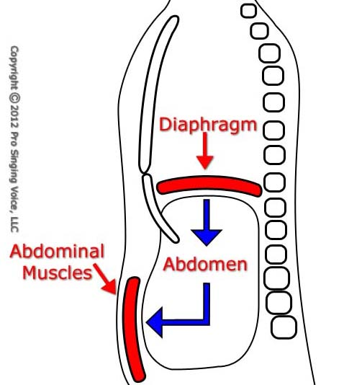

Slide 10
RESPIRATORY MUSCLES -1
Ispiratory muscles:
External intercostals (except interchondrals). These are the primary muscles of inspiration
Any muscle attached to both the chest wall and the vertebral column or arms. These are the accessory inspiratory muscles see fig i.e.
Serratus anterior
Sternomastoids
Scalenus mescles

Slide 11
RESPIRATORY MUSCLES -2
Expiratory muscles. These pull the rib cage downwards. These are;
Rectus abdomini muscles
Internal intercostal muscles
Refer to fig showing rib movements

Slide 12
PRESSURES THAT AFFECT CHEST EXCURSIONS
Lung only anchored at mediatsernum
Otherwise is an elastic bag filling the chest cavity.
Parietal and lungs pleura are held together by fluid but can slide against each other (refer to earlier notes) lubricated by the pleural fluid
Suction of any excess pleural fluid into the lymphatic system maintain negative pressure in the very thin pleural cavity

Slide 13
PLEURAL PRESSURE
Suction and opposing elasticity of chest cage and lung elasticity mentioed before maintain a negativepressure
At beginning of inspiration Pip is about -5 cm of H2O.
In ispiration, lungs pulled outwards by chest cage expasion andpressure lowered to -7.5 cm H2O.
These pressure chnges sre adequate for delivering the resting tidalvolume of 500ml.

Slide 14
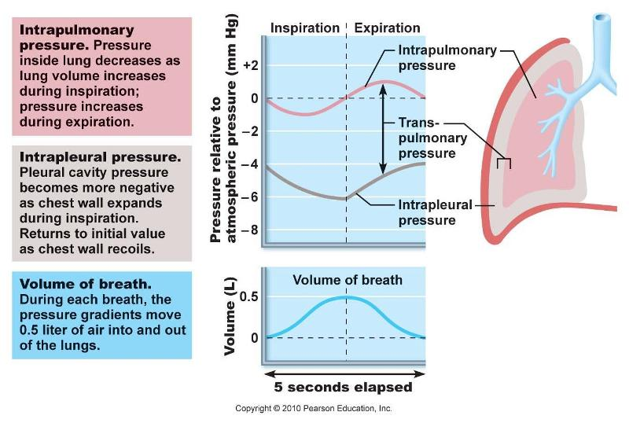

Slide 15
ALVEOLAR PRESSURE
Steady state with glottis open and no air flow means pressure in alveoli is atmoshperic = Zero cm H2O
As figur eshows alveolar pressure ha to fall to allow inspired air in. !cm of H2O is adequate for the resting tidal volume within 2 sec.
In expiration opposite happens and +1mm alveolar pressure above atmospheric pushes tidal volume out in 2 to 3 sec.

Slide 16
TRANSPULMONARY PRESSURE
Is the difference between alveolar pressure and intrapleural pressure. Is a measure of the recoil pressure that is produces by the pull of the lungs away from the paretal pleura beccaus e of the lungs elastic recoil

Slide 17
LUNG COMPLIANCE -1
Is the lungs extent of expansion for each unit of pressure increase
The time element is needed so as to allow the lung volume to equilibrate with the new pressure
Normal total for both lungs +200ml/cm of H2O
The shape of the compliance graph depends on two factors
Surface tension of fluid lining the alveoli
Elastic forces of the lung tissue itself

Slide 18
LUNG COMPLIANCE -2
LUNG ELASTICITY
Provided by interwoven collagen and elastin fibres in the lung tissue
At end of expiration the fibres are in the contracted or relaxed kinked state.
At end inspiration the firbres are stretched and straight thus exerting elastic force to oppose the stretching of the lungs

Slide 19
LUNG COMPLIANCE -3
Alveolar fluid surface tension
Thus saline filled lungs would be hardly compliant compared to air filled lungs (see fig)
Saline filled lungs would have NO surface tension only elastic recoil.
Explain phenomenon of surface tension (ealier notes)
Most of the compliance in air filled lungs (2/3) is produced by the alveolar surface tension
NB without surfactant alveolar surface tension is too high for normal function (ref to Respiratory Distress Syndrome Of The Newborn)

Slide 20
SURFANCTANT -1
Principle of surface tension – explain
Small and large diameter balloon
La Place’s law P = 2T/r
“Surface-active compounds” are “surfactants”
Secreted by type II pmeumocytes
Has phospholipids, proteins and ions i.e. respectively:
Dipalmitoylphosphotidylcholine (and other minor phospholipids)
Surfactant apoprotein
Ca++

Slide 21
SURFANCTANT -2
The phospholipids reduce surface tension as explained earlier
The phospholipid covered alveolar water film has reduces the surface tensionby X2 to X12
Comparative surface tension figures:-
Water =72dynes/cm
Alveolar fluid without surfanctant = 50dynes/cm
Normal surfactant coated alveolar fluid = 5 to 30 dynes /cm

Slide 22
SURFANCTANT -3
OCCLUDED ALVEOLI
If alveolar duct is blocked, alveolar surface tension (ST) tends to collapses the alveolus concerned which tends to push out the air in that alveolus.
The pressure generated by the alveolus obeys La Place”s Law i.e. 2 X surface tension/alveolar radius.
For normal 100microM radius alveolus with durfactant the pressure = 4cm H2O or 3mmHg
Lack of surfactant would raise this to about X 5!
Effect of radius:
Reducing radius by a quarter as in premature babies increases the pressure to FOUR TIMES of the normal
Surfactant secretion begins at 6th to 7th of intrauterine life.
Prematurebabies lungs have inadequate surfactant and tend to suffer resp distress syndrome of the newborn (RDSN) –refer to earlier notes for details including treatment.
NB: thoracic cage has its own viscous and elastic properties. It therefore require muscular force to change its own volume so that ventilationcan occur

Slide 23
WORK OF BREATHING
IN QUIET BREATHING
Inspiration is active, but expiration passive so respiratory muscled only “work” in inspiration
Work of inspiration has 3 components:-
Compliance Work – for expanding lungs against their own elasticity
Tissue Resistance Work – required to overcome viscosity of the structures of the lungs and the chest wall
Airway Resistance Work – work required to overcome the airways resistance to air movement

Slide 24
ENERGY REQUIRED FOR RESPIRATION
IN QUIET RESPIRATION
3% to 5% of total body energy consumption is used for pulmonary ventilation
IN STRENUOUS EXERCISE
Energy required for ventilation increases by x 50. the increase is greater when the subject concerned has abnormal airway resistance of reduced pulmonary compliance
An important limiting factor for degree of severity of exercise which a person can withstand is the amount of muscular energy for pulmonary ventilation which the person can expend

Slide 25
MWISHO i.e. END

