Slide 1
PULMONARY VOLUMES, CAPACITIES AND MEASUREMENTS

Slide 2
SPIROMETRY
This is covered in the applied physiology practical. Computerized spirometry “POWER LAB” is used instead of the spirometers shown in the text books.
Instructions on how to use the power lab have been downloaded and will be posted to your web page. The departmental practical manual will also be issued when you come to do the practical

Slide 3
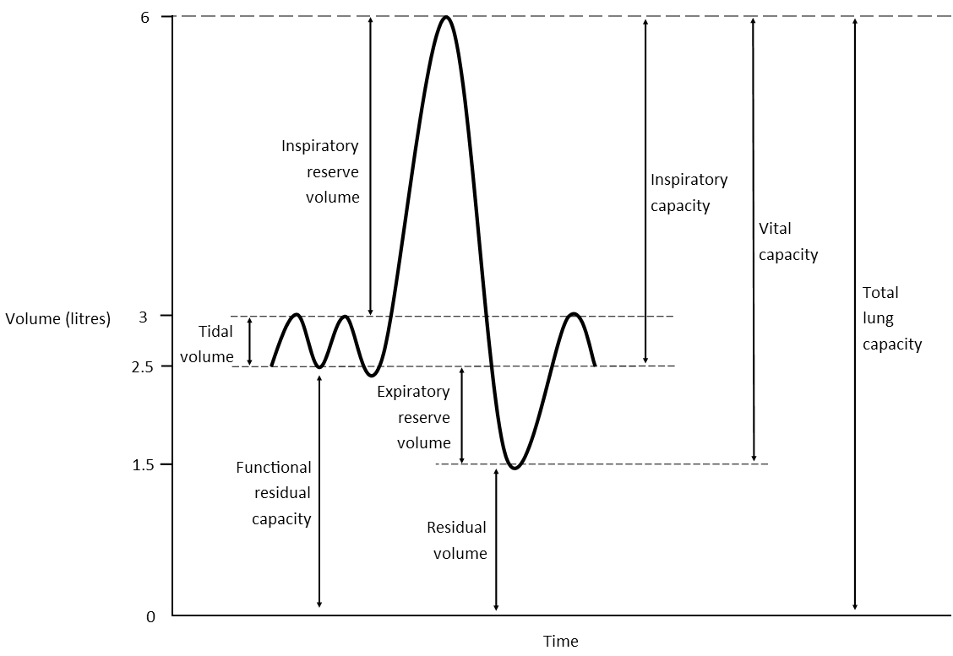

Slide 7
FEV1 = 80%

Slide 8
PULMONARY VOLUMES
Tidal vol (500 ml
Inspiratory Reserve vol (3000ml)
Expiratory Reserve vol (1100ml)
Residual vol (1200ml)
PULMONARY CAPACITIES = Combination of two or more volumes
Inspiratory capacity (3500ML)
Functional Residue capacity (2300 ml )
Vital capacity (4600ml)
Total Lung Capacity (5800 ml)
All volumes and capacities are 20% to 25% less in females. Variations in body types and degree of fitness are also observed. Athletes have large volumes and capacities
FEV ONE = 80% MAX EXP VOL

Slide 9
FUNCTIONAL RESIDUE CAPACITY, RESIDUE VOL AND TOTAL LUNG CAPACITY
THE HELIUM DILUTION METHOD:
The Functional Residue Capacity (FRC)
Is the air that remains in the Lungs at the end of each normal expiration
Direct spirometry cannot measure it because the residue volume of the lungs cannot be exhaled into the spirometer
Indirect spirometry using the helium dilution method is therefore used

Slide 10
HELIUM DILUTION INDIRECT SPIROMETRY -1
A spirometer of known volume is filled with helium a of known concentration
The subject first expires normally. NB at this point the air remaining in the lungs = the functional residue capacity
The subject immediately begins to breath from the spirometer and so the gases in the spirometer mix with the gases from his/her lungs.
Therefore, the helium becomes diluted by the functional residue capacity gases. In this situation, the volume of the functional residue capacity (FRC) can be calculated from the degree of dilution of the helium using the formula:
FRC =( CiHe/CfHe – 1) x Vispir
Where:
CiHe = initial concentration of helium in the spirometer,
CfHe is the final concentration of helium in the spirometer and Vispir is the initial volume of the spirometer.

Slide 11
HELIUM DILUTION INDIRECT SPIROMETRY -2
After determining FRC (functional residue capacity) thus, the residue volume RV can be calculated by subracting expiratory reserve volume (ERV) given by spirometry from this calculated FRC i.e. RV = FRC – ERV . The total lung capacity (TLC) can be calculated by adding inspiratory capacity (IC) to FRC i.e TLC = FRC+IC
NB: Minute ventilation = Respiratory Rate x Tidal Volume
FEV1 = % age of vital capacity which can be expired forcefully in the first second.

Slide 12
ALVEOLAR VENTILATION AND DEAD SPACE
With each breath some of the air goes as far as the non-respiratory part of the air conducting system, from the nose to the terminal bronchioles. It does not reach the alveoli and the respiratory bronchioles and so it does NOT take part in GAS EXCHANGE and is therefore called DEAD SPACE AIR.
In expiration dead space air exits first followed by alveolar air. It therefore does help in removing expiratory gases from the alveoli which is a hindrance to efficiency in refreshing alveolar air with each breath

Slide 13
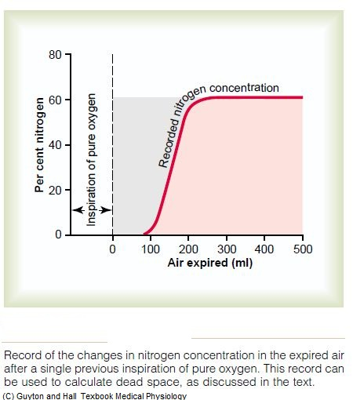

Slide 14
DEAD SPACE MEASUREMENT
The subject suddenly take a deep breath of pure oxygen. This fills the whole of the dead space with O2.
Some O2 also mixes with alveolar air but does NOT replace it.
Then a person expires through a rapidly recording NITRGEN meter which expresses the result in a graph. In the early part of the graph only dead space O2 appears, N2 remains Zero. Then follows alveolar air which is indicated by appearance of N2 concentration curve in the graph. This curve rises steeply from Zero then plateaus because alveolar air contains very much N2 this plateau is equal to the concentration of N2 in the alveolar air.
From the graph, the area before the N2 graph rises = the volume of the total O2 expired and so it is the volume of the DEAD SPACE as shown by the formula:
V(dead space) = a
Area of graph to the left of (i.e. before) the N2 curve*/area under N2 curve + area before curve. i.e. shows fractions of tidal volume made up of dead space and of alveolar volume
NB* = amount of O2 expired.
i.e, if oxygen curve area is 30sq cm and N2 curve area is 70 sq cm dead space volume out of a tidal volume of 500 is 30/(30+70) x500 = 150ml.

Slide 15
ANATOMIC VERSUS PHYSIOLOGICAL DEAD SPACE -1
Any area of lung without blood supply is regarded as an alveolar dead space because it does NOT contribute to blood gas exchange with alveolar air. Alveolar dead space +anatomical dead space = physiological dead space. The alveolar dead space may be huge in severe respiratory disease making the physiological dead space up to x 10 as much as the anatomical dead space i.e. up to 1.5 litres.

Slide 16
ANATOMIC VERSUS PHYSIOLOGICAL DEAD SPACE-2
Alveolar ventilation (ml per minute)
From above considerations the alveolar ventilation rate = respiration rate per min x (tidal volume – physiological dead space)

Slide 17
END

