Slide 1
BLOOD GAS BARRIER AND ALVEOLAR FUNCTION

Slide 5
ANATOMY OF ALVEOLI-1

Slide 6
ANATOMY OF ALVEOLI-2

Slide 7
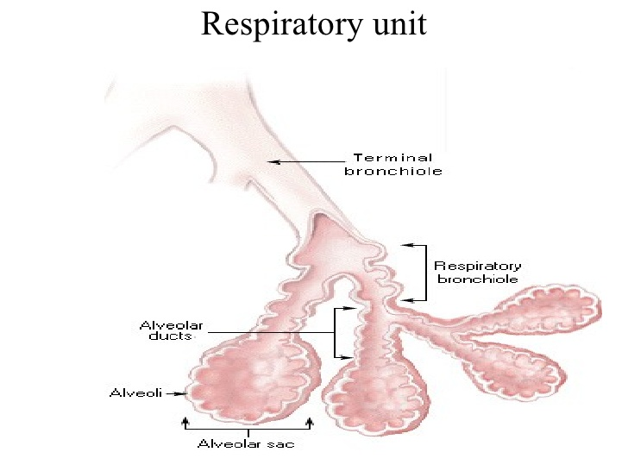

Slide 8
RESPIRATORY UNIT: REPIRATORY MEMBRANE
Same as Respiratory Lobule slide 4 comprises of
Respiratory bronchiole with its:-
Alveolar ducts
Alveolar atria
Alveoli
Total 300 million unit in both lungs
Alveolar diameter = 0.2mm. Walls very thin and has very rich network of capillaries so dense as to make blood flow to appear to be in “sheets of blood” or (el ninos) see sldes 2 and 3 .
The membrane of the whole unit allow gas exchange and are collectively known as the PULMONARY MEMBRANE or THE RESPIRATORY MEMBRANE

Slide 9
RESPIRATORY MEMBRANE -1
See fig 7 And direction of movement of CO2 and O2.
The SIX components of the barrier are:-
Alveolar fluid (surfactant covered)
Thin alveolar epithelium
Basement membrane of alveolar epithelium
Interstitial space between alveolar and capillary membranes very thin and absent in some places
Capillary basement membrane that fuses with alveolar basement membrane where there is no interstitial space*
Capillary endothelium
The thickness average = 0.6 micrometre (0.2 in places* and membrane cell nuclear where present protrude) total surface area = 70 sq metres about 7x10 metres, i.e. like a ¼ of a doubles tennis court
Total volume of blood covering this area is 60 to 140 ml (less than a Quarter of a tea cup) hence the blood sheet idea.
Average pulmonary capillary diameter(5 microM) make RBS ( at 7microM) fold up as they squeeze through as the blood flows. This is an additional factor fro increasing speed of gas exchange.

Slide 10
BARRIERS TO DIFFUSION -1

Slide 11
BARRIERS TO DIFFUSION -1

Slide 12
BARRIERS TO DIFFUSION -3

Slide 13
DIFFUSION FACTORS -1
Refer to diffusion laws discussed before
The factors that affect diffusion are:-
Membrane thickness
Membrane surface area
Diffusion coefficient of gas traversing the membrane
Partial pressure gradient of the gas on either side of the membrane

Slide 14
DIFFUSION FACTORS -1
FACTORS THAT INCREASE MEMBRANE THICKNESS:-
Interstitial edema fluid
Pulmonary fibrosis
FACTORS THAT AFFECT MEMBRANE AREA
Surgical pneumonectomy –decreases
Emphysema – alveoli sometimes burst and coalesce – decreases total surface area so formed (25% to 30% reduction causes severe dyspnea even at rest)
DIFFUSION COEFFICIENT
Depends on solubility of the gas in the membrane and
Also depends inversely on the square root of the molecular weight of the gas
NB CO2 diffuses x 20 as fast as O2
PARTIAL PRESSURE GRADIENT
This reflects differences in gas concentration e.g. Reduced O2 at high altitude
DIFFUSING CAPACITY OF RESPIRATORY MEMBRANE
Definition: The volume of a gas that will diffuse through the membrane per minute for a partial pressure difference of 1mm Hg
Therefore all the factors discussed above affect the DIFFUSING CAPACITY.

Slide 15
DIFFUSION CAPACITY OF OXYGEN
Capacity at rest in a typical physiological male is 21ml/min/1mm Hg
But O2 pressure gradient at rest = 11mm Hg.
Therefore 231 (11 x 21) ml of O2 pass through the respiratory membrane per min (i.e. approx. 230 ml)
230 ml per minute = the rate of O2 consumption by the whole body per minute at rest.

Slide 16
DIFFUSION CAPACITY FOR CO2
Has never been measured DIRECTLY because
CO2 diffuses SO FAST that pCO2 in the alveoli virtually the same as PCO2 in the pulmonary capillary blood
The average difference = less than 1mm Hg
BUT diffusion capacity for gases depends on their diffusion coefficient.
Diffusion coefficient for CO2 = x20 that of O2
Therefore diffusion capacity for CO2 is 400 to 450ml/min/1mmHg.
During exercise this is 1200 to 1300ml/min/mmHg

Slide 17
PARTIAL PRESSURE OF GASES IN THE LUNGS (ALVEOLI; DEAD SPACE;AND BLOOD VESSELS)

Slide 18
DIFFUSION FACTORS -2
INCREASED DIFFUSION CAPACITY IN EXERCISE
During vigorous exercise, increases the capacity by about x3. i.e. up to 65ml/min/mm Hg.
Factors that cause this increase:
Opening of dormant pulmonary capillaries
Better ventilation /perfusion ratio (V/Q)marching
Increased alveolar ventilation by the hyperventilation that accompanies exercise
NB alveoliar ventilation=(tidal volume-anatomical dead space) x respiratory rate:=(500ml-150ml) X 12 = 4200ml average = 4litres. alveolar perfusion= average cardiac output = 5000ml .

Slide 19
VOCALIZATION -1
SPEECH INVOLVES
Higher CNS speech areas
The respiratory system
Articulation and resonance of
Mouth
Nasal cavities
Facial sinuses
PHONATION
Pharynx designed to be the vibrator
Vibration produced by vocal cords (folds) which are located at the glottis (can be visualized with laryngoscope)
For phonation the cords are brought together so that they can be vibrated by exiting air.
Pitch of sound depends on thickness, length , degree of stretch of the cords and how tightly they are apposed and by mass of the edges (hence deeper male voice. Each has a strong elastic ligament (vocal ligament)

Slide 20
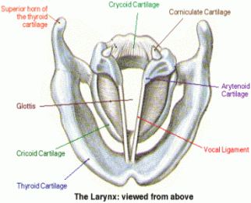

Slide 21
VOCALIZATION -2
Attachments of the vocal ligament
Anteriorly – thyroid cartilage
Posteriorly – arytenoid (vocal process of it)
Both articulate inferiorly with the cricoid cartilage
Vocal cords are stretched by movement of thyroid forward or the posterior rotation of the arytenoids
Thyro-arytenoid muscle in the cords lateral to arytenoid can pull arytenoids towards thyroid to loosen them
Small muscles within the cord can change shape and mass of the vocal cord edges (sharp edges cause high pitch and blunt edges cause low sounds)
Cricoid and arytenoid attached to each other by many small muscles which rotate the cartilages and change the shape of the space between the cords

Slide 22
ARTICULATION AND RESONANCE
Three major organs ARTICULATION
Lips
Tongue
Soft palate
Organs for RESONANCE give a voice a distinctive quality, these organs are
Nose
Nasal sinuses
Mouth
Pharynx
Chest cavity

Slide 23
END

