Slide 1
Physiology of Carbon dioxide
Dr G Ogweno, PhD

Slide 2
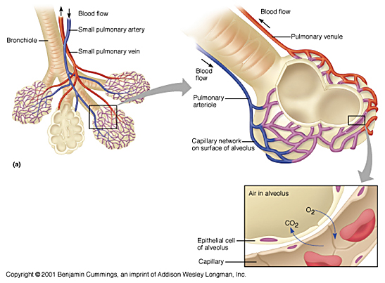

Slide 3
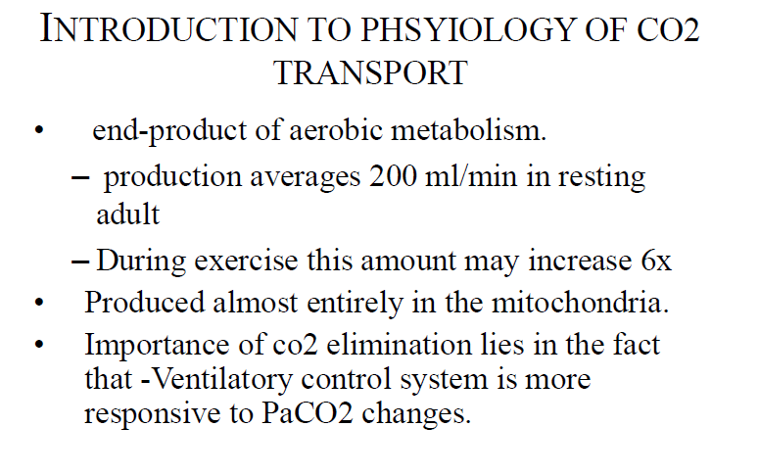

Slide 4
Source of and cascade of Co2
End product of aerobic metabolism
Basal output=162 ml/min
mitochondria
Cell plasma
Arterial=40 mmHg
Exp=32 mmHg
Alveolar=40 mmHg
Capillaries=46+mmHg
Venous=46mmHg
Ins=0.3 mmHg

Slide 5
Carbon dioxide stores
Very large-X 100 0f oxygen=120 L
Equilibrium after 20-30 minutes of the compartments
Supply-tissue metabolism
Rapid-blood, brain, kidneys-alveolar ventilation outflow controlled by chemoreceptors
Medium-skeletal muscles
Slow large capacity-bone, fat

Slide 6
Carbon dioxide transformations
Tissues
Lungs

Slide 7
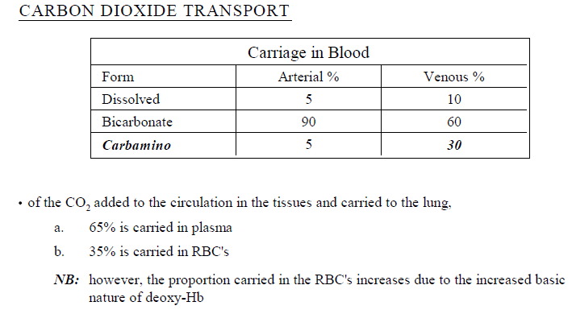

Slide 8
Transport of Co2
HCo2 in plasma and RBC
Carbamino in plasma and RBC

Slide 9
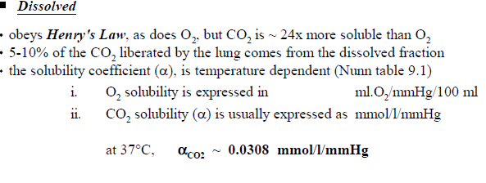
Notes:
C

Slide 10
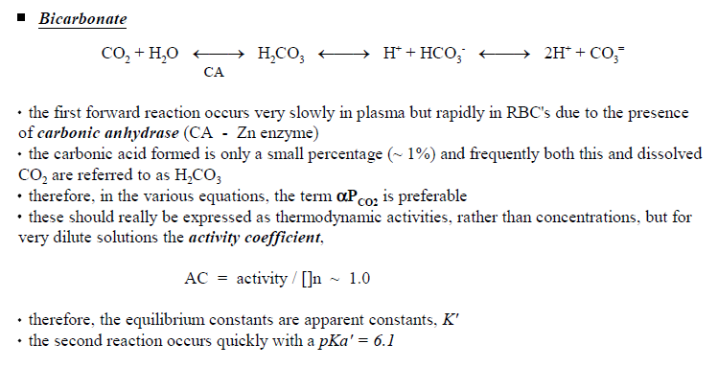
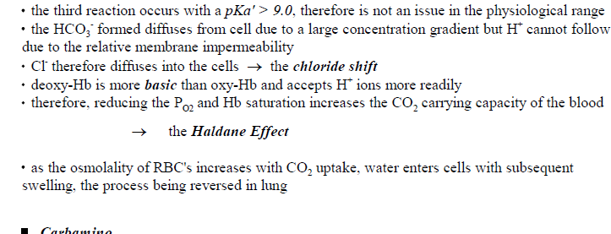

Slide 11
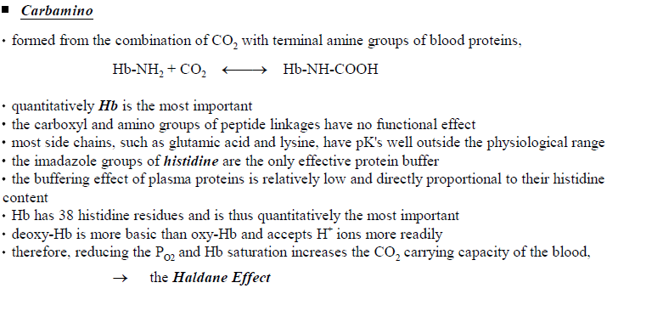

Slide 12
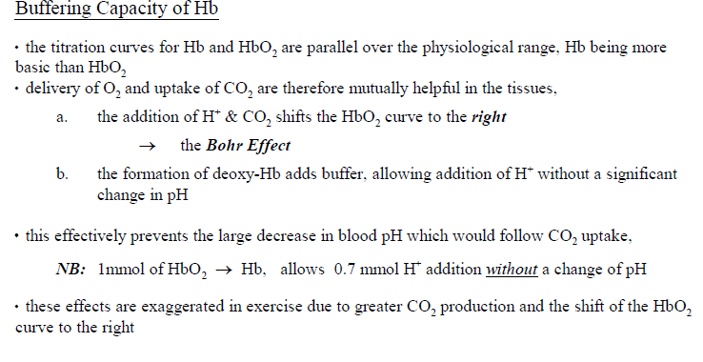
HCo3 and carbamino reactions produce H+
Histidine residues buffer resultant H+
HCo3 shuttled out by Hamburger effect
Notes:
Due to Histidine- contains 38 imidazole groups per tetramer

Slide 14
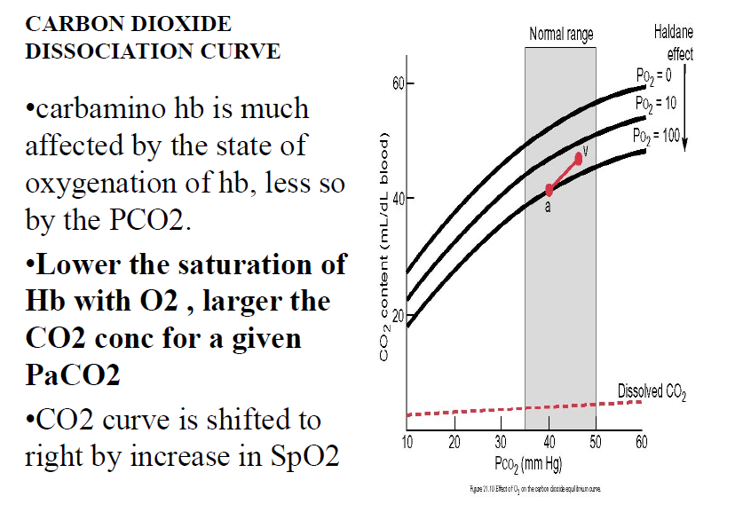

Slide 16
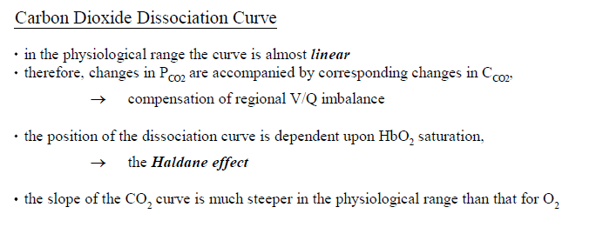
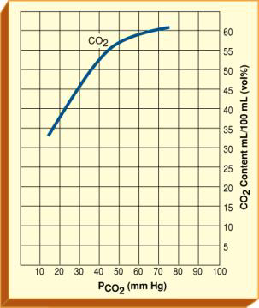
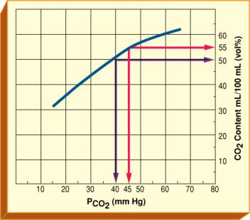

Slide 17
Carbon dioxide dissociation curves

Slide 18
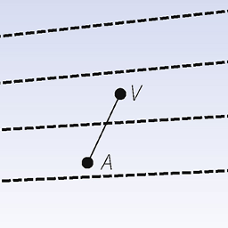
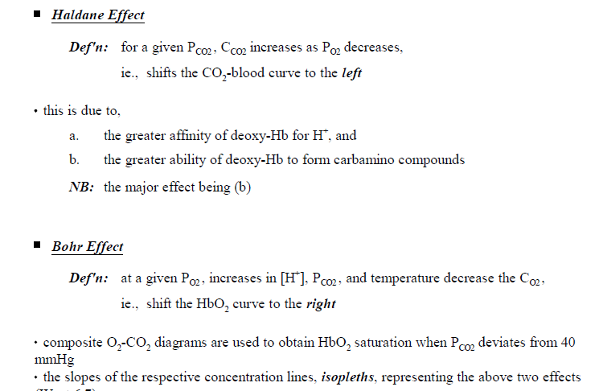
Notes:
Deoxygenation of the blood increases its ability to carry carbon dioxide; this property is the Haldane effect. Conversely, oxygenated blood has a reduced capacity for carbon dioxide
Carbon dioxide can bind to amino groups, creating carbamino compounds. Amino groups are available for binding at the N-terminals and at side-chains of arginine and lysine residues in hemoglobin. This forms carbaminohemoglobin. Carbaminohemoglobin is the major contributor to the Haldane effect

Slide 19
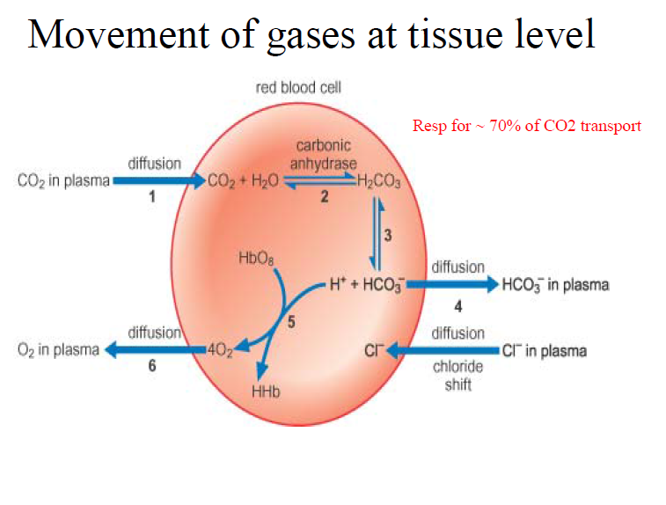

Slide 20
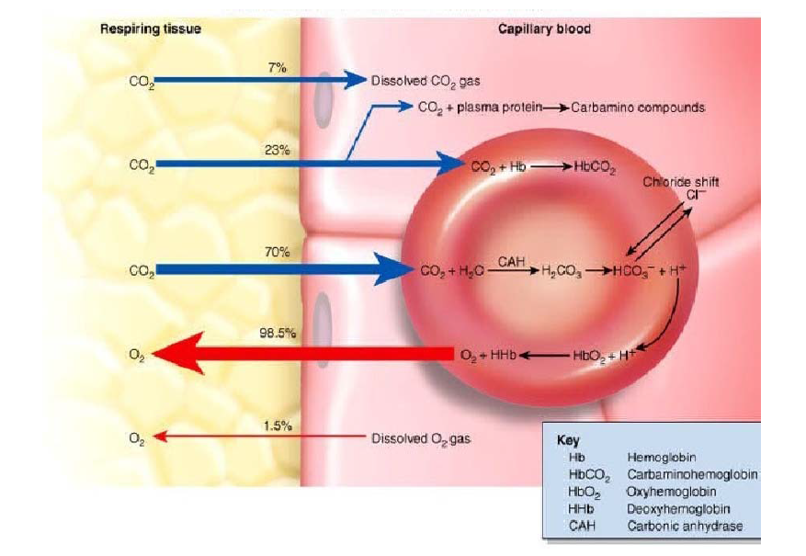

Slide 21
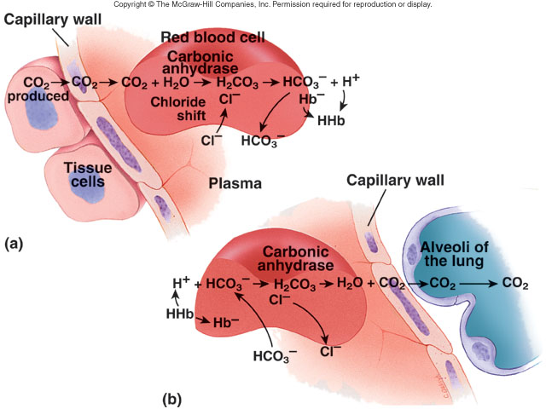
Notes:
Transfer of Co 2 across membranes

Slide 22
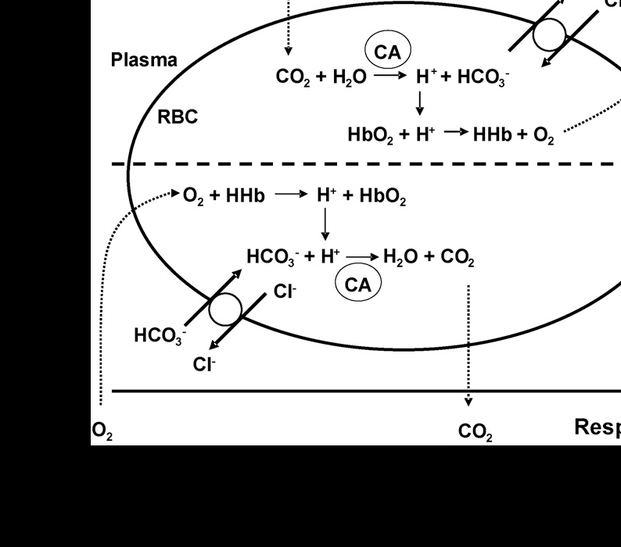

Slide 23
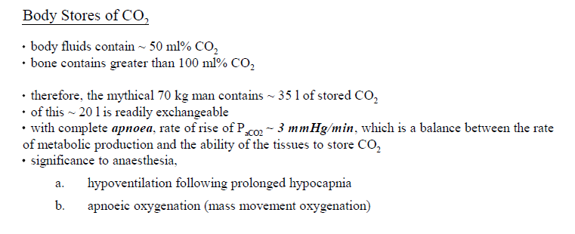

Slide 24
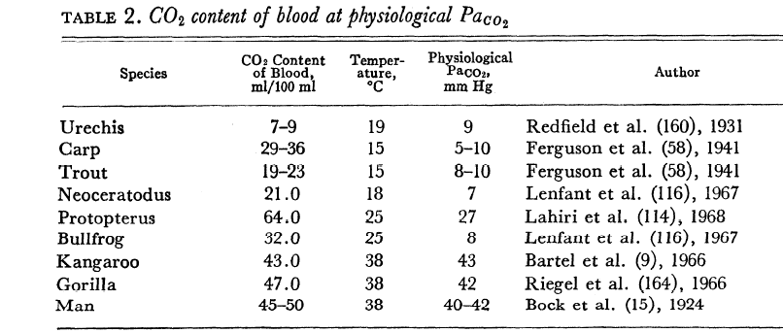

Slide 26
Factors that affect Co2 tension in steady state
Alveolar ventilation-VT, Vd and RR
Alveolar PAco2-Pico2, Barometric pressure, Co2 output and concentration effect
PaCo2-shunts, V/Q scatter
Others-PEco2, A/a Pco2 gradient

Slide 27
Effects of Co2 on Body systems

Slide 28
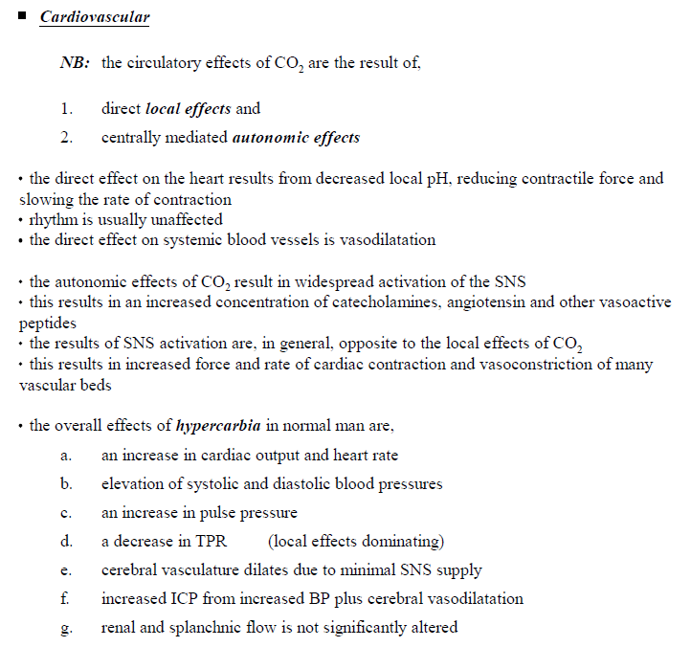

Slide 29
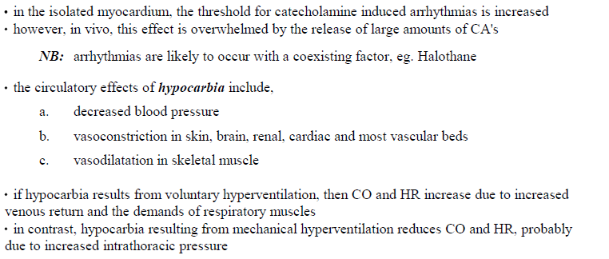
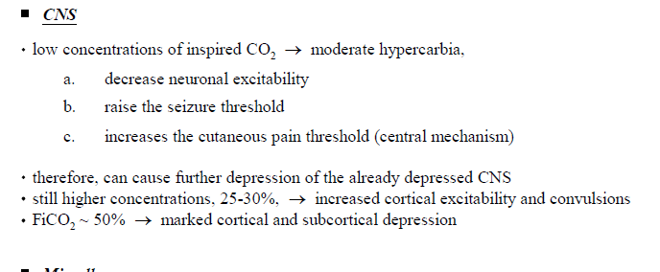

Slide 30
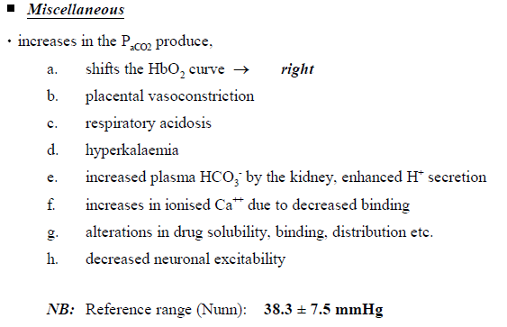

Slide 31
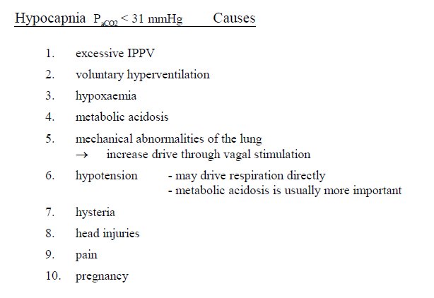

Slide 32
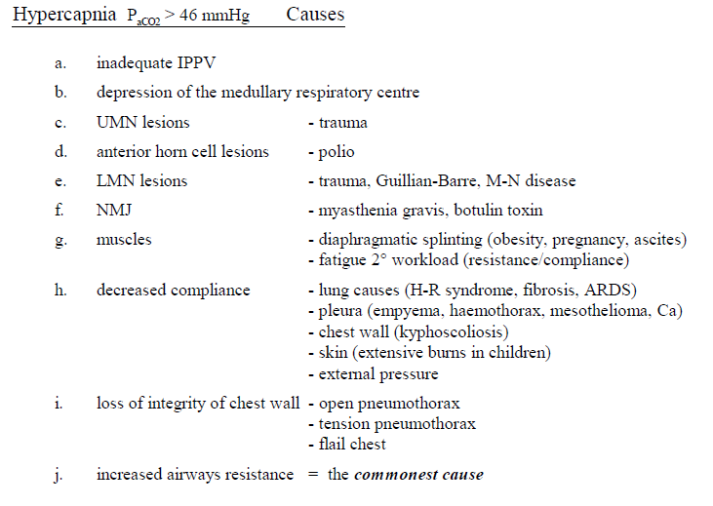

Slide 33
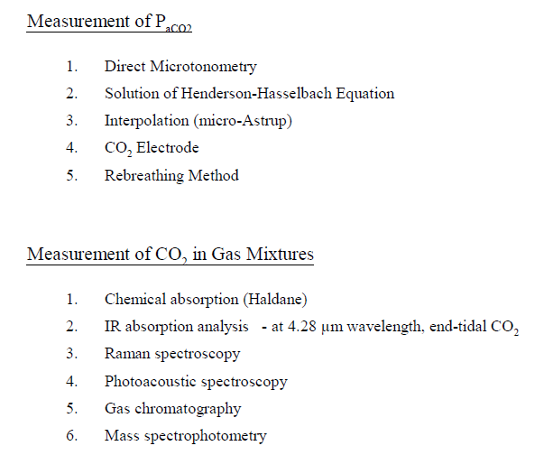

Slide 34
Capnometry
Measurement of Co2 in expired gas
Capnography: change of Co2 tension with respiratory phase
Capnography is the monitoring of the concentration or partial pressure of carbon dioxide (CO2 2) in the respiratory gases
Initially low then rises to reach plateau

Slide 35
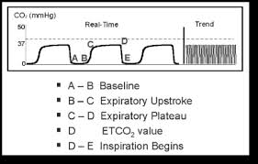
Capnograph phases
AB-dead space
BC-mixed dead space + alveolar gas
CD-plateau, mixed alveolar
D-end expiratory Co2
DE-inspiration phase

Slide 36
Phases of capnograph

Slide 37
Utility of capnograph
Rebreathing-elevated baseline
Obstruction-slanting of BC
Increased output-high ETCo2
Cardiac arrest or oesophageal intubation-no wave on capnograph
Sudden pulmonary embolism-sudden decrease
Derivation of Vd-plot of ETco2 vs expired volume, slope of platea& its relation to PaCo2

Slide 38
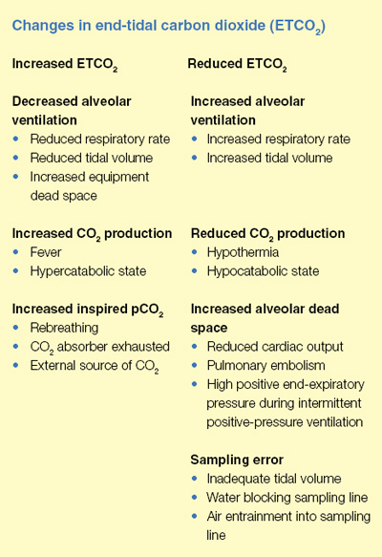

Slide 39
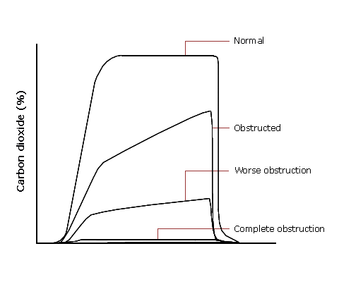
Examples of abnormal capnograms

Slide 40
Clinical uses of carbon dioxide
To stimulate respiration after passive hyperventilation
To expedite uptake and elimination of anaesthetic gases
Treatment of carbon monoxide poisoning-shift of curve to right to release o2 to tissues
To improve cardiac output and regional perfusion

