Slide 1
Physiology of Oxygen : Transport
Dr G Ogweno, PhD

Slide 2
Gas laws
BOYLE’S LAW: Gas pressure in closed container is inversely proportional to volume of container
Charles law: for an ideal gas at constant pressure, the volume is directly proportional to its absolute temperature.
Dalton's law of partial pressures : the pressure of a mixture of gases simply is the sum of the partial pressures of the individual components

Slide 3
Gas Pressures
Partial Pressure
Each gas in atmosphere contributes to the entire atmospheric pressure, denoted as P
Gases in liquid
Gas enters liquid and dissolves in proportion to its partial pressure
1Kpa=7.5 mmHg=100cmH₂
Oxygen is 21% of atmosphere
760 mmHg x .21 = 160 mmHg PO2
This mixes with “old” air already in alveolus to arrive at PO2 of 105 mmHg
Carbon dioxide is .04% of atmosphere
760 mmHg x .0004 = .3 mm Hg PCO2
This mixes with high CO2 levels from residual volume in the alveoli to arrive at PCO2 of 40 mmHg
Henry’s Law: solubility of a gas in a liquid is directly proportional to the partial pressure of the gas above the liquid

Slide 5
Oxygen cascade

Slide 6
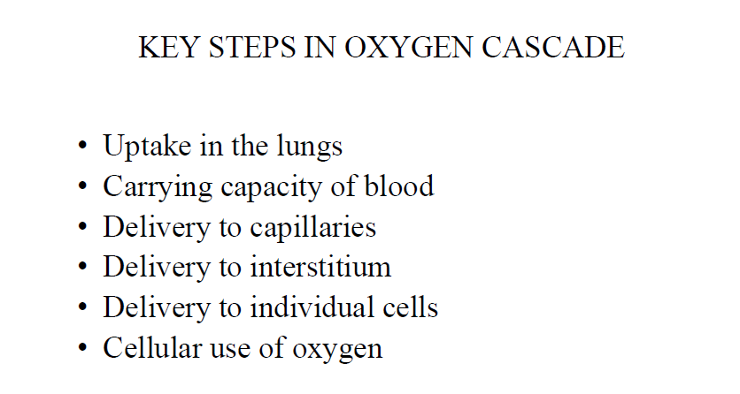

Slide 7
Factors affecting alveolar oxygen tension
Primary Ideal PA₀₂=PI₀₂-PAC₀₂ X (PI₀₂-PE_{o2})/pEco₂
Dry barometric pressure(less svp)
Inspired oxygen concentration/FI_{o2}
Oxygen consumption
Alveolar ventilation
secondary:
cardiac output,
Concentration or third gas effect or Fink effect
Presence of soluble gas

Slide 8
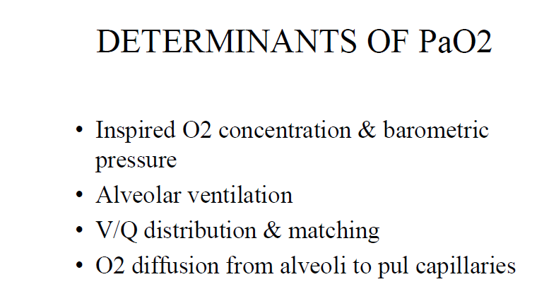

Slide 9
KEY STEPS IN OXYGEN CASCADE
Uptake in the lungs
Carrying capacity of blood
Delivery from lungs to tissue capillaries
Delivery from capillary blood to interstitium
Delivery from interstitium to individual cells
Cellular use of oxygen

Slide 10
Factors influencing alveolo-arterial
Normal~15 mmHg
Shunt/venous admixture
Magnitude of venous admixture-V/Q scatter
Actual alveolar Po₂
Cardiac output
Temp & pH/BE
Hb conc
Alveolar ventilation

Slide 11
Oxygen Transport
The transport of oxygen between the lungs and the cells of the body is a function of the blood and the heart.
Oxygen is carried in the blood in two forms: - as dissolved oxygen in the blood plasma - chemically bound to the hemoglobin (Hb) that is encased in the erythrocytes, or RBC’s

Slide 13
O2 Dissolved in Plasma
As O2 diffuses from the alveoli into the pulmonary capillary blood, it dissolves in the plasma of the blood.
At normal body and temperature about 0.003 ml of O2 will dissolve in 100 ml of blood for every 1 mm Hg of Po2
Vol% represents the amount of O2 in milliliters that is in 100 ml of blood.
In terms of total oxygen transport, a relatively small percentage of O2 is transported in the form of dissolved O2.

Slide 14
Dissolved Oxygen
Henry’s Law states that the amount of gas that dissolves is proportional to its partial pressure.
Dissolved Oxygen=.003 mls x PAo2 .003 x 100=.3mls of dissolved O2

Slide 15
O2 Bound with Hemoglobin
Most of the O2 that diffuses into the pulmonary capillary blood rapidly moves into the RBC’s and chemically attaches to the hemoglobin.
Each RBC contains about 280 million Hb molecules, which are highly specialized to transport O2 and CO2.
The normal hemoglobin value for the adult male is 14 to 16 g% and female is 12 to 15 g%.

Slide 16
Quantity of O2 Bound to Hb
Each g% of Hb is capable of carrying approximately 1.34 ml of O2 thus:
- O2 bound to Hb = 1.34 ml O2 x g% Hb
At a normal Pao2 of 100 MM Hg, hemoglobin saturation (Sao2) is about 97% because of normal physiologic shunts: -thebesian veins (Coronary circ.) -bronchial venous drainage -V/Q mismatch

Slide 17
The Hemoglobin Molecule
Normal adult hemoglobin consists of: -four hemo groups which are the pigmented, iron-containing non-protein portions -four amino chains that collectively constitute globin (a protein)
At the center of each heme group, the iron molecule can combine with one O2 molecule for form oxyhemoglobin: - Hb + O2 <> Hbo2
The amount of O2 bound to Hb is directly related to the partial pressure of O2.

Slide 18
Fetal Vs. Adult Hemoglobin
The globin, or protein portion of each adult Hb molecule consists of two identical alpha chains and two identical beta chains.
Normal fetal Hb (Hb F) has two alpha chains and two gamma chains.
These gamma chains increase hemoglobin’s attraction to O2 and facilitates transfer of maternal O2 across the placenta.
Fetal Hb is gradually replaced with adult Hb (Hb A) over the first year of postnatal life.

Slide 19
Hb Molecule

Slide 20
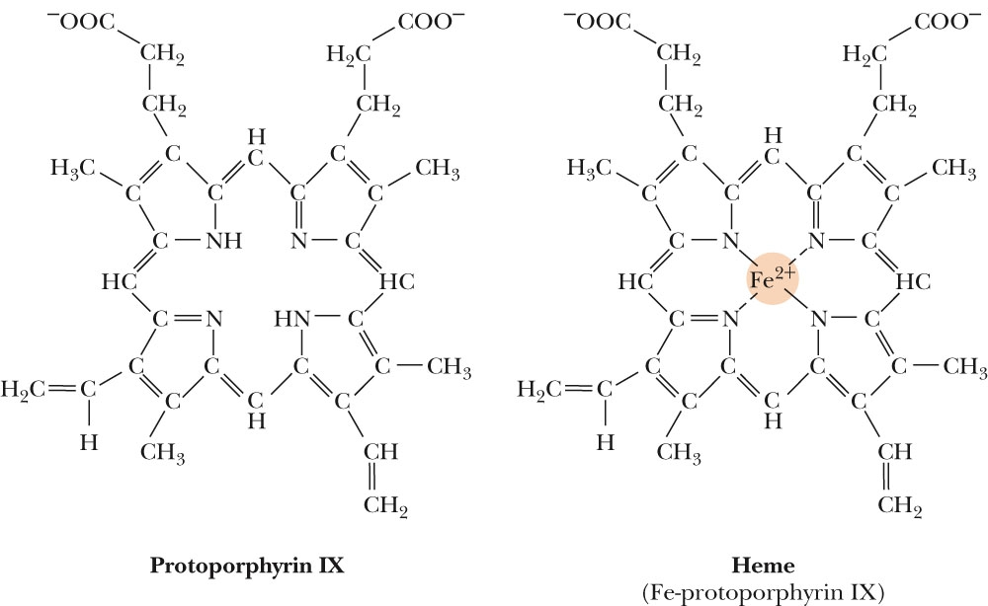
Mb and Hb use porphryins to bind Fe²⁺
Figure 15.22
Heme is formed when protoporphyrin IX binds Fe²⁺

Slide 22
Fe²⁺ is coordinated by His F8
Iron interacts with six ligands in Hb and Mb.
Four of these are the N atoms of the porphyrin.
A fifth ligand is donated by the imidazole side chain of amino acid residue His F8.
(This residue is on the sixth or “F” helix, and it is the 8th residue in the helix, thus the name.).
When Mb or Hb bind oxygen, the O₂ molecule adds to the heme iron as the sixth ligand.
The O₂ molecule is tilted relative to a perpendicular to the heme plane.

Slide 23
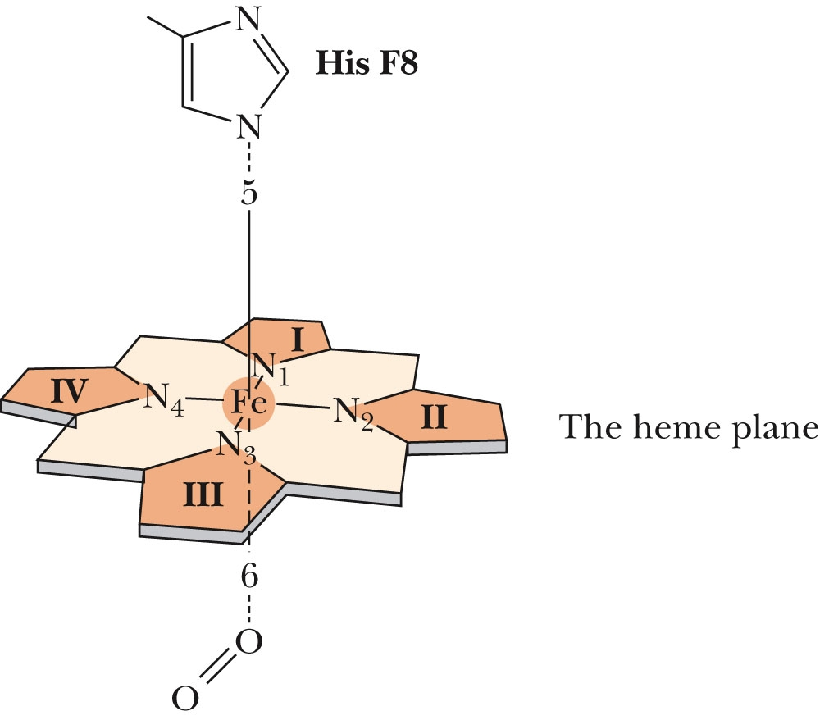
Fe²⁺ is coordinated by His F8
Figure 15.23
The six liganding positions of an iron atom in Hb and Mb.

Slide 24
Kinetics of o₂ Rxn with Hb
Curve sigmoid-typical allosterism
Hb+O₂ ↔ Hb₄O₂ ------K₁
Hb₄O₂+O₂ ↔Hb₄O₄---K₂
Hb₄O₄+O₂ ↔Hb₄O₆₋---K₃
Hb₄O₆+O₂ ↔Hb₄O₈----K₄

Slide 27
Allosteric Enzymes
Usually large; multiple subunits
Compare to Hb
Site for allosteric modulator (R = regulatory) generally different from active site (C = catalytic)
Can be positive or negative

Slide 28
Oxygen Dissociation Curve
The O2 dissociation curve graphically illustrated the percentage of Hb that is chemically bound to O2 at each O2 pressure.
The curve is S-shaped with a steep slope between 10 and 60 mm Hg and a flat portion between 70 and 100 mm Hg.
The flat and steep portions of the curve each have a distinct clinical significance.

Slide 29
HB-O2 dissociation curve

Slide 30
Determinants of P₅₀

Slide 31
Factors that effect the 02 Dissociation
pH- Change in the blood pH
Temperature-temp increases the curve moves to the right
2,3 Diphosphoglycerate-Increases 2,3 DPG results in decreased affinity
Carbon monoxide

Slide 32
EFFECT OF PCO2
Bohr effect-Shift of O2-Hb dissociation curve to right by ↑ PCO2
Important to enhance oxygenation of blood in lungs and to enhance release of O2 in the tissues
In the lungs, CO2 diffuses out of the blood (H+ conc also ↓ due to ↓ in H2CO3 conc) → Shift of O2-Hb curve to left & more avid binding of O2 to Hb → ↑ in quantity of O2 bound to Hb → ↑ O2 transport to tissues.

Slide 33
Clinical consequences of O2 dissociation
Bohr effect -Tissue downloading of O₂-related to pH
2,3 DPG-reduction of oxygen affinity
Blood storage-ACD/CPD
Anaemic-raised 2,3 DPG
Altitude-RBC alkalosis
Carbon monoxide poisoning
Abnormal Hb-SCD, HbS, Thala(HbF), metHb and Fe+++

Slide 34
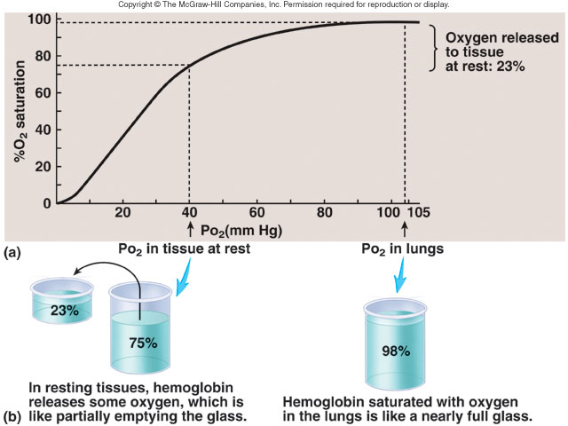

Slide 35
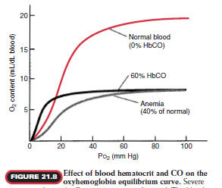

Slide 36
Factors influencing alveolo-arterial Po₂ difference
Shunt/ venous admixture
Magnitude of venous admixture or V/Q scatter
Actual alveolar PO₂
Cardiac output
Temperature, pH and BE
Hb concentration
Alveolar ventilation

Slide 37
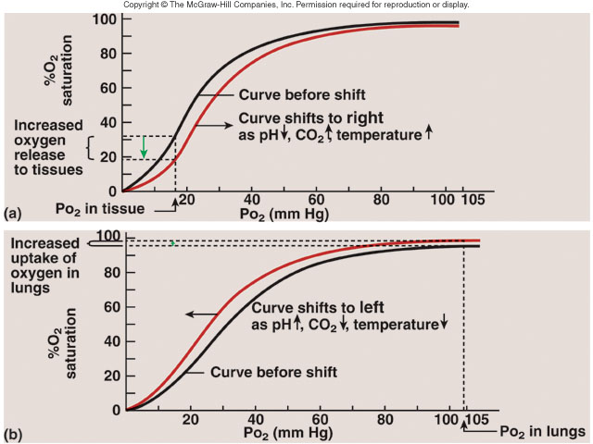

Slide 38
Clinical Significance of Shifts
Individuals with PaO2’s within normal (80-100) limits are rarely afected by shift changes.
However, when a patients PaO2 falls below 80, a shift to the right or left can have remarkable effects on the hemoglobin’s ability to pick up and release oxygen.

Slide 39
Right Shifts
Right shift decrease the loading of oxygen onto Hb at the A-C membrane. -Decreased affinity
The total oxygen delivery may be much lower than indicated by a particular Pao2 when the patient has some disease process that causes a right shift.
Right shift curves enhance the unloading of oxygen at the tissue level.

Slide 40
Left shift
Left shift curves enhance the loading capability of oxygen enhance the loading capability of oxygen a the A-C membrane.
The total oxygen delivery may be higher than indicated by a particular Pao2 when the patient has some disease process that cause a left shift.
Left shift curves decreases the unloading of oxygen at the tissue level.

Slide 42
Total Oxygen Delivery
The total amount of oxygen delivered to the peripheral tissues is dependent on:
the body’s ability to oxygenate blood
the hemoglobin concentration
the cardiac output
Total O2 delivery (D_{O2}) is calculated:
D_{O2} = QT x (Ca_{O2} x 10)
O2 delivery decreases when there is a decline in blood oxygenation, hemoglobin concentration, or cardiac output.

Slide 43
Arterial-Venous Difference
The arterial-venous oxygen content difference, C(a-v)_{O2}, is the difference between the CaO2 and the CvO2.
The normal C(a-v)_{O2} is about 5 vol%.
Clinically, the C(a-v)_{O2} can provide useful information regarding the patient’s cardiopulmonary status.
Notes:
Factors that increase the C(a-v)O2:
decreased cardiac output
increased O2 consumption
exercise
seizures
shivering
increased temp
Factors that decrease the C(a-v)O2:
increased cardiac output
skeletal relaxation (drugs)
peripheral shunting
poisons
decreased temp

Slide 45
Oxygenation Consumption
The amount of oxygen extracted by the peripheral tissues during the period of one minute is called oxygen consumption or V_{O2}.
Oxygen consumption is calculated by:
V_{O2} = QT [C(a-v)_{O2} x 10]
O2 consumption is commonly indexed by the patients body surface area (BSA) and calculated by:
V_{O2} / BSA
Normal V_{O2} index is between 125 - 165

Slide 46
Factors Affecting V_{O2}
Factors that increase O2 consumption:
exercise - seizures
shivering - increased temp
Factors that decrease O2 consumption:
skeletal relaxation
peripheral shunting
certain poisons
decreased temperature

Slide 47
Oxygen Extraction Ratio
The oxygen extraction ratio (O₂ER) is the amount of oxygen extracted by the peripheral tissues divided by the amount of O2 delivered to the peripheral cells.
O₂ER = CaO2 - CvO2 / CaO2
normal O₂ER is .25
Under normal circumstances an individuals Hb returns to the alveoli approximately 75% saturated with O2.

Slide 48
Factors that affect O₂ER
Factors that increase O₂ER:
decreased cardiac output
increased oxygen consumption
anemia
decreased arterial oxygenation
Factors that decrease O₂ER:
increased cardiac output
skeletal relaxation
peripheral shunting
hypothermia - increased Hb
increased arterial oxygenation

Slide 49
Mixed Venous O2 Saturation
Normally, the SvO2 is about 75%, however, clinically an SvO2 of about 65% is acceptable.
Factors that decrease the SvO2:
decreased CO
increased O2 consumption
Factors that increase the SvO2:
increased CO - peripheral shunting
skeletal relaxation
hypothermia

Slide 50
Oxygen flux
Total oxygen flux
Arterial O2 flux is = 5 x 150 x 0.98 x 1.34 + 5 x 100 x 0.03 = 984.9 + 15 = appr. 1000mL O2 per min
Assumes cardiac output of 5L/min
Assumes [Hb] = 150g/L
Assumes SaO2 = 98% and PO2 = 100mmHg
pH 7.4, temp = 37
Similarly,
Mixed venous O2 delivery rate is = 5 x 150 x 0.75 x 1.34 + 5 x 40 x 0.03 = 753.75 + 6 =759.75 = appro. 750mL O2 per min
Assumes SvO2 of 75% and PvO2 of 40mmHg

Slide 51
Summary
Total O2 flux = 1000mL O2 / min
Arterial [O2] = 20mL O2/100mL blood
Mixed venous [O2] = 15mL O2/100mL blood
Normal basal consumption of O2 = 250mL/min
NB:
PaO2 = 100mmHg
PvO2 = 40mmHg
Or
SaO2 = 98% (or 97.5%)
SvO2 = 75%
Thus,
CaO2 = 20mL O2/dL
CvO2 = 15mL O2/dL (appro)

