Slide 1
INTRDUCTION TO: THE SENSORY SYSTEM AND SENSE ORGANS
NB:ALL SENSORY RECEPTORS ARE TRANSDUCERS WHICH TURN VARIOUS FORMS OF ENERGY INTO NERVE IMPULSES i.e. NERVE ACTION POTENTIALS

Slide 4
Encapsulated Nerve Endings Chapter 16 Sense Organs Types Of Sensory Receptors General Senses
← Back To Article
« Prev
Next »

Slide 6
ENCAPSULATED NERVE ENDING SKIN RECEPTORS

Slide 7
RECEPTORS IN HAIRY AND GLABROUS (BARE) SKIN

Slide 9
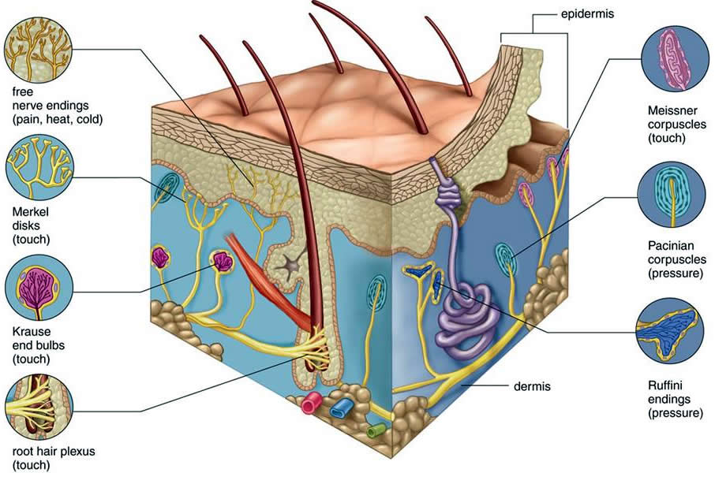

Slide 10
KINESTHETIC SENSORS (MUSCLE SPINDLES AND GOLGI TENDON ORGANS )

Slide 11
BODY REPRESENTATION IN PRIMARY SENSORY (LIGHTGREEN) AND MOTOR (PINK) CORTEX

Slide 13
TOTAL SPECTRUM
Infra-red(Thermal): 770-12000nm (11,230nM)
Visible: 390-770 nm i.e. violet to red (380nM) but most intense of all wave types but not all the sun’s rays reach the earth’s suerface
200-390 nm (190):-
Ultra violet ( cause sun burn and cancer of the skin especially in skins deficient of melanin. NB sun burn at high altitude)
Grenz rays =(Very soft x rays (c.20nm)
X rays
Gamma rays
Cosmic rays
Microwaves
Radio waves
NB:
Visible range of total spectrum covers about 390-770 nm range (.0035%)
Invisible range of spectrum covers 11,420 nm range

Slide 14
THE VISIBLE AND NON-VISIBLE PARTS OF THE SPECTRUM

Slide 15
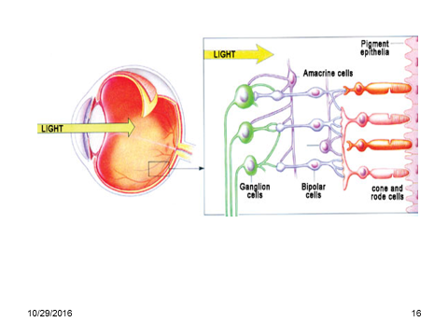

Slide 16
VISUAL RECEPTORS

Slide 17
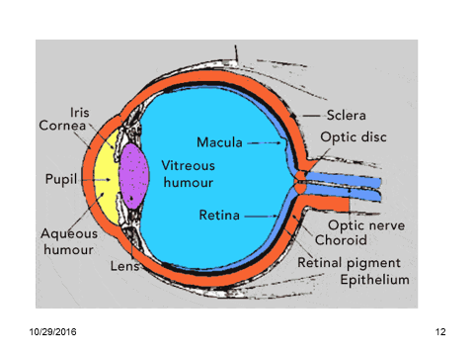

Slide 18
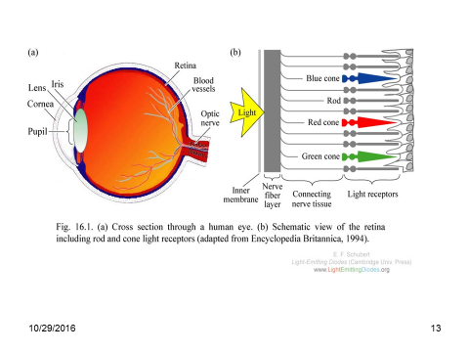

Slide 19
LIGHT WAVE-BAND SENSITIVITY OF BLUE, GREEN AND RED CONES

Slide 21
SIMPLIFIED VISUAL PATHWAYS: NOTE LATERALITY OF VISUAL SYSTEM

Slide 22
VISUAL PATHWAYS IN3D

Slide 23
MULLER CELL FIBEROSCOPIC LIGHT GATHERING AND GUIDING

Slide 25
AUDITORY AND VESTIBULAR RECEPTORS

Slide 26
OUTER MIDDLE AND INNER EAR

Slide 27
MIDDLE EAR

Slide 28
INNER EAR AND COCHLEAR SECTION (Refer to slide 30)

Slide 29
INNER EAR

Slide 31
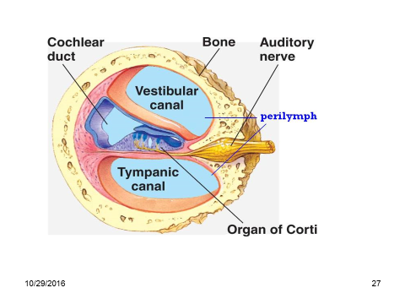

Slide 32
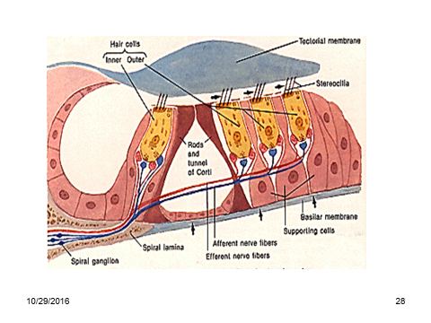

Slide 33
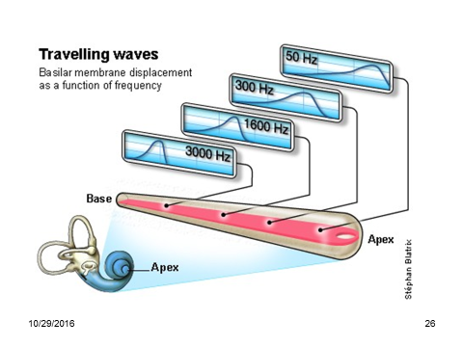

Slide 35
AUDITORY PATHWAYS

Slide 38
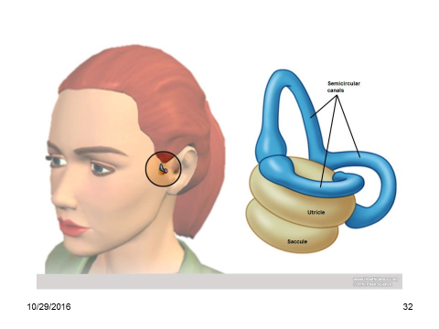

Slide 39
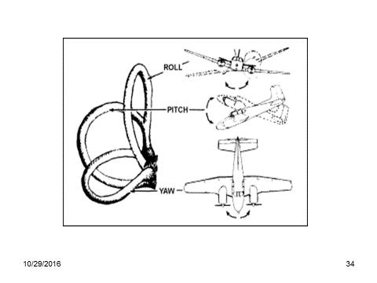

Slide 40
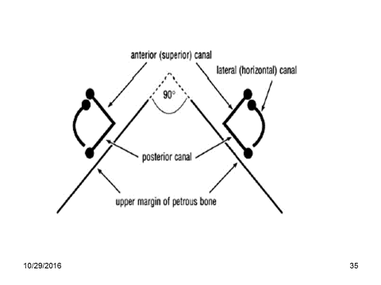

Slide 41
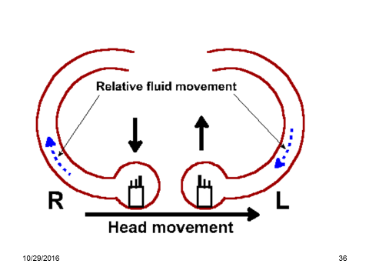

Slide 42
SIMPLIFIED VESTIBULAR PATHWAYS

Slide 45
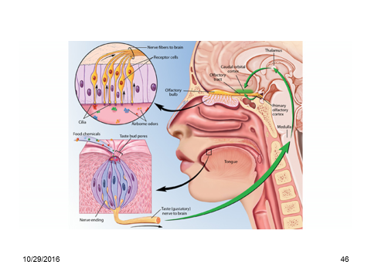
TASTE AND SMELL

Slide 47
TASTE BUD

Slide 52
TASTE (GUSTATORY) PATHWAYS

Slide 54
OLFACTION (SMELL)

Slide 55
OLFACTION

Slide 56
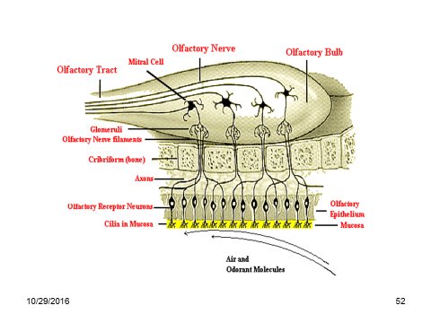
TASTE RECEPTORS AND ALFACTORY BULB

Slide 57
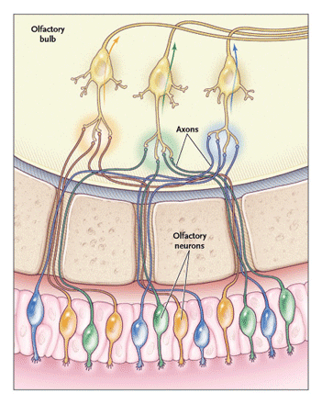

Slide 61
RHINENCEPHALON

Slide 62
RHINENCEPHALON (SMELL BRAIN)
The smell brain is huge in lower mammals
Some have special receptors for pheromones i.e.
The vomeronasal organ VNO -(Jacobson’s organ) – paired organ at the inferior posterior (basal) part of the nasal septum – in amphibia reptiles and mammals for modulating reproductive and social behavior
The organ is vestigial in humans
Helps animal to explore several aspects of the environment
Also processes pheromones
Dogs can identify very many different people by smell
Human children also have remarkable sense of smell
Encephalization of perception later dulls this ability

Slide 63
END

