Slide 1
INTRDUCTION TO: THE SENSORY SYSTEM AND SENSE ORGANS
NB:ALL SENSORY RECEPTORS ARE TRANSDUCERS WHICH TURN VARIOUS FORMS OF ENERGY INTO NERVE IMPULSES i.e. NERVE ACTION POTENTIALS

Slide 2
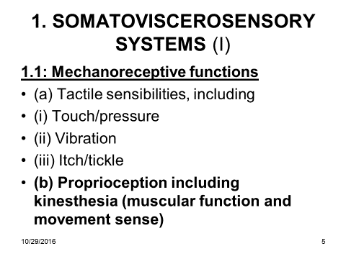

Slide 3
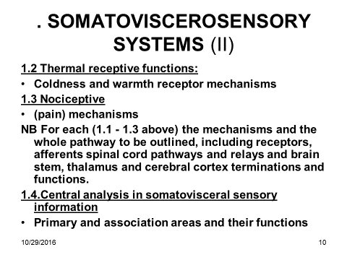

Slide 4
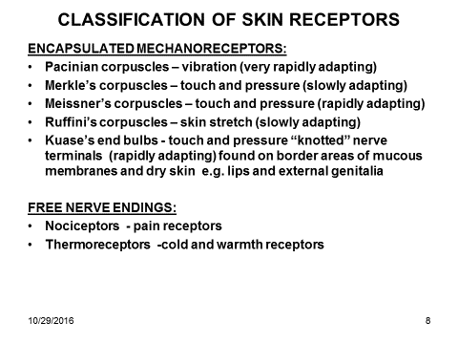
Encapsulated Nerve Endings Chapter 16 Sense Organs Types Of Sensory Receptors General Senses
← Back To Article
« Prev
Next »

Slide 5
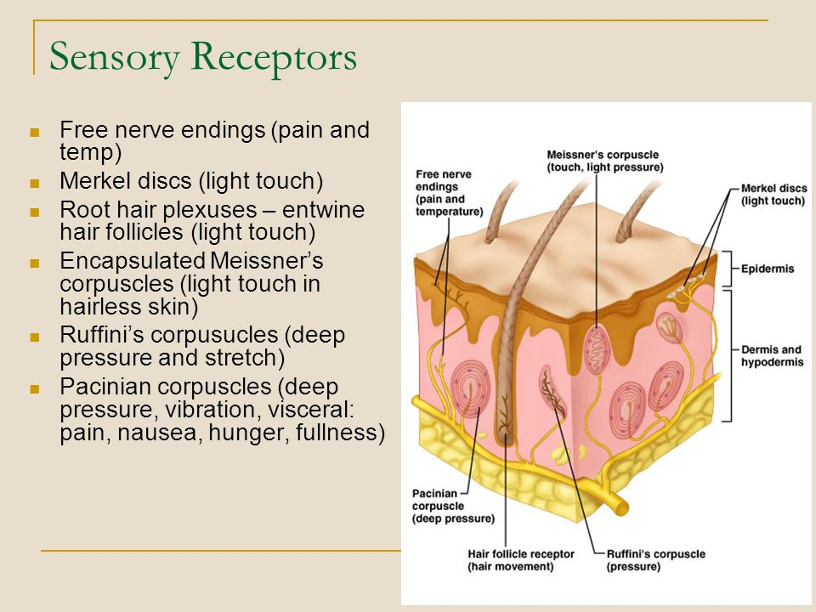

Slide 6
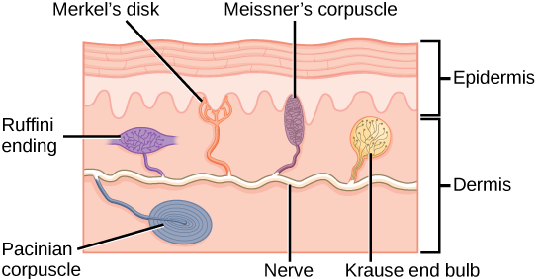
ENCAPSULATED NERVE ENDING SKIN RECEPTORS

Slide 7
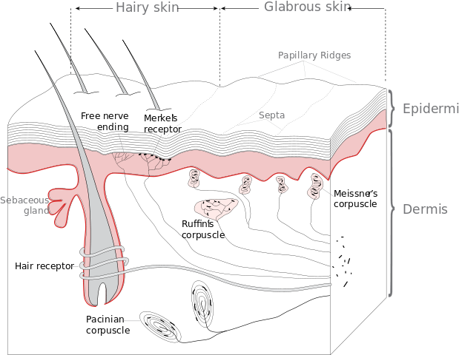
RECEPTORS IN HAIRY AND GLABROUS (BARE) SKIN

Slide 8
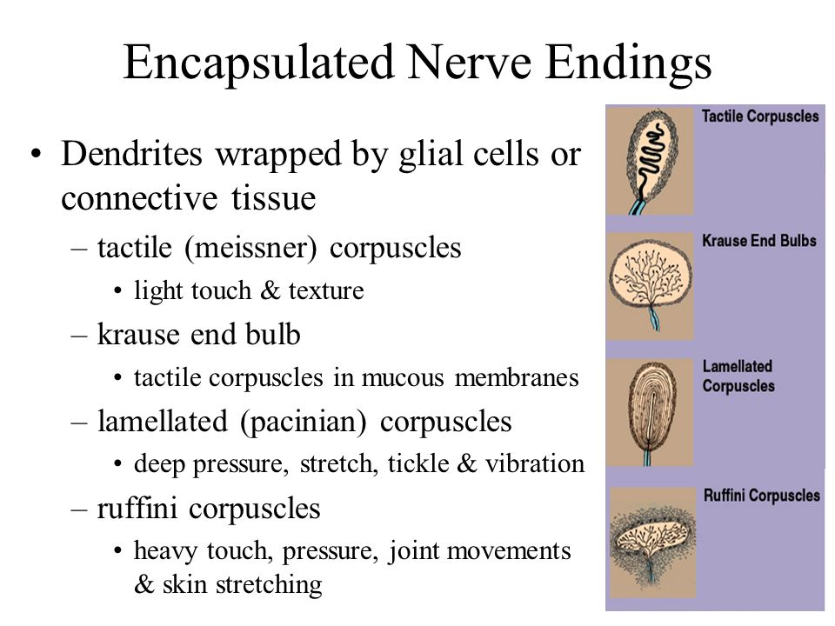

Slide 9
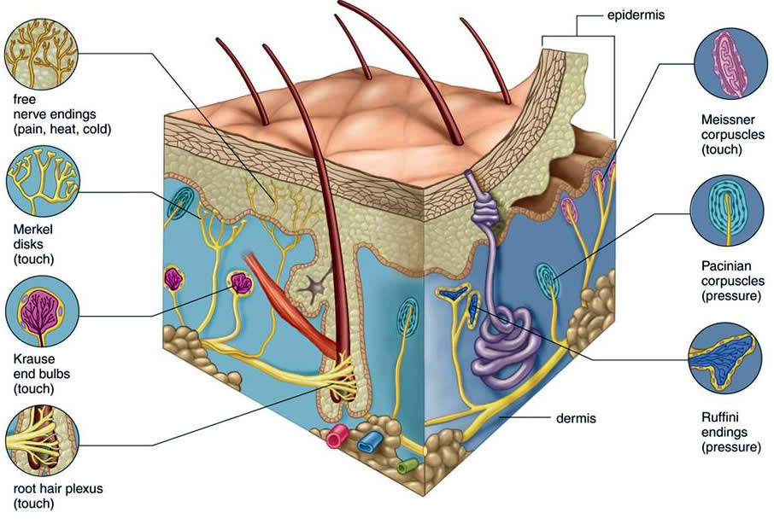

Slide 10
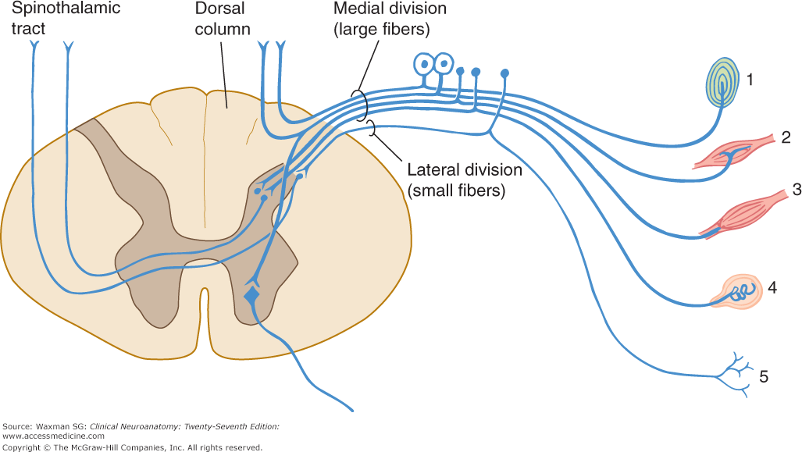

Slide 11
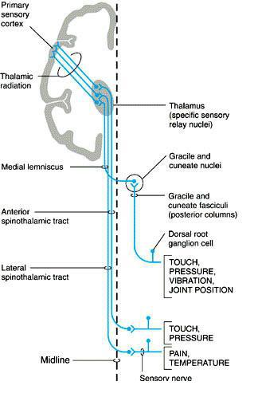

Slide 12
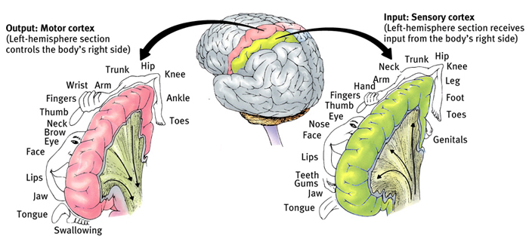
BODY REPRESENTATION IN PRIMARY SENSORY (LIGHTGREEN) AND MOTOR (PINK) CORTEX

Slide 13
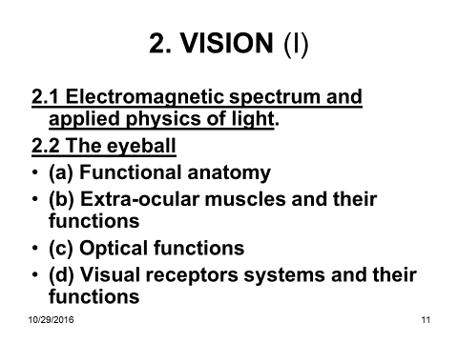

Slide 14
TOTAL SPECTRUM
Infra-red(Thermal): 770-12000nm (11,230nM)
Visible: 390-770 nm i.e. violet to red (380nM) but most intense of all wave types but not all the sun’s rays reach the earth’s suerface
200-390 nm (190):-
  Ultra violet ( cause sun burn and cancer of the skin especially in skins deficient of melanin. NB sun burn at high altitude)
  Grenz rays =(Very soft x rays (c.20nm)
  X rays
  Gamma rays
  Cosmic rays
  Microwaves
  Radio waves
NB:
  Visible range of total spectrum covers about 390-770 nm range (.0035%)
  Invisible range of spectrum covers 11,420 nm range

Slide 15
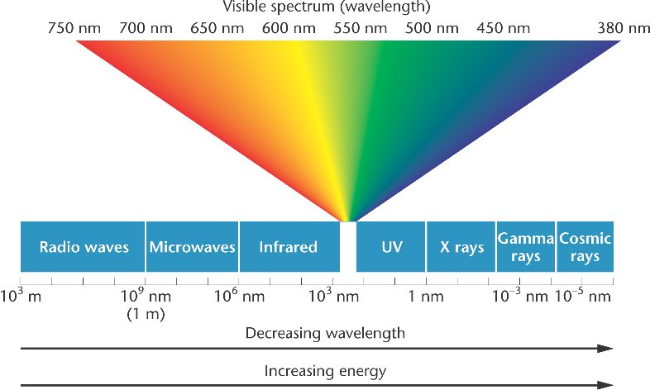
THE VISIBLE AND NON-VISIBLE PARTS OF THE SPECTRUM

Slide 16
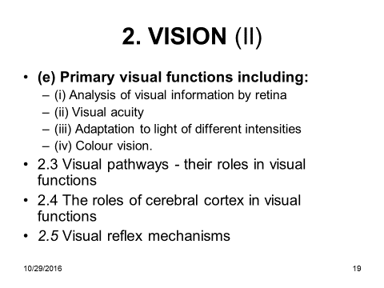
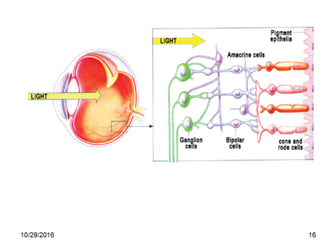

Slide 17
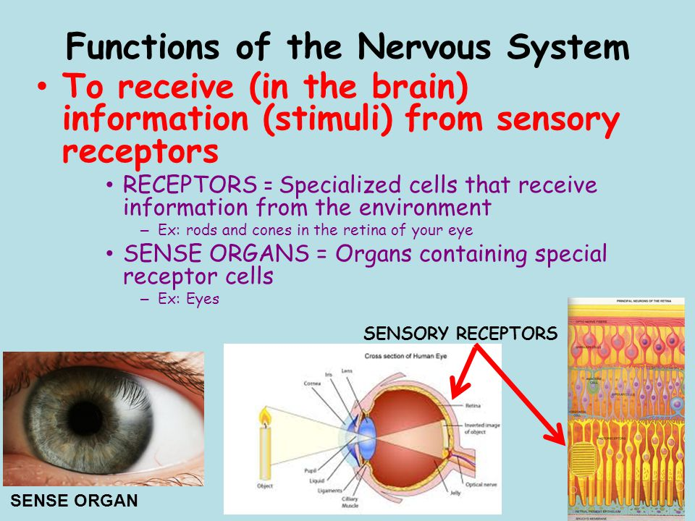
VISUAL RECEPTORS

Slide 18
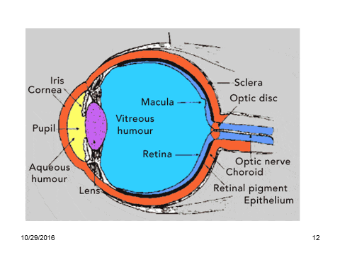

Slide 19
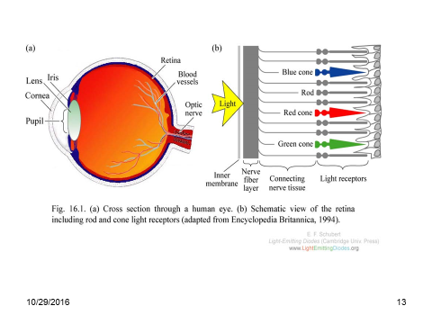

Slide 20
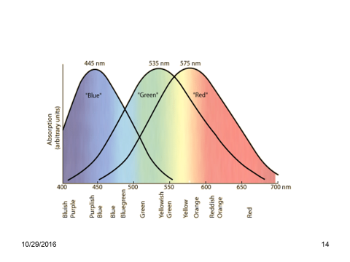
LIGHT WAVE-BAND SENSITIVITY OF BLUE, GREEN AND RED CONES

Slide 21
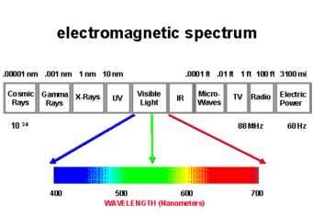

Slide 22
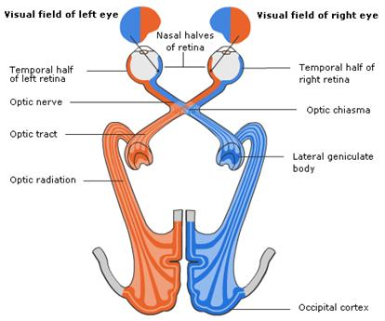
SIMPLIFIED VISUAL PATHWAYS: NOTE LATERALITY OF VISUAL SYSTEM

Slide 23
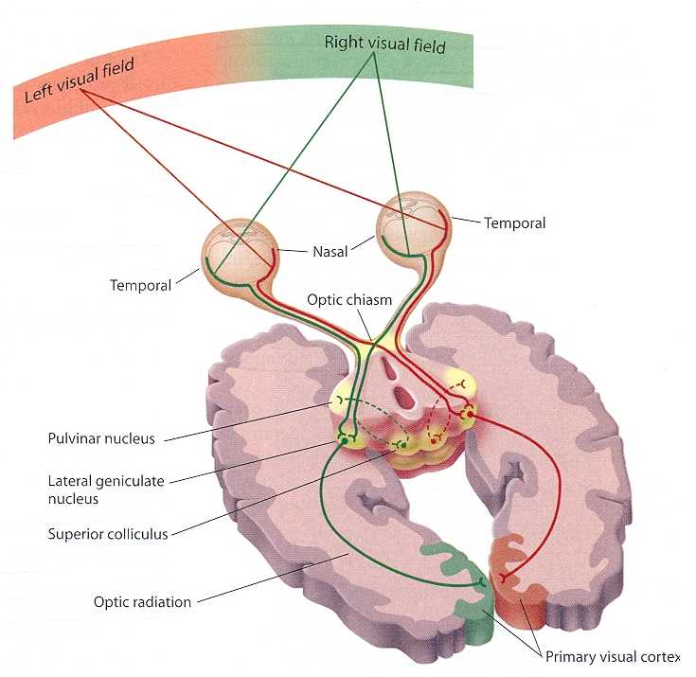
VISUAL PATHWAYS IN3D

Slide 24
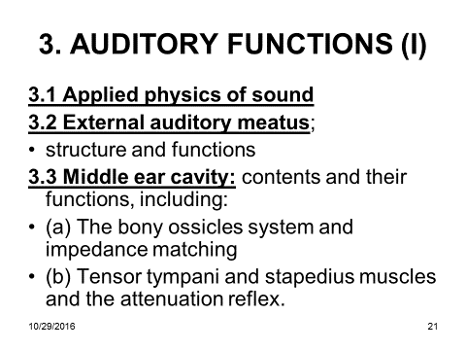

Slide 25
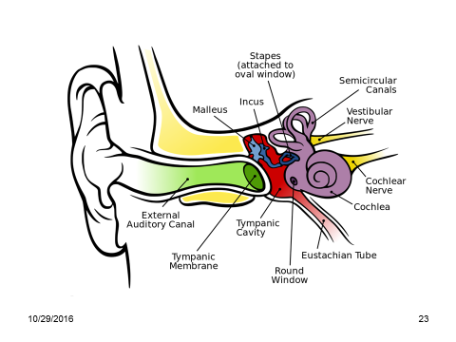
AUDITORY AND VESTIBULAR RECEPTORS

Slide 26
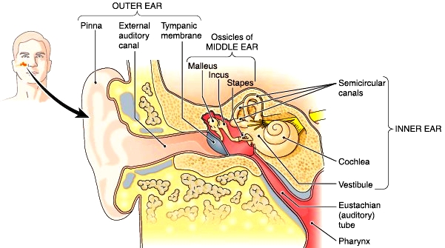
OUTER MIDDLE AND INNER EAR

Slide 27
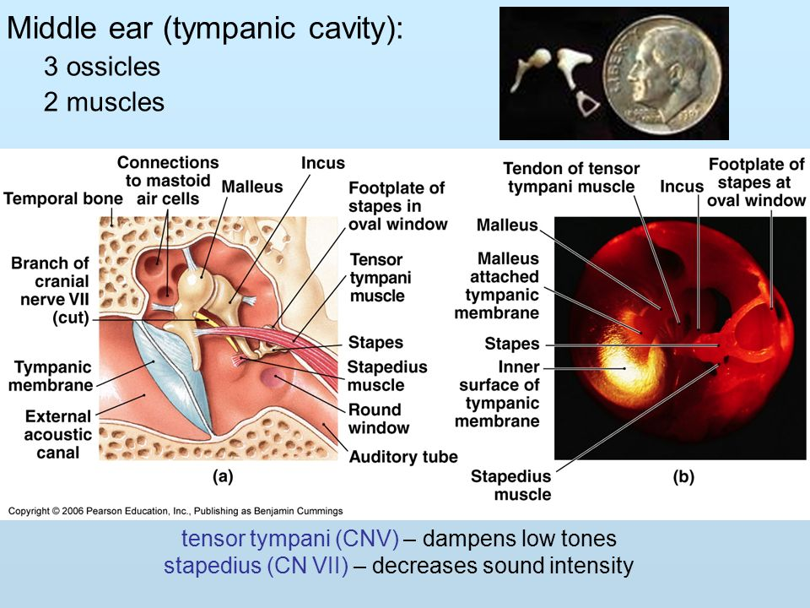
MIDDLE EAR

Slide 28
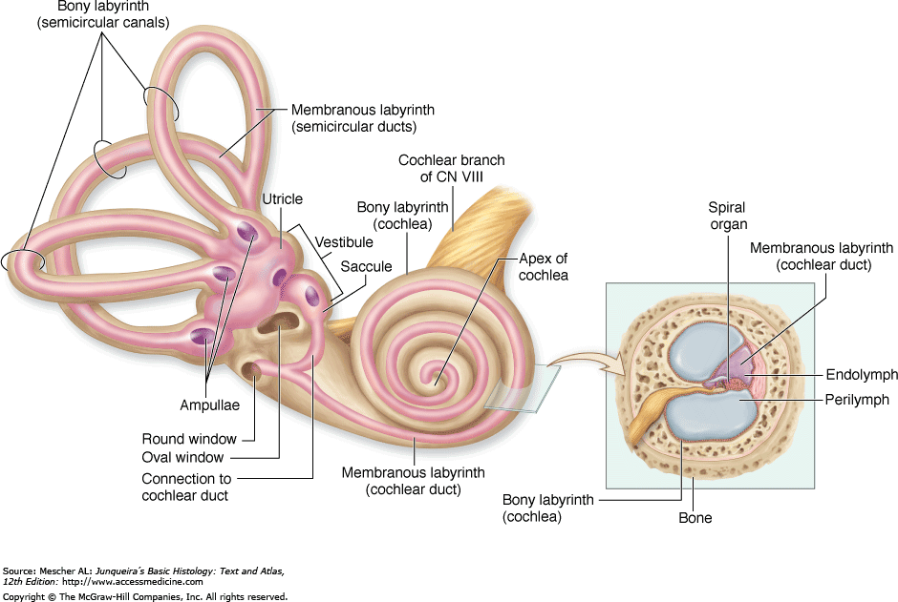
INNER EAR AND COCHLEAR SECTION (Refer to slide 30)

Slide 29
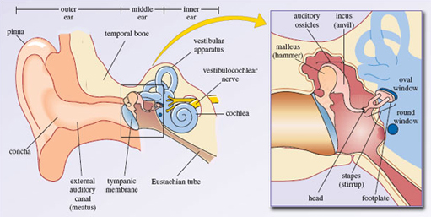
INNER EAR

Slide 30
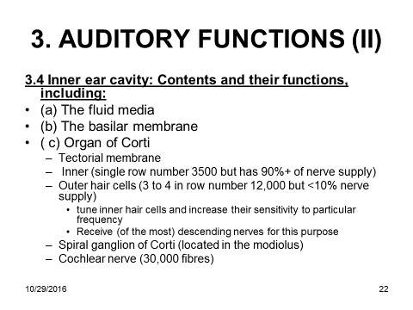

Slide 31
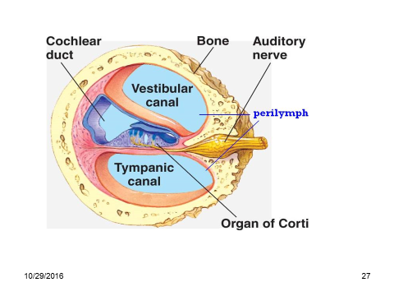

Slide 32
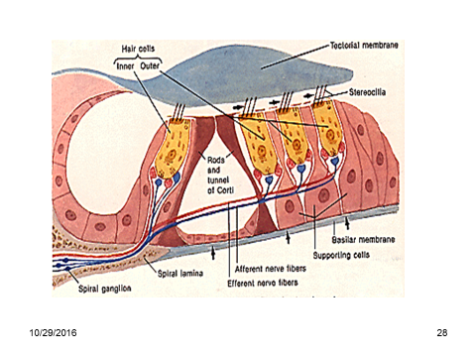

Slide 33
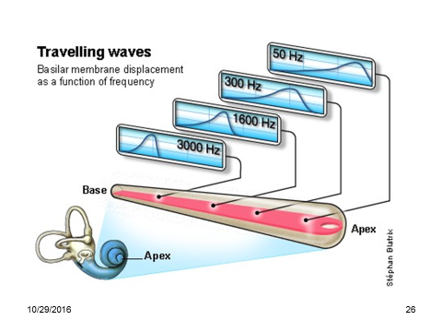

Slide 34
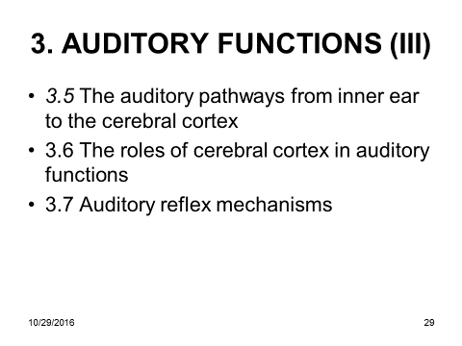

Slide 35
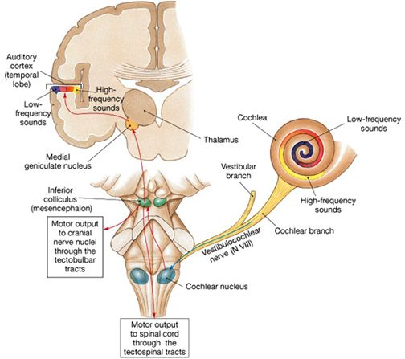
AUDITORY PATHWAYS

Slide 36
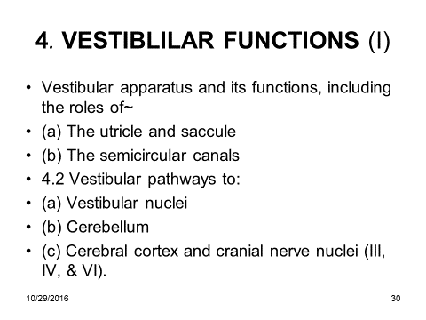

Slide 37
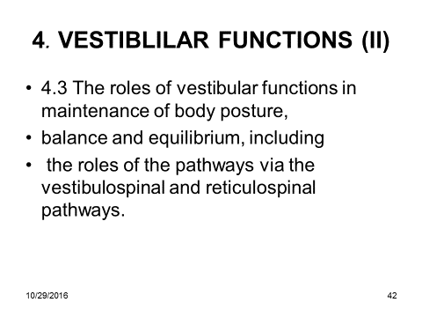

Slide 38
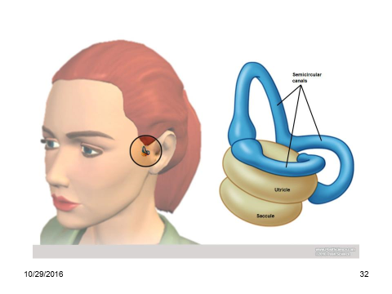

Slide 39
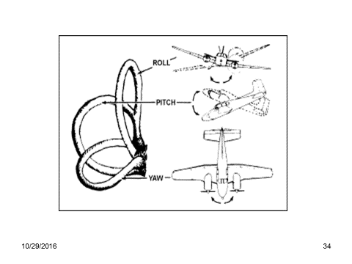

Slide 40
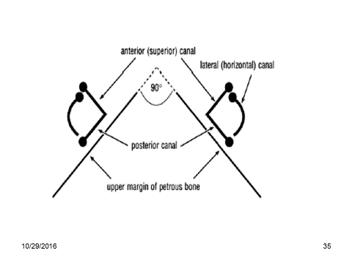

Slide 41
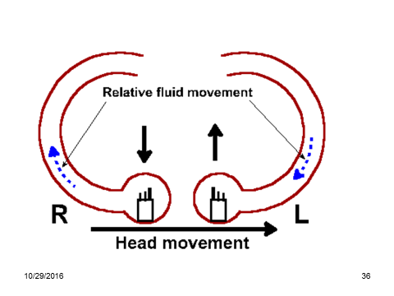

Slide 42
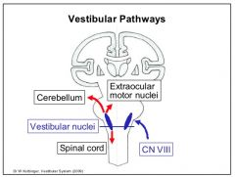
SIMPLIFIED VESTIBULAR PATHWAYS

Slide 43
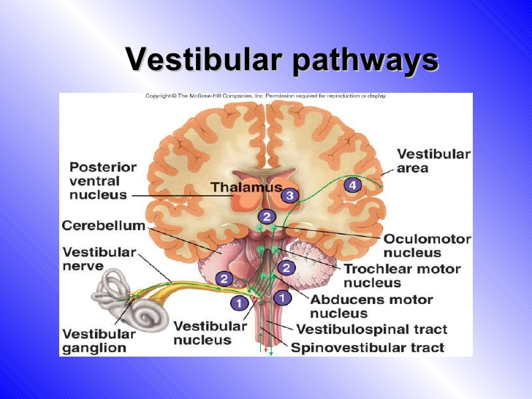

Slide 44
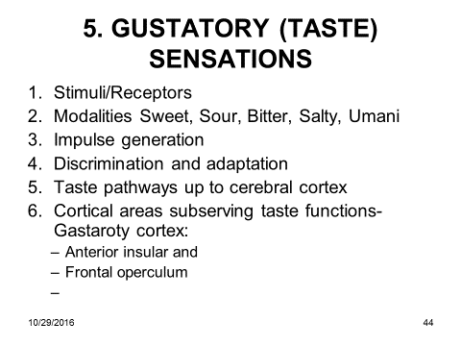

Slide 45
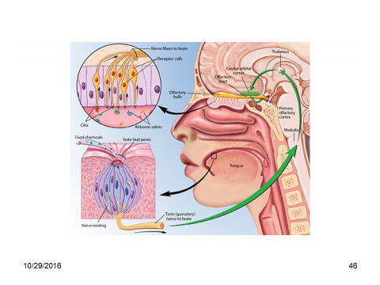
TASTE AND SMELL

Slide 46
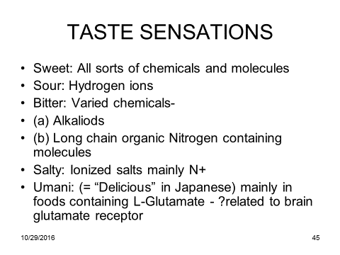

Slide 47
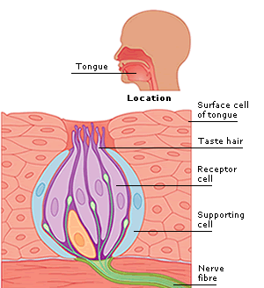
TASTE BUD

Slide 48
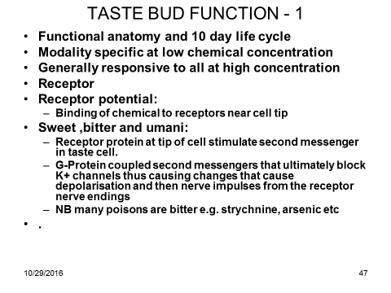

Slide 49
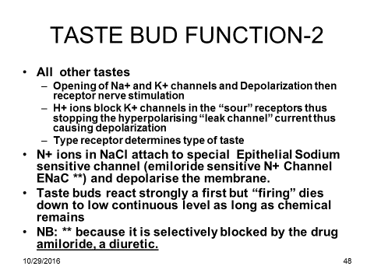

Slide 50
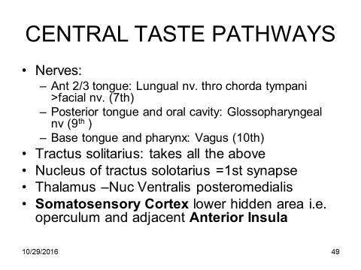

Slide 51
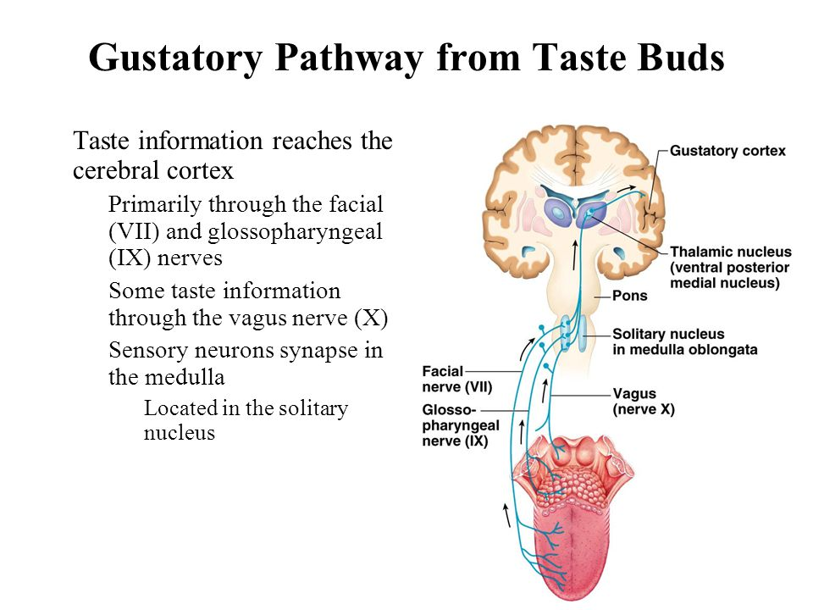

Slide 52

TASTE (GUSTATORY) PATHWAYS

Slide 53


Slide 54

OLFACTION (SMELL)

Slide 55

OLFACTION

Slide 56

TASTE RECEPTORS AND ALFACTORY BULB

Slide 57


Slide 58


Slide 59


Slide 60


Slide 61

RHINENCEPHALON

Slide 62
RHINENCEPHALON (SMELL BRAIN)
The smell brain is huge in lower mammals
Some have special receptors for pheromones i.e.
  The vomeronasal organ VNO -(Jacobson’s organ) – paired organ at the inferior posterior (basal) part of the nasal septum – in amphibia reptiles and mammals for modulating reproductive and social behavior
  The organ is vestigial in humans
Helps animal to explore several aspects of the environment
Also processes pheromones
Dogs can identify very many different people by smell
Human children also have remarkable sense of smell
  Encephalization of perception later dulls this ability

Slide 63
END

