Slide 1
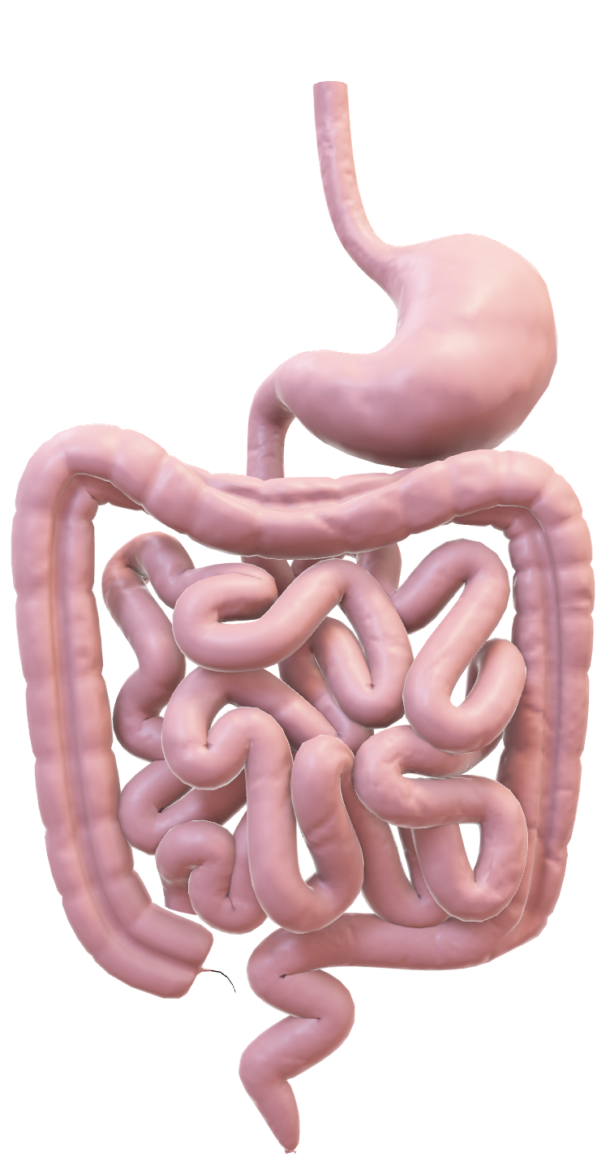
GIT IMAGING

Slide 2

Dr. T. Musila Mutala, M.B., Ch.B. (Nbi), M.Med.(DIRM)(Nbi), M.Onc.Imag.(Pisa)
Consultant Radiologist and Cancer Imaging Specialist
Lecturer, Department of Diagnostic Imaging and Radiation Medicine, University of Nairobi.

Slide 3
OBJECTIVES
Describe the modalities available for GIT imaging
Discuss the indications, contraindications and patient preparation for each of the modalities
Highlight the limitations of the described imaging modalities
Present examples of anatomic and pathological images as demonstrated in each of the modalities

Slide 4
MODES OF GIT IMAGING
Plain radiography
Contrast radiography
Ultrasound
CT Scan
MRI Scan
Radionuclide imaging (Nuclear Medicine)
Angiography

Slide 5
PLAIN RADIOGRAPHY
Main Indication
Plain radiographs are frequently still the first investigation in the acute abdomen
Main Limitations
For non-acute situations, the relatively small yield of information from a plain radiograph does not justify the radiation dose that it entails, unless it is on follow up basis.
Poor soft tissue contrast hinders accuracy of detecting disease outside the GIT lumen.
Caution
Plain radiographic findings must corroborate with clinical findings: sometimes even obvious signs can be non-specific generating a plethora of differential diagnoses. A good example is the presence of air-fluid levels which may be benign or a pointer to obstruction

Slide 6
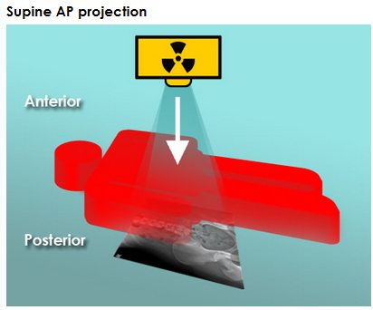
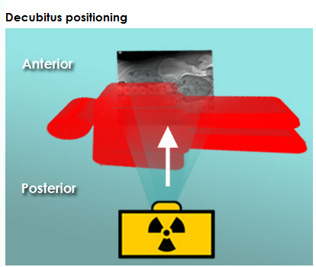
PLAIN RADIOGRAPHY: projections
Indicated when looking for air-fluid levels within the bowel or extra-bowel gas
Usually adequate for detecting general GIT status

Slide 7
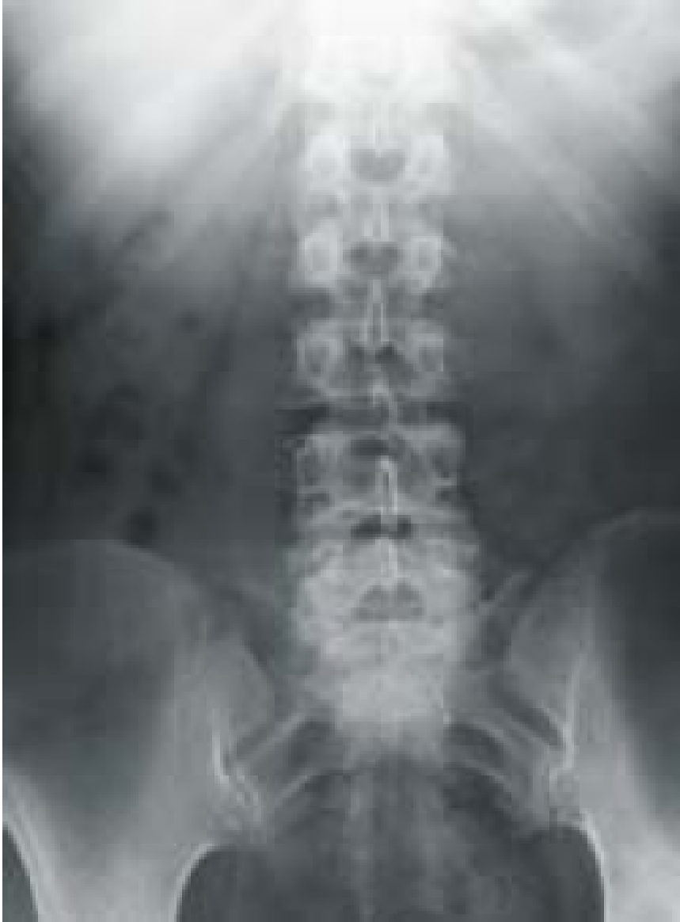
AXR -The densities
Air
Soft tissues
Fat
Calcified structures

Slide 8
Abdominal x-ray: systematic approach – option 1
Check the patient details
Assess quality (including presence of artifacts).
Bowel gas
Soft tissues
Bones
Abnormal calcifications
Be Sure Before Action!

Slide 9
Abdominal x-ray: systematic approach – option 2
Air
Bowel
Density
Organs
External objects and artefacts
ABDO X

Slide 10
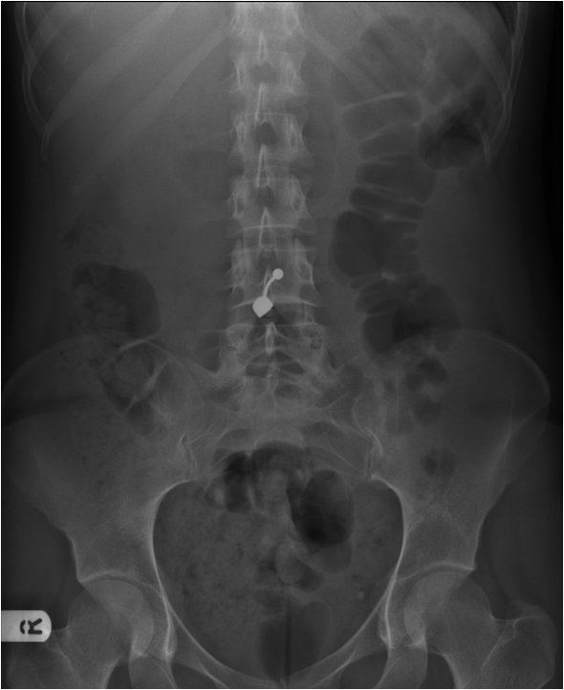
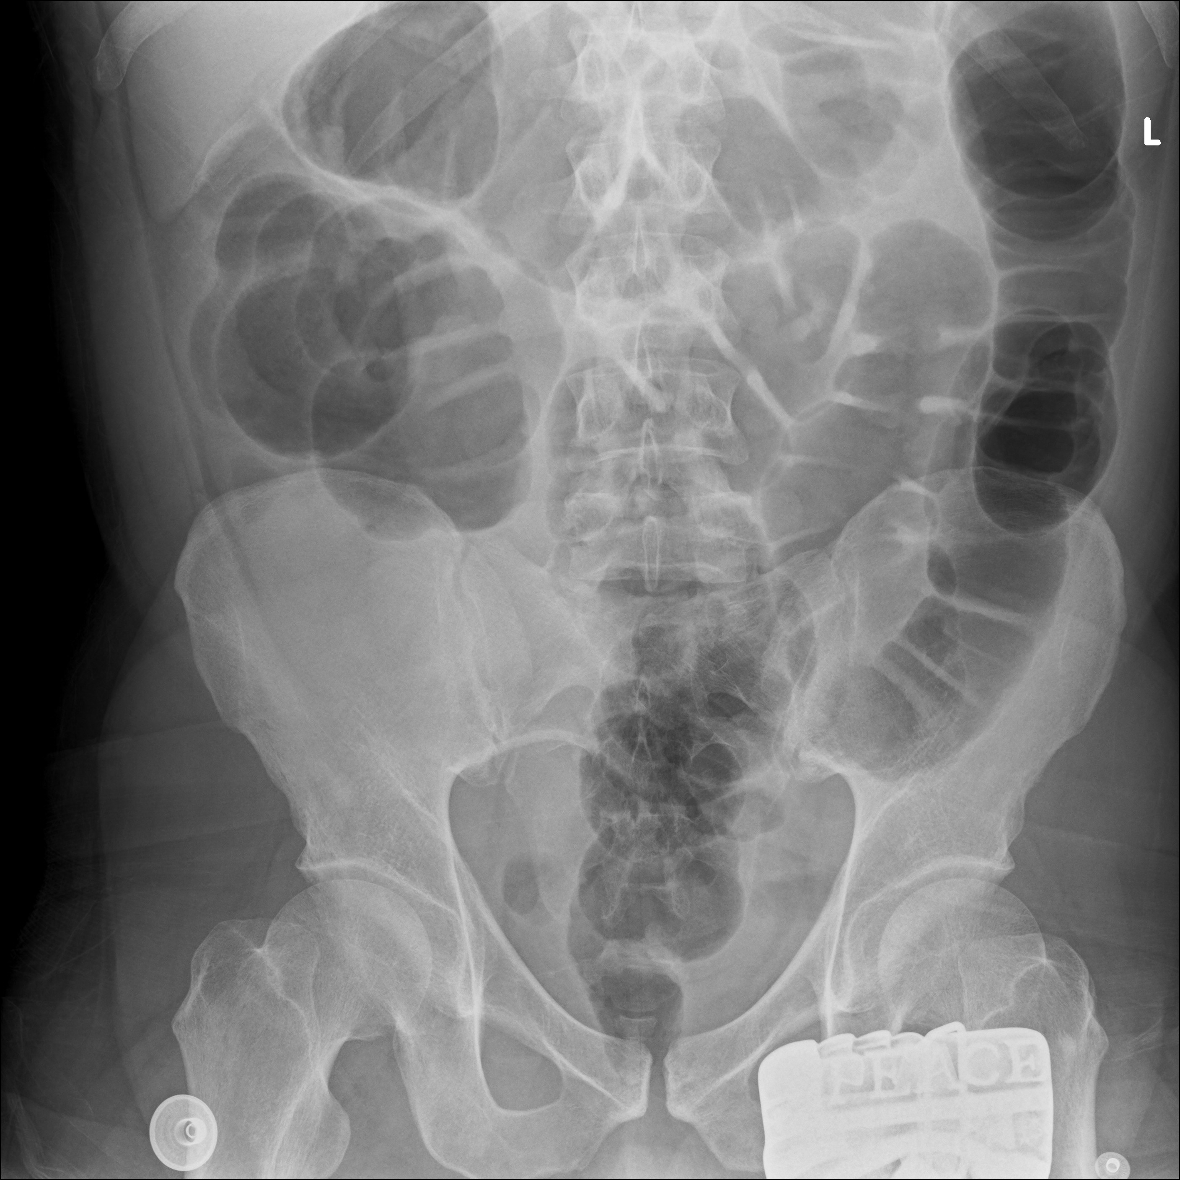
Artefacts!

Slide 11



AXR – Air Distribution (Bowel Gas)
Intraluminal
Extraluminal
Abnormal
Normal
Abnormal

Slide 12


Bowel Gas

Slide 13
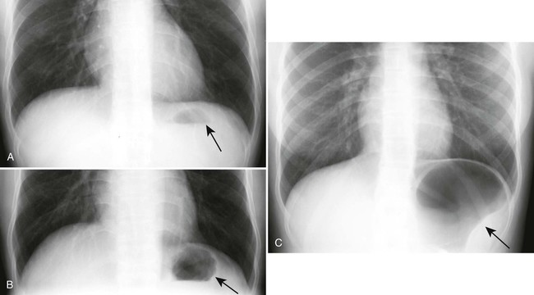
Gastric bubble

Slide 14
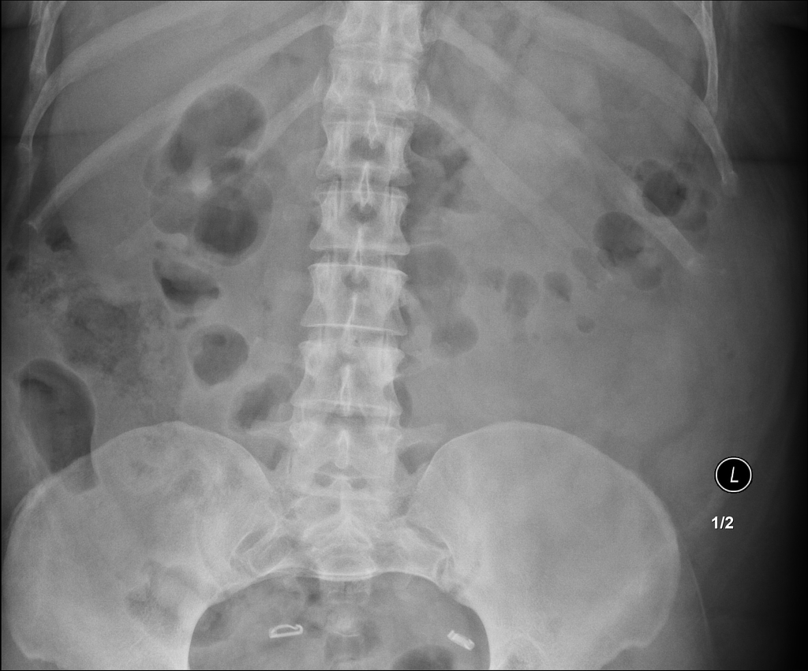
Normal Large bowel gas

Slide 15
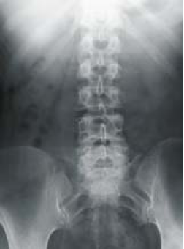
AXR – Air Distribution
Normal findings

Slide 16
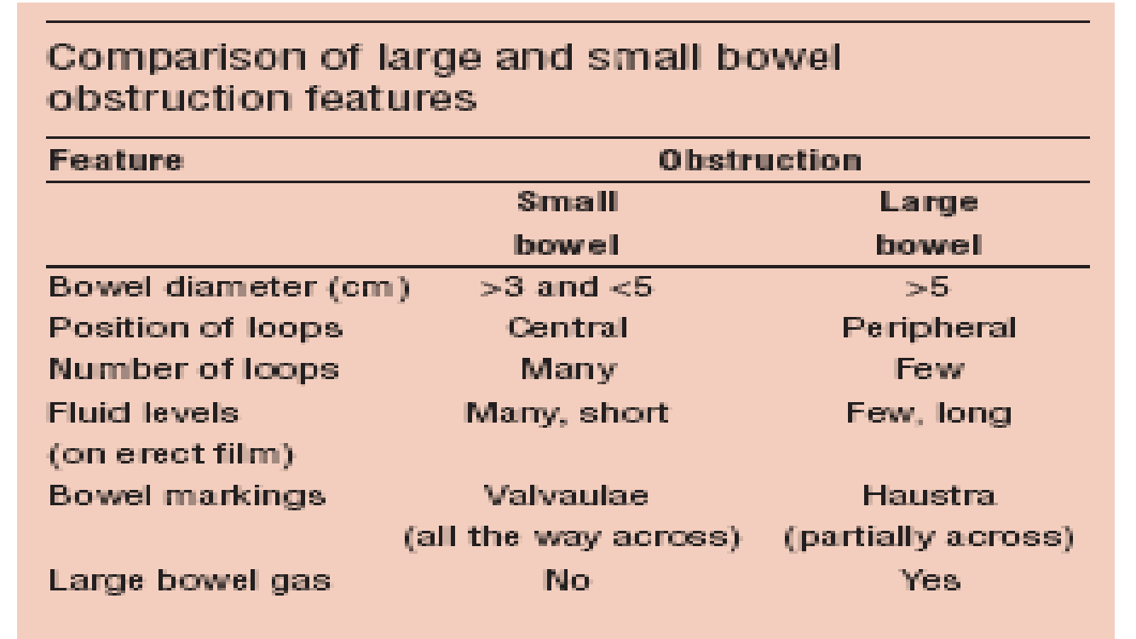
ABNORMAL INTRALUMINAL AIR PATTERN: LOCALISATION

Slide 17
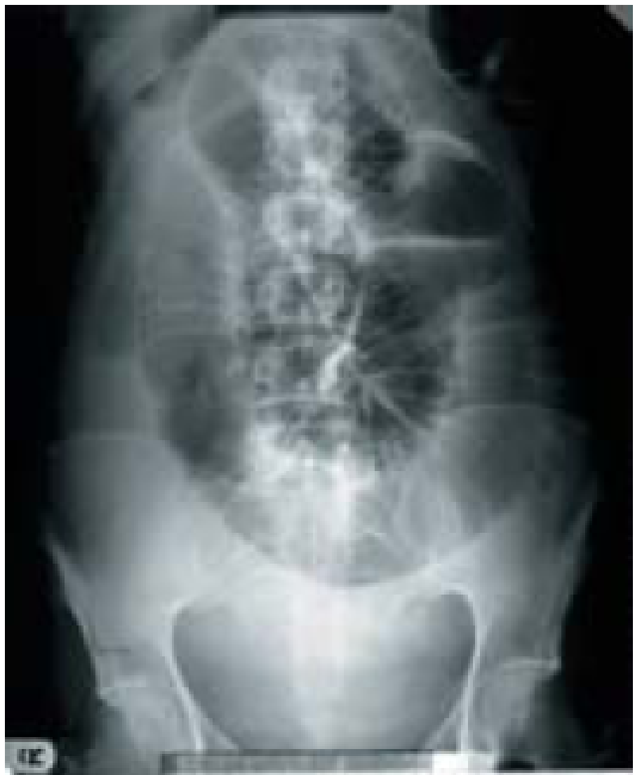
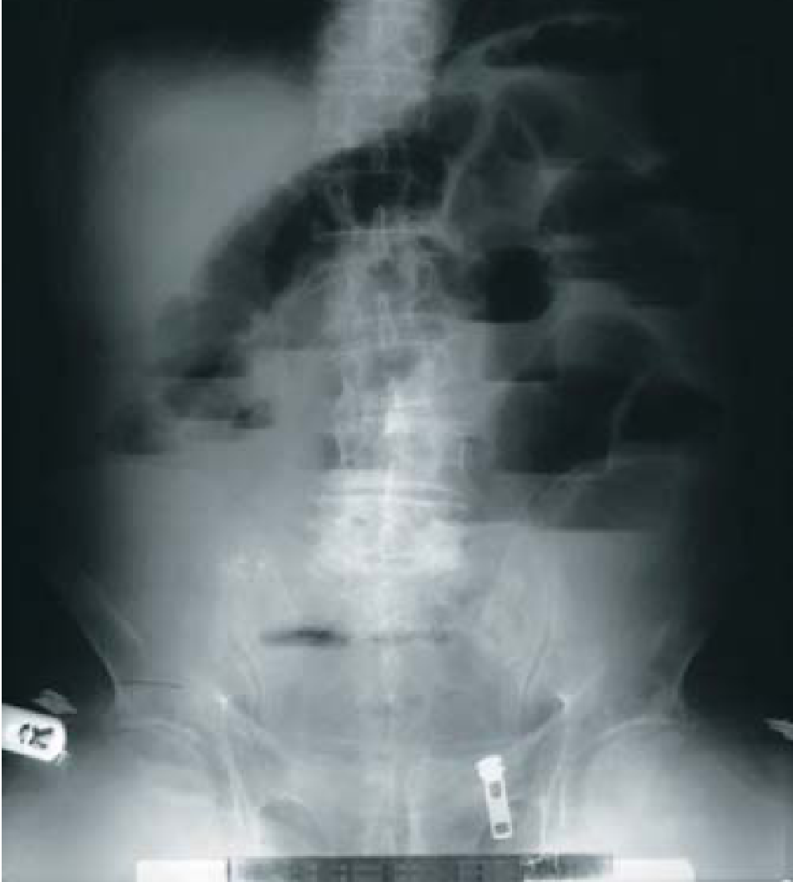
AXR – abnormal Air Distribution – Intraluminal
Erect
Supine
Small bowel obstruction

Slide 18
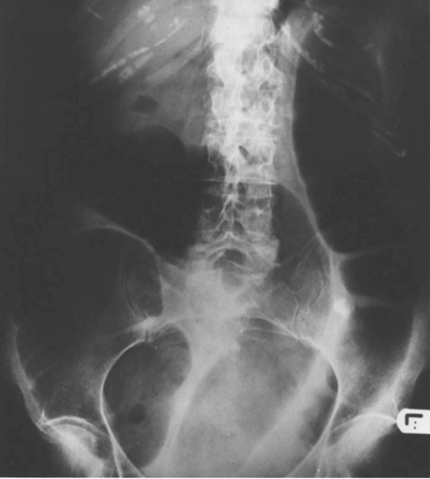
AXR – abnormal Air Distribution -intraluminal
Large bowel obstruction – supine

Slide 19
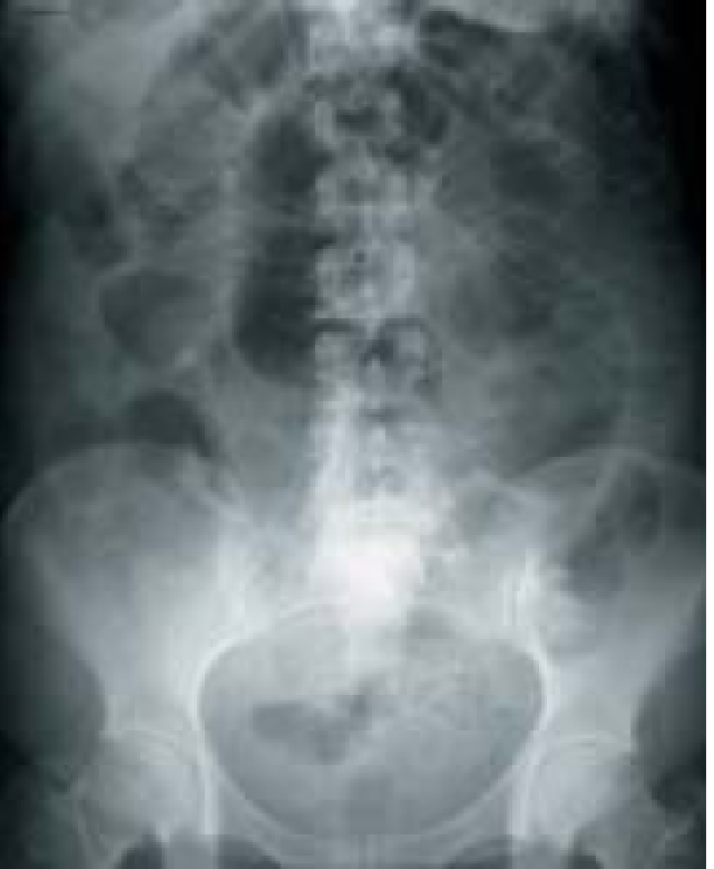
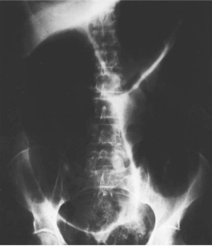
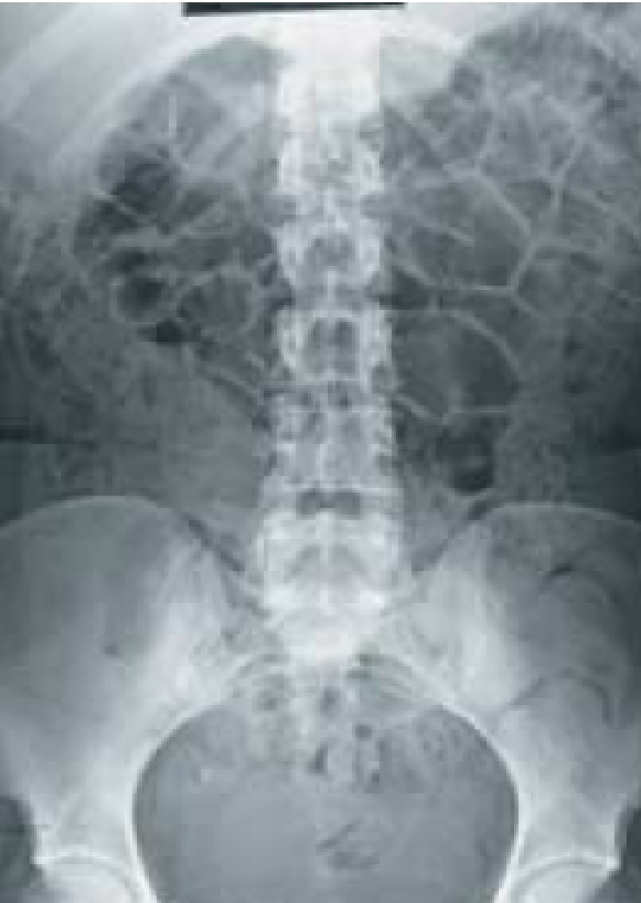
AXR – Air Distribution – intraluminal abnormal
Paralytic ileus
Sigmoid volvulus
meteorism

Slide 20


Slide 21
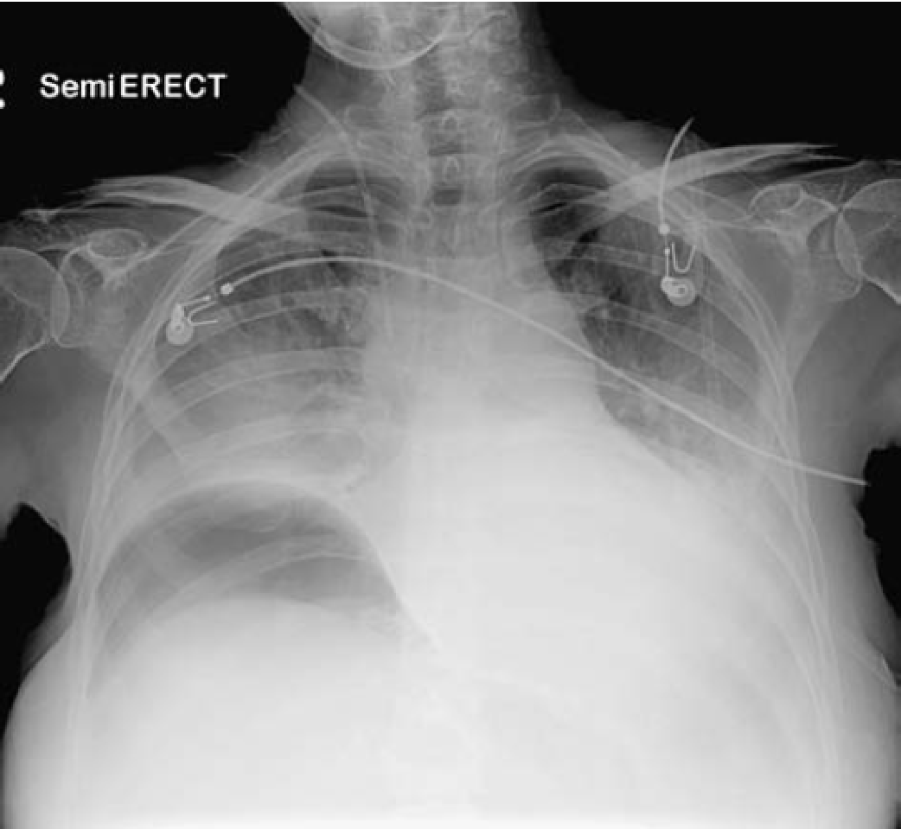
AXR – ABNORMAL Air Distribution - extraluminal
Air under the diaphragm
Pneumoperitoneum – secondary to perforated gut

Slide 22
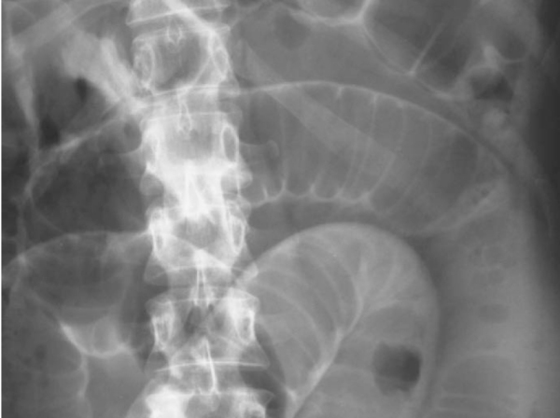
Rigler’s sign – Double wall sign
Pneumoperitoneum – secondary to perforated gut

Slide 23
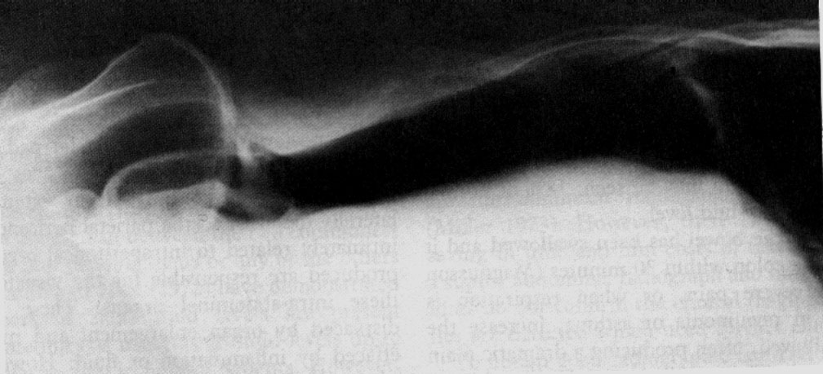
AXR – ABNORMAL Air Distribution - extraluminal
Pneumoperitoneum – Lt lateral decubitus view

Slide 24
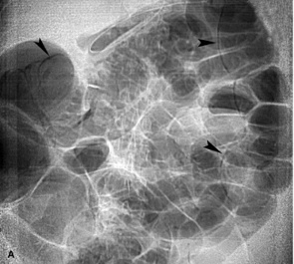
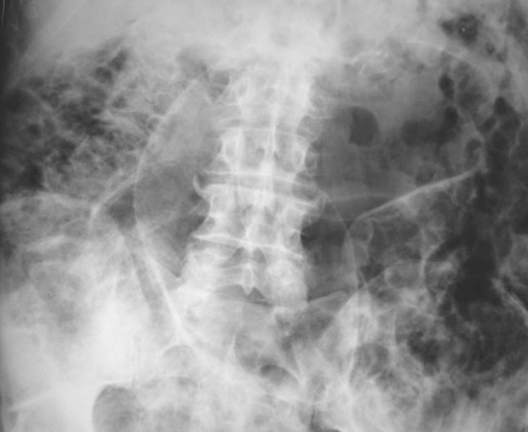
AXR – ABNORMAL Air Distribution – EXTRALUMINAL
Pneumatosis intestinalis (intramural)

Slide 25
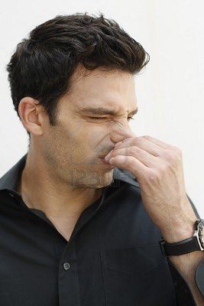
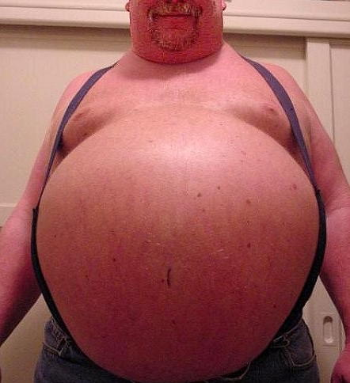
Air shall only be kept within the bowel for it to be considered normal
And in the right proportions

Slide 26
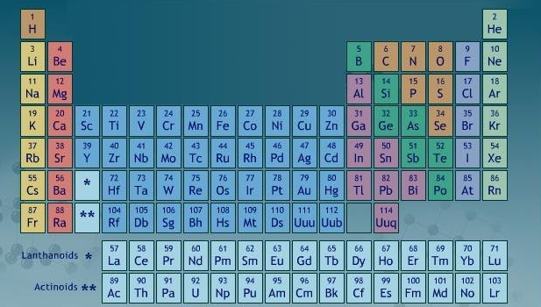

Slide 27
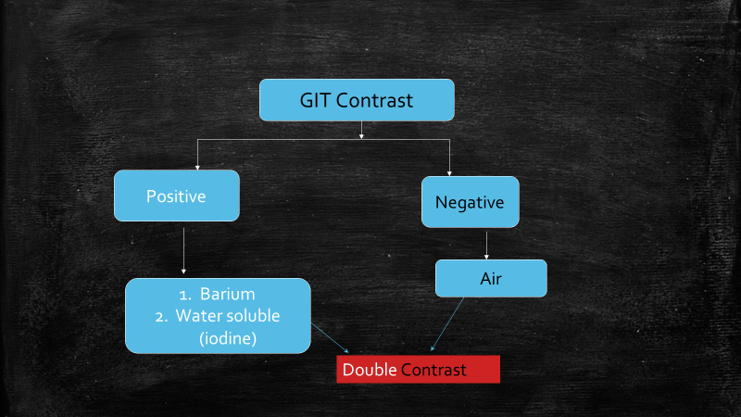

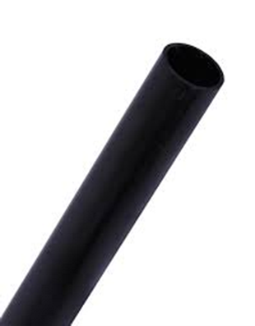
GIT Contrast Radiography
High atomic number material
Low atomic number material
Luminal studies

Slide 28
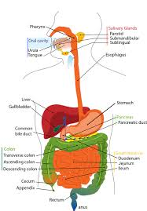
GIT Contrast Radiography
– Modalities
Sialography – salivary glands
Ba. Swallow – oesophagus
Ba.Meal – oesophagus, stomach, duodenum
Ba. meal follow through – o,s,d,sb
Small Bowel Enema (Enteroclysis)-small bowel
Ba. Enema – large bowel
Colostrogram, Sinogram, Fistulogram

Slide 29
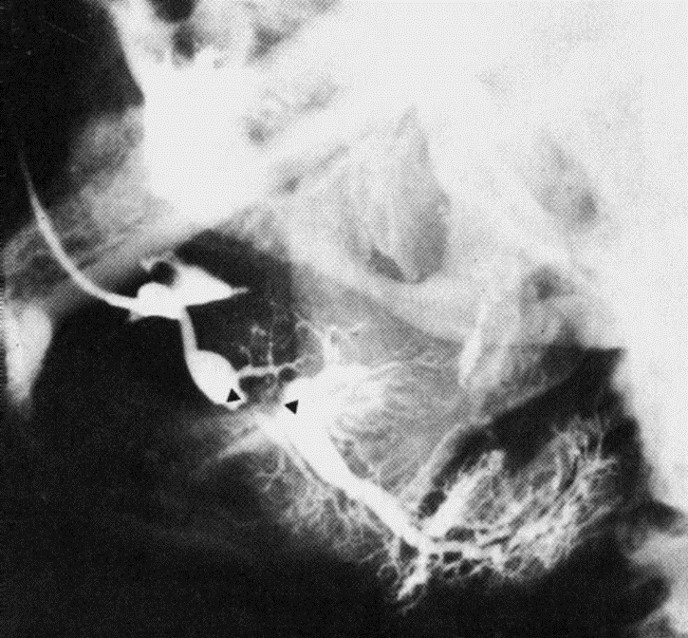
Sialogram

Slide 30
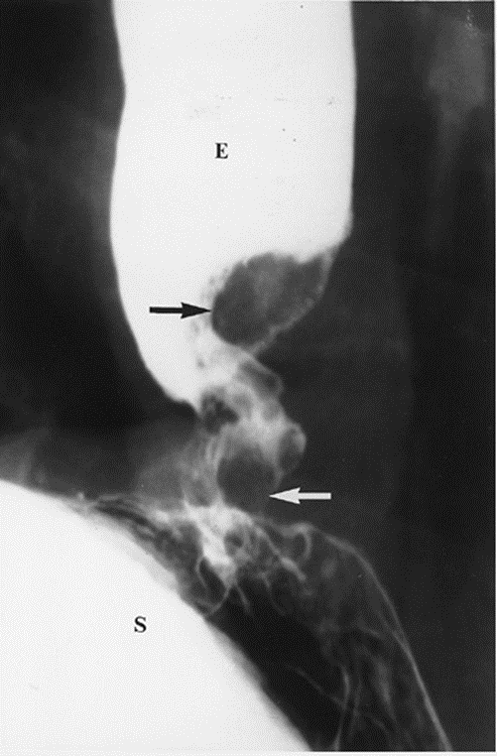
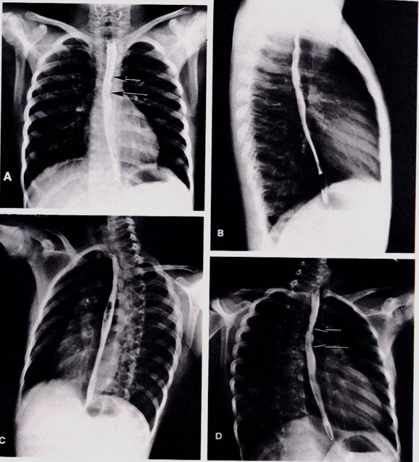
Ba swallow
Ca oesophagus
Normal
Normal

Slide 31
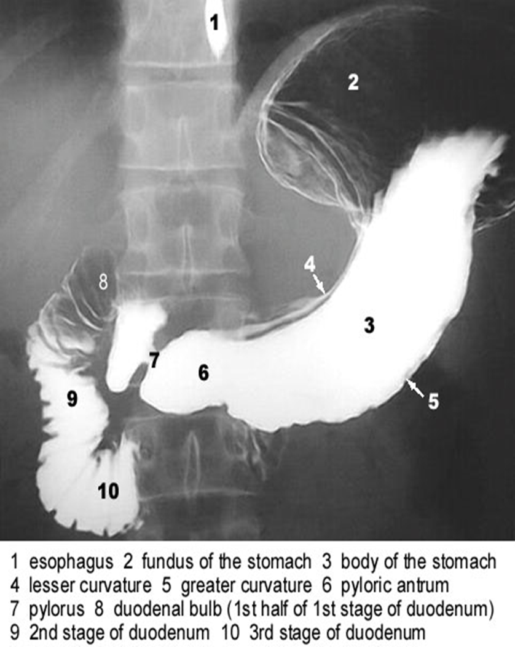
Ba meal

Slide 32
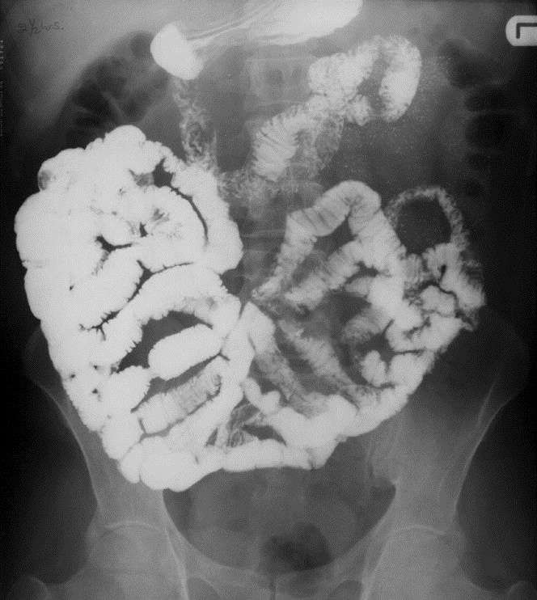
Ba meal follow through

Slide 33
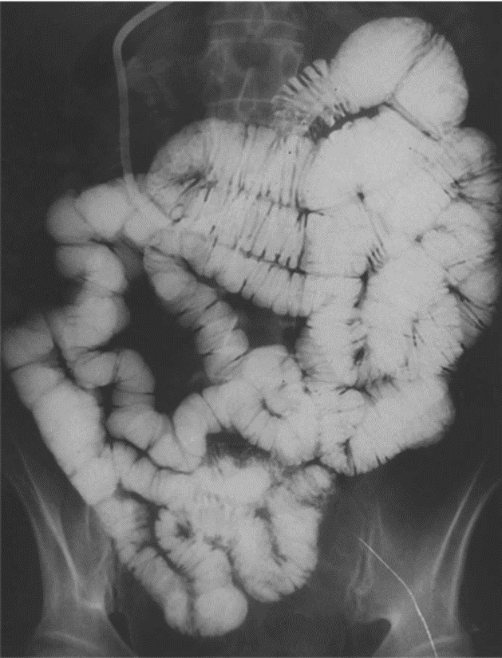
Small bowel enema (enteroclysis)

Slide 34
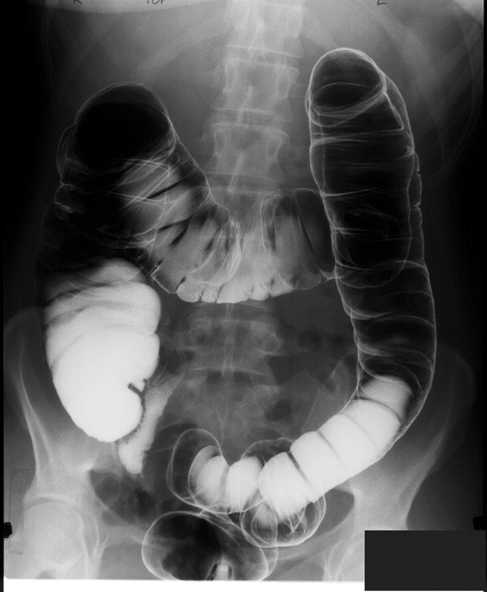
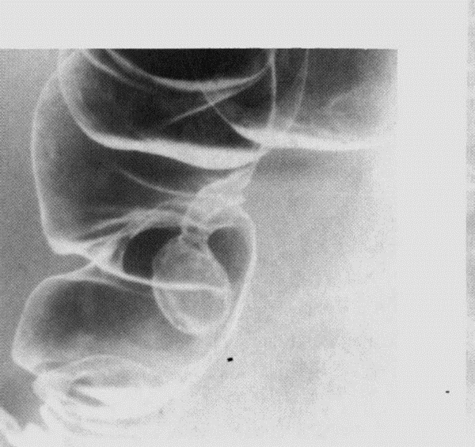
Ba Enema

Slide 35
Ultrasound in GIT Imaging
Though of limited value in imaging the GIT, for the reason that gas produces poor sound penetration, it can be useful in the following areas
Suspected masses
Suspected peritoneal fluid collections
Suspected calculus
Suspected inflammatory conditions like appendicitis
Suspected intusussception
Suspected hernias
The jaundiced patient

Slide 36
Computerised Tomography (CT) in GIT
Gaining popularity as investigation of choice in acute abdomen and trauma
Complements other radiological studies of the GIT to determine the extent of disease
Evaluatethe mesentery, adjacent solid organs, the peritoneal cavity, and the retroperitoneum
Stage malignancies and evaluate for recurrence
CT enteroclysis to evaluate the small bowel
Virtual endoscopy – CT Colonography has largely replaced Ba enema as the imaging modality of choice in large bowel disease. It is also incorporated as a screening tool for colorectal carcinoma in high risk groups.

Slide 37
Computerised Tomography (CT) in GIT
Take note of the following:
CT is relatively expensive and unavailable
Caution has to be taken since it gives high radiation dose to the patient

Slide 38
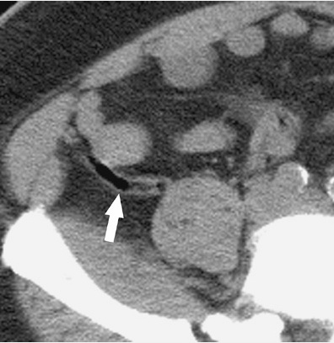
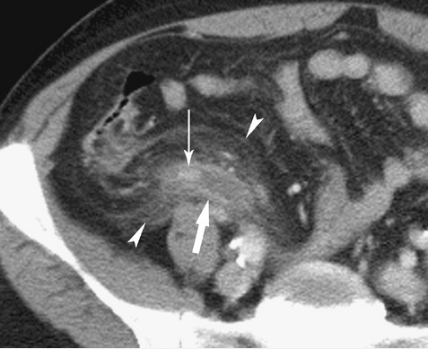
Computerised Tomography (CT) in GIT
Normal appendix
Acute appendicitis

Slide 39
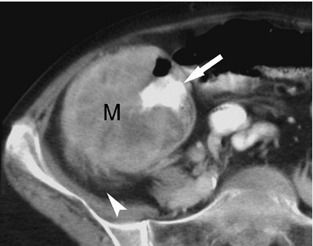
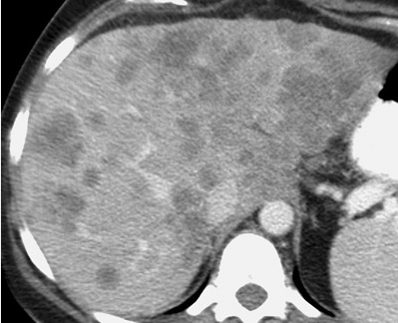
Computerised Tomography (CT) in GIT
Metastatic liver lesions from Ca.colon
Caecal malignant tumour

Slide 40
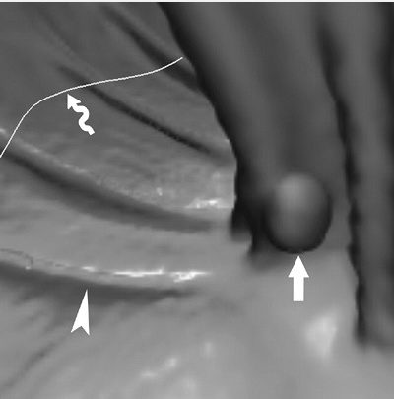
Computerised Tomography (CT) in GIT
CT (virtual) colonoscopy) reveals a polyp

Slide 41
Magnetic Resonance Imaging (MRI) in GIT
Though more expensive and less available compared to the modalities we have already discussed it has these main advantages
Excellent soft tissue contrast
Non- ionising radiation
Multi- sequential multi-planar capabilities
Its application includes the same as CT except that it is not used in acute setting.

Slide 42
Magnetic Resonance Imaging (MRI) in GIT
Though more expensive and less available compared to the modalities we have already discussed it has these main advantages
Excellent soft tissue contrast
Non- ionising radiation
Multi- sequential multi-planar capabilities
Its application includes the same as CT except that it is not used in acute setting.

Slide 43
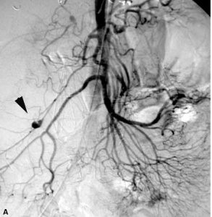
Angiography in GIT
Main role is in combined diagnostic and interventional imaging
Right colic artery extravasation of contrast demonstrating point of hemorrhage

Slide 44
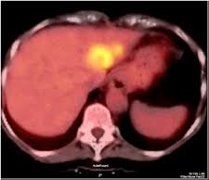
LIVER AND BILIARY TRACT IMAGING – PET (POSITRON EMISSION TOMOGRAPHY)
PET-CT scan image showing a metastatic lesion within the left lobe of the liver

Slide 45
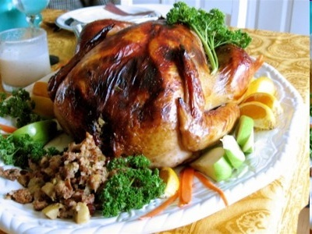
Thank you
Musila Mutala

