Slide 1
ETHICS AND STANDARDS OF PRACTICE IN DIAGNOSTIC IMAGING
Level IV integrated lectures
DR. G. MWANGO

Slide 2
outline
Definitions
General principles in medical ethics
Key ethical considerations in diagnostic imaging

Slide 3
Definition
ETHICS : Principles that form the basis on which the customs of a people are established.
Medical ethics: A system of moral principles that apply values and judgments to the practice of Medicine.

Slide 4
Basis of Medical ethics
Hippocratic Oath
Rabbinic and Christian teachings
Muslim Medicine
Law

Slide 5
Values in Medical Ethics
There are Six main values:
Autonomy- the patient has the right to refuse or choose their treatment.
Beneficence- the doctor should act in the best interest of the patient.

Slide 6
Values in Medical Ethics: cont.
Non-malfeasance- actions intended should not harm or bring harm to the patient or other. “first, do no harm”
Justice- being fair or just to the wider community in terms of the consequences of an action . Distribution of scarce health resources with fairness and equality

Slide 7
Values in Medical Ethics; cont:
Dignity ; the patient (and the person treating the patient) have a right to be treated with dignity
Truthfulness and honesty; the patient has a right to full disclosure in terms of illness, treatment methods, prognosis, outcome etc.
- informed consent

Slide 8
Key issues in diagnostic imaging
JUSTIFICATION :
Appropriateness of the examination
Is the examination necessary or justifiable
Will it change patient management?
Is it the best investigation for the given clinical scenario?
Patient’s clinical condition e.g. can the study precipitate a crisis e.g. use of contrast agents in altered renal function

Slide 9
Key issues in diagnostic imaging: cont.
B. Radiation protection and safety
All ionizing radiation has a potential of causing harm
Stochastic- no threshold
Deterministic- threshold
OPTIMIZATION – minimum radiation dose required to produce diagnostic images
ALARA- AS LOW AS REASONABLY ACHIEVABLE

Slide 10
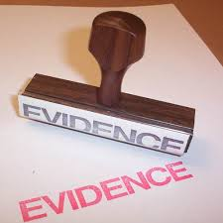
Key issues in diagnostic imaging: cont.
Cost-effectiveness of the investigation
Availability of expertise or imaging modality
Evidence-based medicine

Slide 11
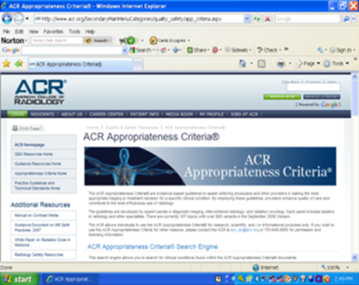
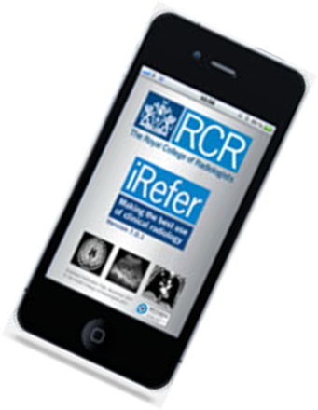
Clinical appropriateness criteria
Imaging Referral Guidelines have been developed for clinicians to determine the most appropriate imaging for a particular patient or clinical scenario
e.g. ACR appropriateness criteria®, iRefer-RCR

Slide 12
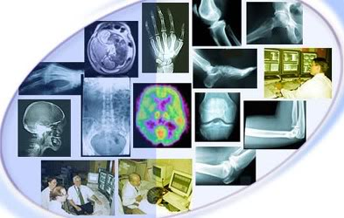
Imaging referral guidelines
Appropriate and detailed history taking and clinical evaluation, patient’s age, clinical condition
Working diagnosis D/Dx
is ionizing radiation and/or contrast media indicated?
BENEFITS
RISKS

Slide 13
Some reasons for unnecessary procedures
Lack of awareness about radiation doses & associated risks
Insufficient access to referral guidelines at the point of care
Low confidence in clinical diagnosis & over-reliance on imaging
Consumer demand (patient's and/or family's expectations)
Self-referral, opportunistic screening, defensive medicine

Slide 14
Some reasons for unnecessary procedures :cont
Pressure from other specialists e.g. "What does the CT shows?"
Pressure from promotion and marketing of sophisticated technology
Lack of dialogue/consultation between referrers and radiologists
Non-availability of other appropriate imaging modality (e.g. US, MRI)
Fragmentation vs. continuity of health care: unnecessarily repeated examinations

Slide 15
AUTONOMY
Patient’s right to choose or refuse any treatment or imaging study
Key considerations
Patient education on the disease, management, risks, prognosis etc leads to informed consent
Patient’s capacity to make decisions- is the patient too young, under age or is there mental incapacity?
Societal-value shift to define medical care in terms of outcomes that are more important to the patient than to the medical professional.

Slide 16
Autonomy; cont
Ethical dilemma
Nondisclosure of information- limiting discussion to prevent severe anxiety, depression or refusal of care until appropriate counseling has been achieved.

Slide 17
BENEFICENCE
Acting in the patients’ best interest.
This is a core value in Medical Ethics.
Generally people trust doctors
It is the duty of the doctor to act in the patients’ best interest. This should supersede the doctor’s self-interest, interests of third parties, hospitals or insurers, drug companies

Slide 18
Beneficence; cont
Ethical dilemma
Risk in performing the imaging study or intervention e.g. exposure of ionizing radiation to unborn fetus or young child
Benefit should always outweigh the risk

Slide 19
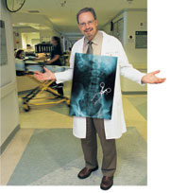
NON-MALFASEANCE
First, Do no harm
Its more important not to harm your patients than to do them good!
Forbids doctors from providing ineffective interventions or acting without due care
Benefits of care should outweigh the risks
Will the imaging study change the patient’s management or increase potential risk?

Slide 20
Non-malfaseance (non-maleficence)
Ethical dilemmas
Desperate situations where the outcome without treatment is grave and the treatment itself is risky
Some treatments while doing good can potentially harm e.g. morphine in terminal care which eases the pain but depresses respiration, x-rays during pregnancy
Many medical malpractice litigation is actually related to this value

Slide 21
JUSTICE
Distribution of scarce healthcare resources with fairness and equality.
And where the resources are limited who should benefit first ?

Slide 22
Importance of communication
Most of the ‘ethical conflicts’ and even medical litigation arise from lack of adequate, appropriate and respectful communication between the doctor/ healthcare team and the patient/ guardians

Slide 23
Radiation protection and safety - key principles- summary
Most appropriate imaging modality (justification)
Radiation dose limitation (ALARA principle)
Minimize non-diagnostic images (optimization)

Slide 24
Imaging request forms evaluation at the Radiology department
Type of imaging requested
Is the indication appropriate
Is there sufficient clinical data
What is the patient’s clinical condition

Slide 25
Possible action pathways: RADIOLOGY
perform the examination
modifying the exam
delay the exam until more information is available
Offer an alternative study

Slide 26
Decision ‘influencers’
Patient’s well being- main basis in ethical practice
Other sources:
Radiologist’s interests
Referring clinician’s demands
Insurance agency’s policy
Managed care organization policy (HMO)

Slide 27
Steps taken to ensure ethical practice Diagnostic Imaging
Justification
All requests that utilize higher doses of ionizing radiation are counter-signed – fluoroscopy, interventional radiology, CT scanning
Examination should benefit the patient; is appropriate for the clinical condition; provided history, working diagnosis
MRI requests also countersigned- rel. expensive, may require sedation, MRI gadolinium contrast is C/I in renal insufficiency, appropriate indication e.g. may not be useful for imaging lung or intestines unless in specific cases

Slide 28
Steps taken to ensure ethical practice in Diagnostic Imaging KNH
Optimization: ALARA
Quality assurance/ quality control (QA/QC) measures such as:
- Regular film-reject analyses
- diagnostic reference level
- use of imaging protocol guidelines

Slide 29
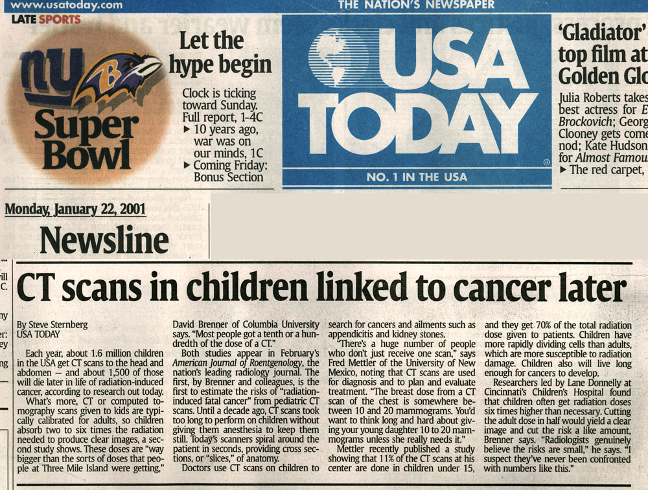
Media attention has increased public awareness
CT criticized for excessive radiation dose since 2001
Notes:
Brink

Slide 30
RADIATION SAFETY CAMPAIGNS
Image Gently, Image Wisely, EuroSafe, AFROSAFE
Stakeholders
Radiation health worker
Patient
Referring clinician
Manufacturers/ innovators
Public- ionizing radiation from medical imaging is approaching the levels of background radiation

Slide 32
In conclusion
Always put the interests of the patient first; justify the examination and the cost incurred
Consider if the ionizing radiation exposure or use of contrast media is necessary (radiation safety)
Always practice patient education. Acquire good communication skills
Always treat your patients with equality, respect and dignity
Optimize the imaging procedure to acquire diagnostic images -ALARA
Remember all patient information is confidential
------------------------------------------------------------------------------------

