Slide 1
CARDIOVASCULAR IMAGING
COMPILED BY EFFIE NAILA

Slide 2
OUTLINE
INTRODUCTION
EMBRYOLOGY
IMAGING MODALITIES
CONGENITAL HEART DISEASES
SPECIFIC CONDITIONS

Slide 3
INTRODUCTION
The fetal heart develops from a series of complex and rapid changes which occur between the 2nd and 8th week of intrauterine life.
During the 3rd to 5th weeks cardiac structures develop most actively and are most susceptible to adverse external influence e.g. rubella virus or drugs such as thalidomide resulting in congenital heart diseases (CHD).

Slide 4
EMBRYOLOGY
The heart originates from the splanchnic mesoderm.
The endocardial tube is the initial basic structure.
The development is characterized by rapid and complex changes
5 dilatations develop in an initially straight longitudinal midline tube. These include:
Common truncus arteriosus
Bulbous cordis
Common primitive ventricle
Common primitive atrium
Sinus venosus

Slide 5
Adult derivatives of the primitive heart

Slide 6
NORMAL FETAL CIRCULATION
Oxygenated blood is carried by the umbilical vein (UV) through the ductus venosus (DV) and IVC into the RA through the foramen ovale.
SVC & IVC blood is passed into RA, RV & PA. Most of the RV output passes through the PDA into the descending aorta to supply lower parts of fetus and the umbilical arteries which supply the fetal placental plexus.
The rest of the RV output then moves into the LA, LV, aorta & systemic arteries.

Slide 8
CHD IMAGING MODALITIES
Plain radiography
Echocardiography → First line choice to assess anatomy and physiology.
Cardiac catheterization → For definition of vascular anatomy.
Radionuclide imaging → To quantify L- R shunts & assess relative pulmonary perfusion.
CT → For description of cardiac and vascular anatomy in relation to other structures of the chest.
MRI → Quantification of cardiac function and vascular flow in vivo.

Slide 9
CHEST RADIOGRAPH: INDICATIONS
Suspected CHD
Cyanosis
Cardiac failure
Failure to thrive
Difficult in feeding in the neonatal period
Fainting spells

Slide 10
CHEST RADIOGRAPH CONT.
Standard views include:
Erect PA/AP chest
Left lateral
The roles of chest radiographs include providing clues to underlying CHD and planning further investigations.
It possesses limited use in neonates and young children and may show related skeletal anomalies.

Slide 11
CHEST RADIOGRAPH ALLOWS ASSESSMENT OF:
Cardiac and visceral situs → situs solitus, situs inversus, situs ambiguous
NB: 2/3 of the heart should be on the left side and 1/3 of the heart should be on the right, if vice versa → dextrocardia
Cardiac size & shape
Mediastinum → Aortic arch, PA, tracheal indentation
Pulmonary vasculature → e.g. normal, plethora, oligemia, congestion
Skeletal features → e.g. Rib notching seen in coarctation of aorta
Post surgical stigmata e.g. sternal sutures, implants etc.

Slide 13
CARDIAC SIZE MEASURMENT

Slide 14
CARDIAC SIZE MEASUREMENT
R- max → Extension of the heart to the right of the midline
L- max → Extension of the heart to the left of the midline
Transverse diameter of the heart = R + L
The transverse diameter of the heart should be 50- 55% of the maximum transverse diameter of the thorax. It goes up to 60% in children.

Slide 15
ECHOCARDIOGRAPHY
This gives a wealth of anatomical and physiological information without ionizing radiation, patient discomfort or significant risk
It is obtained by placing an U/S transducer on the chest wall to image the heart structures as a real- time 2- D slice.
It permits the rapid assessment of cardiac structure and function.
LV wall thickness and EF can be estimated from 2D images.

Slide 16
TYPES OF ECHOCARDIOGRAPHY
1- Dimensional (M Mode)
2- Dimensional → MC used
3 D
Doppler echocardiography:
CFI; ‘non-invasive’ angiogram
Pulsed doppler echo (valves)
Continuous wave doppler
Contrast echocardiography

Slide 17
Contrast echocardiography
This involves the use of IV contrast.
Effects are produced when micro- bubbles of gas present in solution are injected into a peripheral vein or selected area of the heart via a catheter.
Micro- bubbles are generated by the rapid injection of saline, blood, indocyanine.

Slide 18
INDICATIONS
Myocardial perfusion can be investigated directly/indirectly after intra- coronary/ venous contrast injection with/without DSA.
Better definition of anatomy not shown well on 2D E.g. imaging the anomalous venous connections to the heart
Enhancement of endocardial boundaries increasing sensitivity of wall motion abnormalities e.g. valvular regurgitation, shunts etc.

Slide 19
Doppler echocardiography
Used to study venous flow from IVC, SVC, pulmonary vessels and flow across the valves
It allows the measurement of direction and speed of blood flowing through the heart and blood vessels
It enables one to check for abnormal communication between left and right side of the heart and regurgitation
It allows calculation of CO/ EF
Color flow- Doppler:
Flow towards the transducer → RED
Flow away from the transducer → BLUE
Turbulence flow → YELLOW (mixture of red and blue)

Slide 20
Para- sternal long axis view →shows regurgitant jet consistent with massive aortic insufficiency
Apical 4c view → systolic murmur
Apical 4c view → severe left vent. Systolic dysfunction. Tricuspid regurgitation is shown
Para- sternal long axis → shows aorto- right ventricular fistula (arrow) with aortic regurgitation

Slide 21
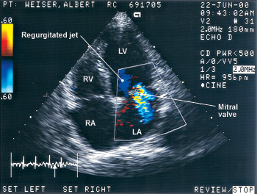

Slide 22
CLINICAL APPLICATIONS OF ECHOCARDIOGRAPHY
Congenital heart disease
Anatomical defects, shunts
Stress echo
Pericardial disease
Coronary artery disease
Cardiomyopathies
Valvular disease
Cardiac masses
Diseases of the aorta

Slide 23
ANGIO- CARDIOGRAPHY
This is an important technique for cardiac and great vessel anatomy.
Coronary angiography is the commonest modality.
The trans- femoral approach is done using Judkins or Amplatz catheters
Pulmonary angiography: for possible embolism.
Advantage: offers high resolution images of the heart and great vessels.
Disadvantages:
Requires experienced hands and cardiac monitoring
It is invasive

Slide 24
CONT.
Indications:
CHD
Valvular/myocardial disease
Ventricular function assessment
Technique;
Right sided structures are studied by introducing a catheter into a peripheral vein, i.e., femoral or ante- cubital or basilica
Left sided structures are studied by introducing a catheter into the femoral artery in retrograde fashion.
CM-LOCM 370; 1ml/kg at 18-20mls/s (adults),1.5ml/kg ( 0-1yr);1.0ml/kg (>5 yrs)***

Slide 25
EQUIPMENT
Equipment:
Fluoroscopy unit on a C-arm with DSA facilities
Pressure recording device
ECG monitor
Blood oxygen analyser
Catheters ( pigtail, NIH)
Cournand catheter → for pressure measurements
NB: Angled views which place the pathological lesion at right angles to the X- ray beam increase diagnostic accuracy of cardiography

Slide 26
COMPLICATIONS
Sudden death
Arrhythmias
MI
Contrast Media side effects

Slide 27
I ➔ Intermediate branch
S ➔ Septal branch
D ➔ Diagonal branch
OM ➔ Obtuse marginal
Cx ➔ Circumflex artery

Slide 28
Open arrowhead ➔ Left Anterior Descending Artery
Solid arrowhead ➔ Diagonal branches
Arrow ➔ Circumflex Artery

Slide 29
Solid arrow head ➔ Right Coronary Artery
White arrow ➔ Postero- lateral LV branch
Open arrow head ➔ Posterior Descending Coronary Artery
Black Arrow head ➔ Sinus Nodal Artery
Black arrow ➔ Inverted u at the crux

Slide 30
CARDIAC MRI
Advantages: Provides for the study of anatomy as well as dynamic motion studies of function, flow and chemistry with minimal risk to the patient
Disadvantages:
Expensive
Unavailability
Metallic implants pose a challenge

Slide 31
CLINICAL APPLICATIONS
Ventricular function analysis
Myocardial function at rest and during stress
Myocardial perfusion
Measurement of coronary flow
Valvular heart disease
Pericardial pathology
Cardiac tumors and thrombi
Cardiomyopathies
Assessing great vessels- aortic/pulmonary disease

Slide 32
Pulse sequences used
Tissue characterization → done using:
T1W → best anatomic depiction
Blood shows signal void
T2W
Contrast enhancement
Spectroscopy
Gradient echo→ Impart bright signal to coherently flowing blood (white blood)
Fast spin echo → Vascular wall bright; Blood black

Slide 33
C/MRI –cont’d
Gradient recalled echo-technique → applied for motion studies, to show flowing blood as well as cardiac motion
ECG gated MRI of the heart → Velocity mapping sequences
Images → tomographic slices of any selected plane

Slide 34
GADOLINIUM AS CONTRAST IS USED IN:
Myocardial perfusion
MR angiography:
Time of flight MRA
Phase contrast MRA
Contrast enhanced MRA
Myocardial infarction
Ischemia

Slide 35
TRANSVERSE IMAGE THROUGH VENTRICLES AT AV LEVEL
Open arrow: Tricuspid valve
Curved arrow: Mitral valve

Slide 36
OBLIQUE AXIAL IMAGE OF THE HEART – TURBO S. E. IMAGE
Solid white arrow ➔ Parietal band
CT➔ crista terminalis,
Black arrow ➔ RCA
Curved arrow ➔ Left Circumflex CA
Da ➔ LAD
A ➔ Aorta
P ➔ Pulm. Vein
AV ➔ Aortic valve

Slide 37
CARDIAC CT
Good images of thoracic anatomy and major cardiac structures and large vessels
CECT → 1st line in imaging aortic rupture or dissection
Indicated for evaluation of the coronary vessels e.g. calcification
Disadvantages:
Ionizing radiation
Motion artefact

Slide 38
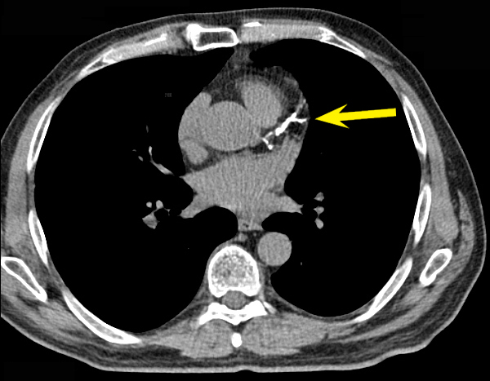
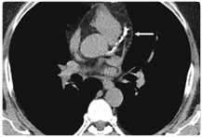

Slide 39
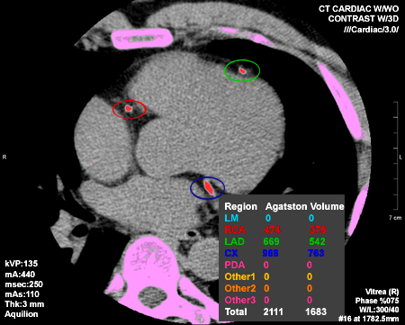

Slide 40
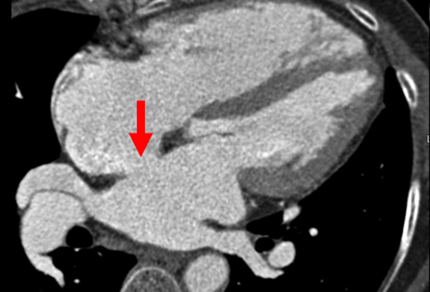
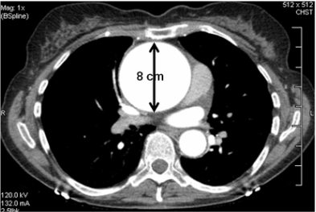
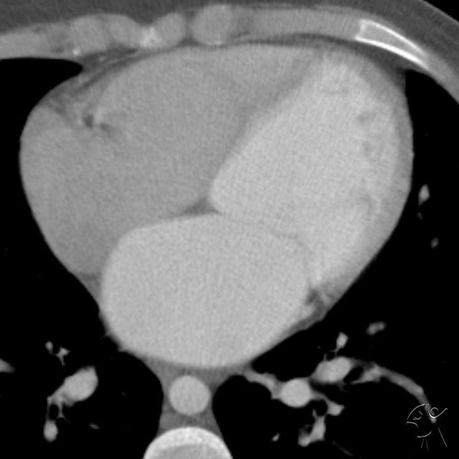
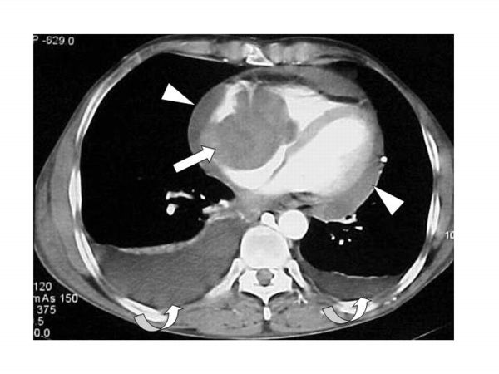

Slide 41
Coronal 3D reconstruction of right heart chambers using MDCTA.
RAO views of right heart shown by MIP
D-volume rendered technique-RCA running in the low attenuation fat of the ant. Atrioventricular groove
E&F-Sagittal 3D Reconstruction of right chambers using MDCTA by (E) MIP and (F) VRT showing
position of pulmonary valve (white arrows)

Slide 42
CARDIAC SCINTIGRAPHY
Injection of radio- pharmaceutical to study the heart
Indications:
Assessment of myocardial perfusion
Ischemia
Infarction
Viability.
Ventricular function
Diagnosis and quantification of abnormal passages

Slide 43
PERFUSION STUDIES
Used to diagnose ischemia and m/infarction
Radio- pharmaceuticals used include;
Thallium 201
Technetium 99m labeled tracers like tetrofosmin

Slide 44
TECHNIQUE
Scans are taken in stress and resting phases
Stress is induced by:
Physical exercise test e.g. treadmill or bicycling.
Pharmacologic stress test: dipyridamole, adenosine, dobutamine.
The heart is scanned in longitudinal, vertical and short axes

Slide 45
PERFUSION SCANS
Normal scans:
Horse- shoe shaped in vertical and long axes
Doughnut- shaped in short axis
Stress and rest images are the same in normal myocardial perfusion
Ischemia → normal at rest and reduced at stress
Infarcted and scars → reduced in both

Slide 46
CONT.
VERTICAL LONG
AXIS
SHORT
AXIS
HORIZONTAL LONG
AXIS

Slide 47
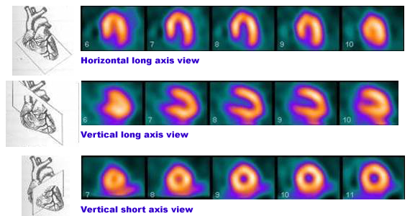
Normal perfusion scan showing cardiac slice information and horizontal long, vertical long and vertical short axis images.

Slide 48
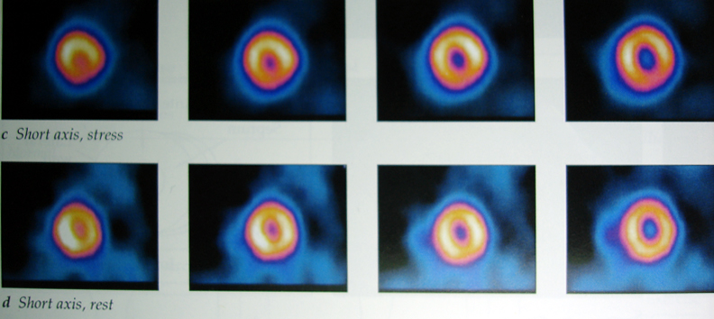
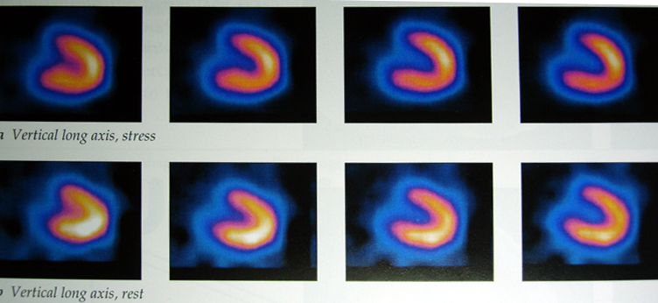
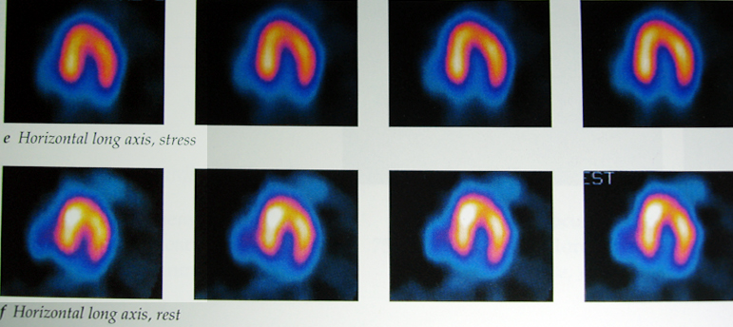
Normal examination
Short axis
Stress
Rest
Vertical long axis
Stress
Rest
Horizontal long axis
Stress
Rest

Slide 49
Normal Thallium myocardial perfusion tomograms in vertical long axis (left), horizontal long axis (centre), and short axis planes (right).
Stress images (top) and redistribution (bottom).
There is homogenous uptake of tracer throughout the myocardium

Slide 50
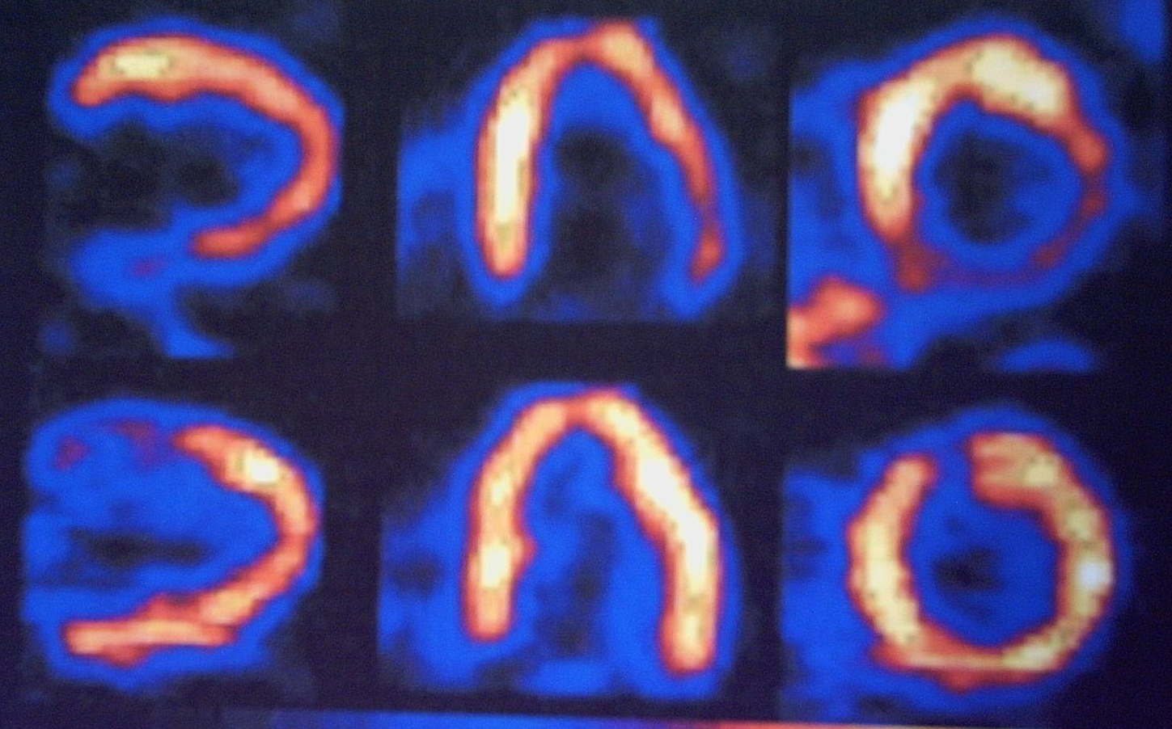
Hibernating myocardium; vertical long axis-(left), horizontal long axis (centre),and short axis( right)
PET images
Ammonia perfusion images (top) show decreased uptake in the inferior and basal lateral regions. But the glucose metabolic images (bottom) show increased metabolism in these areas. Typical of hibernating myocardium

Slide 51
CLINICAL APPLICATIONS OF RADIONUCLIDE IMAGING (RNI)
Diagnosis of coronary heart disease
Prognosis of CAD
Myocardial infarction; infarct detection
Myocardial viability and hibernation
Other myocardial disease; alcoholic induced, viral, metabolic
Valve disease
Arrhythmias

Slide 52
Viscero- atrial situs solitus, isolated dextrocardia.

Slide 53
Situs ambiguous- central cardiac apex, transverse liver.

Slide 54
SITUS INVERSUS

Slide 55
CHD HAS AN INCIDENCE OF 6- 8 PER 1000 BIRTHS

Slide 56
RISK FACTORS OF CHD
Genetic
Downs syndrome-25%
Holt-Oram Syndrome
Ellis van Creveld Syndrome
Turner’s syndrome
Noonan’s syndrome
Alcohol
Prenatal Rubella infection, Toxoplasmosis.
Drugs: Thalidomide toxicity ➔ 17% have a cardiac lesion.
Gestational diabetes

Slide 57
Patent Ductus Arteriosus

Slide 58
Patent Ductus Arteriosus
Persistence beyond 10 days is considered abnormal.
Accounts for 15% of all CHDs.
Commoner in females (M:F ➔ 1: 2-3)
Associated with:
Low birth weight
Prematurity
High altitudes.

Slide 59
CXR
PDA FINDINGS:
Prominent central pulmonary arteries.
Cardiomegaly.
Enlarged left atrial appendage.

Slide 60
2D + Color Doppler Echo (PDA)

Slide 61
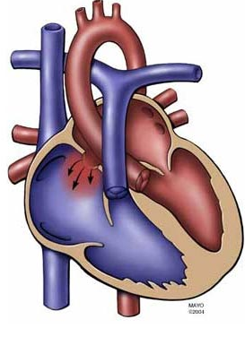
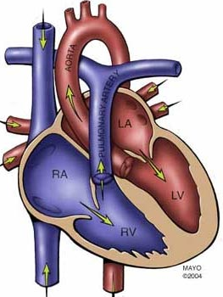
Secundum ASD - accounts for 80%
Defect at the center
Normal Heart for comparison

Slide 62
SECUNDUM ASD
Apical 4 chamber view echo.
Note the enlarged right chambers.

Slide 63
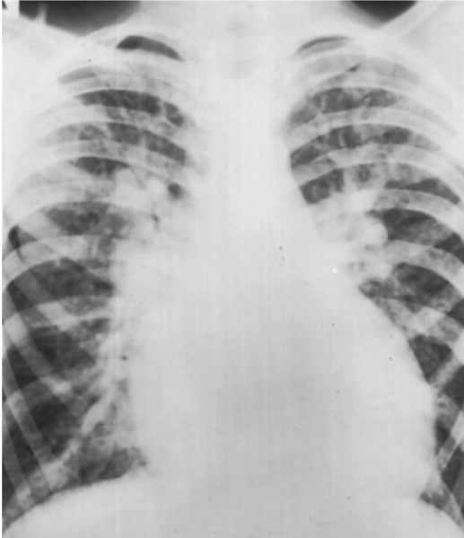
ASD BEFORE EISENMENGER
Note the pulmonary plethora:
Large heart
Large central pulmonary arteries.
Large peripheral pulmonary arteries.
Recruitment of upper zone arteries( Cephalization)
No pulmonary edema.
Patient had ASD.

Slide 64
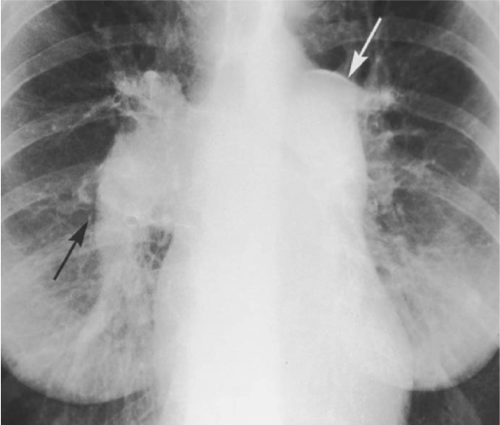
COMPLICATIONS OF ASD
Eisenmenger syndrome.
Enlargement of the right atrium causing tachy- arrhythmias.
Paradoxical thrombo- embolic stroke.
This patient initially had a large ASD with a major left to right shunt. Note the large central pulmonary arteries with peripheral pruning. Arrow points @ calcified lt. pulmonary artery.

Slide 65
VSDS
One of the commonest anomaly (2nd only to bicuspid aortic valves). Incidence 3570/1m live births.
50% of patients with VSD have associated cardiac anomaly e.g. coarctation of the aorta.
80% are peri- membranous & the vast majority(75%) of small ones close spontaneously.

Slide 66
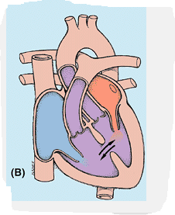
ANATOMY
The Inter- ventricular septum has two parts, the larger muscular and the smaller membranous part.
The membranous part is the postero-superior region.
Membranous VSDs account for 80% of all VSDs.
Muscular VSDs tend to close spontaneously.
Its possible to have multiple VSDs at any part of the interventricular septum.

Slide 67
CONGENITAL CYANOTIC HEART DISEASE
For clinically detectable central cyanosis, there must be at least 5g of reduced Hb per 100 ml of aortic blood.
This occurs in 3 ways:
Direct right to left shunt e.g. TOF
Transposition of great arteries.
Common chambers e.g. Common atria, common ventricle, truncus arteriosus.

Slide 68
TETRALOGY OF FALLOT
Most common cyanotic heart lesion.
Incidence: 3-5 per 10,000 live births.
Primary hypoplasia of infundibular septum secondary to unequal partitioning of the cono- truncus.
Cono- truncal septum displaced anteriorly, and its lowermost component, the Infundibular septum fails to fuse with the top of the IV septum.
Features include:
Infundibular right ventricular outflow tract stenosis
Subaortic VSD
Over-riding aorta
Right ventricular hypertrophy

Slide 69
CONT
Desaturated blood enters RA, flows through RVOT into lungs.
Some blood shunts right to left through VSD into ascending aorta.

Slide 70
Graphic: sub- valvular (infundibular) stenosis, small pulmonary valve, large aortic valve, over-riding aorta, VSD, RVH, rt arch.
CTA cor- hypoplastic MPA, high VSD, over-riding aorta.

Slide 71
RADIOLOGY
“Boot-shaped heart” ➔ “coeur en sabot”.
Right ventricular hypertrophy.
Concave pulmonary artery segment.
Decreased pulmonary vascularity(oligemia).
Normal heart size at birth.
Right aortic arch, mirror image branching (25%).

Slide 72
Boot shaped heart, concave pulmonary artery segment.
Right aortic arch, elevated cardiac apex, pulmonary oligemia

Slide 73
Parasternal long axis- VSD, over-riding aorta,
CF doppler- right to left flow from RV to aorta.

Slide 74
Ebstein anomaly
Downward displacement of septal & posterior leaflets of tricuspid valve.
Insufficient separation of tricuspid valve leaflets and chordae tendineae from Rt ventricular endocardium.
Massive tricuspid regurgitation.
Associated anomalies-PFO, ASD in 90%.
Normal or decreased vascularity
Rt. to Lt. shunt thru PFO causes cyanosis

Slide 75
CONT.
Inferior displacement of tricuspid valve leaflets into RV.
Thin-walled, low-pressure “atrialized” segment of RV.
tricuspid valve is grossly insufficient.
RA blood flow is shunted rt. to lt. across an ASD or PFO into LA. Some blood may cross the RVOT and enter PA.
Severe cyanosis will develop in neonates when PDA closes.

Slide 76
Graphic-Downward displacement of posterior valve leaflet, incorporated into RV.
MR cine- Dilated RA, low placement of tricuspid valve, atrialized RV

Slide 77
IMAGING
Radiography: Severe right sided cardiomegaly.
Echo: Rt chamber enlargement, enlarged tricuspid annulus, tricuspid regurgitation, PFO with Rt. to Lt. shunting.
Treatment: Tricuspid valve replacement and/ or valvuloplasty

Slide 78
Massive globular cardiomegaly (RA dilatation), pulmonary oligemia.
DDX: pericardial effusion

Slide 79
A. Subcostal 4 chamber - displacement of tricuspid valve leaflets inferiorly.
B. Color Doppler- severe regurgitation of the dysplastic tricuspid valve.

Slide 80
Mri cine- 16mm distance btn septal leaflets of MV & TV(arrow).
CECT- RA dilatation, apical displacement of septal tricuspid leaflet.

Slide 81
REFERENCES
Grainger & Allisons textbook of diagnostic imaging 5th edition
Textbook of radiology and imaging Volume 1 7th By David Sutton

