Slide 1
Craniocerebral trauma
(Head injury)
Dr N. M. Kimani
Lecturer DIRM
8th Dec.2016

Slide 2
Craniocerebral trauma(head injury)
Injuries to the skull and brain
-blunt
-penetrating.
Commonest indications for neuroimaging.
A major cause of;
- disability,
- morbidity
- mortality
Has significant direct and indirect financial costs to individuals and society.
Imaging plays an important role in diagnosis and management.

Slide 3
Epidemiology
Over 10 million people sustain TBIs resulting in death or extensive hospitalization. (WHO;2011 estimates )
Over 4.5 million deaths occur annually due to TBIs
(10% deaths in the world).
BY 2020 TBIs will be the leading cause of death and disability.(WHO)
TBIs account for 6-7% of all ED visits. ( USA and Canada )

Slide 4
Kenya situation
Over 3,000 Kenyans die as a result of RTA every year and about 40 % are pedestrians.
TBI accounts for about 50% of all RTA deaths
(Saidi, Macharia, & Atinga, 2005).
In Kenya, the economic cost of road crashes is 5.6% of the GDP (about 300 billion KSHS annually).

Slide 5
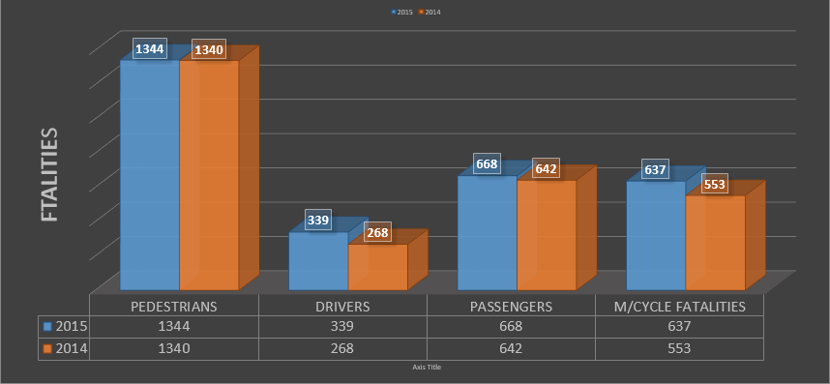
NTSA comparison of fatalities 2014/2015

Slide 6
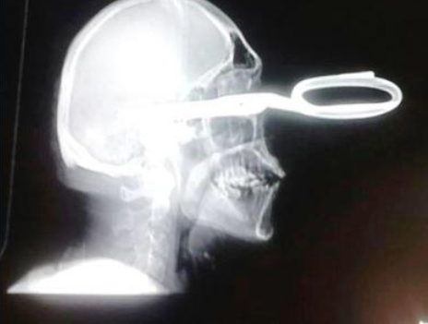
CAUSES OF HEAD INJURY
Motor vehicle accidents –commonest cause.
Assault.
Firearms ; intentional or unintentional.
Falls.
Sport related.
Non-Accidental Trauma in children

Slide 7
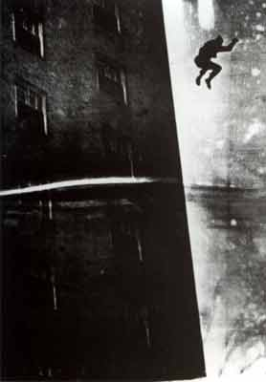
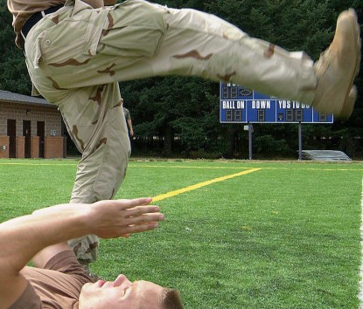
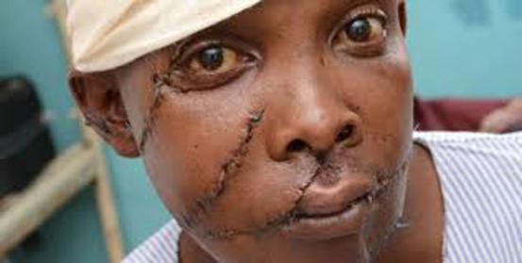
Causes of head injury
Motor vehicle accidents –commonest cause.
Assault.
Firearms ; intentional or unintentional.
Falls.
Sport related.
Non-Accidental Trauma in children

Slide 8
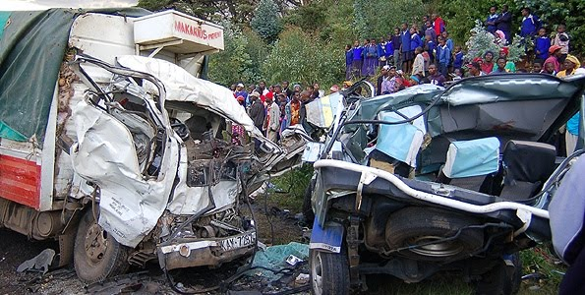
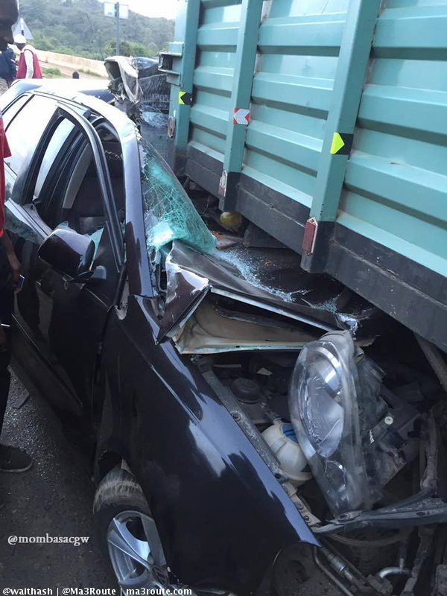
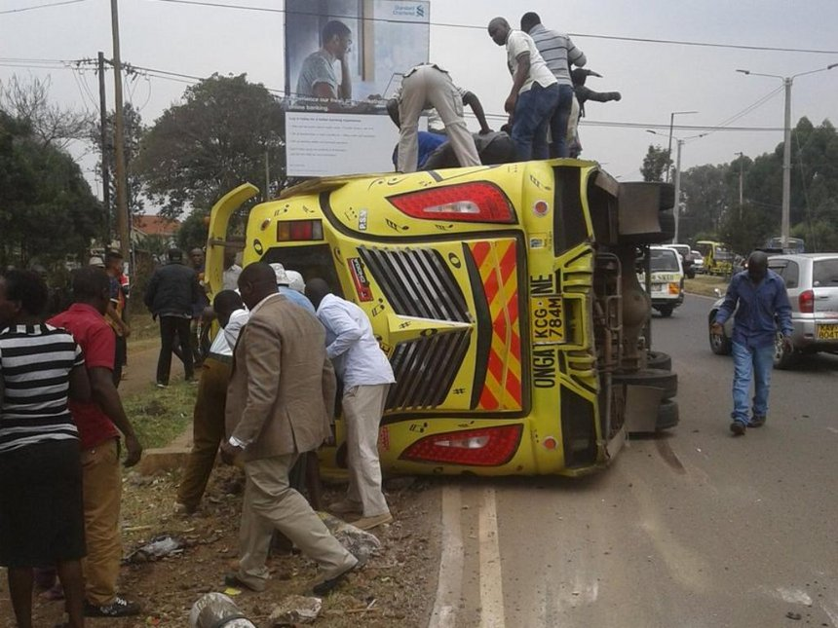
Motor vehicle accidents –commonest cause

Slide 9
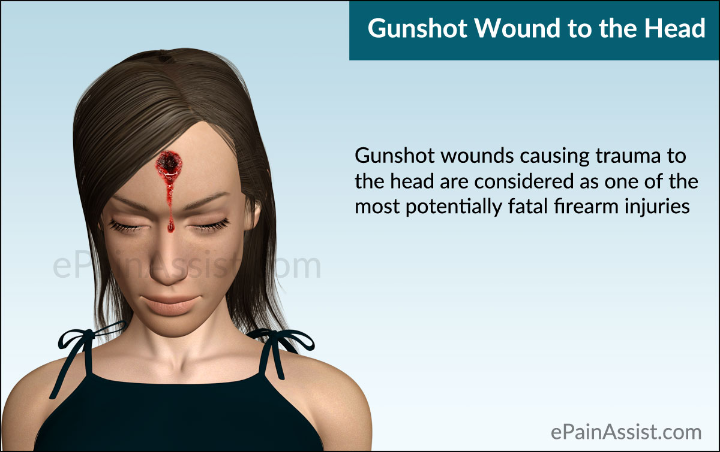
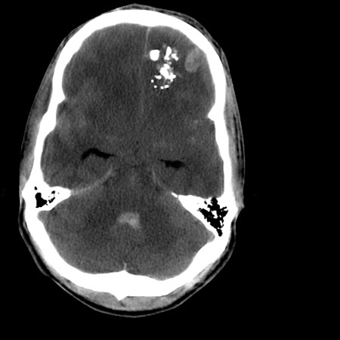
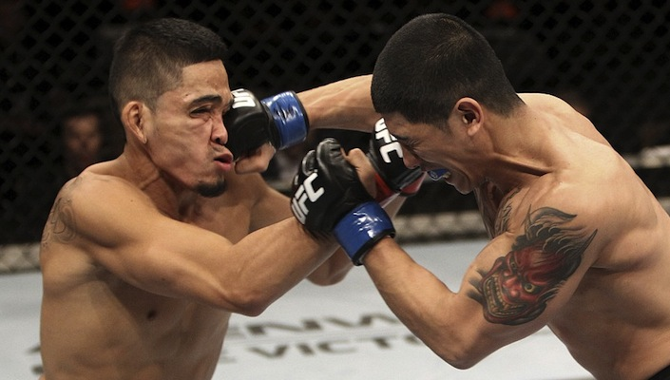
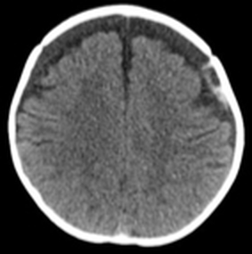
Assault.
Firearms ; intentional or unintentional.
Falls.
Sport related.
Non-Accidental Trauma in children

Slide 10
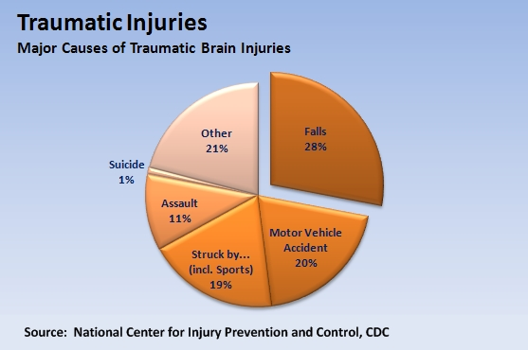

Slide 11
Review of anatomy
scalp,
skull
meninges
Vascular anatomy of the brain.

Slide 12
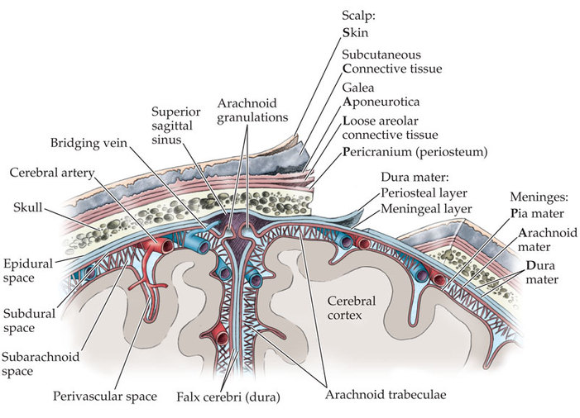
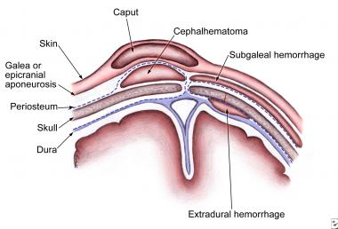
scalp
S: Skin(3-8mm)
C: Connective tissue
A: Aponeurosis/Galea
L: Loose connective tissue/subgalea
P: Periosteum.
These are important for location of haematoma.

Slide 13
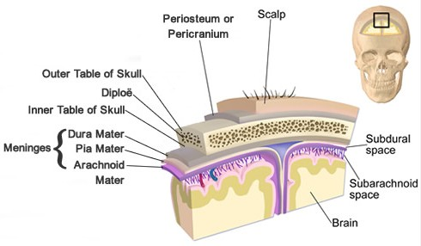
Skull
Two layers of cortical bone
-inner &
- outer table
separated by cancellous bone(diploe)

Slide 14
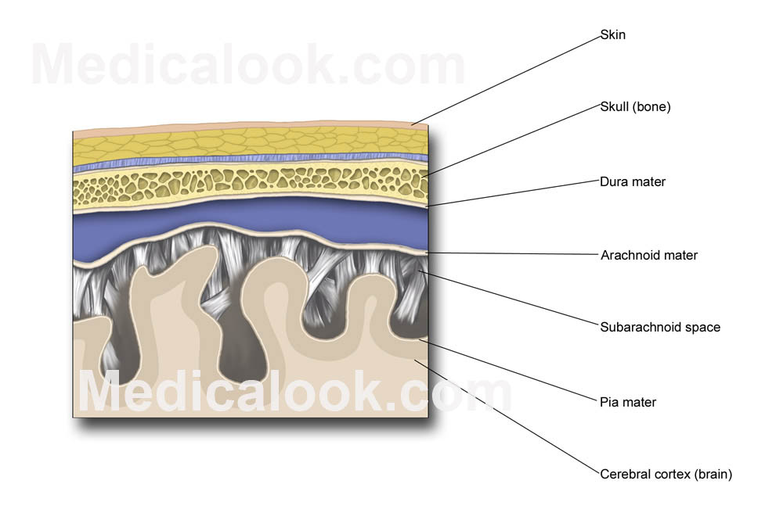
Meninges
Three layers of protective membranes
Dura:( 2 layers)
  Periosteal-outer layer attached to bone
  meningeal: inner layer closer to brain.
  The two layers are fused except in areas enclosing dural sinuses.
Arachnoid: middle layer ‘spider web like.’
Pia : Attached to brain.
Pia and arachnoid form the leptomeninges.

Slide 15
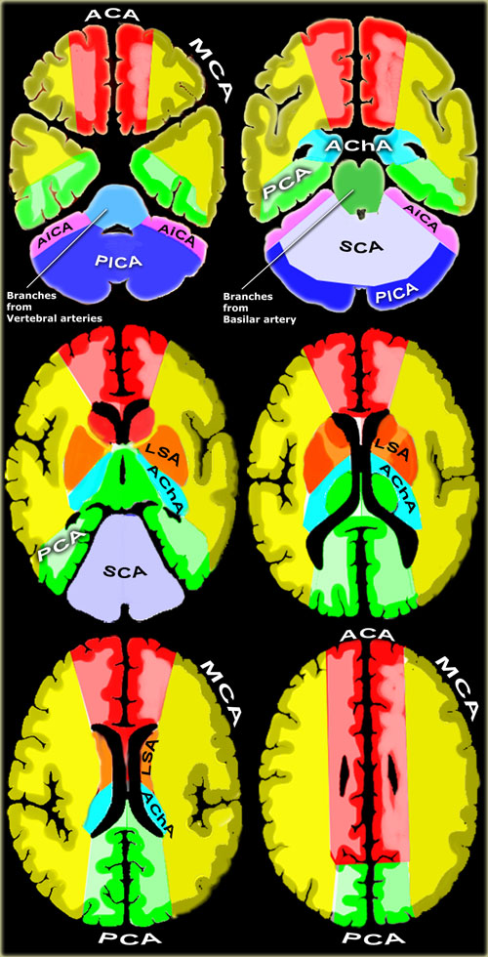
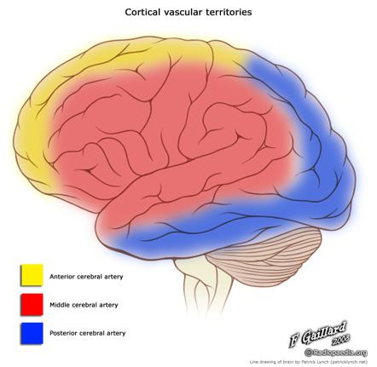
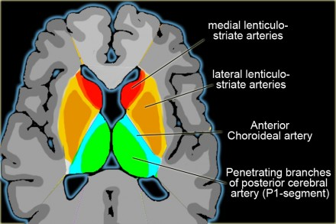
BRAIN ARTERIAL SUPPLY/TERRITORIES

Slide 16
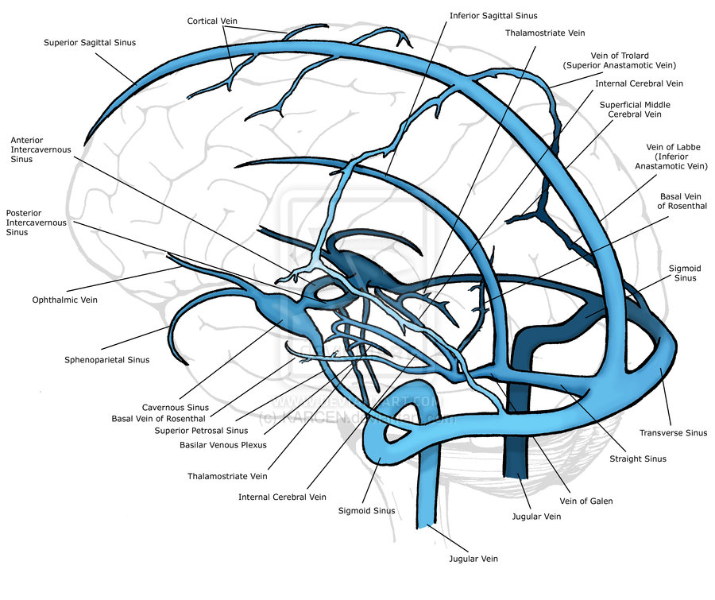
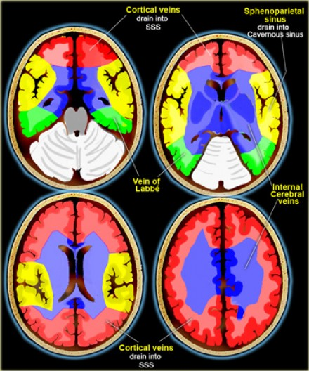
Cerebral venous drainage

Slide 17
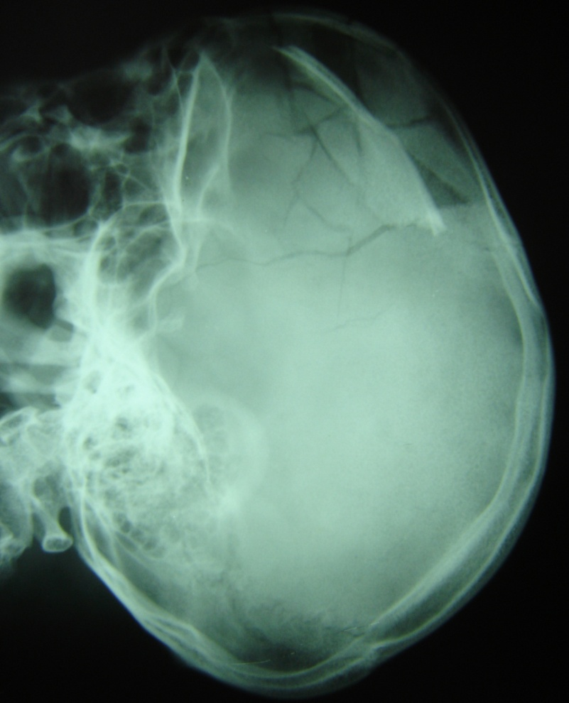
Imaging modalities
Plain skull radiographs (X-Ray): No role in the modern evaluation of TBI.
1/4 of patients with fatal brain injuries have no skull fracture at autopsy.

Slide 18
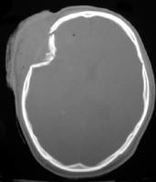
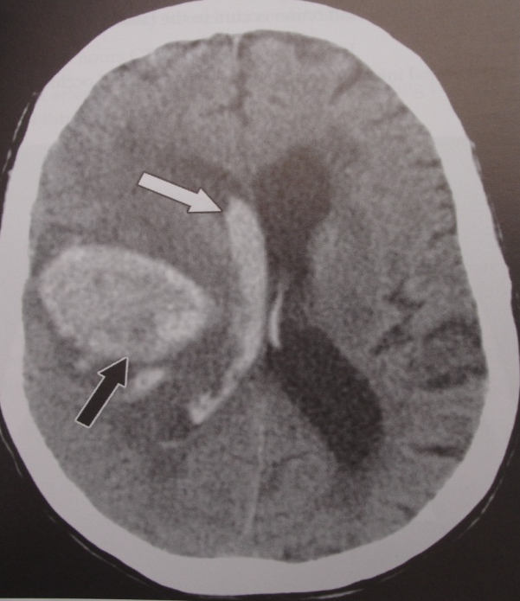
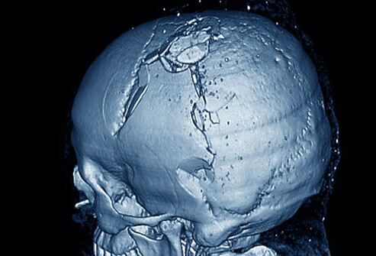
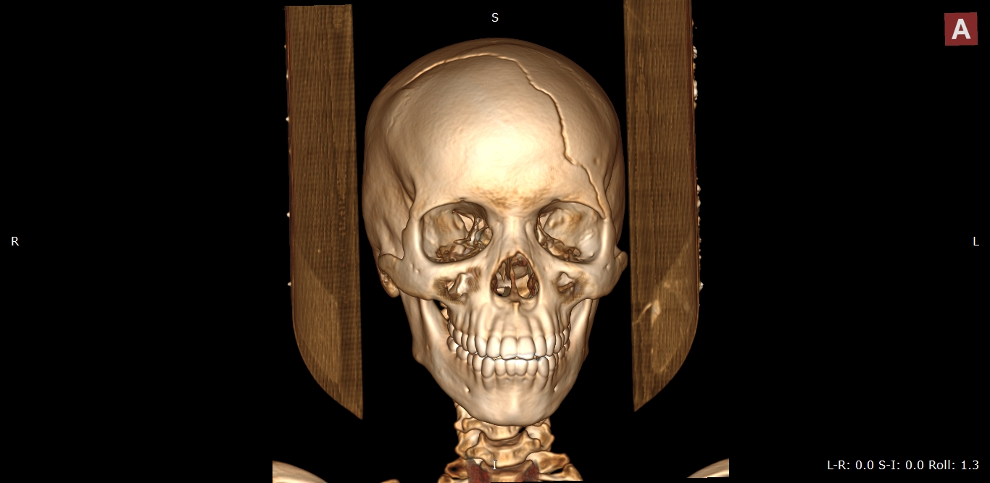
NECT
  Fast, available, sensitive for both bone and brain injury.
  Both bone and soft tissue reconstruction algorithms should be used. Soft tissue reconstructions should be viewed with both narrow (“soft tissue”) and intermediate (“subdural”) windows.
  3D reconstruction and curved MIPs of the skull have been shown to improve fracture detection over the use of axial sections alone.

Slide 19
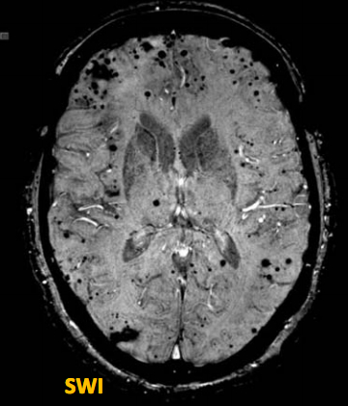
MRI
T2* MRI is more sensitive than CT in detecting;
  all stages of ICH,
  non hemorrhagic contusions,
  injuries in the posterior fossa,
  brainstem and
  DAI.
  Susceptibility weighted imaging(SWI ) MRI for head trauma increases sensitivity for detection of microhemorrhages and hemorrhagic axonal injury.
  (sensitive to compounds which distort the local magnetic field and as such make it useful in detecting blood products, calcium)

Slide 20
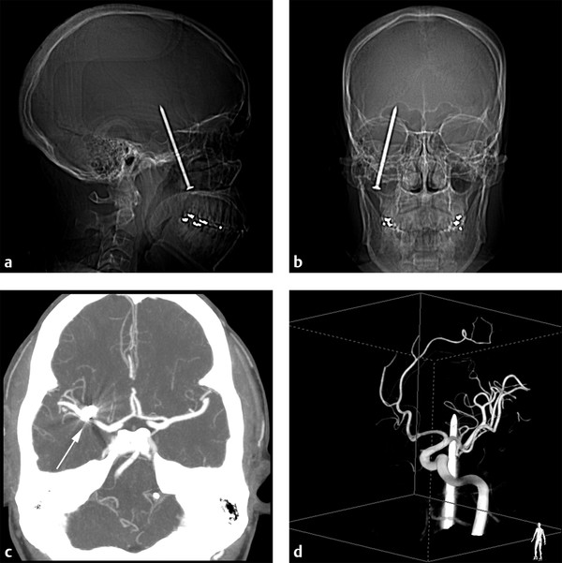
IMAGING MODALITIES
ANGIOGRAPHY
  (CTA/CTV/MRA/MRV): Suspected intracranial arterial or venous injury.
  Conventional angiography: In inconclusive CT or MR angiography and for intervention.
Notes:
Severe jaw pain and normal neurologic examination 24 hours after an unsuspected injury sustained while using a nail gun: (a,b) Scout images from the computed tomography (CT) show the nail that entered under his zygoma, passed through the mouth, and penetrated the brain. (c) The nail is visible immediately anterior to the right M1 segment (arrow) on the CT angiogram maximum intensity reconstruction. (d) Three-dimensional rotational angiographic reconstruction from the right posterior oblique view shows the nail passing in close proximity to the M1 segment of the middle cerebral artery. Vascular structures were also normal on follow-up angiography following removal of the nail.
7YRS OLD penetrating head injury with a knife.

Slide 21
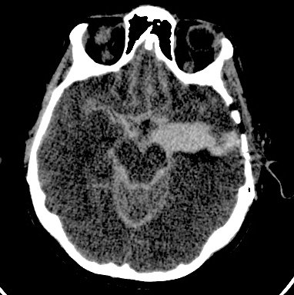
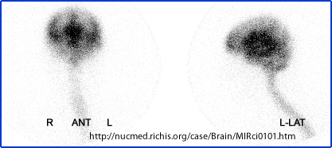
CISTERNOGRAPHY
  High-resolution non contrast skull base CT may be helpful to identify the source of the leak .
  CT or radionuclide cisternography(I-¹¹¹ DTPA ) may have a secondary role if skull base CT is inconclusive.
  High-resolution MRI may have a role if post-traumatic cephalocele is suspected .

Slide 22
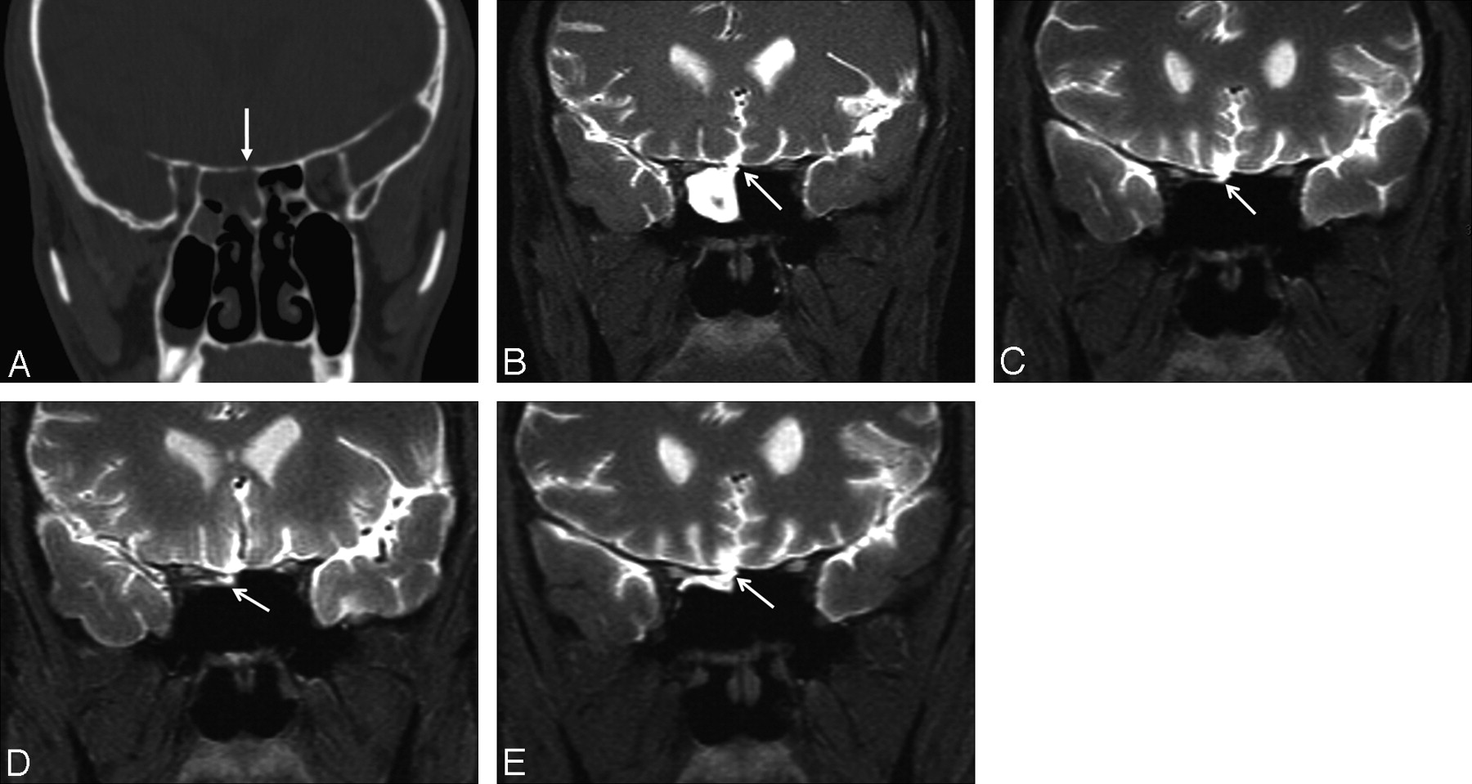
MR CISTERNOGRAPHY
A-defect roof of sphenoid sinus
B-T1 fat sat GD-DTPA contrast leakage in sphenoid sinus

Slide 23
Choice of imaging modality
Availability
Cost
Speed of performance
Diagnostic information desired
Clinical circumstances
Limitation of technique

Slide 24
WHAT TO LOOK FOR ON IMAGING
Mnemonic which is used to read an emergency head CT scan is:
Blood Can Be Very Bad.
B: blood EDH ,SDH, IPH,IVH,SAH and extracranial hemorrhage.
C: cisterns: Presence of blood, effacement and asymmetry in four key cisterns (circummesencephalic, suprasellar, quadrigeminal and sylvian cisterns).
B: brain:Asymmetry or effacement of the sulcal pattern, GW matter differentiation, structural shifts and abnormal hypo/hyperdensities.
V: ventricles:IVH, ventricular effacement/shift and hydrocephalus.
B: bone:skull fracture.Paranasal sinuses fluid in the setting of trauma should raise the possibility of a skull fracture; intracranial air.

Slide 25
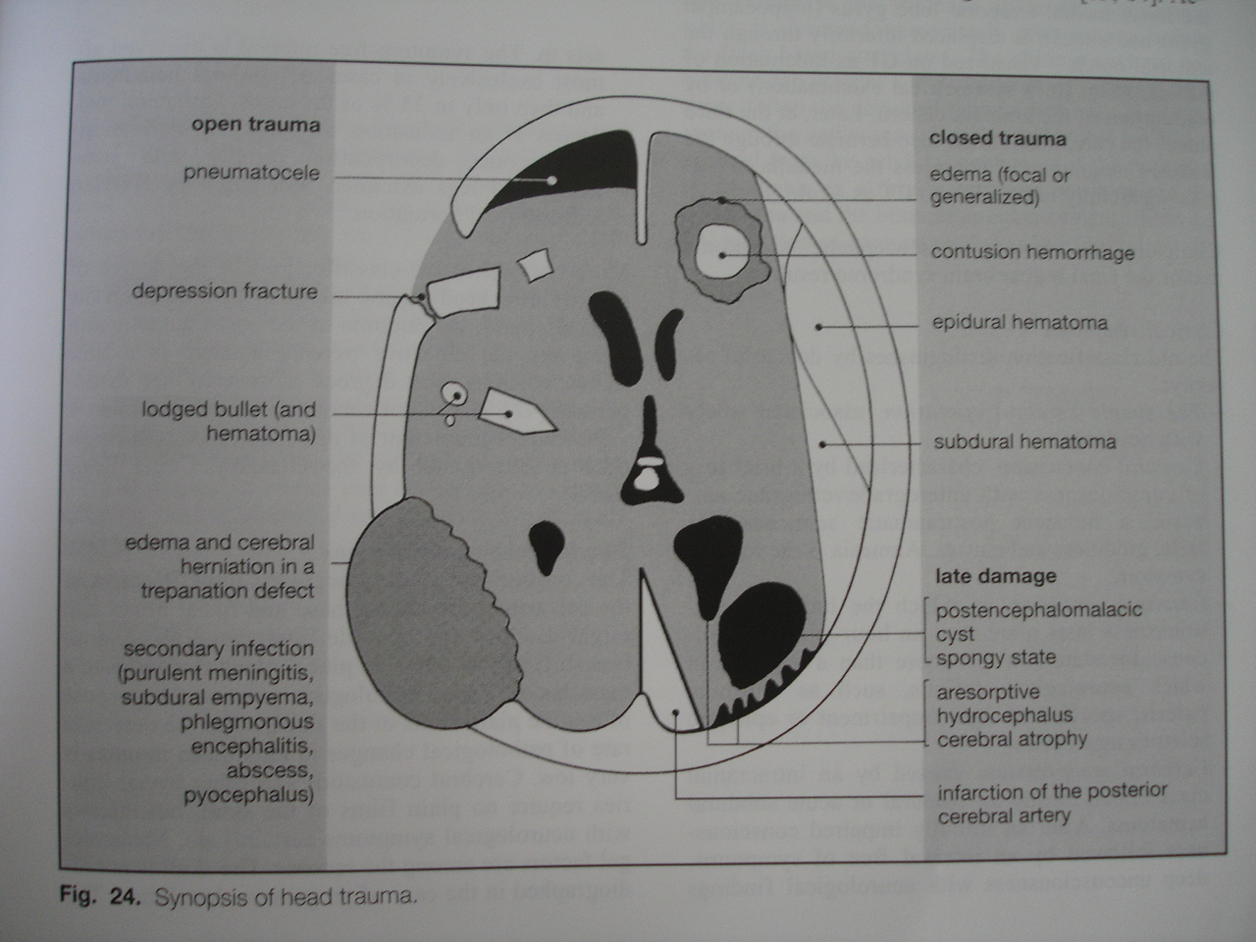

Slide 26
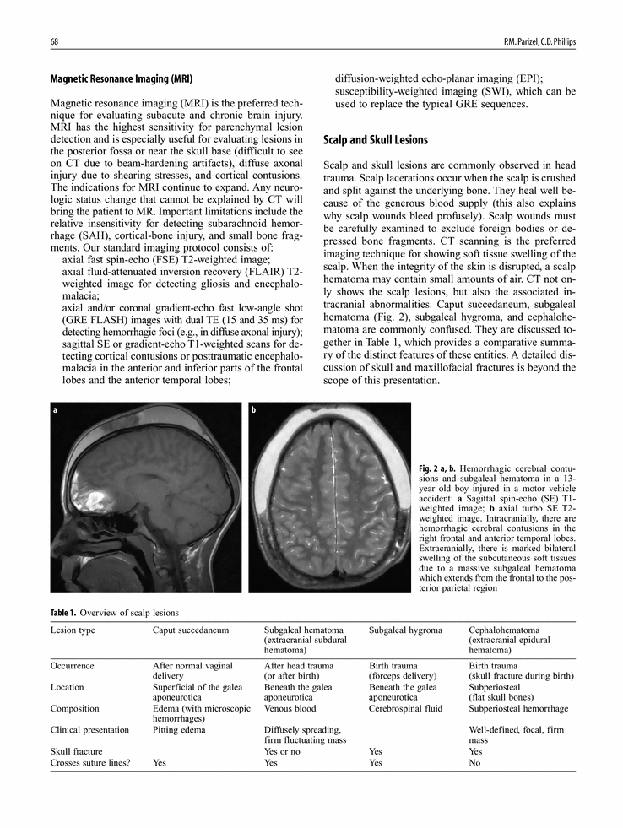
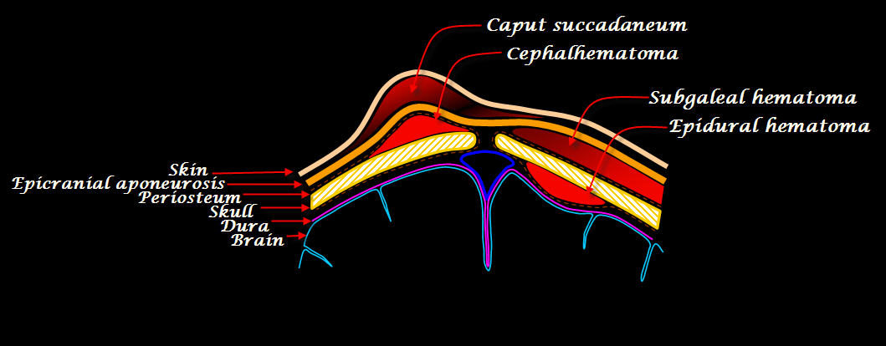
SCALP INJURIES
Scalp injuries: Lacerations, hematomas.
Laceration:
  Variable extent and thickness
  Foreign bodies, subcutaneous air common.
Hematoma: Hemorrhage in or between scalp layers
  Caput succadenium
  Subgaleal hematoma
  cephalohematoma

Slide 27
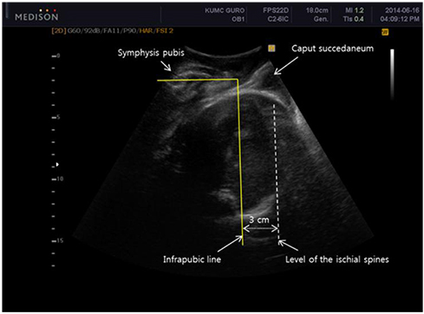
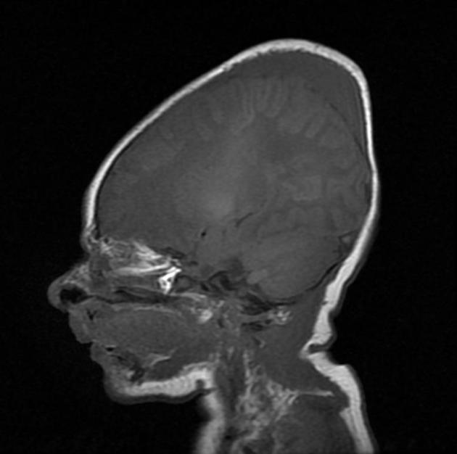
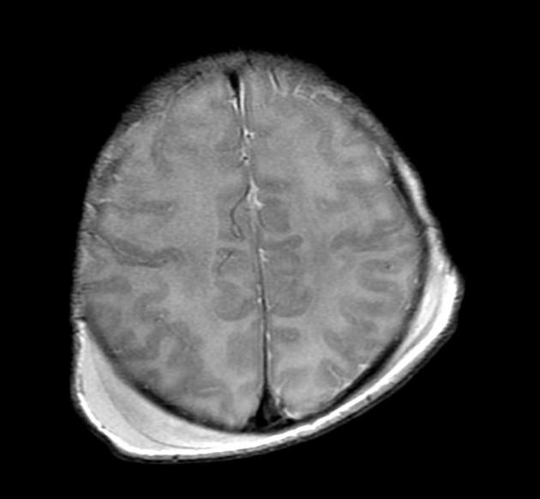
CAPUT SUCCADENIUM
It is a manifestation of birth trauma.
Consists of a subcutaneous extraperiosteal serosanguineous fluid collection.
Results from pressure on the presenting part of the skull against the dilating cervix.
It extends across the midline and over suture lines and is associated with head moulding.
Does not usually cause any complication and usually resolves over the first few days.

Slide 28
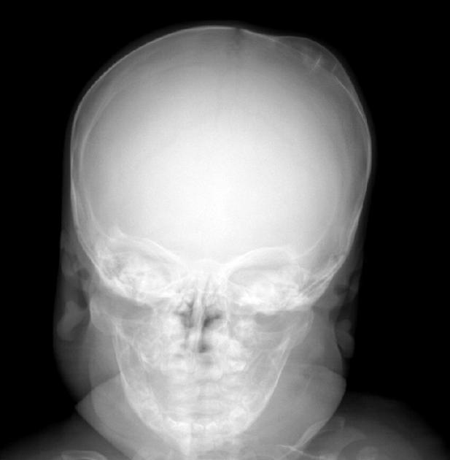
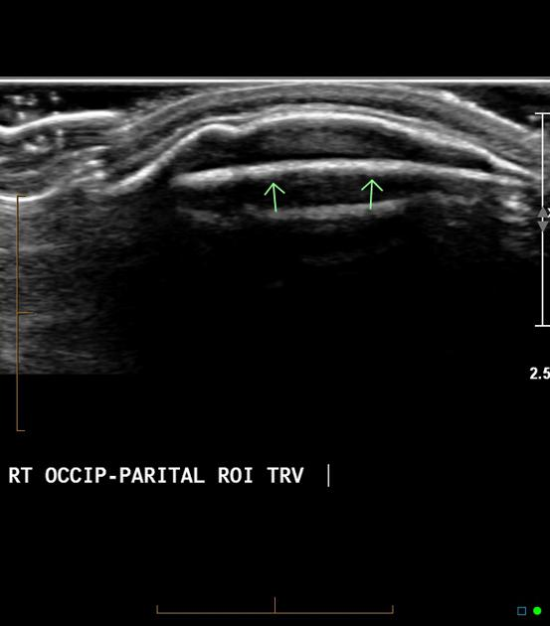
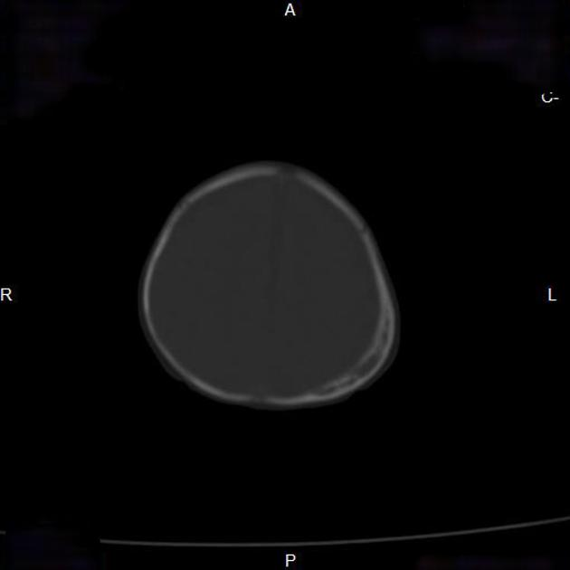
CEPHALOHEMATOMA
Subperiosteal hematoma
  Between outer table of calvaria, periosteum.
  Elevates periosteum.
  Does not cross sutures.
  Extracranial equivalent of intracranial epidural hematoma.
  Usually unilateral.

Slide 29
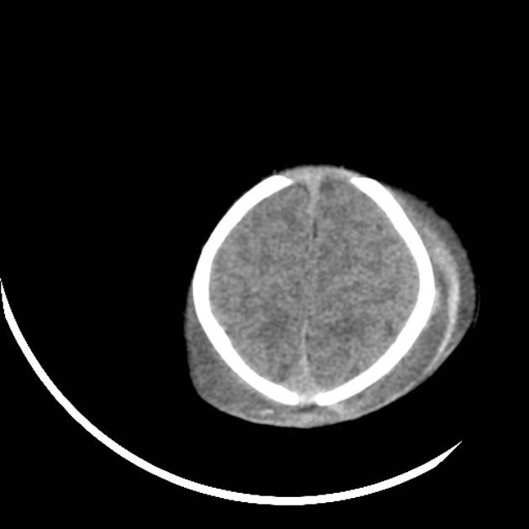
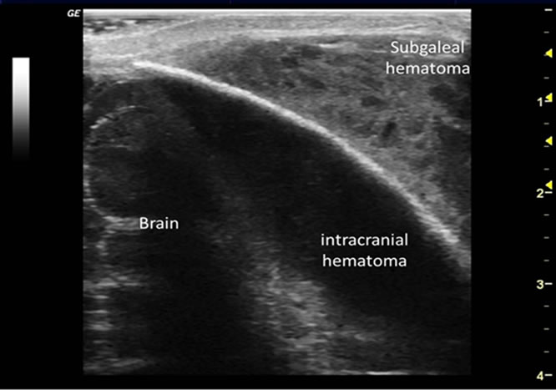
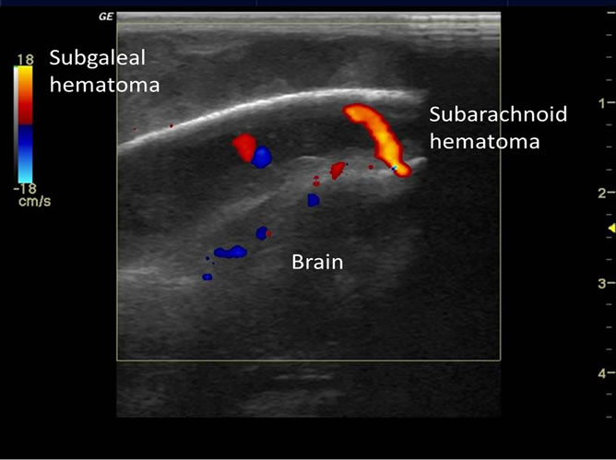
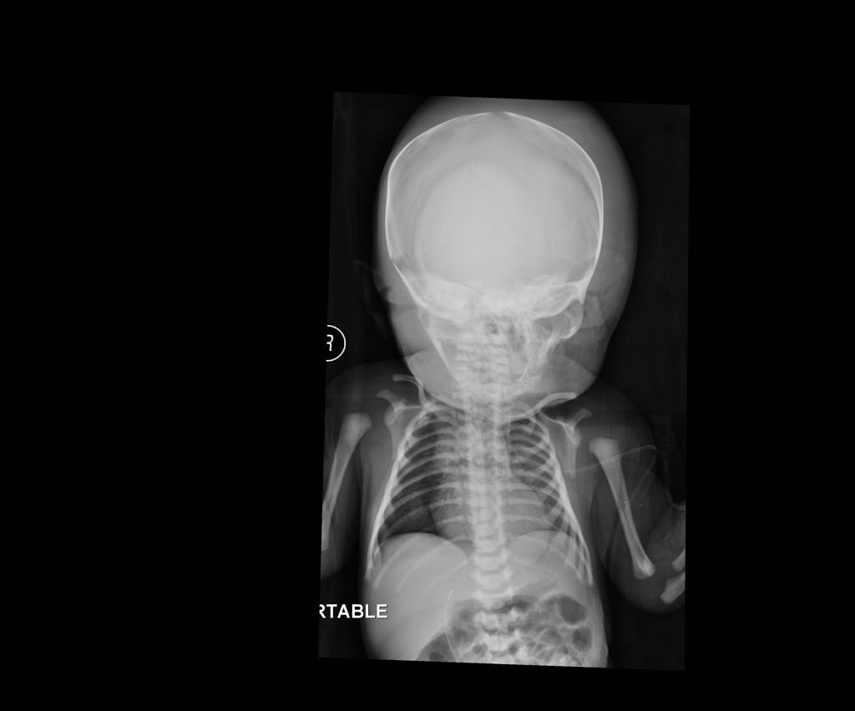
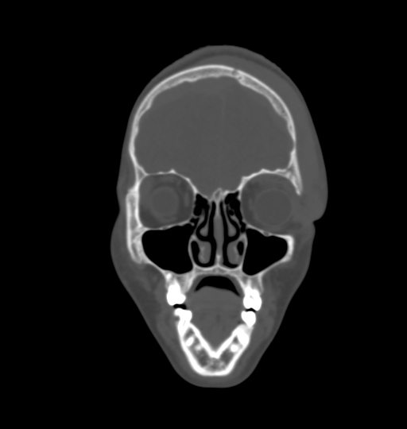
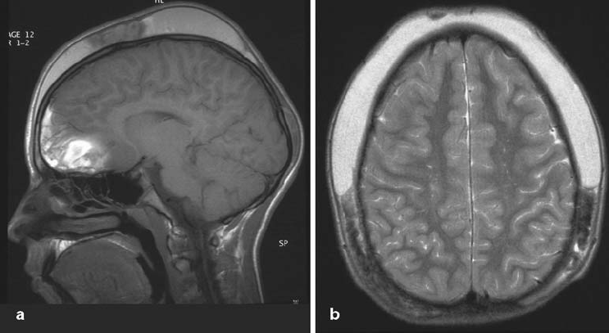
SUBGALEAL HEMATOMA
Hematoma under aponeurosis (galea) of
occipitofrontalis muscle.
External to periosteum.
Not limited by sutures
Notes:
Abnormal head shape and swelling after vacuum delivery at the hospital.
13-year old boy injured in a motor vehicle accident. Sagittal T1-weighted image a shows hemorrhagic cerebral contusions in the inferior frontal and anterior temporal lobes. In addition, there is marked bilateral swelling of the subcutaneous soft tissues due to a massive subgaleal hematoma, which extends from the frontal to the posterior parietal region, as seen on an axial T2-weighted imag

Slide 30
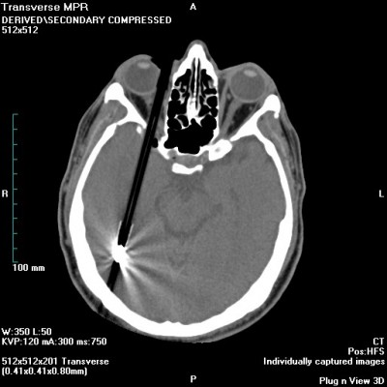
Ball point pen in-situ
Ct scan

Slide 31
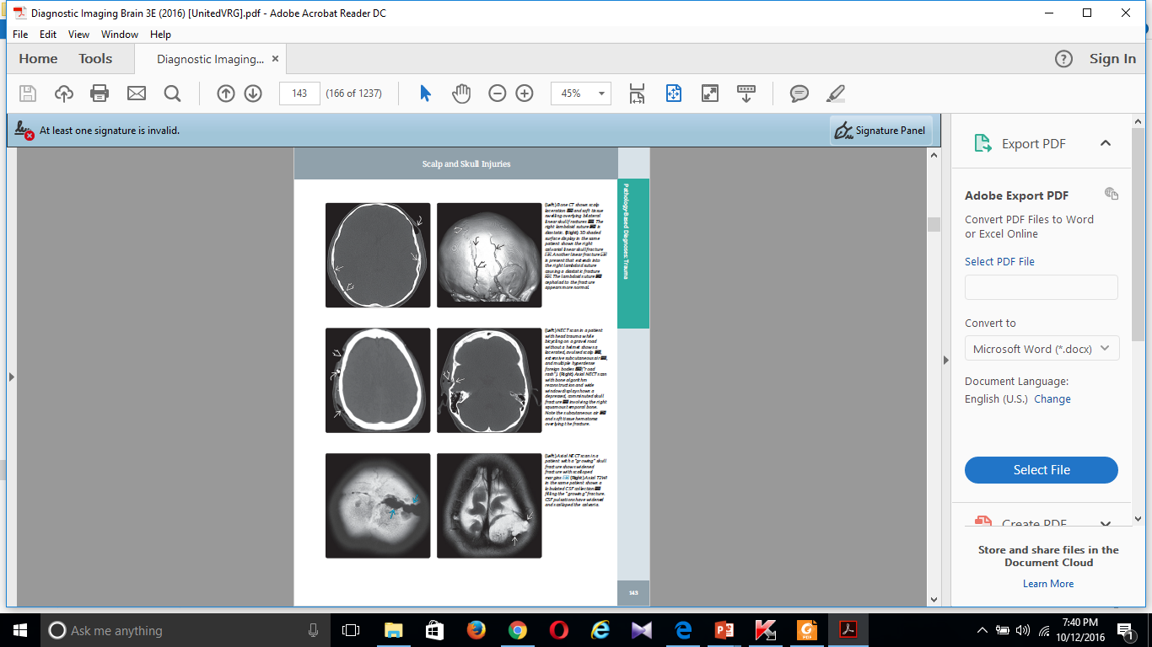
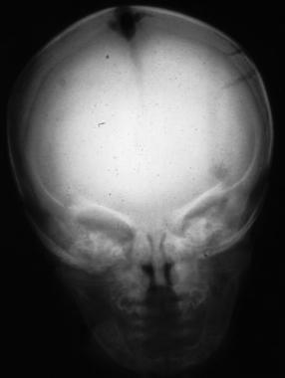



SKULL FRACTURES
Linear skull fracture: Sharply marginated lucent line(s).
Depressed skull fracture: Comminuted fragments imploded inwardly.
Elevated skull fracture: Elevated, rotated skull segment.
Diastatic skull fracture: Widened suture or synchondrosis.Usually accompanied by linear skull fracture.
"Growing" skull fracture.
  Difficult to detect in acute stage.
  Progressively widening, unhealing fracture.
  Lucent lesion with rounded, scalloped margins.
  CSF and soft tissue trapped within expanding fracture.
  Brain is usually encephalomalacic.
2/3 of patients with moderate TBI have an associated skull fracture.

Slide 32



TRAUMATIC BRAIN INJURY
Intra-axial:. Brain parenchyma
Extra-axial: outside brain
Brain herniation:

Slide 33

INTRACRANIAL HERNIATION SYNDROMES
Subfalcine herniation.
Descending transtentorial hearniation
Ascending transtentorial herniation
Transalar herniation
Tonsillar herniation
Transdural/transcranial herniation

Slide 34



Extradural/epidural hematoma
Blood collection between inner table of skull and outer (periosteal) layer of dura
Associated with fractures

Slide 35




Subdural hematoma
Between inner border cell layer of dura and arachnoid .
- Crescent-shaped extra-axial fluid collection
○ May cross sutures, not dural attachments
○ May extend along falx, tentorium, and anterior and middle fossa floors .
NECT:
Hyperacute(<6hrs)-heterogenous/hypodense, Acute-hyperdense,
Subacute-iso/hypodense& Chronic-hypodense.
MRI: Variable signal depending on stage

Slide 36





Slide 37


Traumatic Subarachnoid hemorrhage
Trauma is the most common cause(tSAH found in 33% with moderate TBI, 60% with severe TBI).
Location
  Can be focal or diffuse.
  Focal SAH adjacent to contusion, subdural/epidural hematoma, fracture, laceration.
  Most common Sylvian fissure, inferior frontal subarachnoid spaces.
  Isolated convexity sulci (adjacent to contusion)
  Diffusely in subarachnoid space &/or basal cisterns.
  Layering on tentorium

Slide 38


Slide 39


PNEUMOCEPHALUS
Presence of air or gas within skull in any compartment.
Mechanism: Dural tear.
NECT(Best diagnostic tool). Very low density (-1,000 HU).
MR: Foci of absent signal on all sequences,
Present in 3% of all skull fractures, 8% of paranasal sinus fractures.
Complications: CSF leak (50%) Infection (25%).Mortality 15%.

Slide 40


Notes:
Left deep frontal lobe hemorrhage (H) that has ruptured into left lateral ventricle (V).
Arrowheads point to edema (arrowheads). E is edema.
Yellow arrow points to displaced craniotomy flap from brain herniation (red arrows).
Small white arrow points to compressed left lateral ventricle.

Slide 41

end

